Slide 1
EBS Class
2017

Slide 2
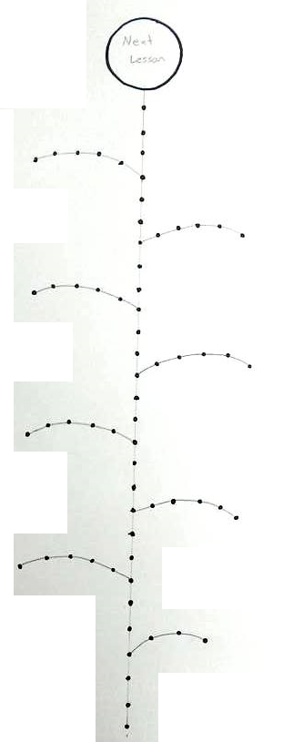
Sticker Board
You can win stickers
Put the stickers on the flower.

Slide 3
Sticker Board
When you finish a leaf, you can win a prize

Slide 4
Sticker Board
If you finish all the way to the top, you can choose the next lesson
Lesson Topic (dinosaurs, sports, hobbies)
Lesson Type (math, puzzle solving, music)
Game

Slide 5
Folders
Put your name on your folder.

