Slide 1
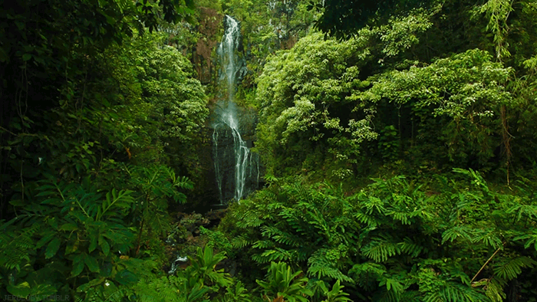
Rainforest

Slide 2
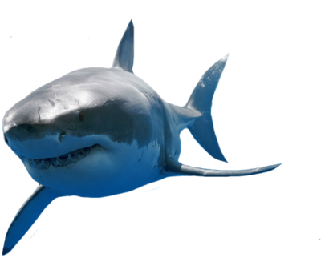
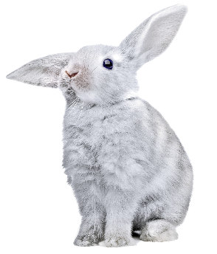
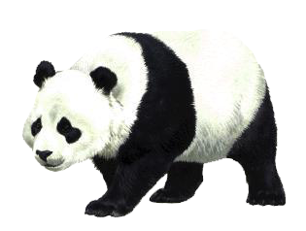
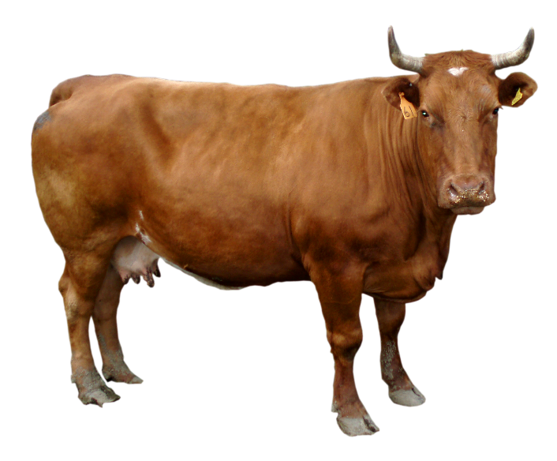
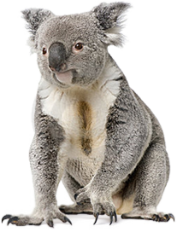
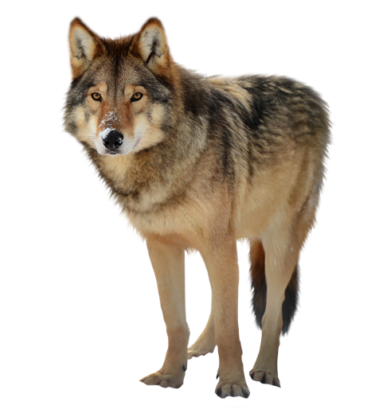
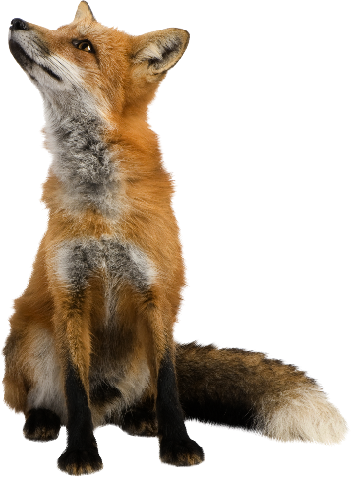
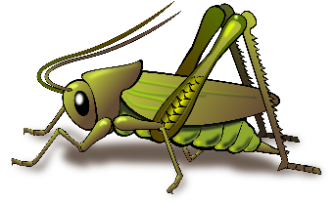
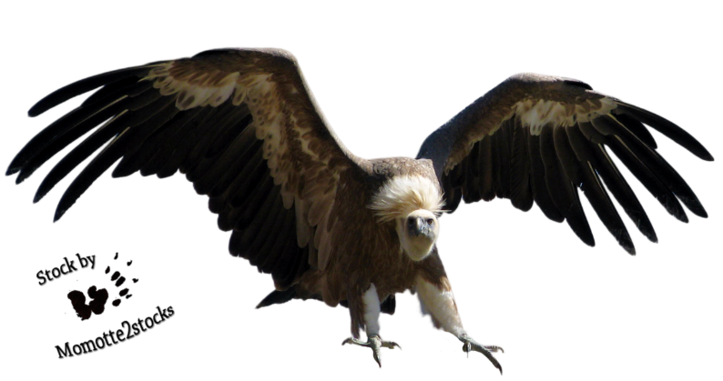
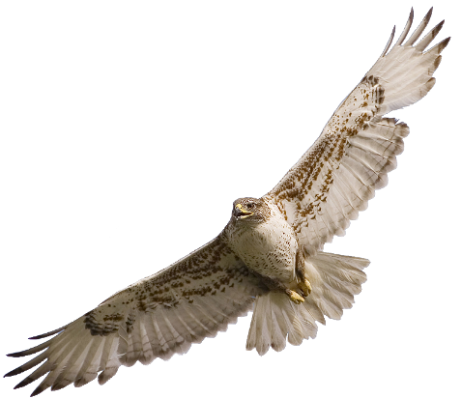
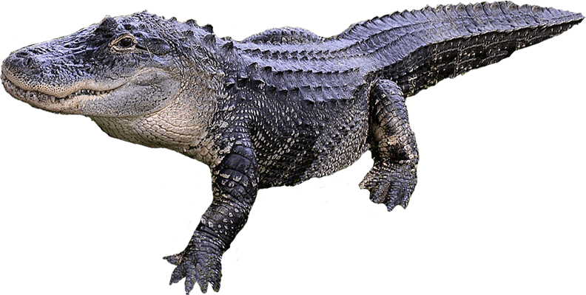
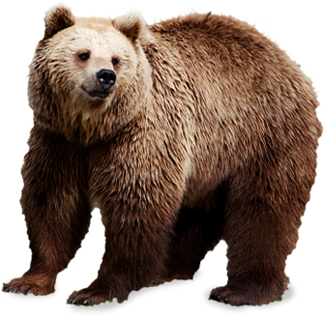
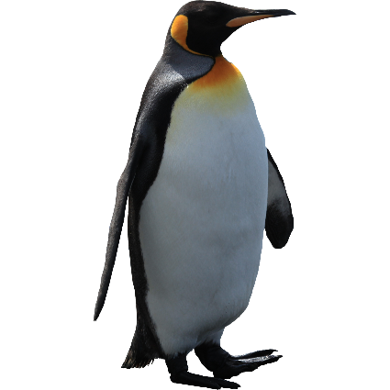
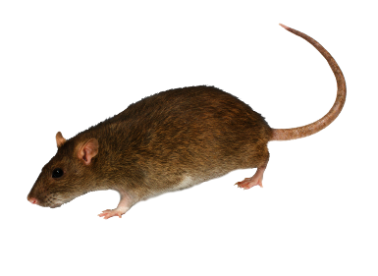
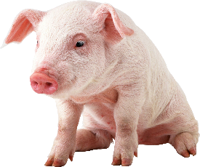
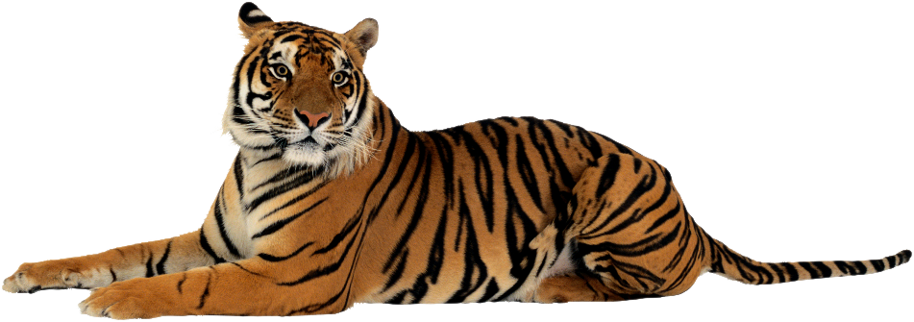
Click 8 Carnivores:
1
7
3
4
2
6
8
5

Slide 3
Click 6 Herbivores:
2
3
5
1
4
6

Slide 4
Click 3 Omnivores:
1
3
2

Slide 5
Click the Scavengers:
1
2

Slide 6
Rainforest

Slide 9
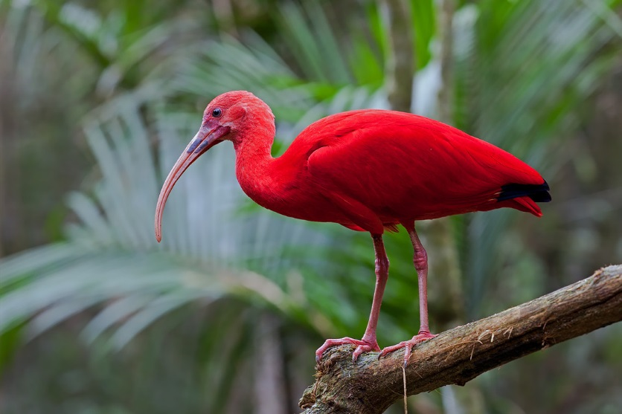
Carnivore
Scarlet Ibis

Slide 10
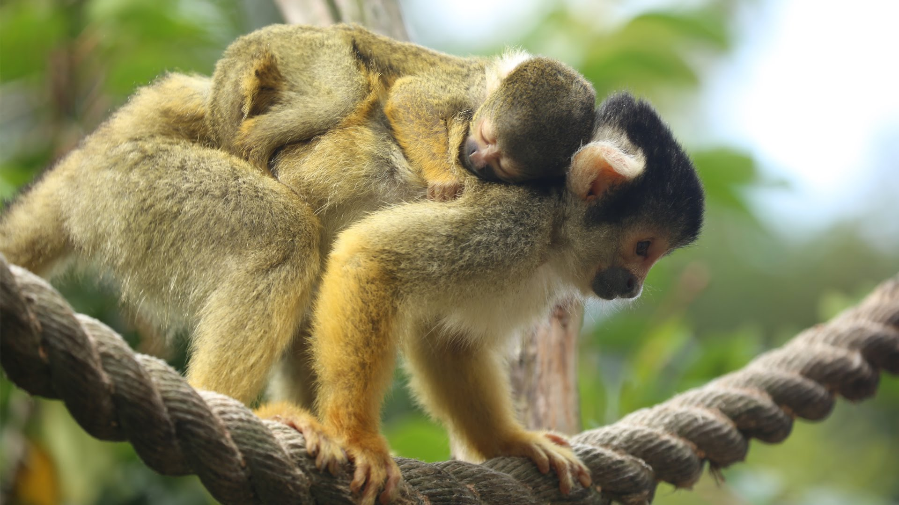
Omnivore
Squirrel Monkey

Slide 11
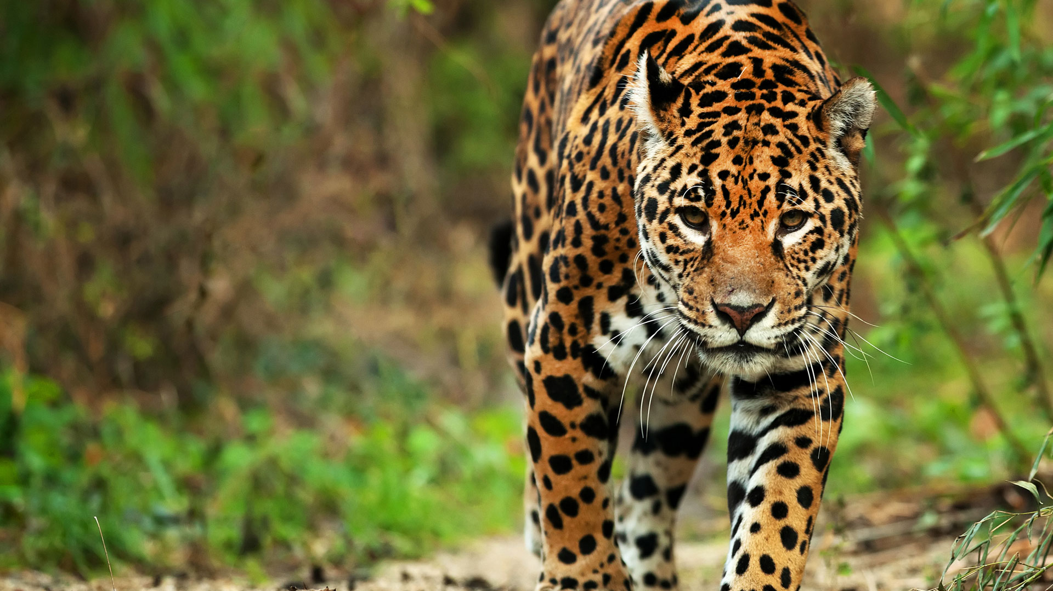
Carnivore
Jaguar

Slide 12
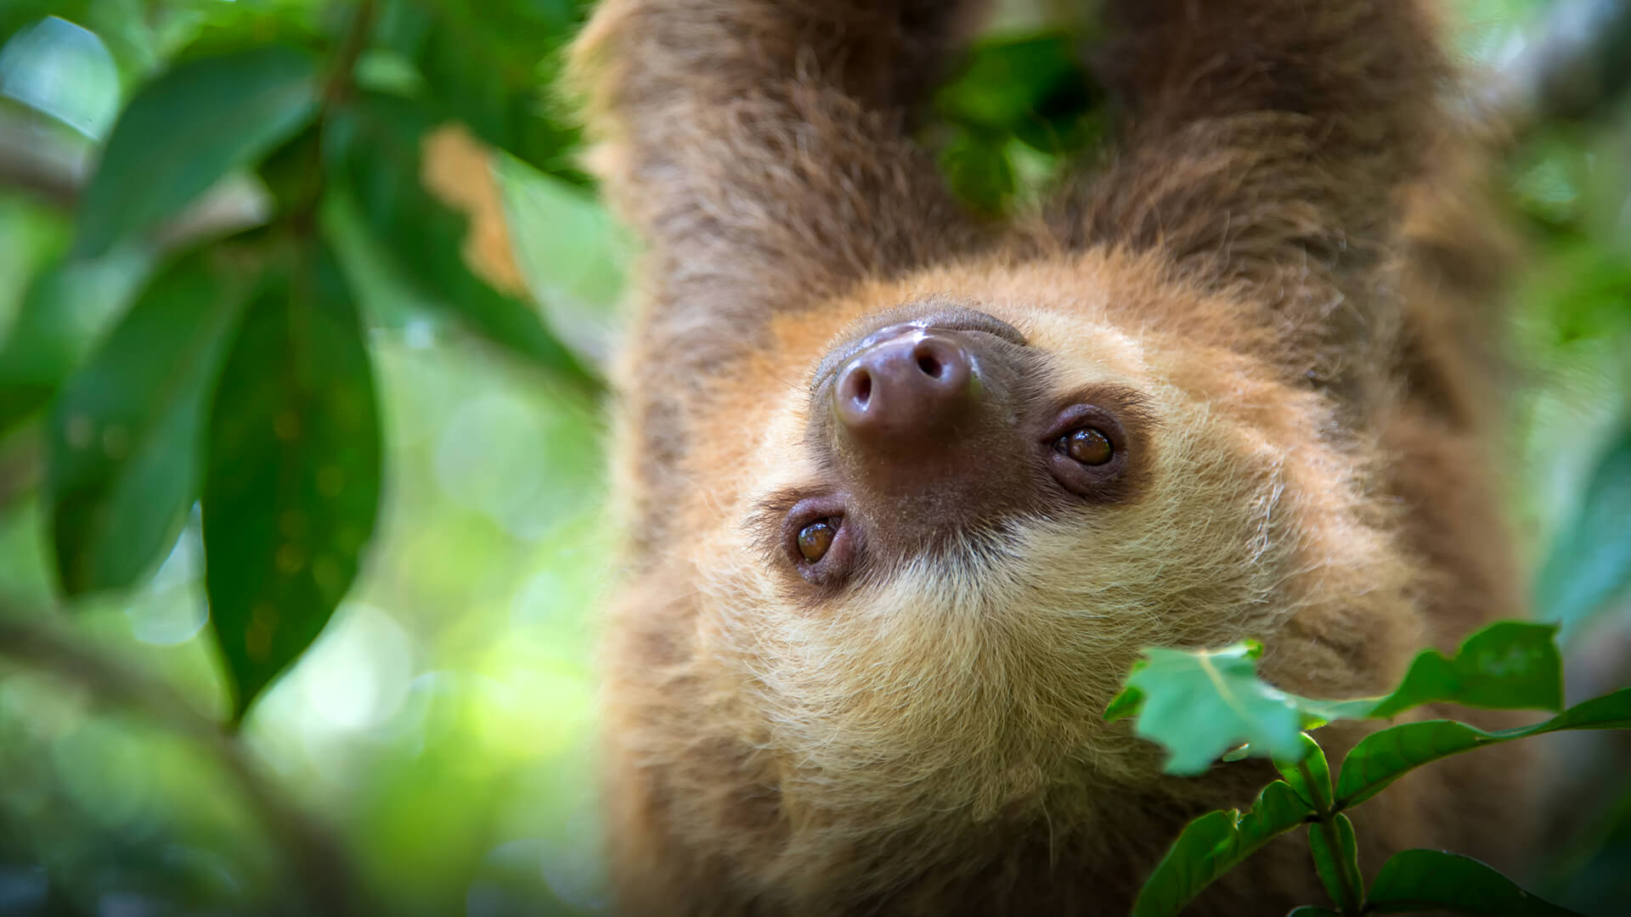
Herbivore
Two Toed Sloth

Slide 13
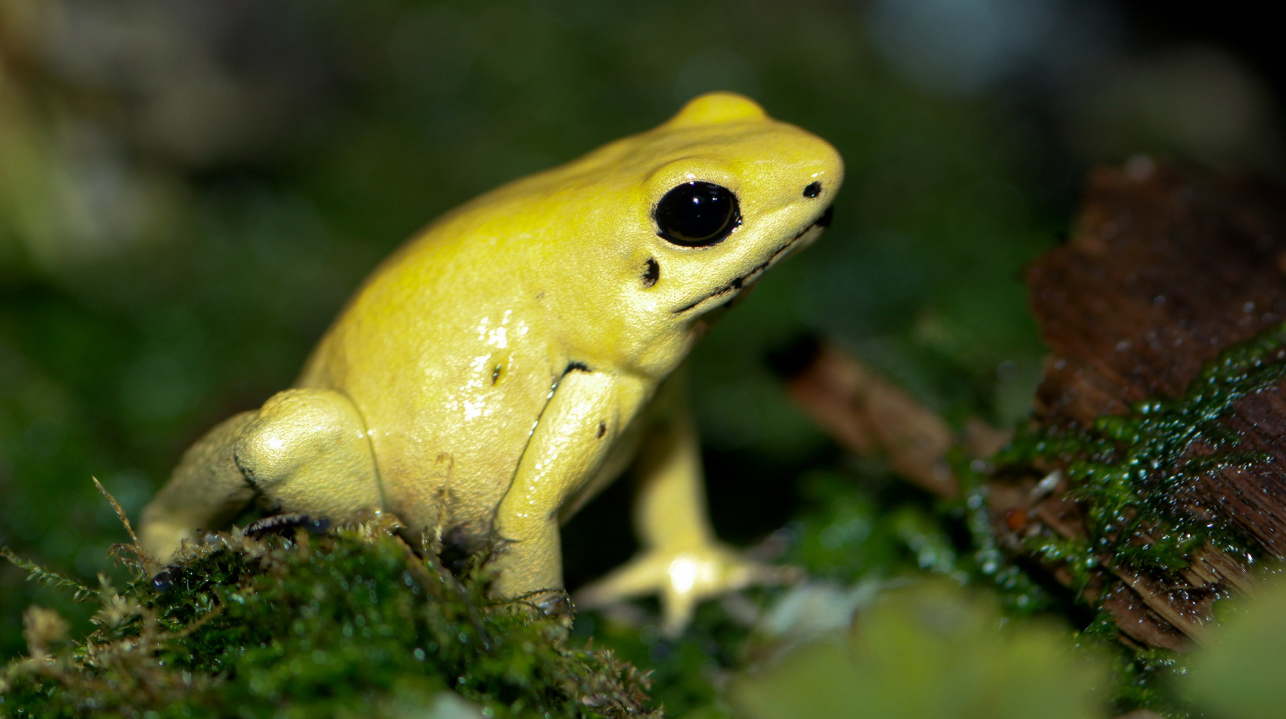
Carnivore
Golden Arrow-Poison Frog

Slide 14
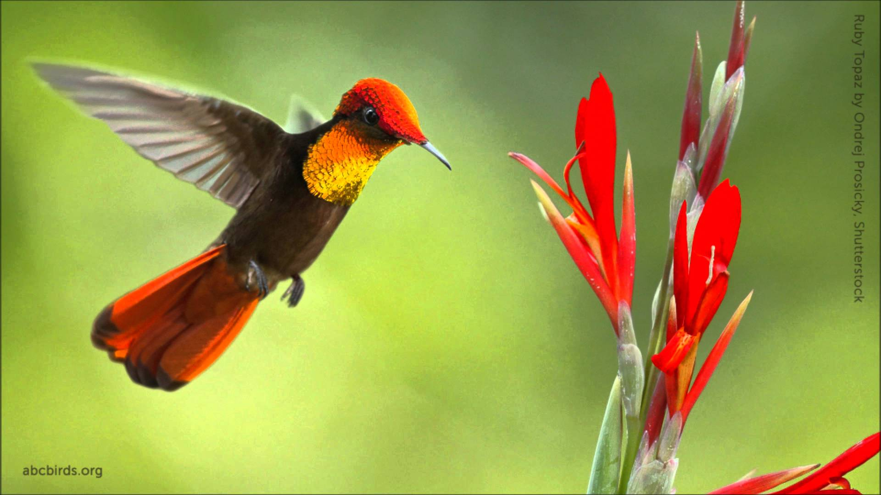
Herbivore
Ruby Topaz Hummingbird

Slide 15
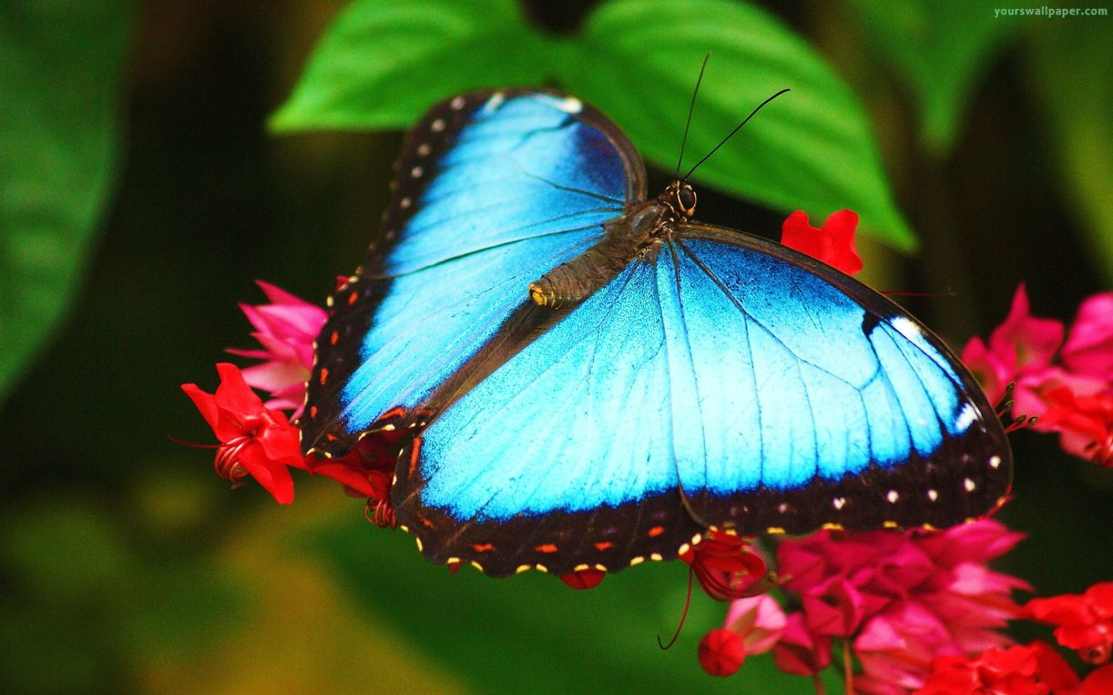
Herbivore
Morpho Butterfly

Slide 16
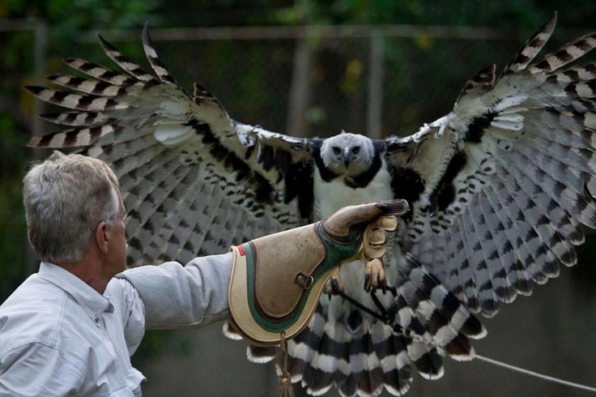
Carnivore
Harpy Eagle

Slide 17
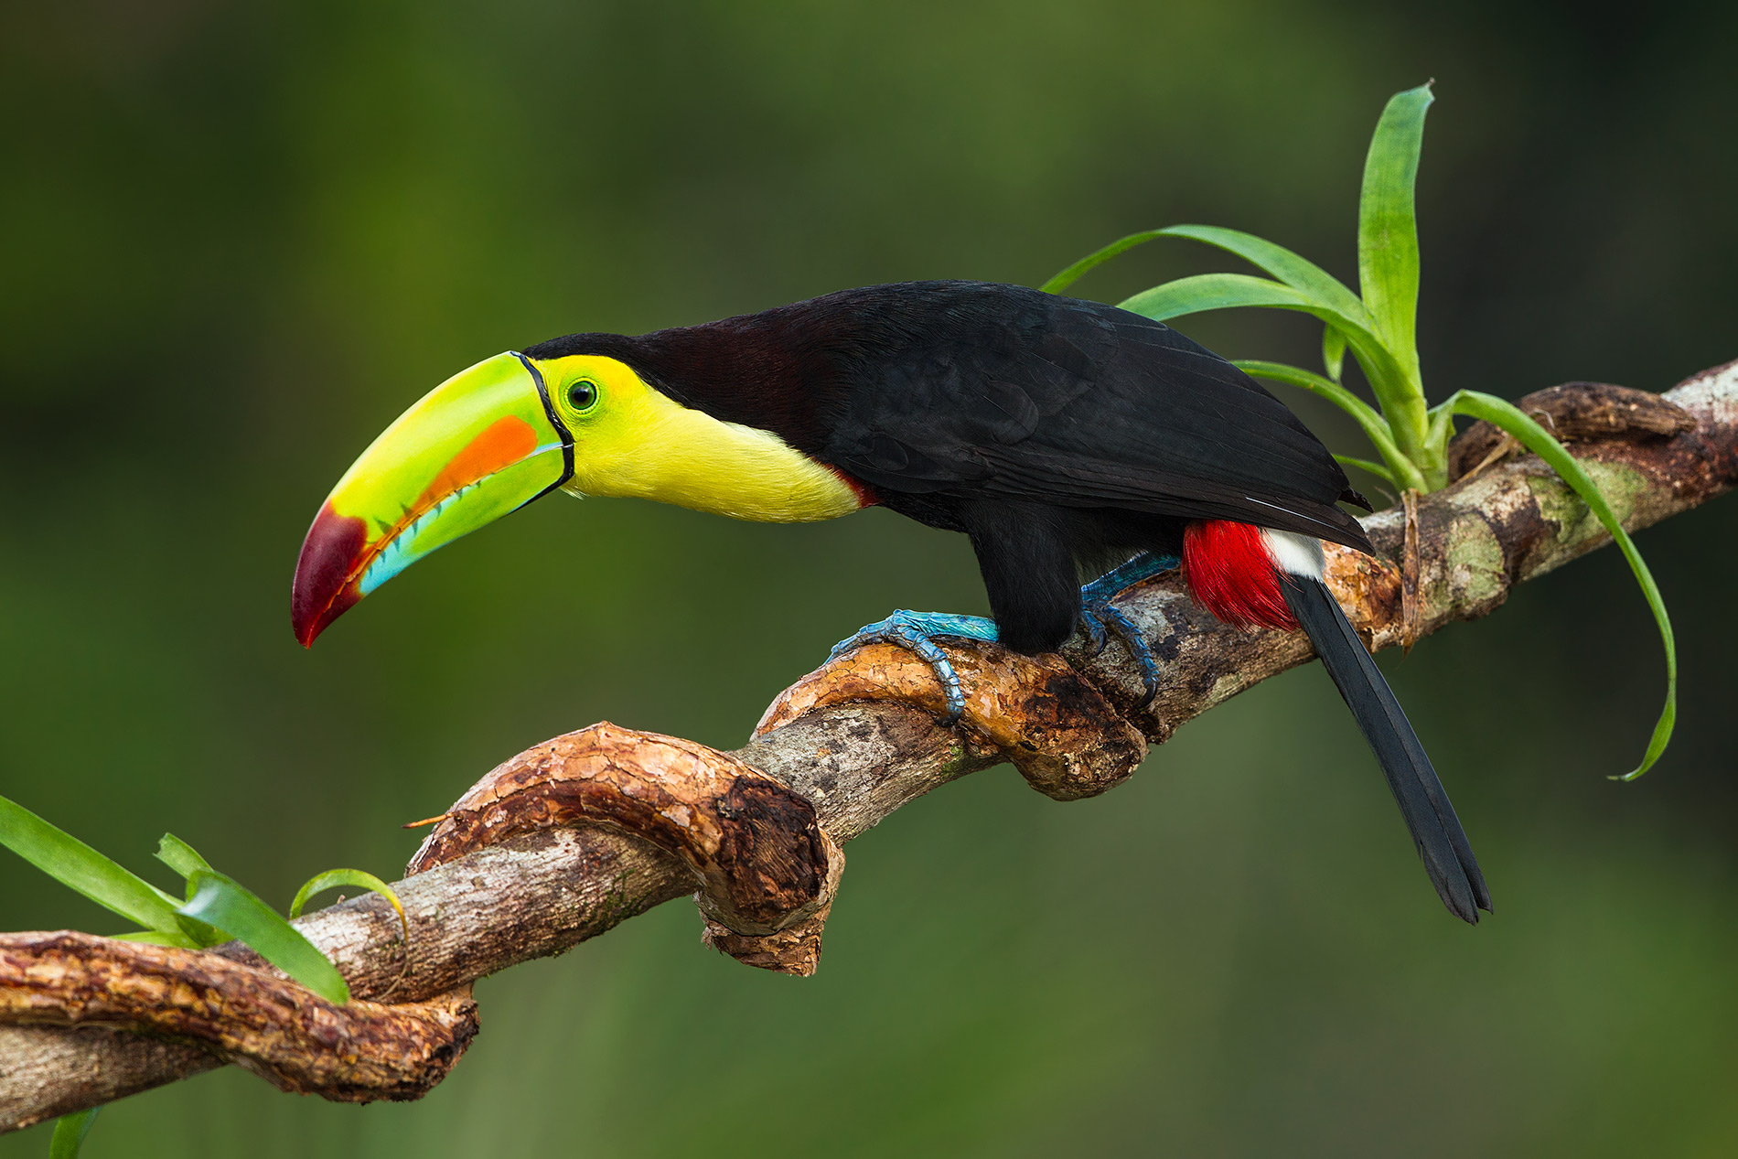
Keel-Billed toucan
Herbivore

Slide 18
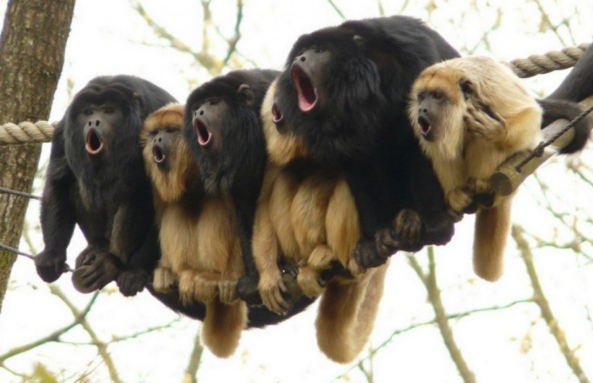
Herbivore
Howler Monkey

Slide 19
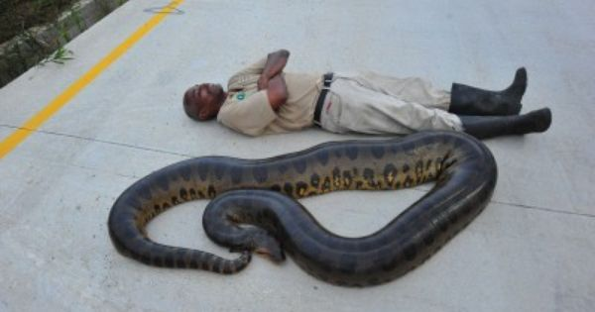
Carnivore
Anaconda

Slide 20
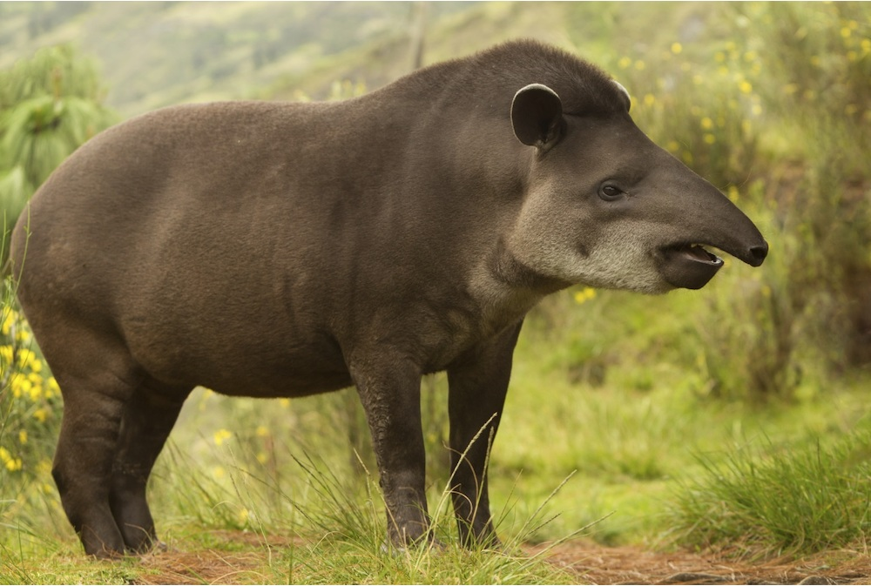
Herbivore
Tapir

Slide 21
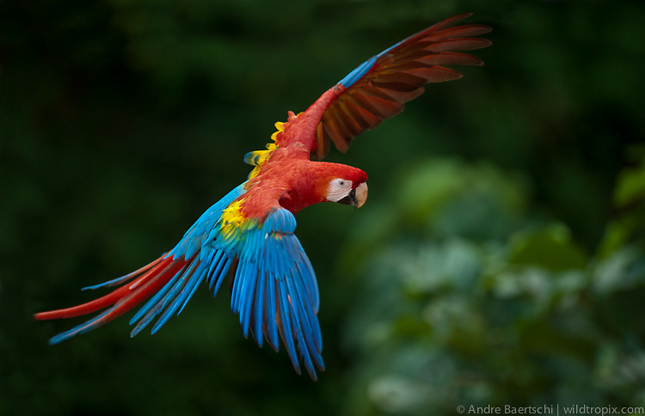
Herbivore
Scarlett Macaw

Slide 22
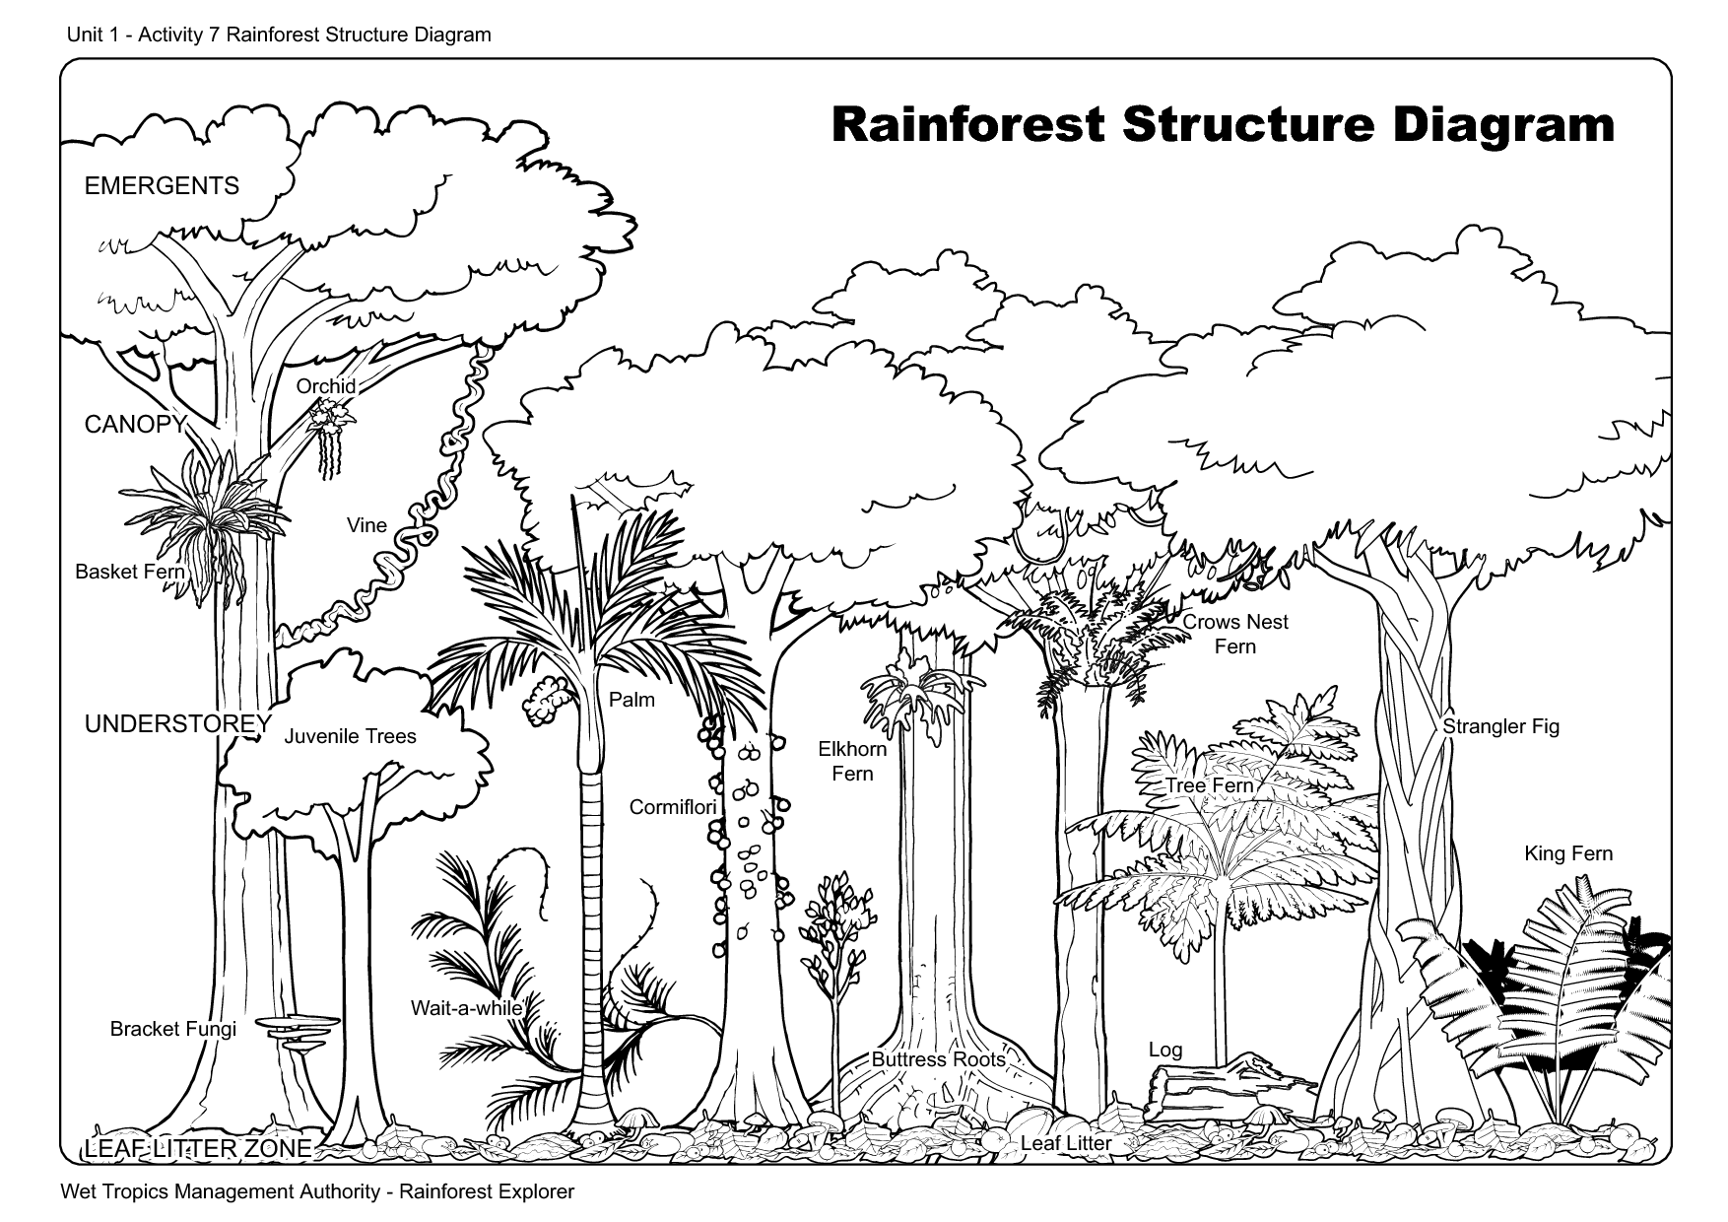
Notes:
http://gozoneguide.com/layers-of-the-rainforest-worksheet/

Slide 24
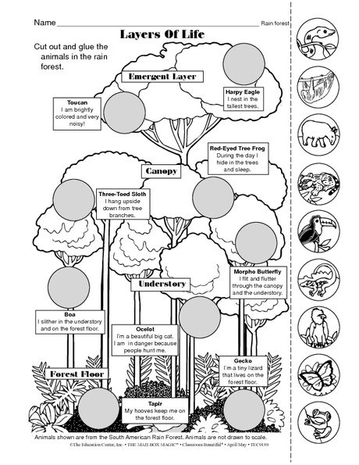
Notes:
http://gozoneguide.com/layers-of-the-rainforest-worksheet/

Slide 25
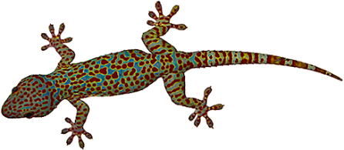
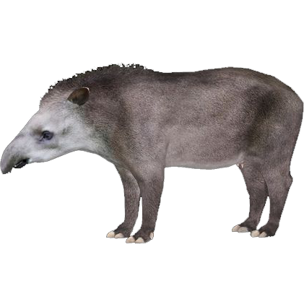
Forest Floor
2%

Slide 26
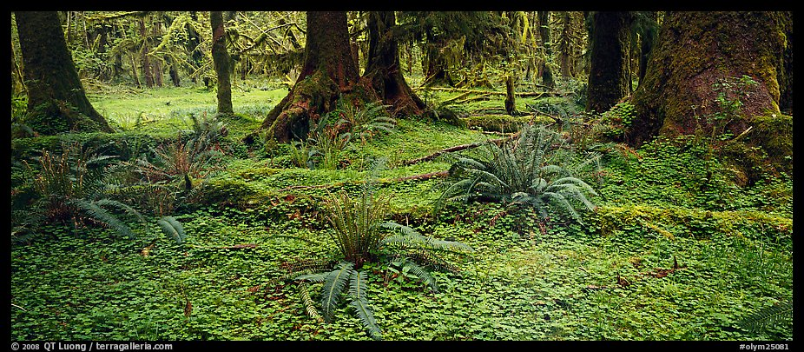

Slide 27
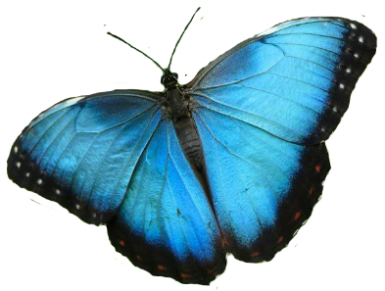
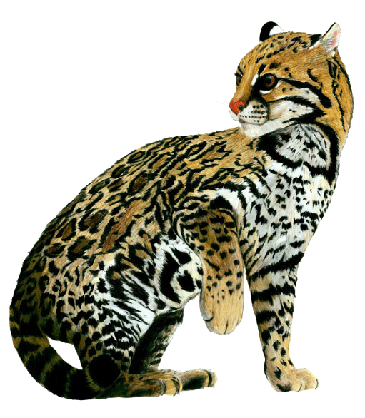
Understory
2-15%

Slide 29
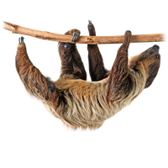
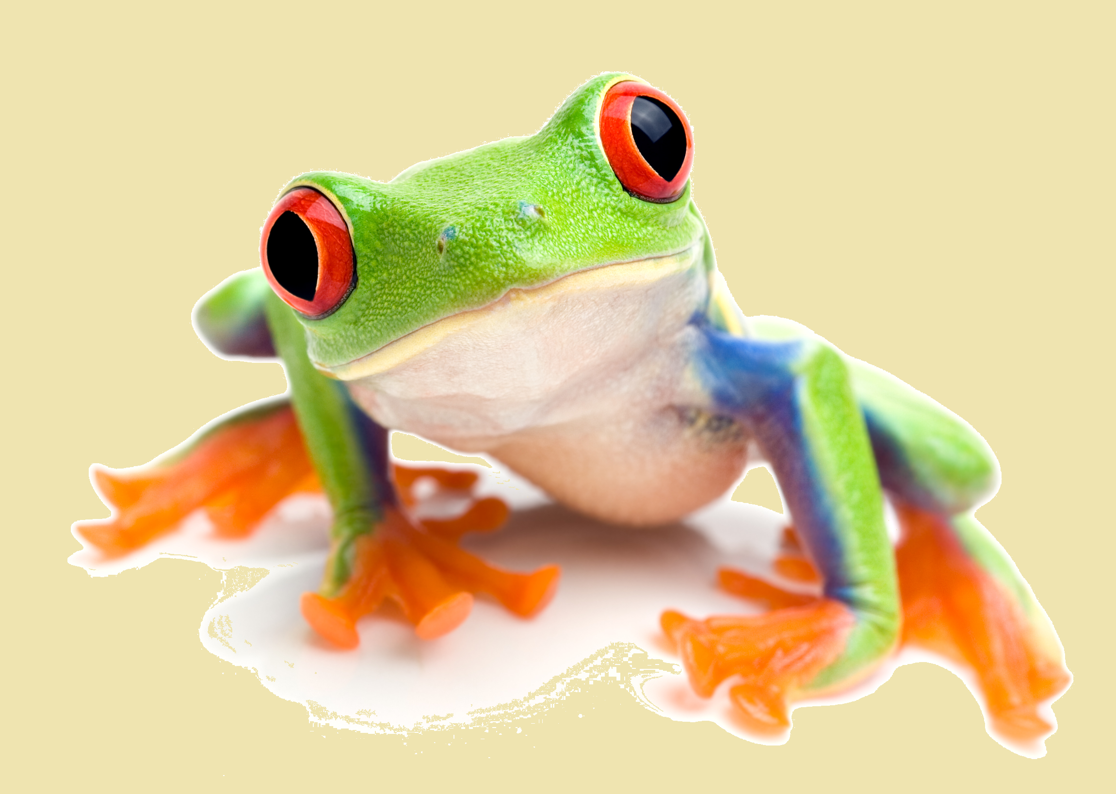
Canopy
95%

Slide 31
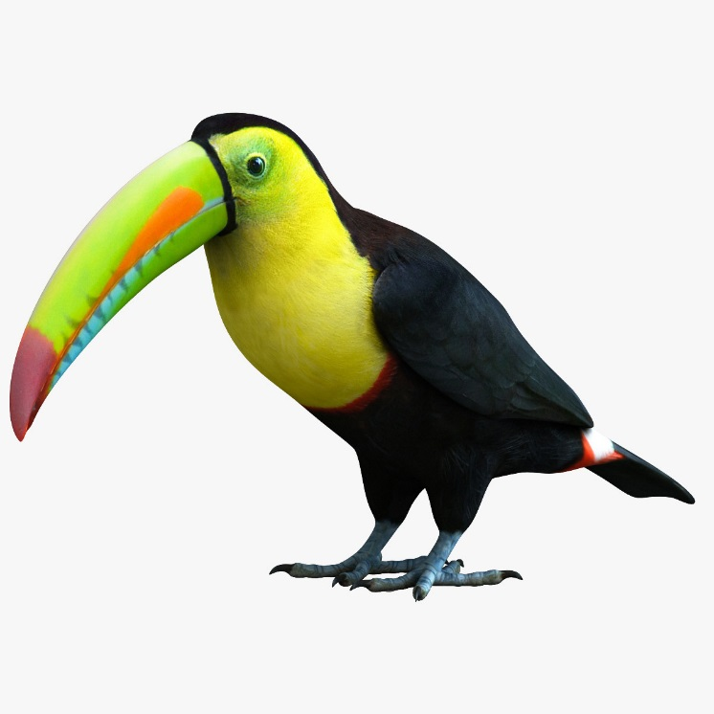
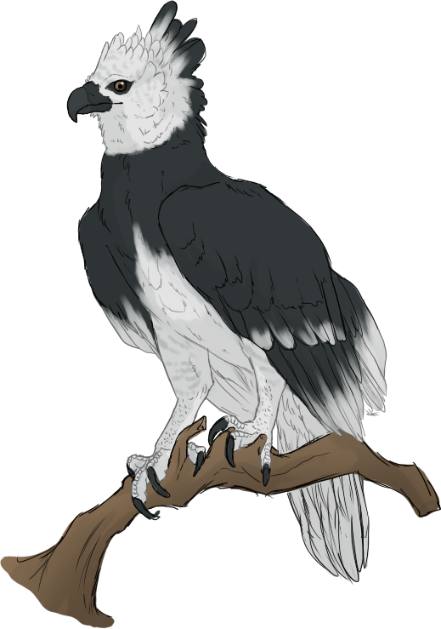
Emergent Layer
100%

Slide 33
Amazing Amazon
https://www.youtube.com/watch?v=HiwgpA4ReEc

Slide 34
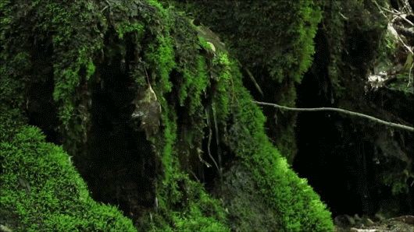
How long does it take rain to hit the ground?
10 minutes

Slide 35
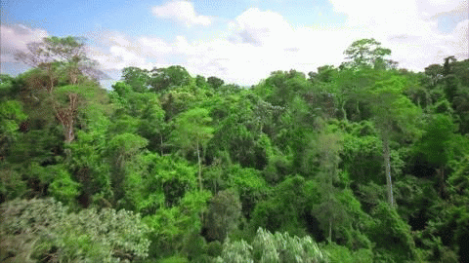
What is the largest rain forest in the world?
10
Amazon

Slide 36
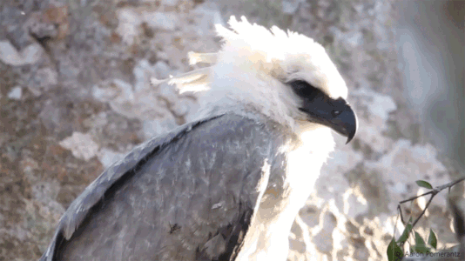
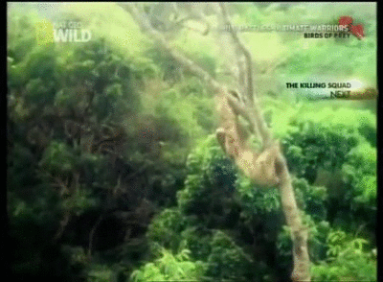
What does the Harpy Eagle eat?
9
Monkeys and Sloths

Slide 37
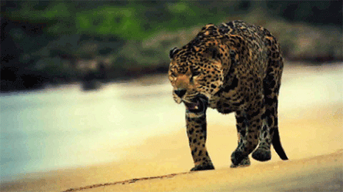
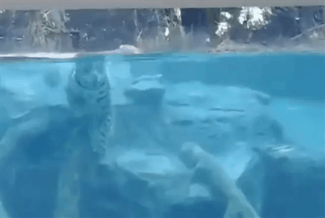
What is the 3rd largest cat in the world?
8
Jaguar

Slide 38
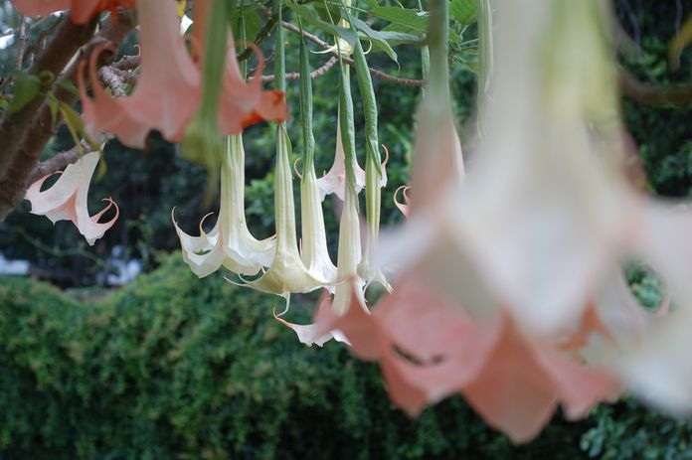
Should you eat the “Angel’s Trumpet”?
7
No.

Slide 39
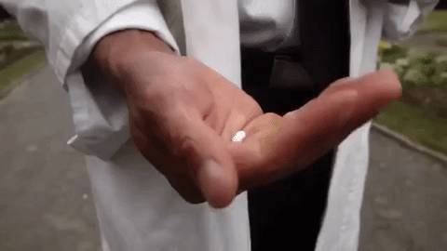
About _____% of anti-cancer drugs are from the Amazon rainforest.
6
50

Slide 40
There are over 300 types of ______ in the Amazon.
5
Butterflies

Slide 41
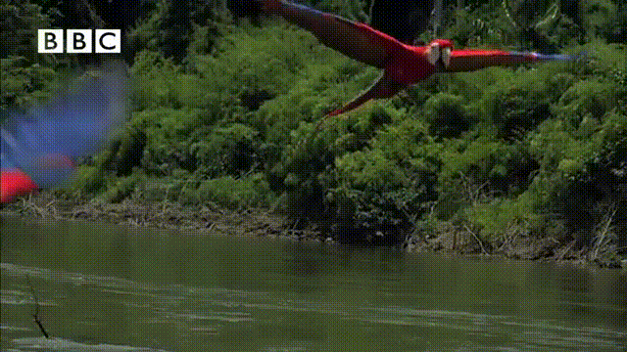
Who are the loudest birds in the Amazon?
4
Macaws

Slide 42
How many tribes have never talked to the rest of the world?
3
~50

Slide 43
The Amazon is the ______ of the planet.
2
Lungs

Slide 44
How many bridges go over the Amazon River?
1
0

Slide 45
Notes:
http://gozoneguide.com/layers-of-the-rainforest-worksheet/

Slide 47
https://www.youtube.com/watch?v=wcuCO2CLM6I

