Slide 1
Puss in Boots
Three Diablos
https://www.netflix.com/watch/70242145?trackId=3623124&tctx=1%2C2%2C8058c8c6-6a29-4db0-b6a5-f25a436b44d7-293083951

Slide 2
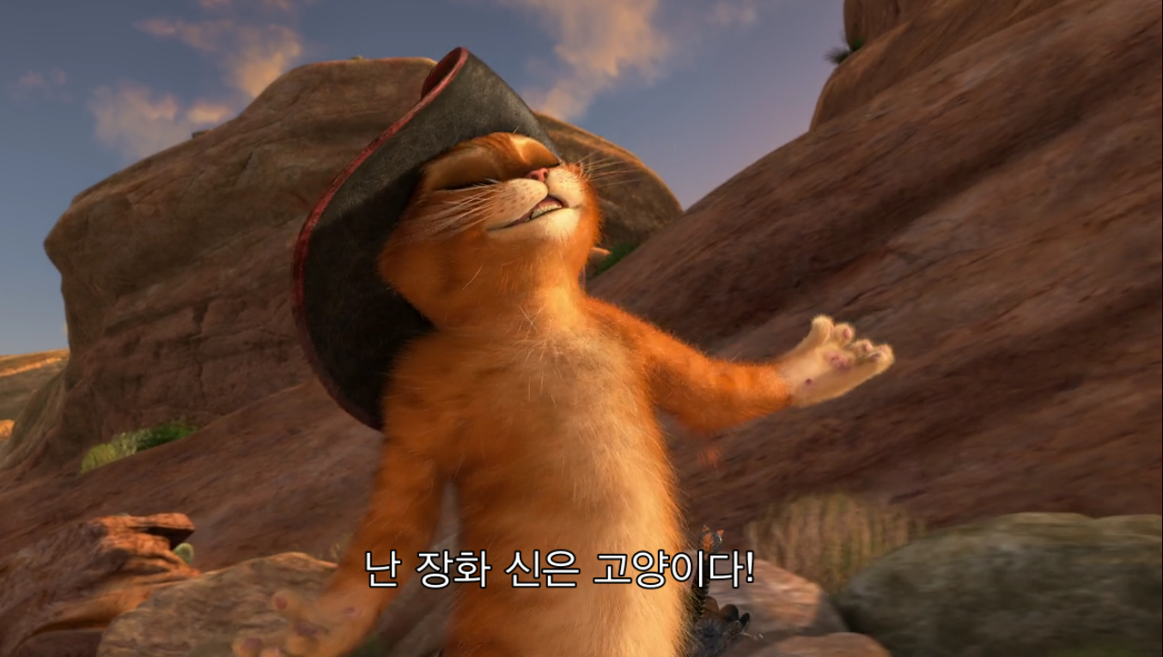

Slide 3
What did they need to find?
Heart (jewel)

Slide 4
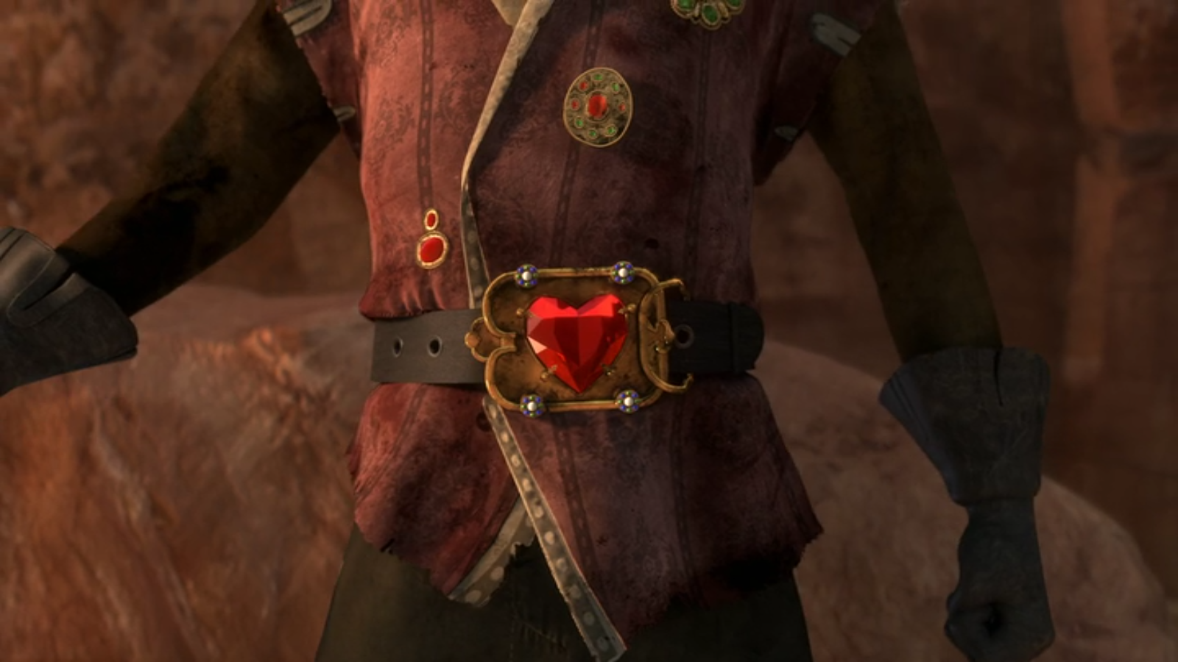

Slide 5
Who stole the heart?
The Whisperer

Slide 6
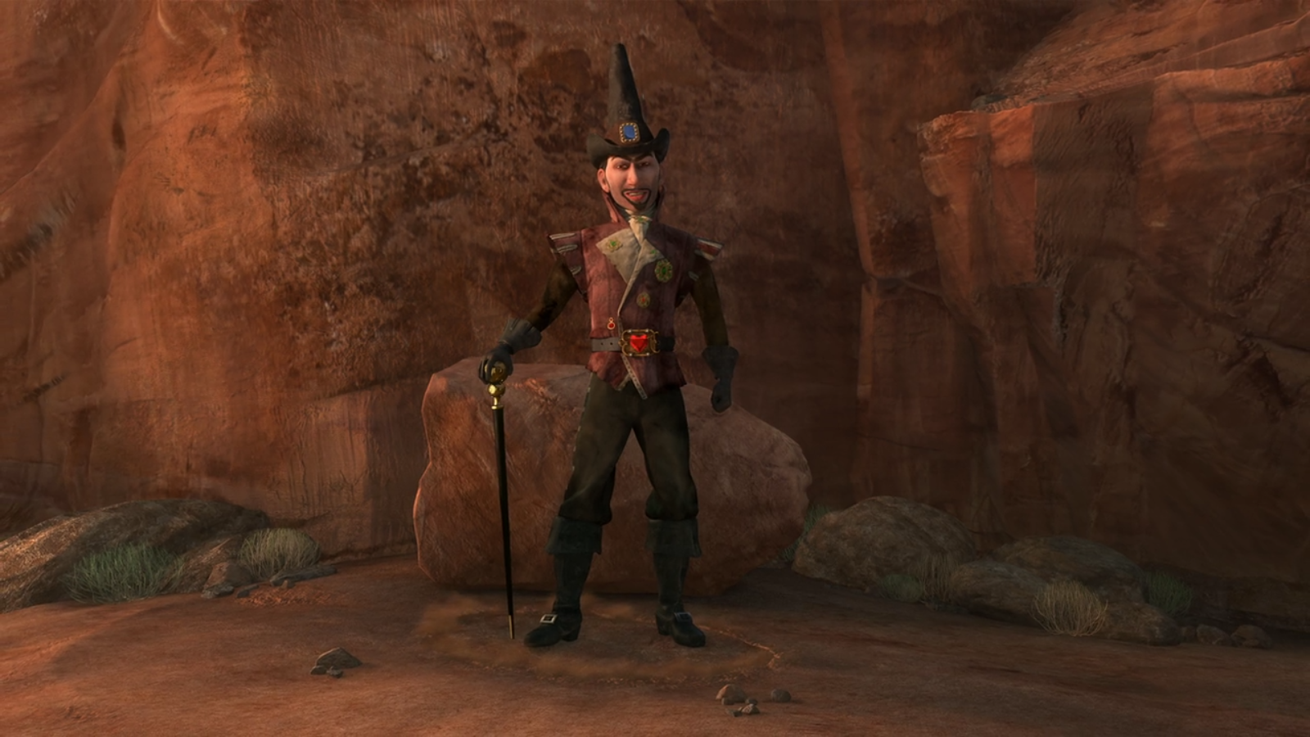

Slide 7
What food will they eat?
Fish sticks

Slide 9
What is it called when you don’t have parents?
Orphans

Slide 10
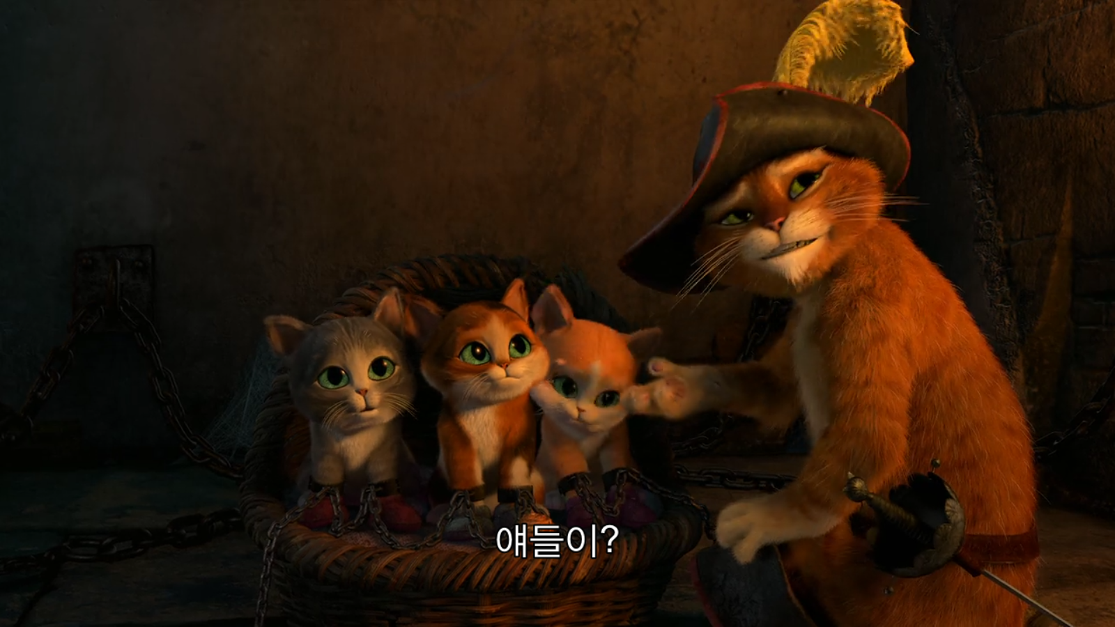

Slide 11
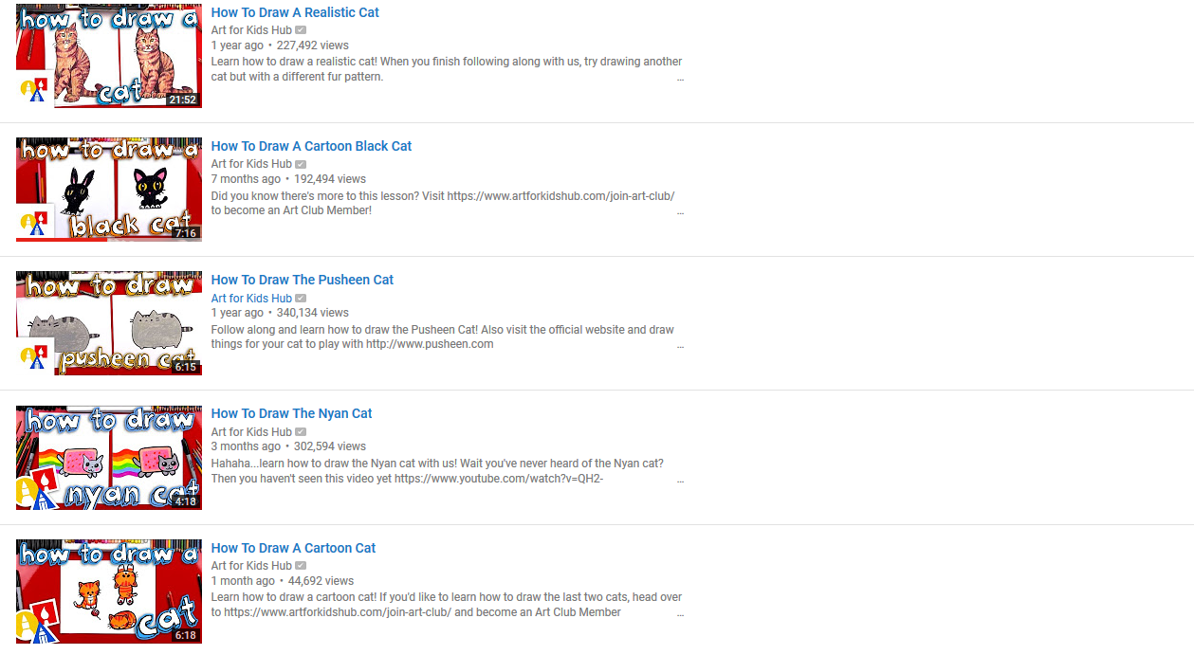
Let’s Draw:
https://www.youtube.com/user/ArtforKidsHub/search?query=cat

Slide 12
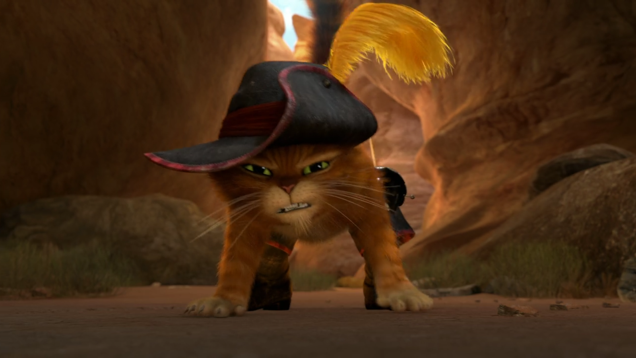

Slide 13
Quick Draw
https://quickdraw.withgoogle.com/#

