Slide 1
Halloween Costumes
Take a picture

Slide 2
What is a costume?
Clothes that make you look like something else.

Slide 3
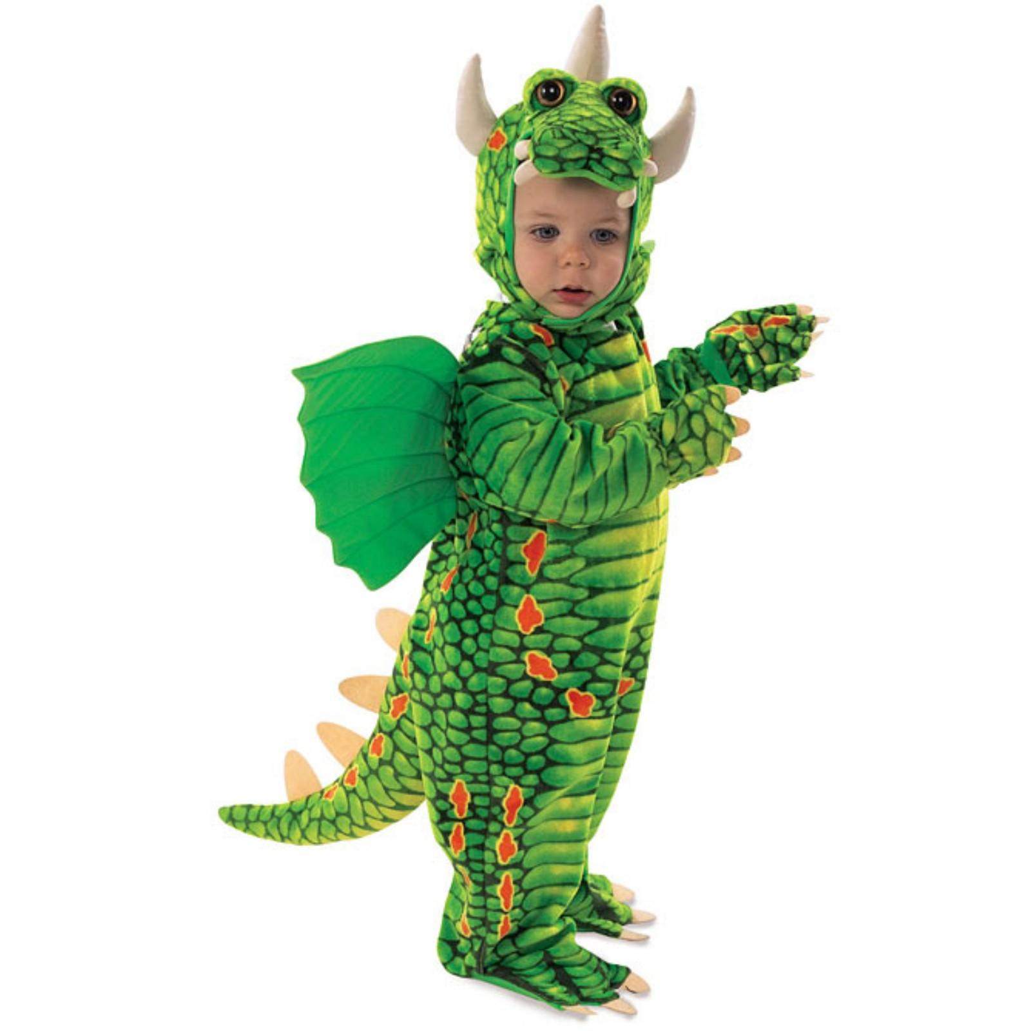
Some Costume Ideas:
Dragon

Slide 4
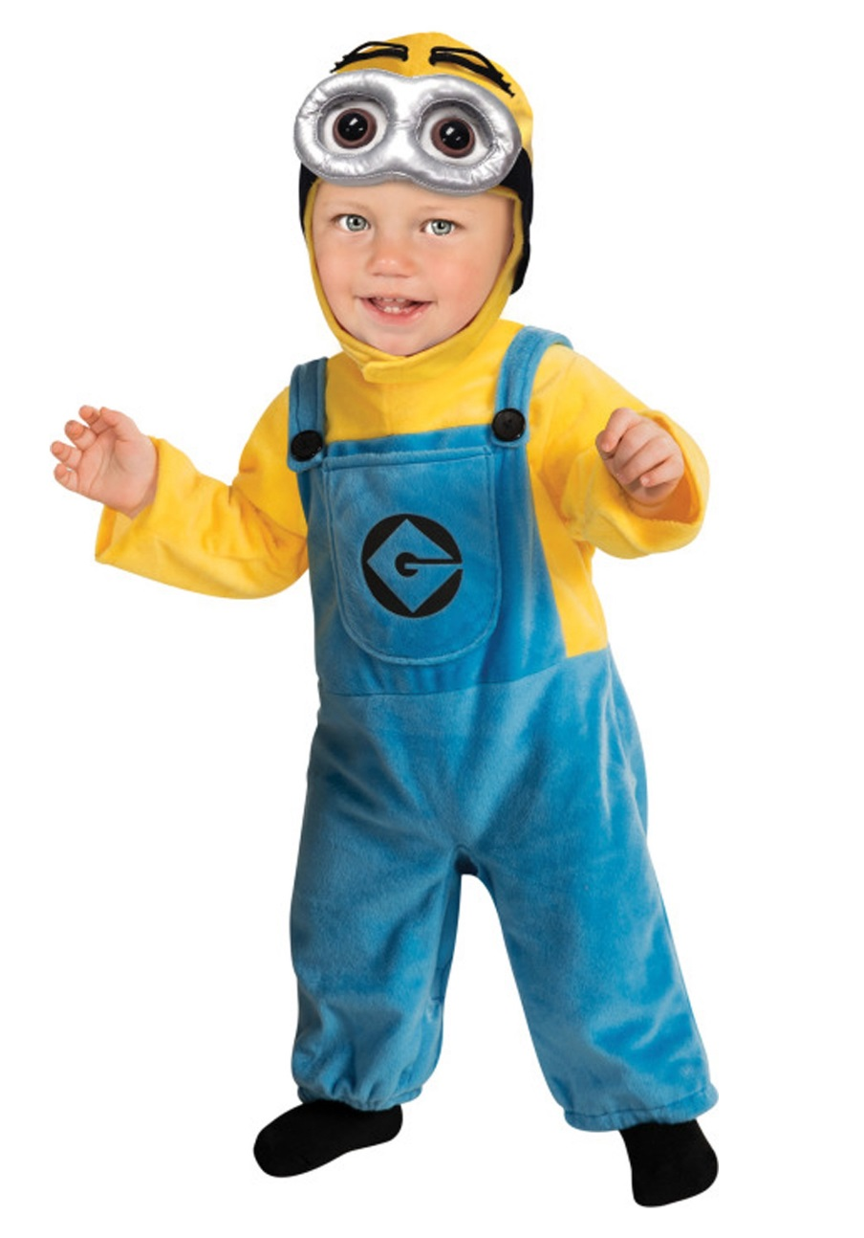
Some Costume Ideas:
Minion

Slide 5
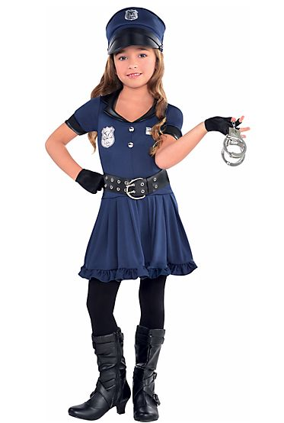
Some Costume Ideas:
Police Officer

Slide 6
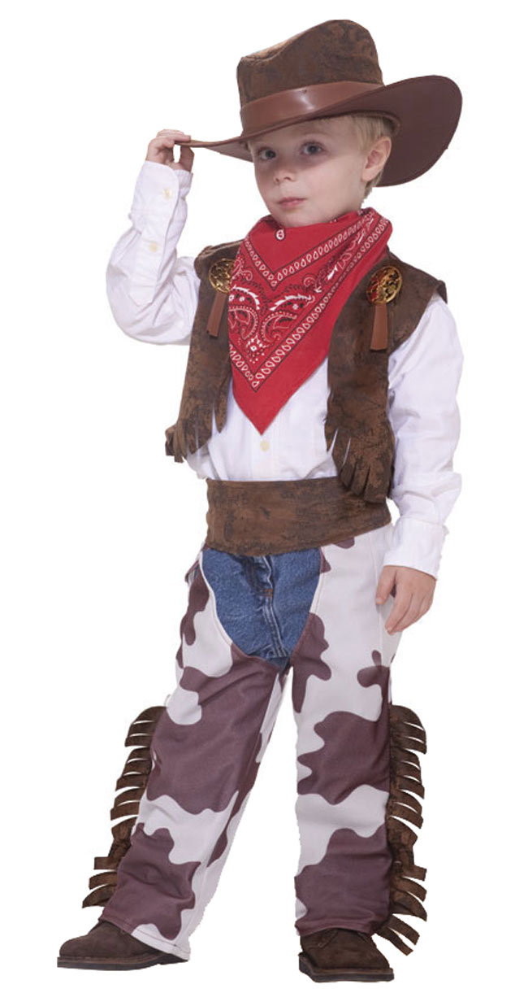
Some Costume Ideas:
Cowboy

Slide 7
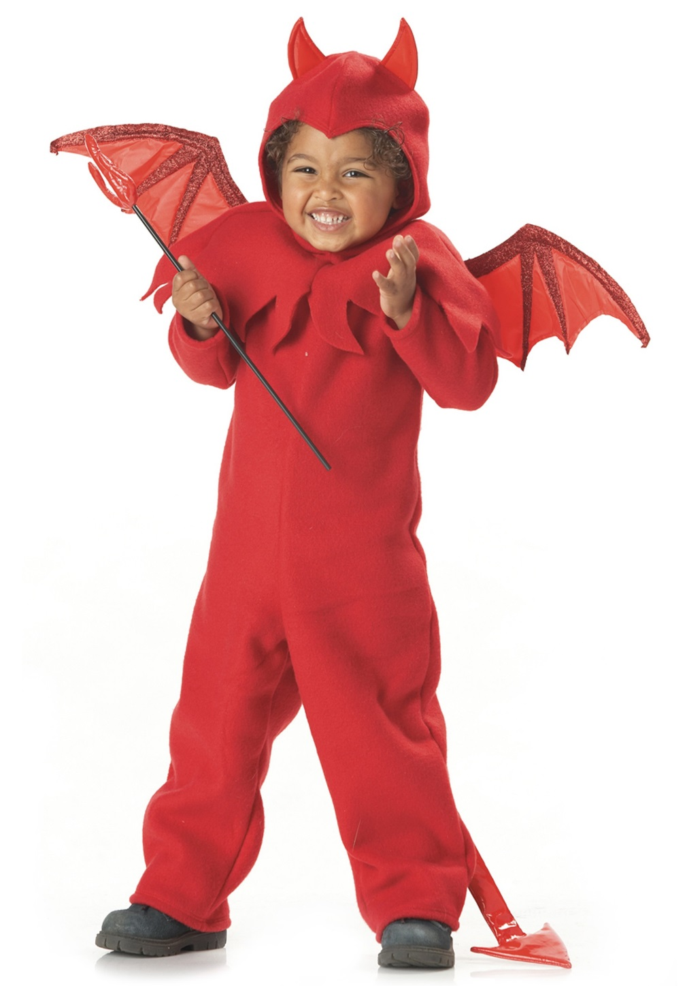
Some Costume Ideas:
Devil

Slide 8
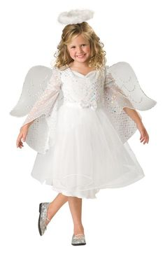
Some Costume Ideas:
Angel

Slide 9
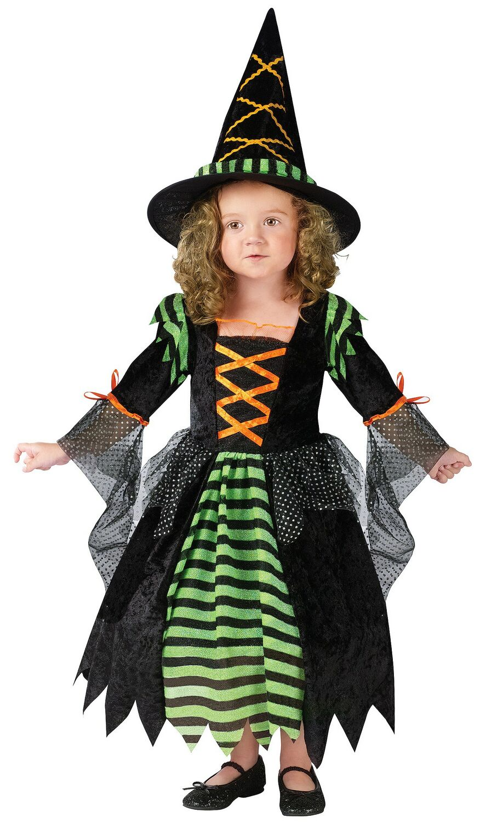
Some Costume Ideas:
Witch

Slide 10
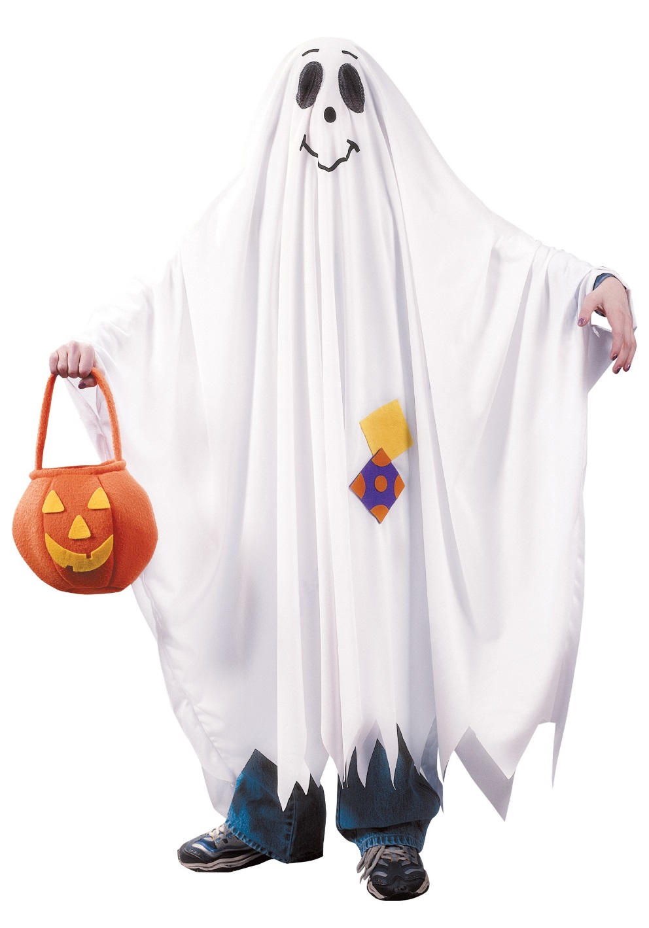
Some Costume Ideas:
Ghost

Slide 11
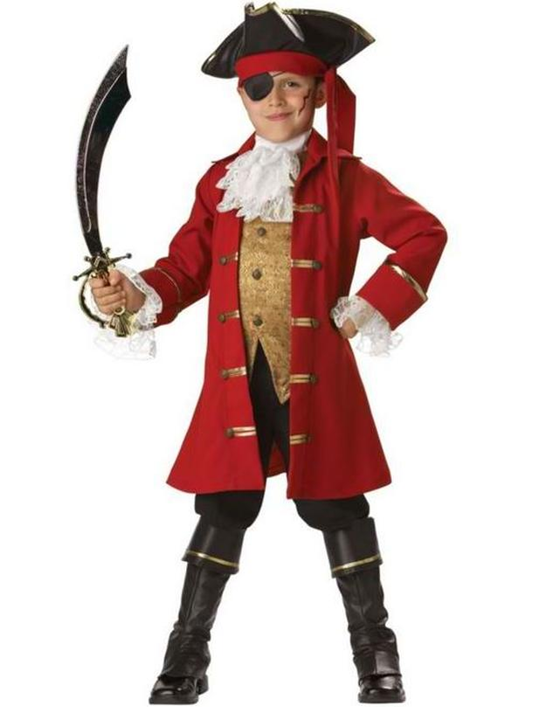
Some Costume Ideas:
Pirate

Slide 12
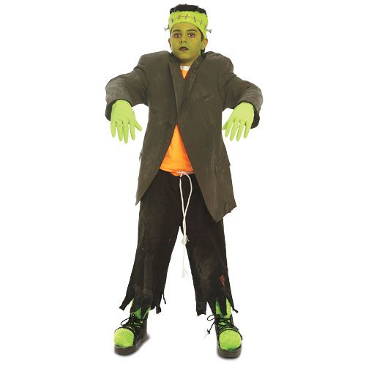
Some Costume Ideas:
Frankenstein

Slide 13
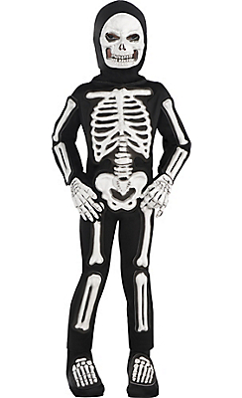
Some Costume Ideas:
Skeleton

Slide 14
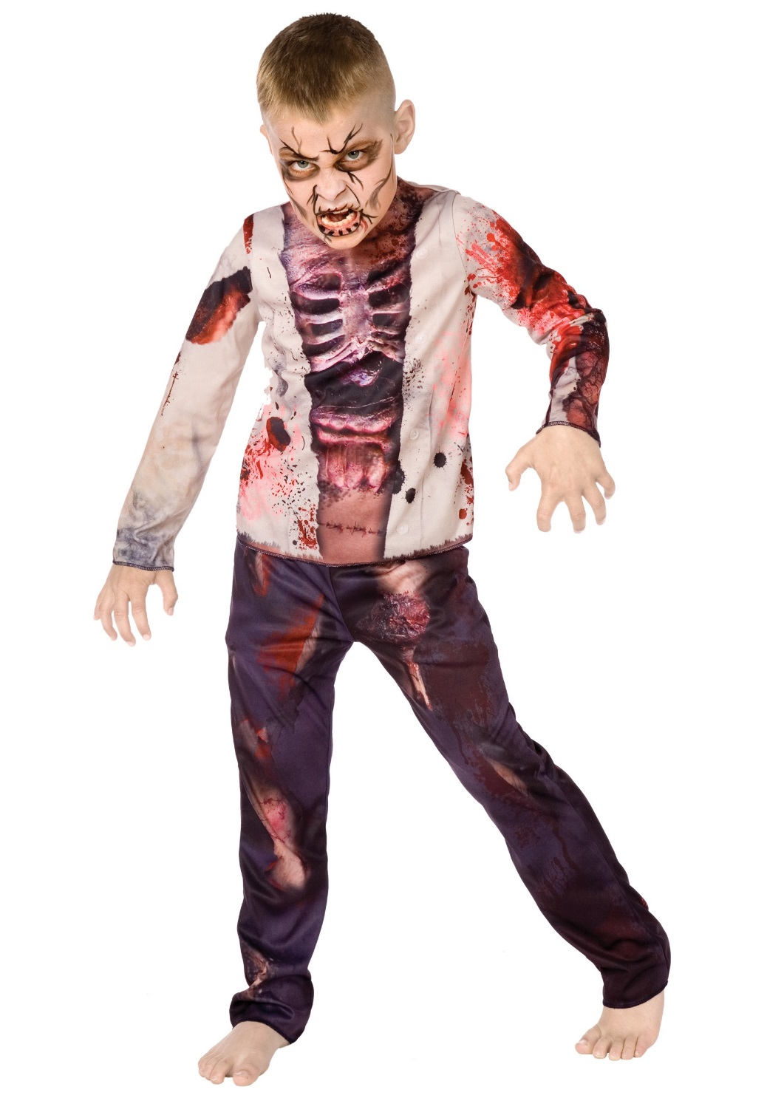
Some Costume Ideas:
Zombie

Slide 15
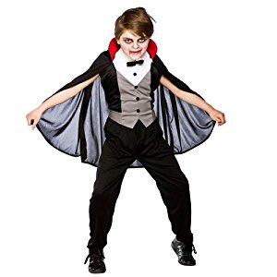
Some Costume Ideas:
Vampire

Slide 16
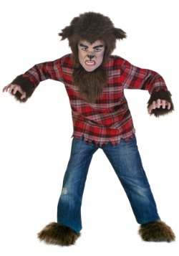
Some Costume Ideas:
Werewolf

Slide 17
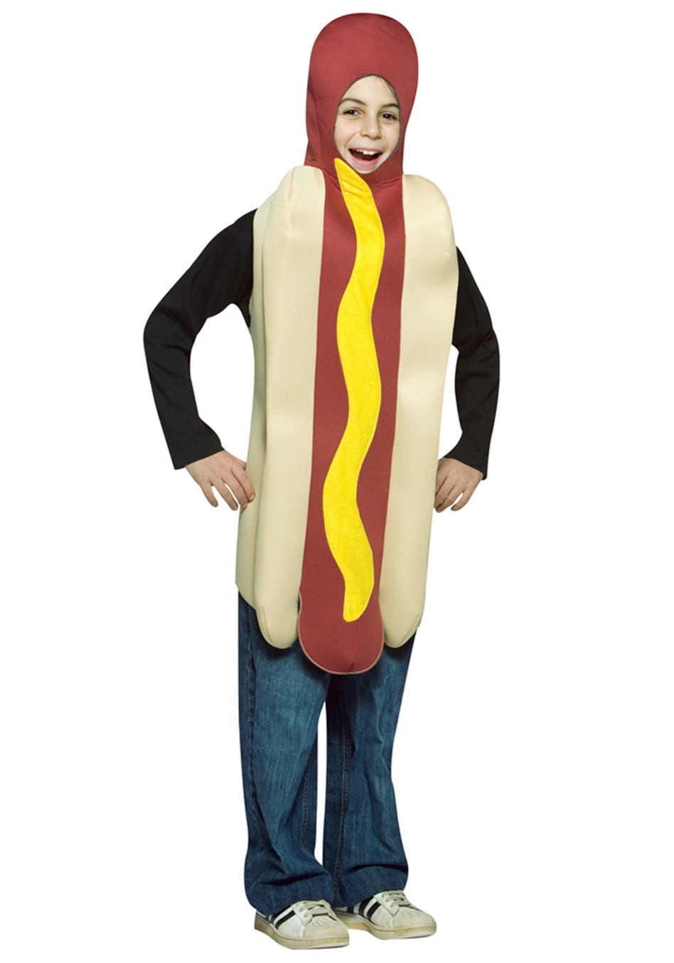
Some Costume Ideas:
Hotdog

Slide 18
Prop Box Costume
TODAY you can wear a costume from the prop box.
BUT you must return it by the end of class.

Slide 19
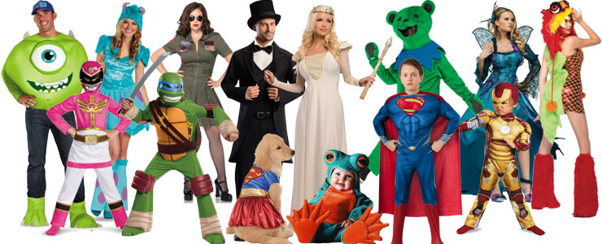

Slide 20
Tell us about your costume:

Slide 21
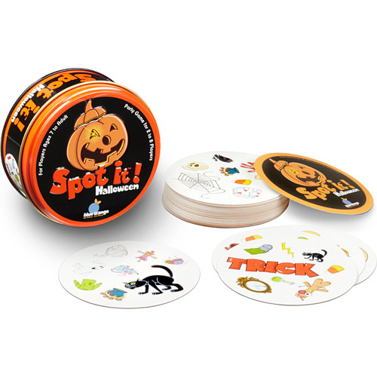
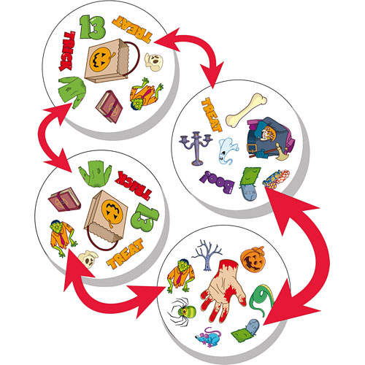

Slide 22
Design a Costume
Using the pictures from the start of class,
draw a costume on the other students.

Slide 23
Three Groups
One group will play Spot It
One group will make costumes
One group will do work sheets

