Slide 1
Go Fish
Dr. Seuss Edition

Slide 6
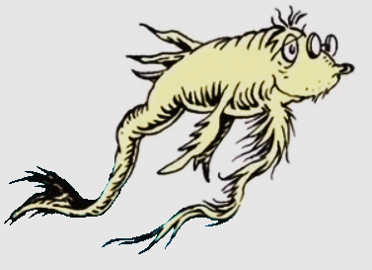

Slide 7
