Slide 1
Twisted Tales

Slide 2
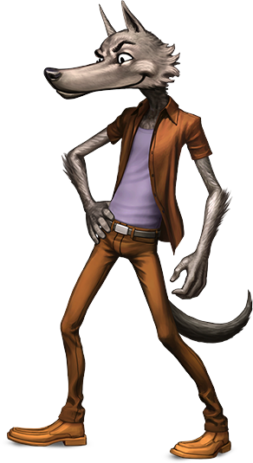
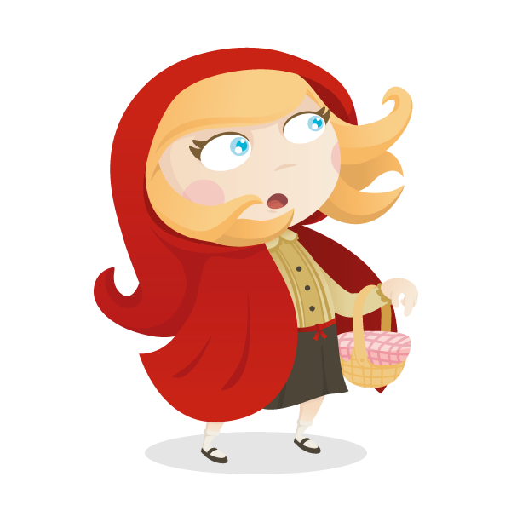
Do you know Little Red Riding Hood?
Tell me the story

Slide 3
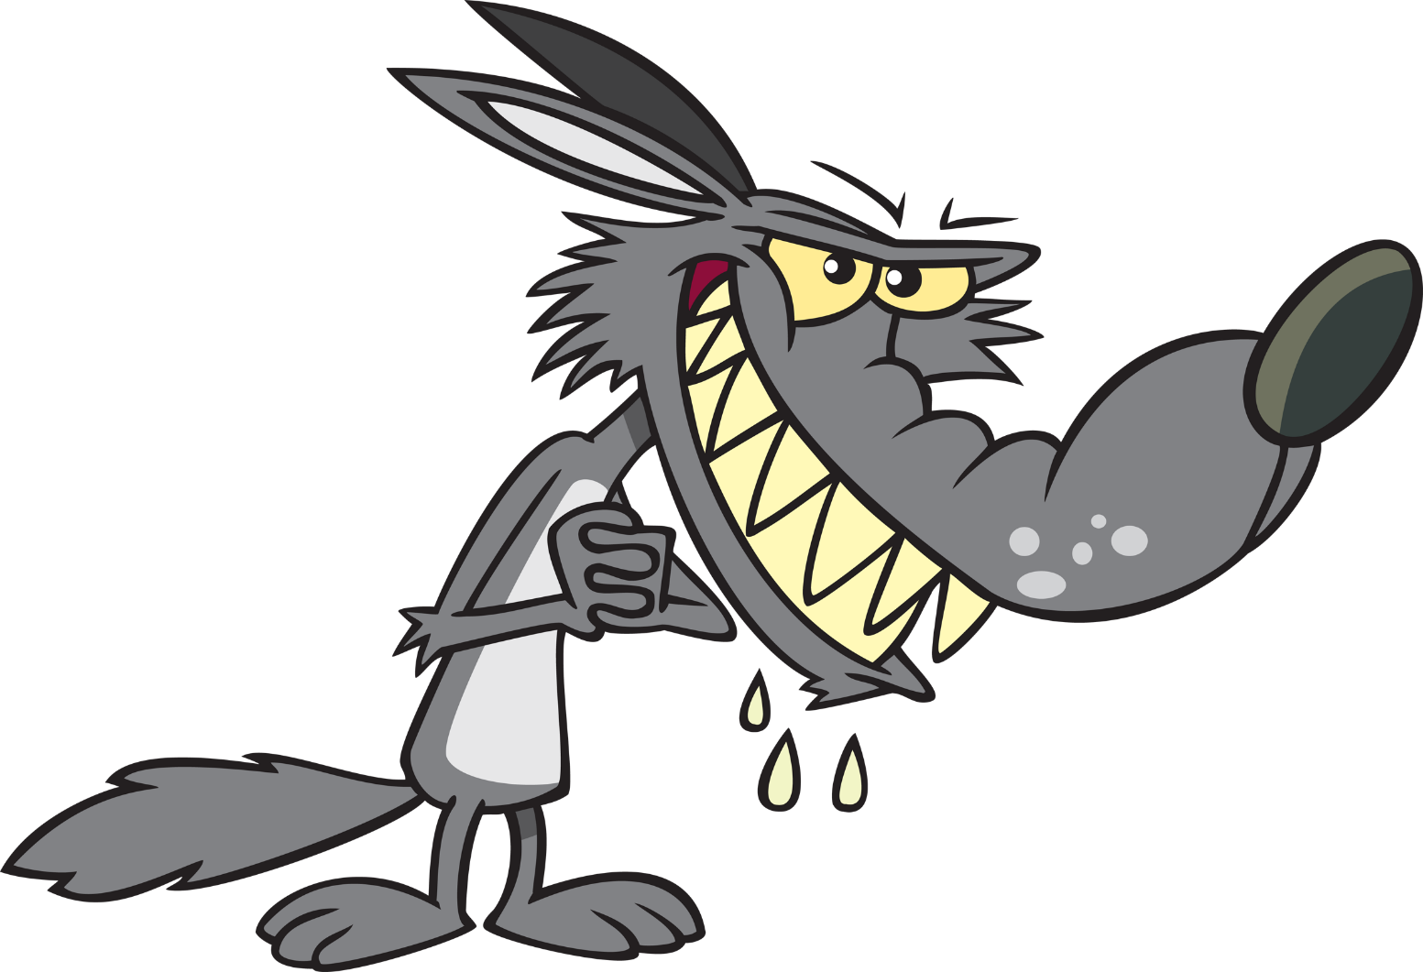
Tell me about the Big Bad Wolf

Slide 4
Listen to the story from Big Bad Wolf
Put the pictures into the correct act.

Slide 5
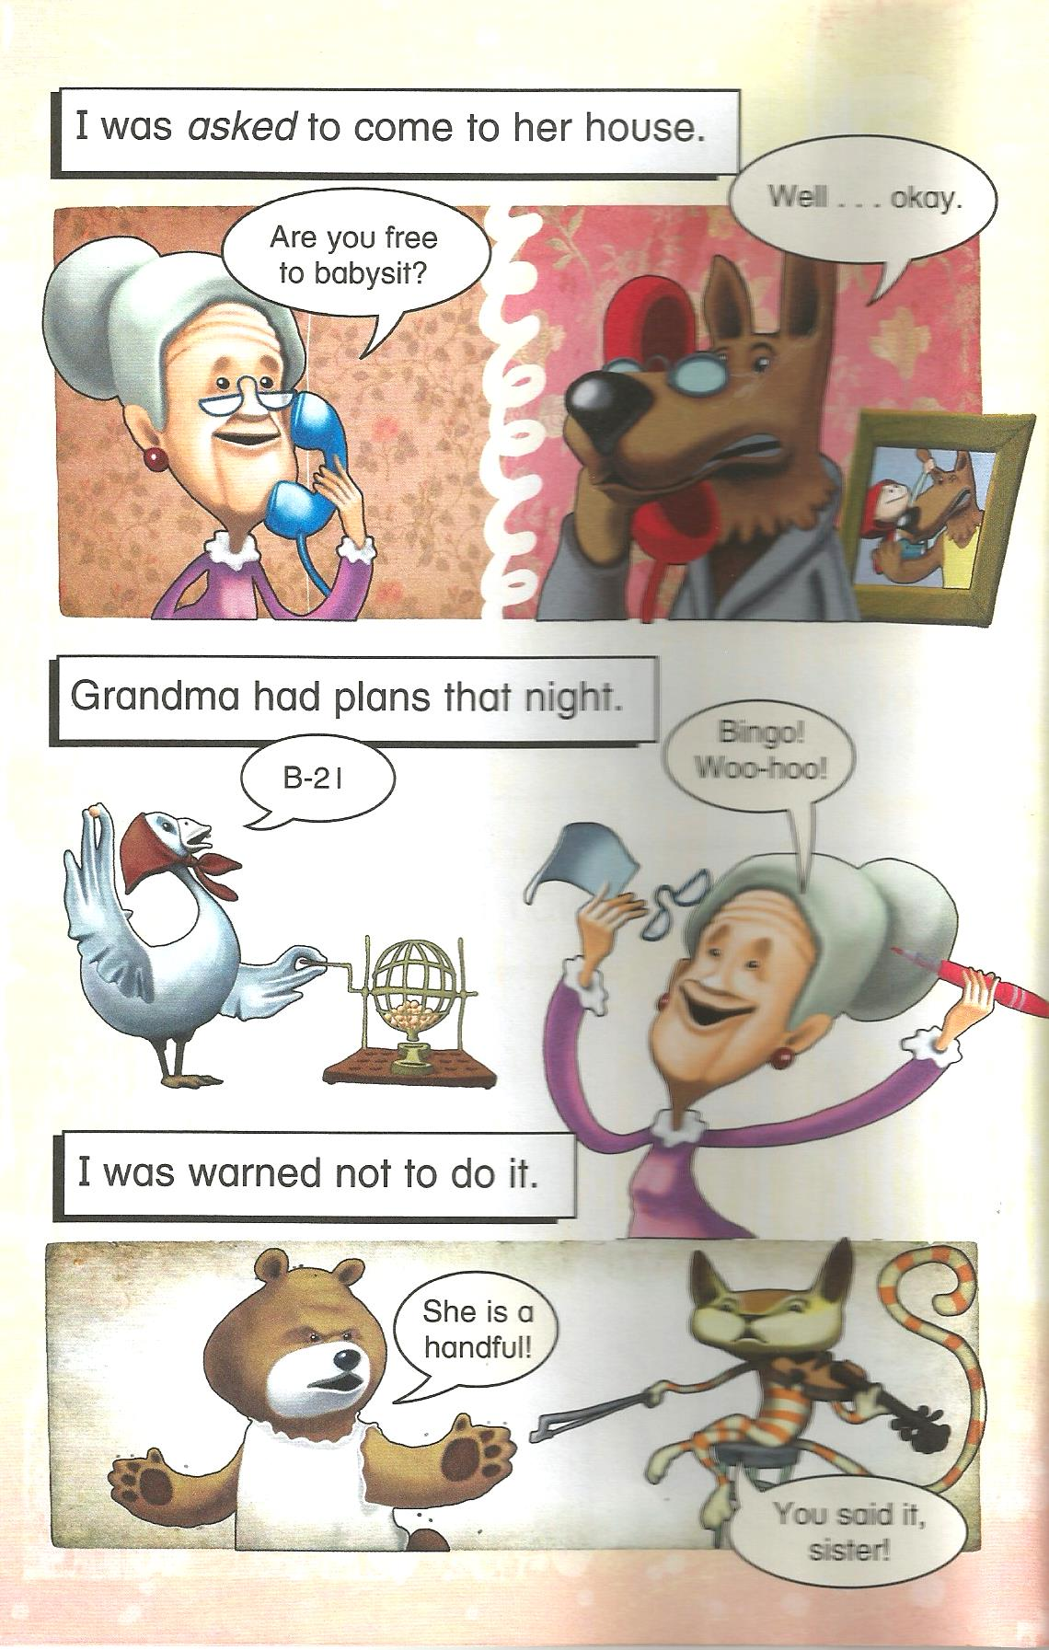

Slide 6
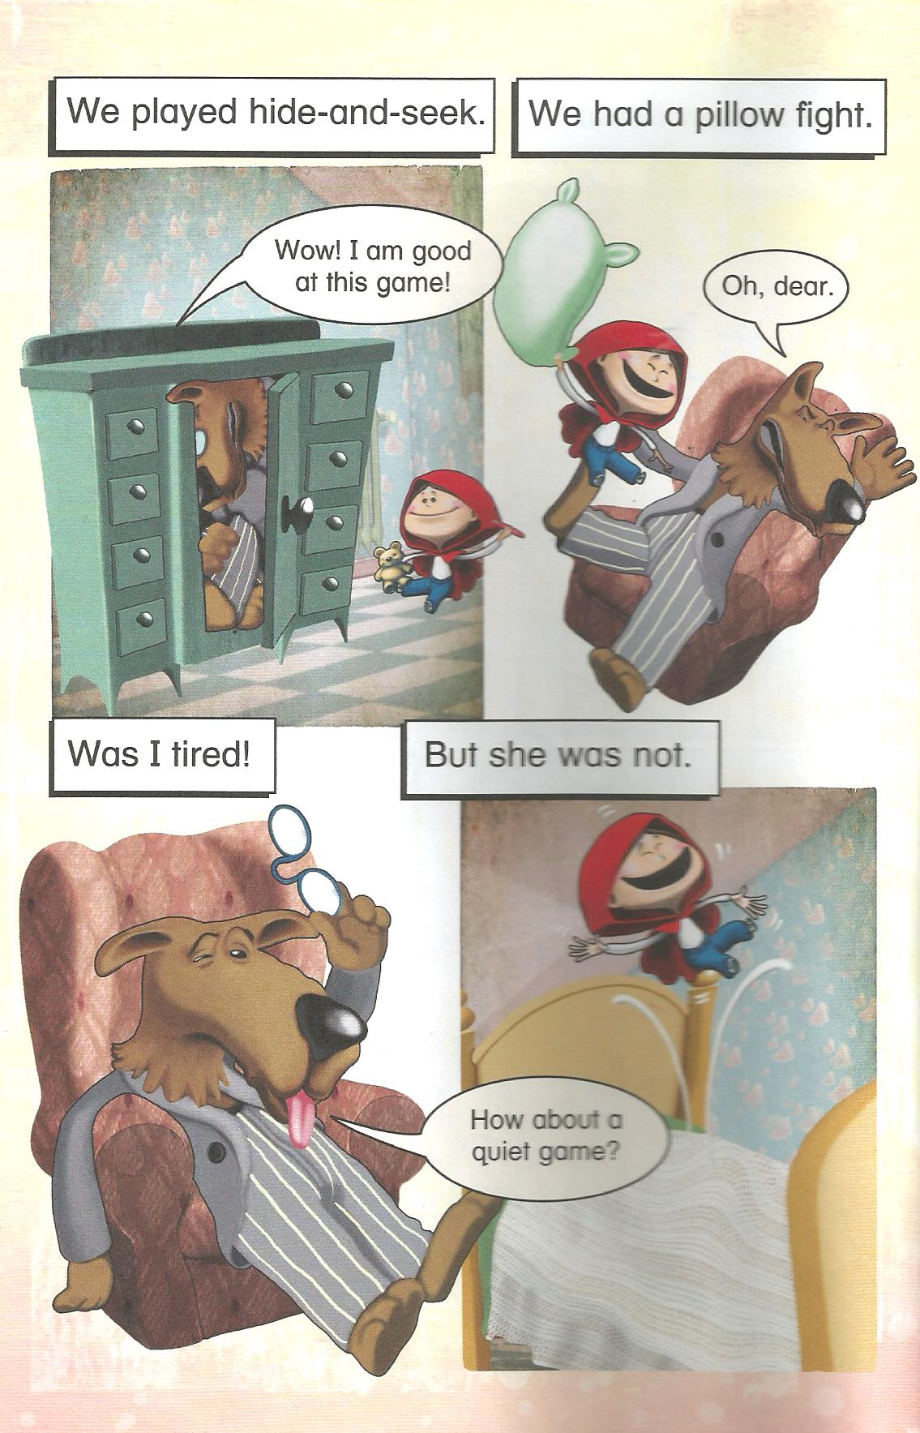

Slide 7
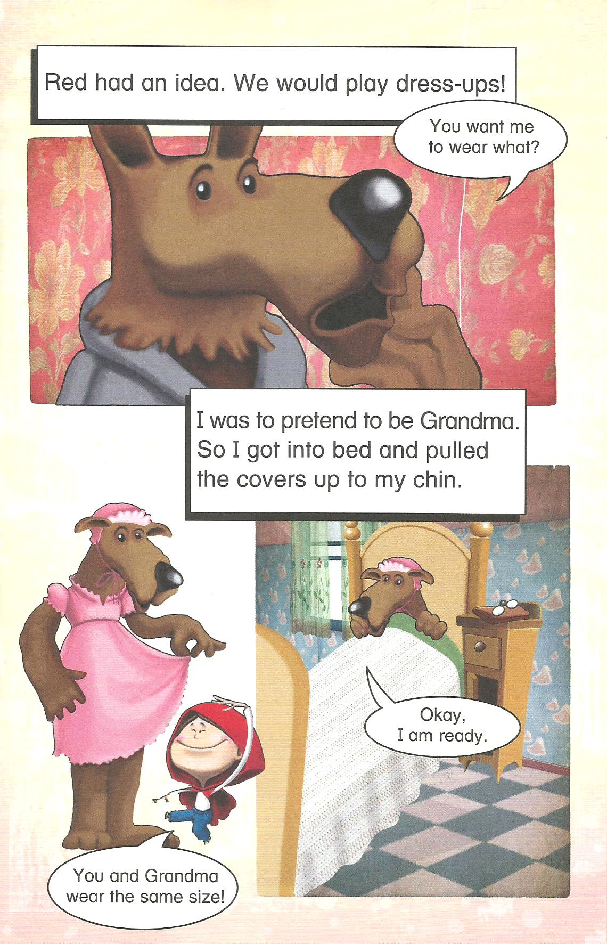
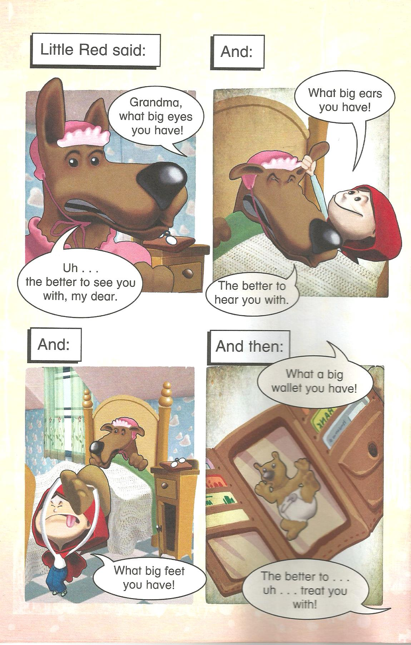

Slide 8
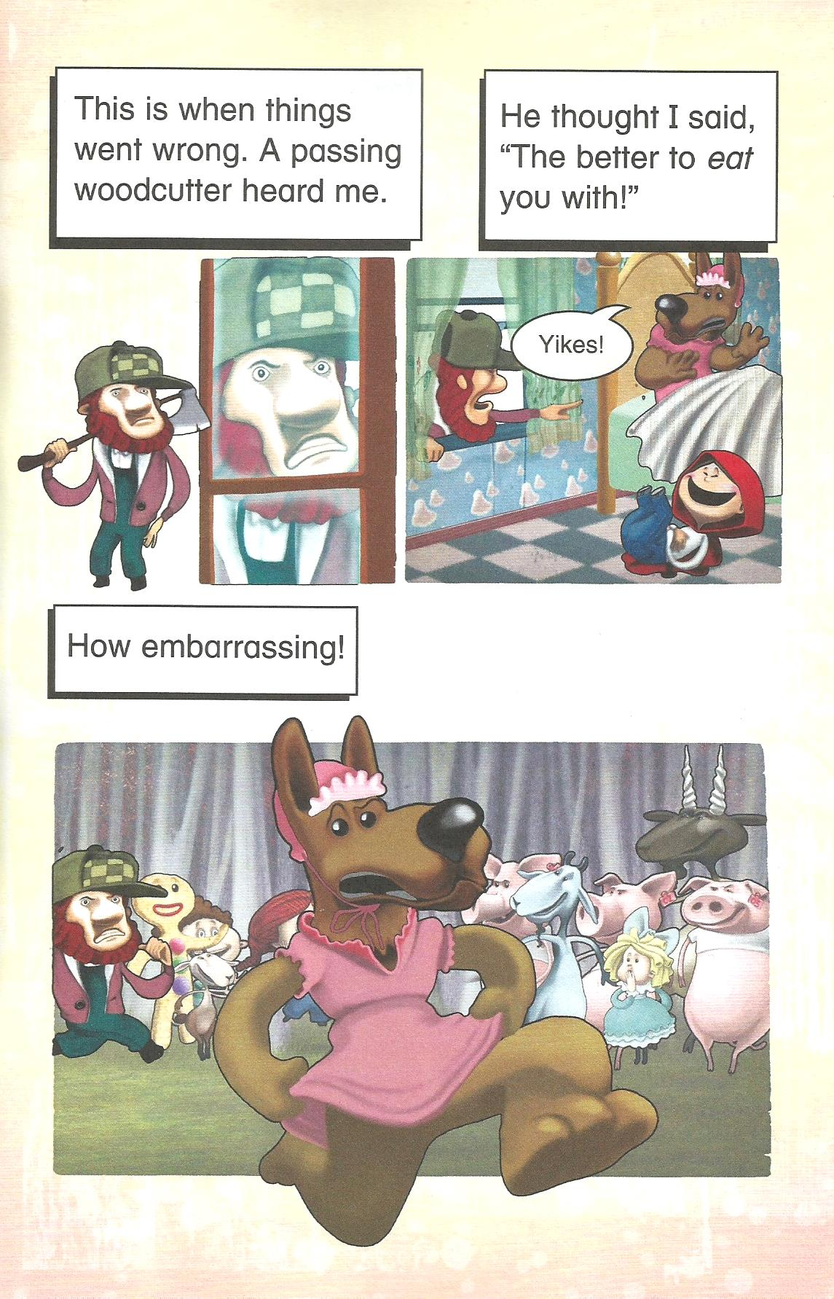
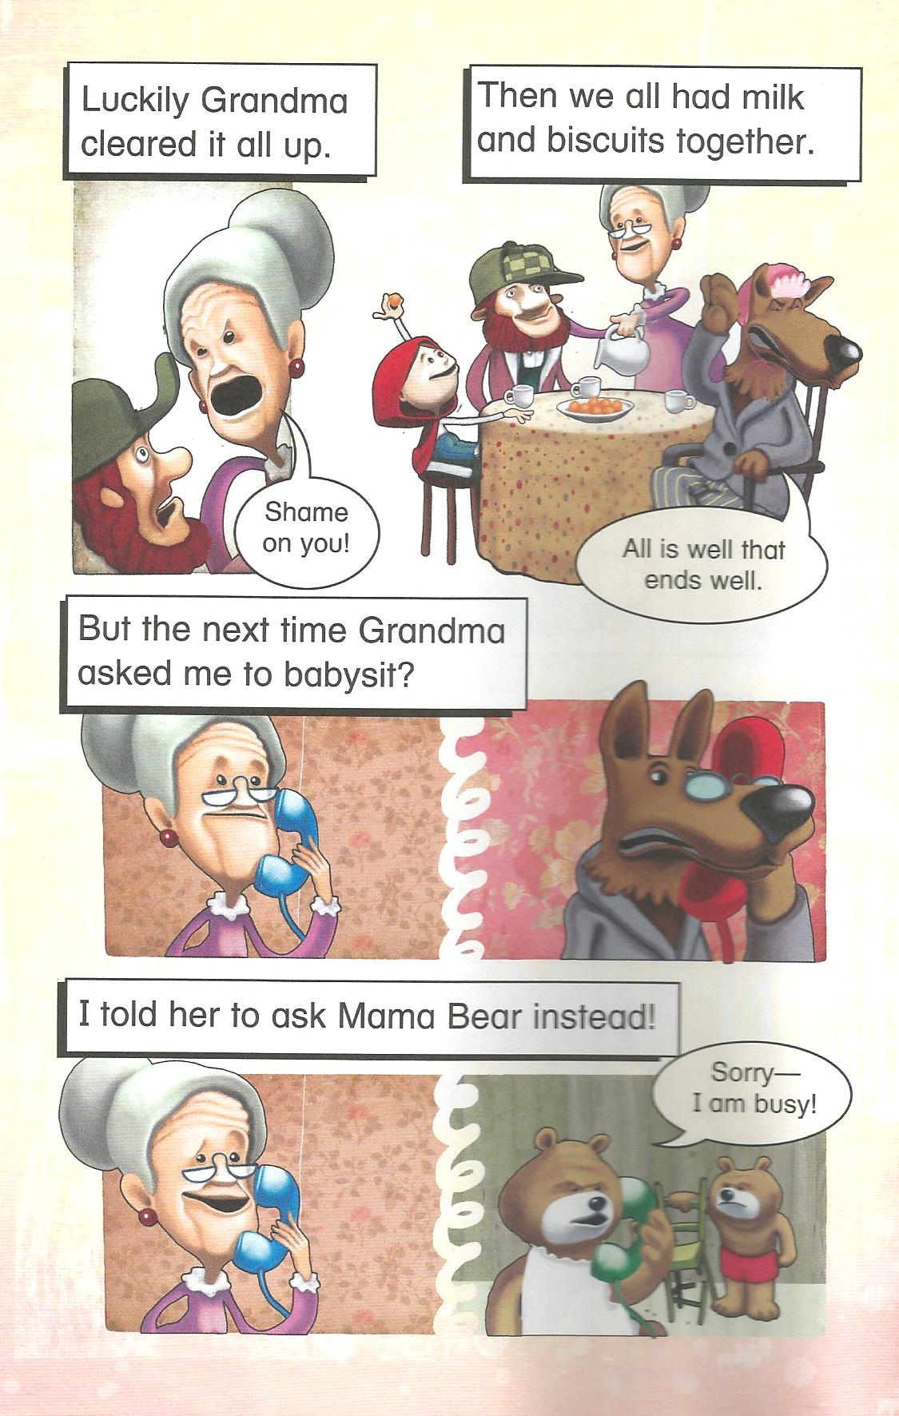

Slide 9
Did the Wolf eat Grandma?

Slide 10
Where was grandma?

Slide 11
What games did they play?

Slide 12
Why was the wolf dressed like grandma?

Slide 13
Why did the man think the wolf was going to eat Red Riding Hood?

Slide 14
Will the Wolf babysit again?

Slide 15
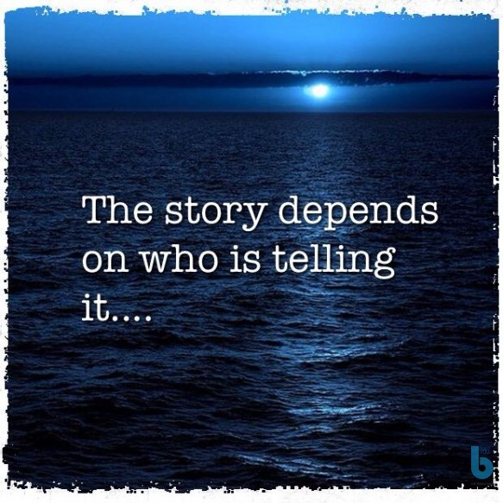
There are always two sides to a story

Slide 16
Think of a story
How could it be different from another character’s Point of View

Slide 17
Do you know the story on Hansel and Gretel?
Tell me about it

Slide 18
How might the story be different?
Lets read…

Slide 19
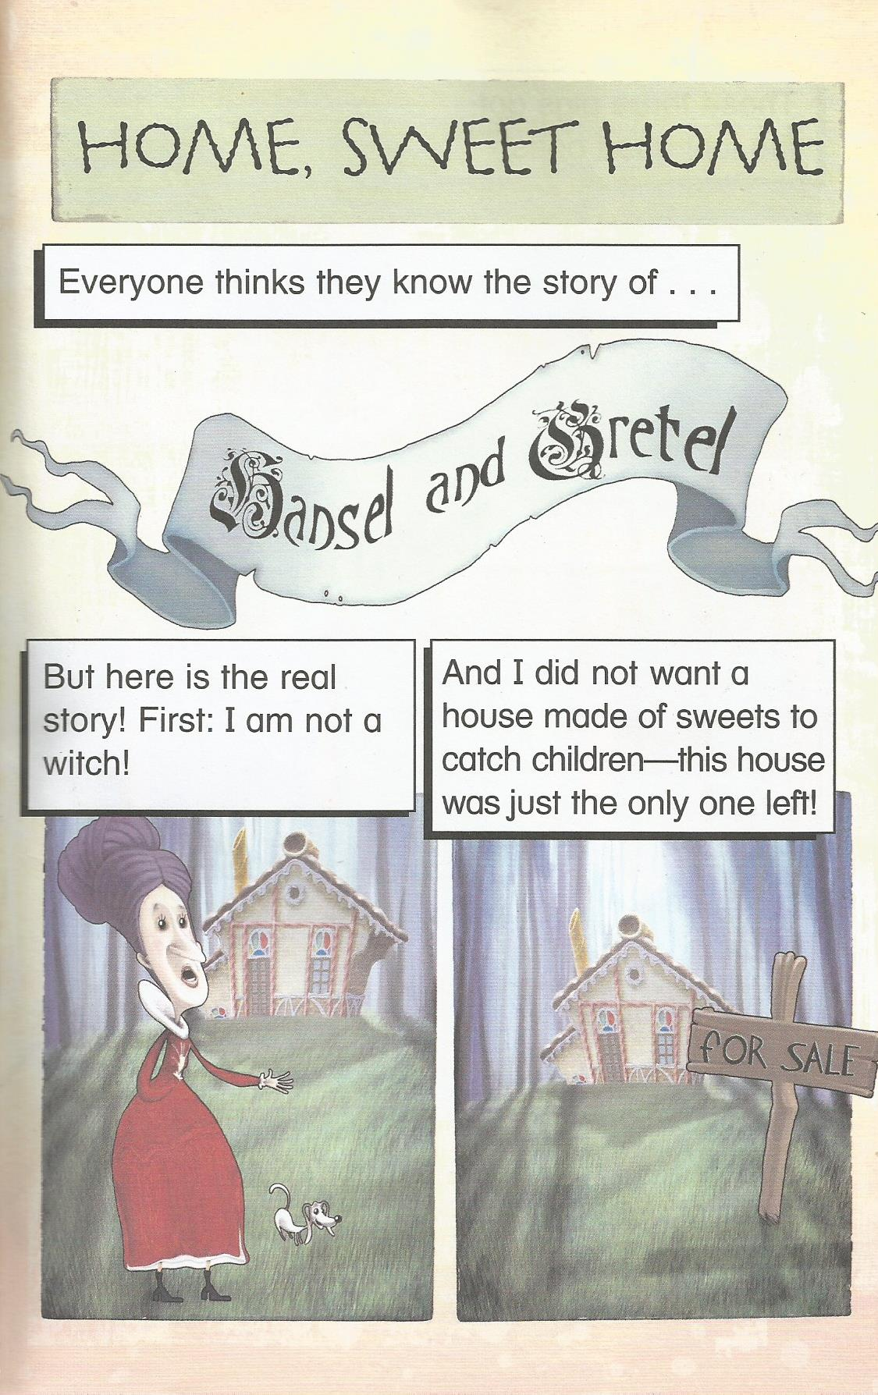

Slide 20
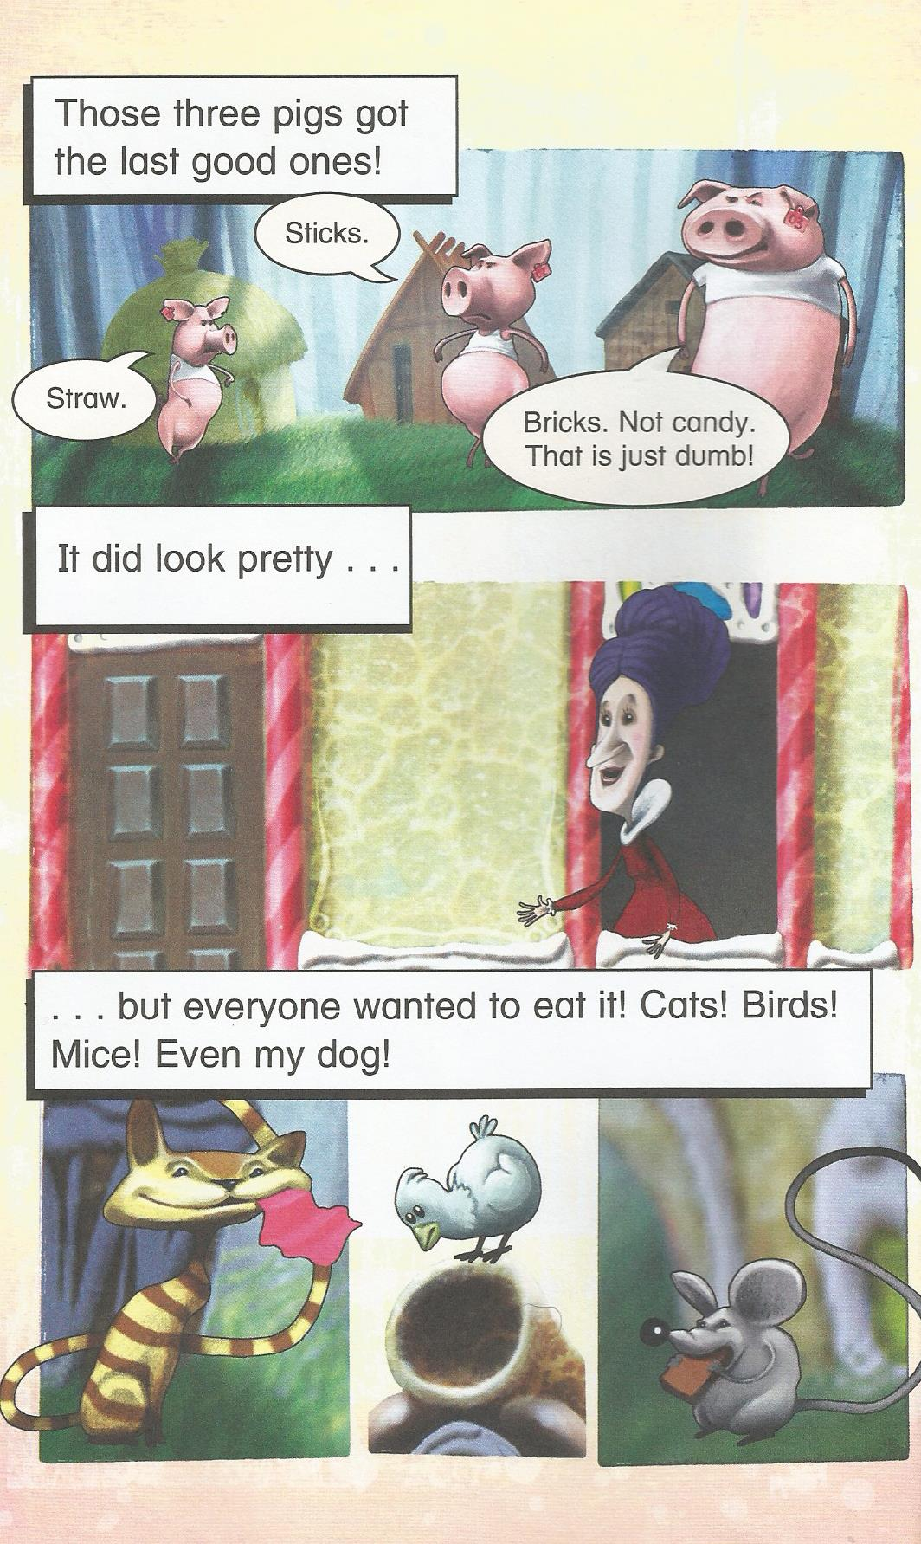

Slide 21
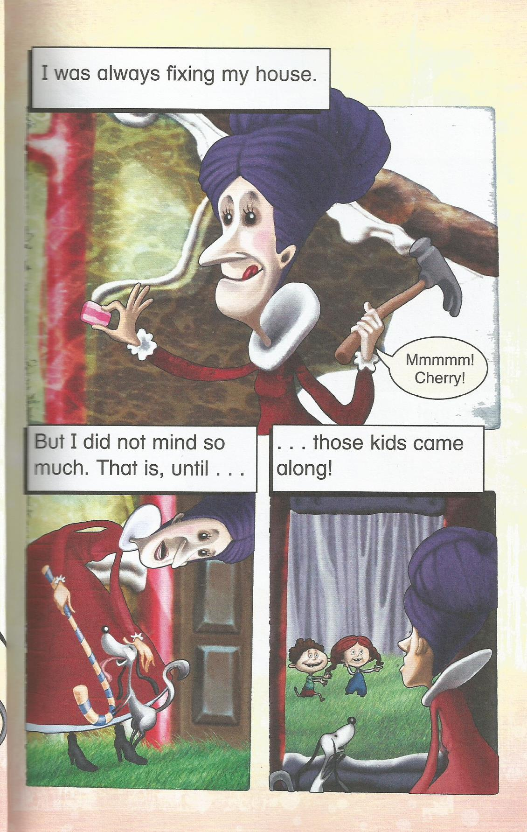

Slide 22
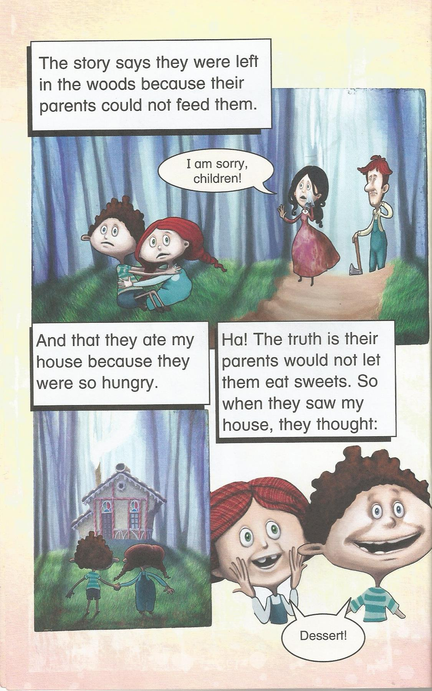

Slide 23
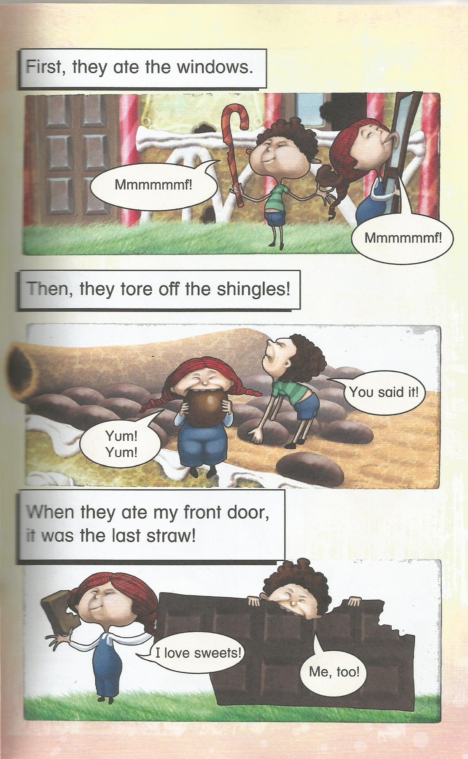

Slide 24
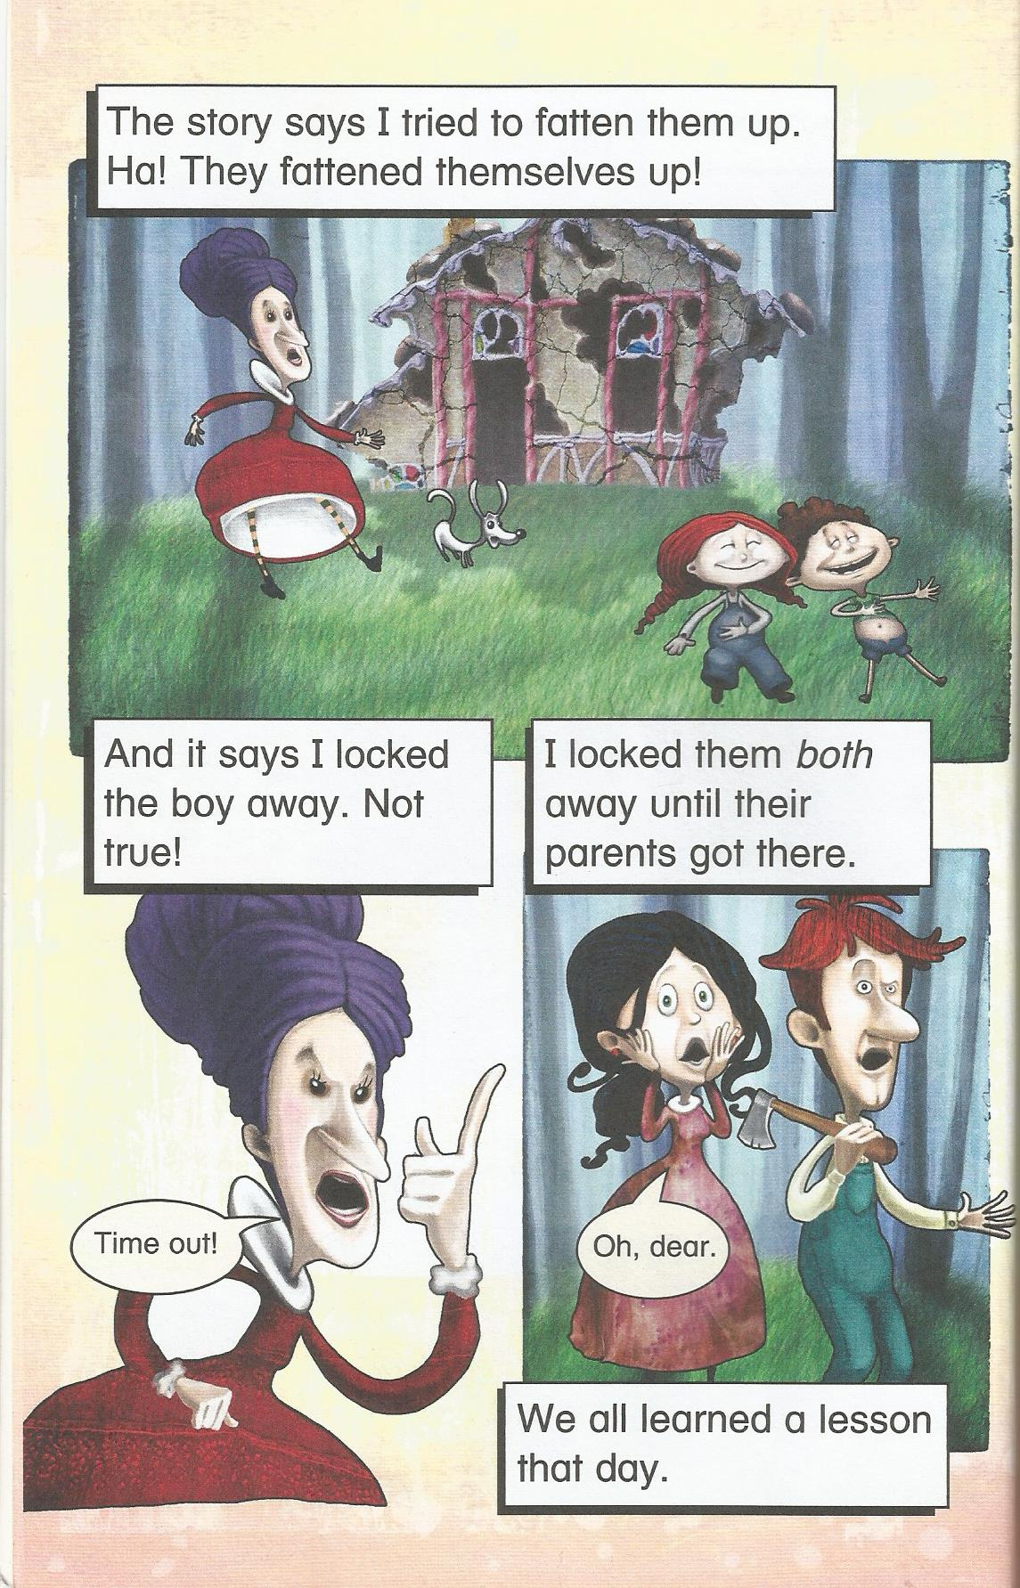

Slide 25
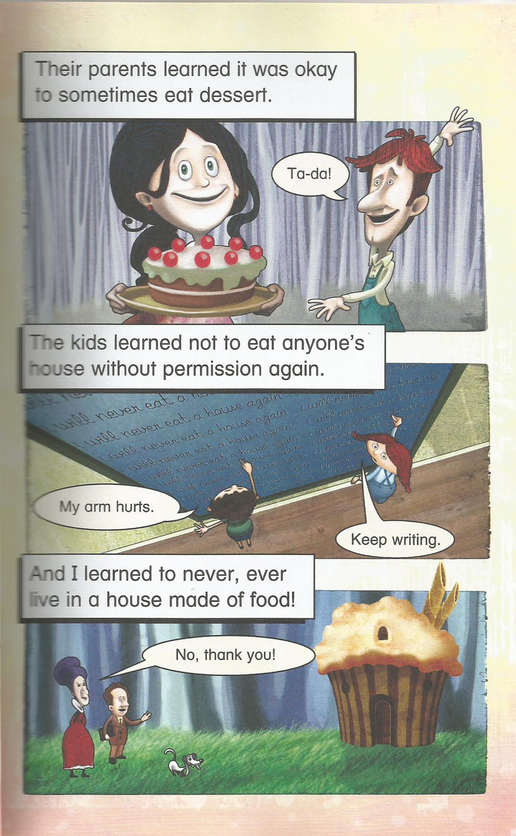

Slide 26
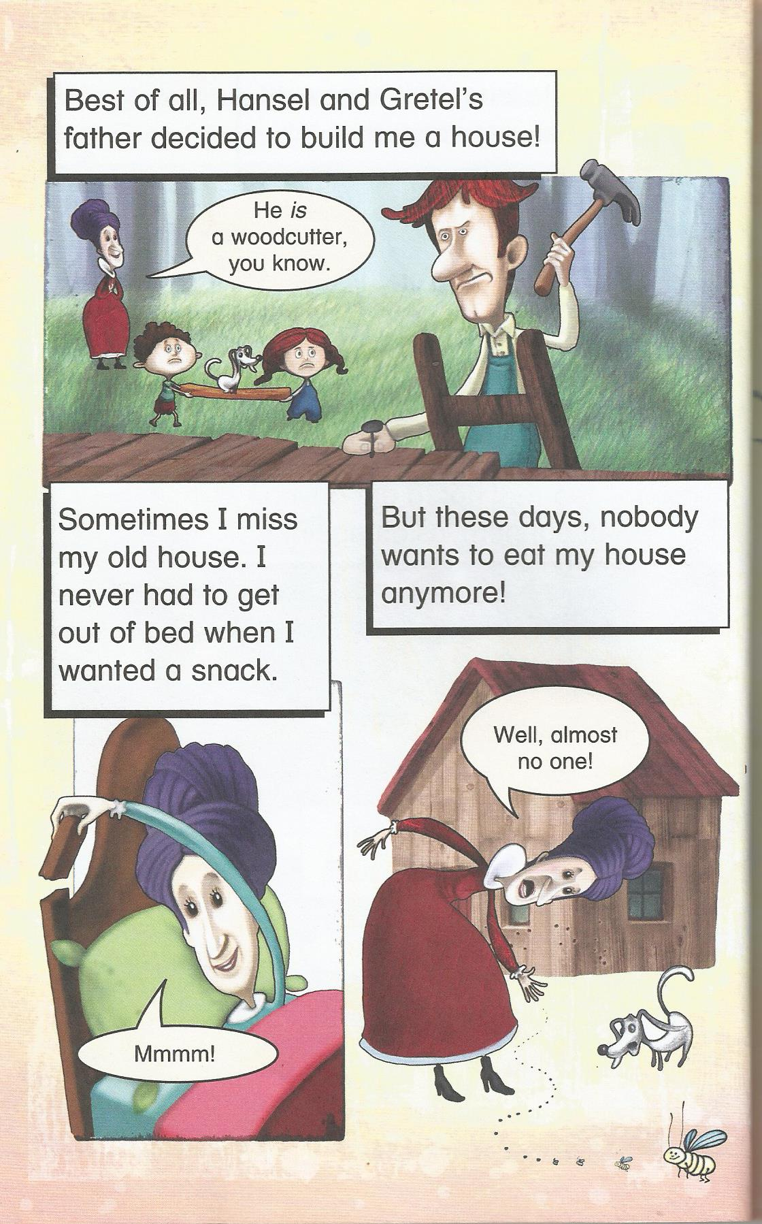

Slide 27
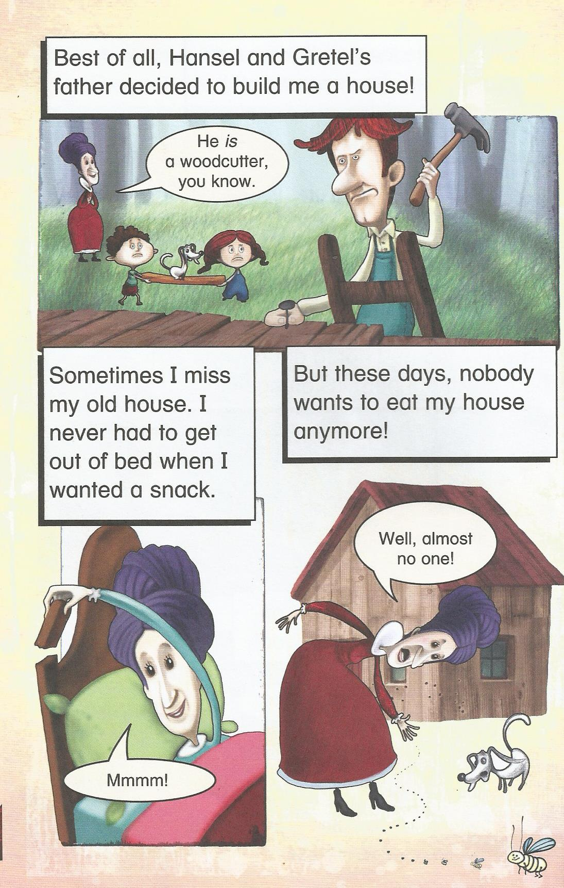

Slide 28
The End

Slide 29
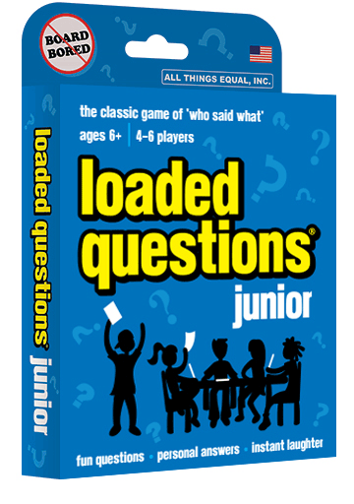
Loaded Questions
If there is extra time

