Slide 1
Colors
What is your favorite color?

Slide 2
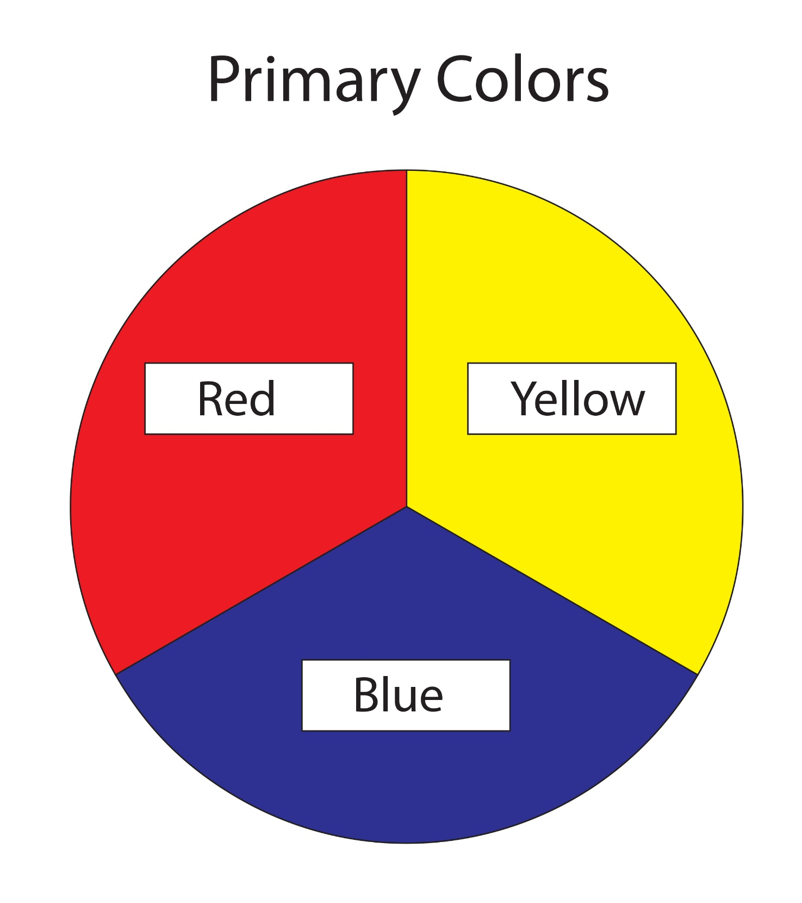
Primary Colors:

Slide 3
Secondary Colors:

Slide 4
Red + Yellow =

Slide 5
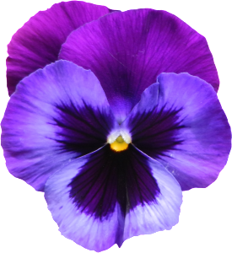
Red + Blue =

Slide 6
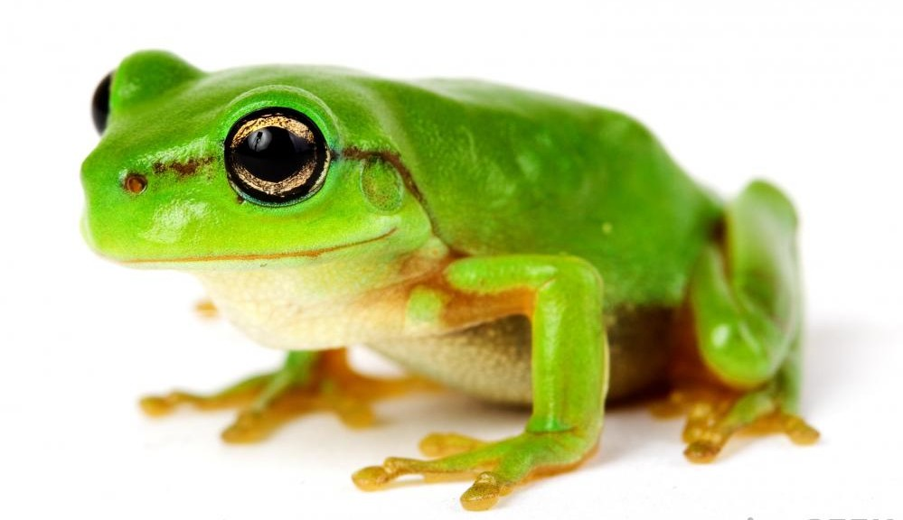
Blue + Yellow =

Slide 7
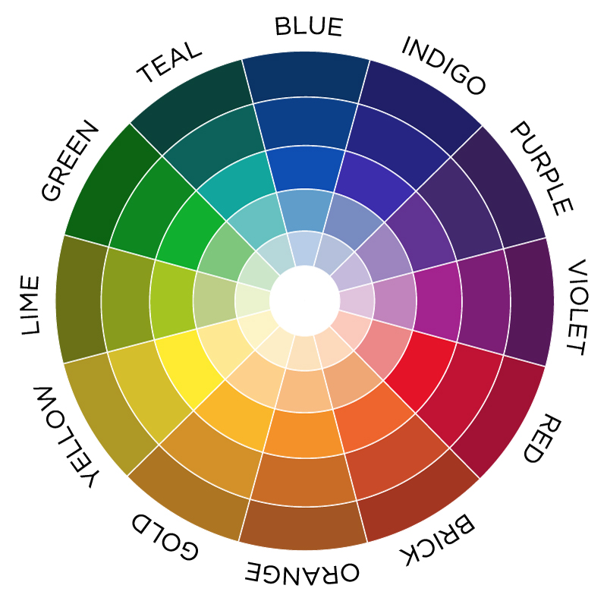
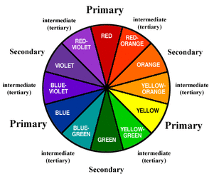
Tertiary Colors

Slide 8
Light vs Dark

Slide 9
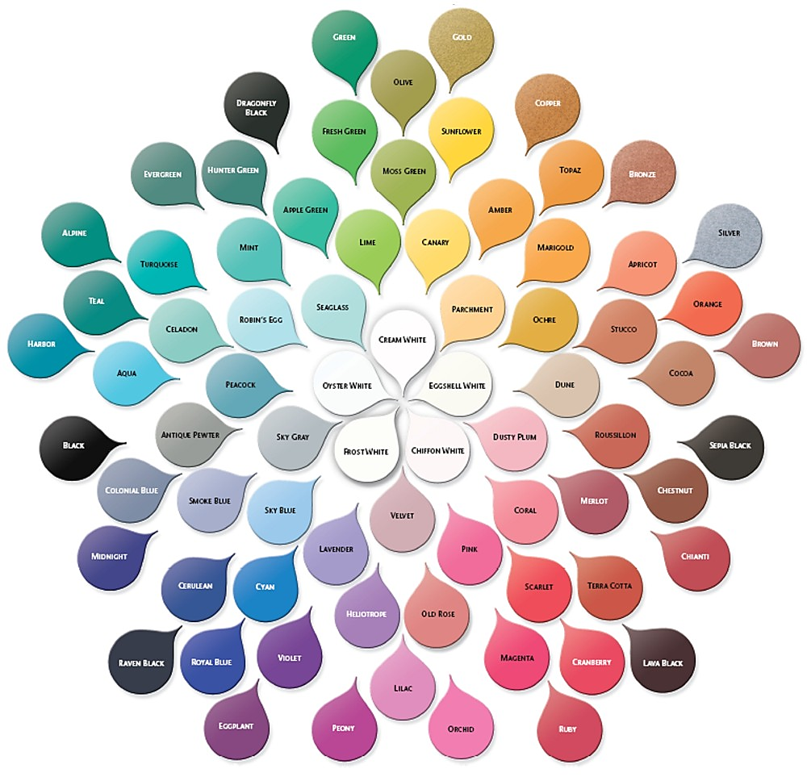

Slide 10
Patterns

Slide 11
Polka Dots

Slide 12
Stripes

Slide 13
Horizontal / Vertical / Diagonal

Slide 14
Plaid

Slide 15
Solid

Slide 16
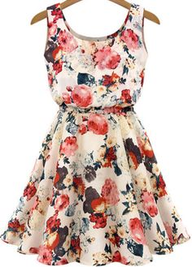
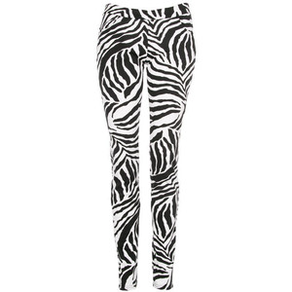
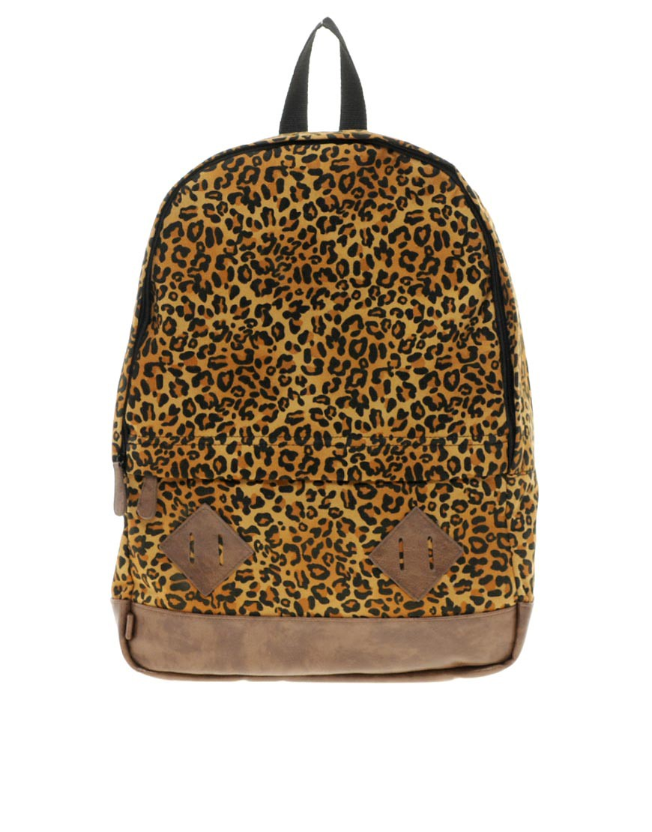
Print

Slide 17
Dress Up
Follow the instructions to color the clothes

Slide 18
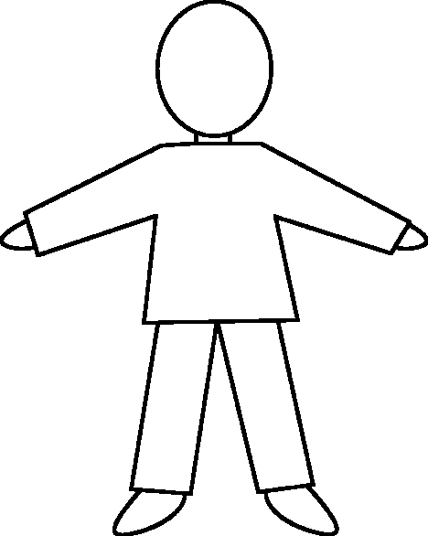
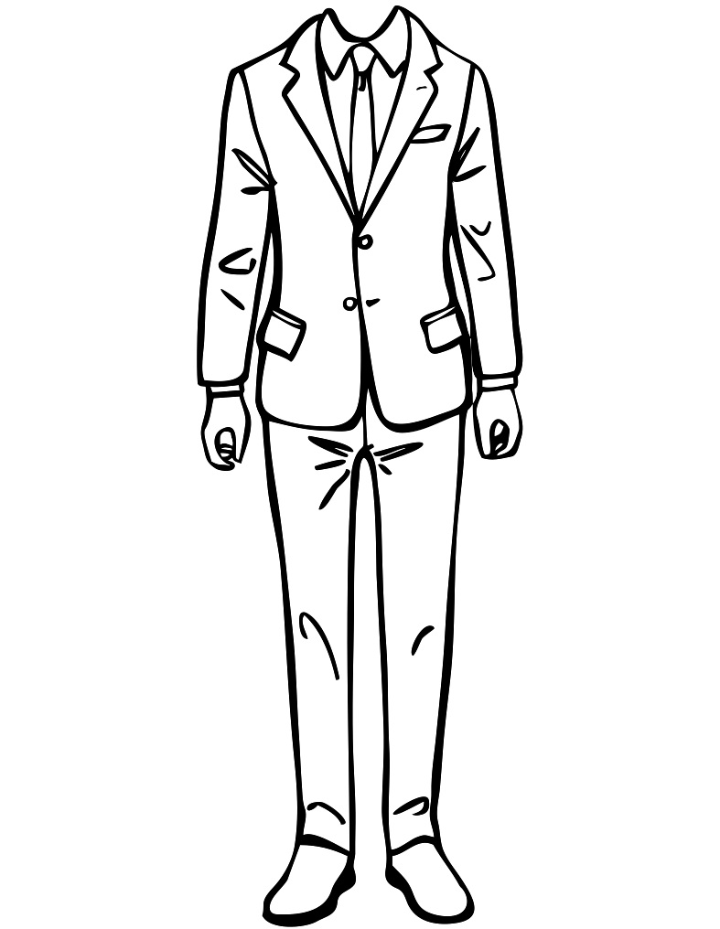
She’s wearing a violet dress with light green polka dots.
She’s wearing solid teal shoes.
She’s wearing solid gold jacket.
He’s wearing solid, light blue shirt.
He’s wearing a dark blue jacket.
He’s wearing a pink tie with white polka dots.
He’s wearing vertical striped black and grey pants.
He’s wearing solid, dark brown shoes.
He’s wearing a solid red shirt.
He’s wearing a black and white striped pants.
He’s wearing solid brown shoes.

Slide 19
Create an Outfit
Draw a person and their clothes on the back of your paper

