Slide 1
Food Chain Continued…
https://www.facebook.com/WeJustLoveUSA/videos/232846347198360/?pnref=story

Slide 2
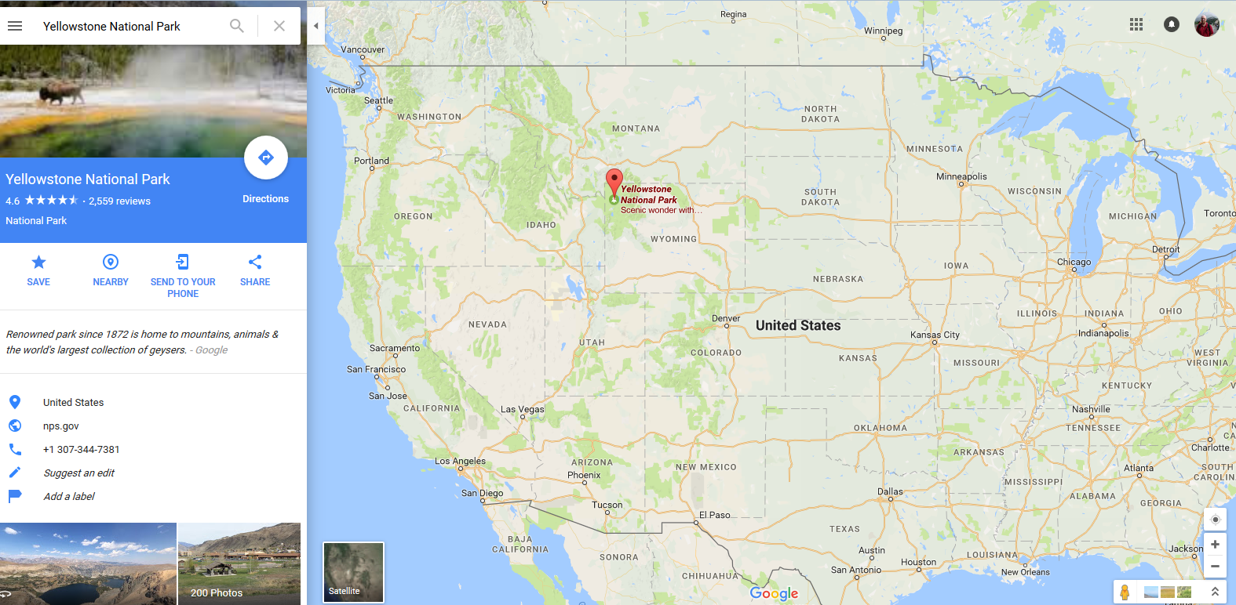
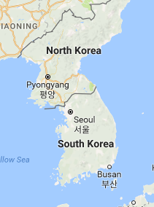
Put in the park again

Slide 3
Amazing and Unbelievable

Slide 4
Why?
Don’t go to

Slide 5
Not there

Slide 6
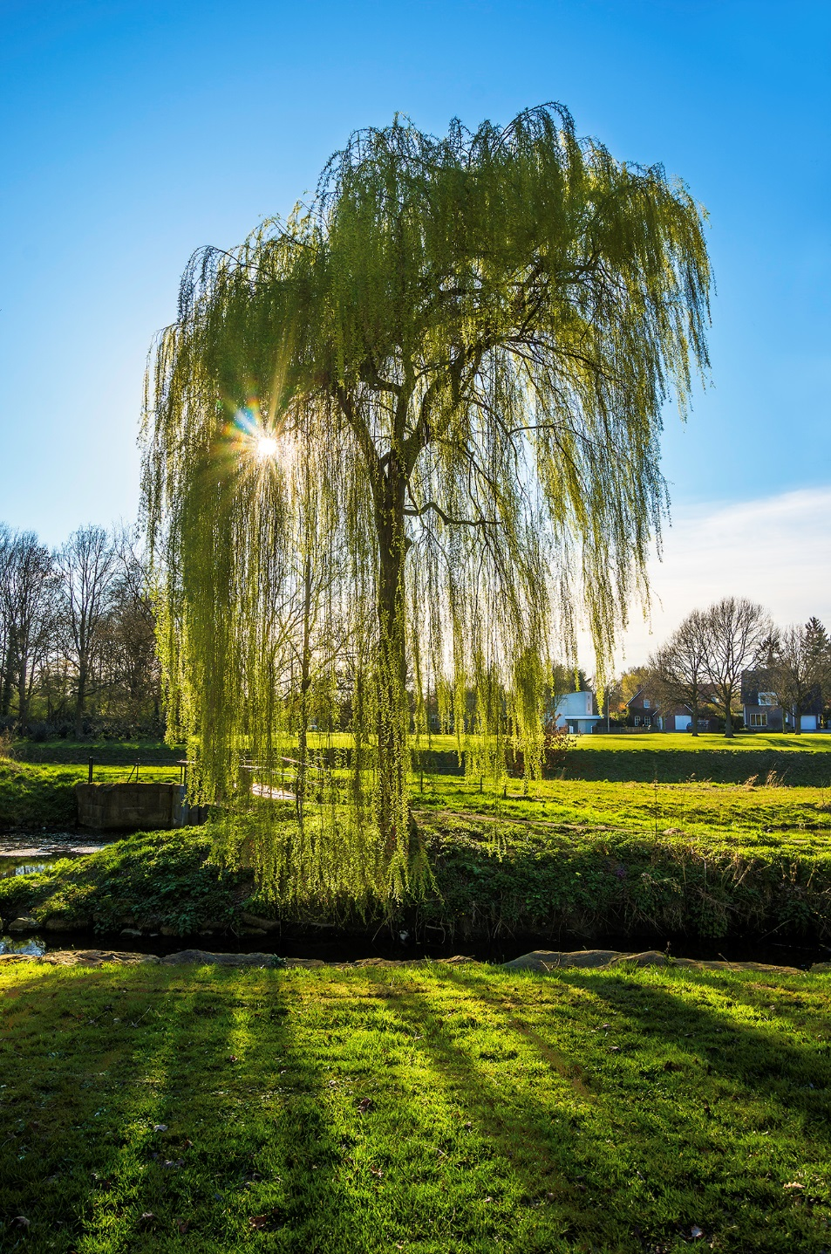
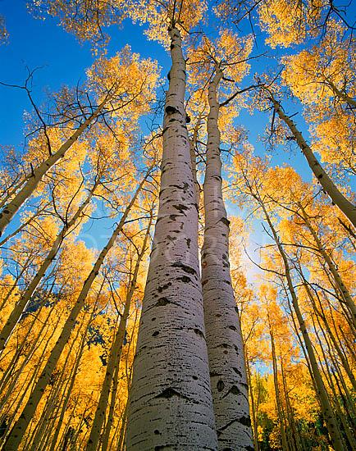
Do very well.

Slide 8
Insects

Slide 9
Many different

Slide 10
Go up
Want to come

Slide 11
All dead

Slide 12
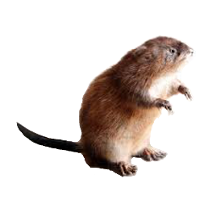
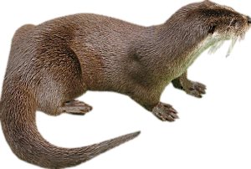

Slide 14
How many

Slide 15
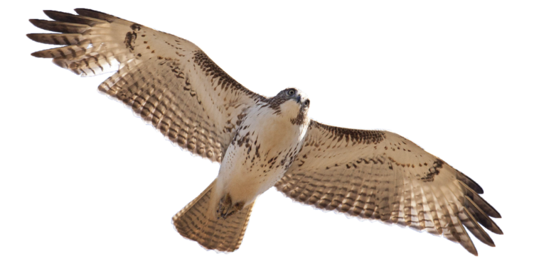
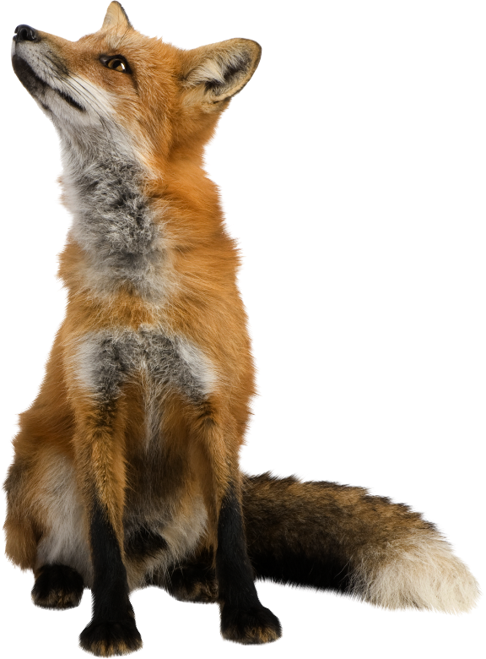
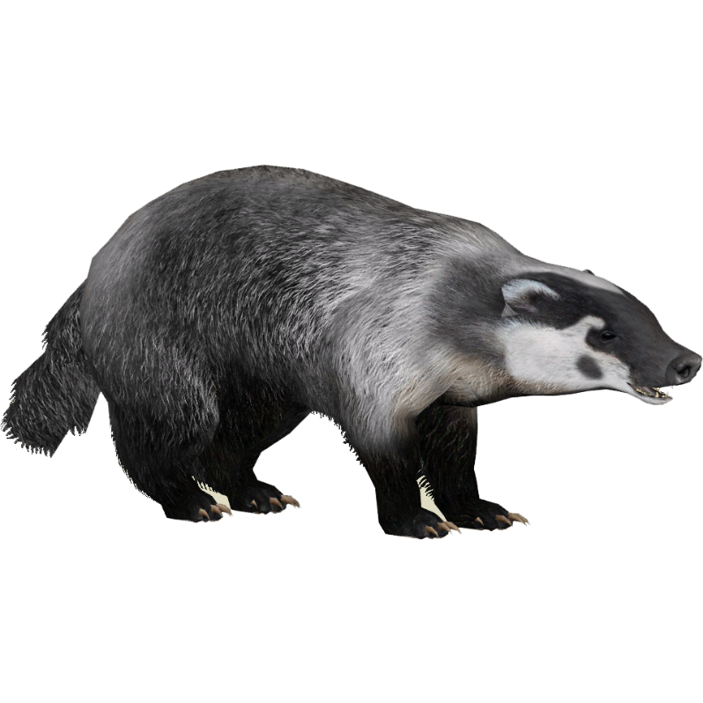
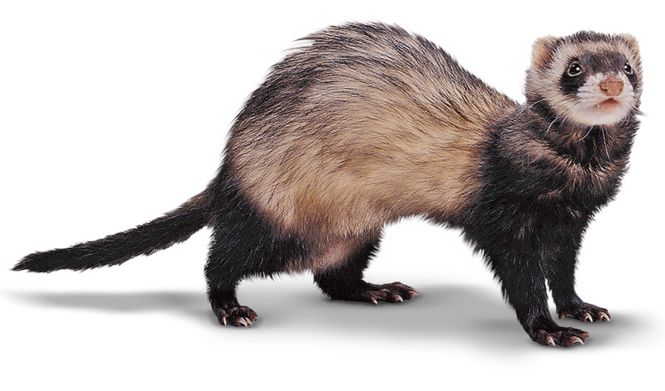

Slide 20
Do very well

Slide 21
Trees, grass, flowers

Slide 26
What is the ecosystem?

Slide 28
Wolf Population

Slide 29
Why does it change?

Slide 30
The Wolves of Yellowstone
http://en.newsner.com/14-wolves-were-released-in-a-park-the-impact-shows-that-we-must-take-care-of-our-amazing-planet/about/animals

Slide 31
Herbivore, Carnivore, Omnivore
Herbivores
plants, trees, grass, vegetables
eat

Slide 32
Herbivore, Carnivore, Omnivore
Carnivores
meat, other animals.
eat

Slide 33
Herbivore, Carnivore, Omnivore
Omnivores
Grass, vegetables, plants, meat, etc.
eat

Slide 34
Herbivore, Carnivore, Omnivore
Scavengers
anything
eat

Slide 35
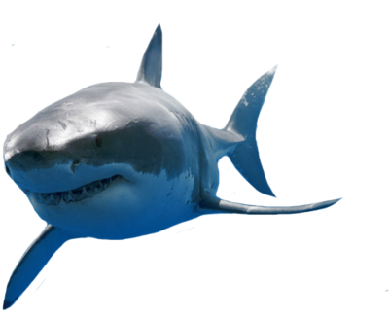
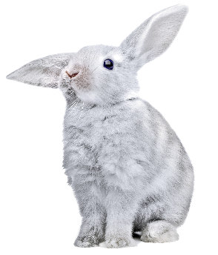
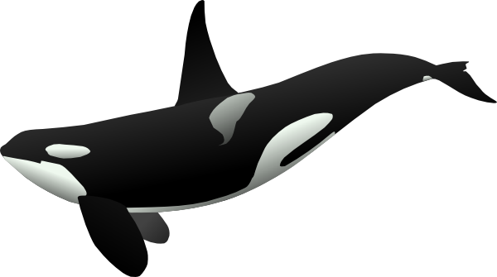
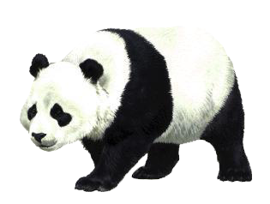
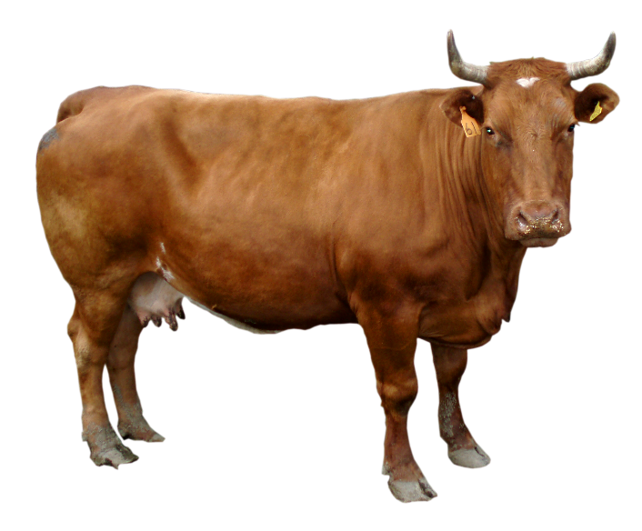
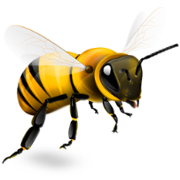
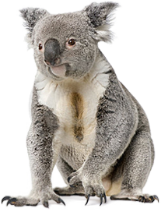
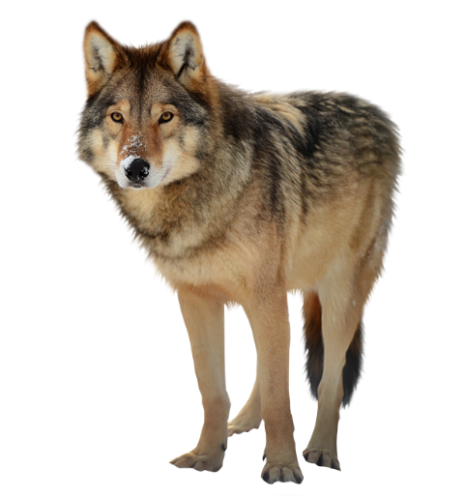
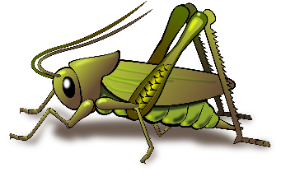
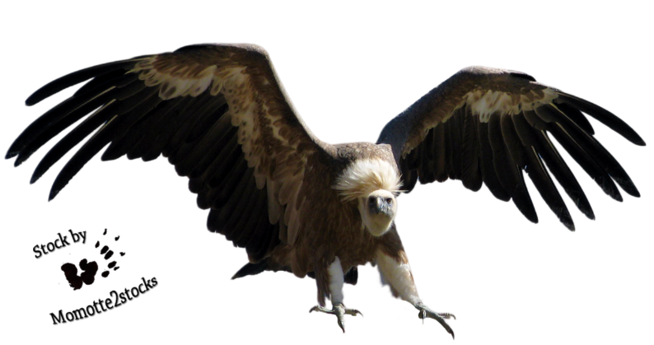
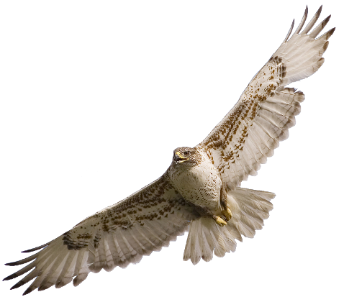
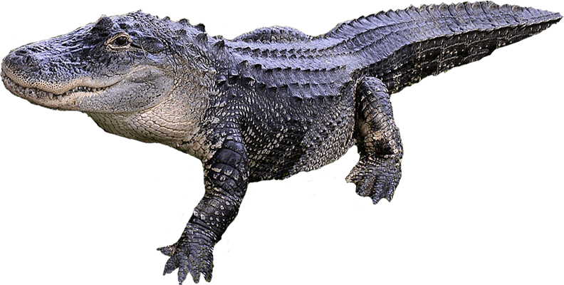
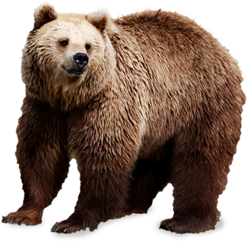
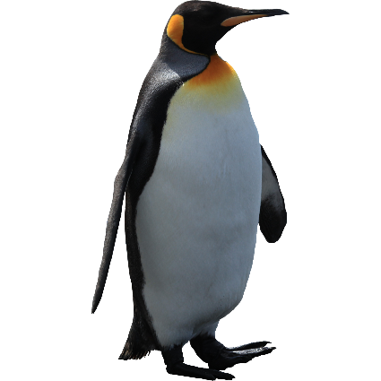
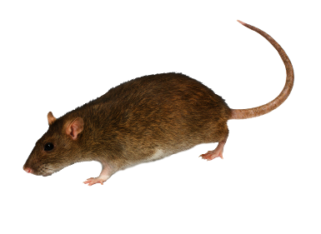
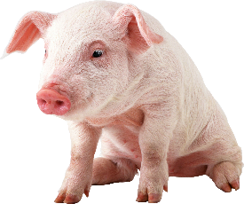
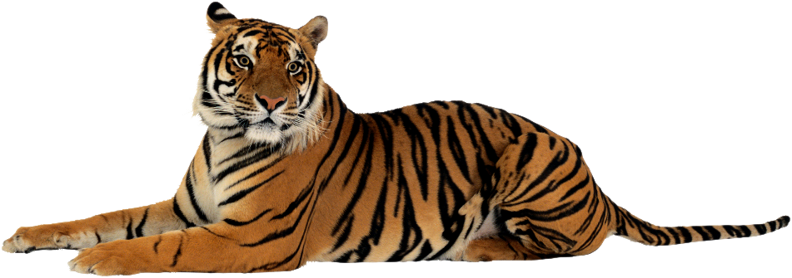
Click 8 Carnivores:
1
7
3
4
2
6
8
5

Slide 36
Click 6 Herbivores:
2
3
5
1
4
6

Slide 37
Click 3 Omnivores:
1
3
2

Slide 38
Click the Scavengers:
1
2

Slide 39
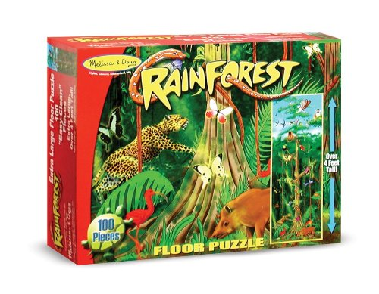
Puzzle Time

