Slide 1
All About Me

Slide 2
Survey

Slide 3
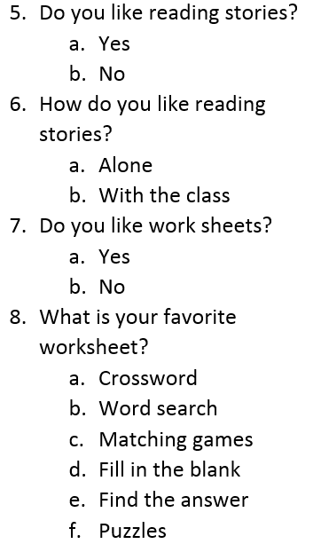
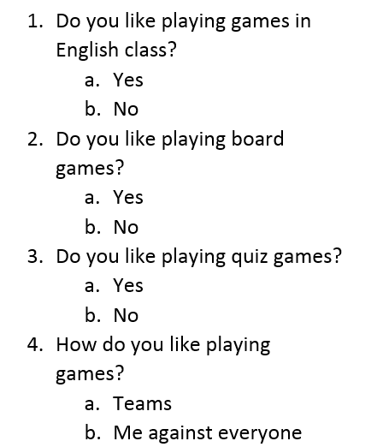

Slide 4
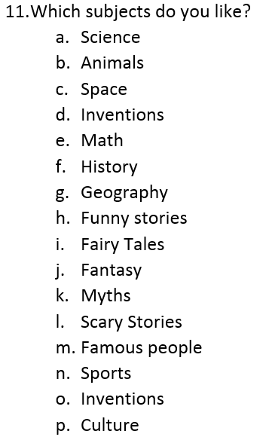
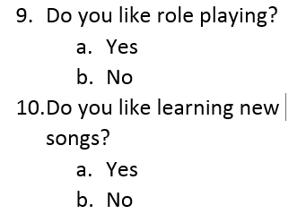

Slide 5
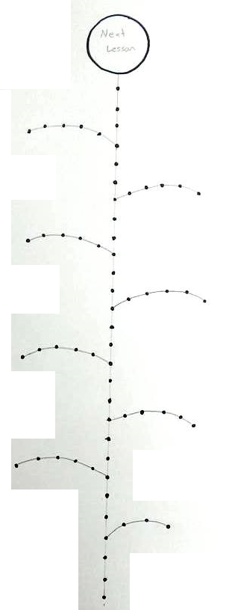
Sticker Board
You can win stickers
Put the stickers on the flower.

Slide 6
Sticker Board
When you finish a leaf, you can win a prize

Slide 7
Sticker Board
If you finish all the way to the top, you can choose the next lesson
Lesson Topic (dinosaurs, sports, hobbies)
Lesson Type (math, puzzle solving, music)
Game

Slide 8
Folders
Put your name on your folder.

Slide 9
