Slide 1
Coral Reefs
http://explore.org/live-cams/player/pacific-aquarium-tropical-reef-camera?popoff=true

Slide 2
Identify the Sea Creatures
http://www.seasky.org/deep-sea/deep-sea-menu.html

Slide 3
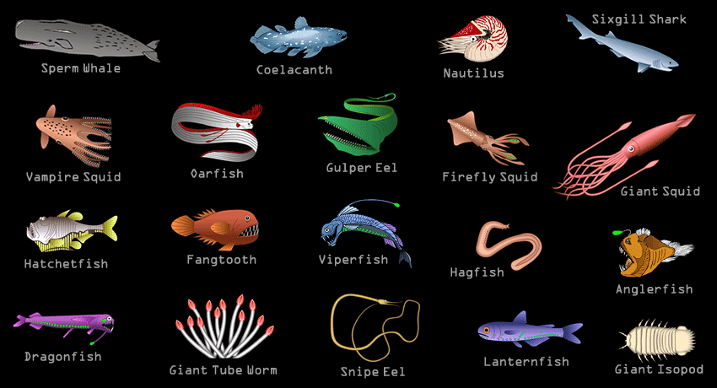

Slide 4
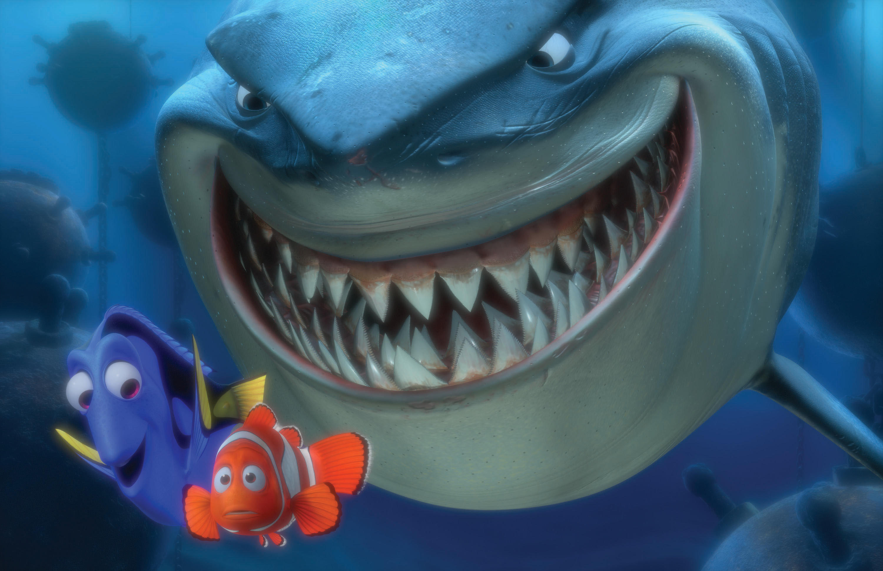
Nemo
https://www.youtube.com/watch?v=y9ZgTXDJb0U

Slide 5
Some Deep Sea Creatures
https://www.youtube.com/watch?v=KEjU6RhoSGU

Slide 6
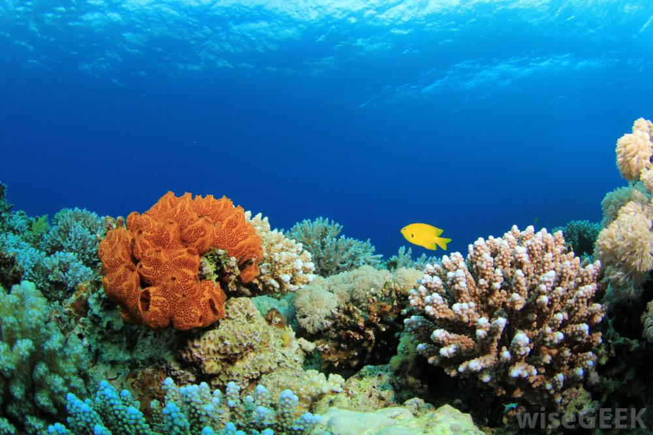
Coral Reefs

Slide 7
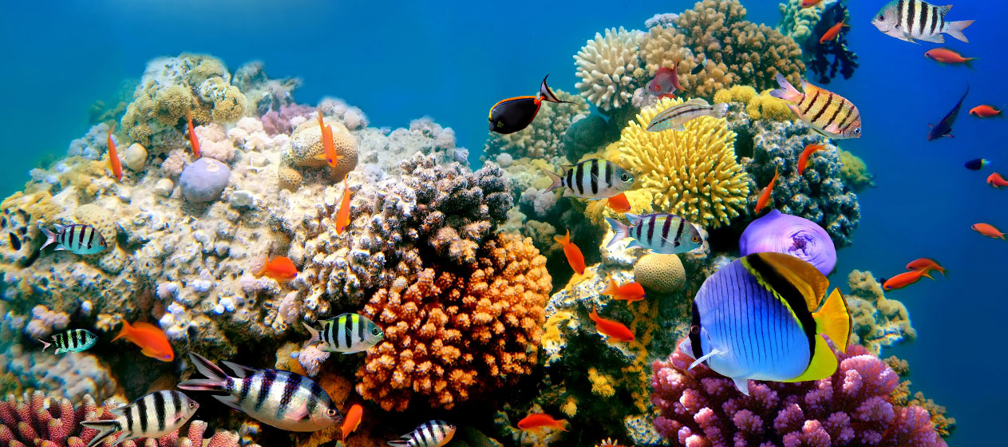

Slide 8
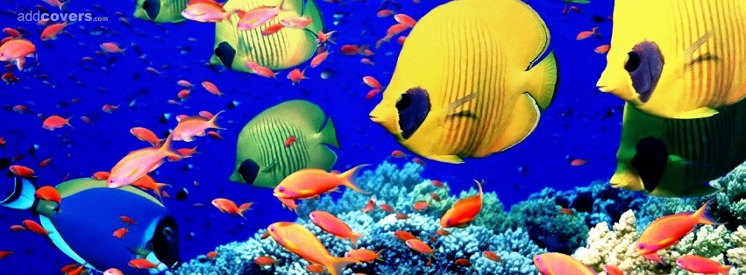
The coral reef is one of the major marine biomes. Although it is a relatively small biome, around 25% of the known marine species live in coral reefs.

Slide 9
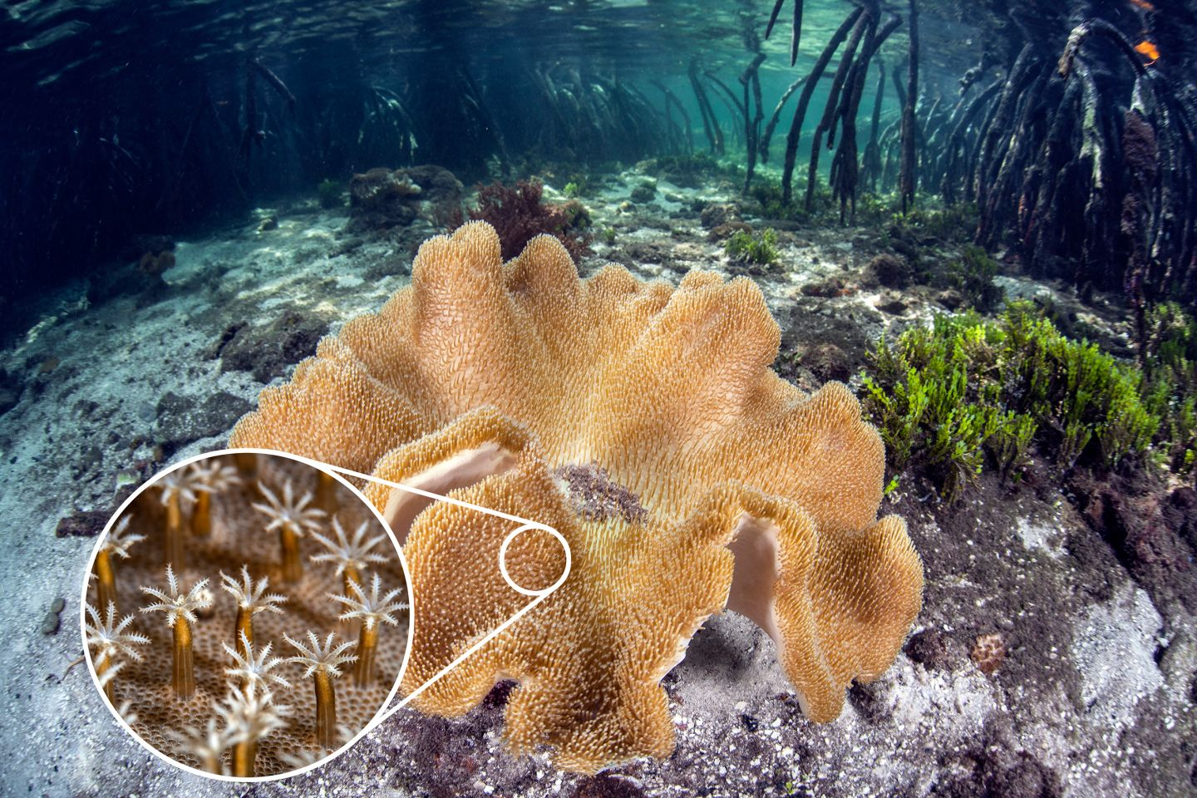
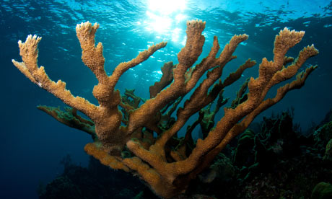
At first glance, you may think that coral reefs are made up of rocks, but they are actually live organisms. These organisms are tiny little animals called polyps. Polyps live on the outside of the reef. As polyps die, they become hard and new polyps grow on top of them causing the reef to grow.
What is a coral reef?

Slide 10
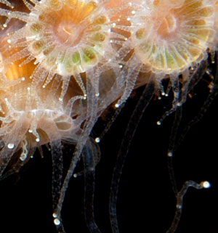
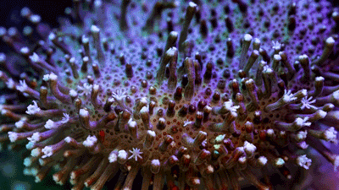
Since polyps need to eat to stay alive, you can think of the coral reef as eating, too. They eat small animals called plankton as well as algae. The algae get their food from the sun by using photosynthesis. This is why coral reefs form close to the surface of the water and in clear water where the sun can feed the algae.
Does the coral reef eat?

Slide 11
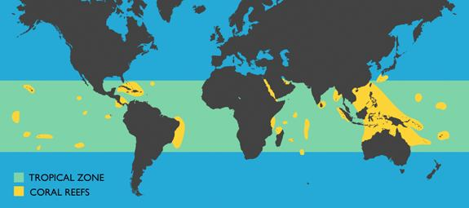
Coral reefs need warm, shallow water to form. They form close to the equator near coastlines and around islands throughout the world. A significant portion of the world's coral reefs are located in Southeast Asia and near Australia. The largest coral reef is the Great Barrier Reef located off of Queensland, Australia. The Great Barrier Reef stretches for 2,600 miles.
Where are coral reefs located?

Slide 12
There are three main types of coral reefs:
Types of Coral Reefs

Slide 13
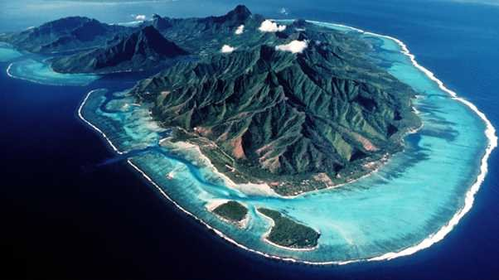
Fringe reef - Fringe reefs grow close to the shore line. It can be attached to the shore or there may be a narrow strip of water called a lagoon or channel between the land and the coral reef.
Types of Coral Reefs

Slide 14
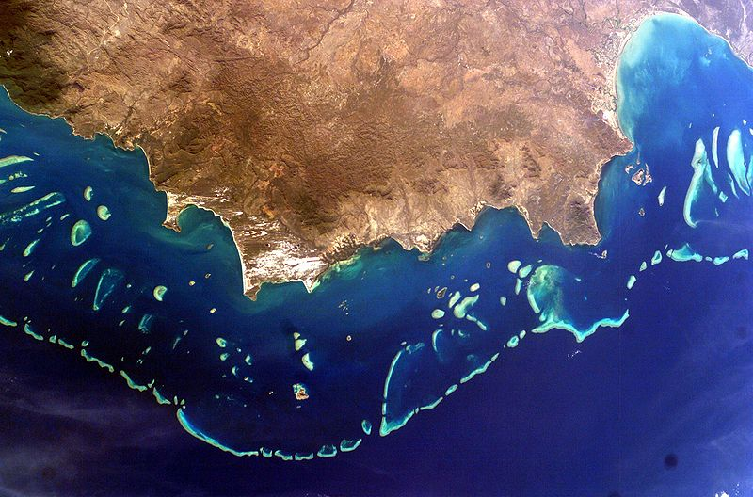
Barrier reef - Barrier reefs grow further from the shore line, sometimes several miles from the shore.
Types of Coral Reefs

Slide 15
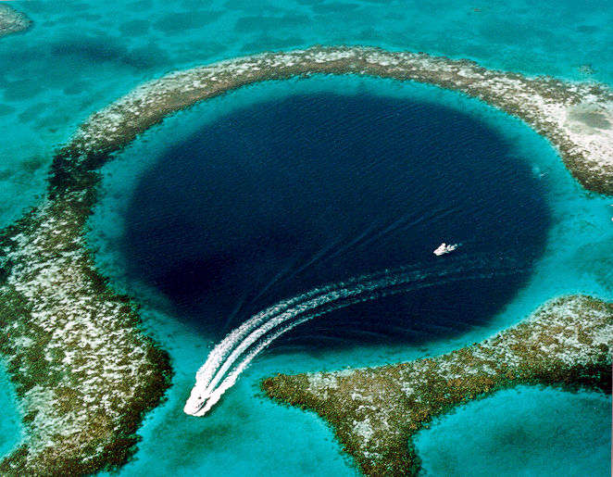
Atoll - An atoll is a ring of coral surrounding a lagoon of water. It starts out as a fringe reef around a volcanic island. As the coral grows up, the island sinks into the ocean and just the ring of coral is left. Some atolls are so big that people live on them. An example of this is the Maldives.
Types of Coral Reefs

Slide 16
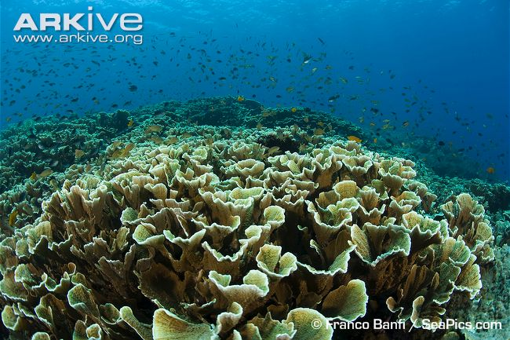
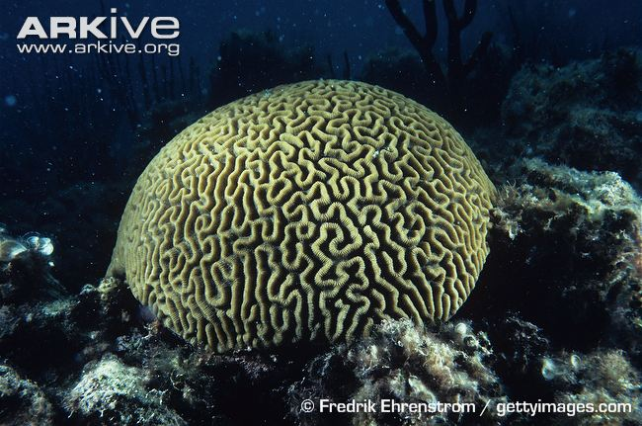
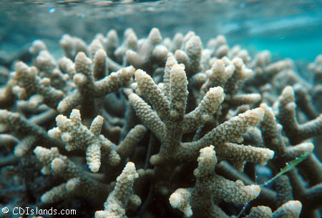
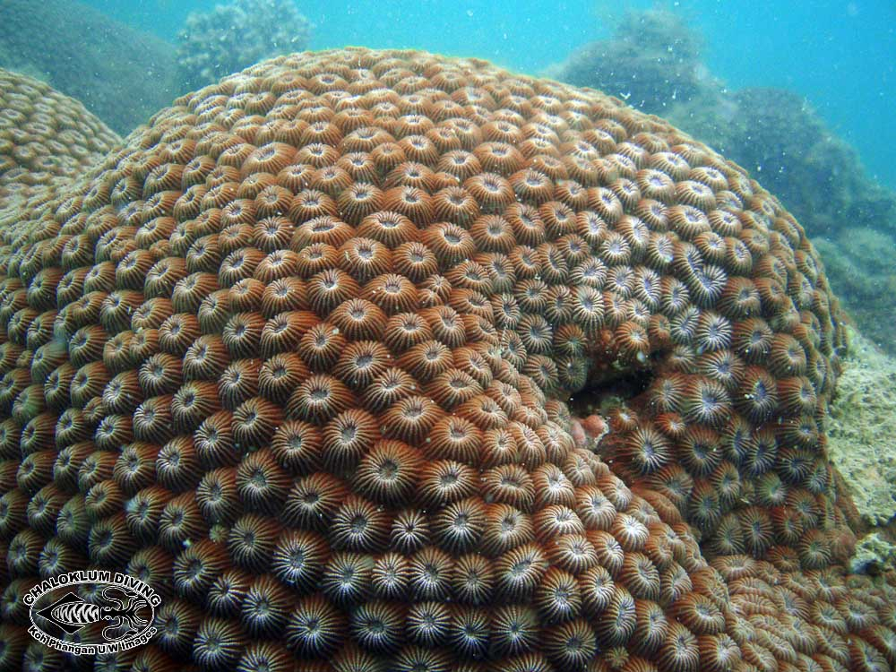
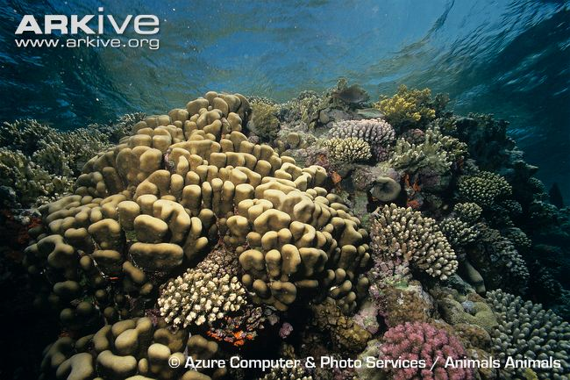
All sorts of animals live around a coral reef. This includes many different types of corals such as star coral, brain coral, column coral, cactus coral, and finger coral.
Coral Reef Animals

Slide 17
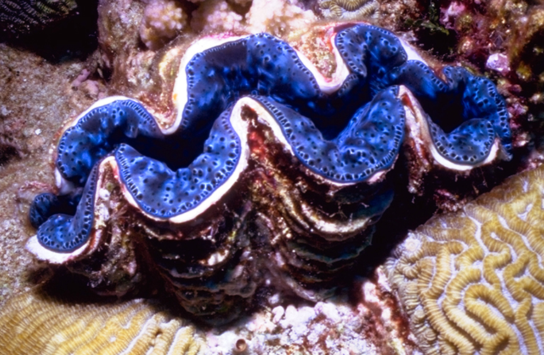
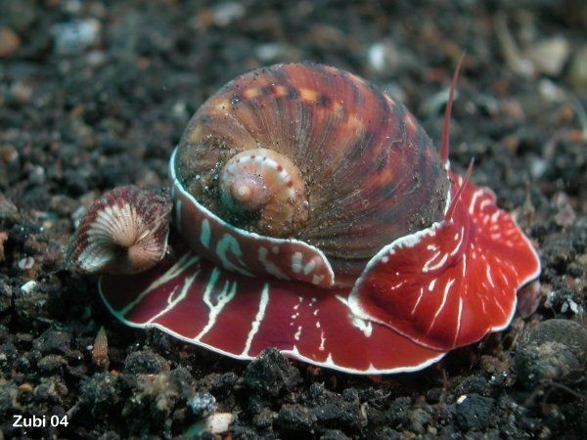
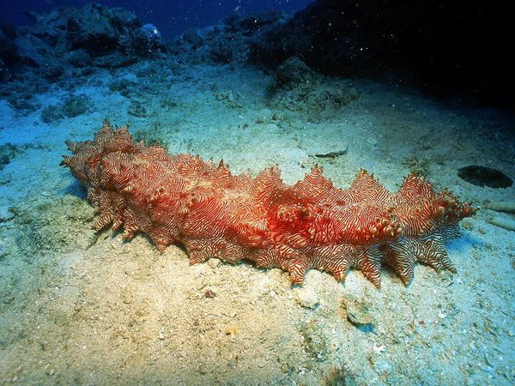
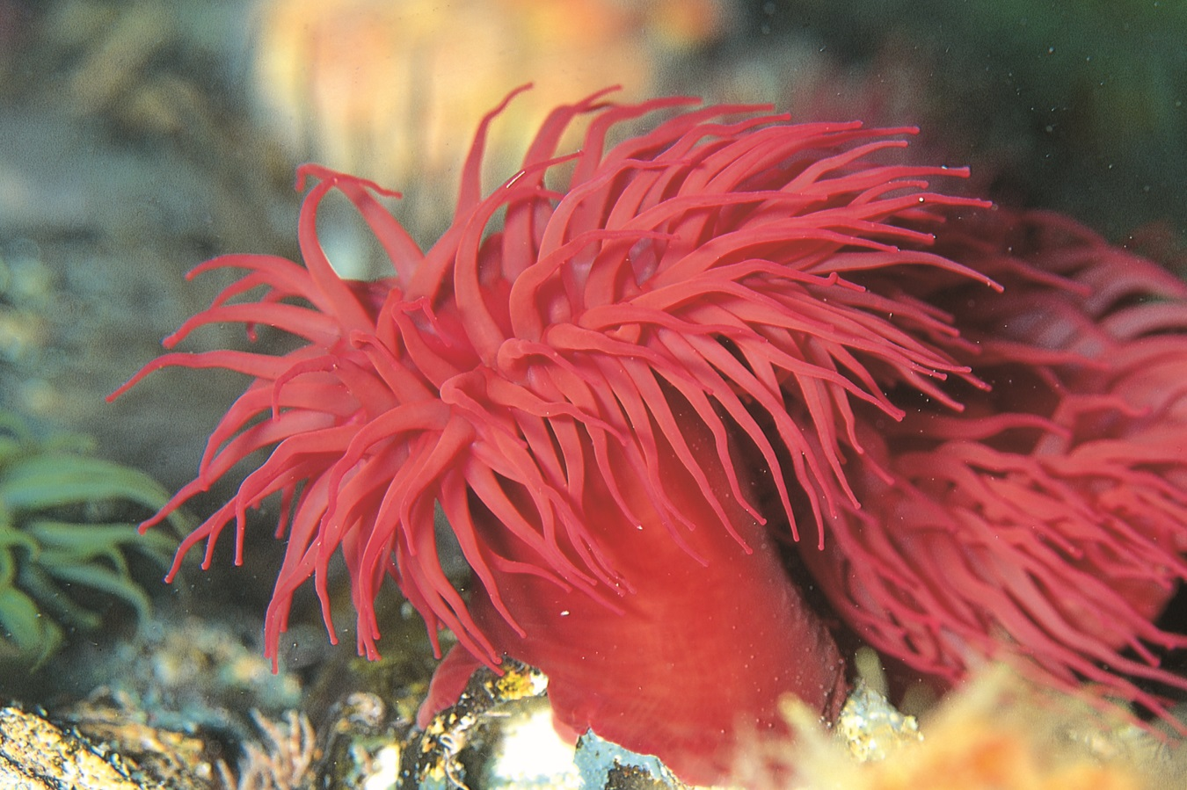
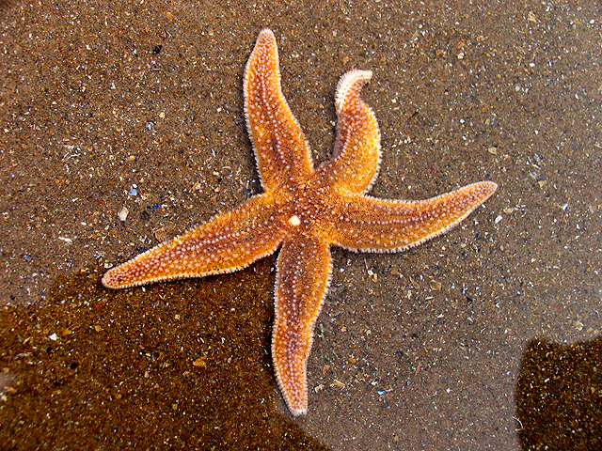
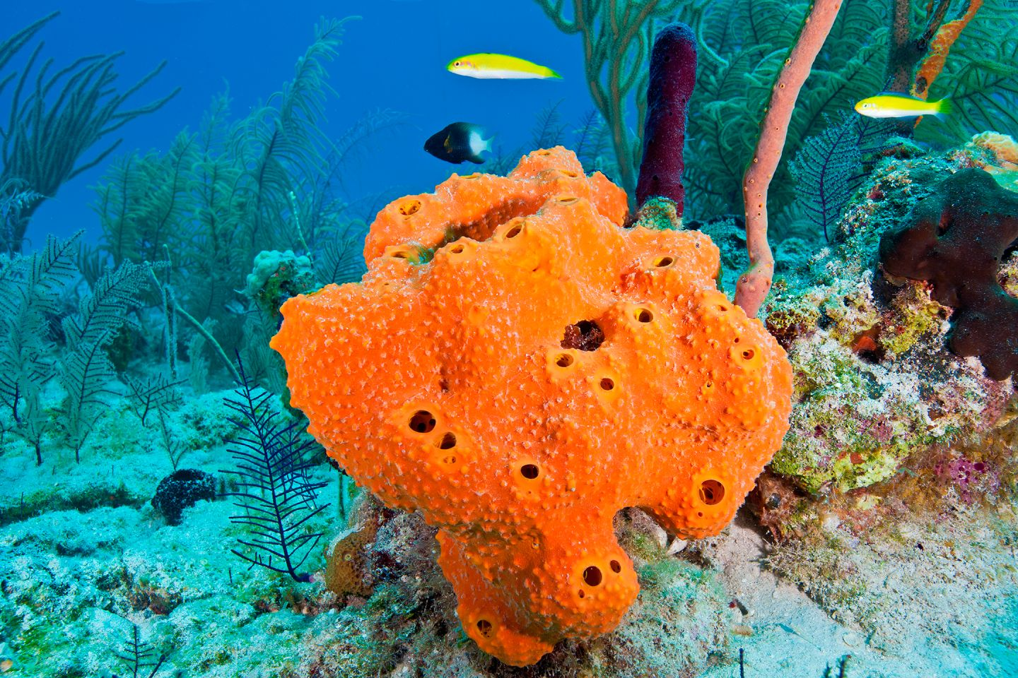
Some of the most strange and interesting creatures in the world live here. Many animals attach themselves to the reef covering nearly every square inch. They include sponges, starfish, anemones, cucumbers, snails, and clams. Also, there are lots of fish swimming around such as cuttlefish, sharks, lionfish, pufferfish, clownfish, and eels. There are 1500 species of fish and 400 species of coral that live on the Great Barrier Reef alone.
Coral Reef Animals

Slide 18
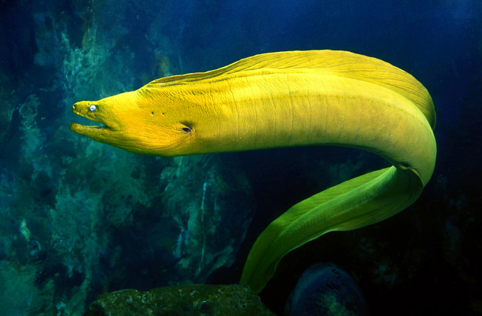
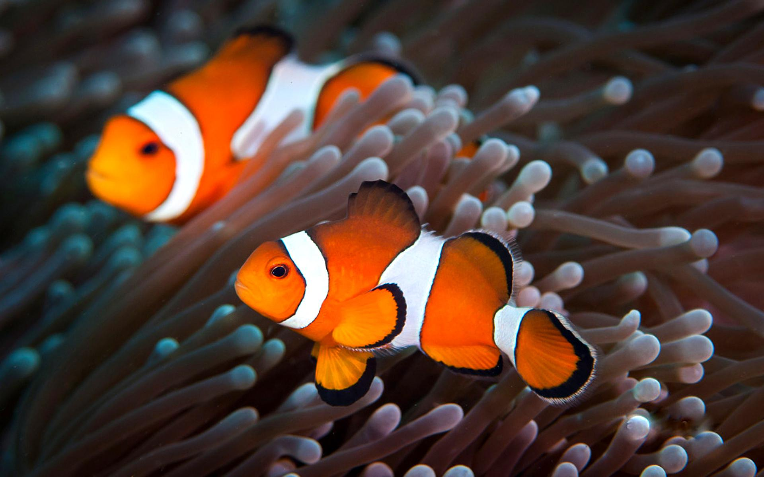
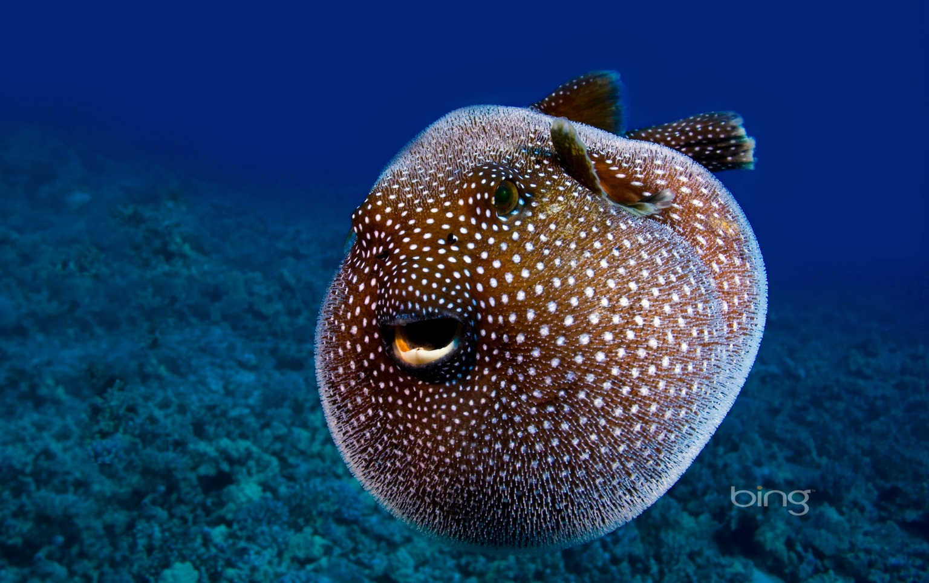
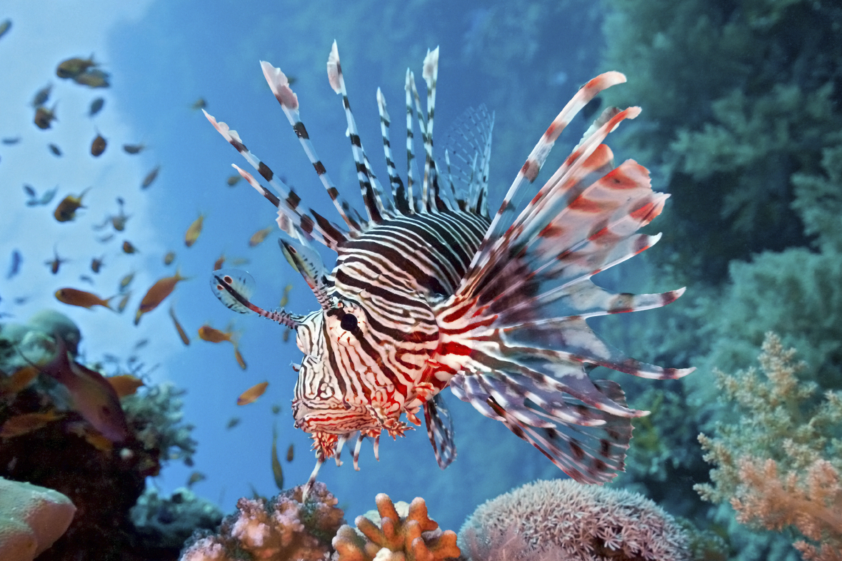
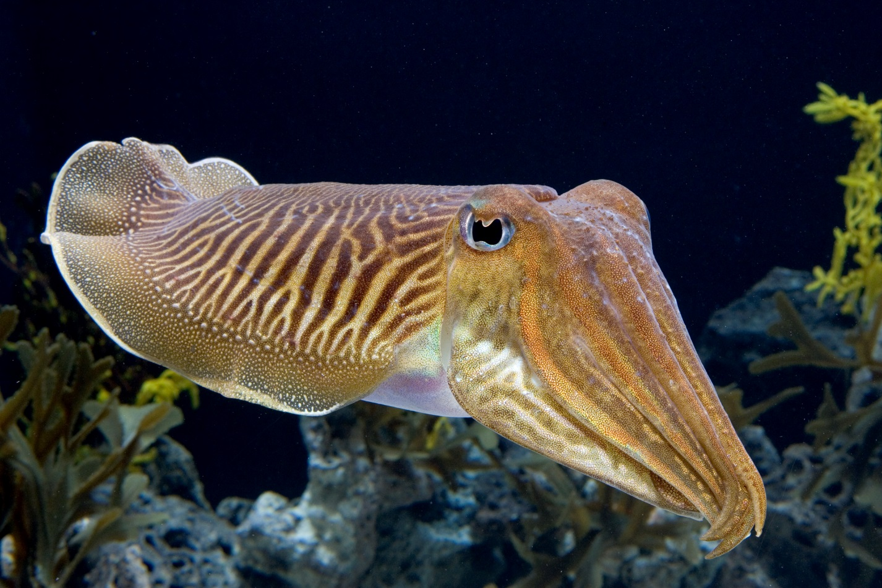
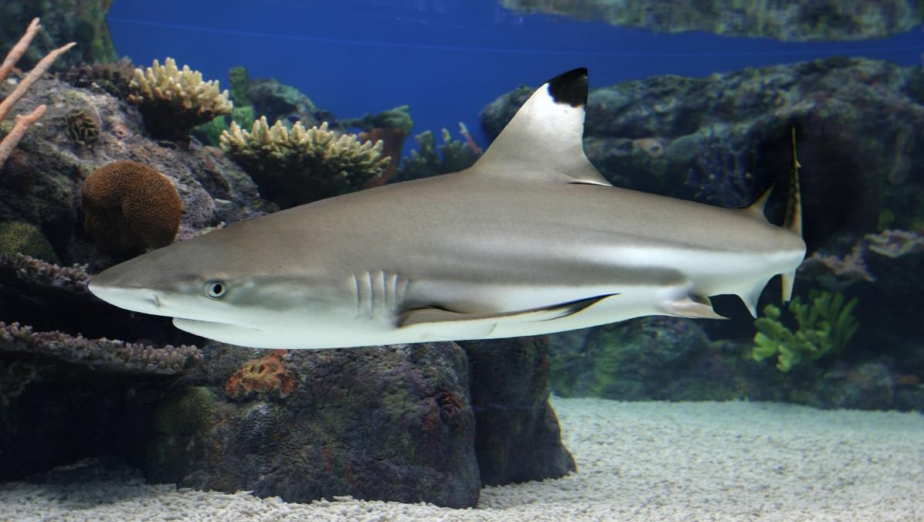
Some of the most strange and interesting creatures in the world live here. Many animals attach themselves to the reef covering nearly every square inch. They include sponges, starfish, anemones, cucumbers, snails, and clams. Also, there are lots of fish swimming around such as cuttlefish, sharks, lionfish, pufferfish, clownfish, and eels. There are 1500 species of fish and 400 species of coral that live on the Great Barrier Reef alone.

Slide 19
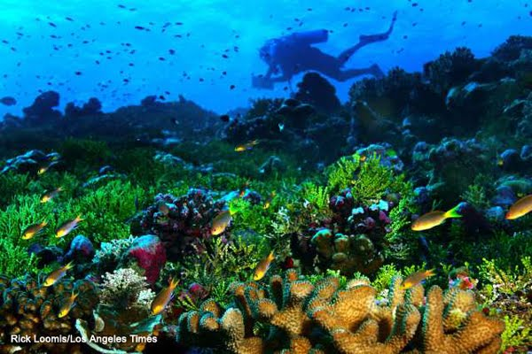
The majority of the plants living on the coral reef are various species of sea grass, seaweed, and algae.
Coral Reef Plants

Slide 20
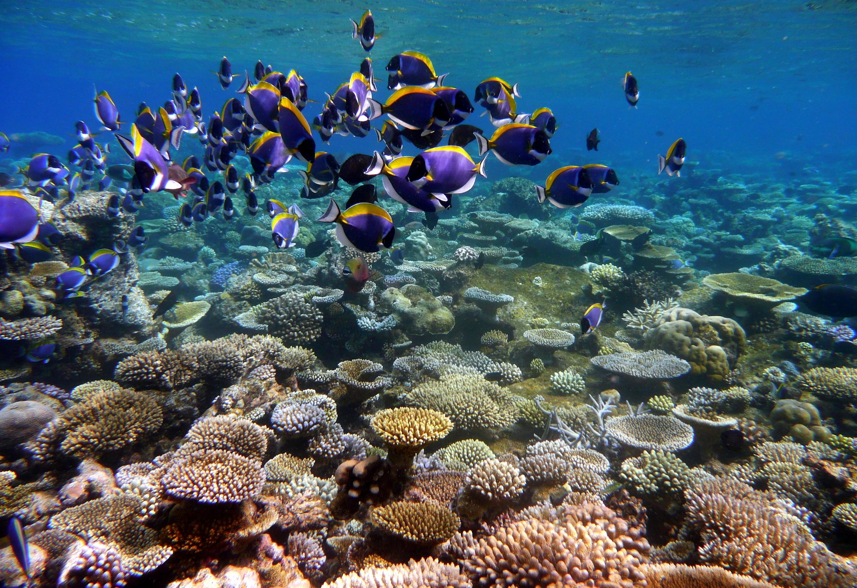

Slide 21
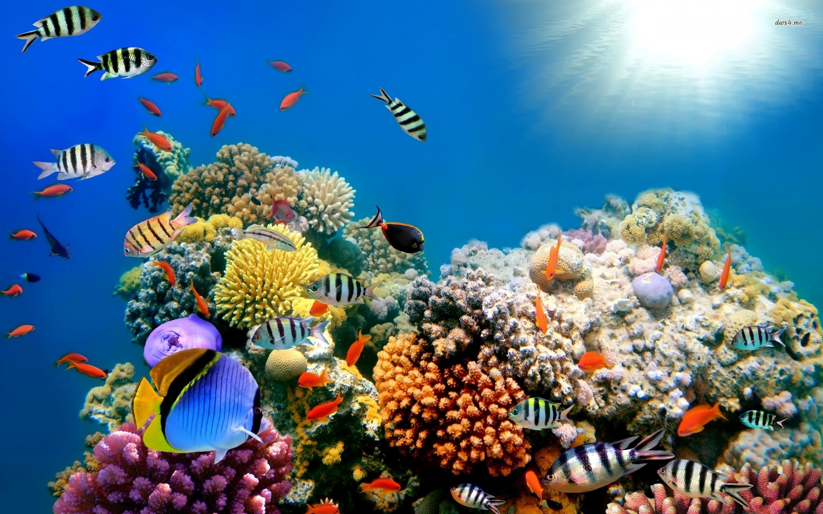

Slide 22
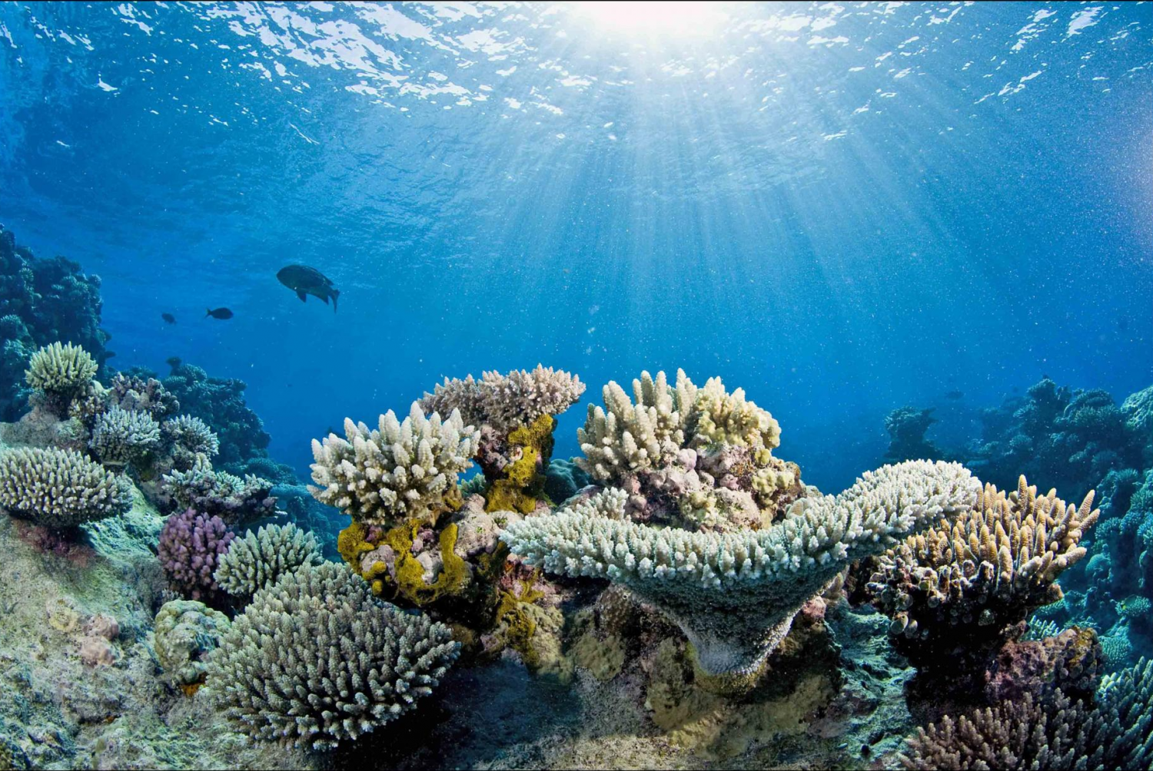

Slide 23
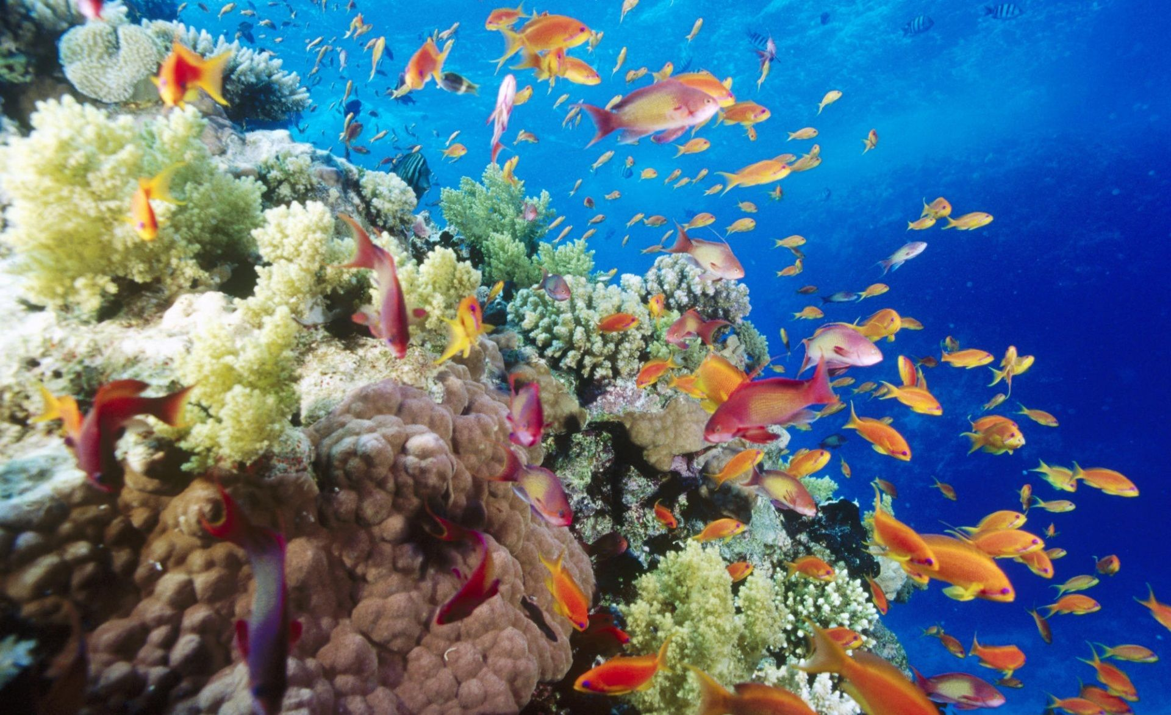

Slide 24
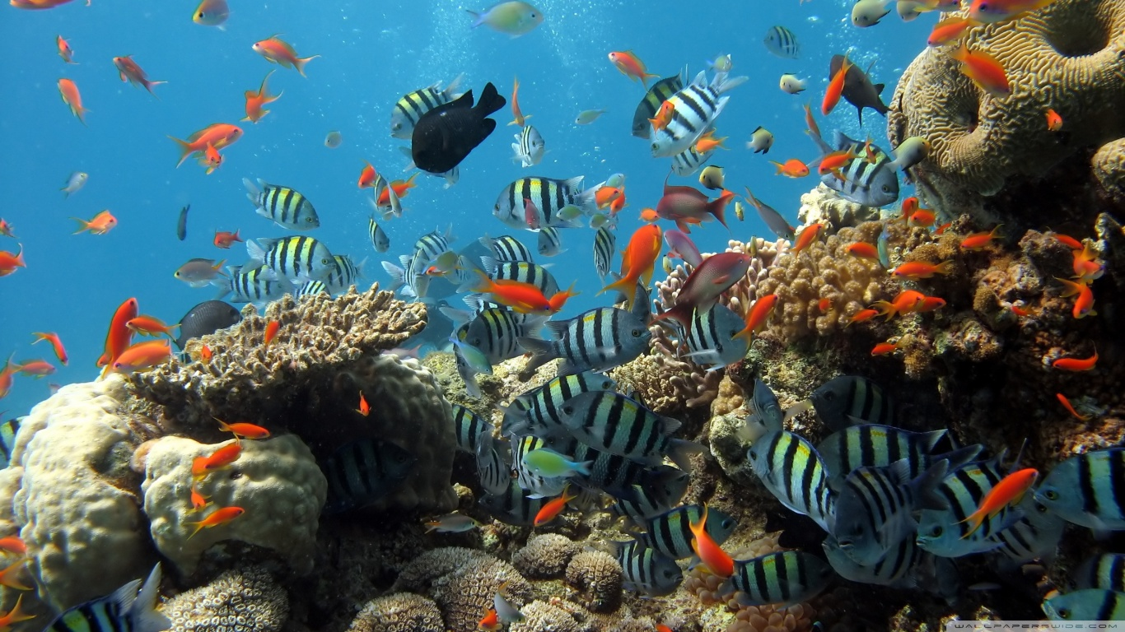

Slide 25
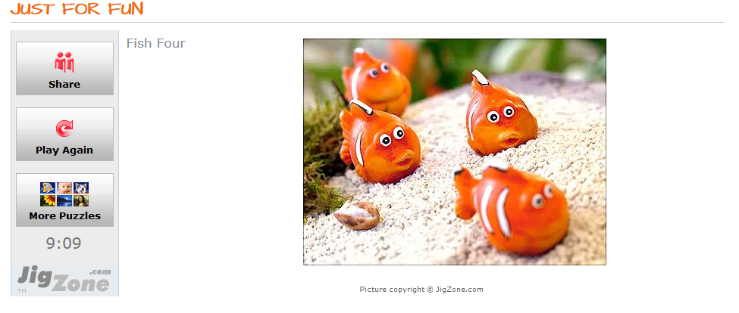
http://mrsfranksesl.weebly.com/coral-reefs.html

Slide 26
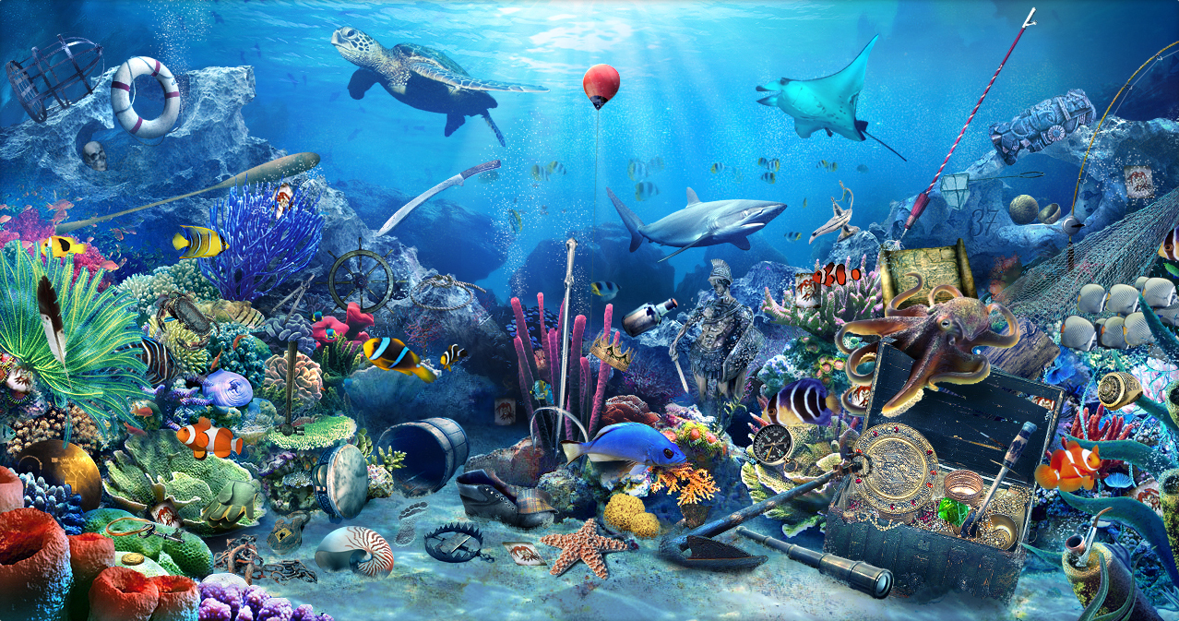
Footprint
Crab
Rope
Magic lamp
Fishing pole
An aquarium
fish net
Nautilus
Octopus
Skull
Starfish
Sword
37

