Slide 1
Tardigrades
https://www.youtube.com/watch?v=cjV2WP0wkvo

Slide 2
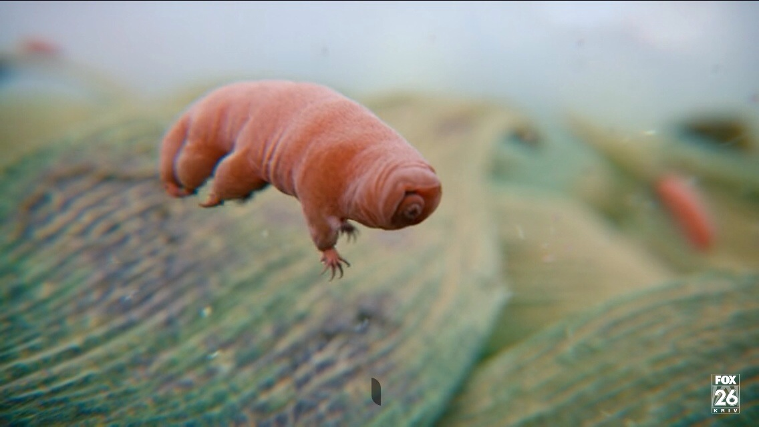
Tardigrade Nicknames:
Water Bear
Moss Piglets

Slide 3
Where do they live?
Deep Ocean
Polar Regions
Ocean
Jungle
Mountain
Desert
Humans
Polar bears
Elephants
Goat
Crocodiles
Crab
Penguin
Spiders
Mosquitoes
Tardigrades

Slide 4
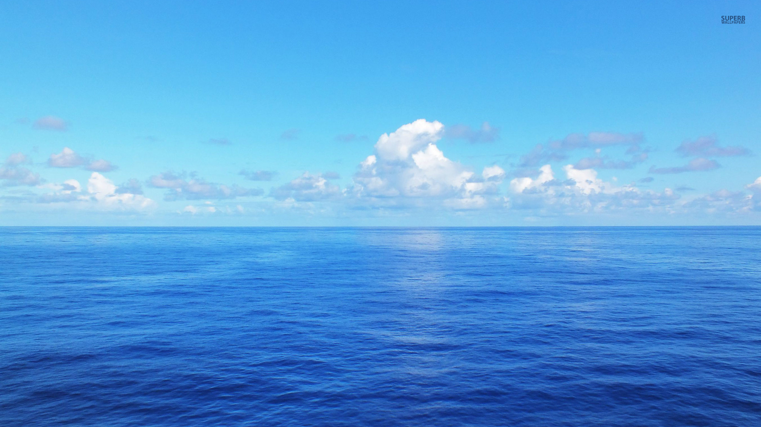
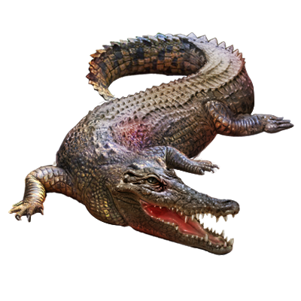
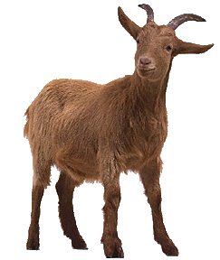
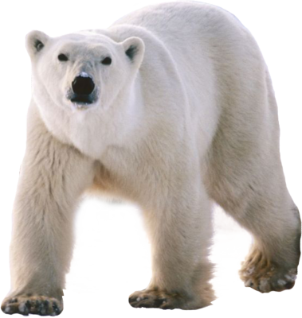
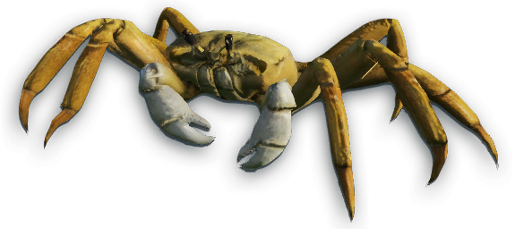
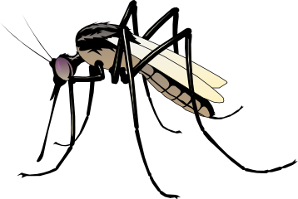
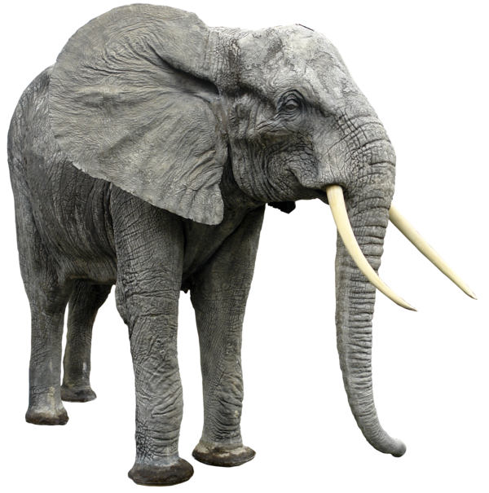
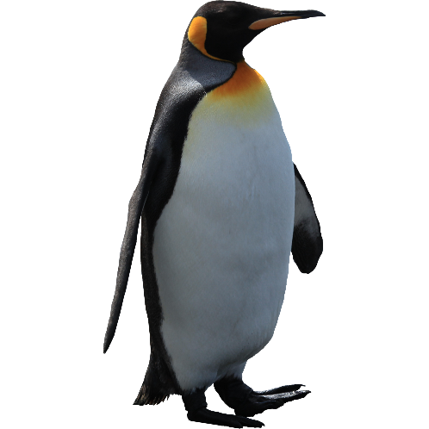
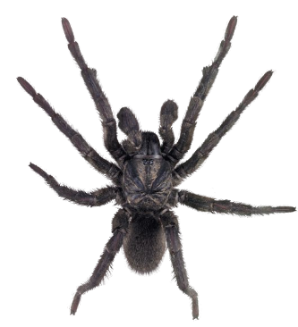
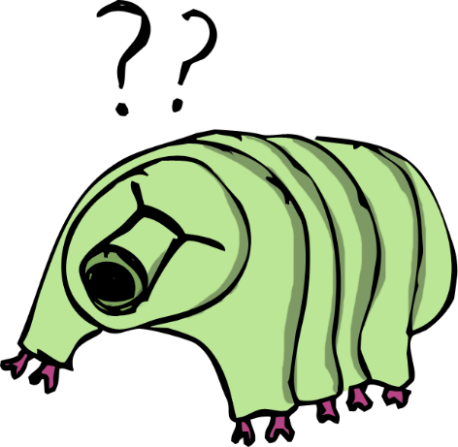
I live in the ocean

Slide 5
I live in the deep ocean

Slide 6
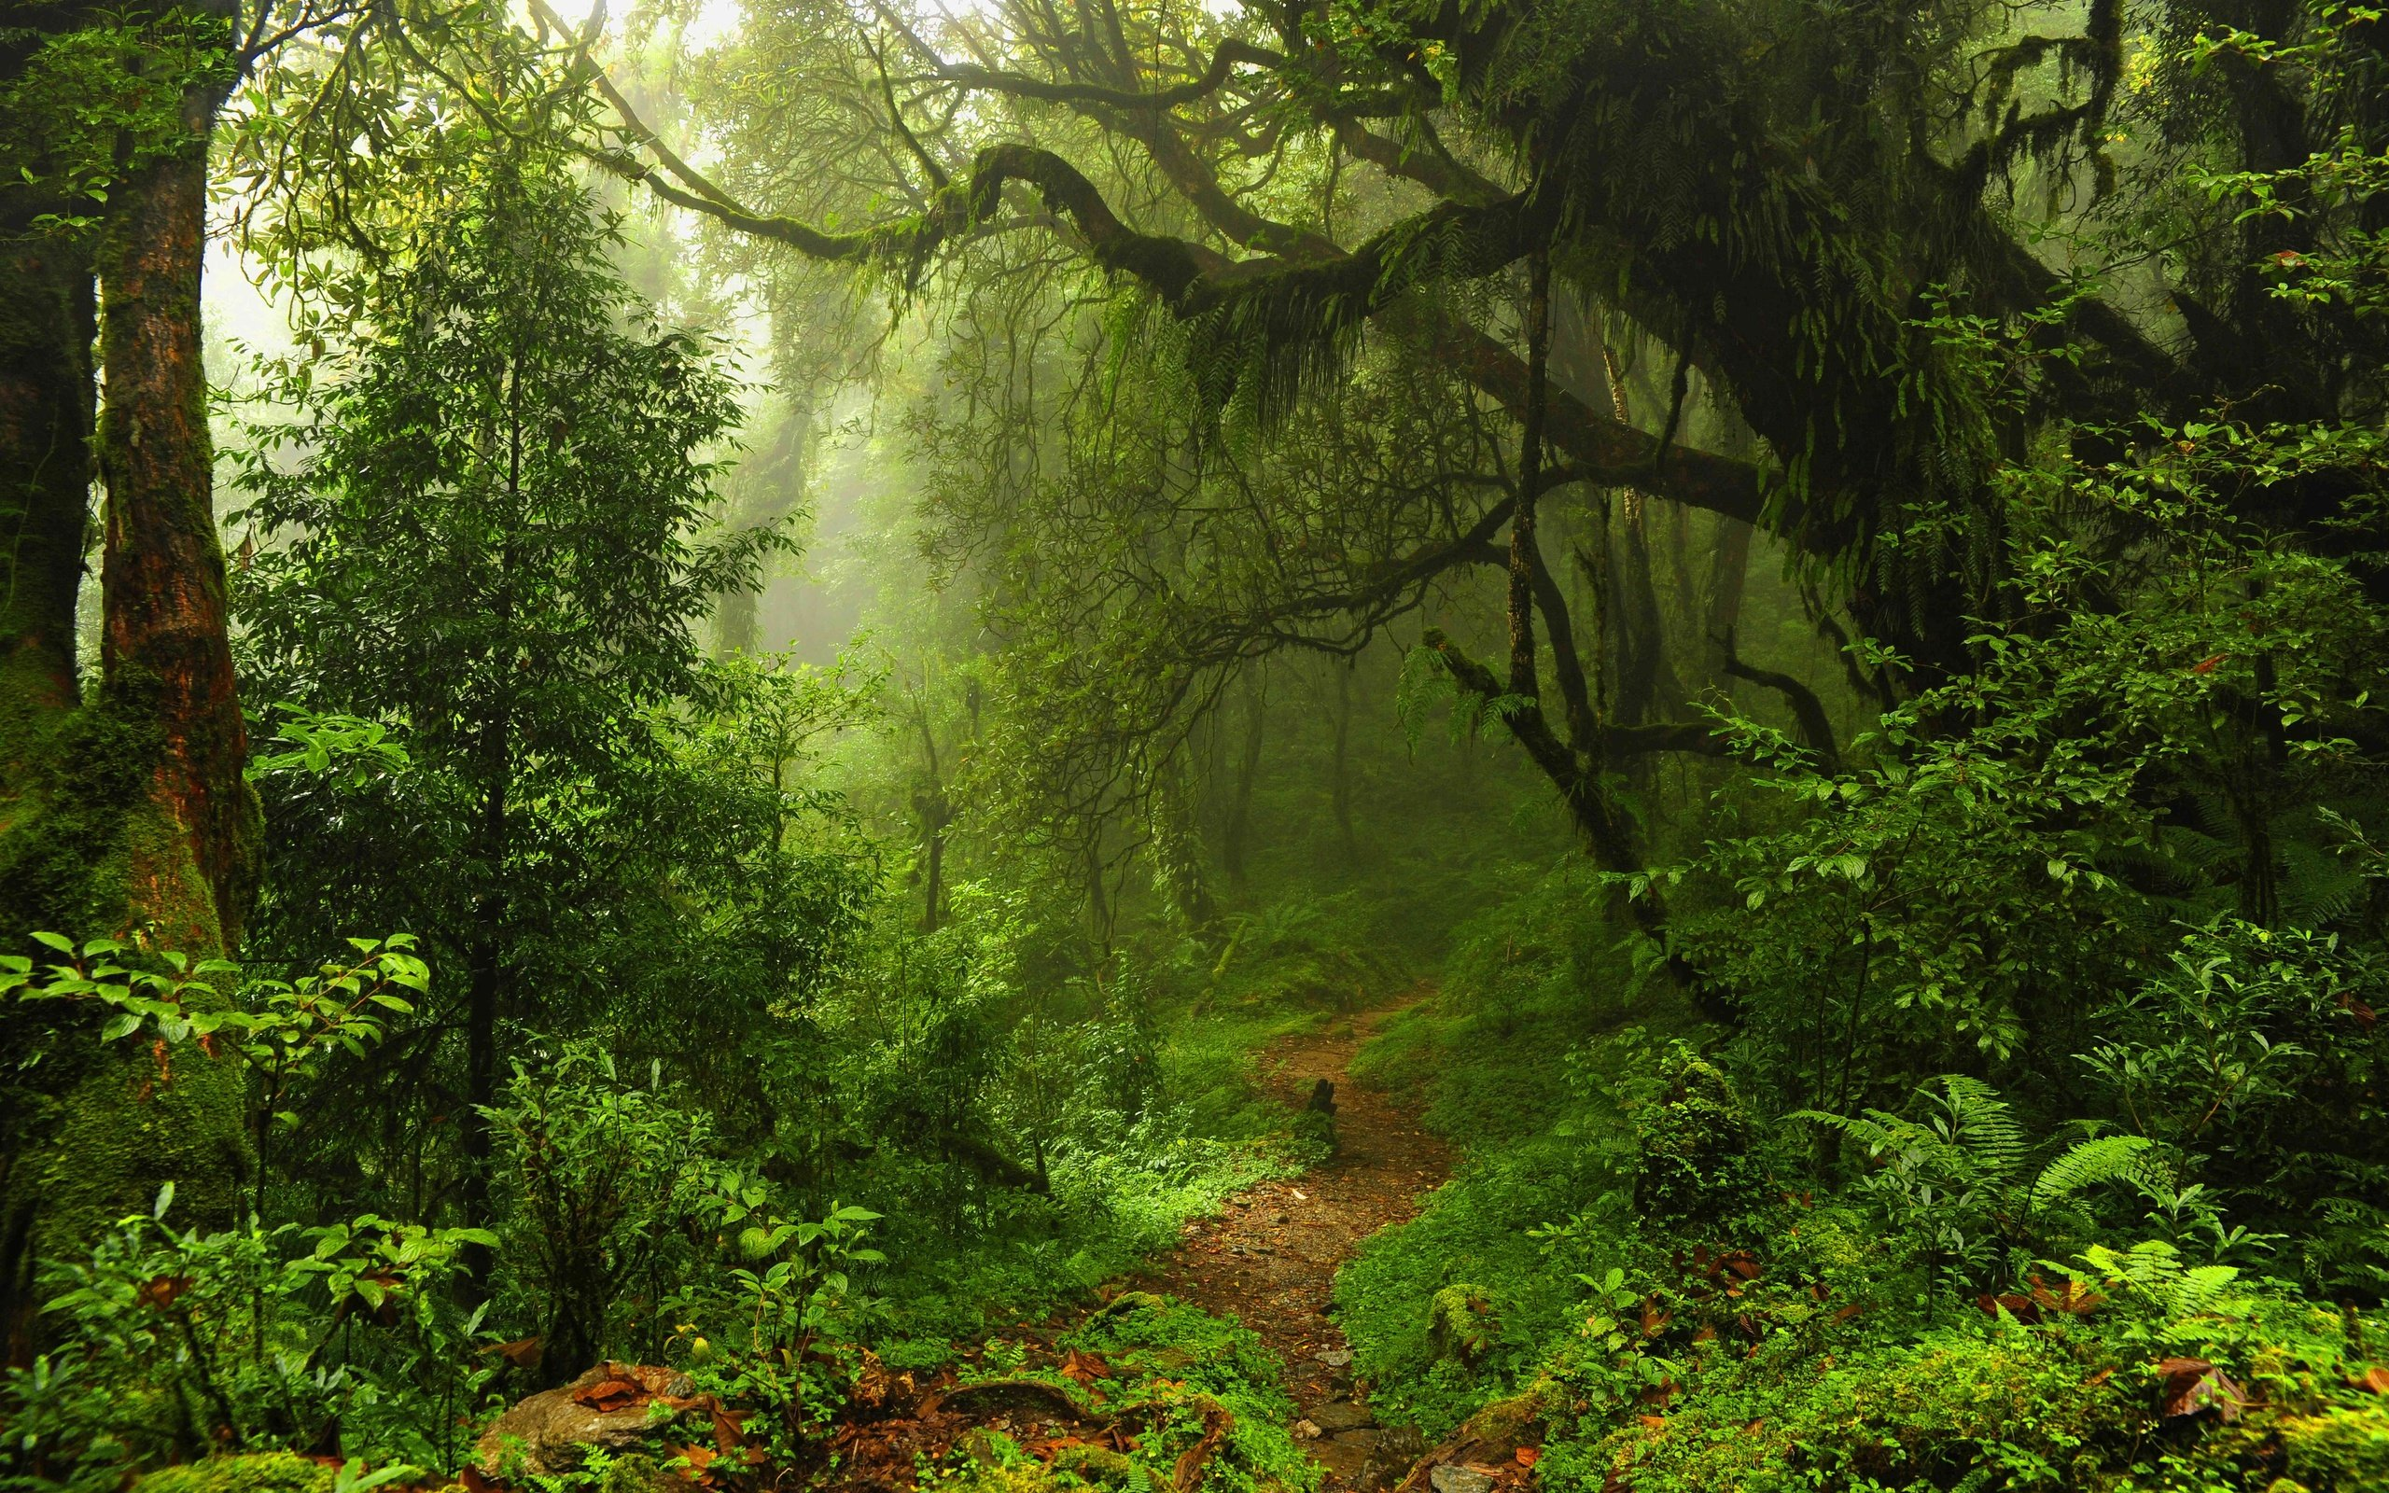
I live in the jungle.

Slide 7
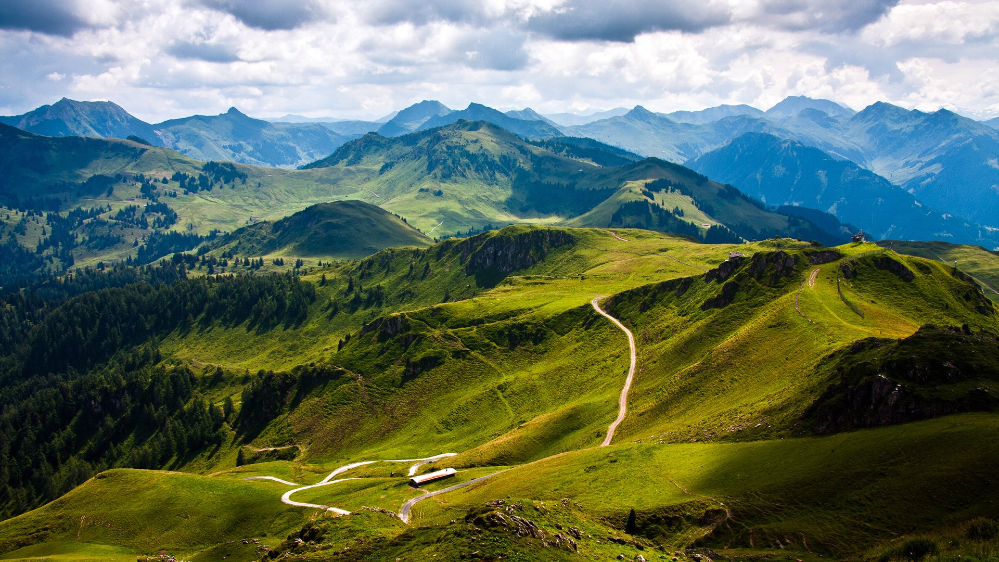
I live in the mountain

Slide 8
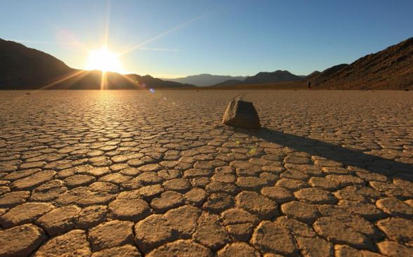
I live in the desert.

Slide 9
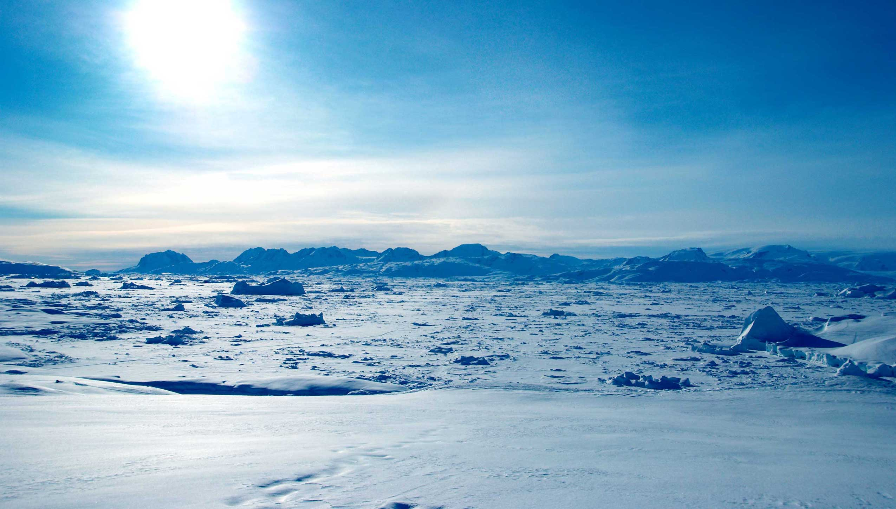
I live in the polar regions.

Slide 10
Where do they live?
Deep Ocean
Polar Regions
Ocean
Jungle
Mountain
Desert
Humans
Polar bears
Elephants
Goat
Crocodiles
Crab
Penguin
Spiders
Mosquitoes
Tardigrades

Slide 12
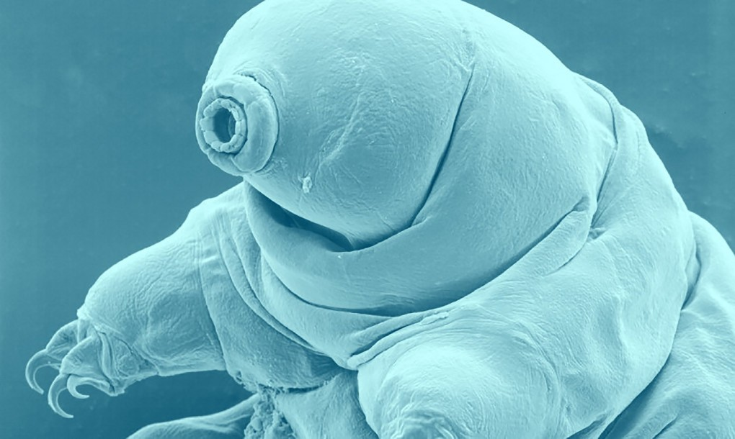
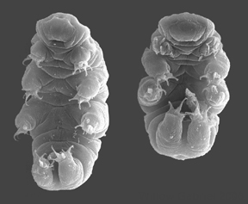
How do tardigrades survive?
Dehydrate and rehydrate

Slide 13
Extreme Animals #1
https://www.youtube.com/watch?v=2GPv8CwU0Ls

Slide 14
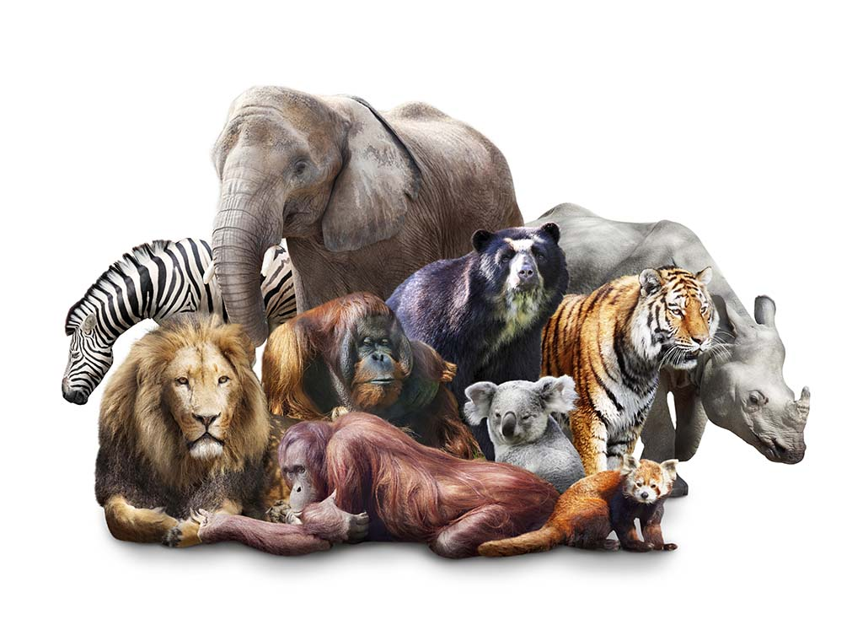
Animal Adjectives

Slide 15
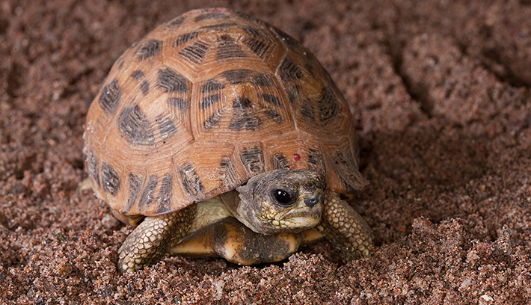
Hard / Tough / Thick Skinned

Slide 16
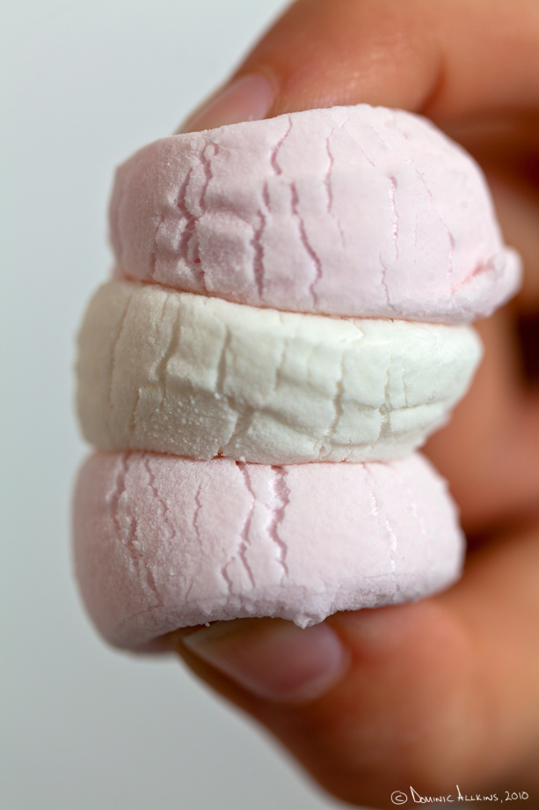
Soft / Mushy / Squishy

Slide 17
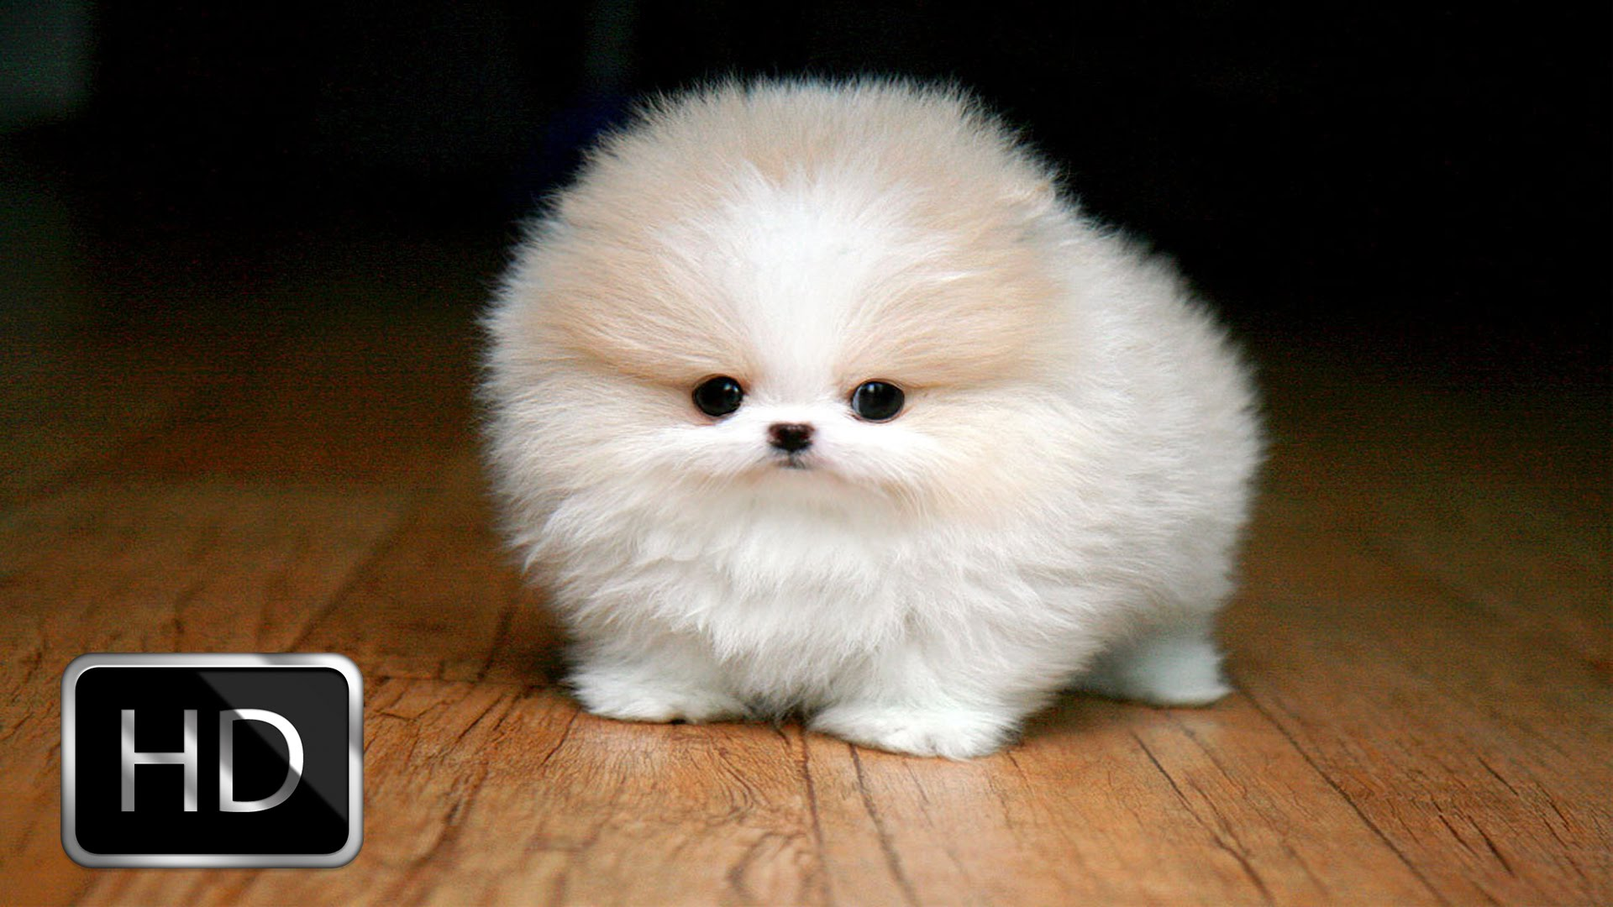
Hairy / Fluffy / Furry

Slide 18
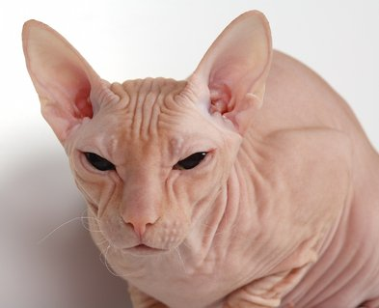
Hairless / Bald / Bare

Slide 19
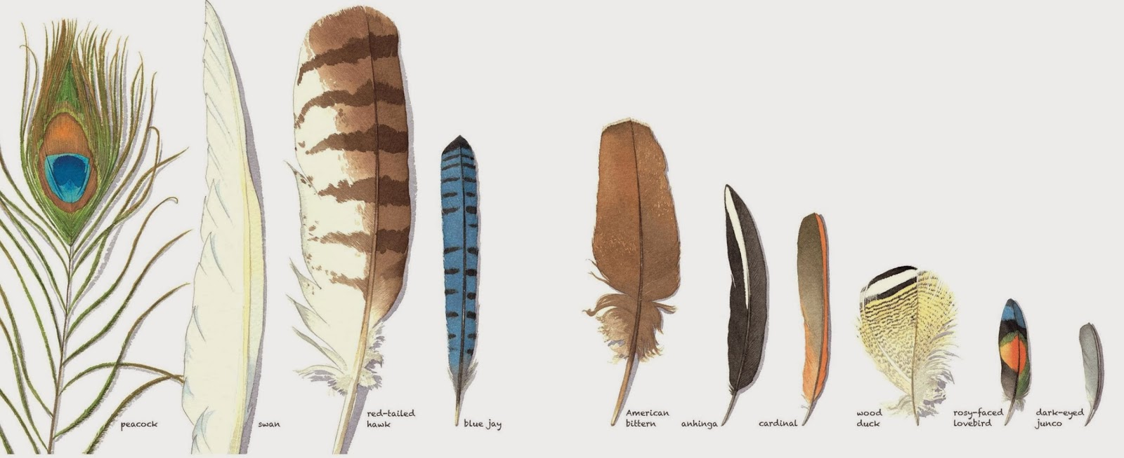
Feathery

Slide 20
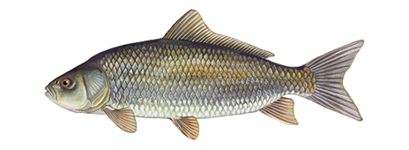
Scaly

Slide 21
Slimy / Greasy / Slippery

Slide 22
Smelly / Stinky

Slide 23
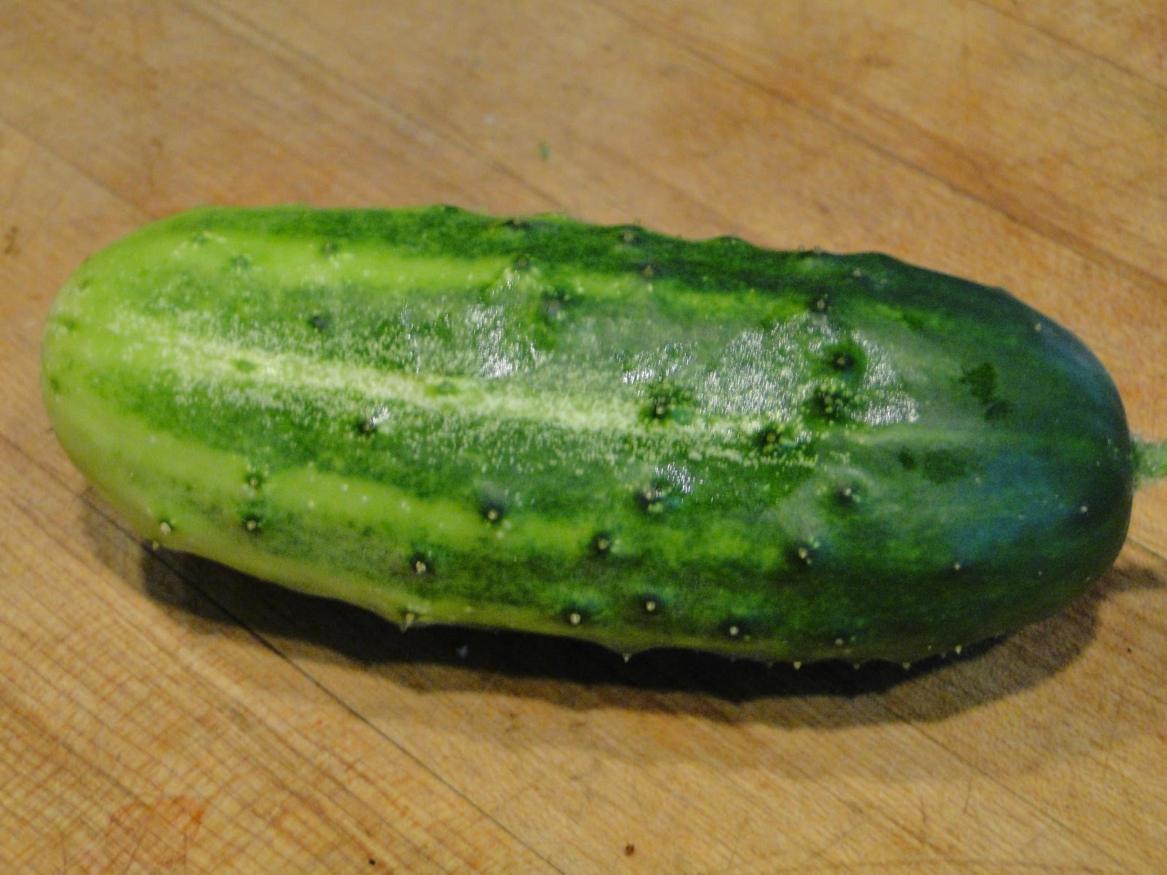
Bumpy / Rough

Slide 24
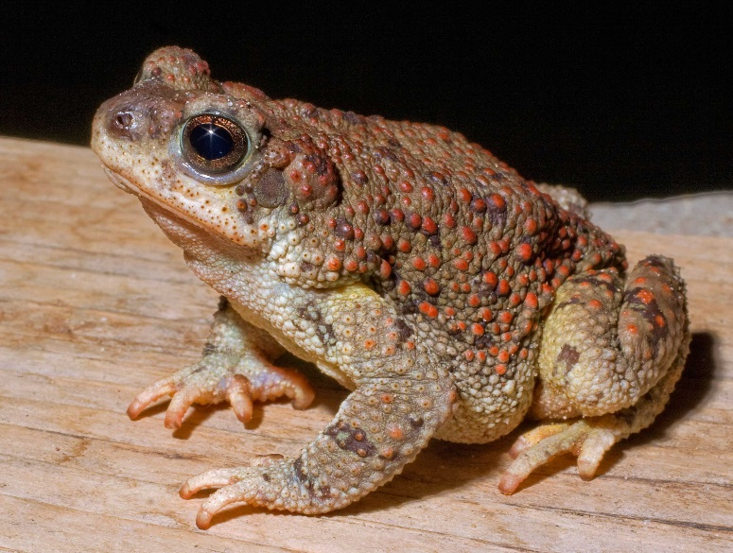
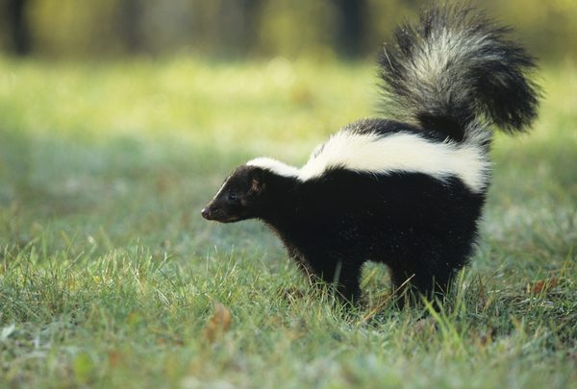
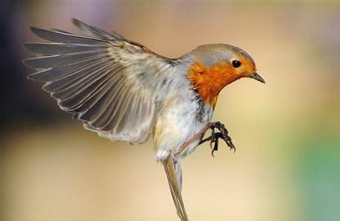
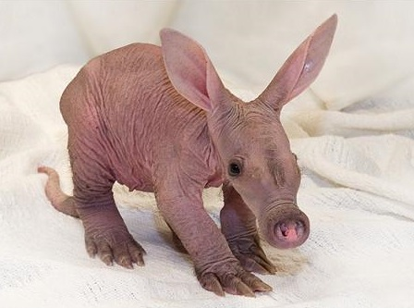
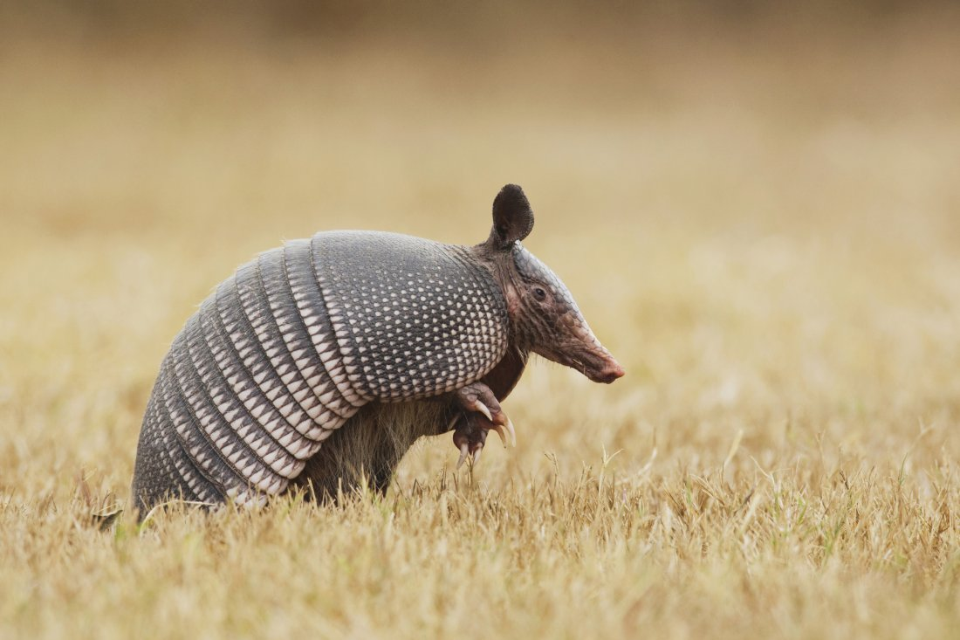
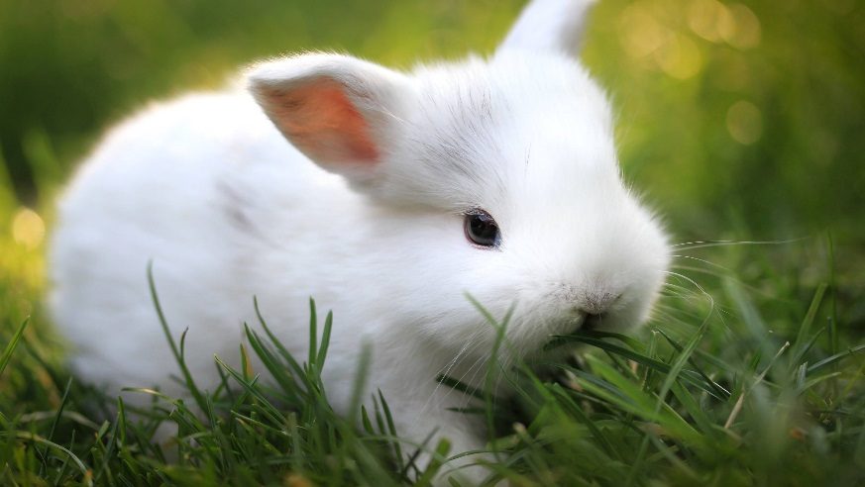
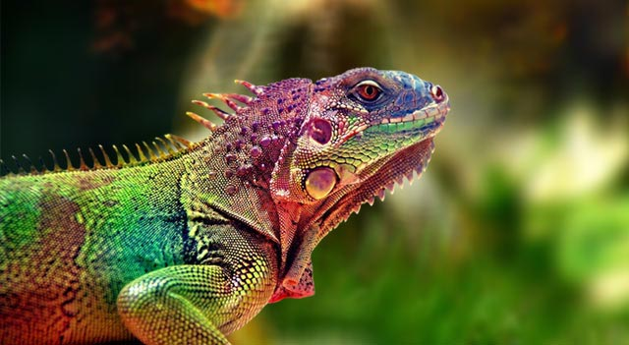
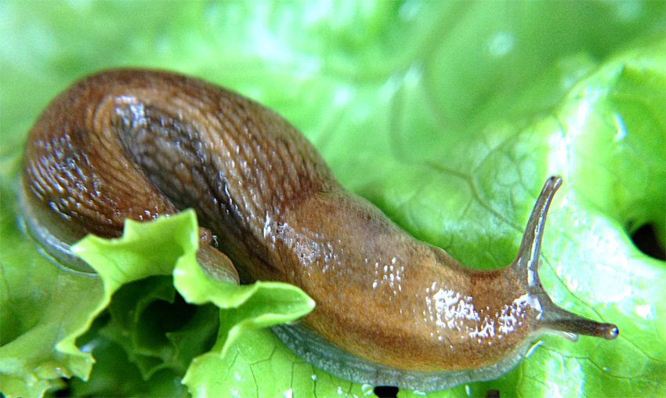
Slimy

Slide 25
Bare

Slide 26
Stinky

Slide 27
Bumpy

Slide 28
Fluffy

Slide 29
Scaly

Slide 30
Tough

Slide 31
Feathery

Slide 32
Apples to Apples

