Slide 1
Longitude / Latitude
http://world-geography-games.com/
(review)

Slide 2
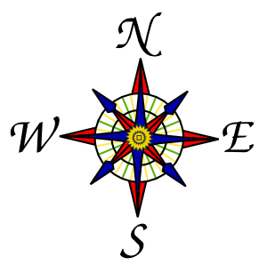
How do you read a map?
Compass

Slide 3
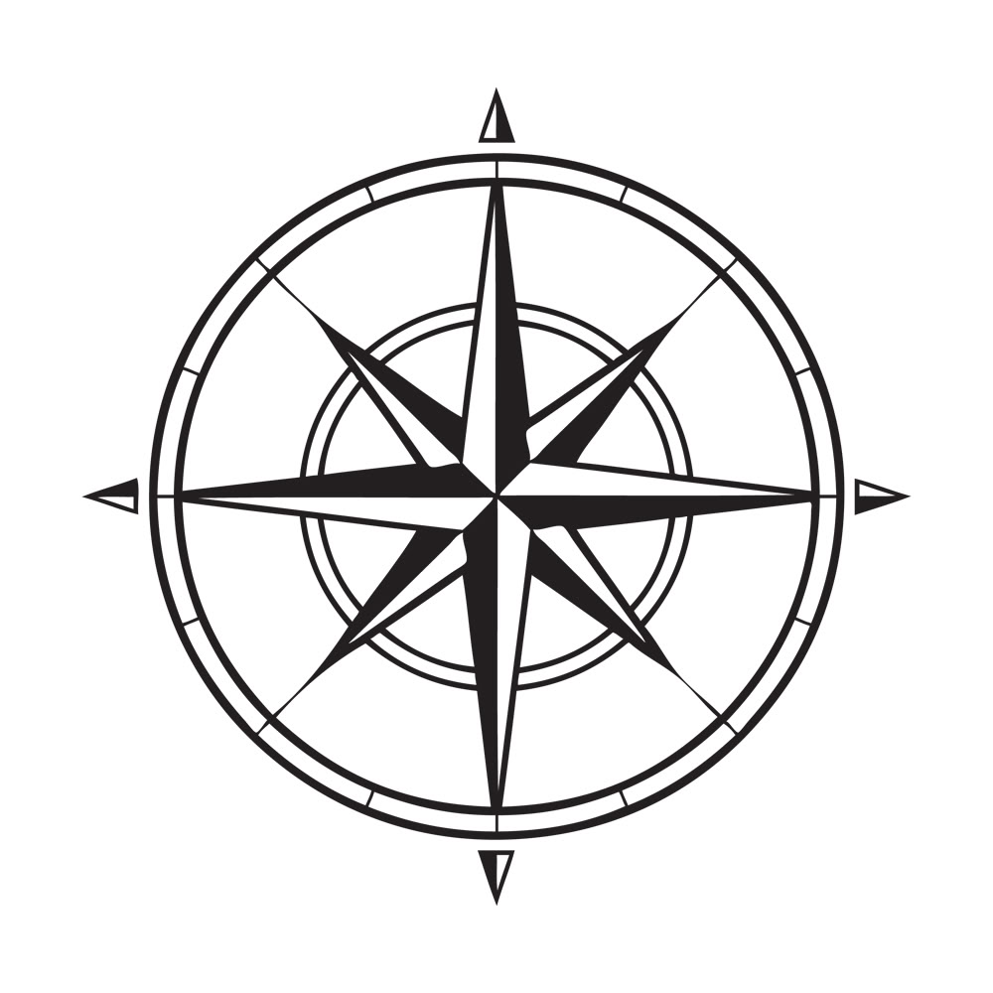

Slide 4
How do you read a map?
We need a way to say where something is on a map.
The best way to do that is to draw a “grid” on it.
We can use the numbers on the grid to describe where something is.

Slide 5
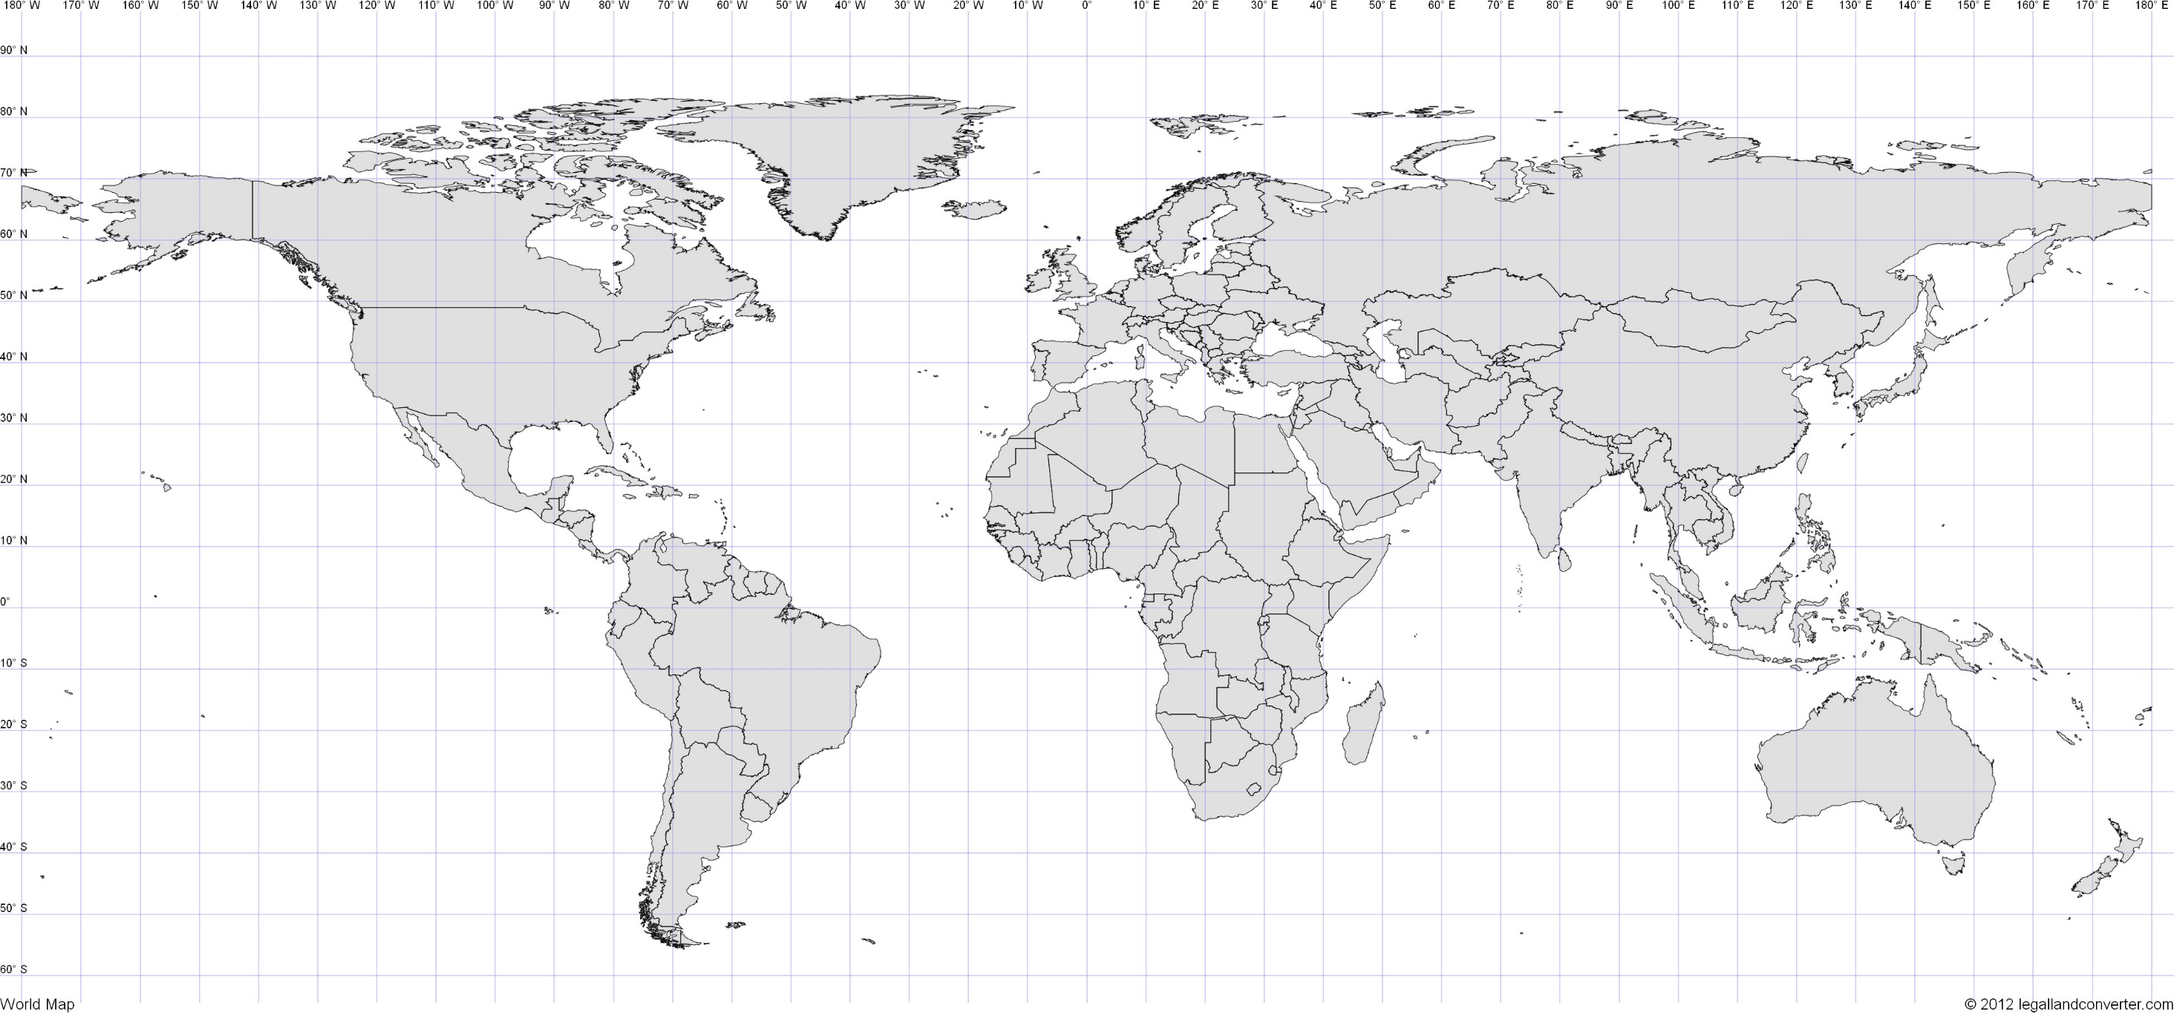
What is at 0⁰?
Equator

Slide 6
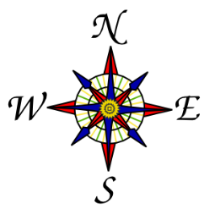

Slide 7
Latitude

Slide 8
Longitude

Slide 9
What continent is 40⁰N and 20⁰E
Europe

Slide 10
What ocean is found at 20⁰S and 100⁰E
Indian Ocean

Slide 11
What continent is at 20⁰S and 140⁰E
Australia

Slide 12
What ocean is at 20⁰S and 160⁰W
(South)
Pacific Ocean

Slide 13
What continent is at 40⁰N and 100⁰E
Asia

Slide 14
Find the COUNTRY

Slide 15
48⁰N, 2⁰E
France

Slide 16
40⁰N, 116⁰E
China

Slide 17
12⁰S, 77⁰W
Peru

Slide 18
33⁰S, 151⁰E
Australia

Slide 19
43⁰N, 79⁰W
Canada

Slide 20
20⁰S, 50⁰E
Madagascar

Slide 21
36⁰N, 127⁰E
South Korea

Slide 22
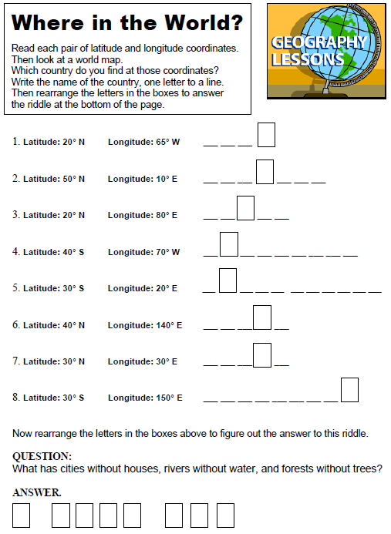
Use your map to find the answers:

Slide 24
Answers for the Where in the World? work sheet:
1. CUBA,
2. GERMANY,
3. INDIA,
4. ARGENTINA,
5. SOUTH AFRICA,
6. JAPAN,
7. EGYPT,
8. AUSTRALIA.
Riddle Answer: A ROAD MAP.

