Slide 1
Countries
http://world-geography-games.com/

Slide 2
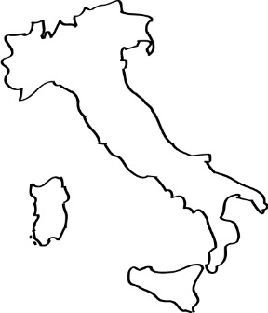
Famous Places
Find the answers to the crossword using famous places
The answer is the country name.
Italy

Slide 3
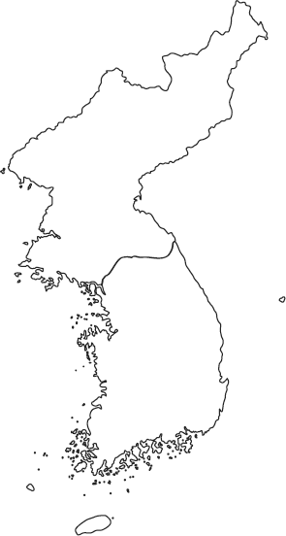
Find the Country
Use the shapes to find the country names
Korea

Slide 4
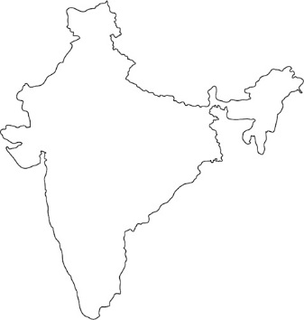
Find the Country
Use the shapes to find the country names
India

Slide 5
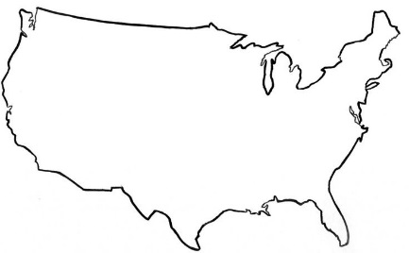
Find the Country
Use the shapes to find the country names
USA

Slide 6
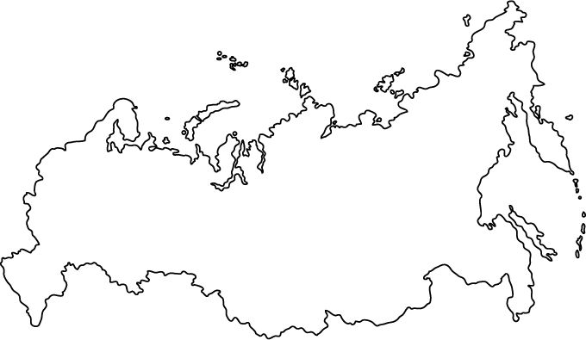
Find the Country
Use the shapes to find the country names
Russia

Slide 7
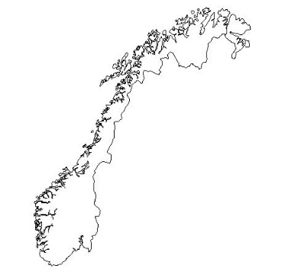
Find the Country
Use the shapes to find the country names
Norway

Slide 8
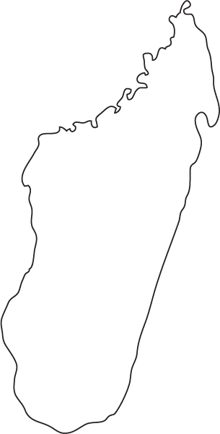
Find the Country
Use the shapes to find the country names
Madagascar

Slide 9
Find the Country
Use the shapes to find the country names
Indonesia

Slide 10
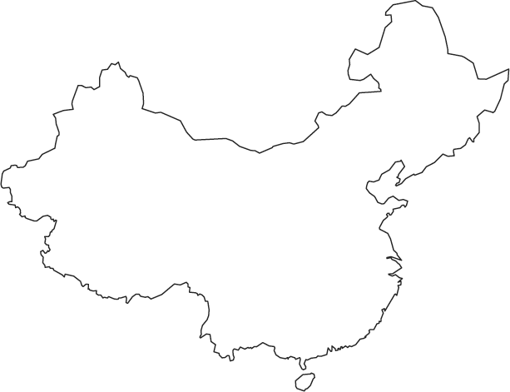
Find the Country
Use the shapes to find the country names
China

Slide 11
Find the Country
Use the shapes to find the country names
Spain

Slide 12
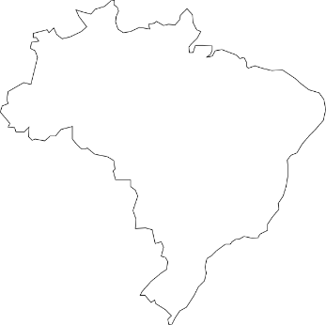
Find the Country
Use the shapes to find the country names
Brazil

Slide 13
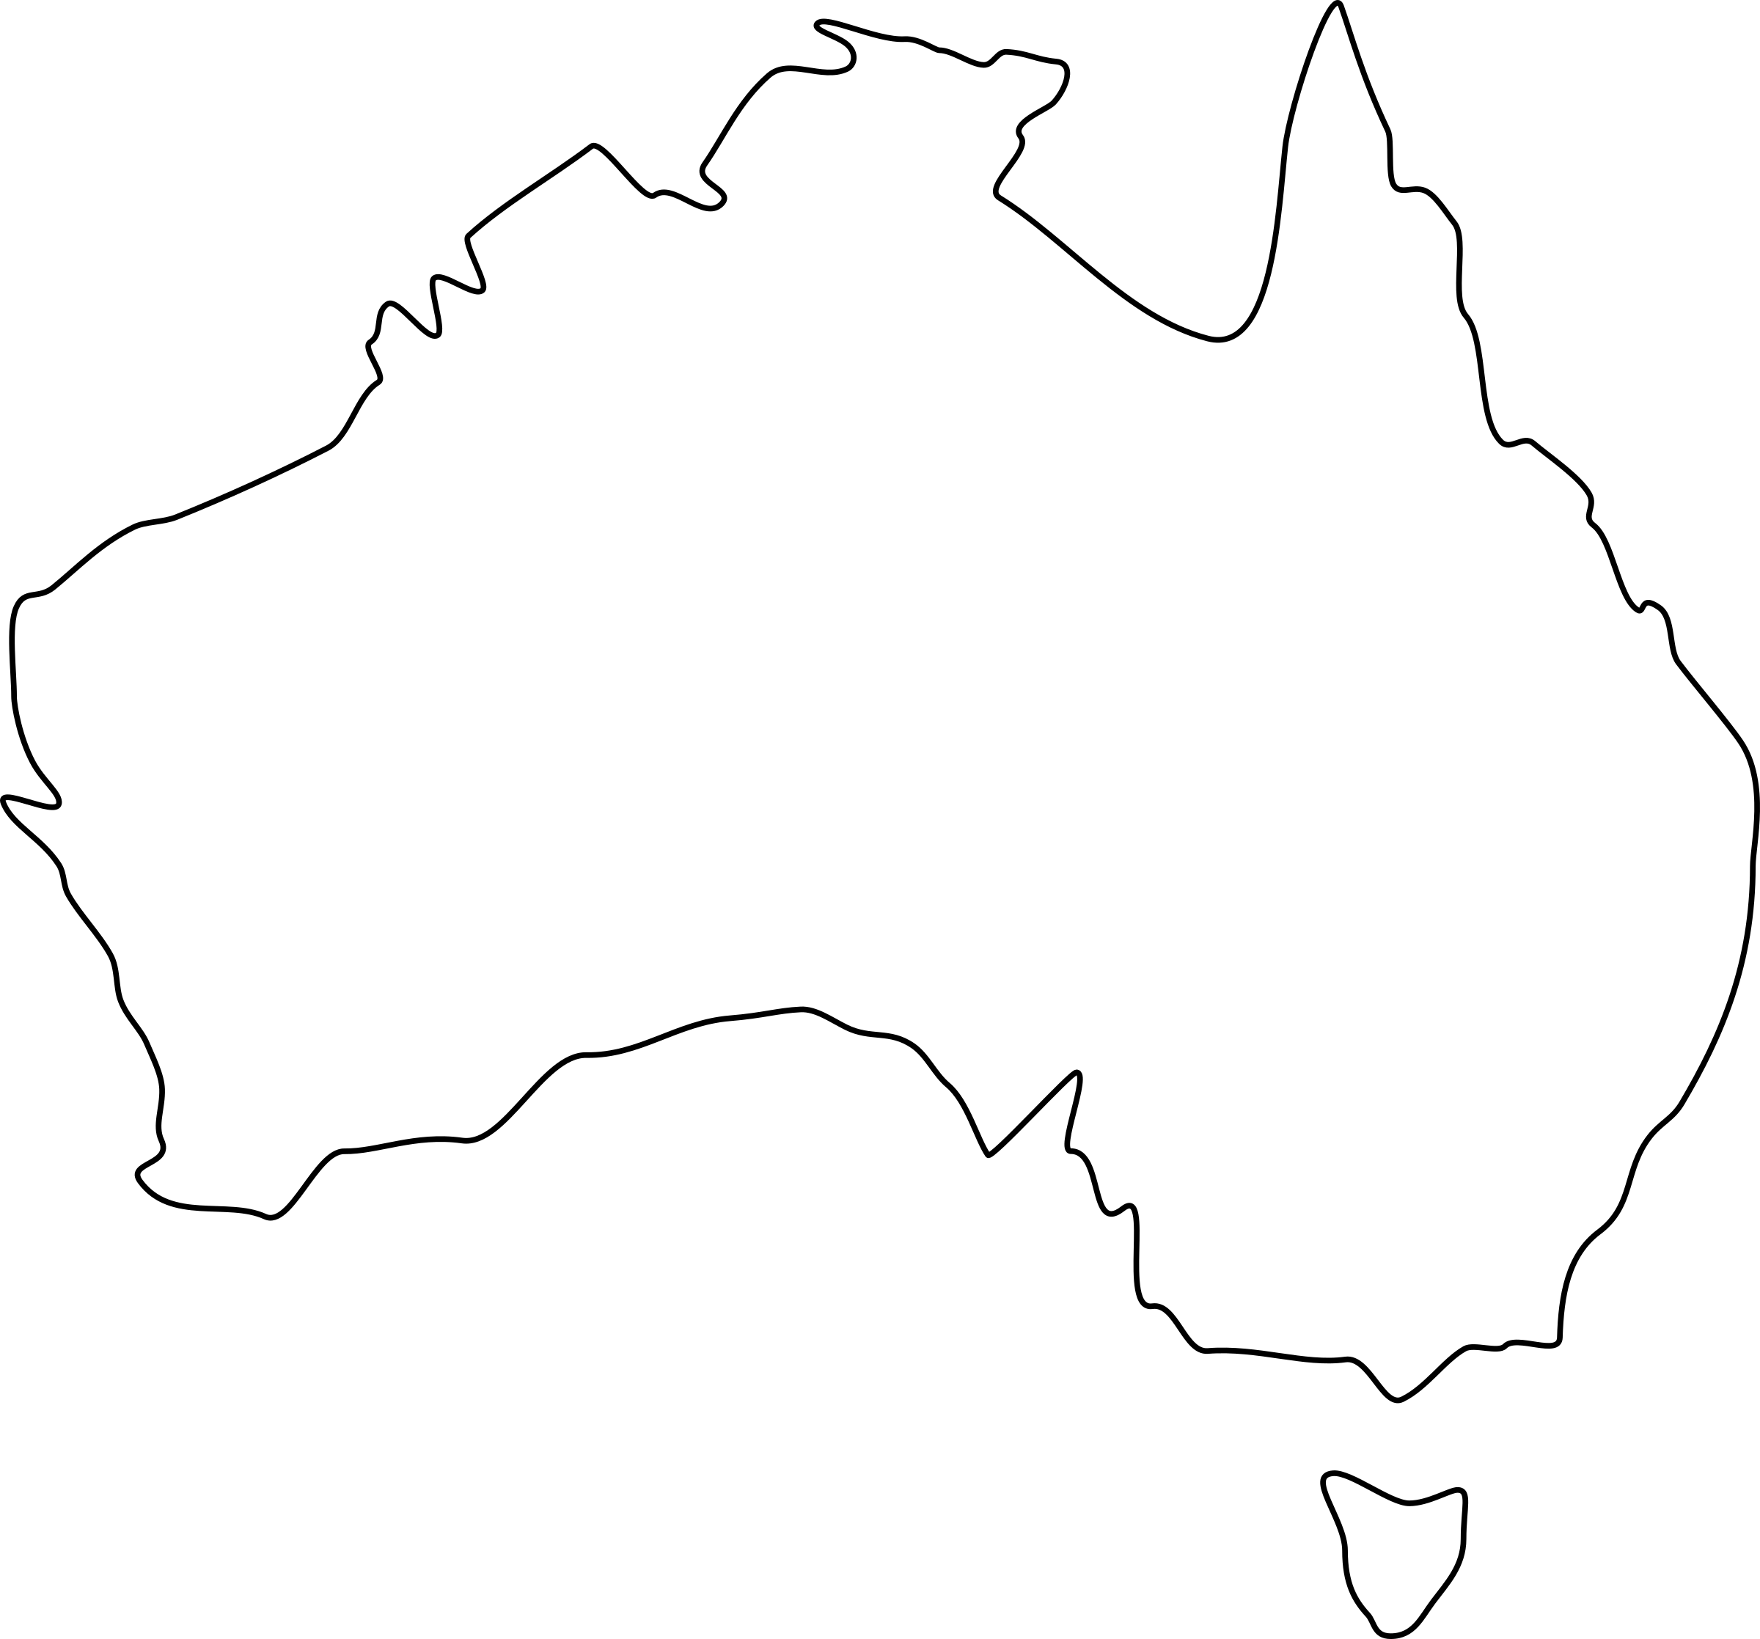
Find the Country
Use the shapes to find the country names
Australia

Slide 14
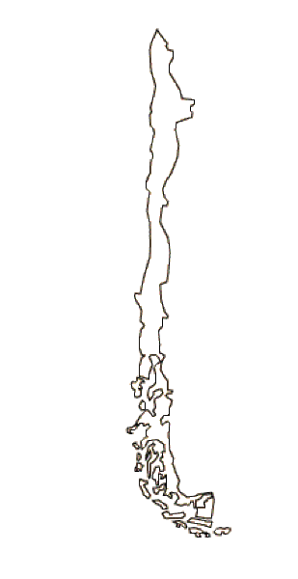
Find the Country
Use the shapes to find the country names
Chile

Slide 15
Find the Country
Use the shapes to find the country names
Mexico

Slide 16
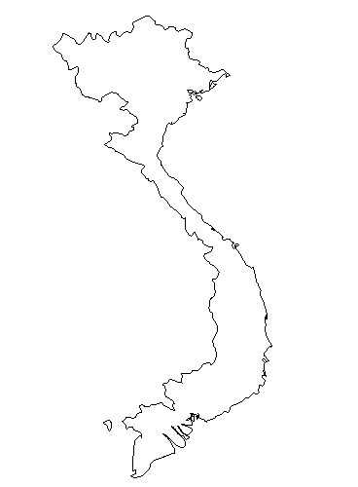
Find the Country
Use the shapes to find the country names
Vietnam

Slide 17
Find the Country
Use the shapes to find the country names
Mongolia

Slide 18
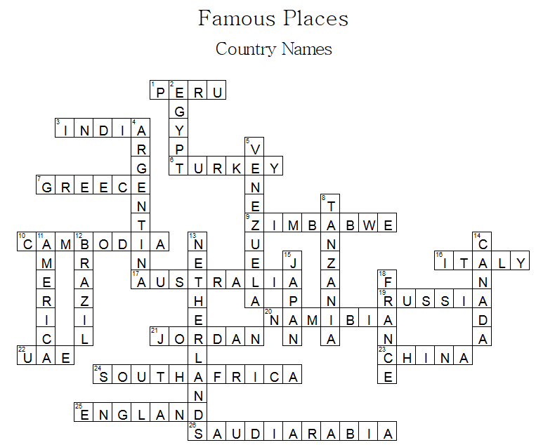
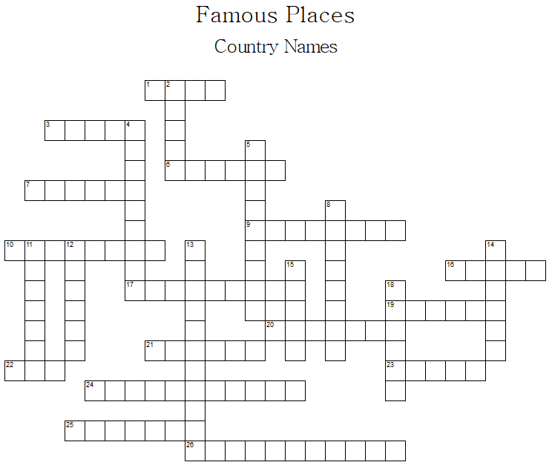
Across
 | 1 | Machu Picchu
 | 3 | Taj Mahal
 | 6 | The Blue Mosque
 | 7 | Parthenon
 | 9 | Victoria Falls
 | 10 | Angkor Wat
 | 16 | Leaning Tower of Pisa
 | 17 | Sydney Opera House
 | 19 | St. Basil’s Cathedral
 | 20 | Twyfelfontein
 | 21 | The Lost City of Petra
 | 22 | burj khalifa
 | 23 | The Great Wall of China
 | 24 | Table Mountain
 | 25 | Tower Bridge
 | 26 | Mecca
 | 2 | Pyramids
 | 4 | Iguaçu Falls
 | 5 | Angel Falls
 | 8 | Kilimanjaro
 | 11 | Statue of Liberty
 | 12 | Christ the Redeemer
 | 13 | Windmills at Kinderdijk
 | 14 | CN Tower
 | 15 | Mount Fuji
 | 18 | Eiffel Tower
Down

