Slide 1
Root Words

Slide 2
Root Words -
Smaller words
Starting words

Slide 3
Find the Root Word:
Apples
Apple

Slide 4
Find the Root Word:
Started
Start

Slide 5
Find the Root Word:
Carefully
Care

Slide 6
Find the Root Word:
Unhappy
Happy

Slide 7
Find the Root Word:
Recreate
Create

Slide 8
Find the Root Word:
Sickness
Sick

Slide 9
Find the Root Word:
Useless
Use

Slide 10
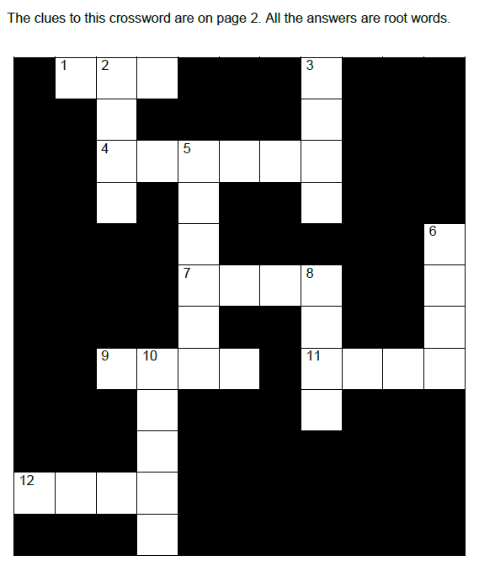
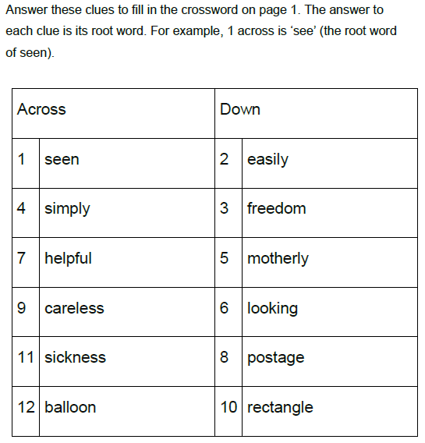

Slide 11
Root Word Quiz
http://www.bbc.co.uk/skillswise/topic/root-words

Slide 12
Match the Root Words

Slide 13
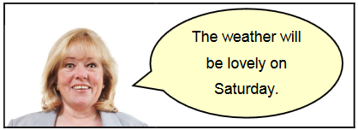
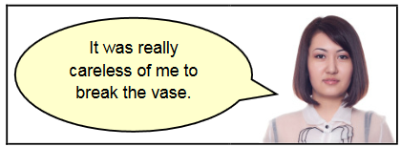
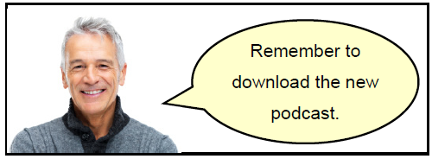
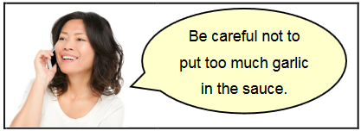
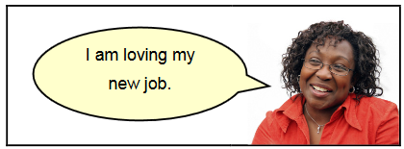
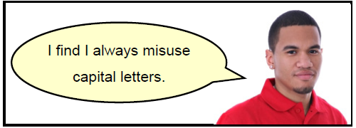
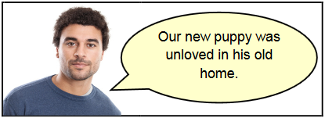
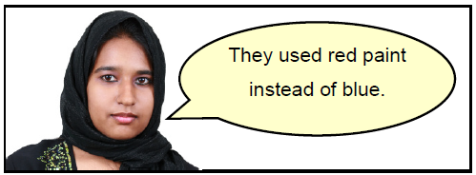
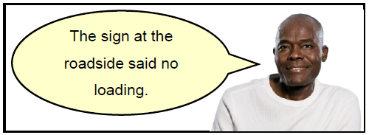
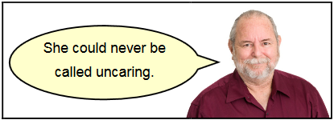
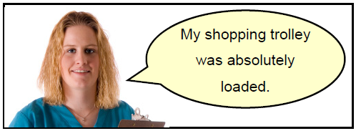
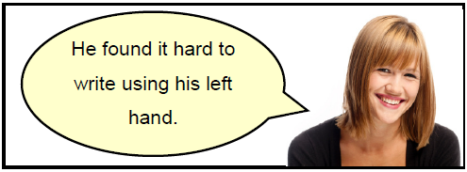

Slide 14
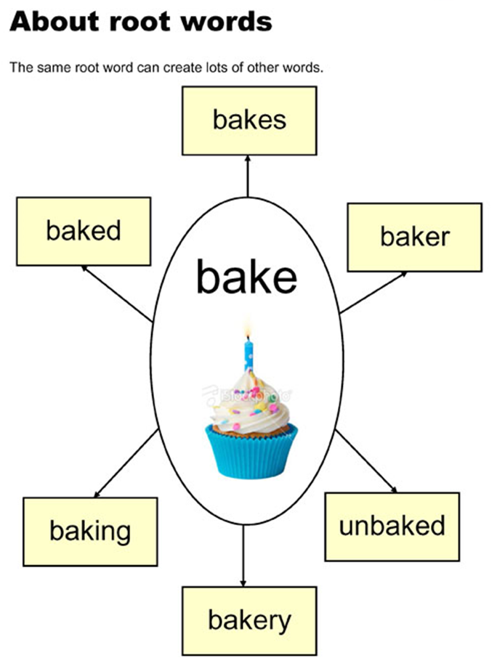

Slide 15
How many words can you make?
use

Slide 16
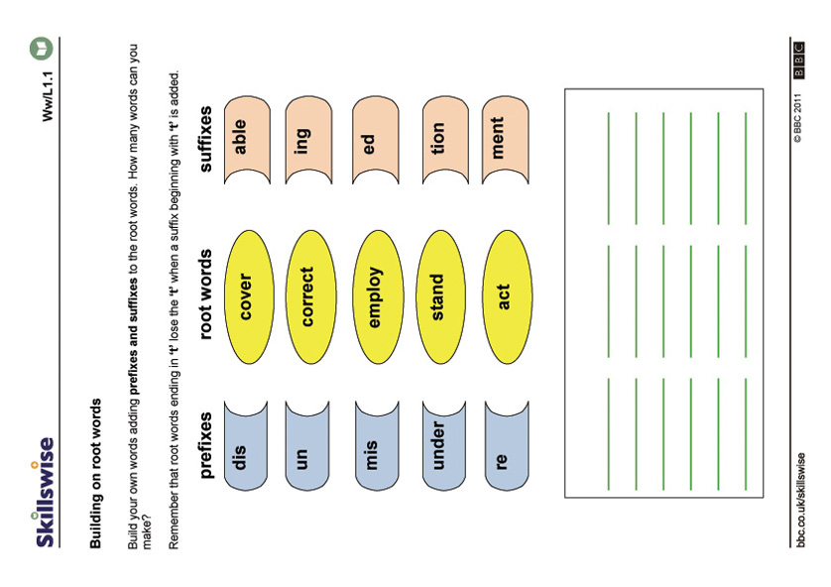
Notes:
http://www.bbc.co.uk/skillswise/worksheet/en18root-l1-w-building-on-root-words

Slide 17
