Slide 1
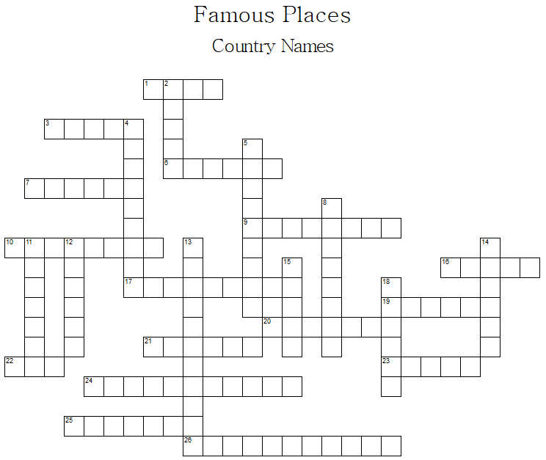
Across
 | 1 | Machu Picchu
 | 3 | Taj Mahal
 | 6 | The Blue Mosque
 | 7 | Parthenon
 | 9 | Victoria Falls
 | 10 | Angkor Wat
 | 16 | Leaning Tower of Pisa
 | 17 | Sydney Opera House
 | 19 | St. Basil’s Cathedral
 | 20 | Twyfelfontein
 | 21 | The Lost City of Petra
 | 22 | burj khalifa
 | 23 | The Great Wall of China
 | 24 | Table Mountain
 | 25 | Tower Bridge
 | 26 | Mecca
Down
 | 2 | Pyramids
 | 4 | Iguaçu Falls
 | 5 | Angel Falls
 | 8 | Kilimanjaro
 | 11 | Statue of Liberty
 | 12 | Christ the Redeemer
 | 13 | Windmills at Kinderdijk
 | 14 | CN Tower
 | 15 | Mount Fuji
 | 18 | Eiffel Tower

