Slide 1
National Symbols
http://designlike.com/100-most-famous-landmarks-around-the-world/

Slide 2
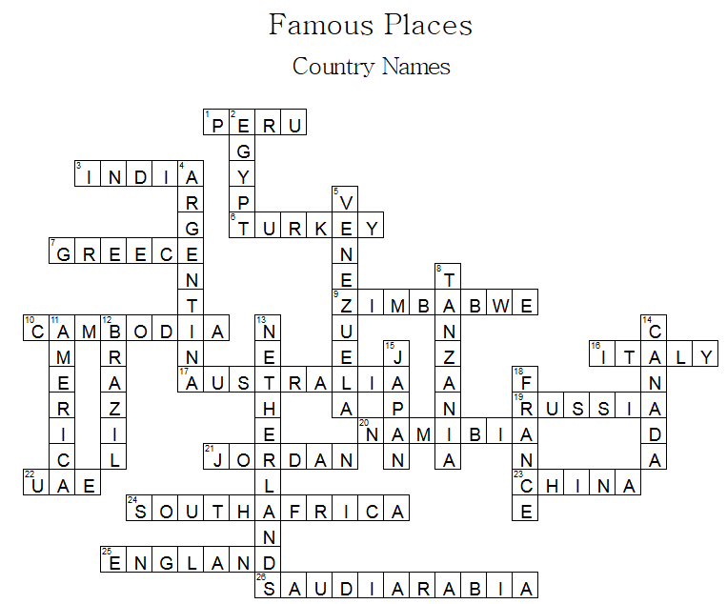
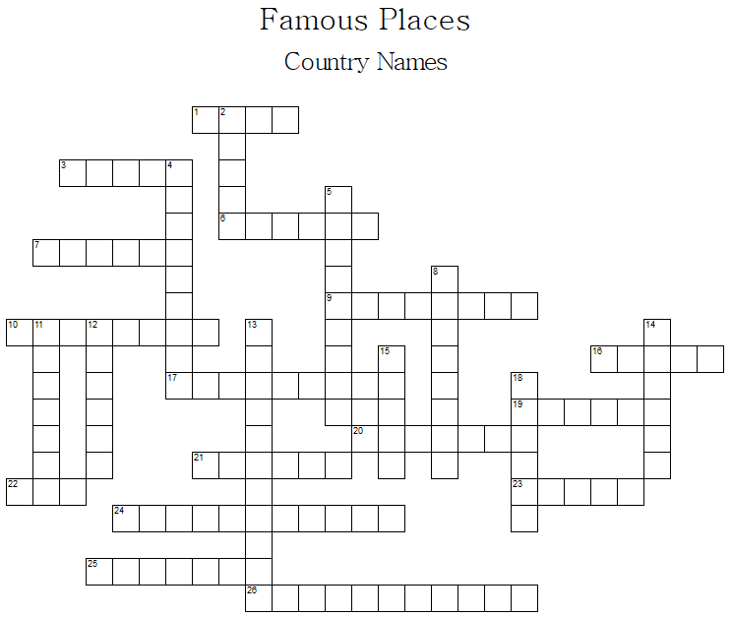
Across
 | 1 | Machu Picchu
 | 3 | Taj Mahal
 | 6 | The Blue Mosque
 | 7 | Parthenon
 | 9 | Victoria Falls
 | 10 | Angkor Wat
 | 16 | Leaning Tower of Pisa
 | 17 | Sydney Opera House
 | 19 | St. Basil’s Cathedral
 | 20 | Twyfelfontein
 | 21 | The Lost City of Petra
 | 22 | burj khalifa
 | 23 | The Great Wall of China
 | 24 | Table Mountain
 | 25 | Tower Bridge
 | 26 | Mecca
 | 2 | Pyramids
 | 4 | Iguaçu Falls
 | 5 | Angel Falls
 | 8 | Kilimanjaro
 | 11 | Statue of Liberty
 | 12 | Christ the Redeemer
 | 13 | Windmills at Kinderdijk
 | 14 | CN Tower
 | 15 | Mount Fuji
 | 18 | Eiffel Tower
Down

Slide 3
Landmarks Quiz
http://www.mirror.co.uk/news/weird-news/landmarks-quiz-can-you-tell-3457455

Slide 4
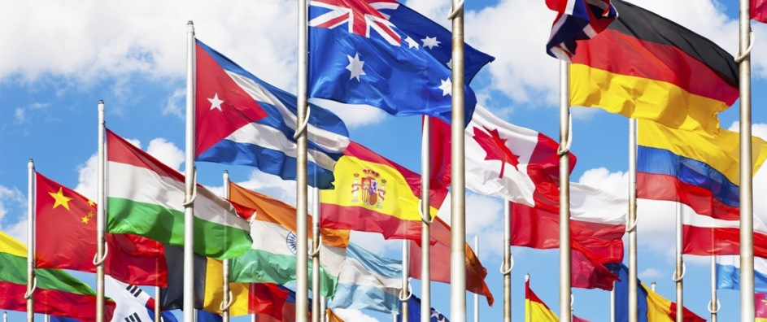
Nation (country)

Slide 5
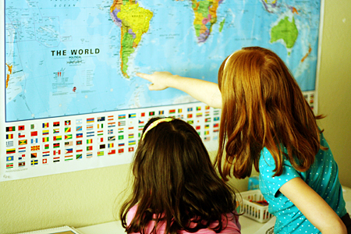
National (about the country)

Slide 6
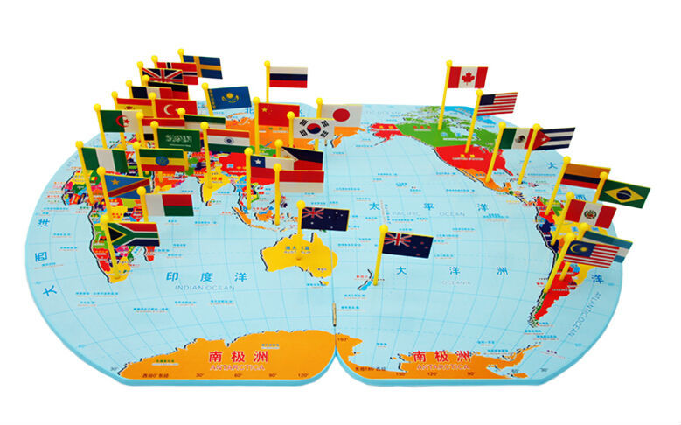
National Symbols
Things that represent a country
Things the country is famous for

Slide 7
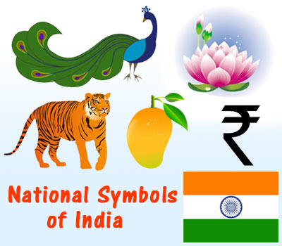
What are some types of national symbols?

Slide 8
National Animals

Slide 9
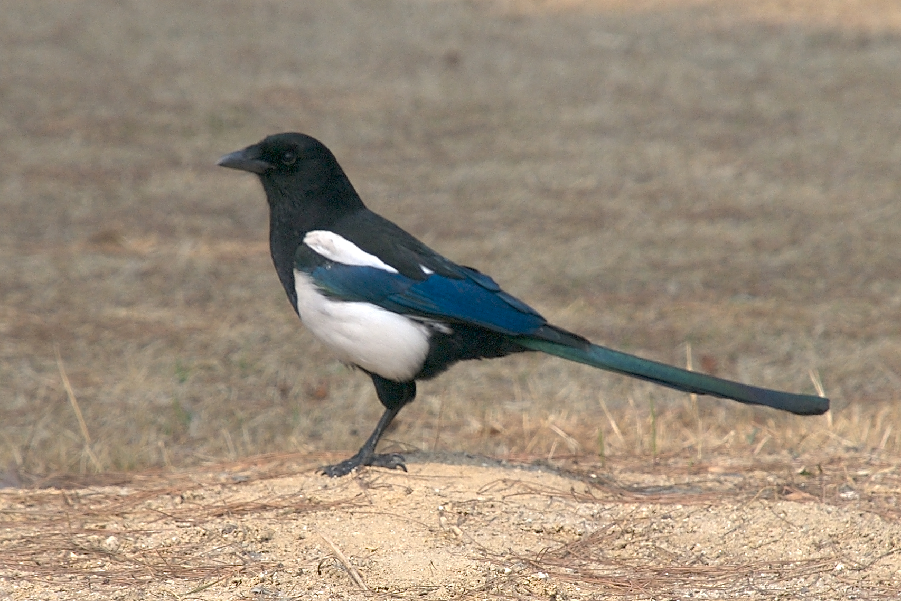
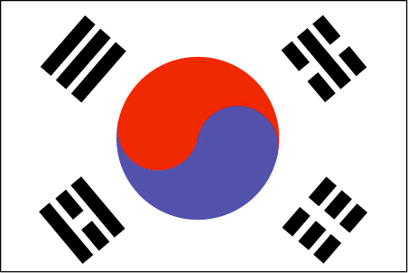
Magpie
Korea

Slide 10
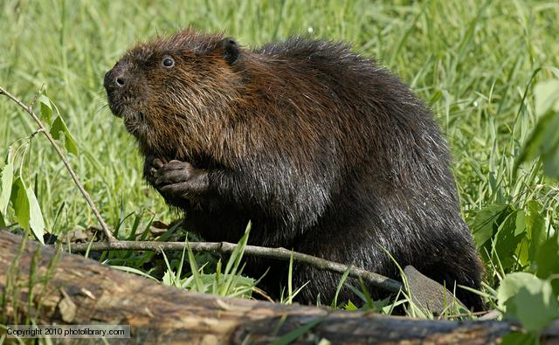
Beaver
Canada

Slide 11
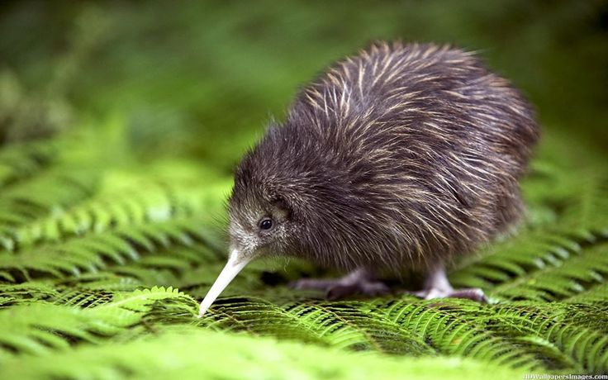
Kiwi
New Zealand

Slide 12
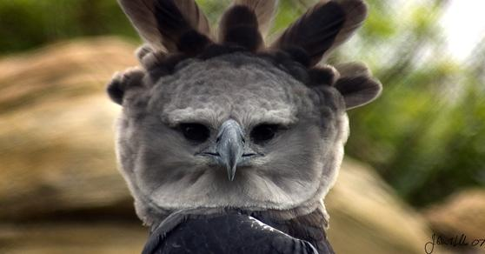
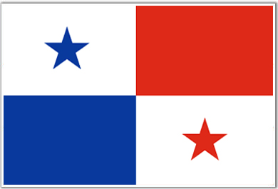
Harpy Eagle
Panama

Slide 13
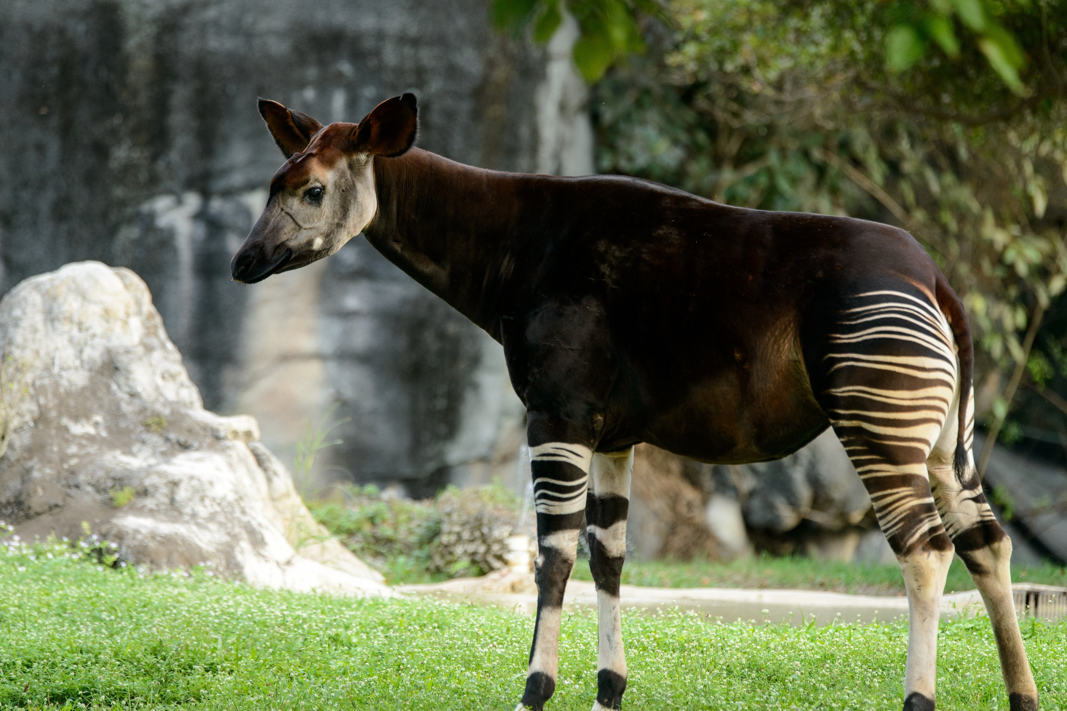
Okapi
Democratic Republic of the Congo

Slide 14
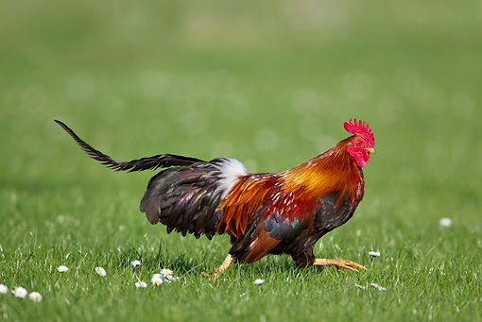
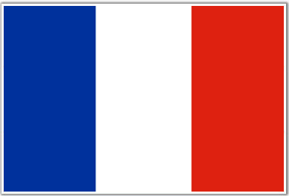
Gallic Rooster
France

Slide 15
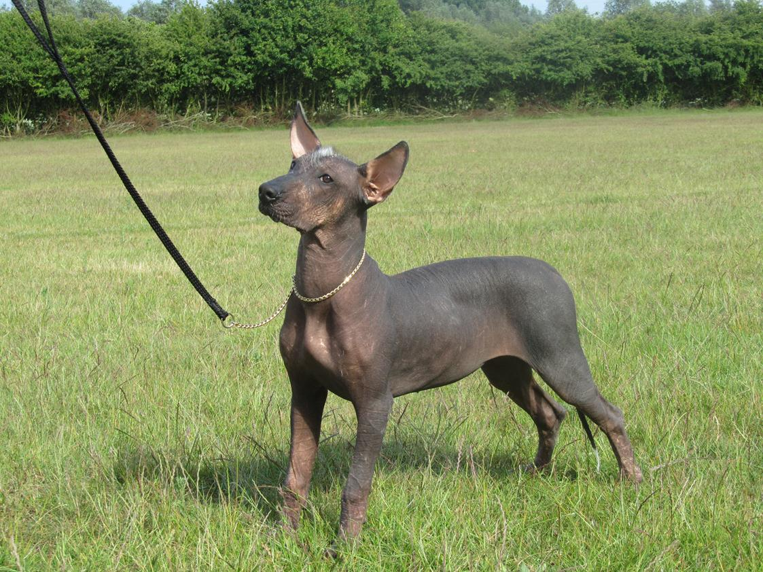
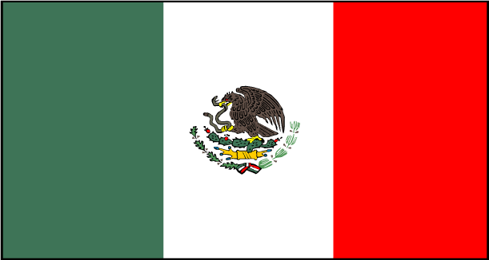
Mexican Hairless
Mexico

Slide 16
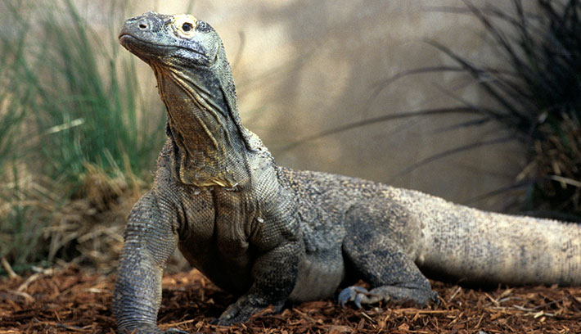
Komodo Dragon
Indonesia

Slide 17
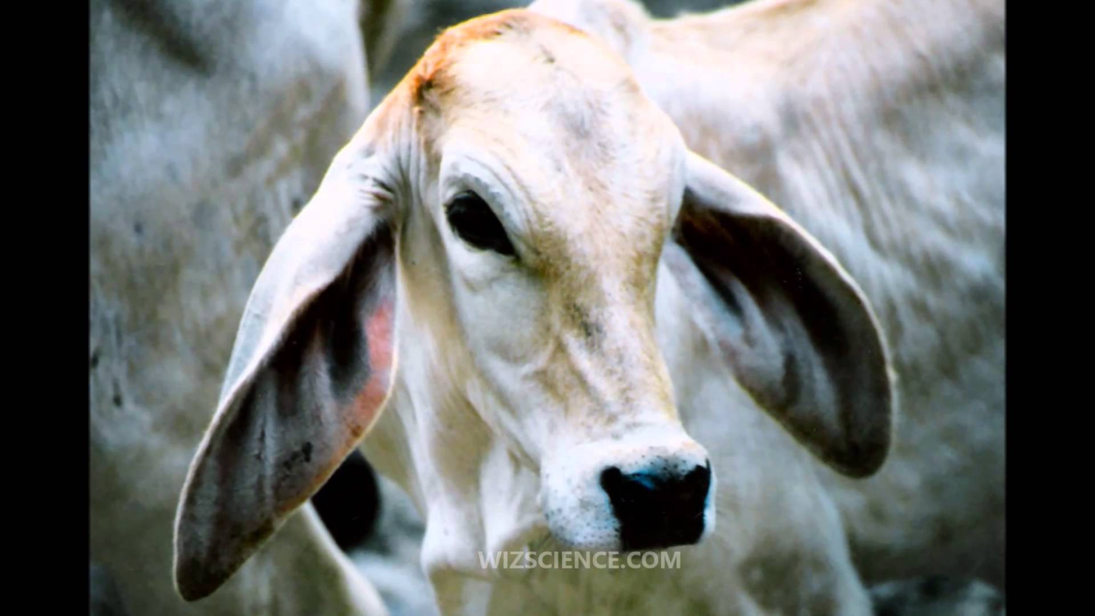
Zebu
Nepal

Slide 18
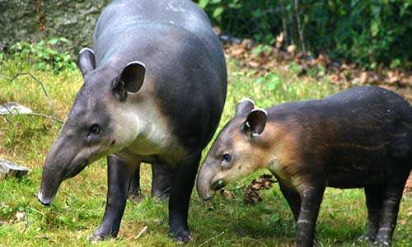
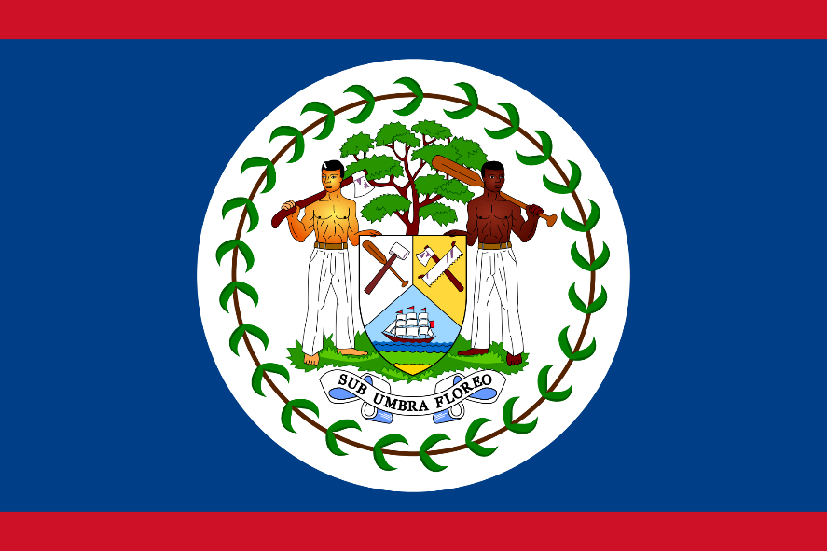
Tapir
Belize

Slide 19
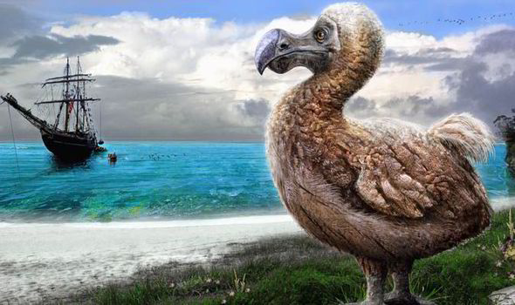
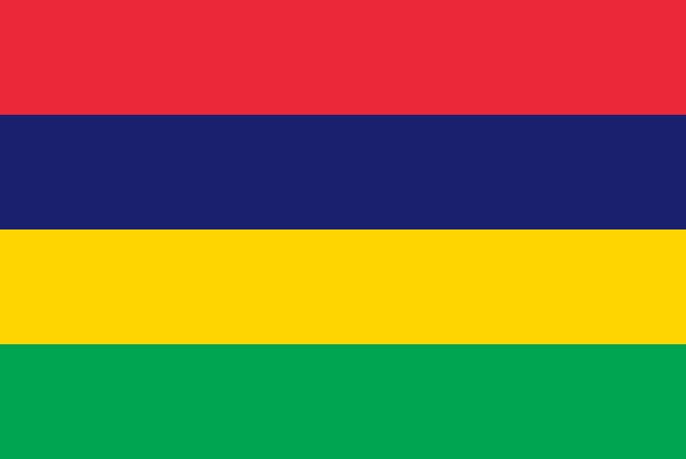
Dodo
Mauritius

Slide 20
Mythical National Animals

Slide 21
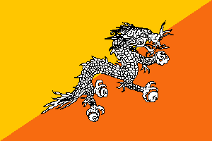
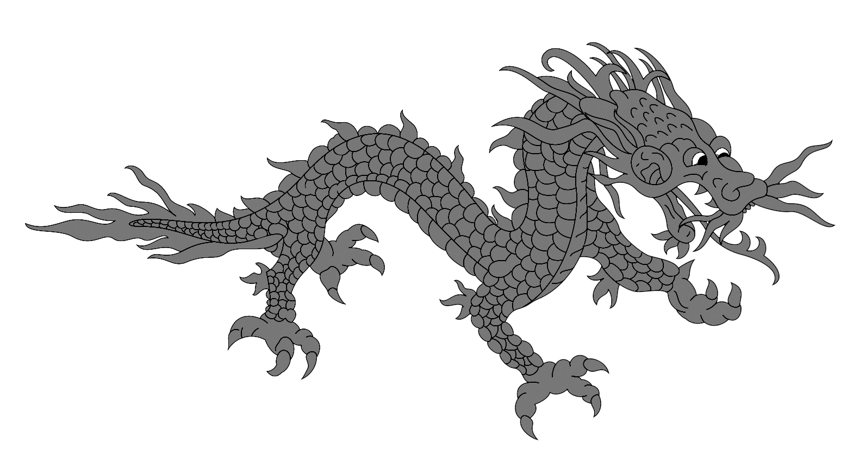
Druk
Butan

Slide 22
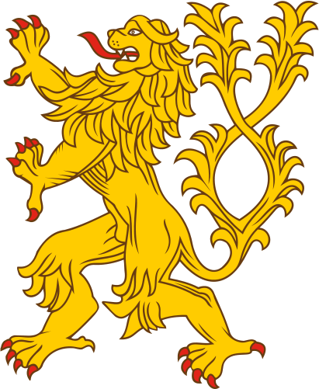
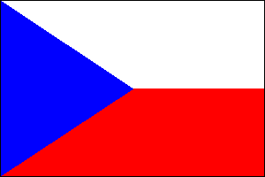
Double Tailed Lion
Czech Republic

Slide 23
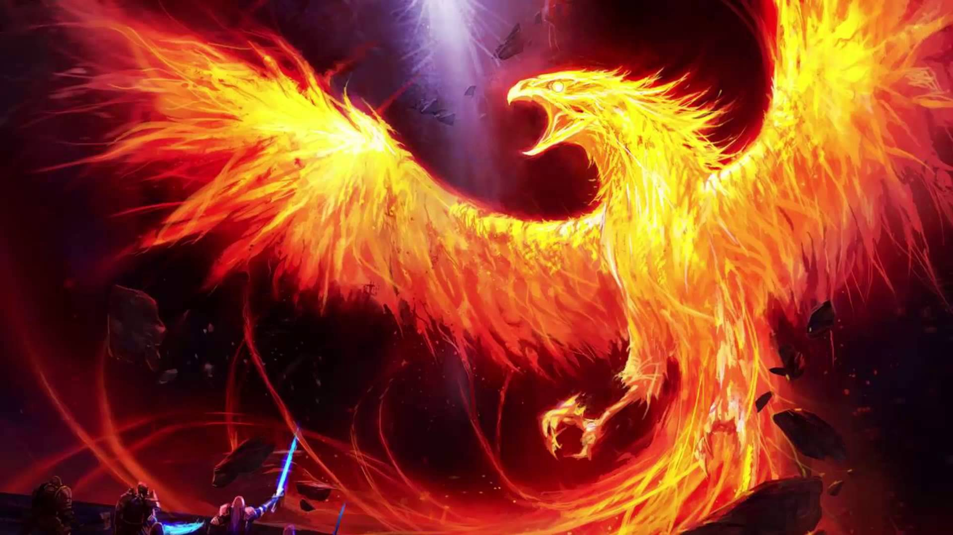
Phoenix
Greece

Slide 24
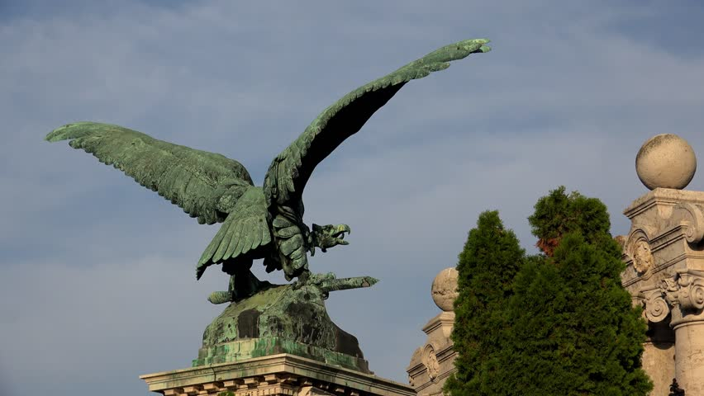
Turul
Hungary

Slide 25
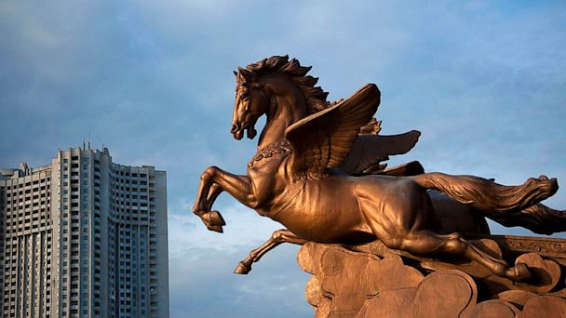
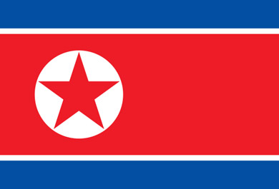
Chollima
North Korea

Slide 26
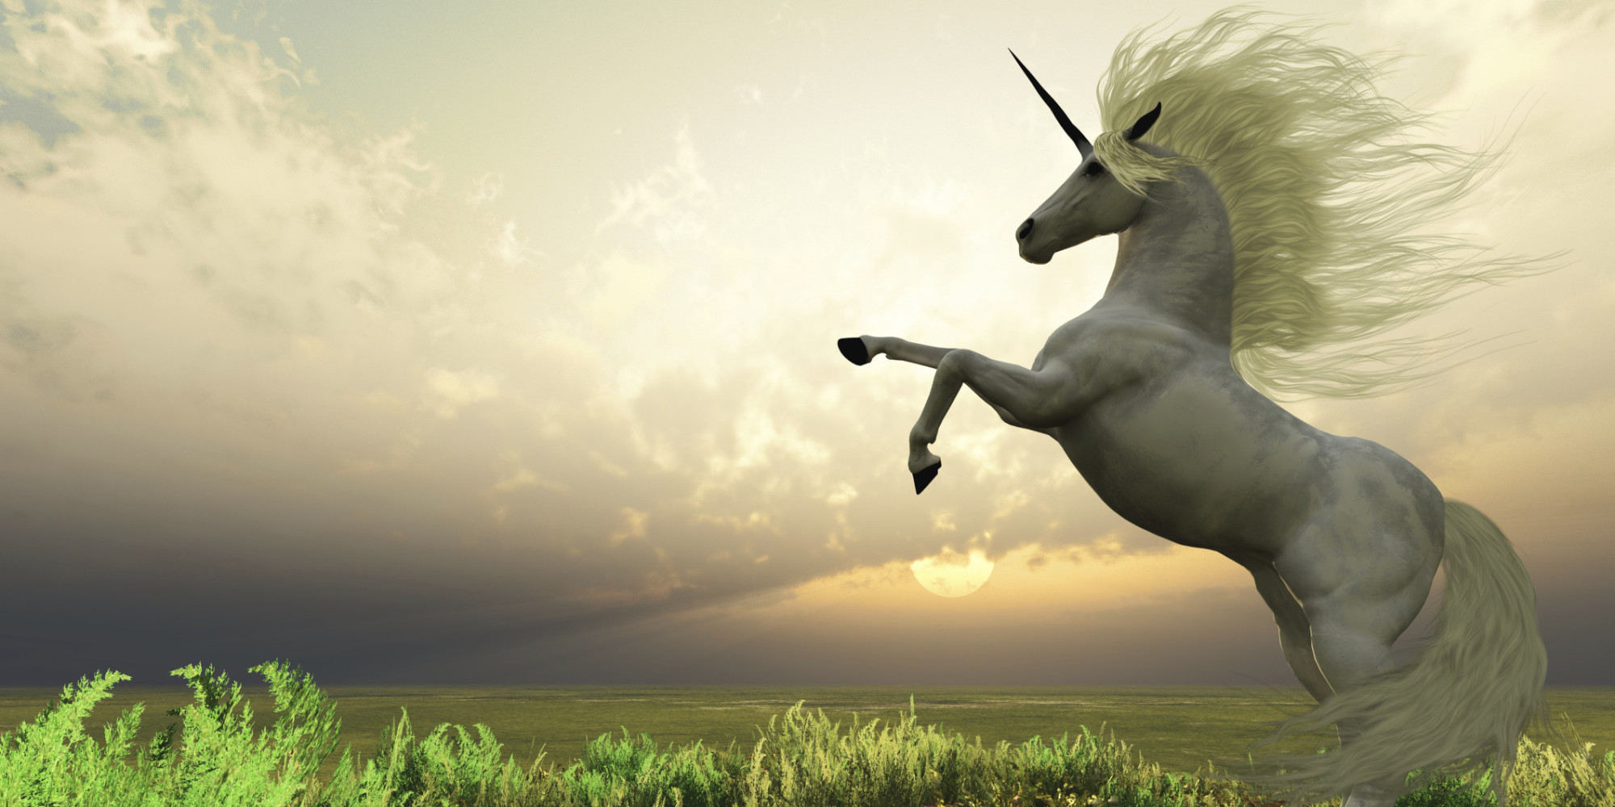
Unicorn
Scotland

Slide 27
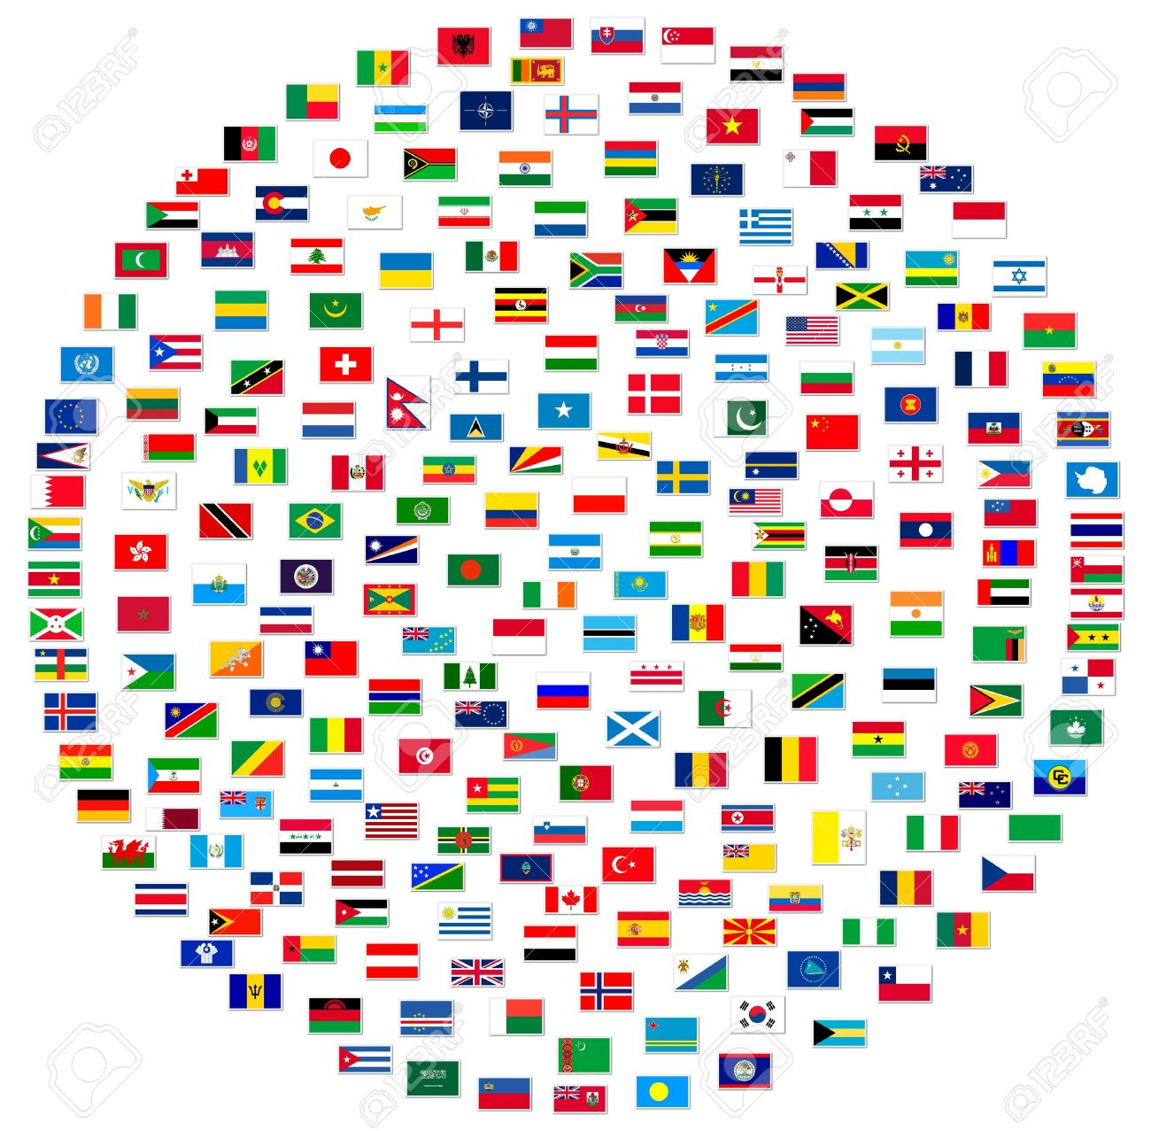
National Symbols – Flag

Slide 28
National Flags Quiz
http://world-geography-games.com/flags_asia.swf

Slide 29
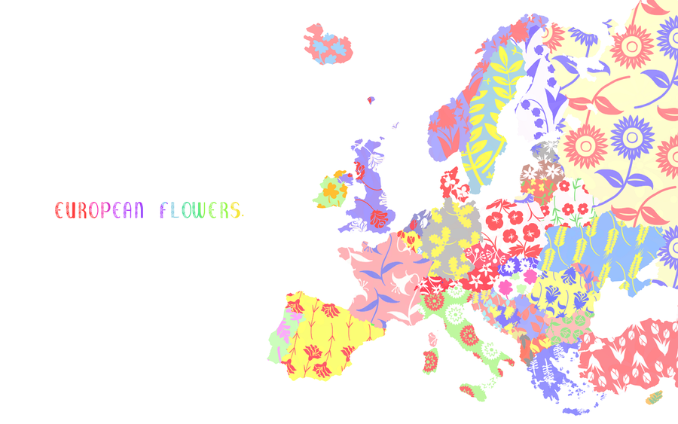
National Symbols – National Flower

Slide 30
Holidays
What are some holidays celebrated around the world?

Slide 31
Traditional
Traditional clothes

