Slide 1
Prefix / Suffix

Slide 2
What is a root word?
http://www.teachingandlearningresources.co.uk/rootwords.shtml

Slide 3
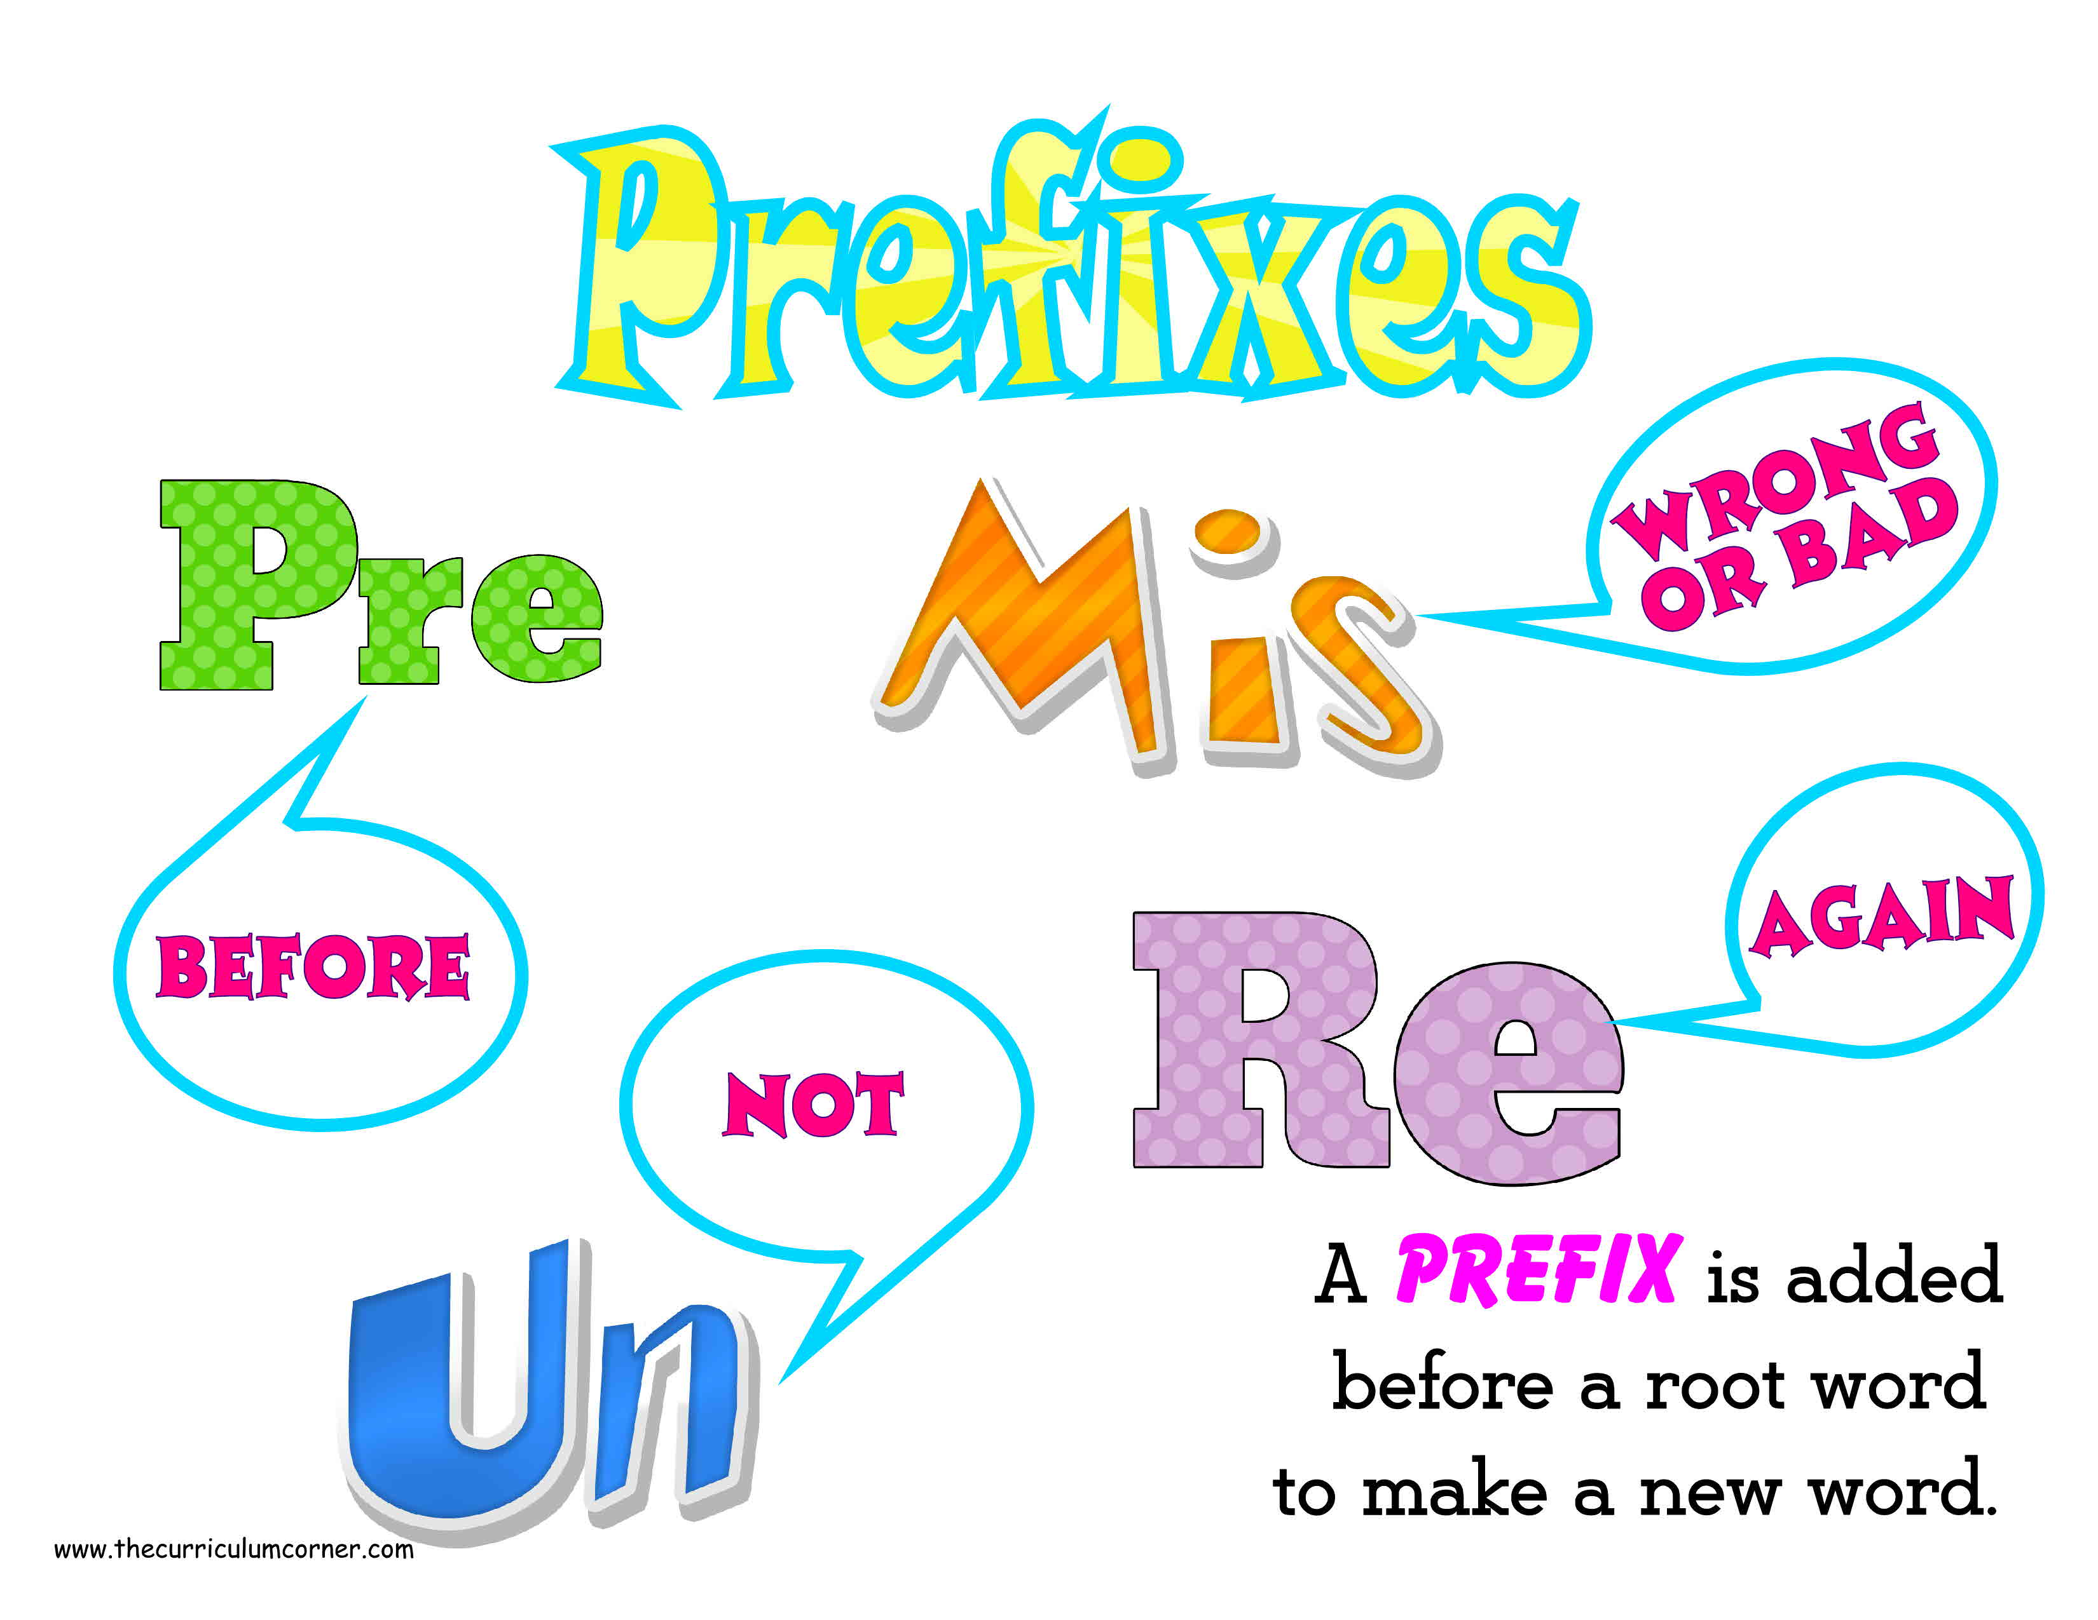

Slide 6
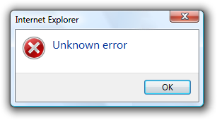
Able =
I can do it
Unable =
I can’t do it

Slide 7
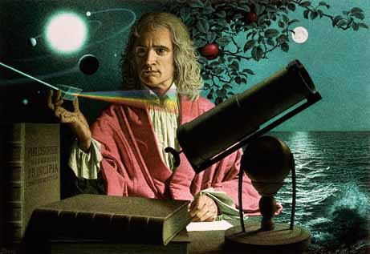
Wise =
smart, knowledgeable
Unwise =
Not smart, stupid

Slide 8
Capable =
I can do it.
Incapable =
I can’t do it.

Slide 9
Animate =
It moves.
Inanimate =
It doesn’t move.

Slide 10
Sane =
Not crazy
Insane =
Crazy

Slide 11
Active =
Moves a lot
Inactive =
Doesn’t move

Slide 12
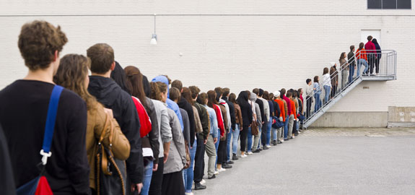
Patient =
I can wait.
Impatient =
I can’t wait.

Slide 13
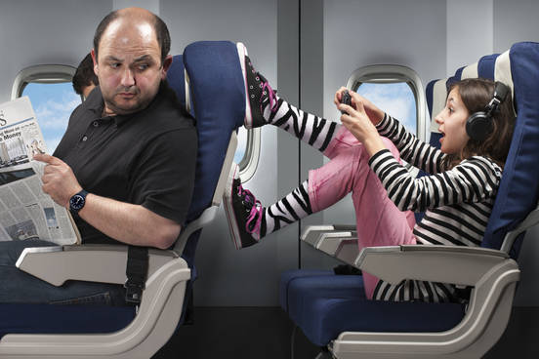
Polite =
Nice, not mean
Impolite =
Not nice, mean

Slide 14
Mortal =
I can die.
Immortal =
I can’t die.

Slide 15
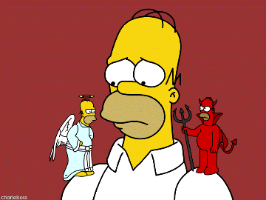
Moral =
What you SHOULD do. Good.
Immoral =
What you shouldn’t do. Bad.

Slide 16
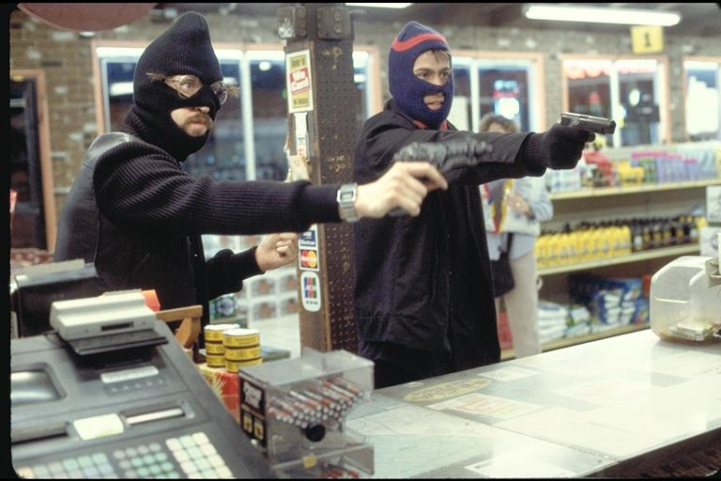
Legal =
I follow the rules.
Illegal =
I don’t follow the rules.

Slide 17
Logical =
It makes sense.
Illogical =
It doesn’t make sense.

Slide 18
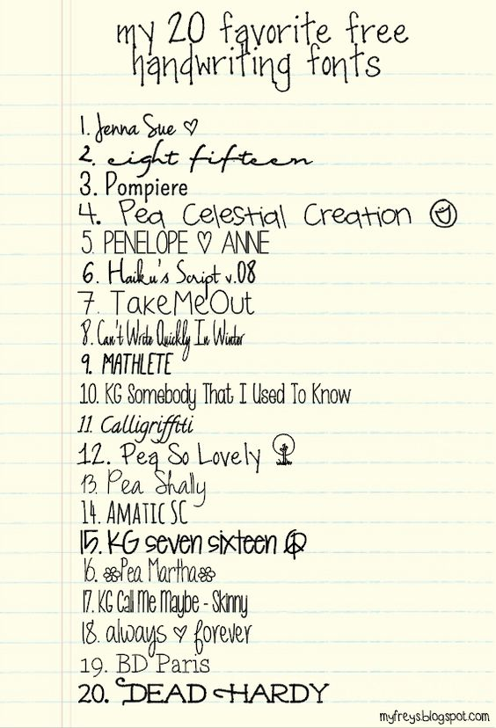
Legible =
I can read it.
Illegible =
I can’t read it.

Slide 19
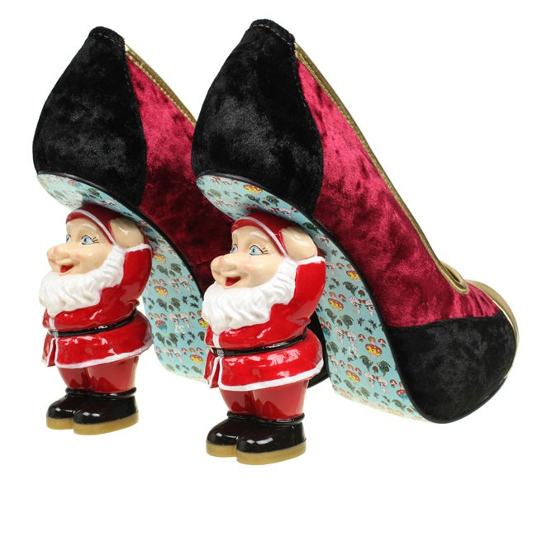
Regular =
Normal
Irregular =
Not normal

Slide 20
Reversible =
It can be changed back.
Irreversible =
It can’t be changed.

Slide 21
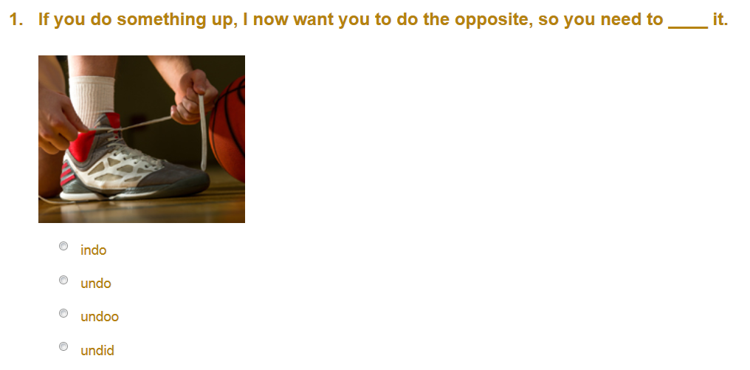
Undo
Notes:
http://www.educationquizzes.com/ks1/english-spelling/year-1-prefix-un/

Slide 22
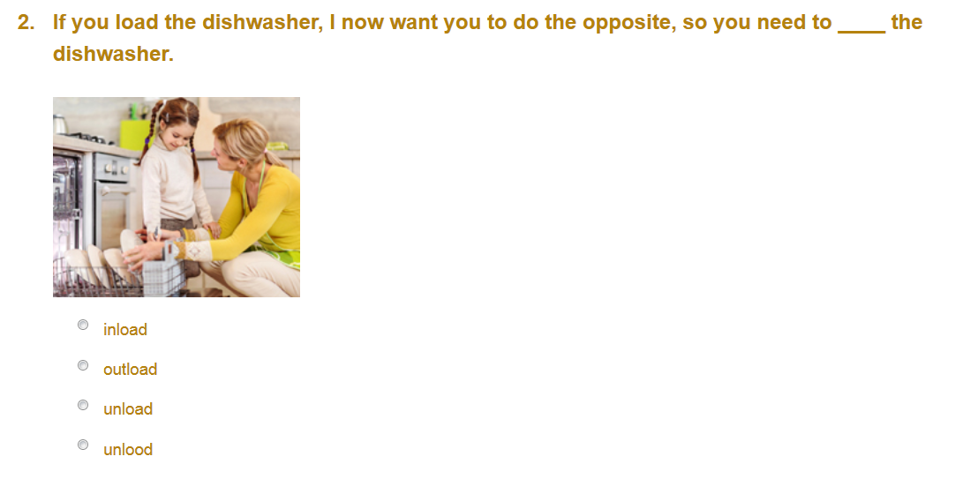
Unload
Notes:
http://www.educationquizzes.com/ks1/english-spelling/year-1-prefix-un/

Slide 23
Unfair
Notes:
http://www.educationquizzes.com/ks1/english-spelling/year-1-prefix-un/

Slide 24
Unlock
Notes:
http://www.educationquizzes.com/ks1/english-spelling/year-1-prefix-un/

Slide 25
Undone
Notes:
http://www.educationquizzes.com/ks1/english-spelling/year-1-prefix-un/

Slide 26
Unable
Notes:
http://www.educationquizzes.com/ks1/english-spelling/year-1-prefix-un/

Slide 27
Unfit
Notes:
http://www.educationquizzes.com/ks1/english-spelling/year-1-prefix-un/

Slide 28
Unkind
Notes:
http://www.educationquizzes.com/ks1/english-spelling/year-1-prefix-un/

Slide 29
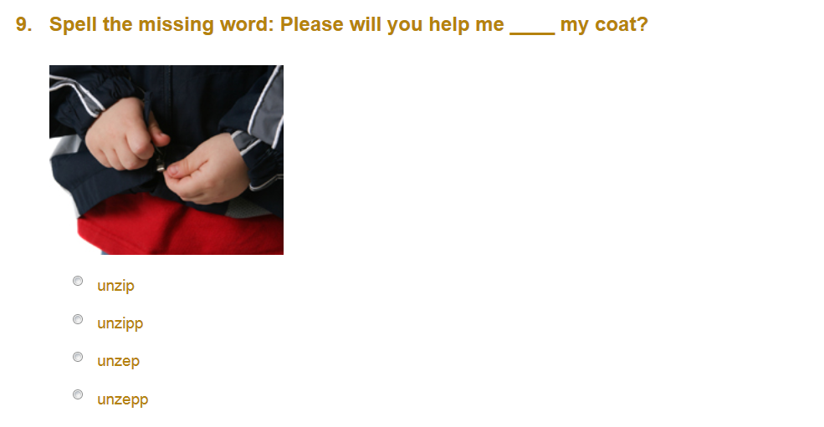
Unzip
Notes:
http://www.educationquizzes.com/ks1/english-spelling/year-1-prefix-un/

Slide 30
Unwell
Notes:
http://www.educationquizzes.com/ks1/english-spelling/year-1-prefix-un/

Slide 31
Re -
Do it again.

Slide 32
Pre -
Before

Slide 33
Post -
After
Mail

Slide 34
Co -
Together

Slide 35
Ex -
Not anymore

Slide 36
Non -
Not, without

Slide 37
Super -
Better, more.

Slide 38
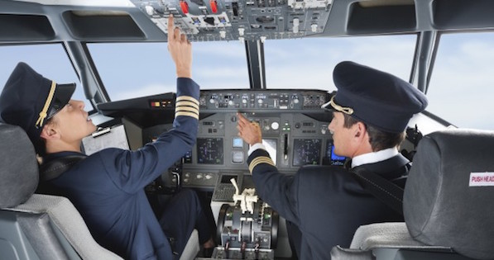
What’s his job?

Slide 39
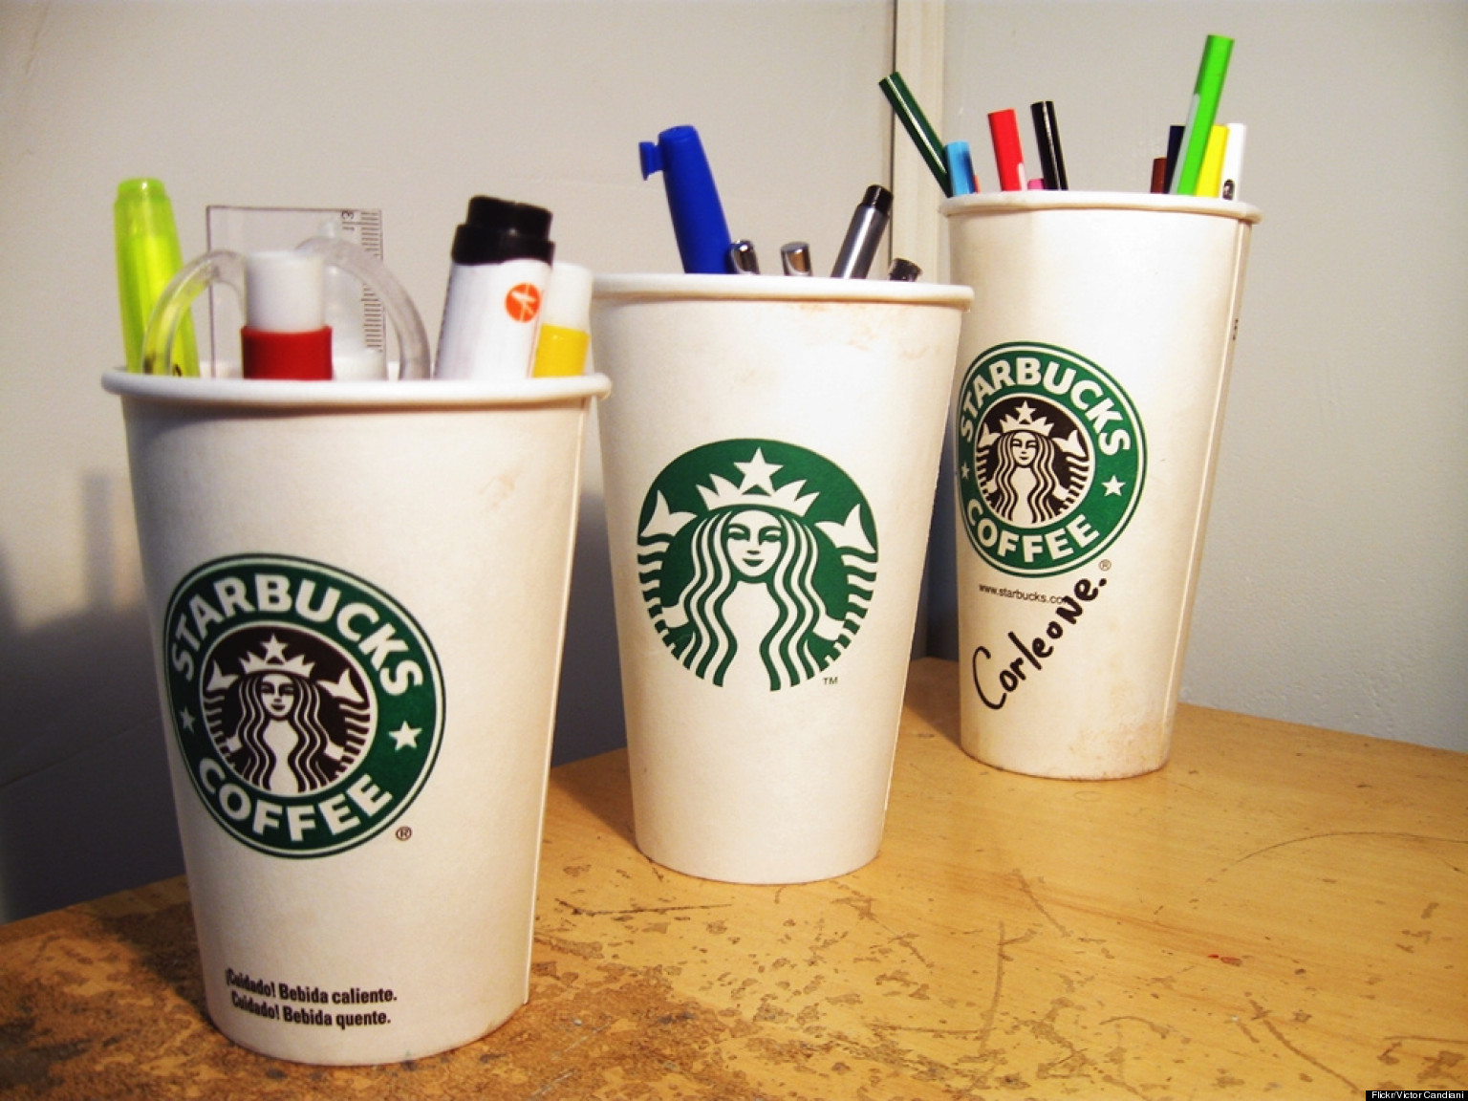

Slide 40
This doesn’t make sense.

Slide 41
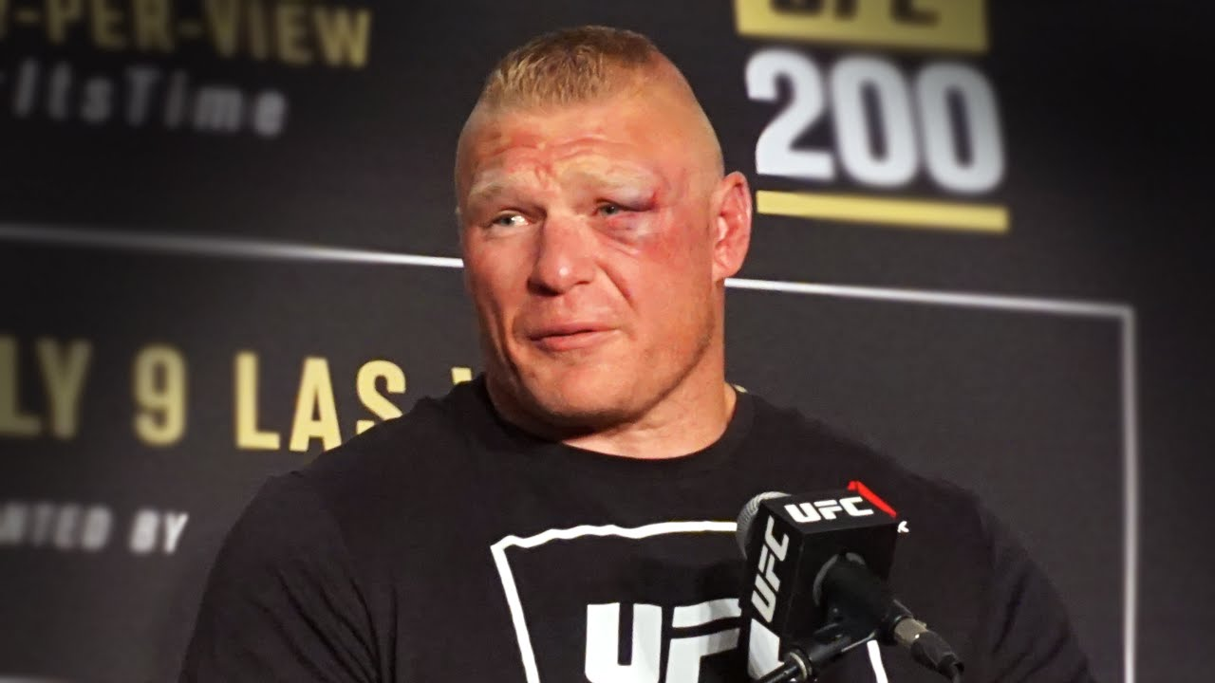

Slide 42
What does preview mean?

Slide 43
Existent means that is there.
The picture is ______________.

Slide 44
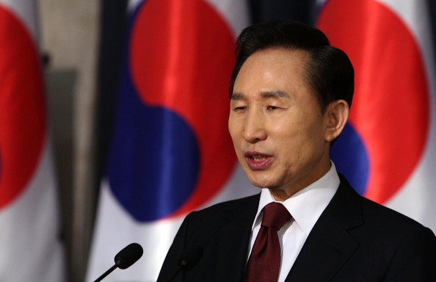
He is the ____________.

Slide 45
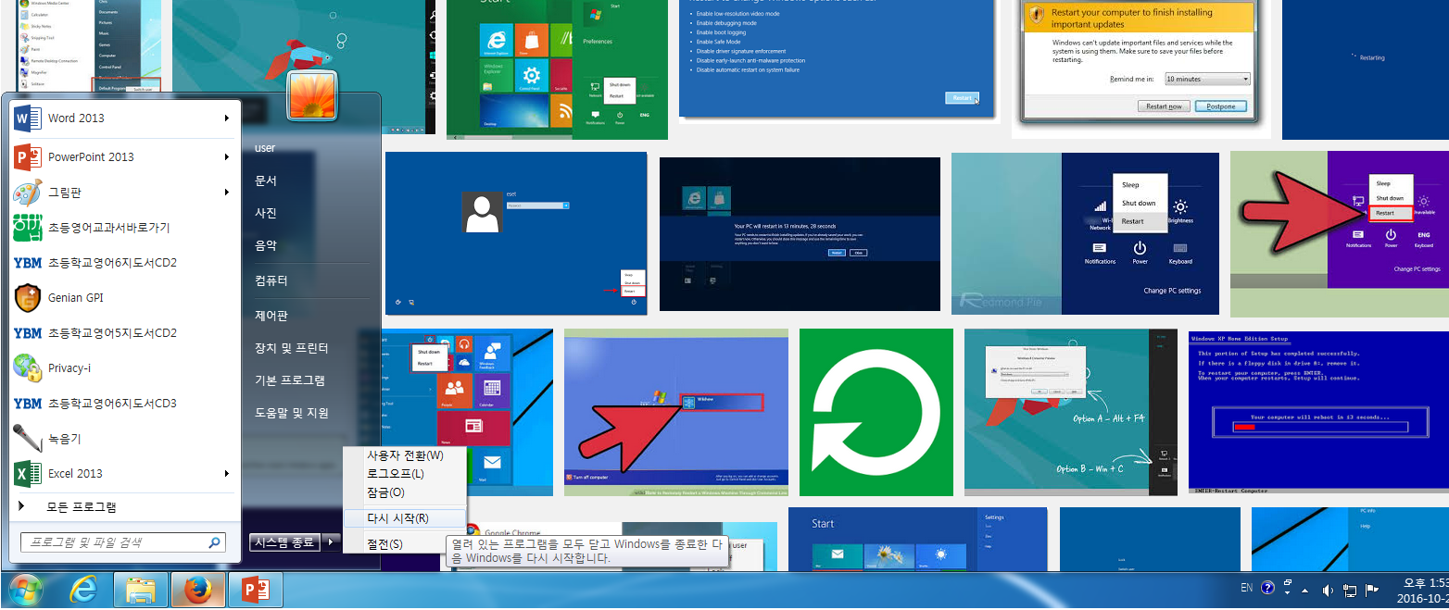
What does this mean?

Slide 46
This car is faster than most cars

Slide 47
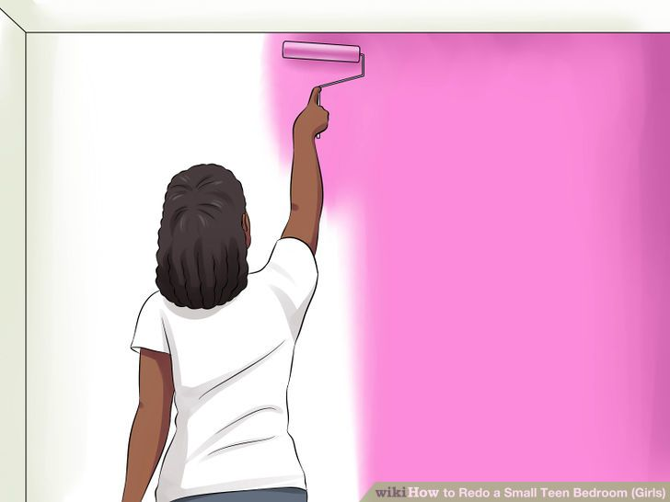

Slide 48
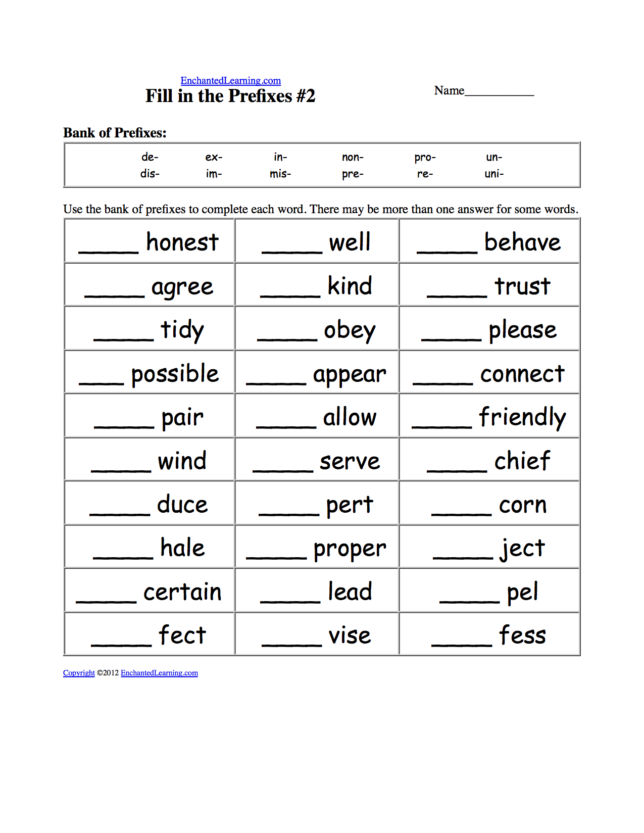
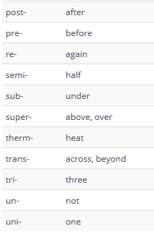
Notes:
http://www.myenglishteacher.eu/blog/prefixes-suffixes-list/

