Slide 1
Design a Country

Slide 2
National Sports

Slide 3
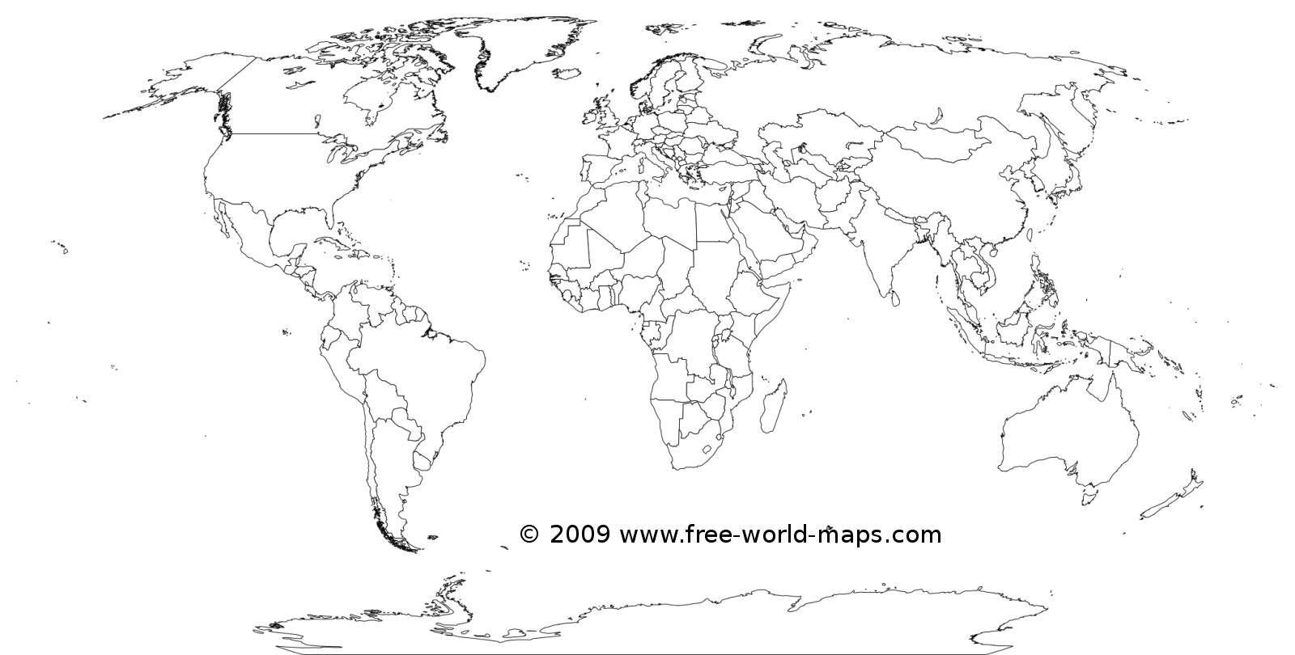
Color each sport:

Slide 4
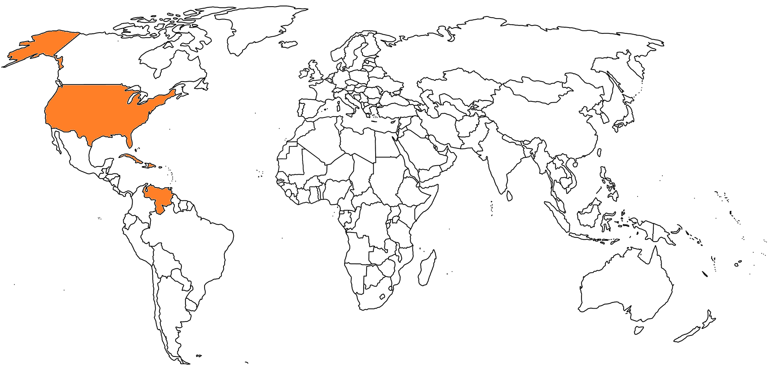
Baseball
Cuba
Dominican Republic
United States of America
Venezuela

Slide 5
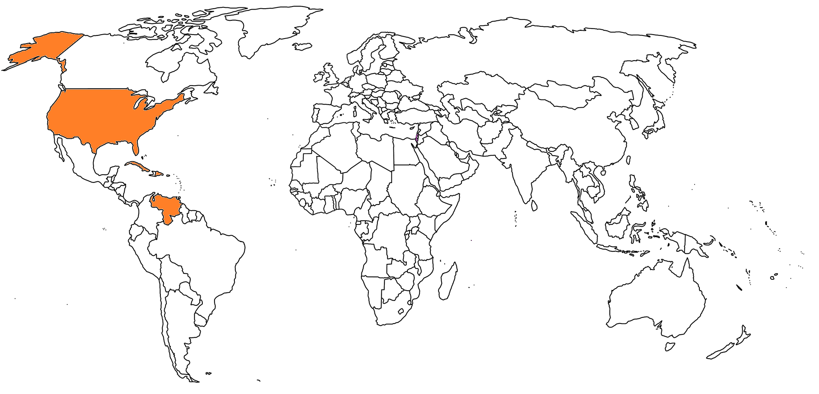
Soccer (Football)
Israel
Mauritius

Slide 6
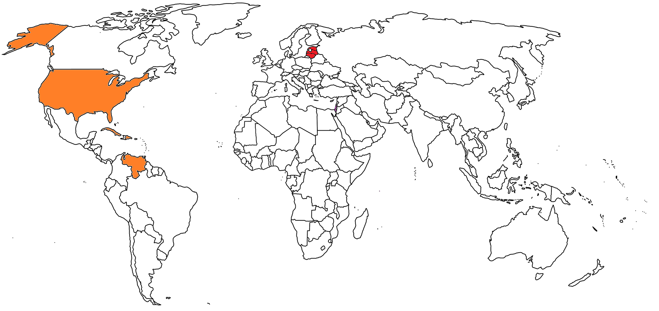
Basketball
Estonia
Latvia
Lithuania

Slide 7
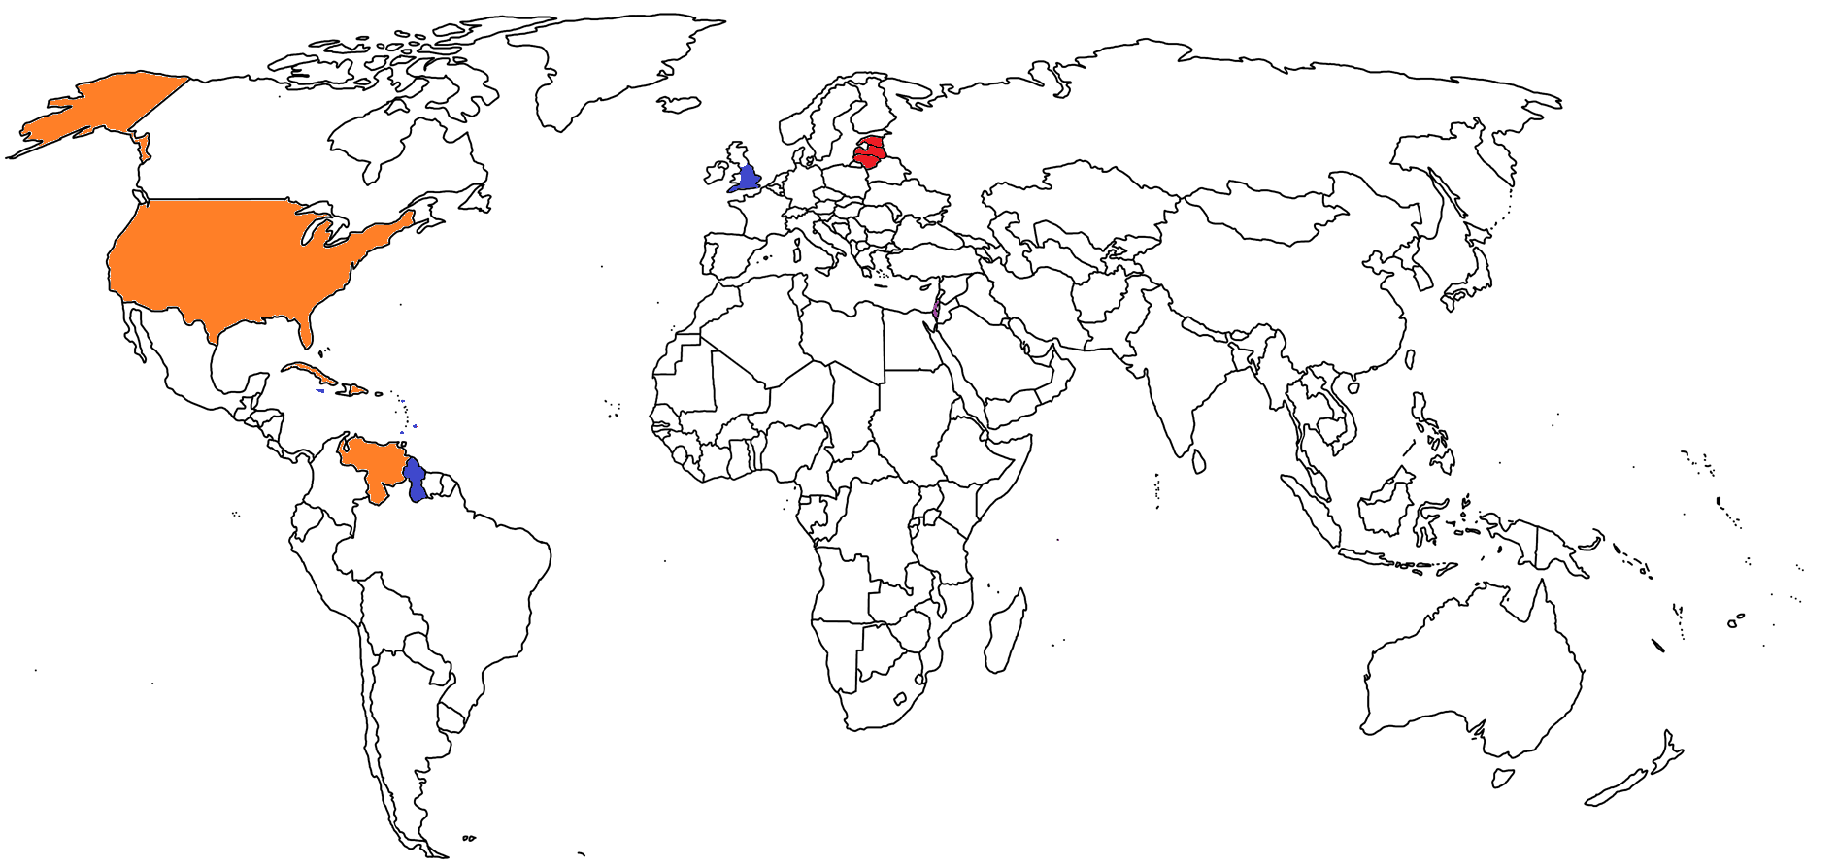
Cricket
Antigua and Barbuda
Barbados
Bermuda
England
Grenada
Guyana
Jamaica

Slide 8
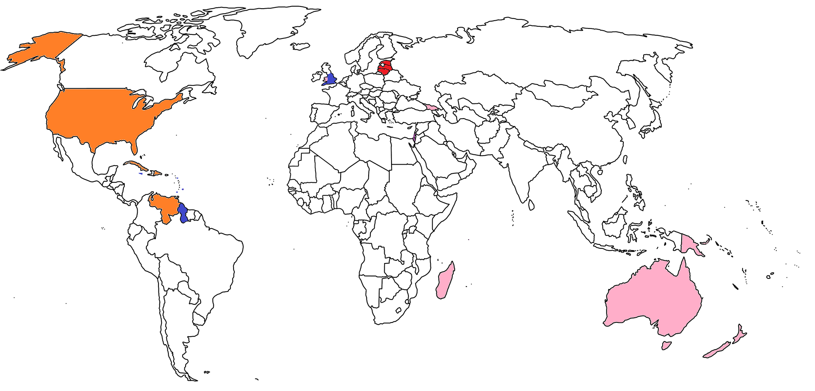
Rugby
Australia (Aussie Rules)
Georgia
Madagascar
New Zealand
Papua New Guinea
Wales

Slide 9
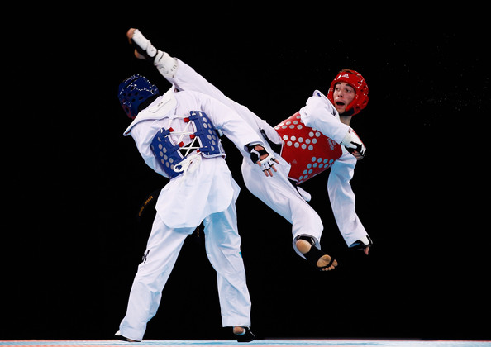
Taekwondo
Korea

Slide 10
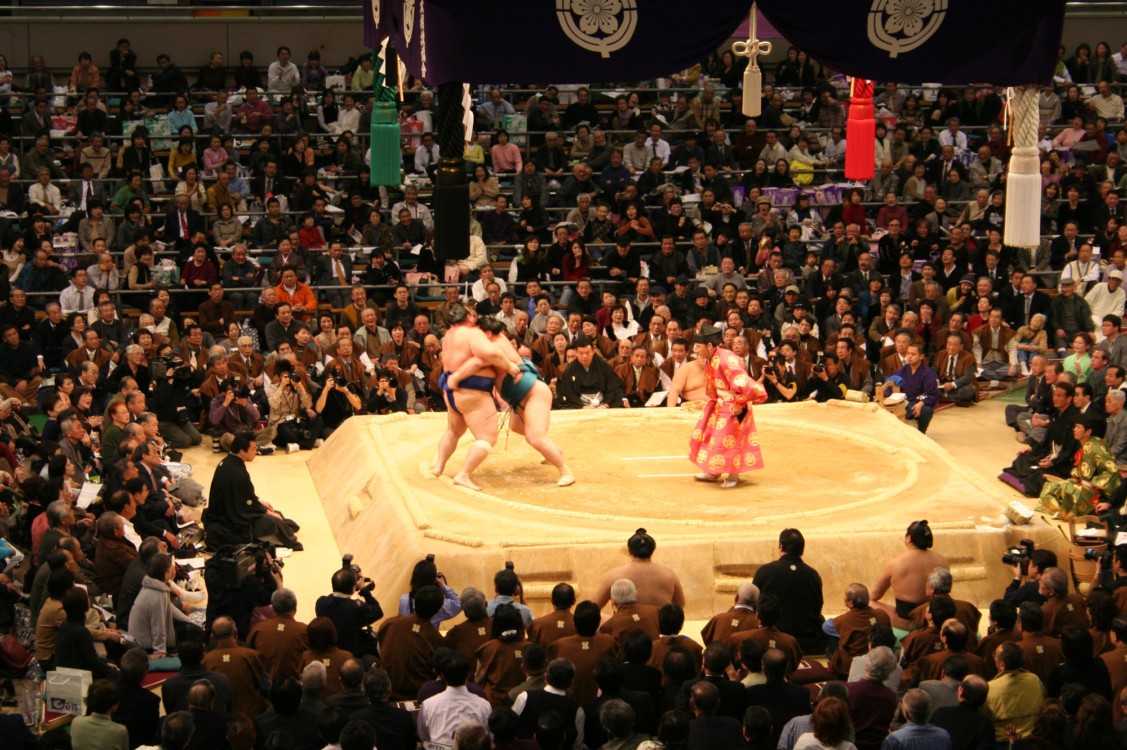
Sumo Wrestling
Japan

Slide 11
Golf
Scotland

Slide 12
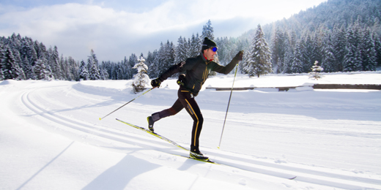
Cross-Country Skiing
Norway

Slide 13
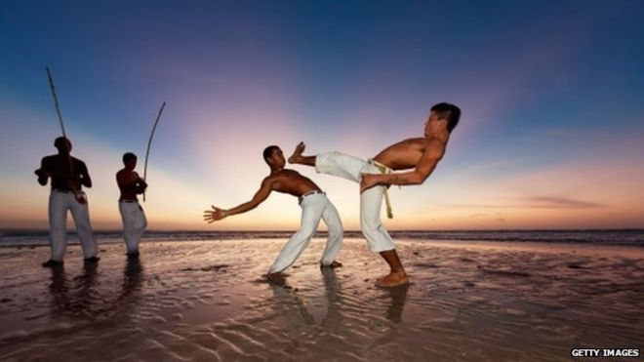
Capoeira
Brazil

Slide 14
Lacrosse
Canada

Slide 15
Field Hockey
Pakistan

Slide 16
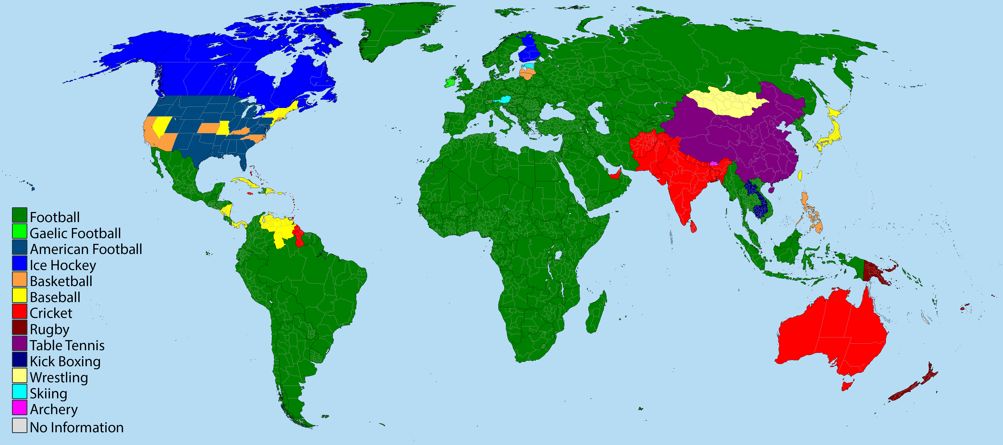
Most popular sports in each country:

Slide 17
National Flower / National Tree

Slide 18
Rose
Cyprus
Czech Republic
Ecuador
Iraq
Iran
Luxembourg
Maldives
Romania
Slovakia
Slovenia
Spain
USA

Slide 19
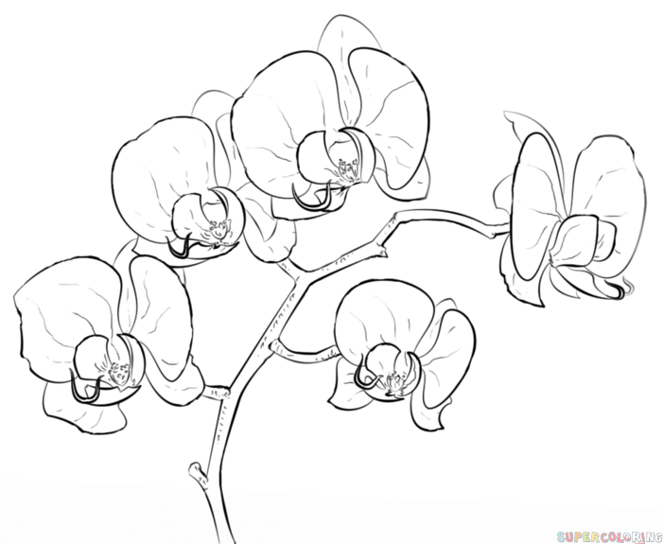
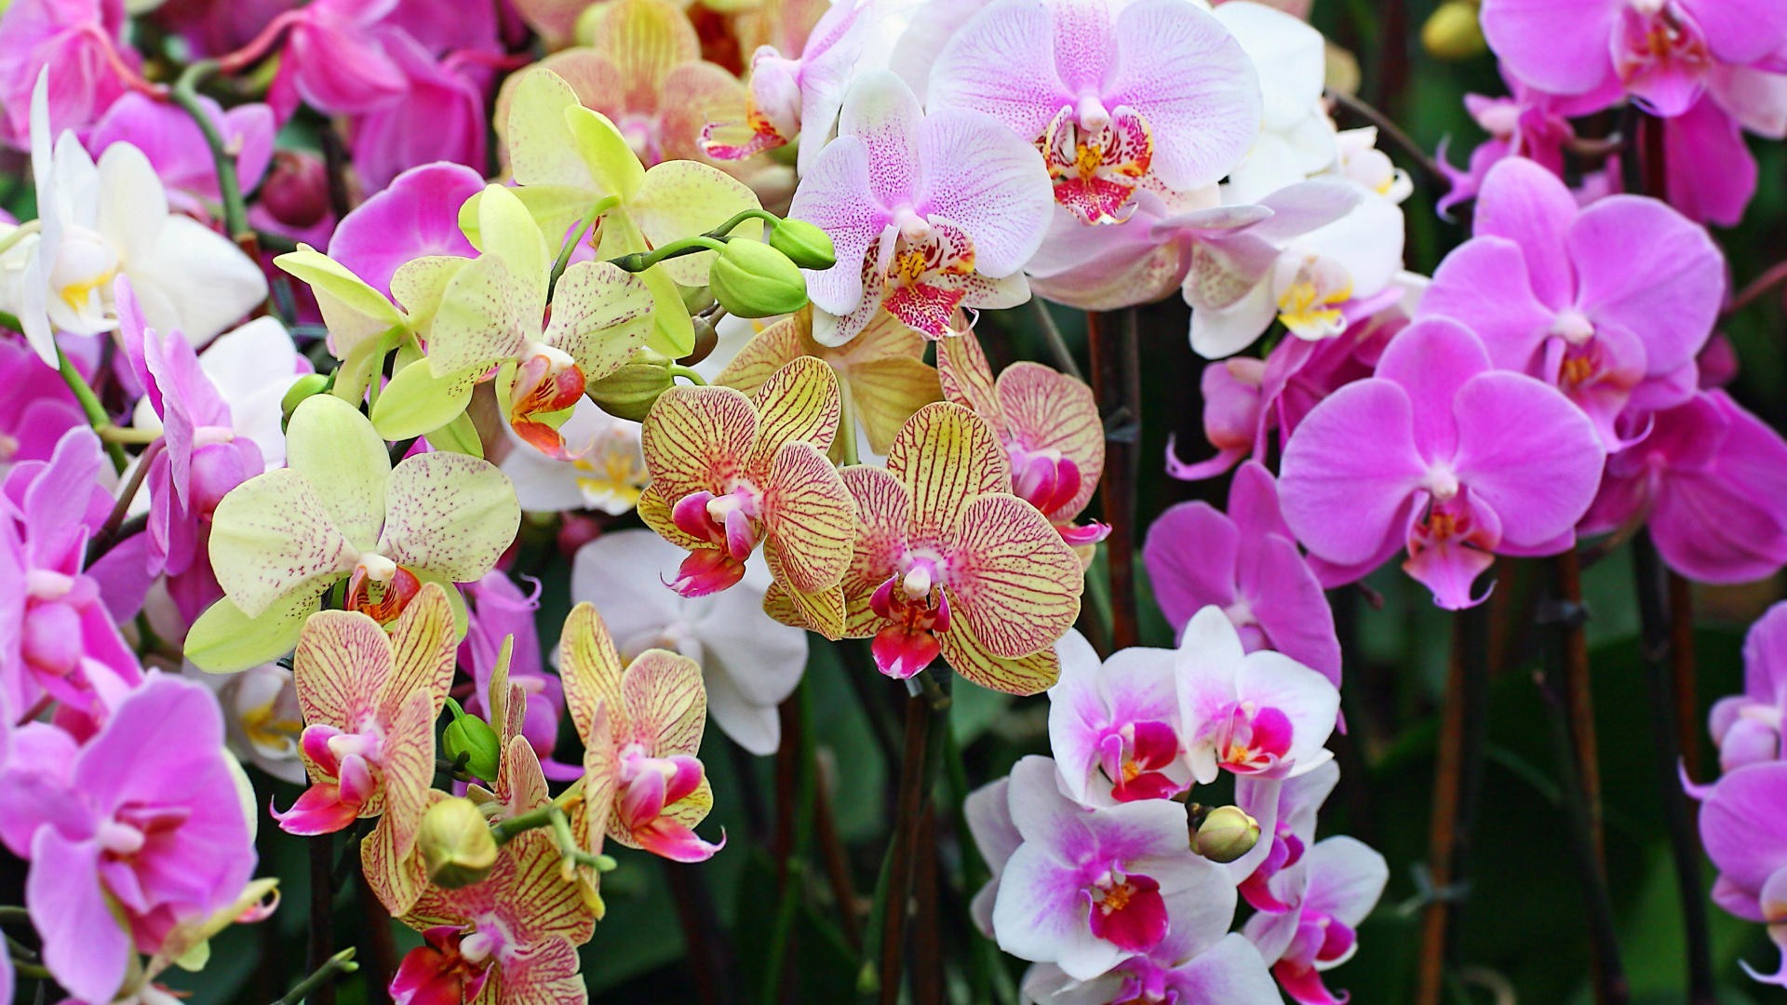
Orchid
Belize
Brazil
Cayman Islands
Colombia
Guatemala
Honduras
Hong Kong
Singapore
Venezuela

Slide 20
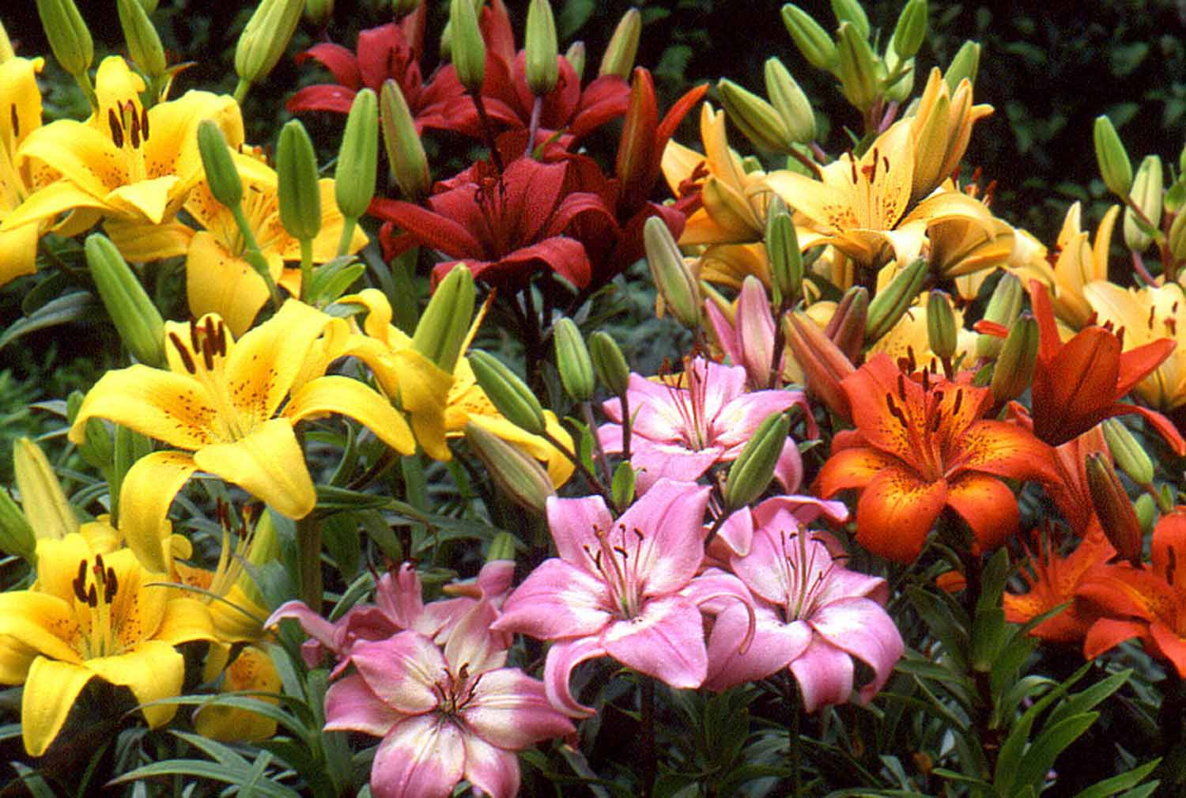
Lily
Italy
Kazakhstan
Zimbabwe

Slide 21
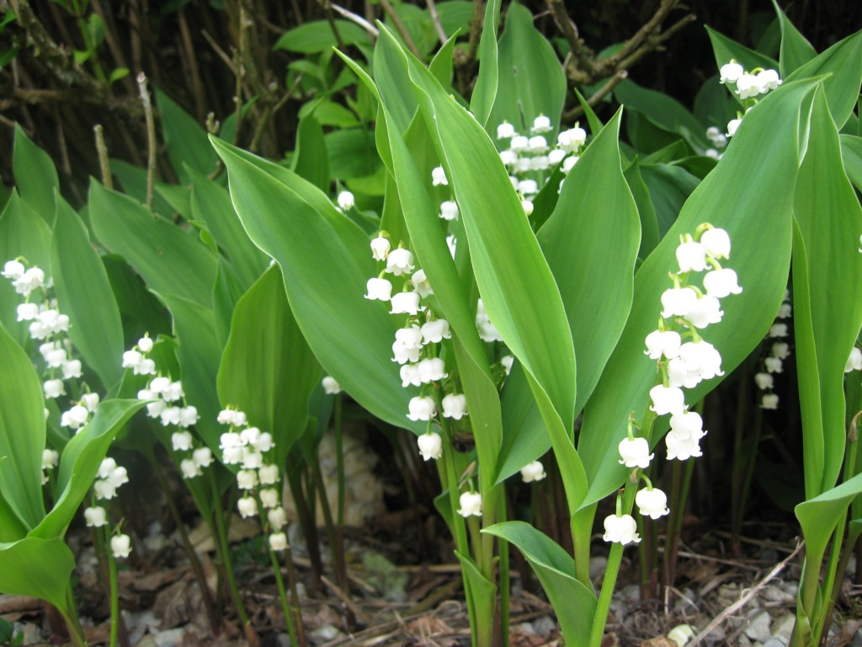
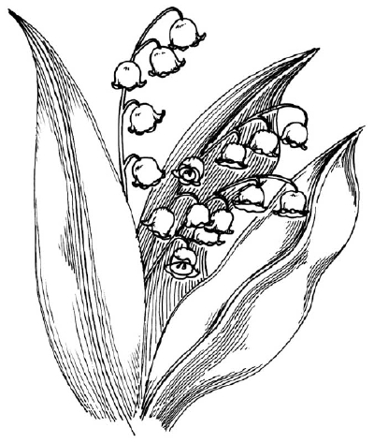
Lily-of-the-Valley
Finland
Yugoslavia

Slide 22
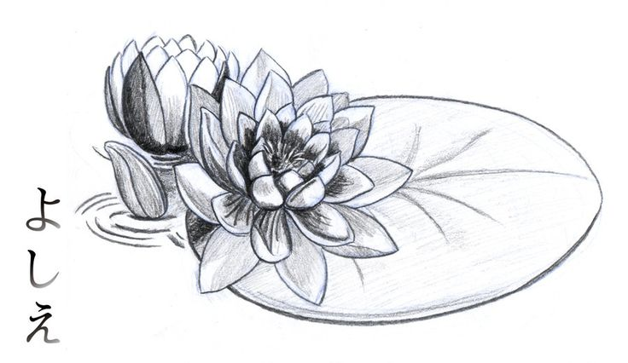
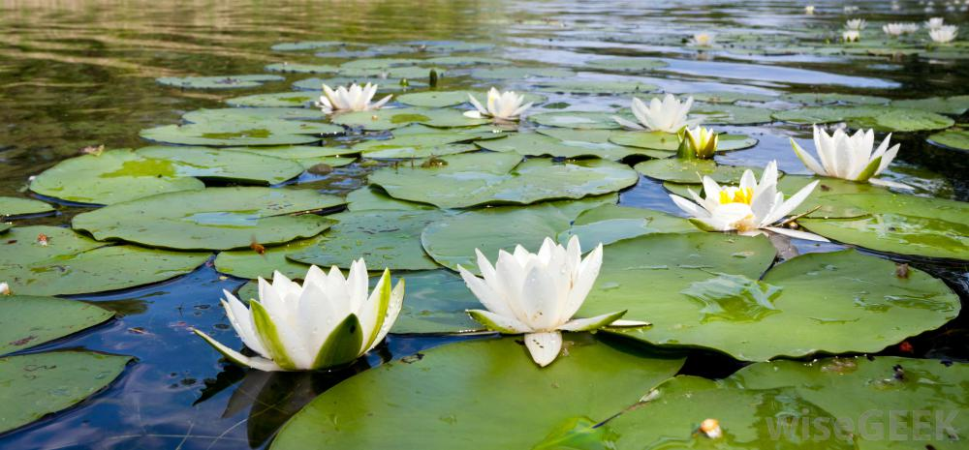
Water Lily
Bangladesh
Guyana
Sri Lanka

Slide 23
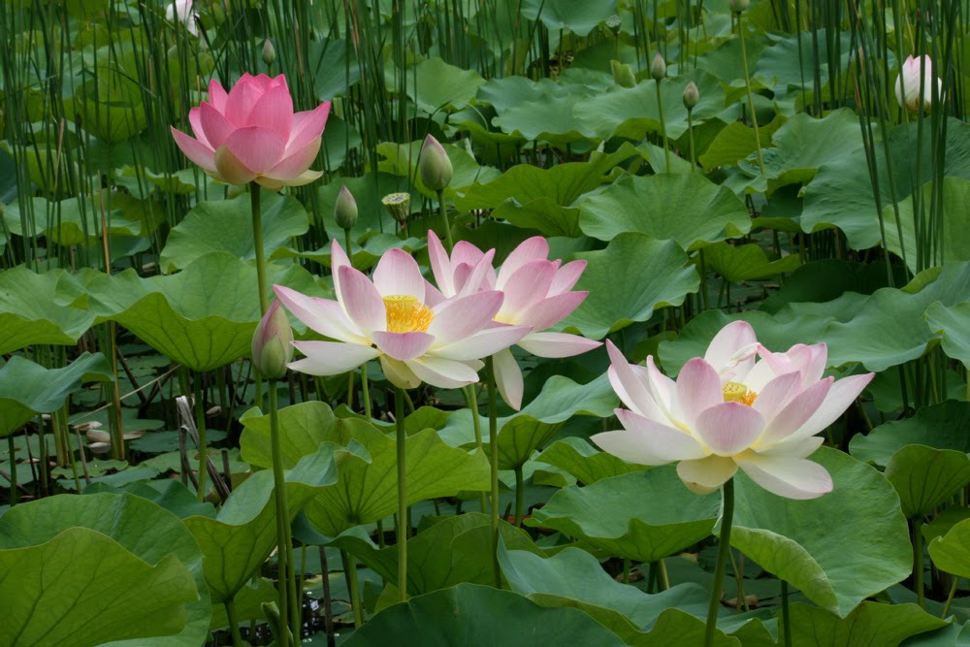
Lotus
Egypt
India

Slide 24
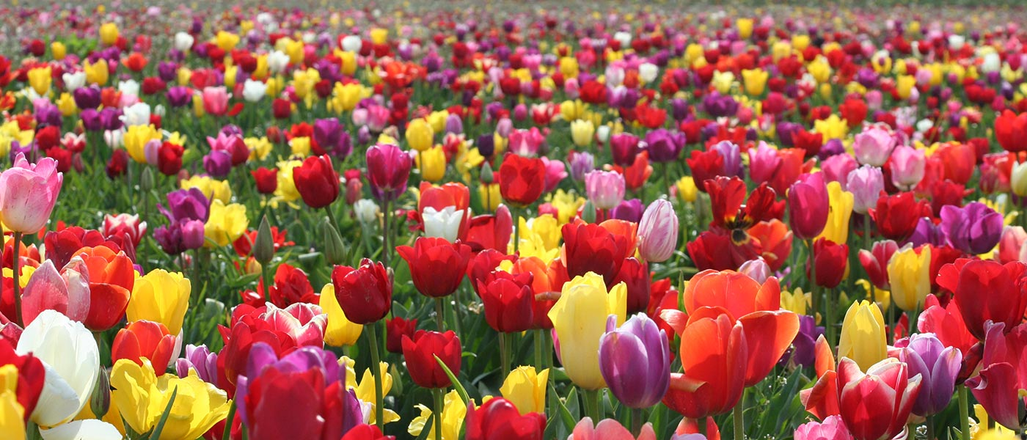
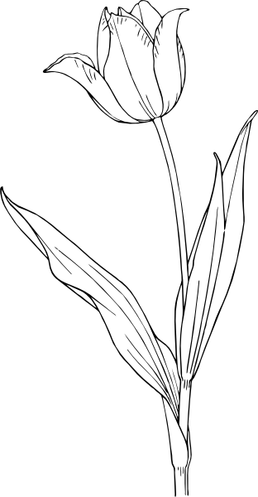
Tulip
Netherlands
Hungary
Kyrgyzstan
Turkey

Slide 25
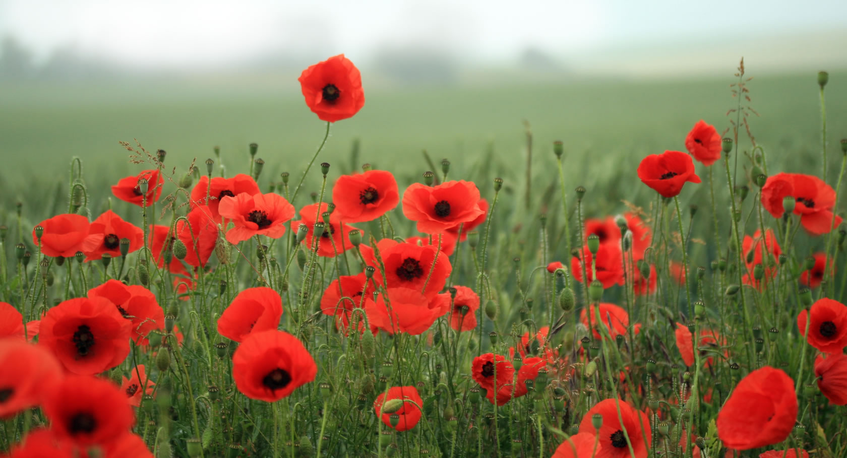
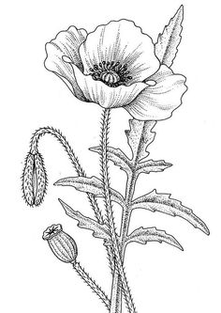
Poppy
Belgium
Bhutan
Poland

Slide 26
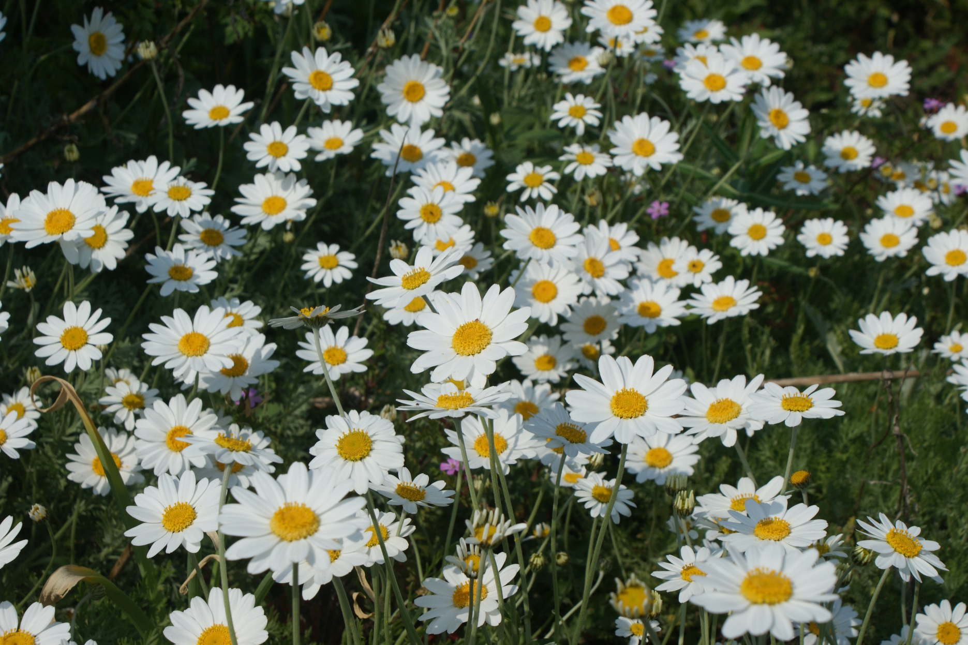
Daisy
Denmark
Latvia

Slide 27
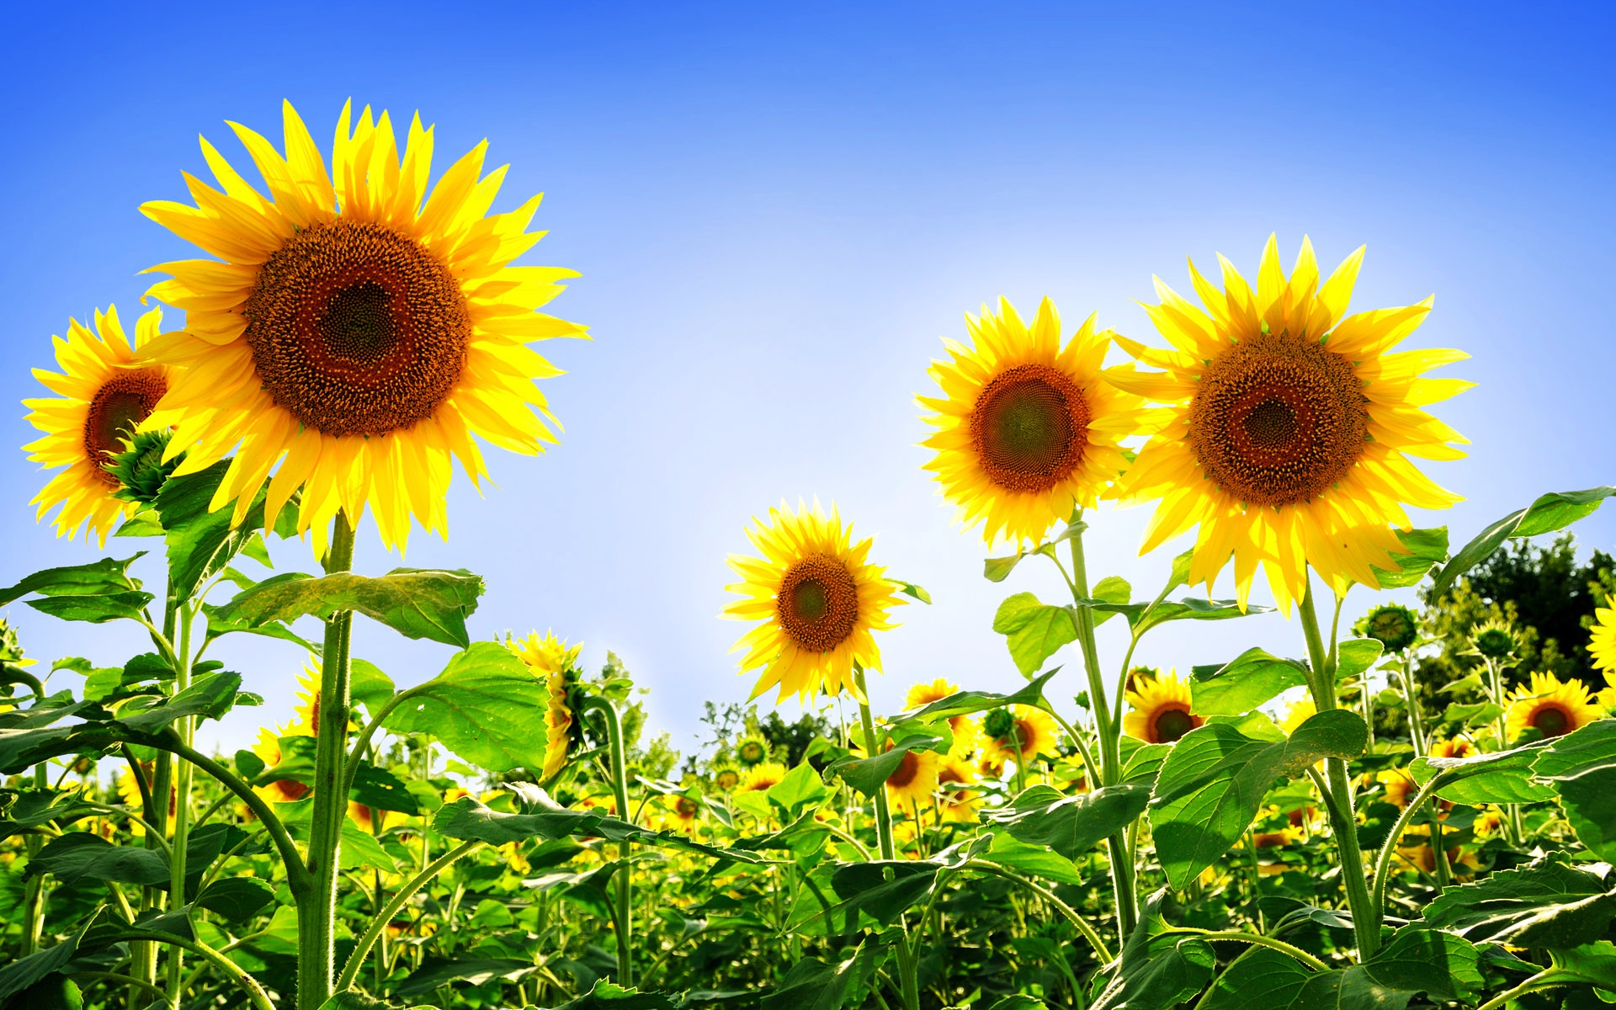
Sunflower
Ukraine

Slide 28
What is Korea’s National Flower?

Slide 29
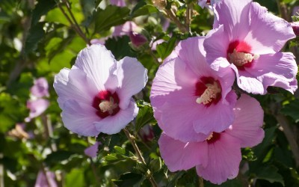
Korea – Rose of Sharon

Slide 30
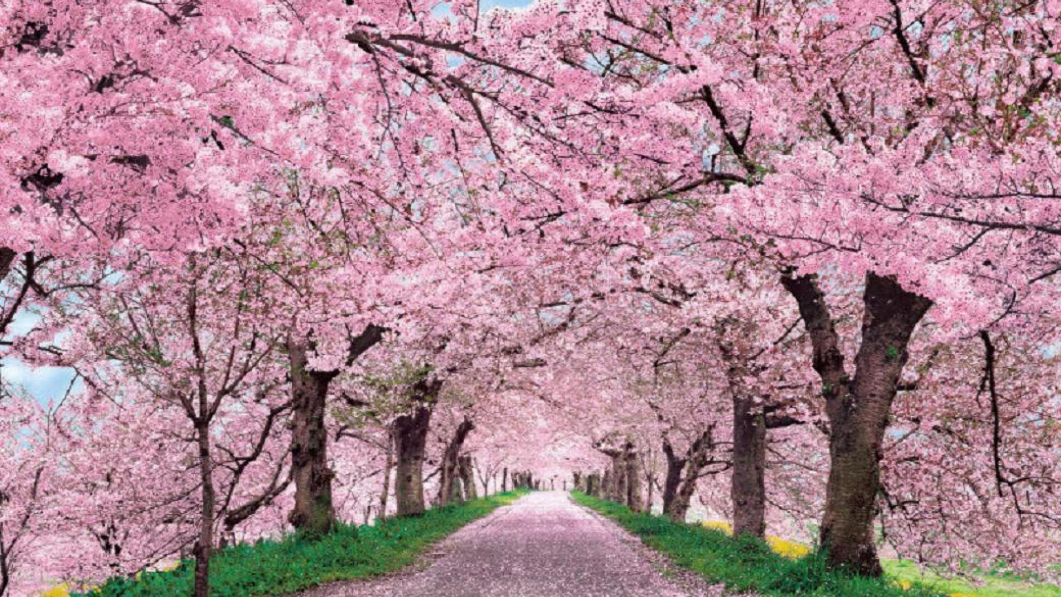
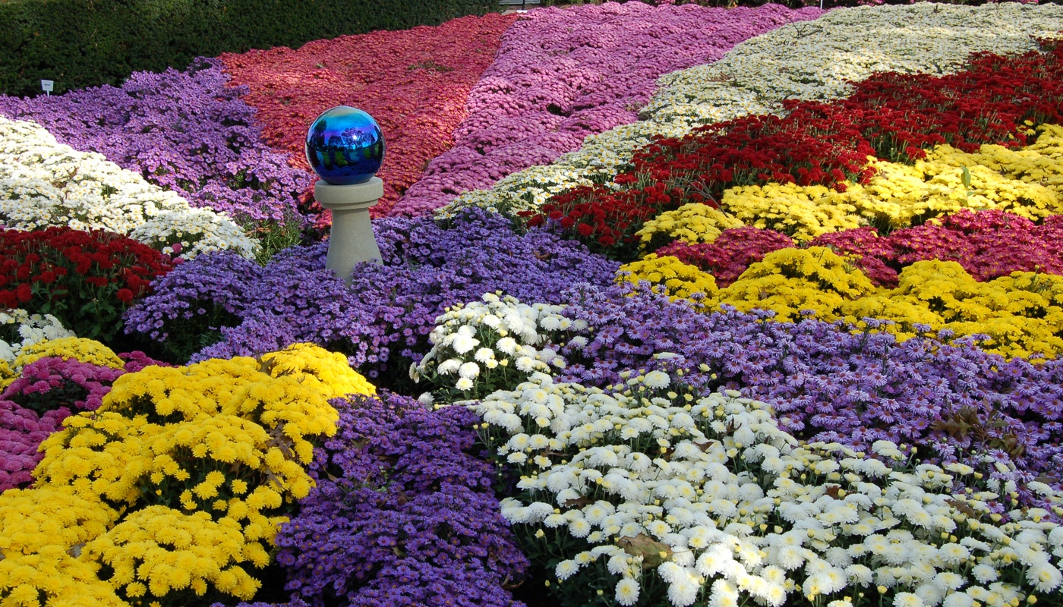
Japan – Cherry Blossom / Chrysanthemum

Slide 31
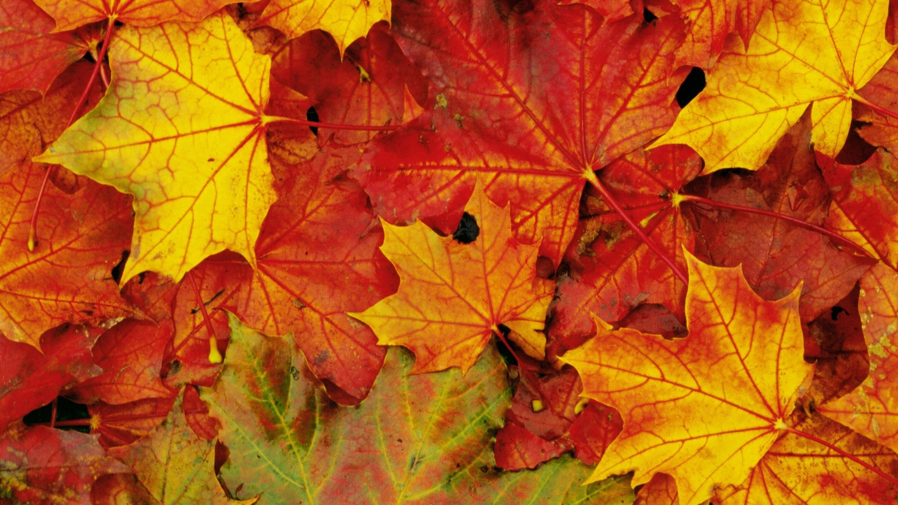
Canada – Maple Leaf

Slide 32
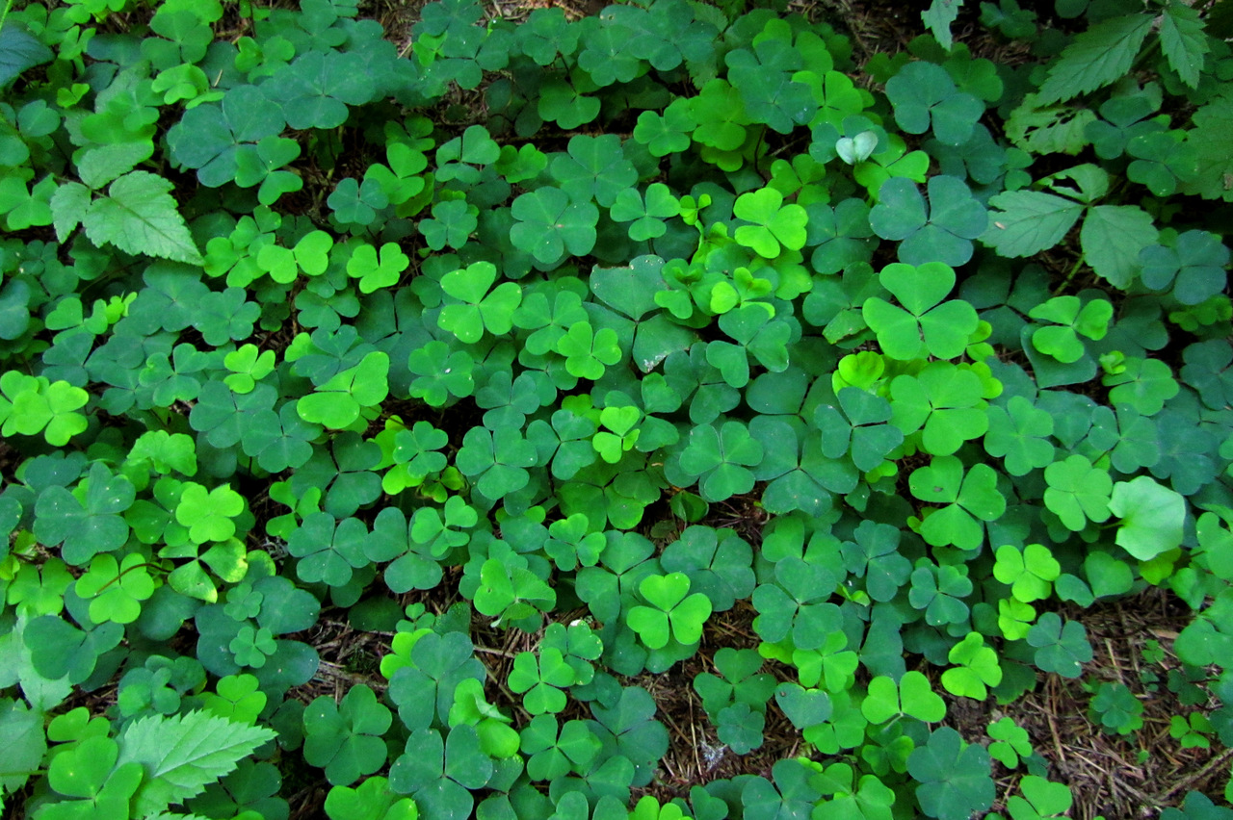
Ireland – Shamrock

Slide 33
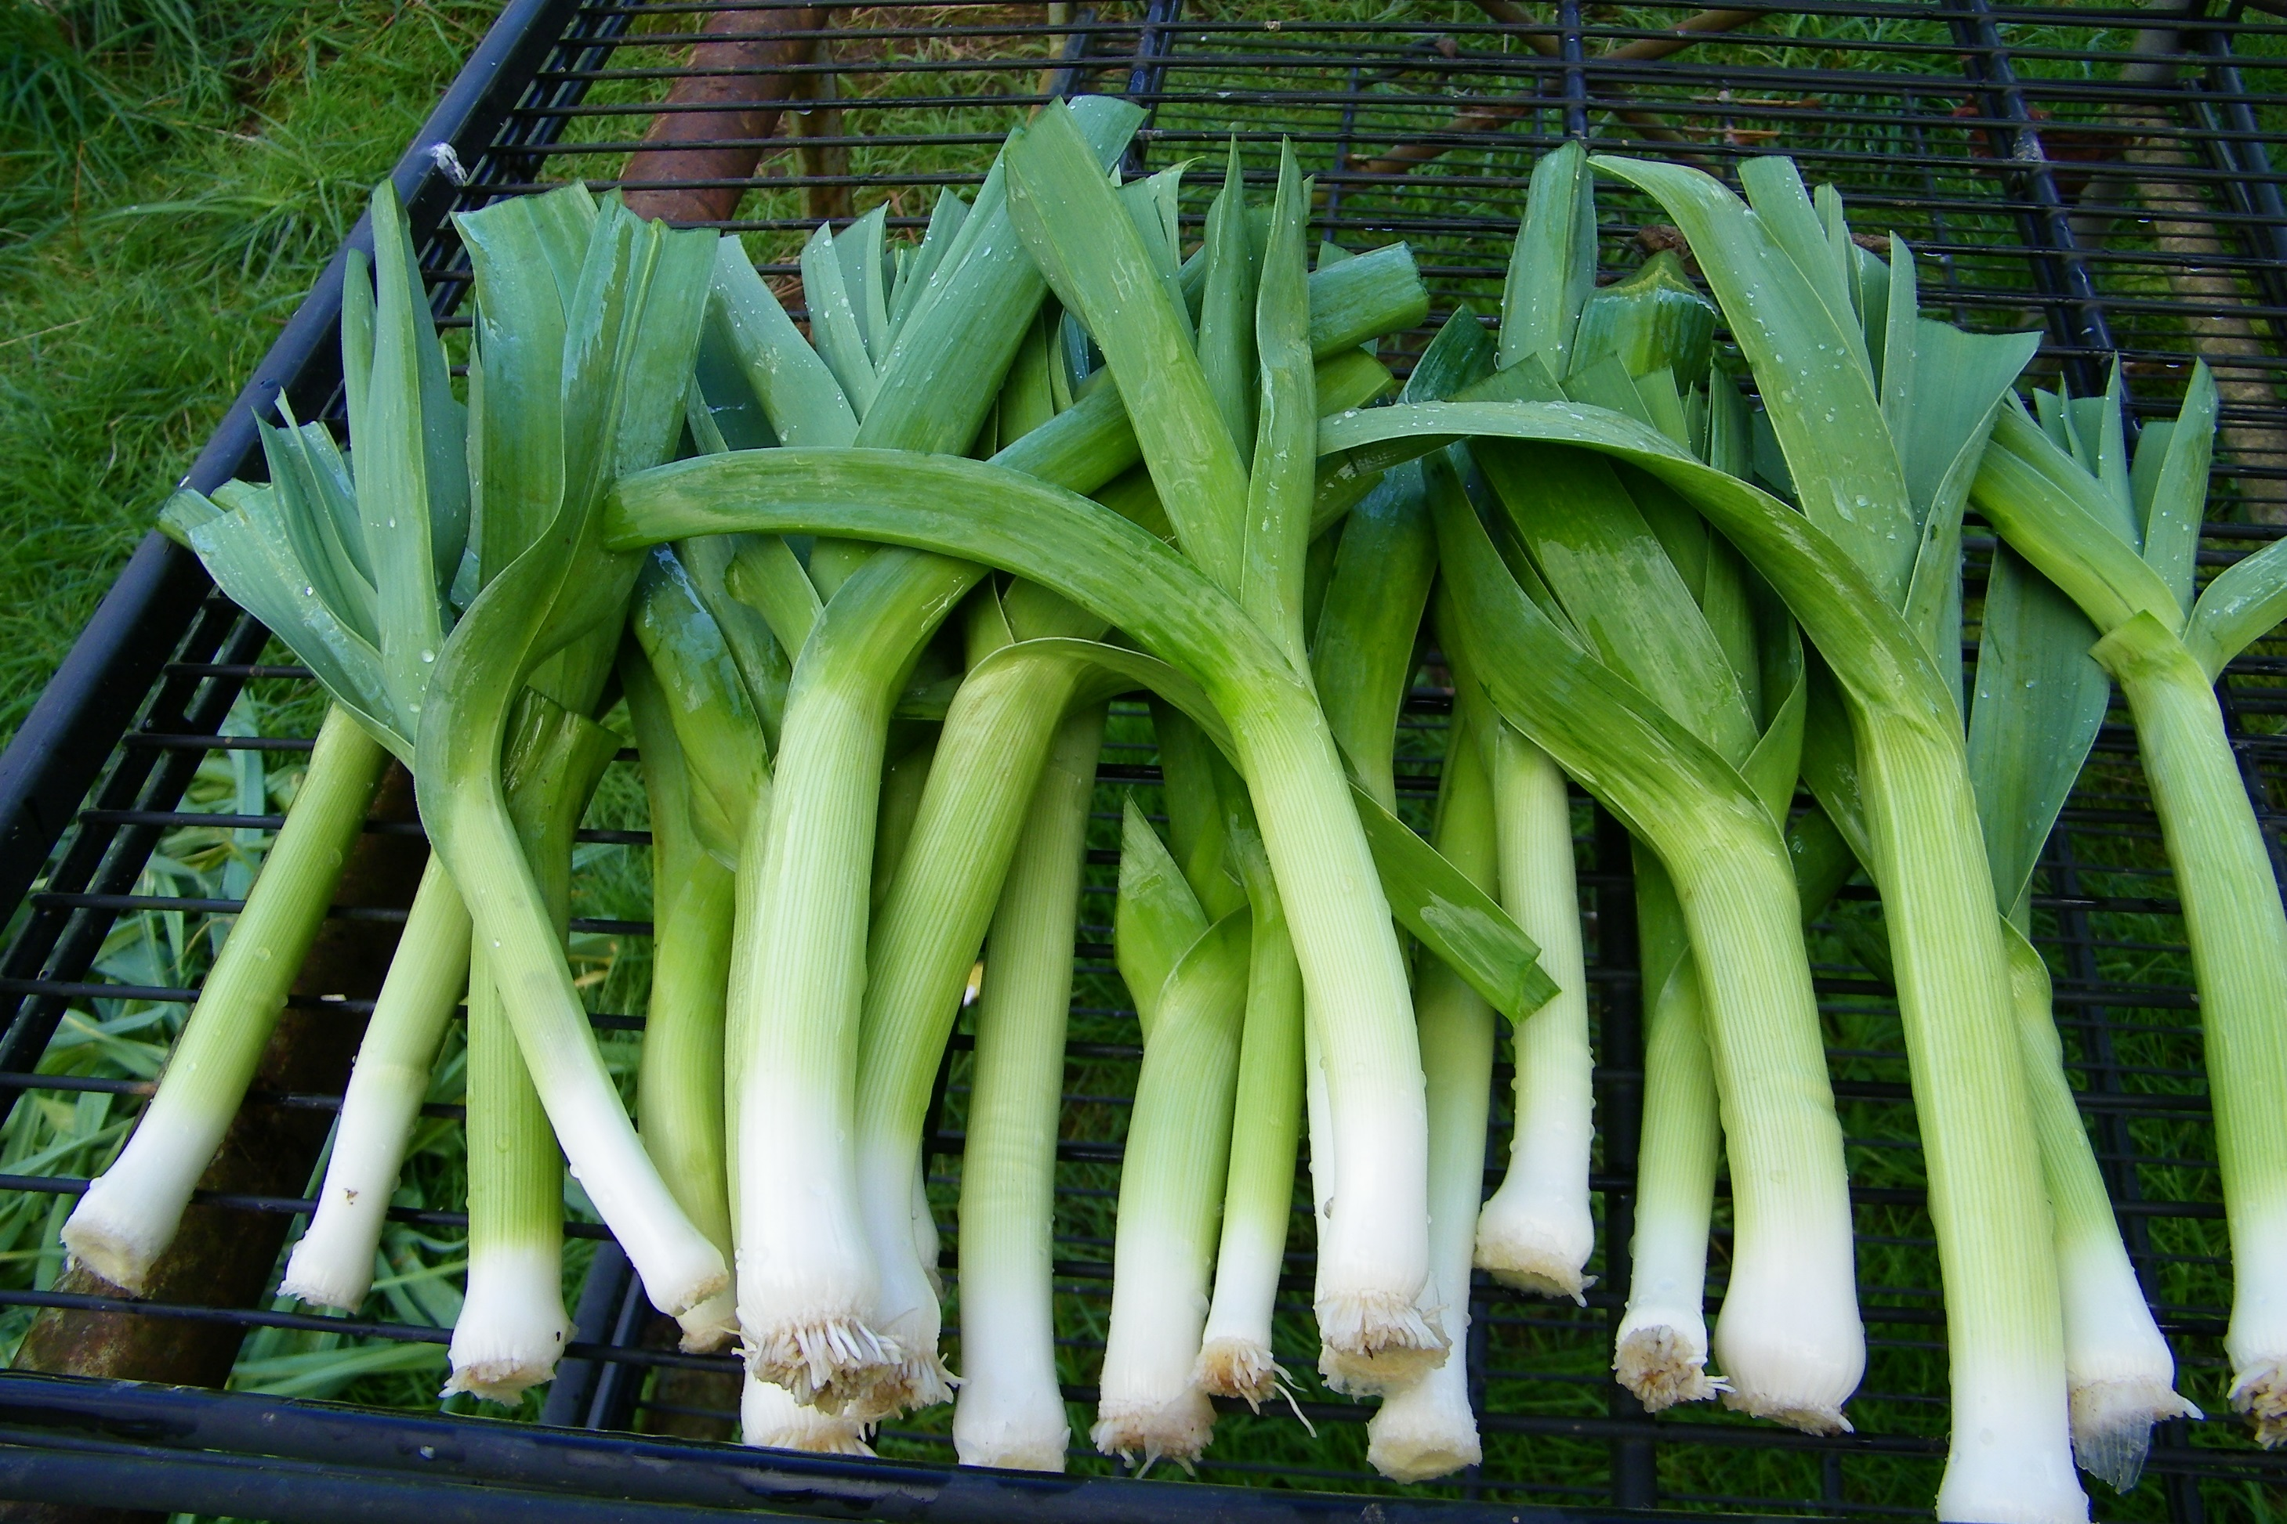
Wales – Leek

Slide 34
Design Your Own Country

