Slide 1
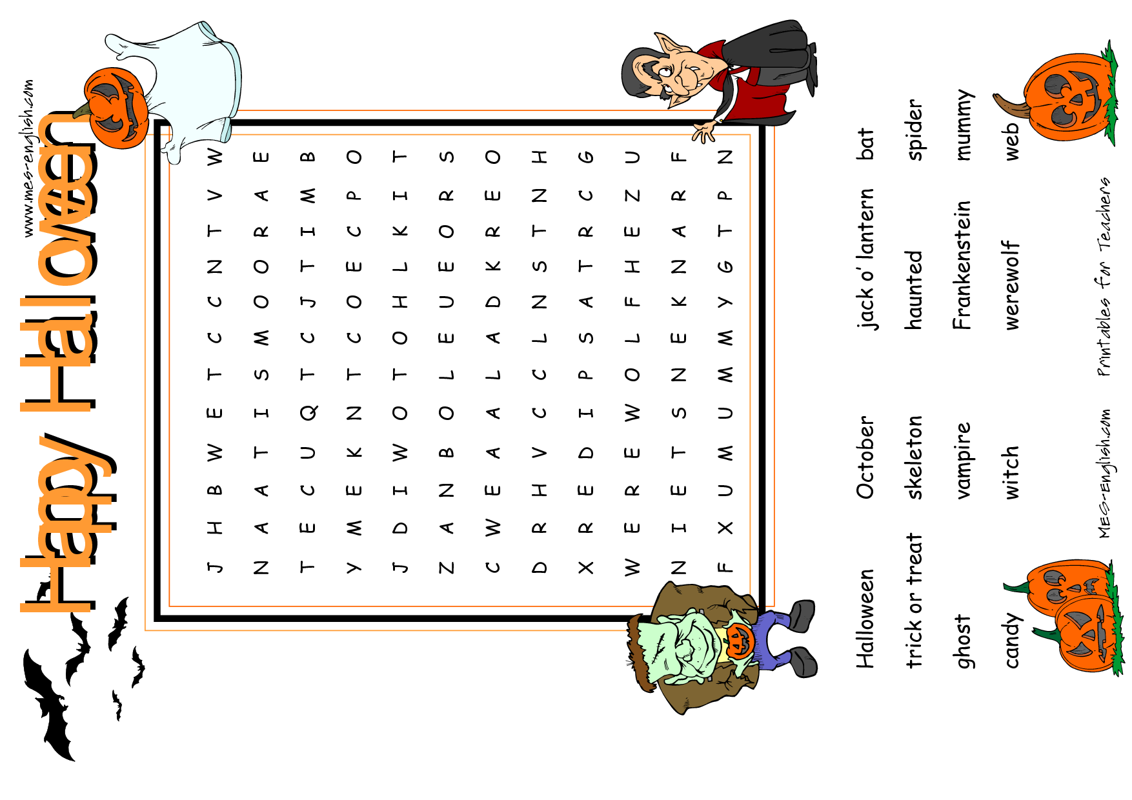

Slide 2
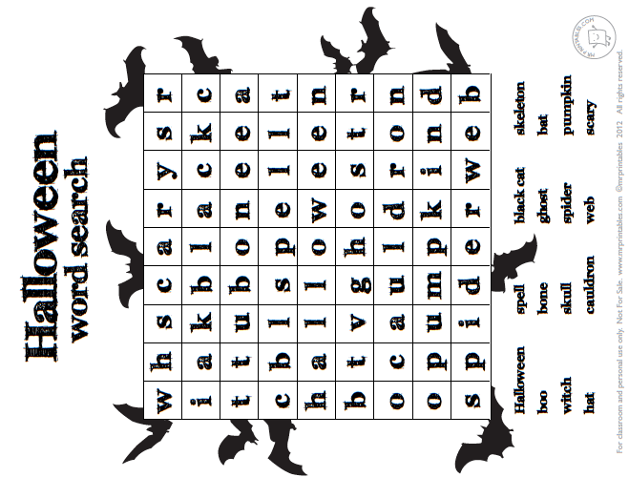

Slide 3
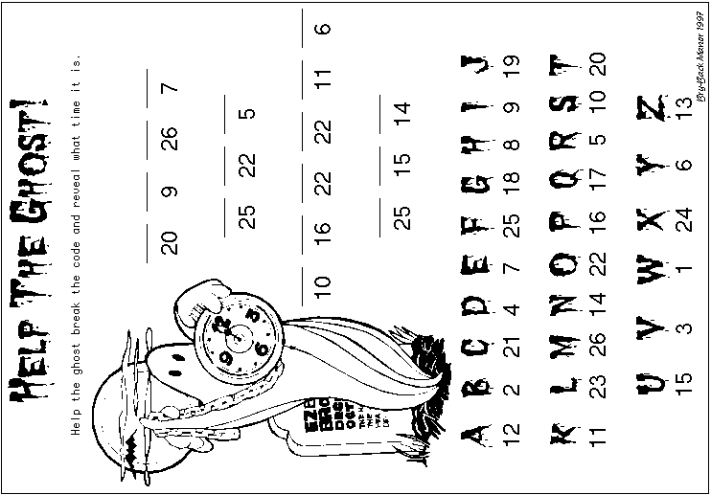

Slide 5
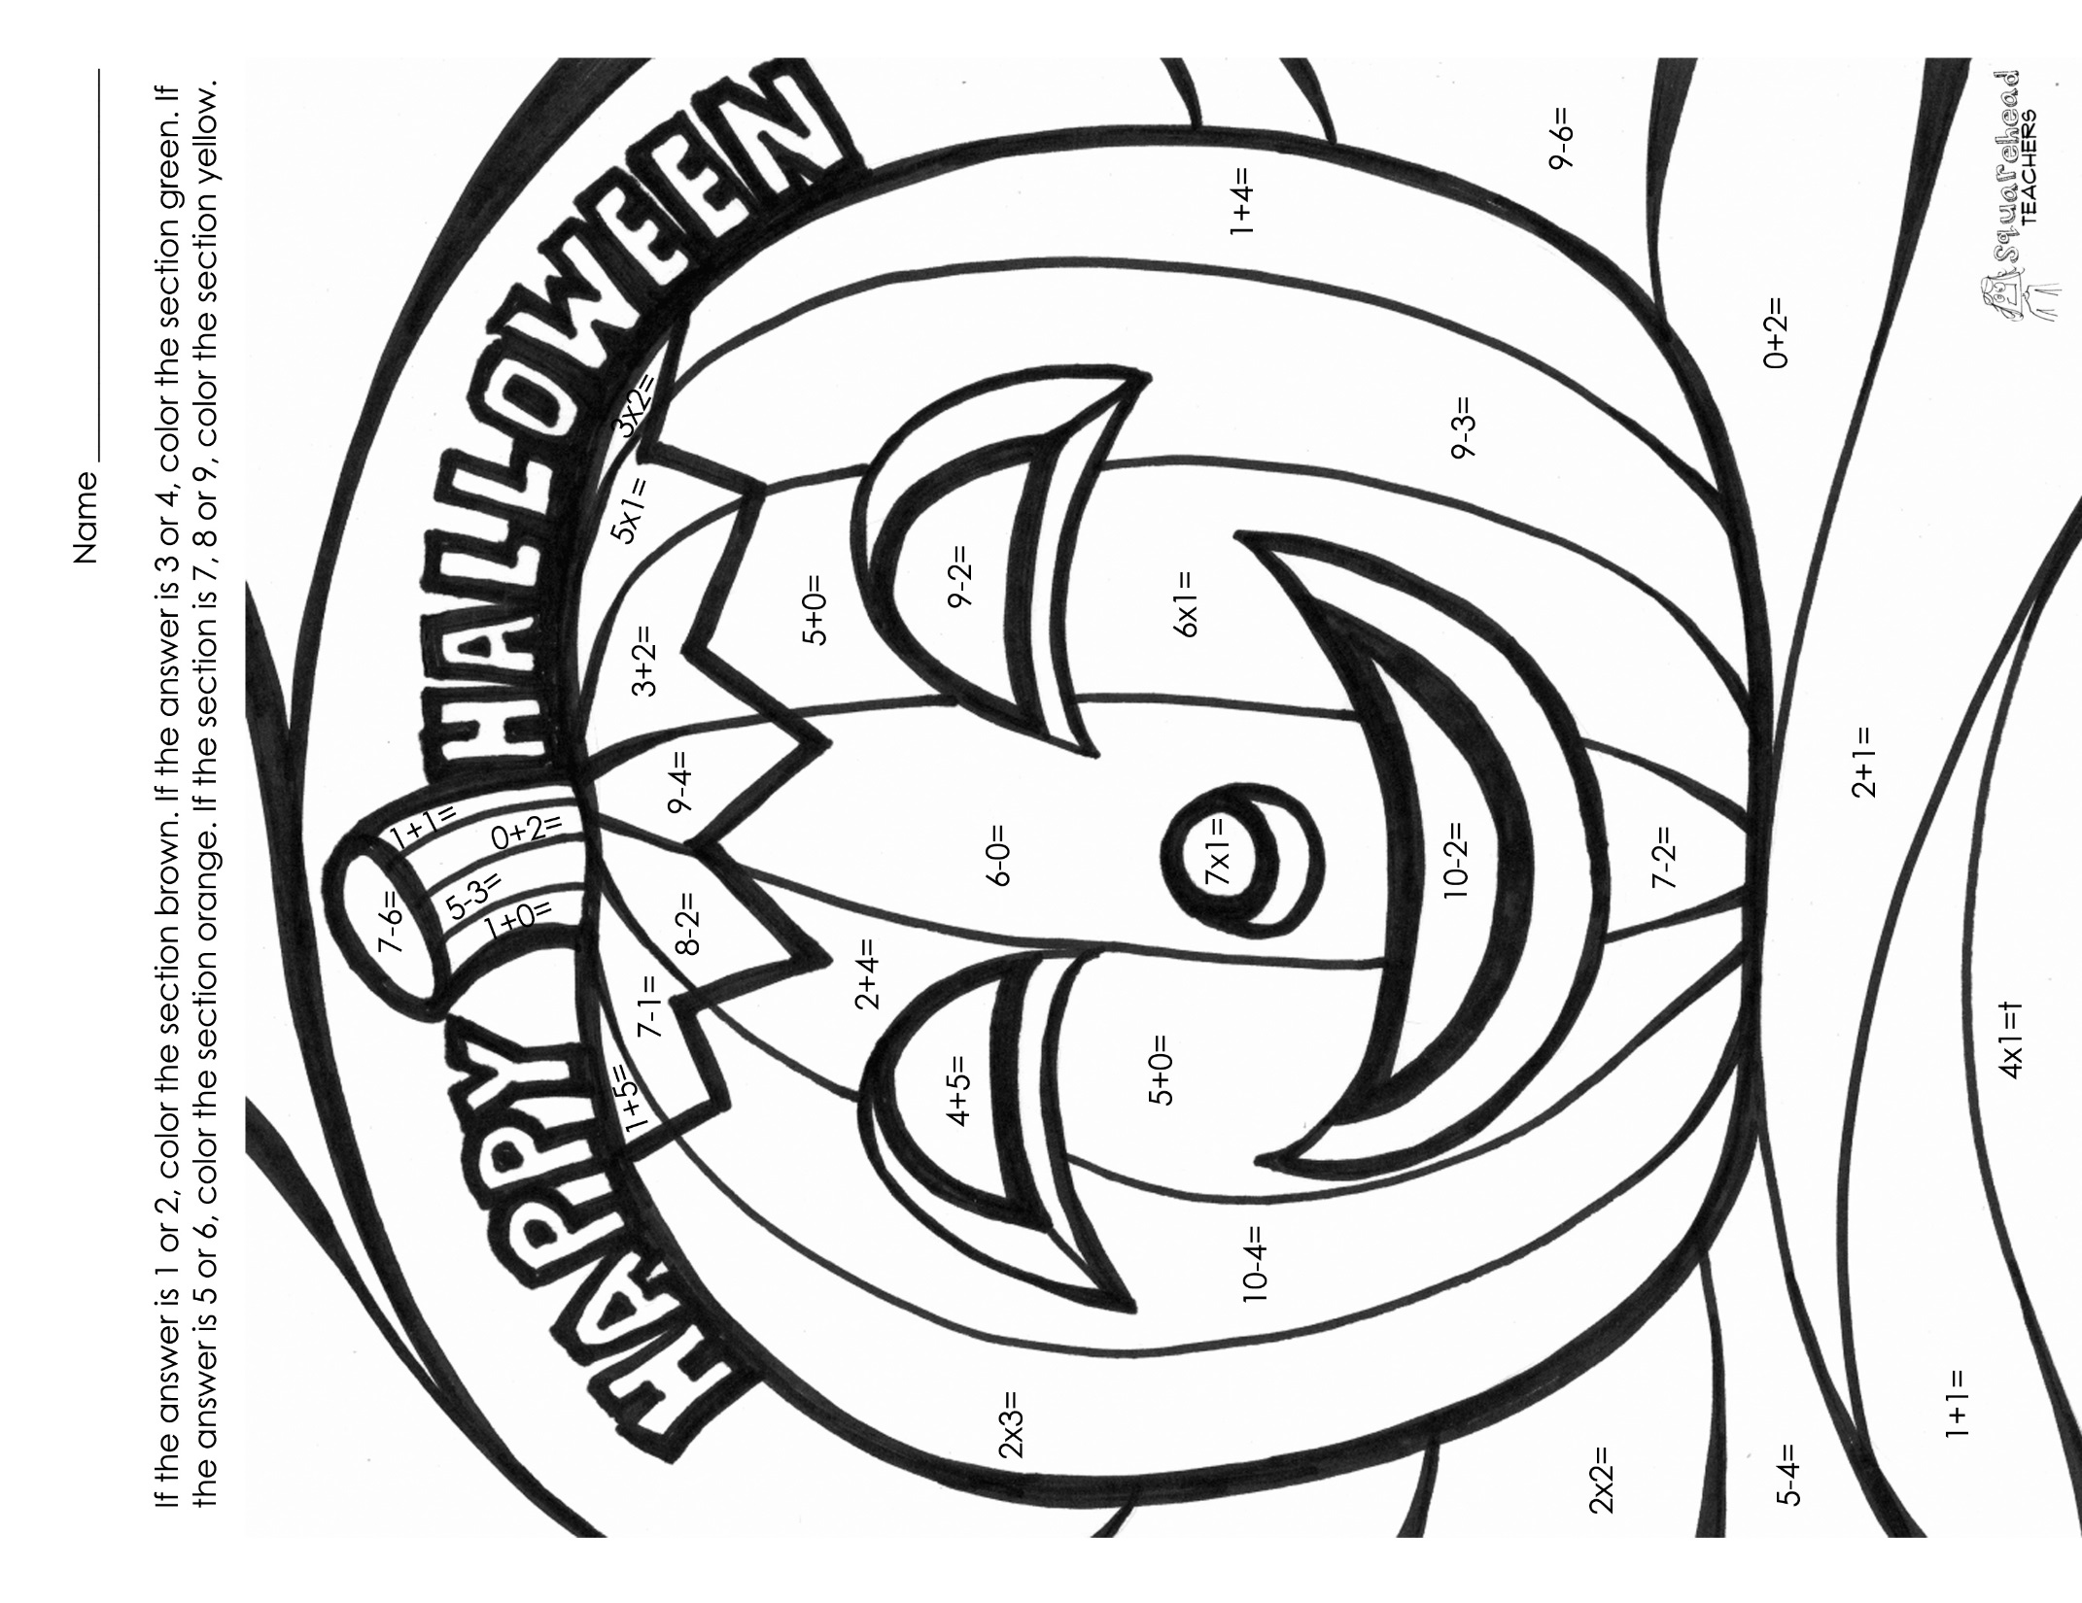

Slide 6
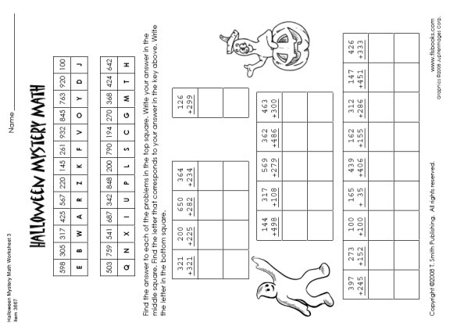

Slide 7
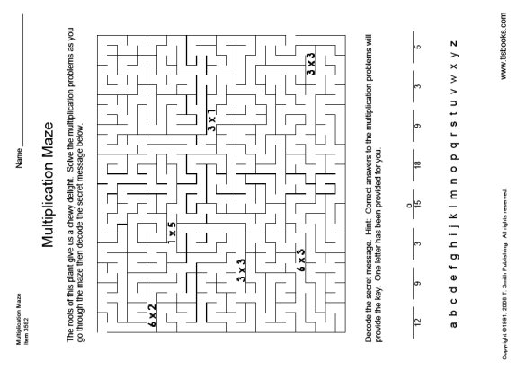

Slide 8
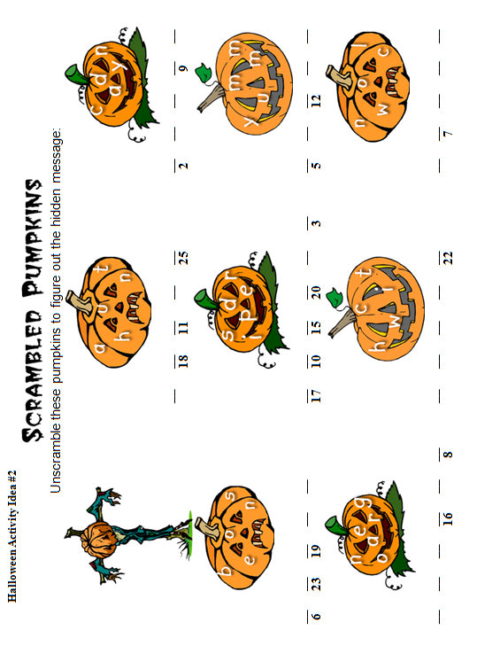
Notes:
http://www.mathgametime.com/blog/2011/10/halloween-math-worksheets-activities/

Slide 9
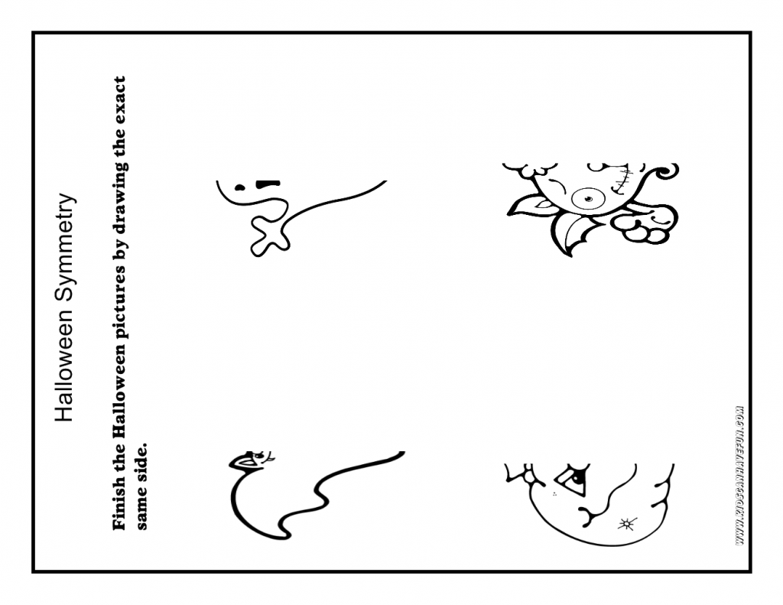
Notes:
http://www.kidscanhavefun.com/blog/tag/halloween-worksheets/

Slide 10
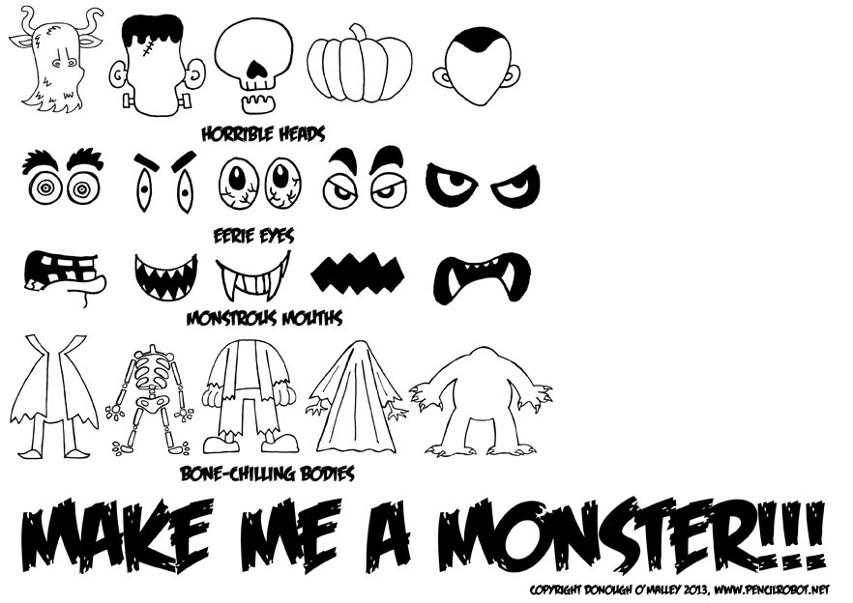
Cut out this paper and trace the body parts
Notes:
https://donoughomalley.wordpress.com/2013/10/30/free-halloween-worksheet/

Slide 11
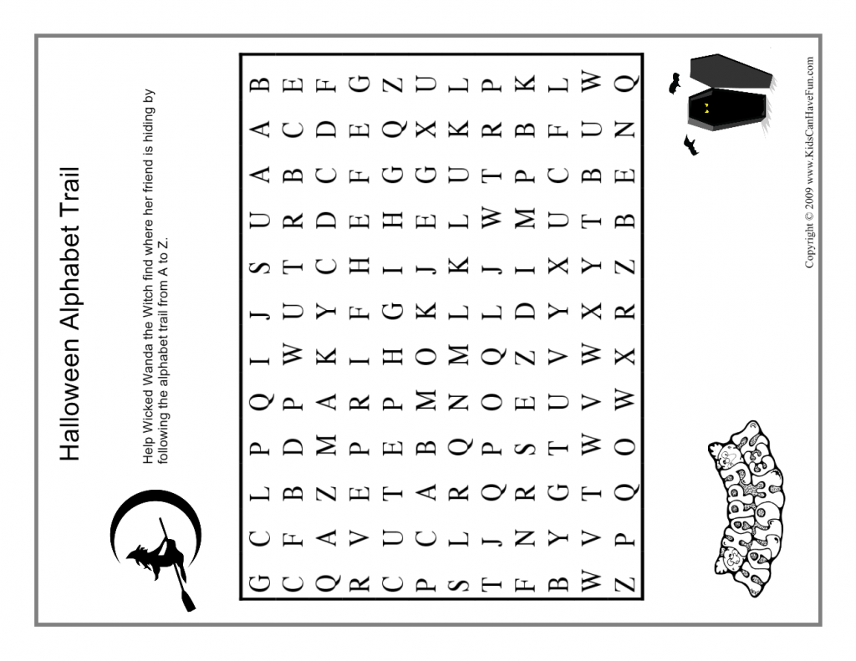
Notes:
http://www.kidscanhavefun.com/blog/tag/halloween-worksheets/

Slide 12
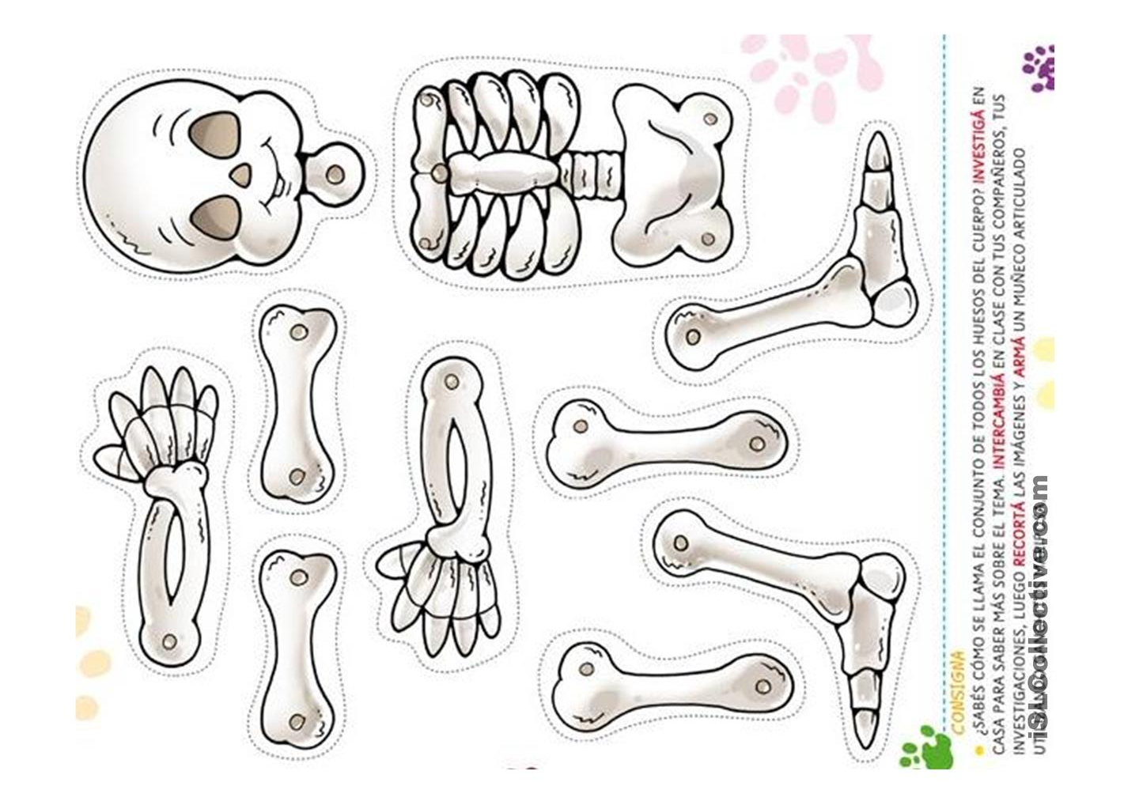
Notes:
http://www.kidscanhavefun.com/blog/tag/halloween-worksheets/

Slide 13
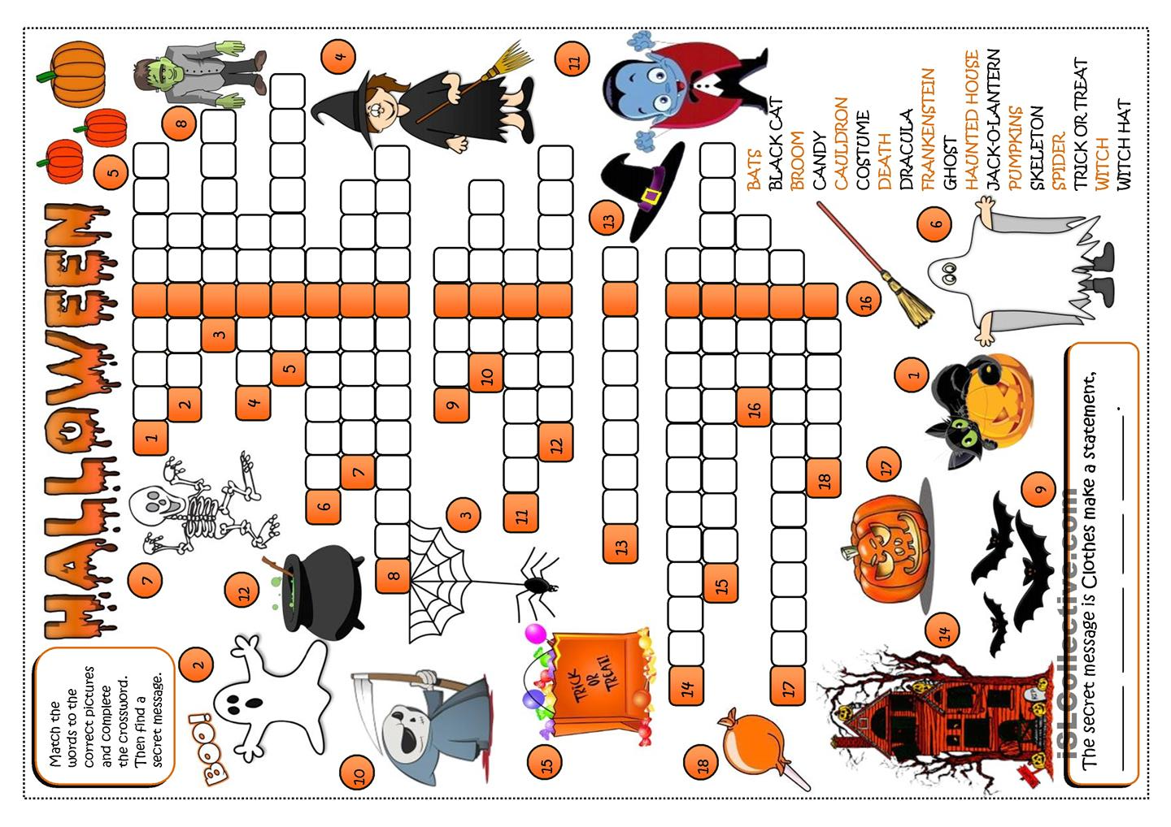
Notes:
https://en.islcollective.com/resources/search_result?Vocabulary_Focus=Halloween&searchworksheet=GO&type=Printables&page=2

Slide 14
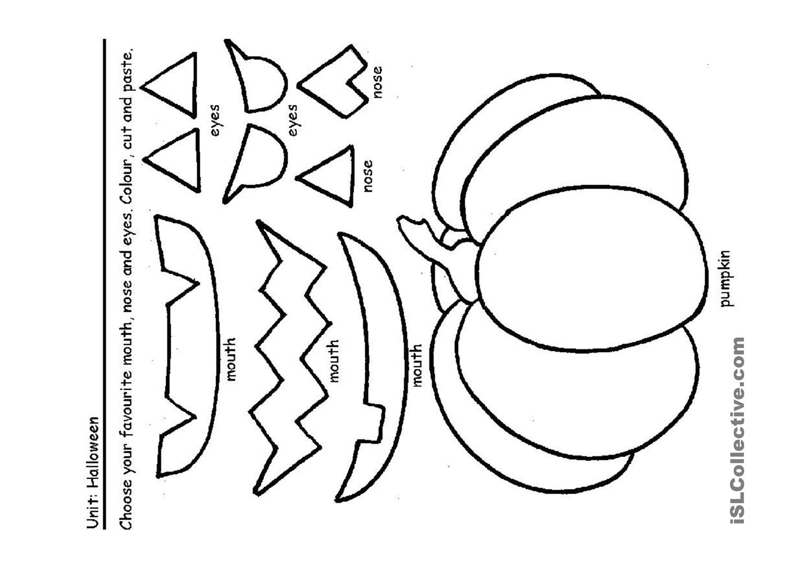
Notes:
https://en.islcollective.com/resources/search_result?Vocabulary_Focus=Halloween&searchworksheet=GO&type=Printables&page=2

Slide 15
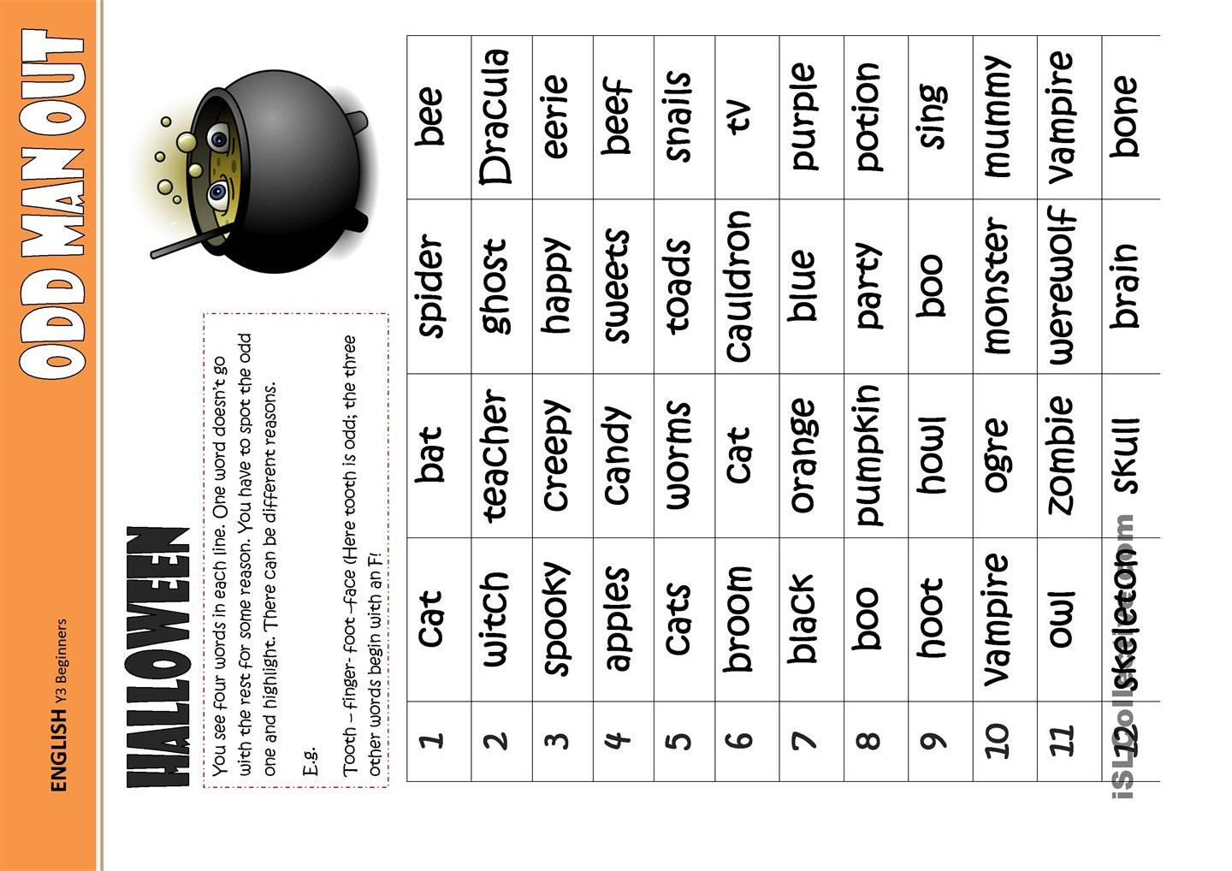
Notes:
https://en.islcollective.com/resources/printables/worksheets_doc_docx/odd_one_out_-halloween/halloween-halloween-odd/10166

Slide 16
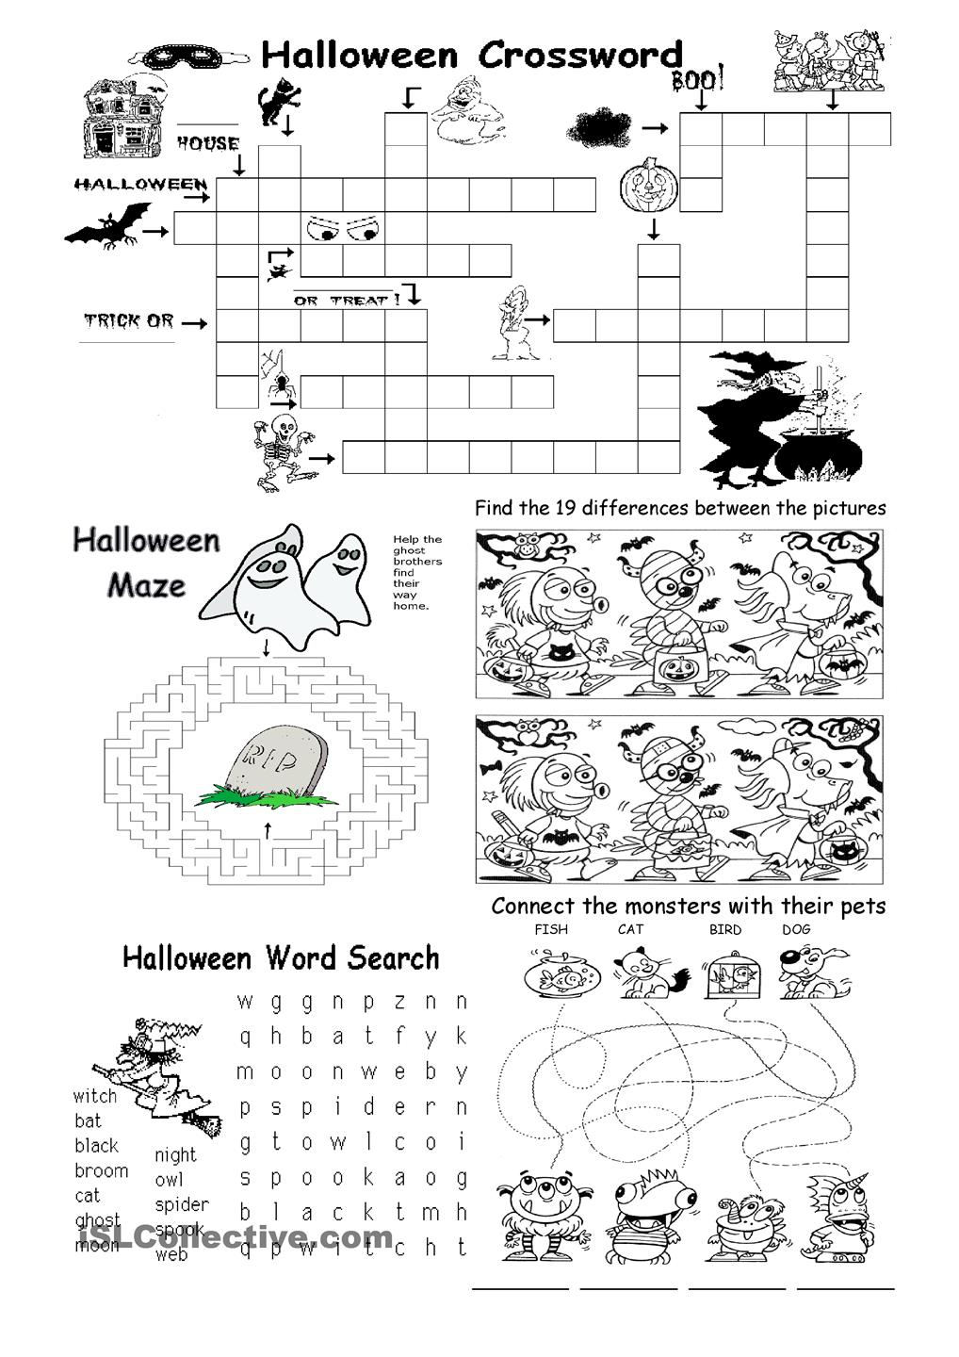
Notes:
http://www.kidscanhavefun.com/blog/tag/halloween-worksheets/

Slide 17
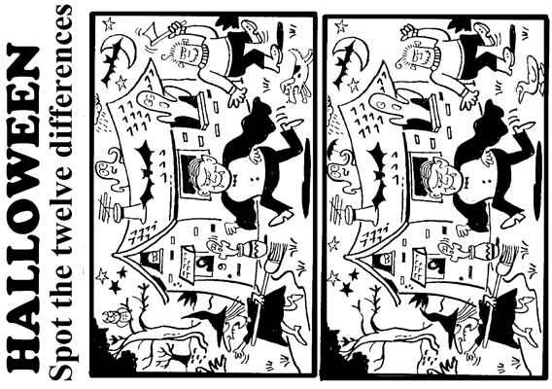

Slide 18
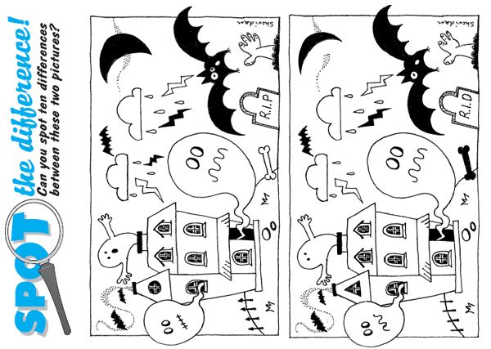

Slide 19
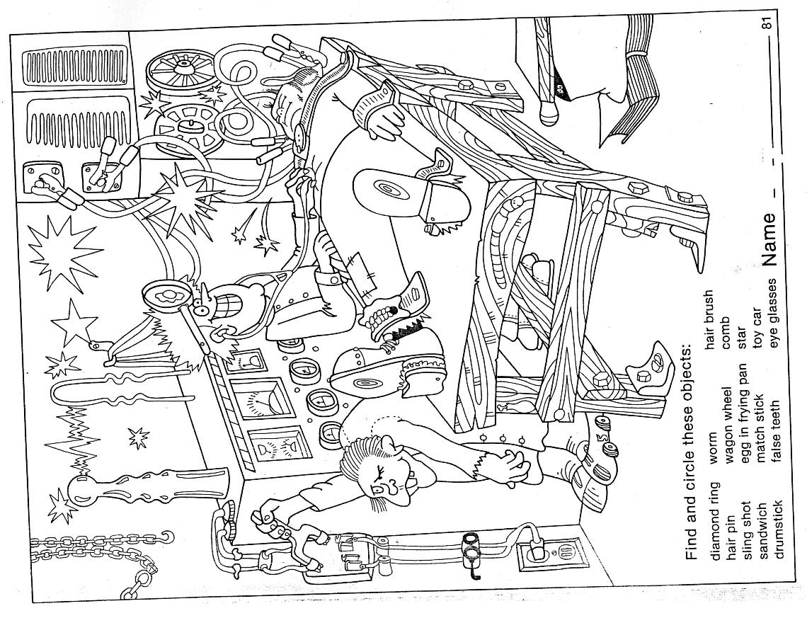

Slide 20
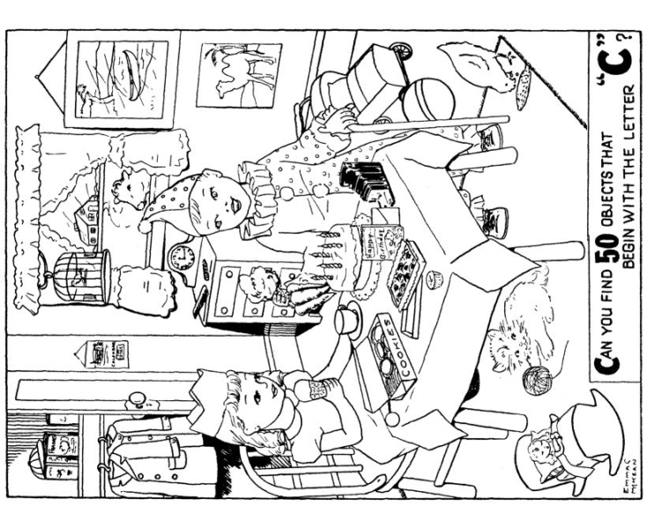

Slide 21
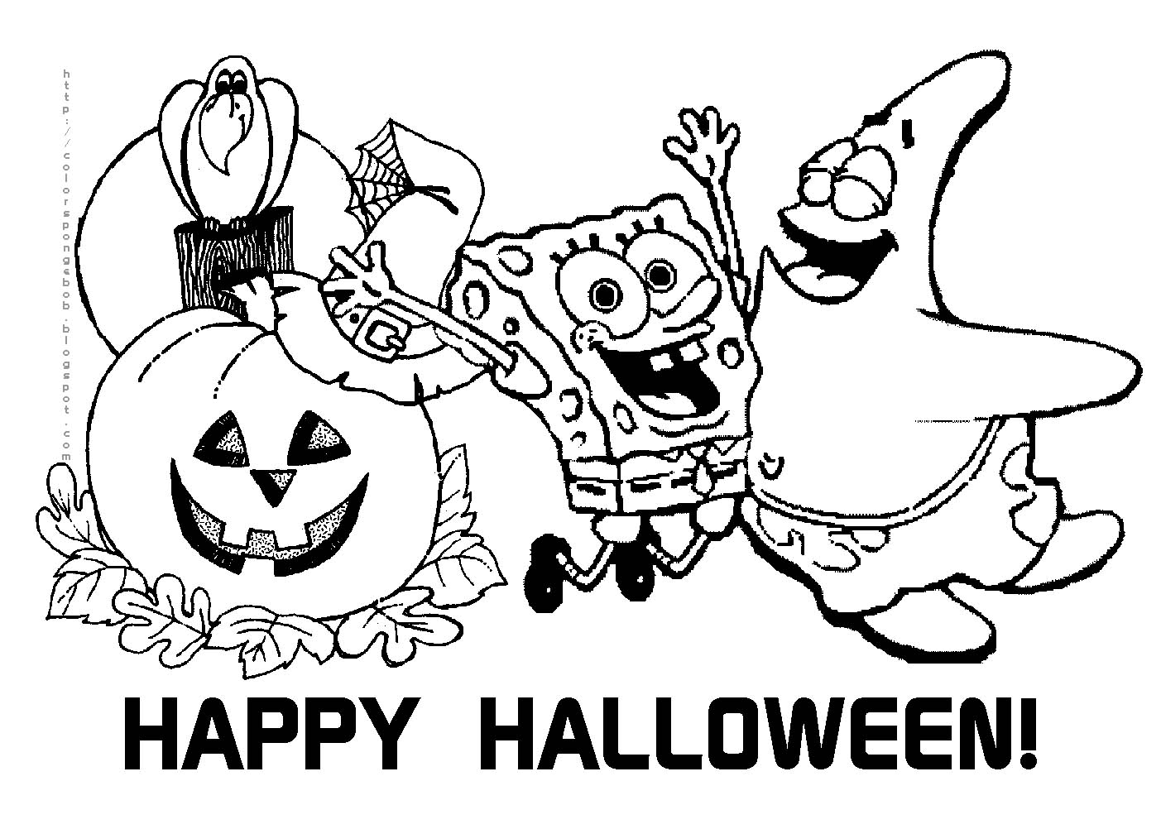

Slide 22
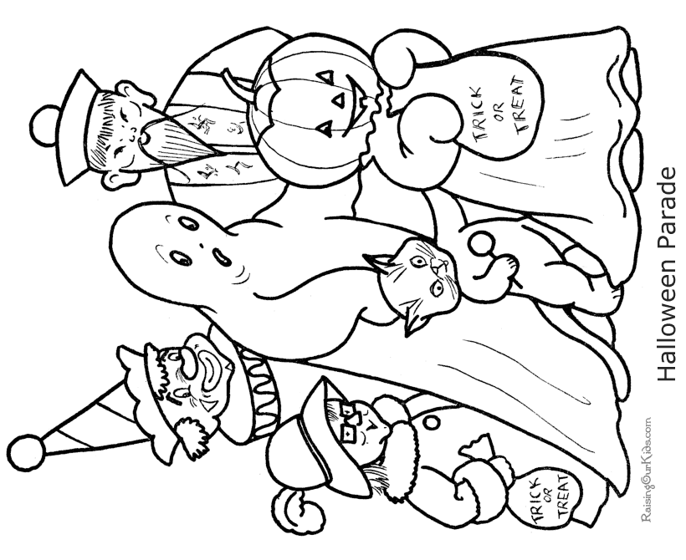

Slide 23
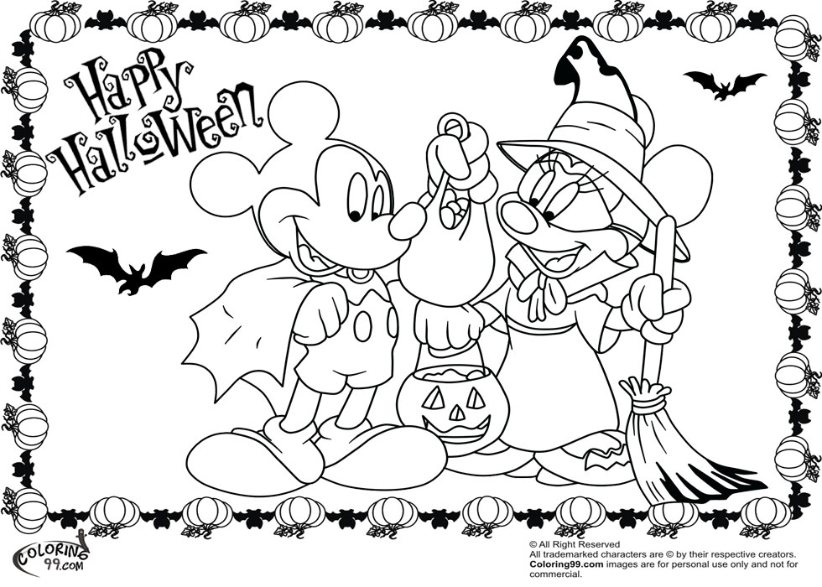

Slide 24
