Slide 1
Suffixes
They come after a word

Slide 2
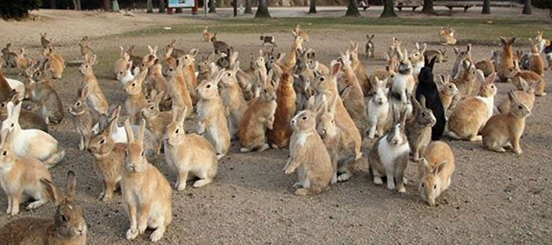
Plural =
More than one

Slide 3
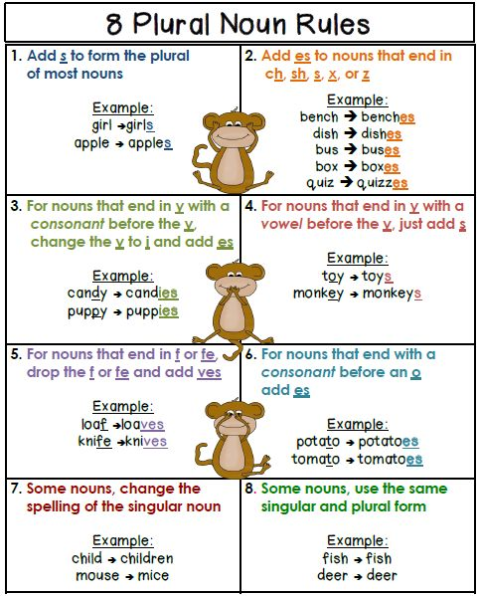
Plural
Add “–s”
Add “–es”
For words that end in sh, ch, x, z and s
Change the ‘f’ to ‘ves’
For words that end in f, fe
Change “y” to “ies
For words ending in a consonant + “y”
Special Cases
Notes:
https://kr.pinterest.com/pin/112238215687696567/

Slide 4
Change it from singular (one) to plural:
Cat
Light
Church
Fox
Life
Candy
Monkey
Tomato
Wish
Test
Quiz
Baby
Towel
Peach
Boy
Girl

Slide 5
Singular OR Plural
Men Mice Child Goose Man
Geese Knives Feet Tooth Children Foot
Knife Mouse Teeth

Slide 6
Past Tense
It happened before

Slide 7
Notes:
http://okarayy.site40.net/pronunciation+rules+simple+past+tense+regular+verbs/

Slide 8
Change it from present (now) to past tense:
Call
Talk
Smile
Live
Play
Study
Stop
Pass
Wish
Use
Try
Laugh
Cry
Paint
Trap
Arrive

Slide 9
Jobs

Slide 10
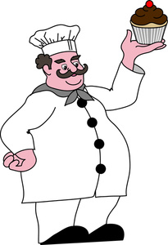
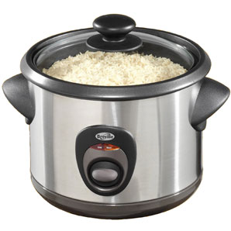
Jobs (-er, -or)
A person or thing that does a specific action.
Turn a verb into a job

Slide 11
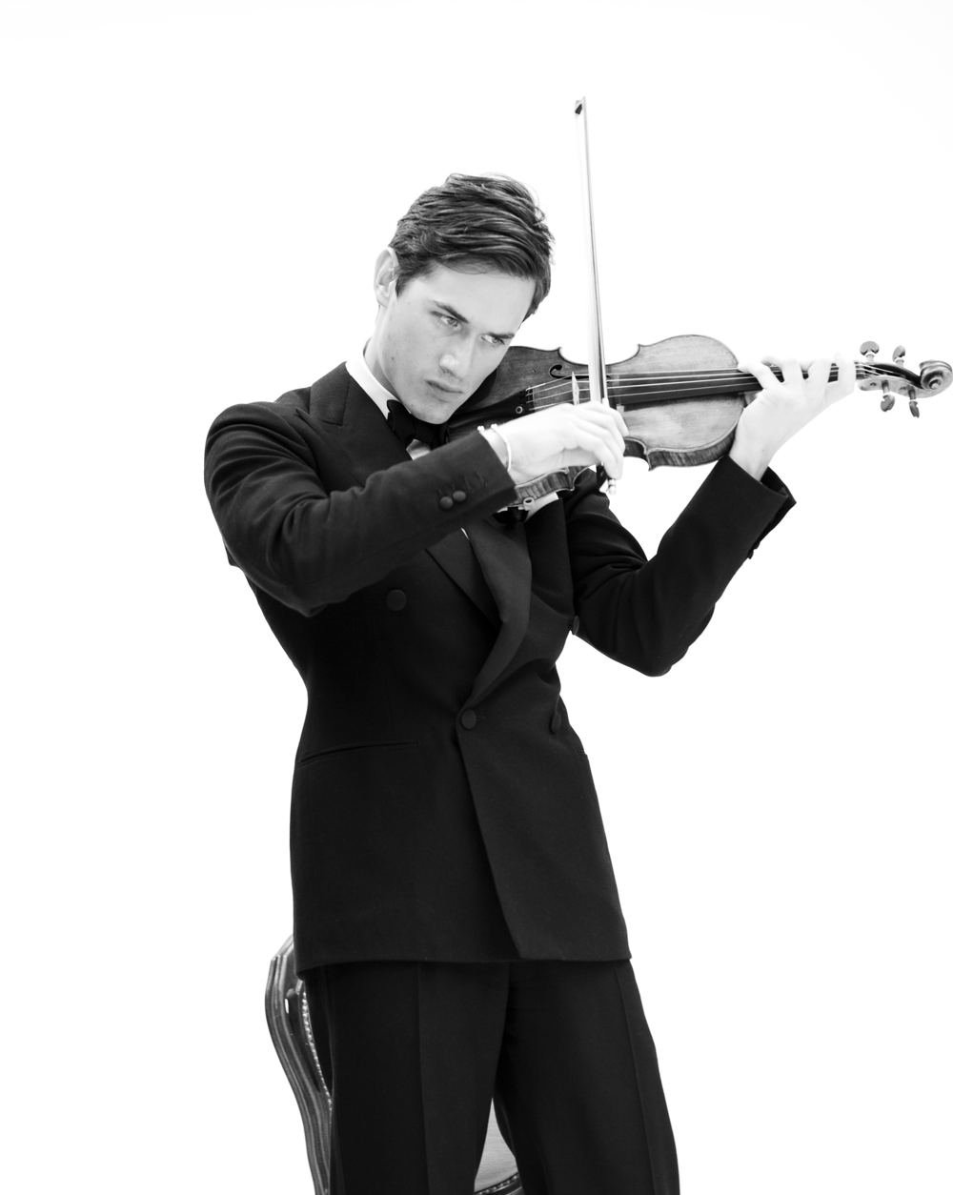
Jobs (-ist)
Someone who studied a lot for their job.

Slide 12
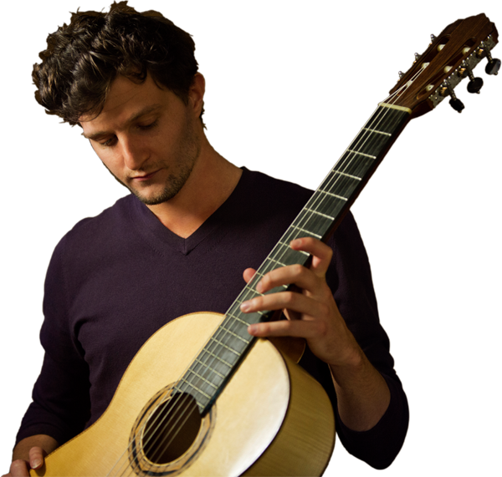
Jobs (-ian)
Someone who studied a lot for their job.
Turn a noun into a job

Slide 13
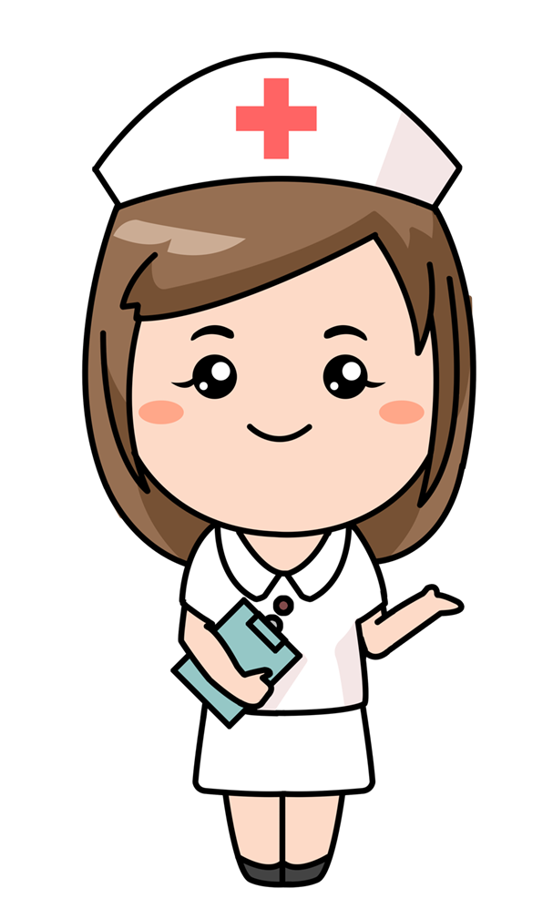
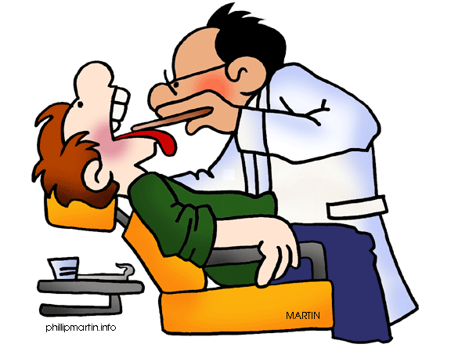
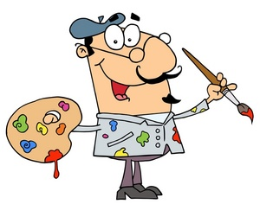
Which one is different?

Slide 14
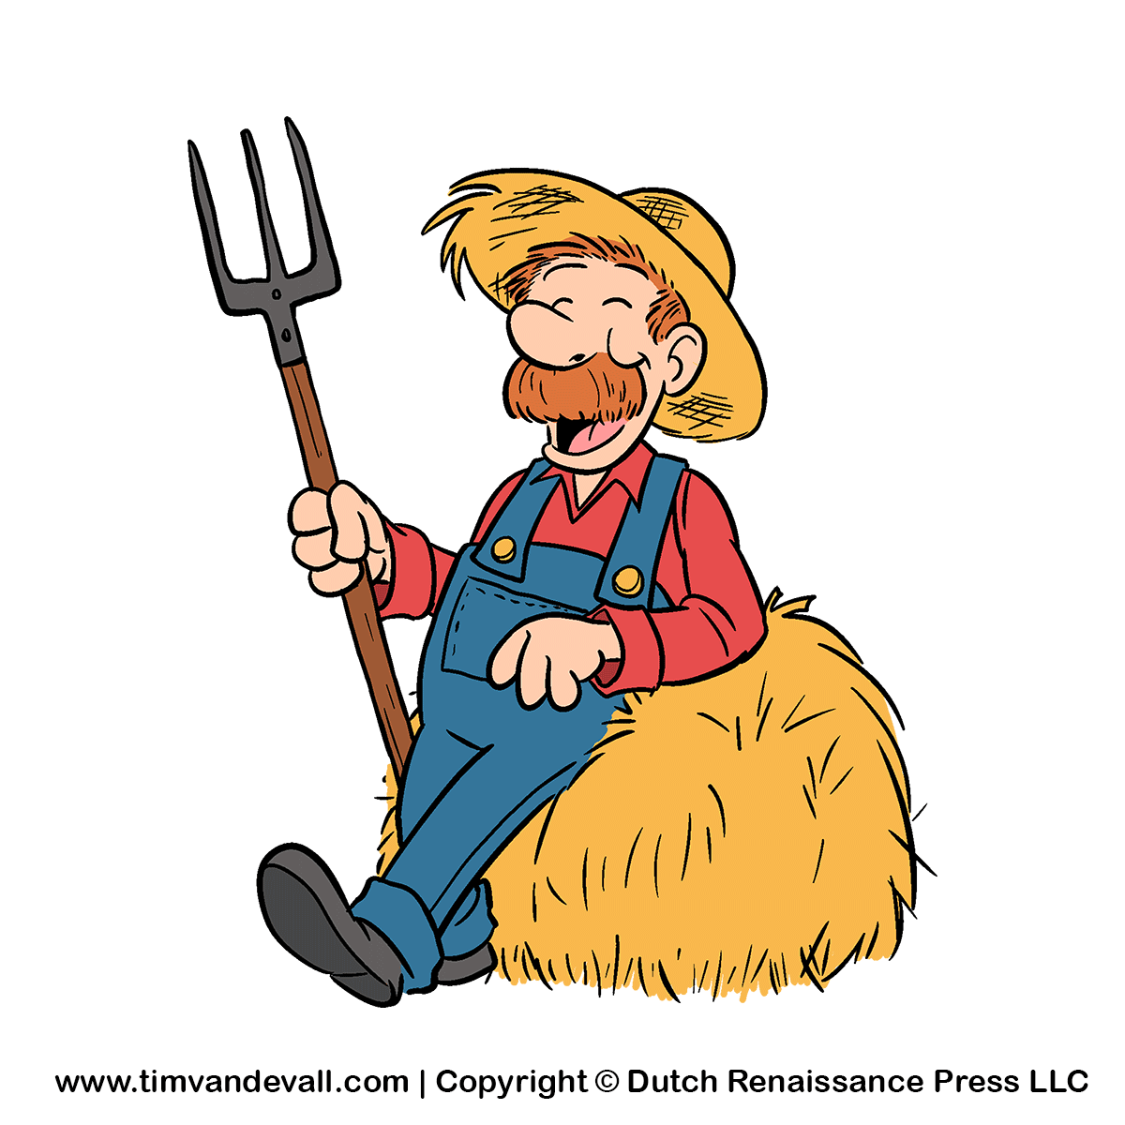
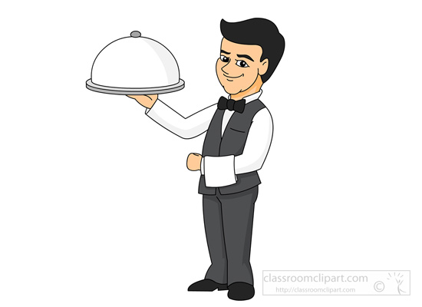
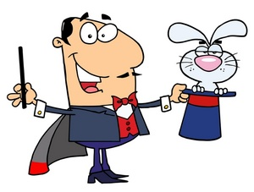
Which one is different?

Slide 15
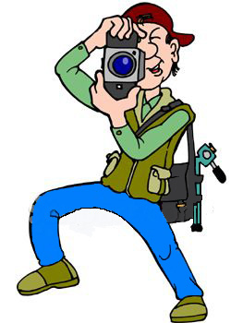
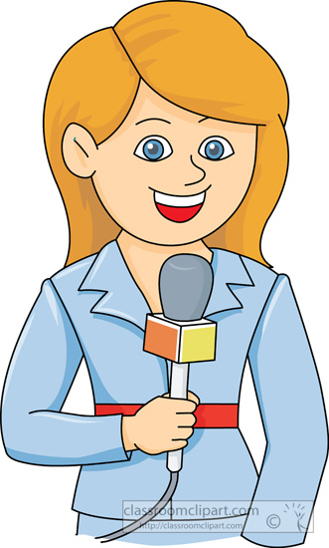
Which one is different?

Slide 16
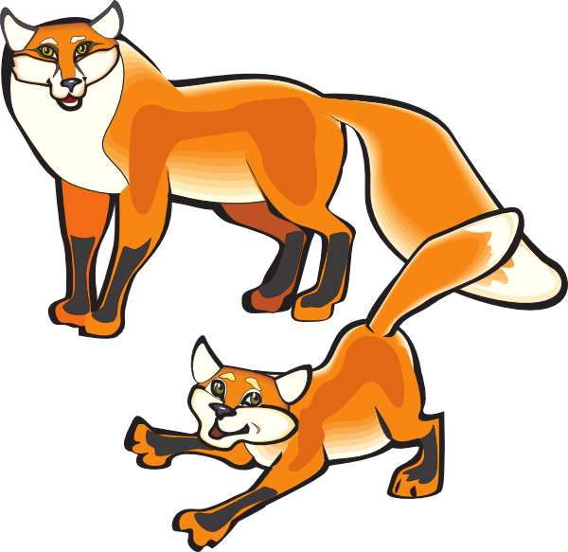
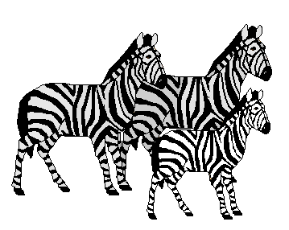
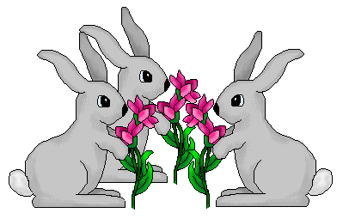
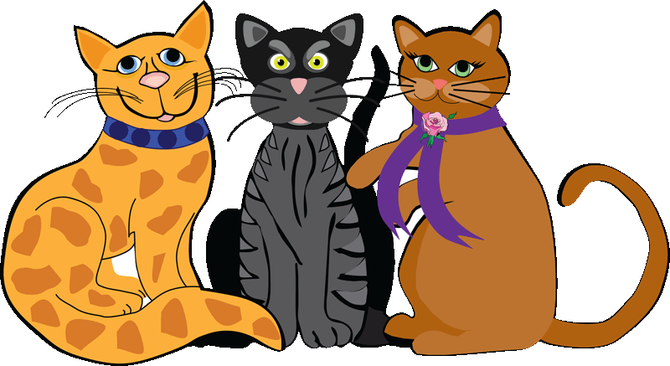
Which one is different?

Slide 17
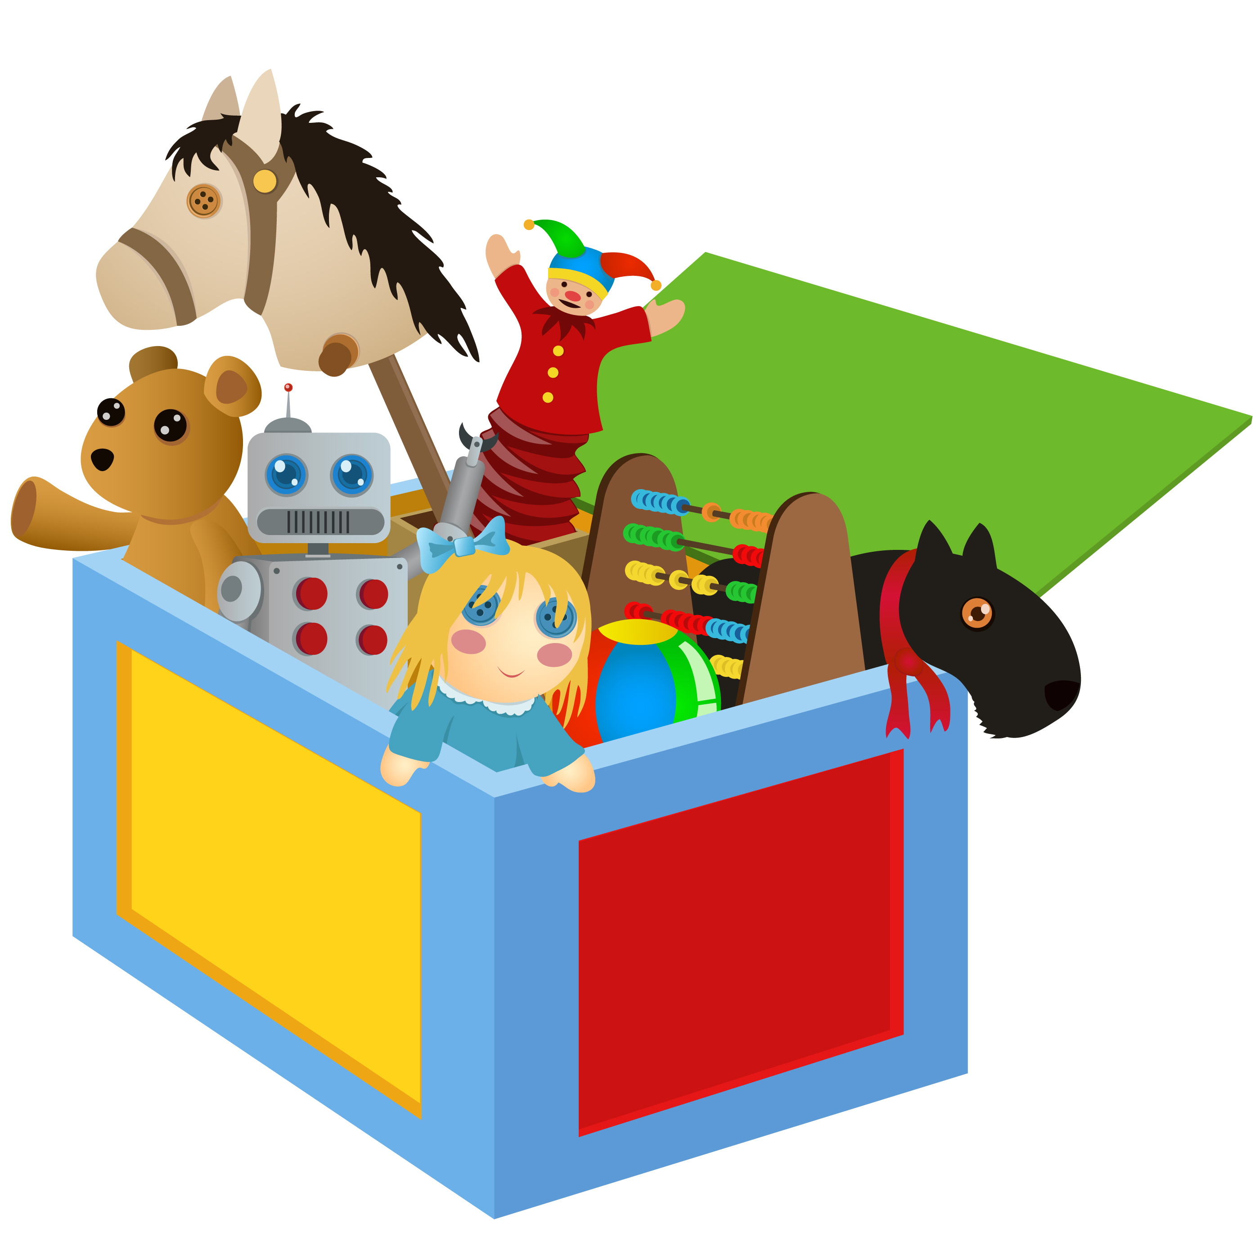
Which one is different?

Slide 18
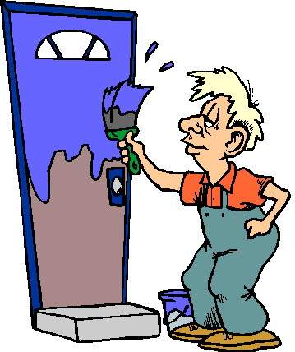
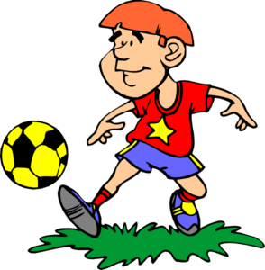
Which one is different?

