Slide 1
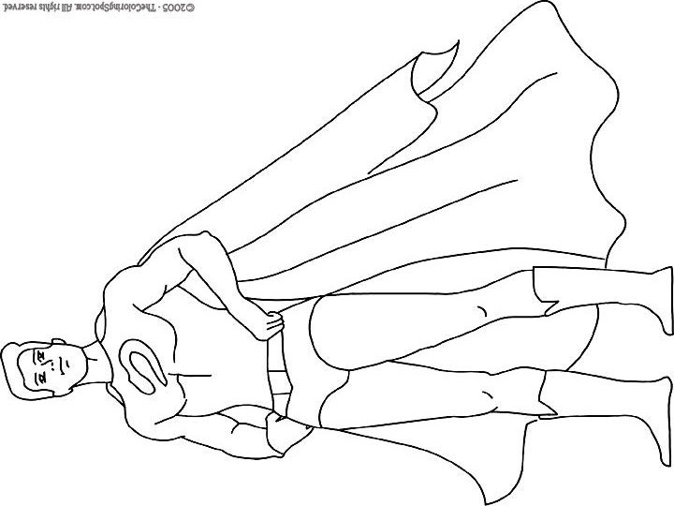
Superhero Name: _____________
(100 points total)
Size: Power:
Speed: Morality:
Intelligence:
Attractiveness:

Slide 2
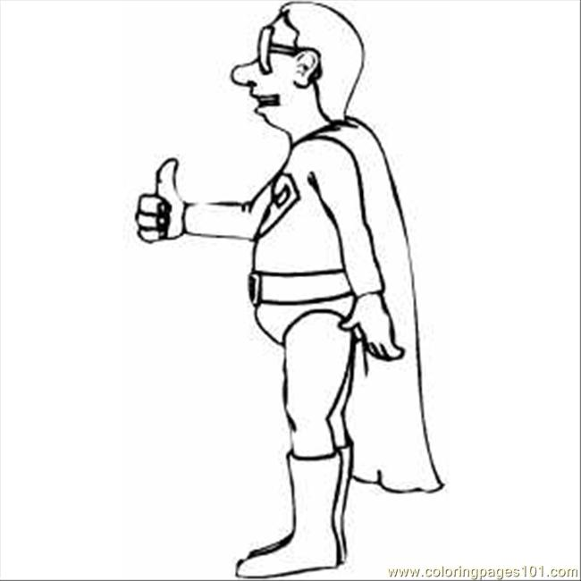
Superhero Name: _____________
(100 points total)
Size: Power:
Speed: Morality:
Intelligence:
Attractiveness:

Slide 3
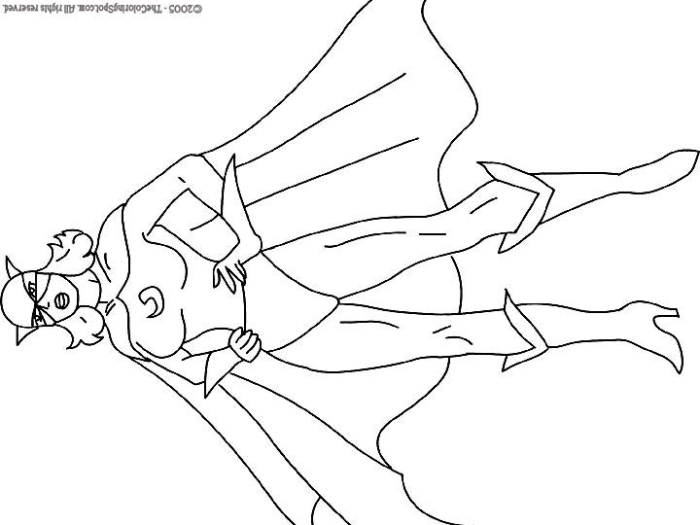
Superhero Name: _____________
(100 points total)
Size: Power:
Speed: Morality:
Intelligence:
Attractiveness:

Slide 4
Superhero Name: _____________
(100 points total)
Size: Power:
Speed: Morality:
Intelligence:
Attractiveness:

Slide 5
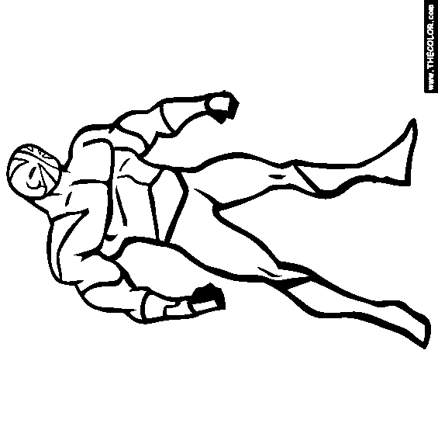
Superhero Name: _____________
(100 points total)
Size: Power:
Speed: Morality:
Intelligence:
Attractiveness:

Slide 6
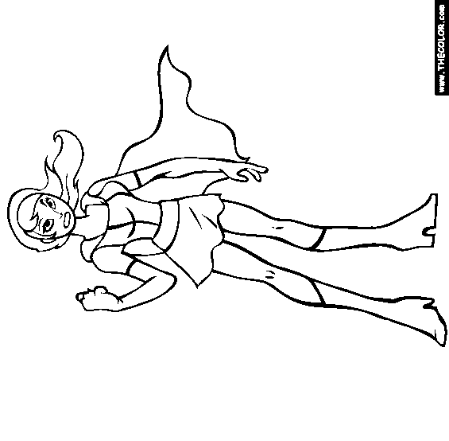
Superhero Name: _____________
(100 points total)
Size: Power:
Speed: Morality:
Intelligence:
Attractiveness:

Slide 7
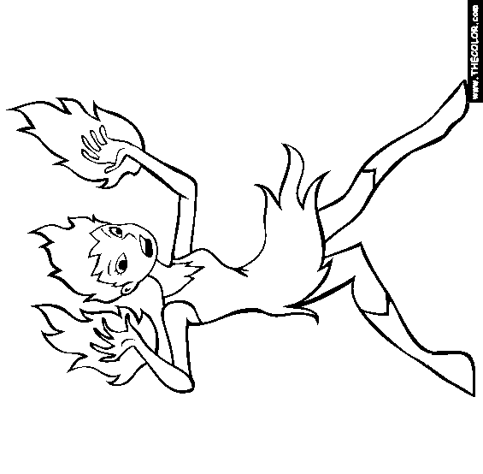
Superhero Name: _____________
(100 points total)
Size: Power:
Speed: Morality:
Intelligence:
Attractiveness:

Slide 8
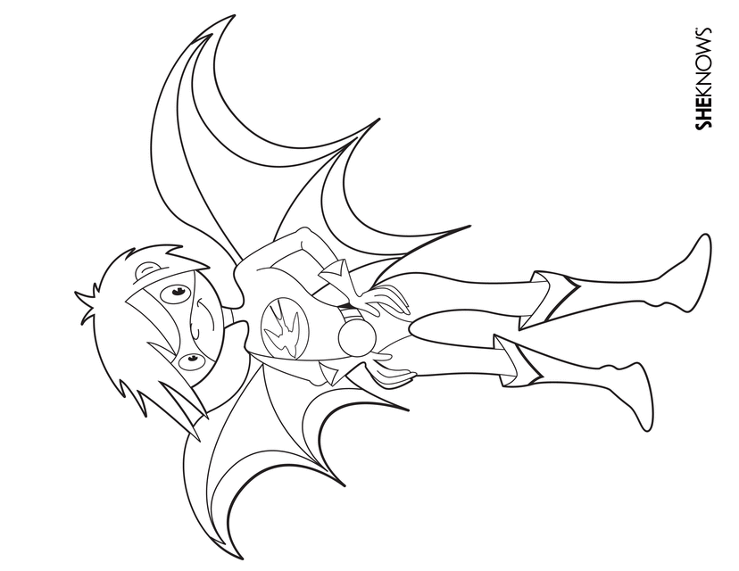
Superhero Name: _____________
(100 points total)
Size: Power:
Speed: Morality:
Intelligence:
Attractiveness:

Slide 9
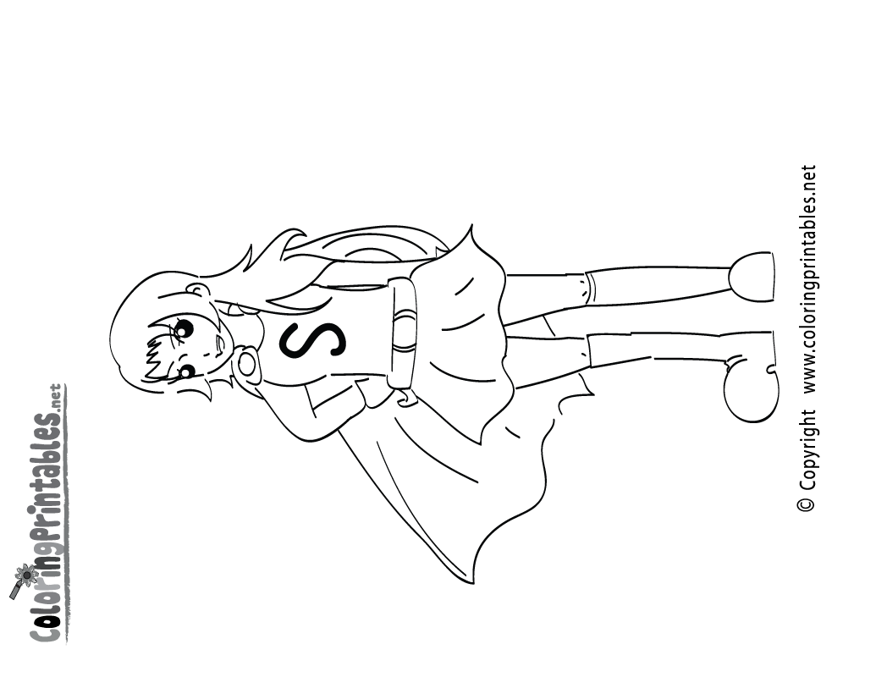
Superhero Name: _____________
(100 points total)
Size: Power:
Speed: Morality:
Intelligence:
Attractiveness:

Slide 10
Superhero Name: _____________
(100 points total)
Size: Power:
Speed: Morality:
Intelligence:
Attractiveness:

Slide 11
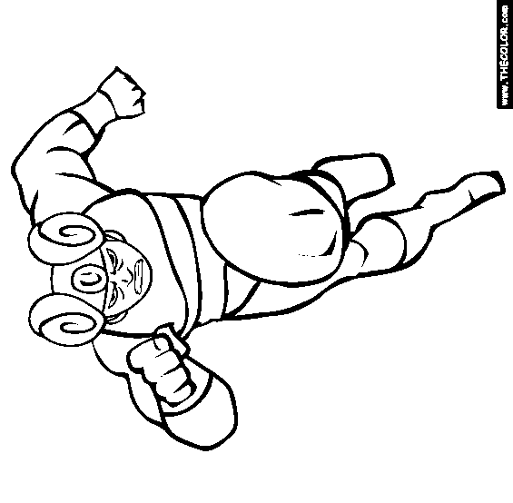
Superhero Name: _____________
(100 points total)
Size: Power:
Speed: Morality:
Intelligence:
Attractiveness:

Slide 12
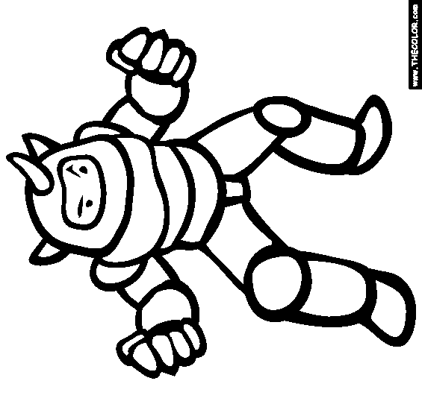
Superhero Name: _____________
(100 points total)
Size: Power:
Speed: Morality:
Intelligence:
Attractiveness:

Slide 13
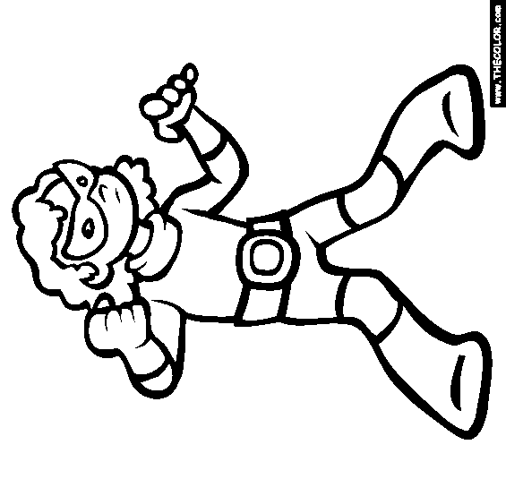
Superhero Name: _____________
(100 points total)
Size: Power:
Speed: Morality:
Intelligence:
Attractiveness:

Slide 14
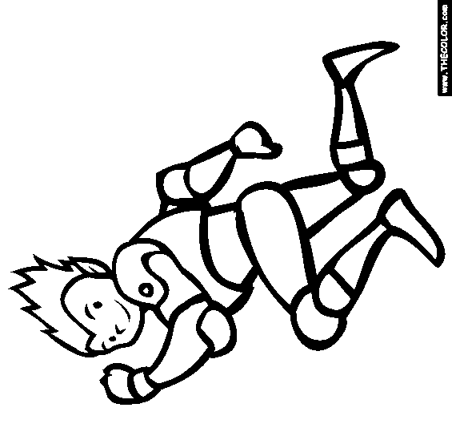
Superhero Name: _____________
(100 points total)
Size: Power:
Speed: Morality:
Intelligence:
Attractiveness:

Slide 15
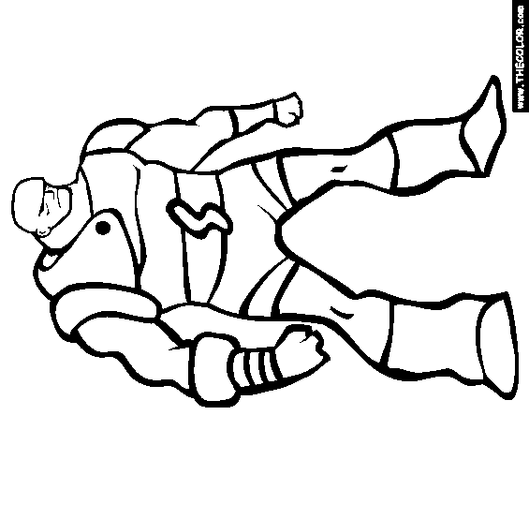
Superhero Name: _____________
(100 points total)
Size: Power:
Speed: Morality:
Intelligence:
Attractiveness:

Slide 16
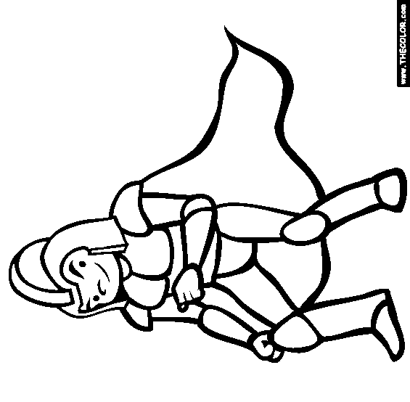
Superhero Name: _____________
(100 points total)
Size: Power:
Speed: Morality:
Intelligence:
Attractiveness:

Slide 17
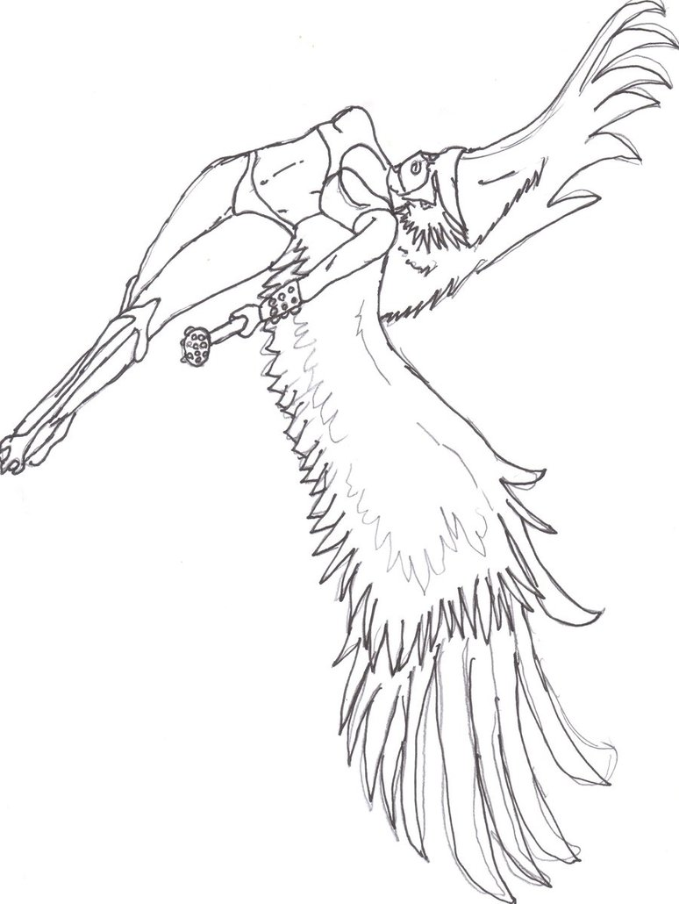
Superhero Name: _____________
(100 points total)
Size: Power:
Speed: Morality:
Intelligence:
Attractiveness:

Slide 18
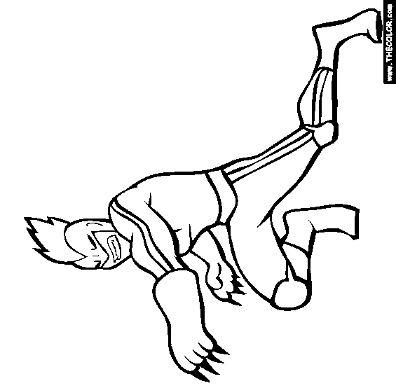
Superhero Name: _____________
(100 points total)
Size: Power:
Speed: Morality:
Intelligence:
Attractiveness:

Slide 19
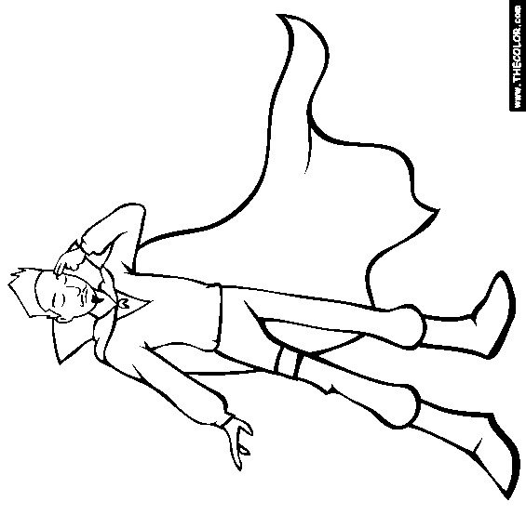
Superhero Name: _____________
(100 points total)
Size: Power:
Speed: Morality:
Intelligence:
Attractiveness:

Slide 20
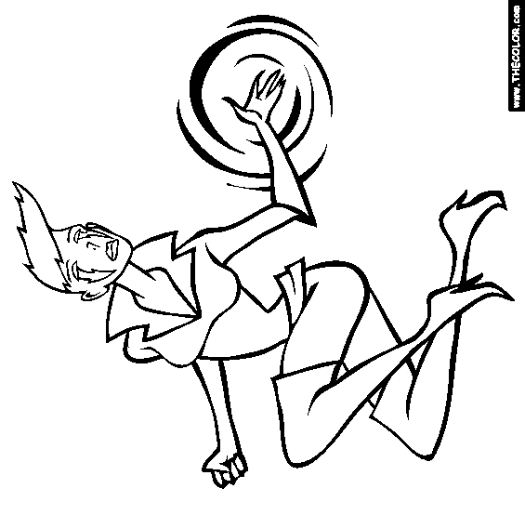
Superhero Name: _____________
(100 points total)
Size: Power:
Speed: Morality:
Intelligence:
Attractiveness:

