Slide 1
Suffixes 2
-able, -ible, -ful, -ly, -less

Slide 2
-able, -ible
Possible
Capable

Slide 3
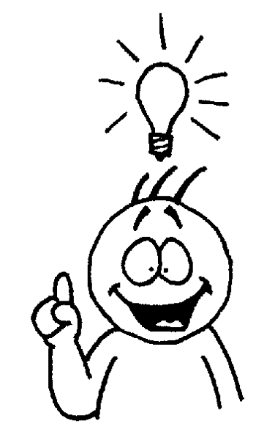
I can understand:
Understandable

Slide 4
I can break it:
Breakable

Slide 5
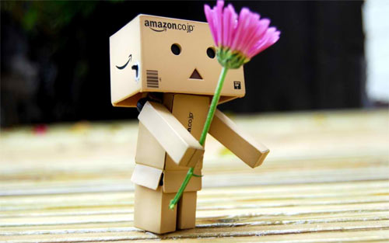
I can love it:
Lovable

Slide 6
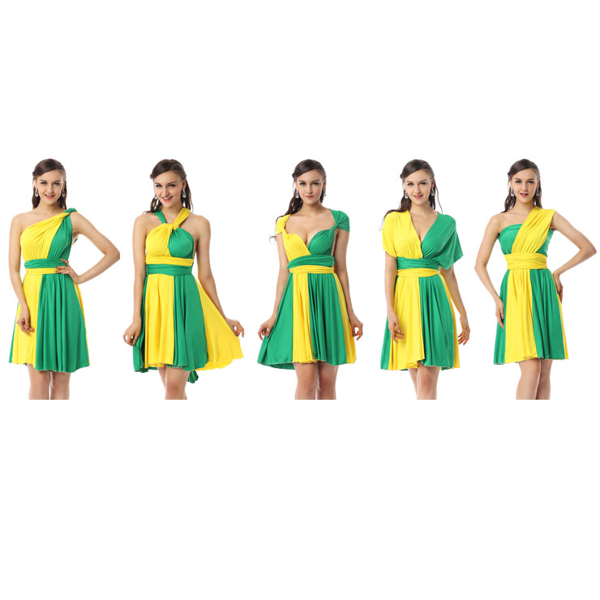
I can change it:
Changeable

Slide 7
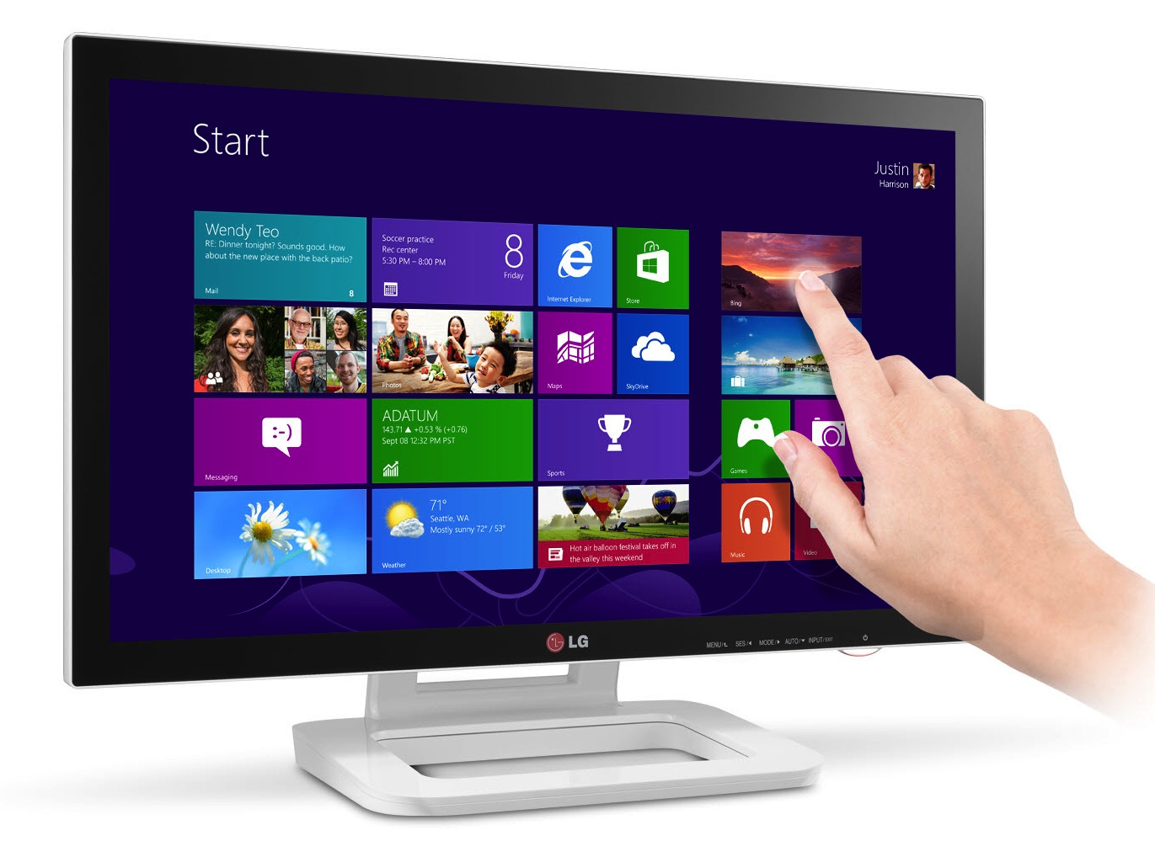
I can touch it:
Touchable

Slide 8
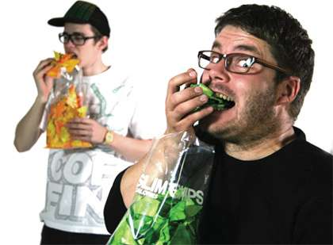
It’s possible to eat:
Edible

Slide 9
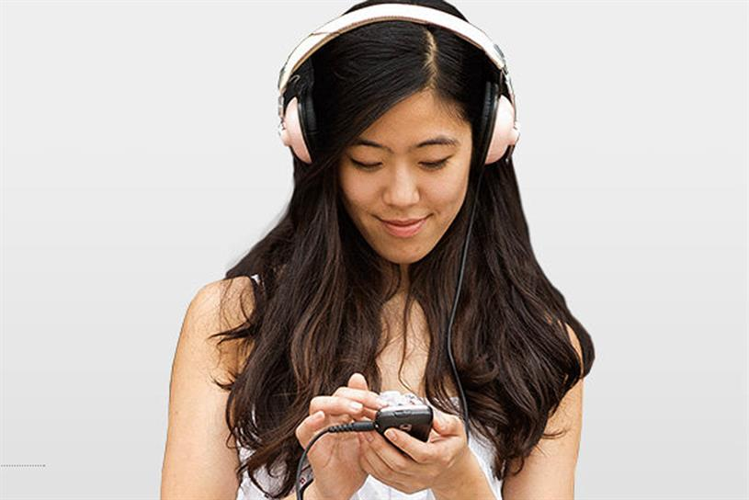
It’s possible to hear:
Audible

Slide 10
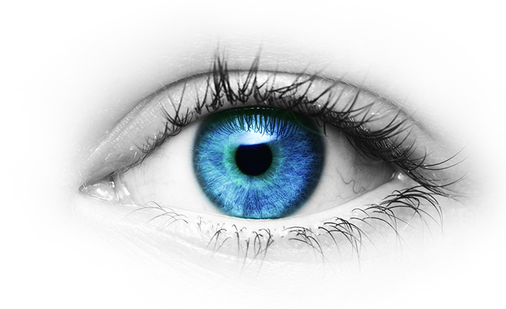
It’s possible to see:
Visible

Slide 11
It’s impossible to see:
Invisible

Slide 12
-ly
How it is done
Quality

Slide 13
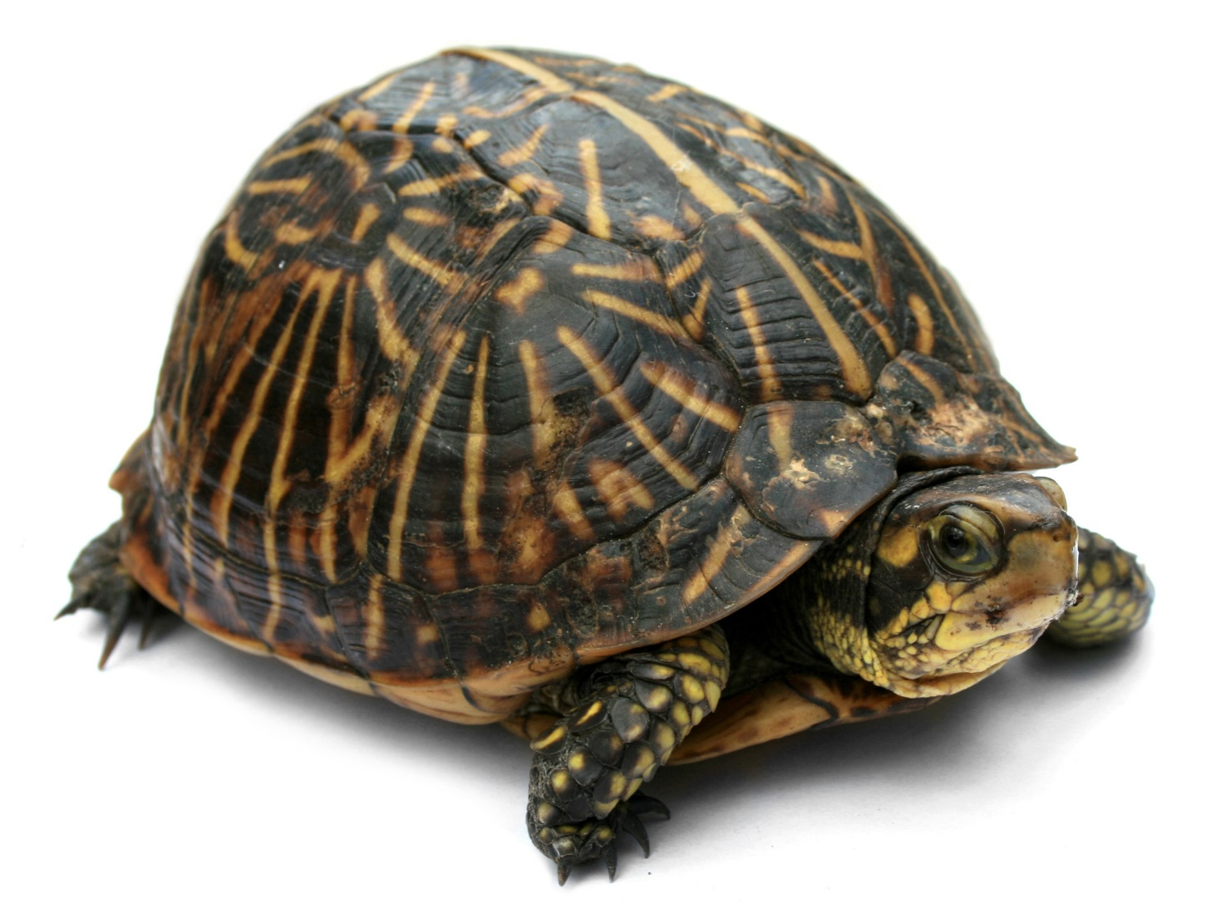
The turtle moves:
Slowly

Slide 14
He does it by being happy:
Happily

Slide 15
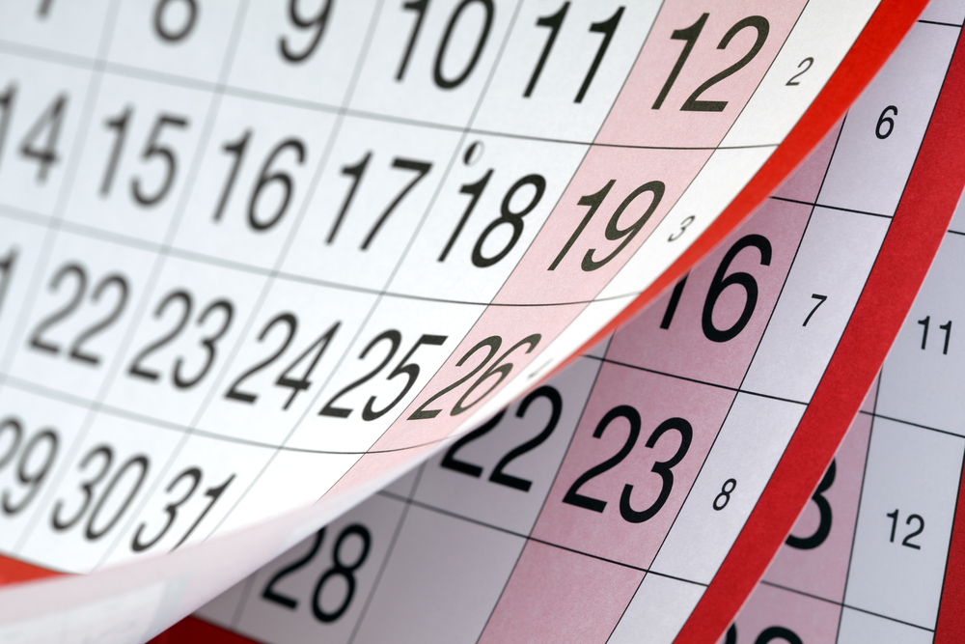
She does it every week:
Weekly

Slide 16
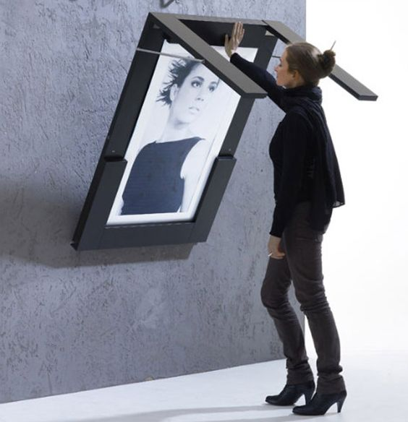
It is done in a clever way:
Cleverly

Slide 17
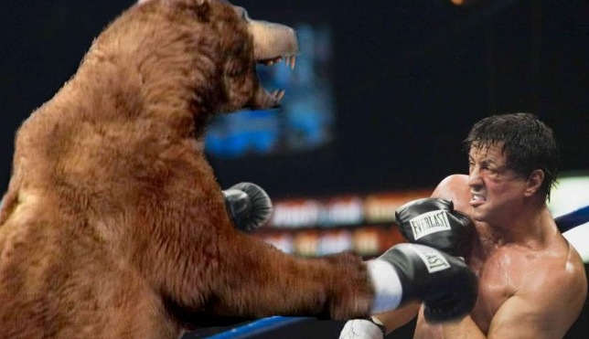
He fights a bear:
Bravely

Slide 18
She speaks so that he can hear:
Audibly

Slide 19
-ful
What it is known for
Full of _____.

Slide 20
Full of beauty:
Beautiful

Slide 21
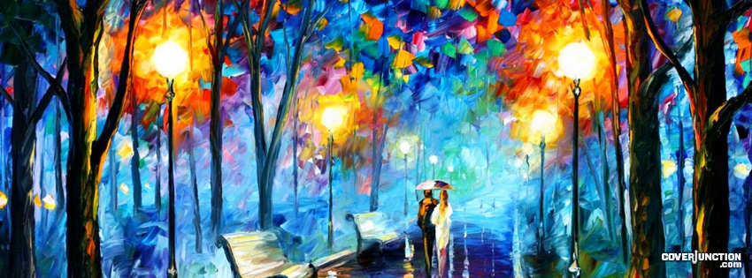
It has a lot of color:
Colorful

Slide 22
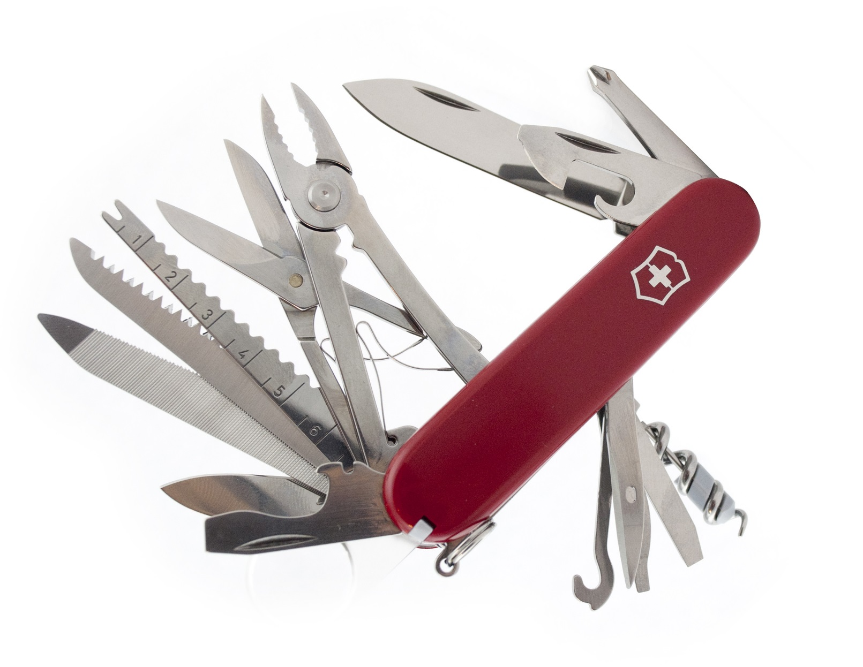
It has many uses:
Useful

Slide 23
She said thank you a lot:
Thankful

Slide 24
-less
Without

Slide 25
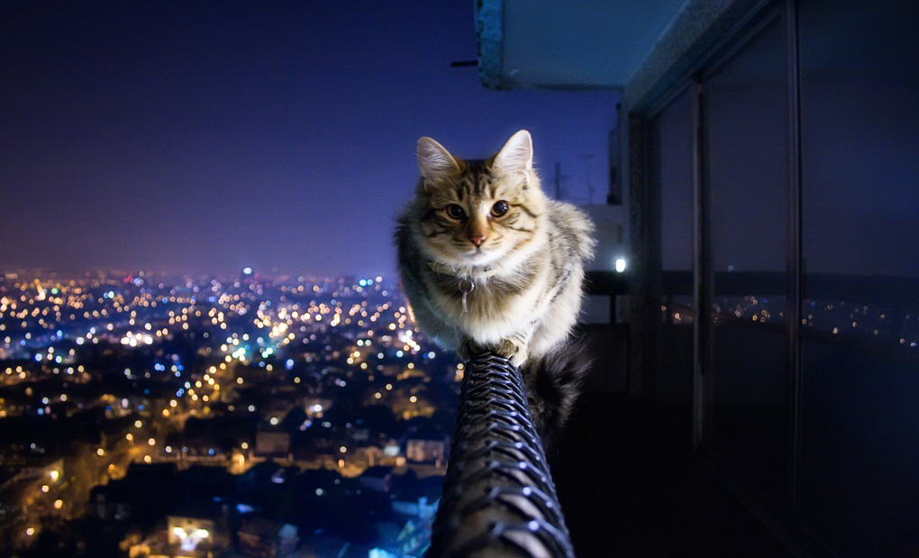
No fear:
Fearless

Slide 26
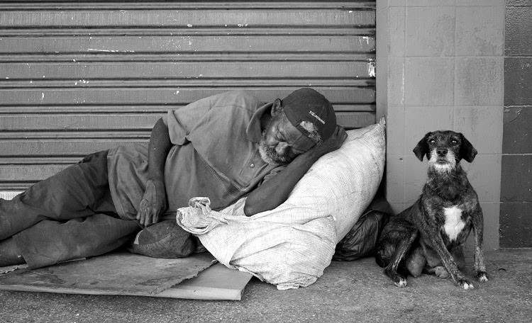
No home:
Homeless

Slide 27
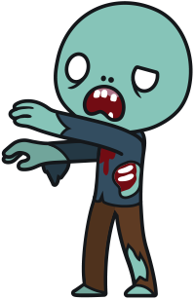
No brain:
Brainless

Slide 28
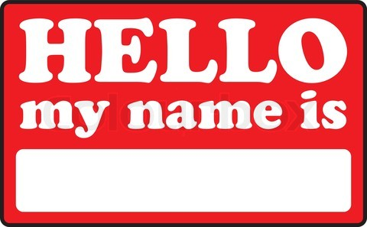
It doesn’t have a name:
Nameless

Slide 29
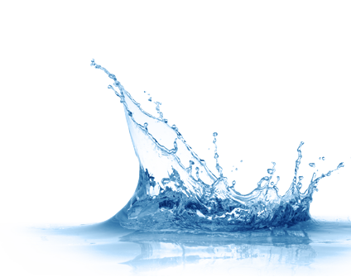
It doesn’t have a taste:
Tasteless

Slide 30
