Slide 1
Compound Words
https://www.youtube.com/watch?v=Ct6BUPvE2sM

Slide 2
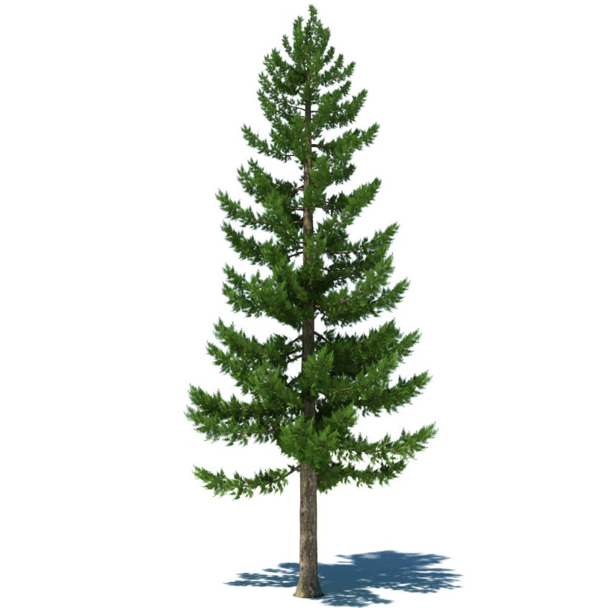
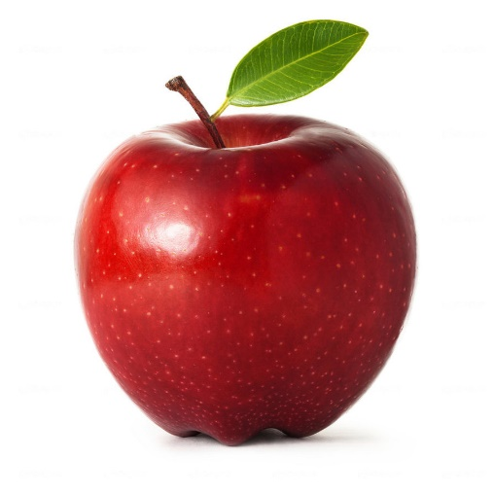
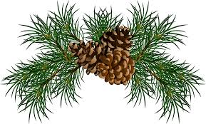
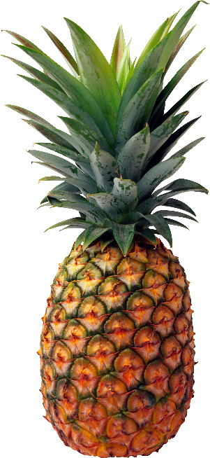
Pine
apple

Slide 3
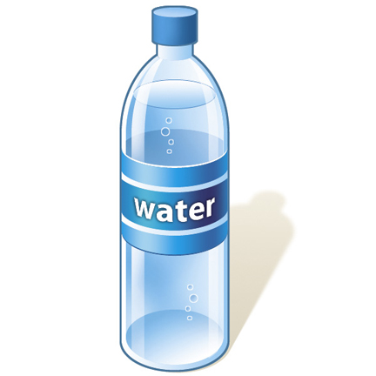
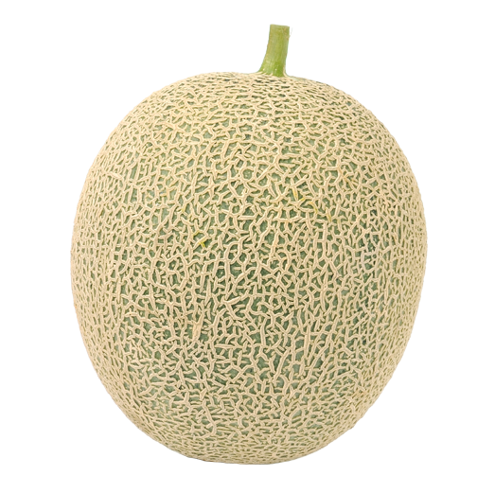
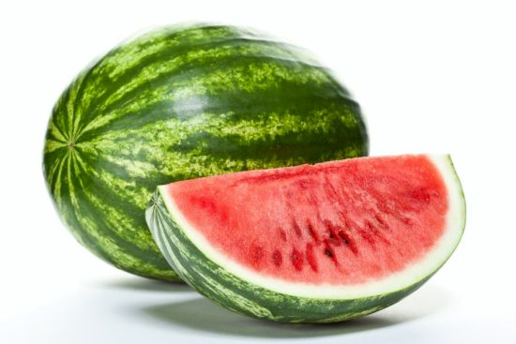
Water
melon

Slide 4
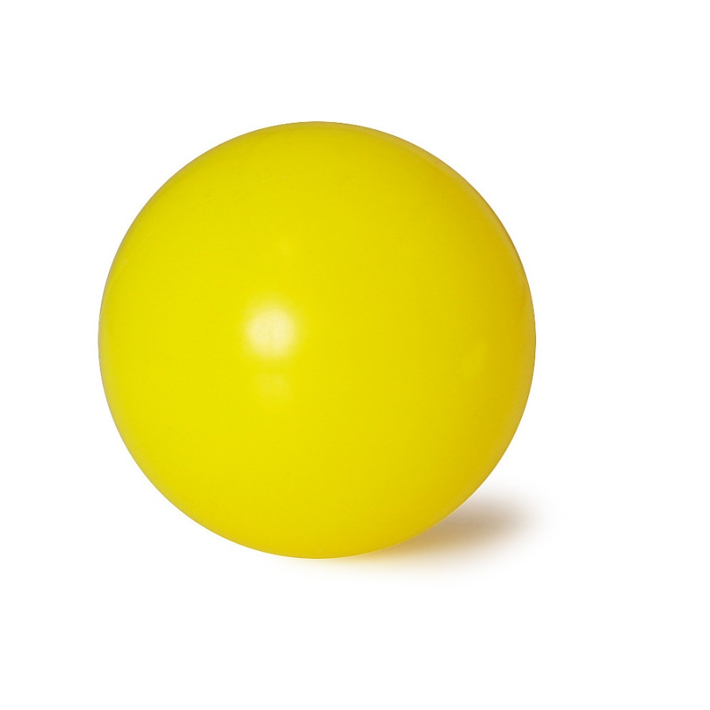
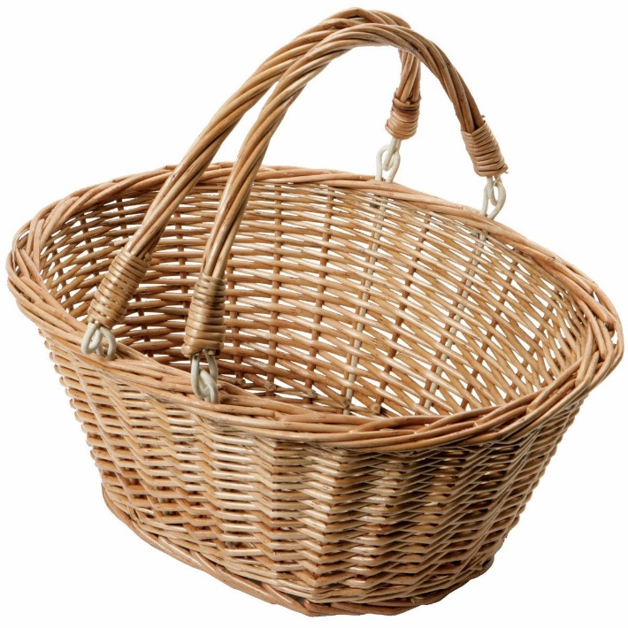
Basket
ball

Slide 5
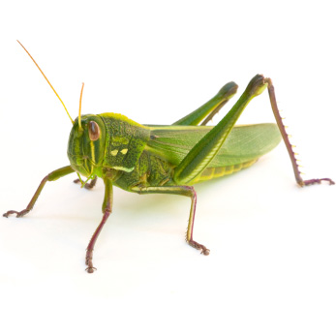
Grass
hopper

Slide 6
Fire
works

Slide 7
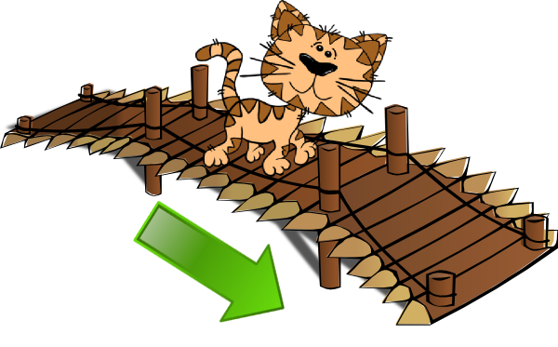
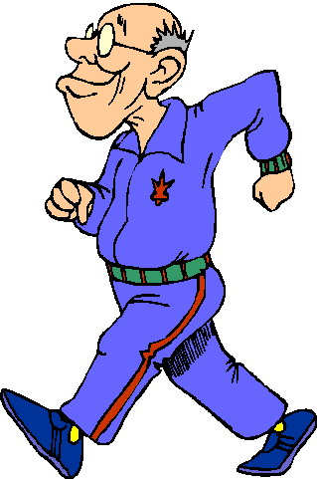
Cross
walk

Slide 8
Some
one
thing
where

Slide 9
Any
one
thing
where

Slide 10
No
one
thing
where

Slide 11
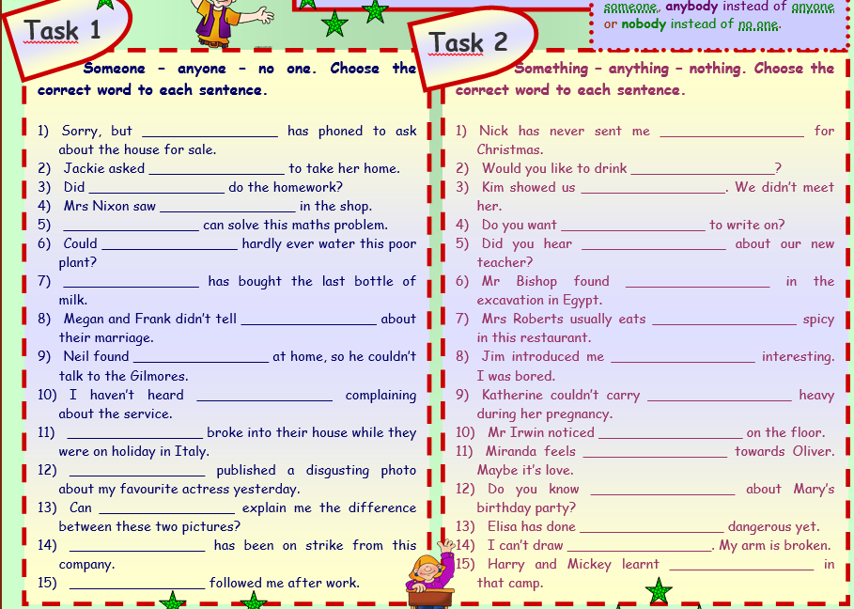
Notes:
https://en.islcollective.com/resources/printables/worksheets_doc_docx/compound_words_made_with_some_any_and_no__grammar__5_tasks__2_pages__with_key__fully_editable/someany-preintermediate-a2/5810

Slide 12
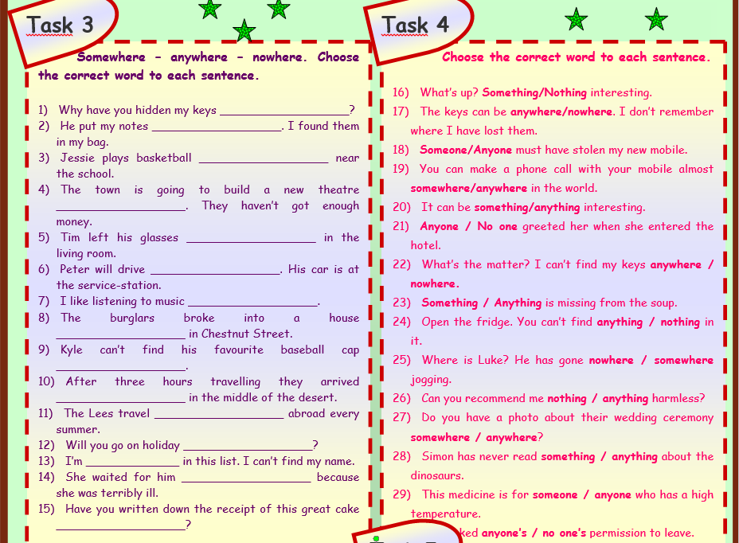
Notes:
https://en.islcollective.com/resources/printables/worksheets_doc_docx/compound_words_made_with_some_any_and_no__grammar__5_tasks__2_pages__with_key__fully_editable/someany-preintermediate-a2/5810

Slide 13
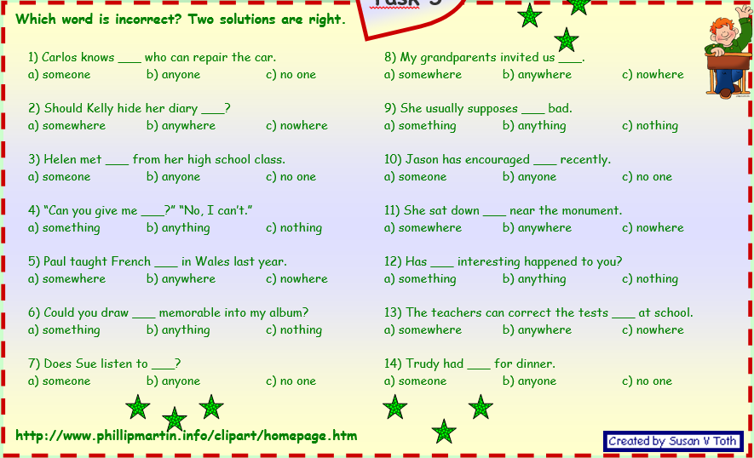
Notes:
https://en.islcollective.com/resources/printables/worksheets_doc_docx/compound_words_made_with_some_any_and_no__grammar__5_tasks__2_pages__with_key__fully_editable/someany-preintermediate-a2/5810

Slide 14
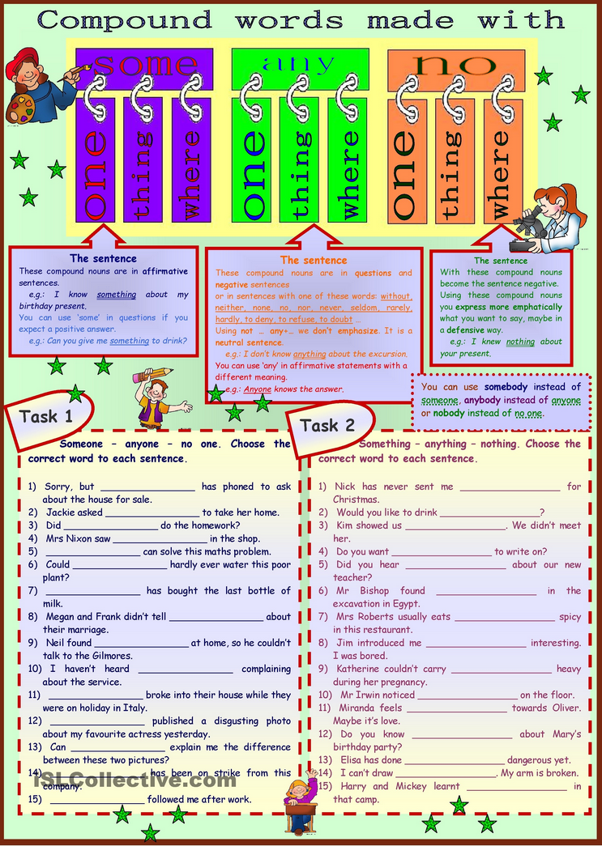
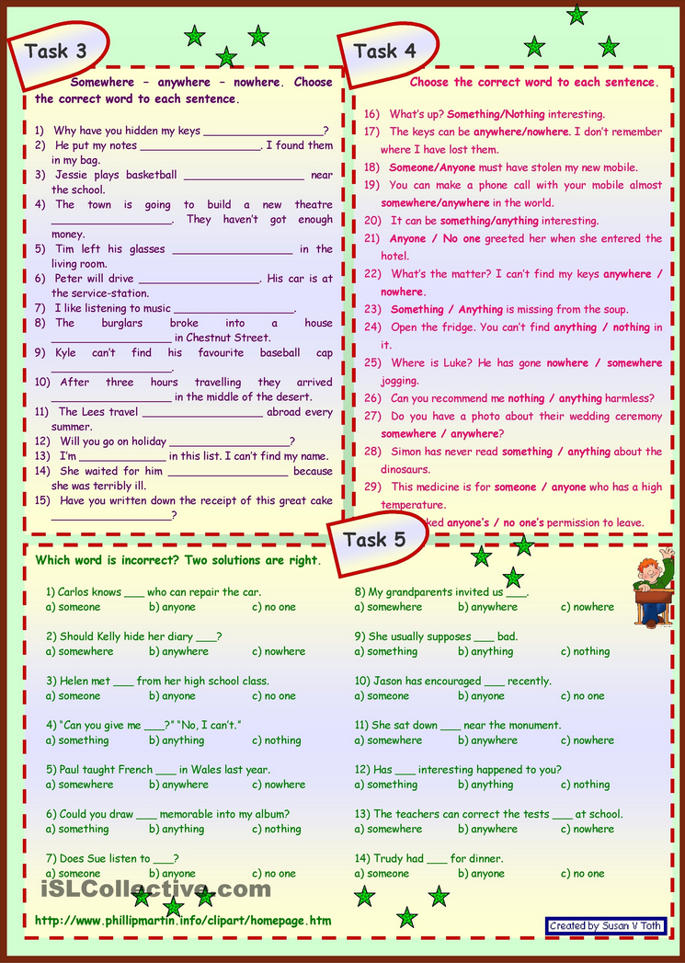
Notes:
https://en.islcollective.com/resources/printables/worksheets_doc_docx/compound_words_made_with_some_any_and_no__grammar__5_tasks__2_pages__with_key__fully_editable/someany-preintermediate-a2/5810

Slide 15
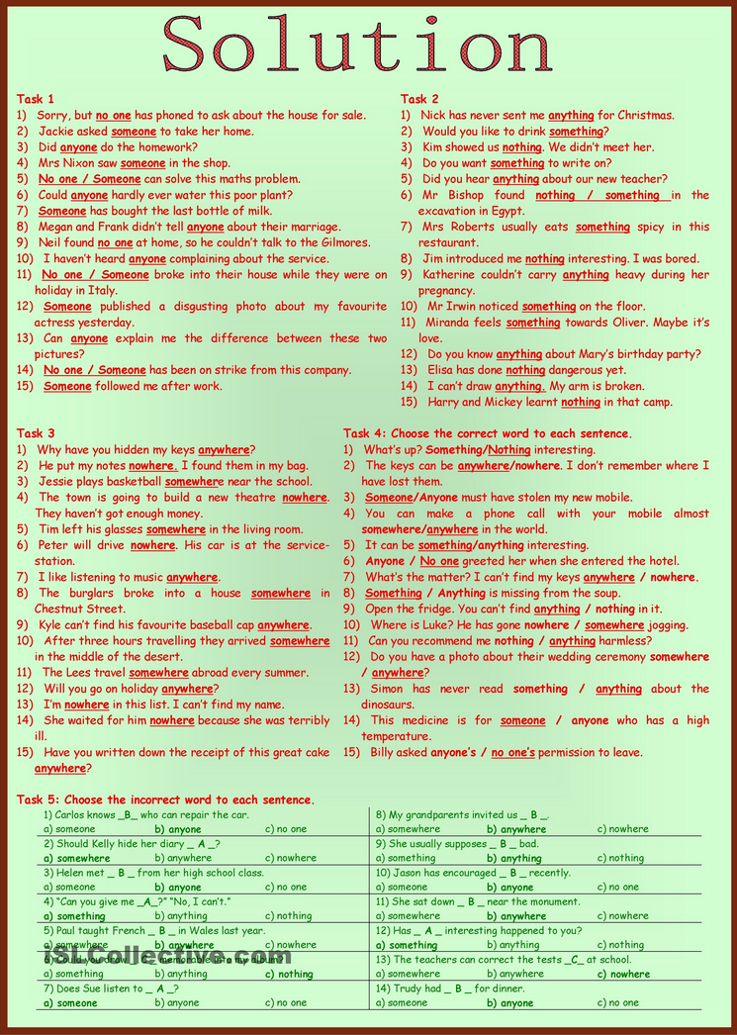
Notes:
https://en.islcollective.com/resources/printables/worksheets_doc_docx/compound_words_made_with_some_any_and_no__grammar__5_tasks__2_pages__with_key__fully_editable/someany-preintermediate-a2/5810

Slide 16
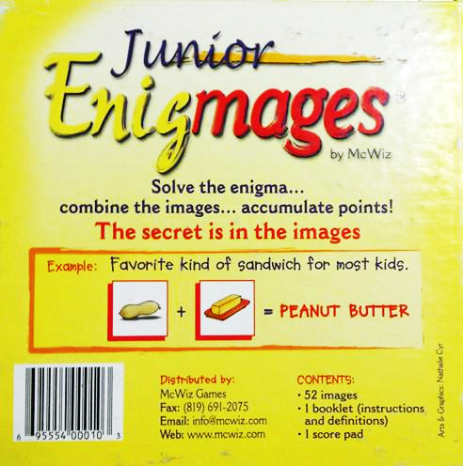
Other Compound Words:
Enigmas

