Slide 1
Tiny titans

Slide 2
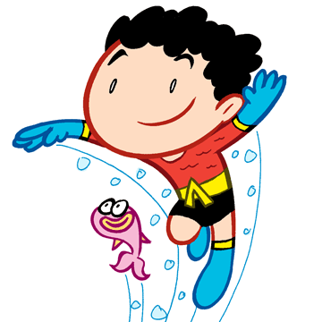
Communicate –
Sea life -

Slide 3
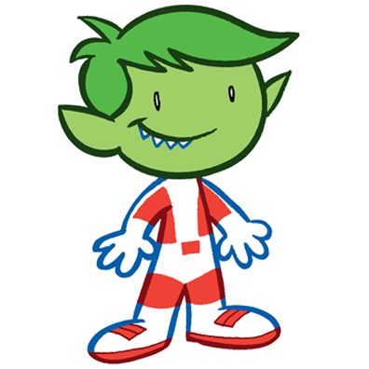
Desires –
Prankster –
Crush (love) -

Slide 4
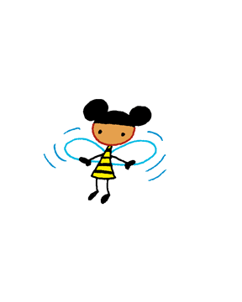
Tiniest -
Buzz -
Stinger -

Slide 5
Hip -
Pop culture -

Slide 6
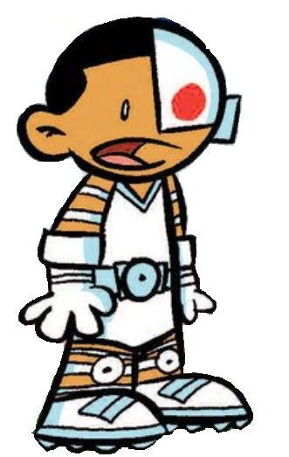
Tinkering –
Gadgets –
Battle Cry -

Slide 7
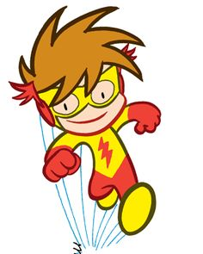
Quick witted –
High metabolism –
Sugar Rush -

Slide 8
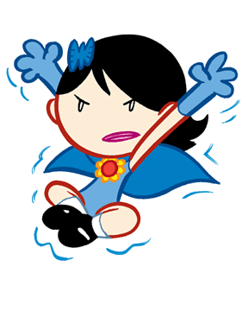
Mysterious –
Practical Joke –
Substitute Teacher -

Slide 9
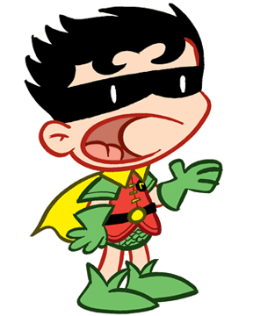
Brave –
Moody –
Crush (love) -

Slide 10
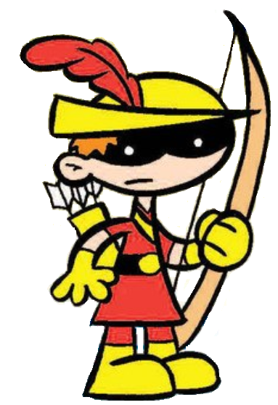
Trick Shot –
Aiming (aim) –

Slide 11
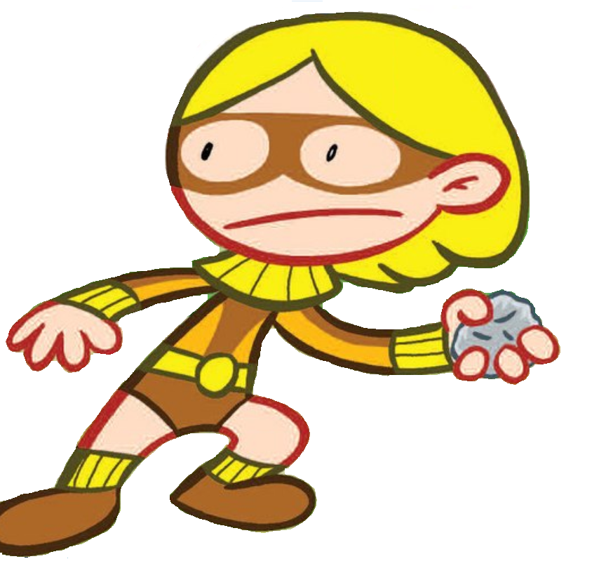
Principal –
Teacher’s Pet –
Weirdo -

Slide 12
Naïve -
Free Spirited –
Crush (love) –

Slide 13
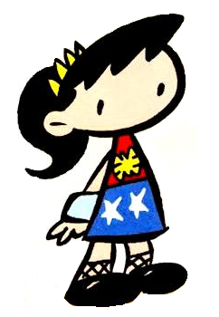
Amazon Women –
Skeptical (Skeptic) -

Slide 14
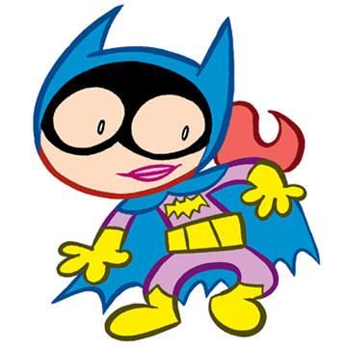
Barbara Gordon

