Slide 1
http://guardiansofthegalaxy.marvelkids.com/games/guardians-of-the-galaxy-defend-the-galaxy

Slide 2
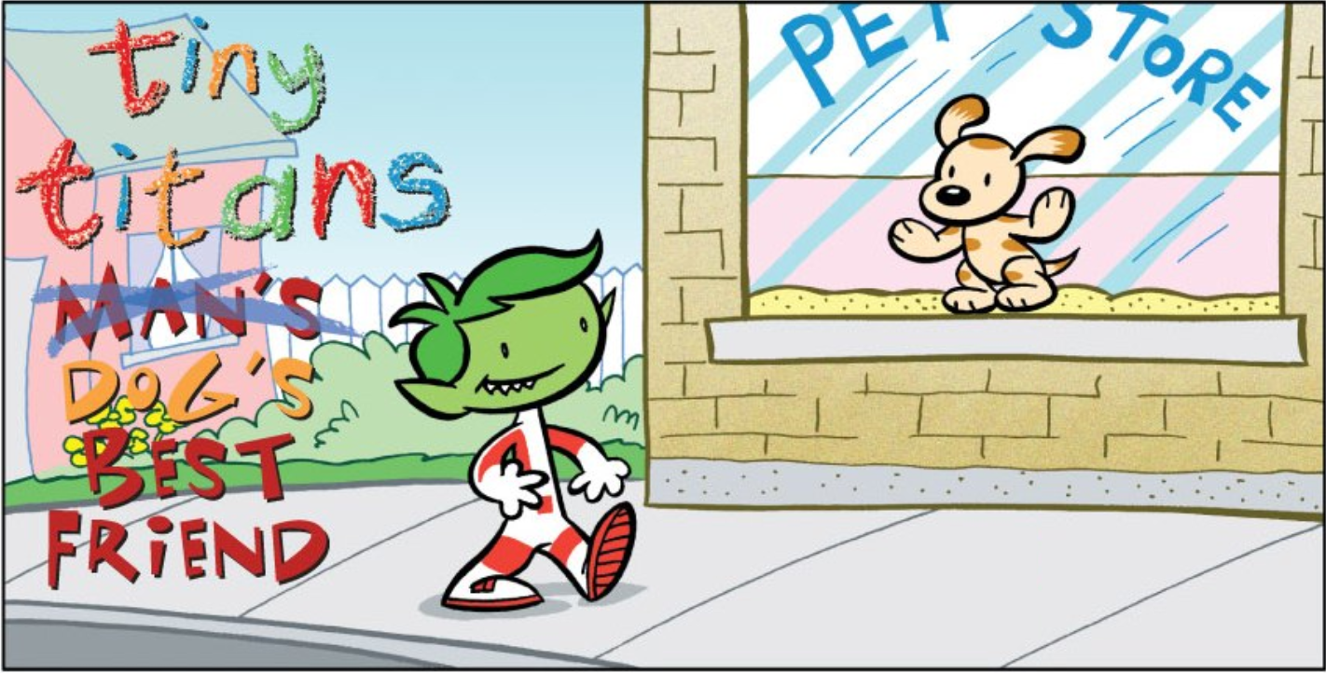

Slide 3
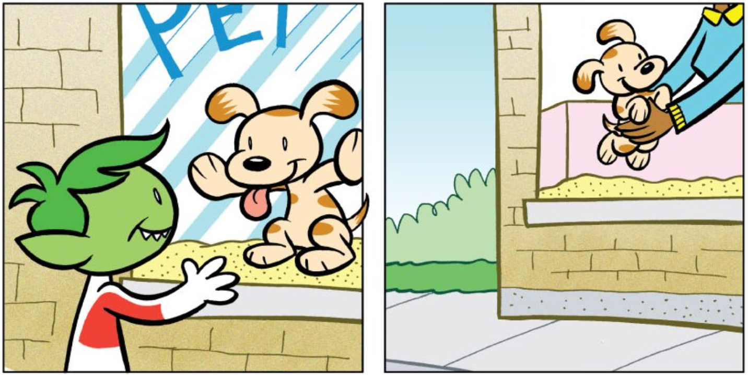

Slide 4
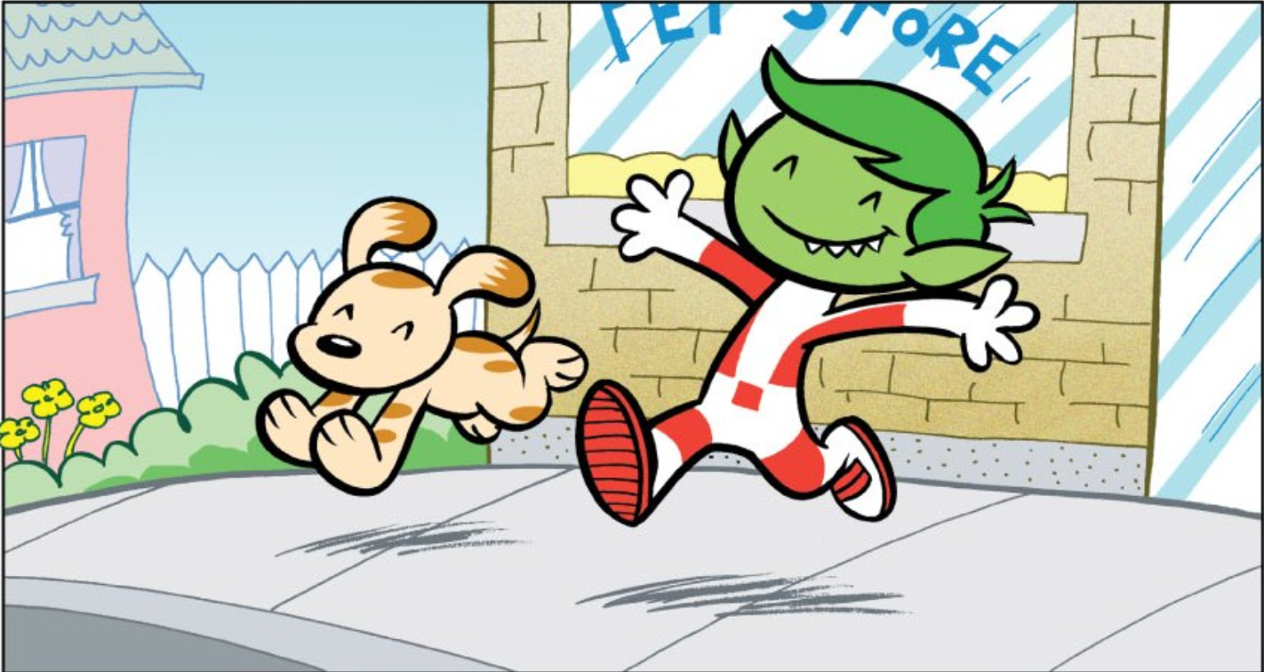

Slide 5
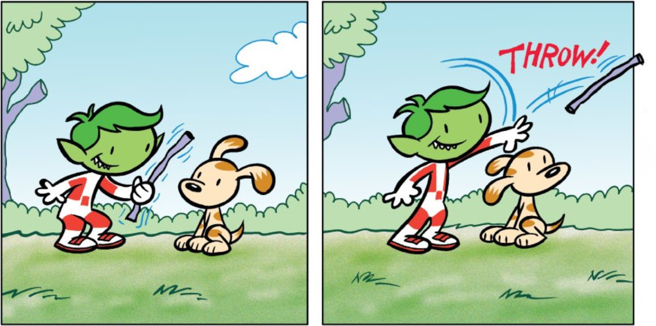

Slide 6
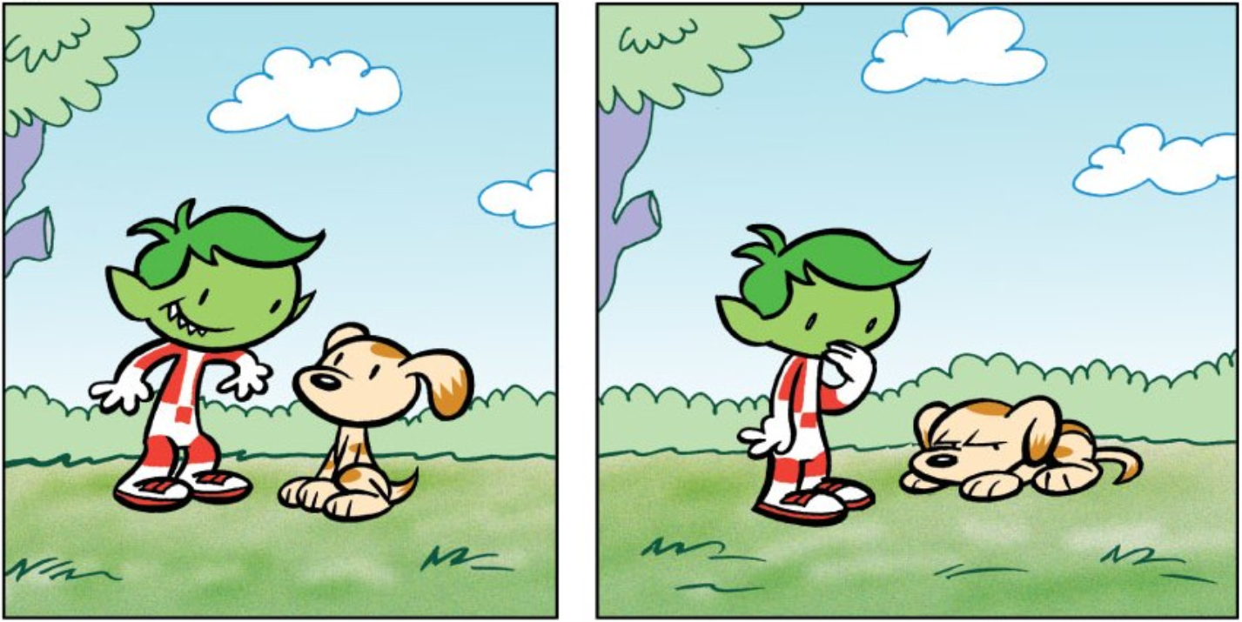

Slide 7
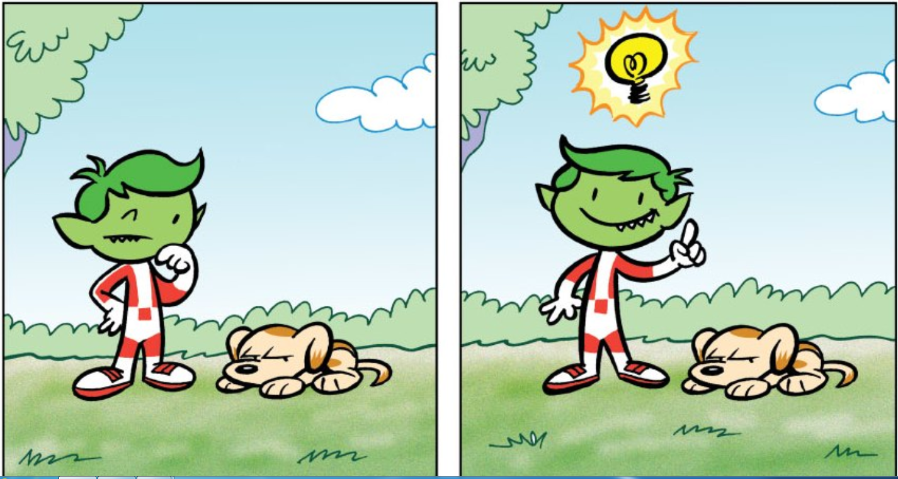

Slide 8
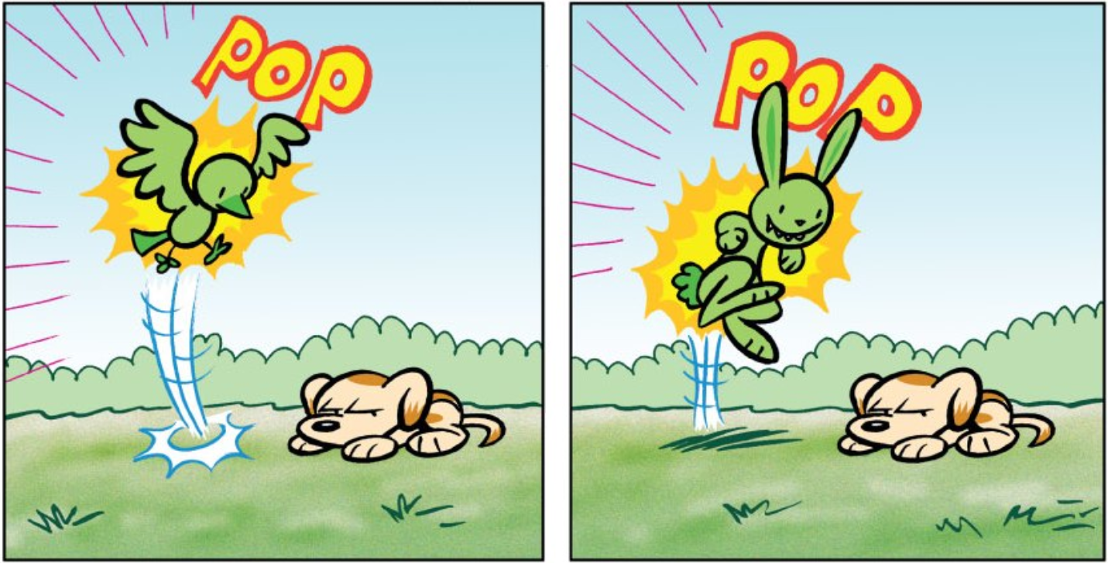

Slide 9
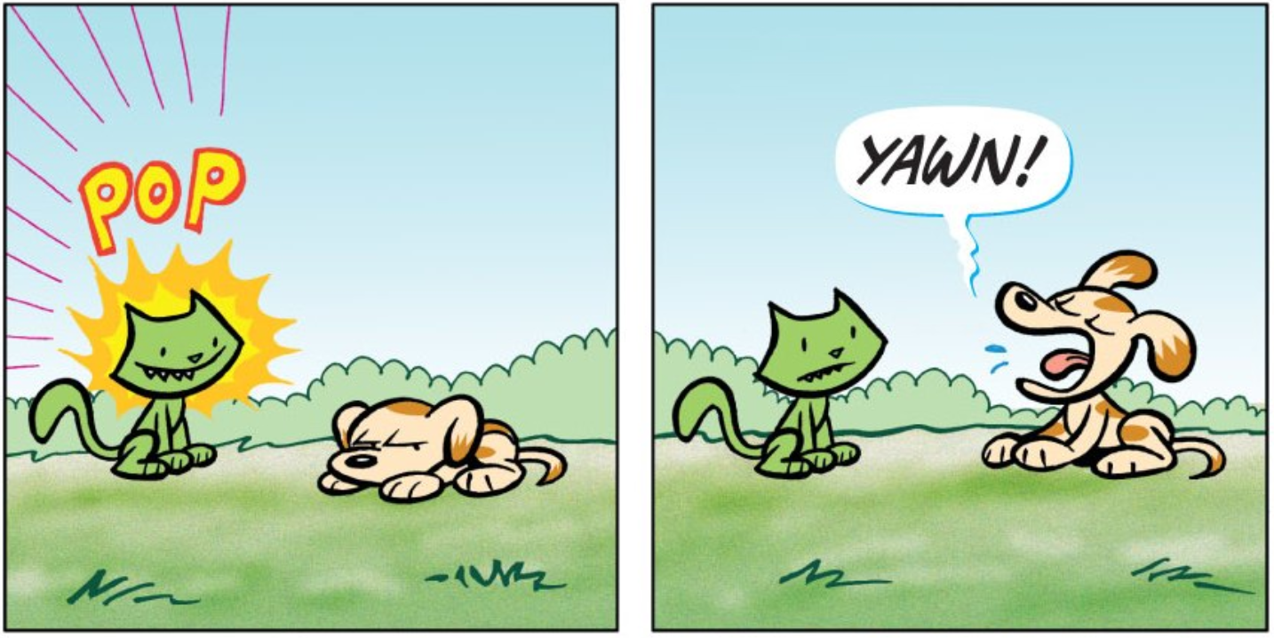

Slide 10
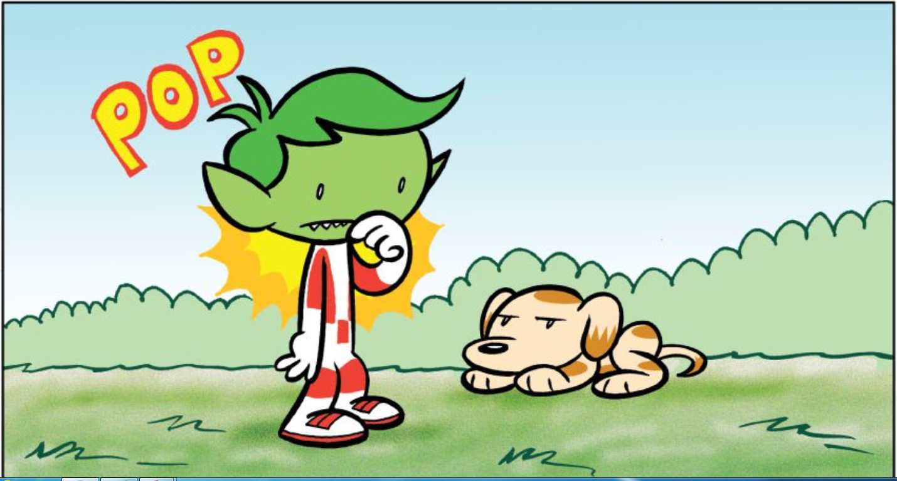

Slide 11
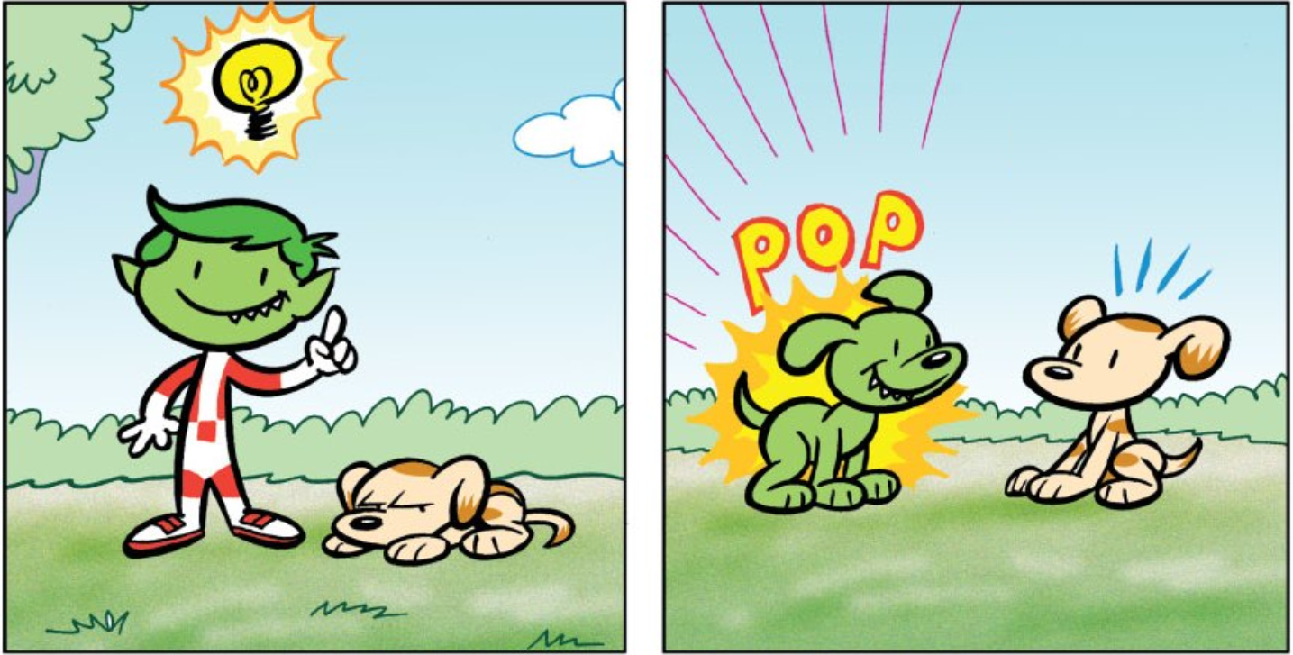

Slide 13
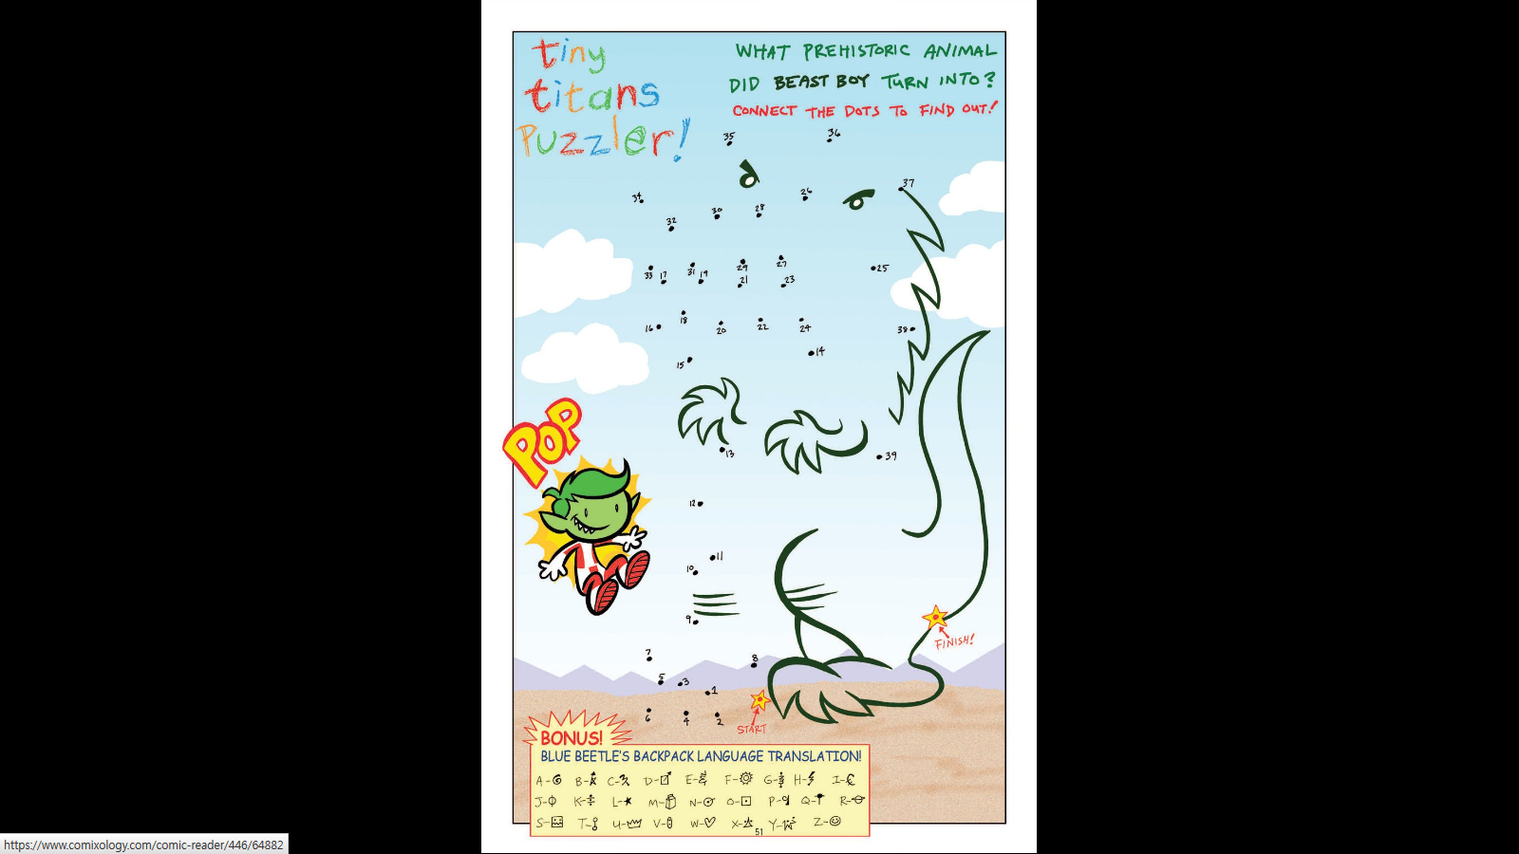

Slide 14
Super Powers

Slide 15
Brainstorm Super Powers:

Slide 16
Super Powers:

Slide 17
Super Powers:

Slide 18
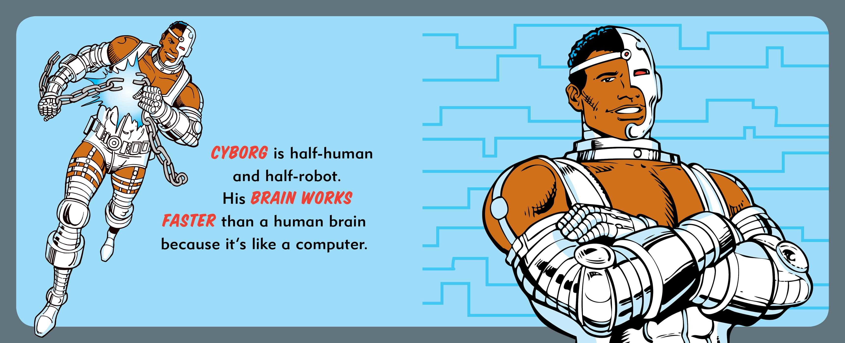
Super Powers:

Slide 19
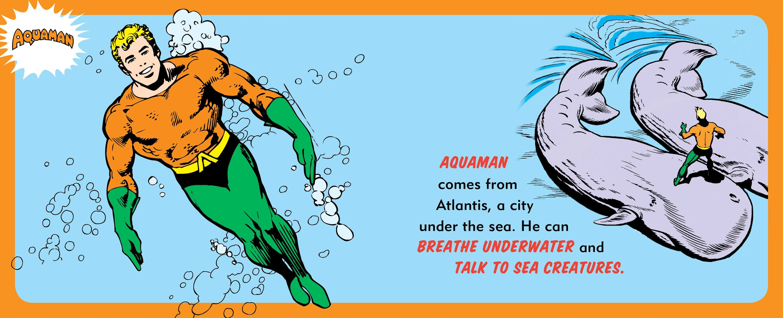
Super Powers:

Slide 20
Super Powers:

Slide 21
Super Powers:

Slide 22
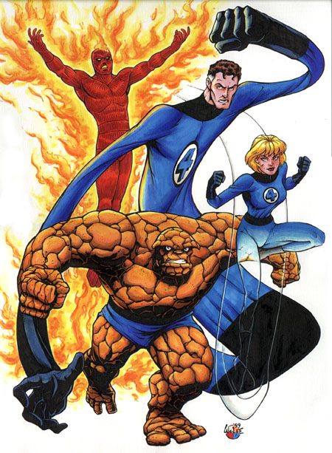
Brainstorm Super Powers:

Slide 23
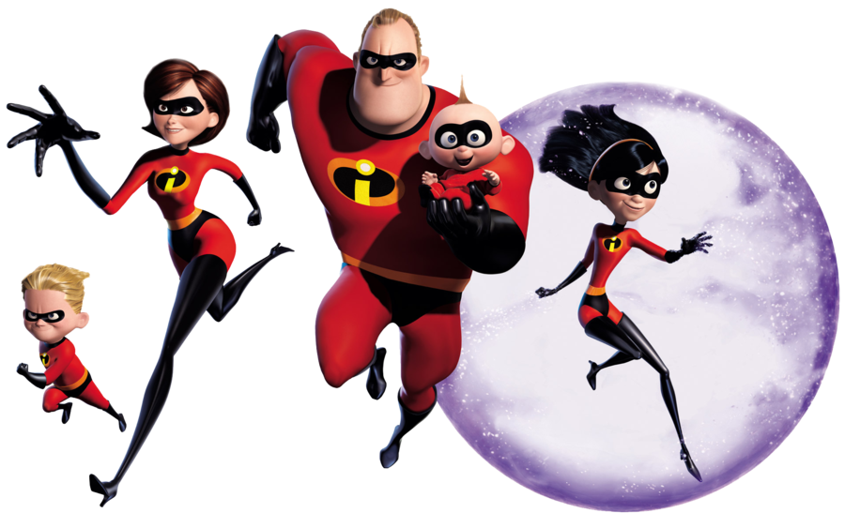
Brainstorm Super Powers:

Slide 24
Brainstorm Super Powers:

Slide 25
Brainstorm Super Powers:
Super smell
Super sight
Super hearing

Slide 26
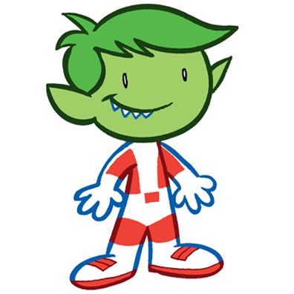
Brainstorm Super Powers:

Slide 27
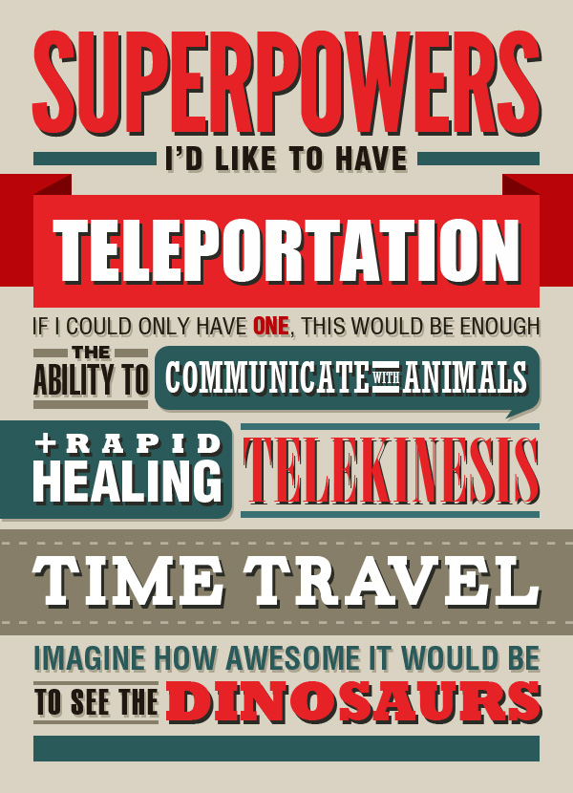
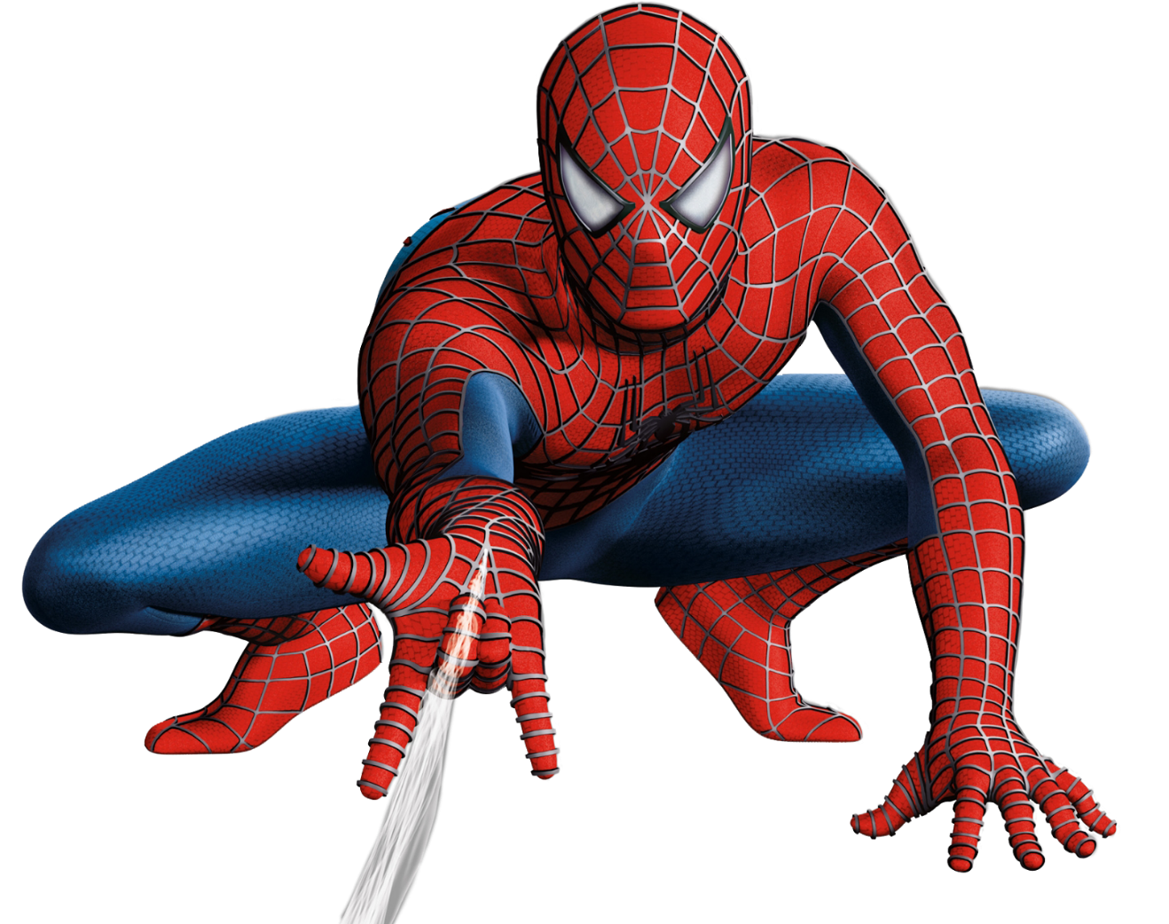
Brainstorm Super Powers:

Slide 28
- People can’t see you
Invisibility

Slide 29
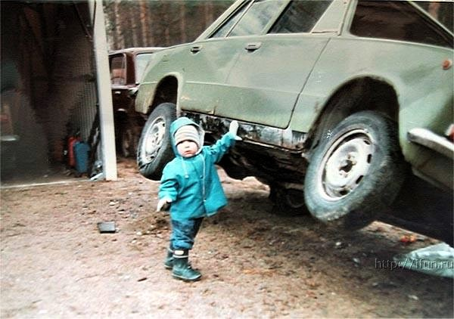
- Very, very strong
Super Strength

Slide 30
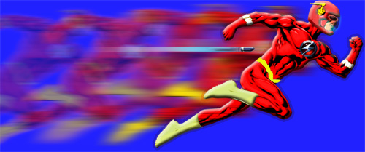
- Very, very fast
Super Speed

Slide 31
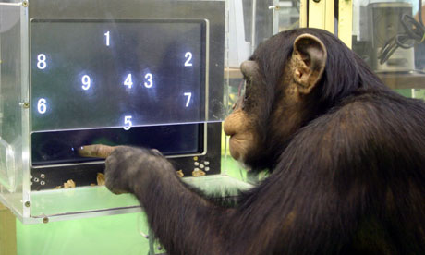
- Very, very smart
Super Genius

Slide 32
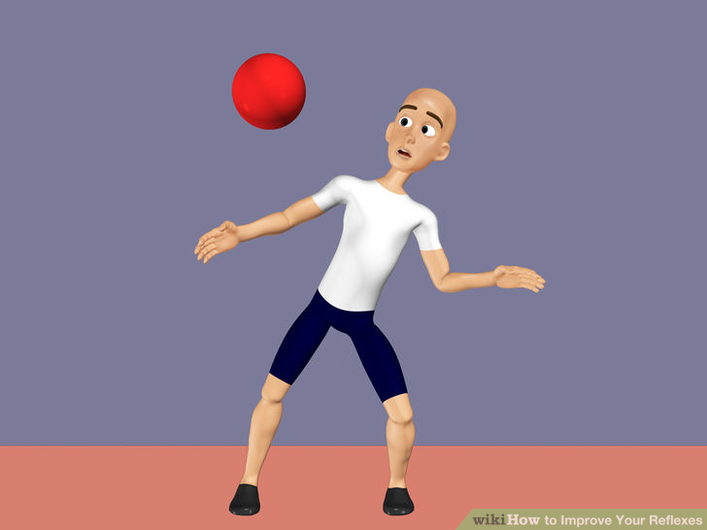
- Can react and move quickly
Quick Reflexes

Slide 33
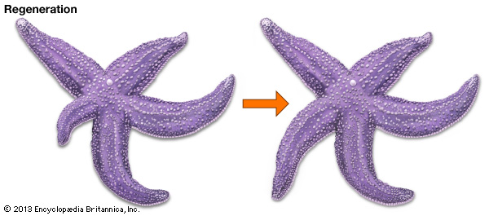
- Can grow new body parts
Regeneration

Slide 34
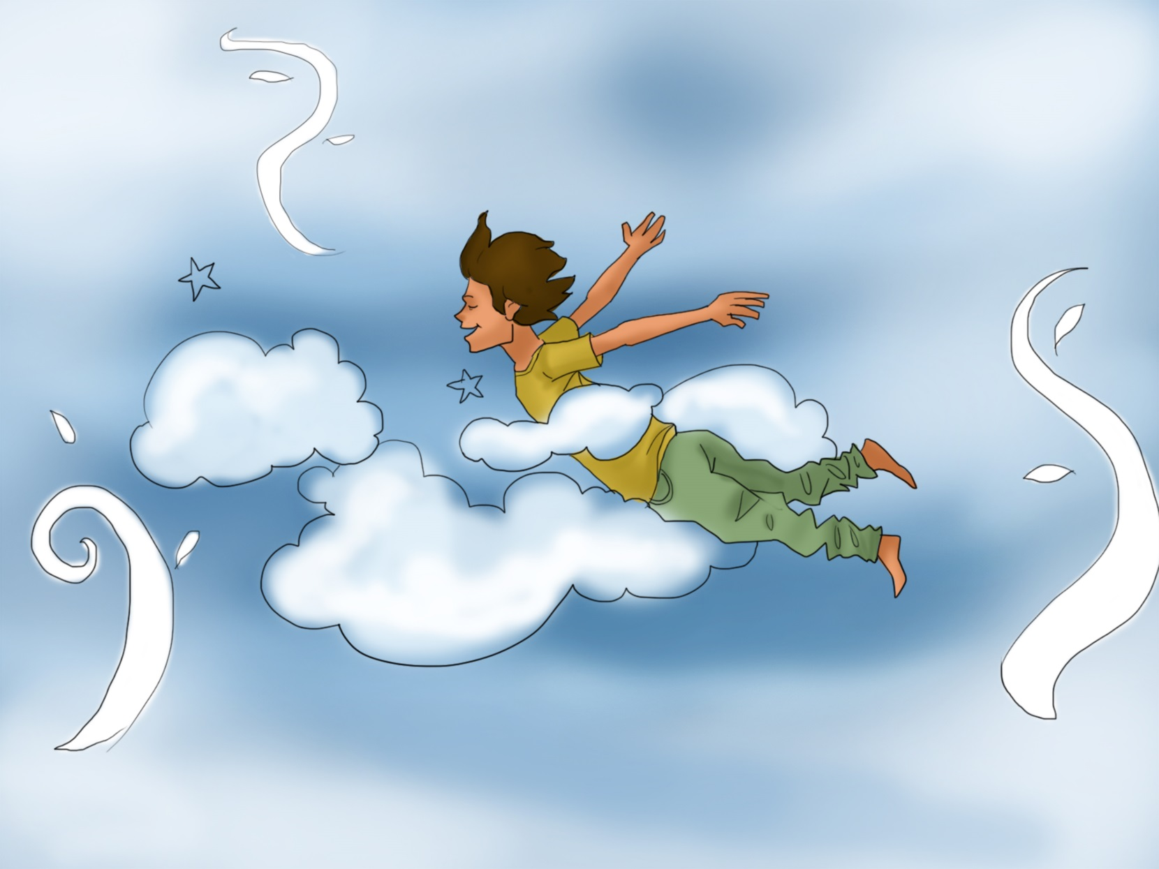
- Flying
Flight

Slide 35
- Move from one place to another
Teleportation

Slide 36
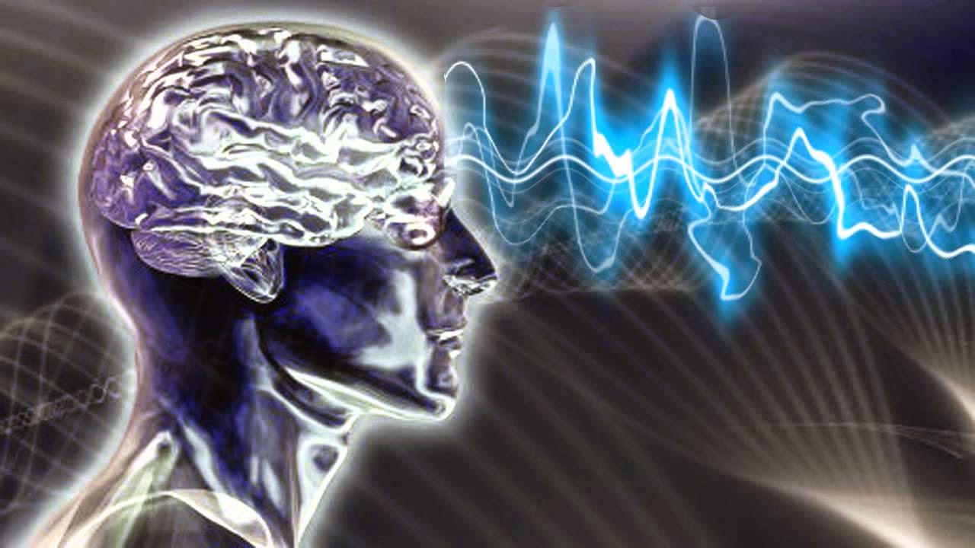
- Make other people do what you want
Mind-Control

Slide 37
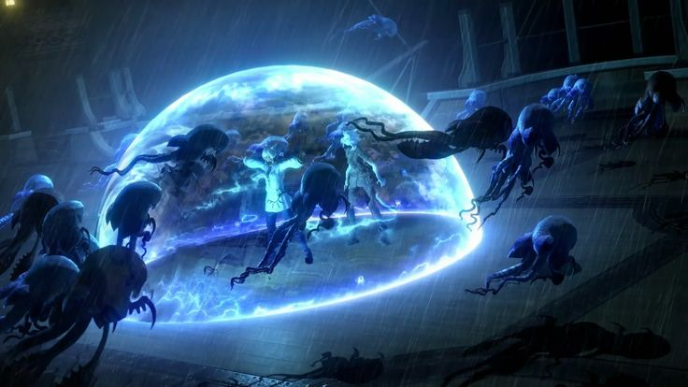
- Create a bubble that protects you
Force Field

Slide 38
- Change into another shape
Shape-Shifting

Slide 39
- Power over the weather
Weather Control

Slide 40
- Know what people are thinking
Mind Reading

Slide 41
What Super Power do you Want?

Slide 42
Choose a Super Power
How would you use that power?

Slide 43
Homework
Choose a character:
Copy the picture and find out what the words mean

Slide 44
Create a Hero
http://www.dckids.com/dcnation/htmlgame/id/20446

