Slide 1
Compound Words 2

Slide 2
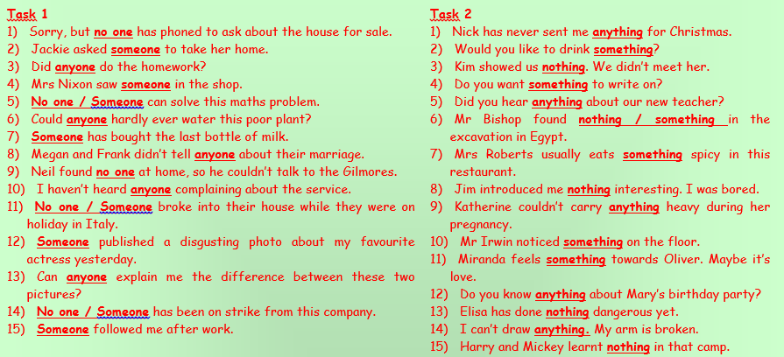
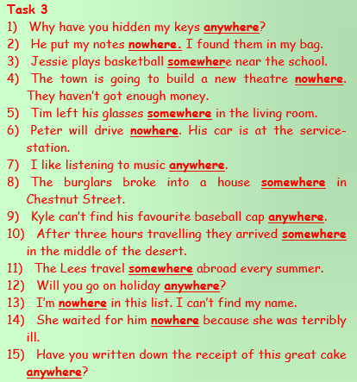
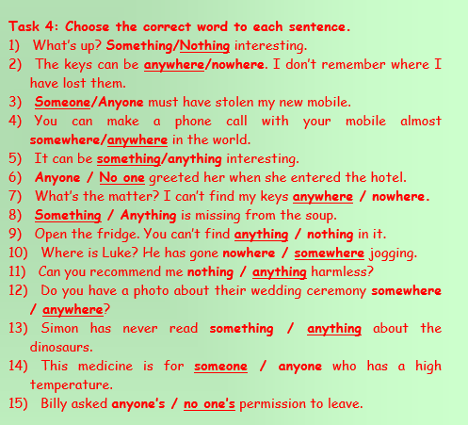

Slide 3
Use the picture clues to find the answer.

Slide 4
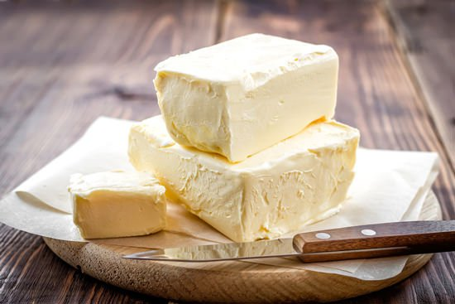
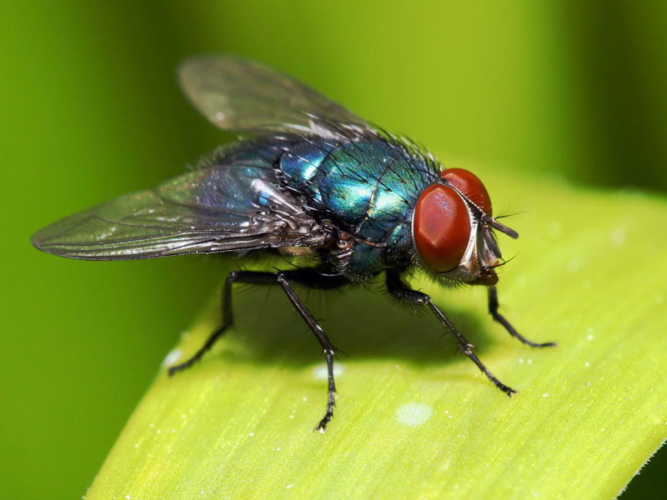
Butterfly

Slide 5
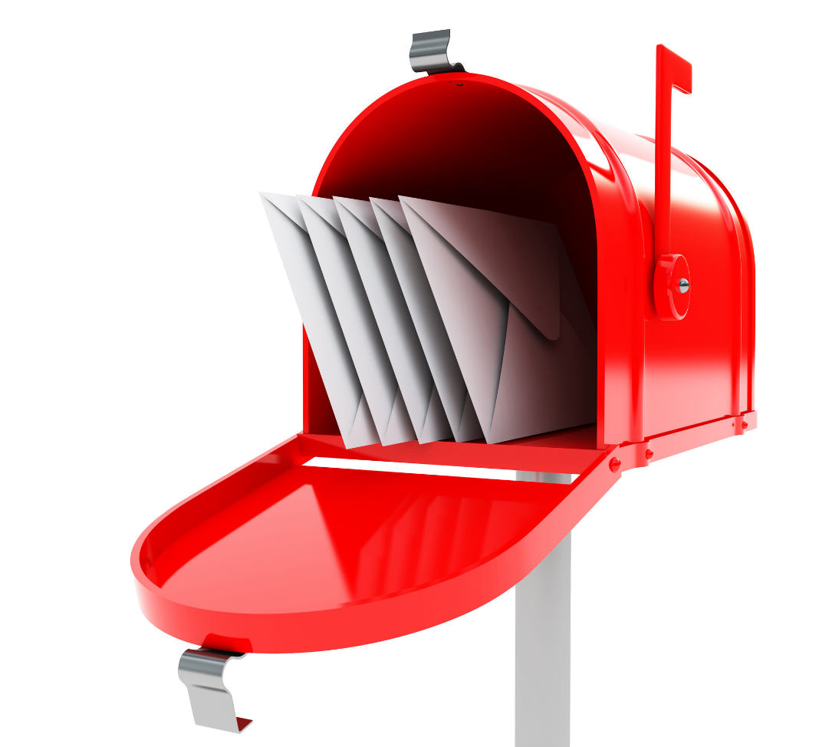
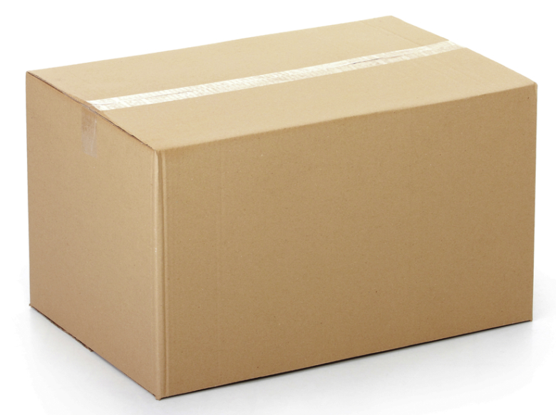
Mailbox

Slide 6
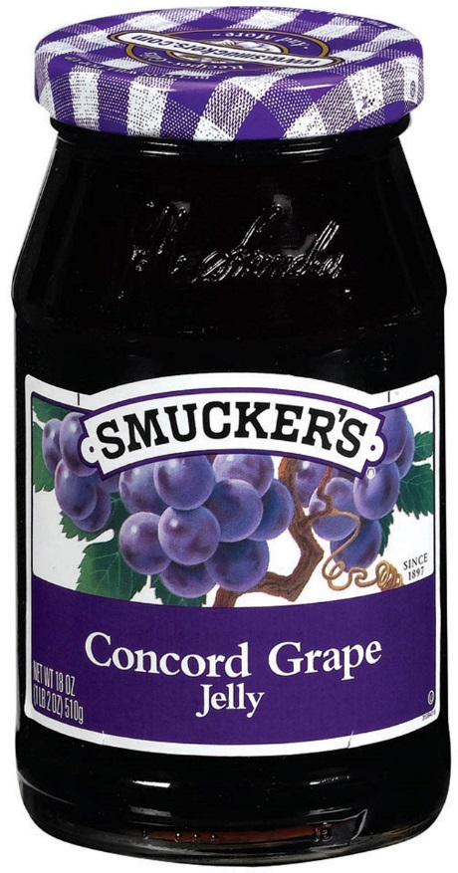
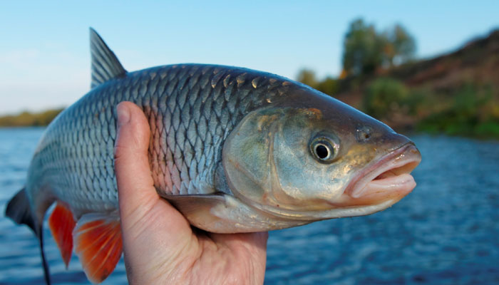
Jellyfish

Slide 7
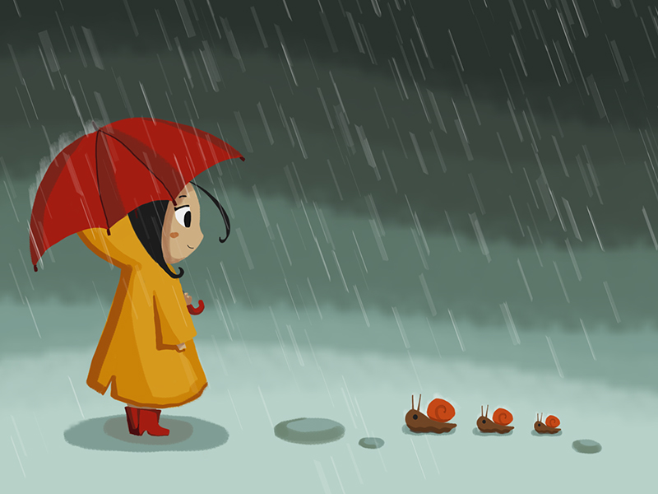
Rainbow

Slide 8
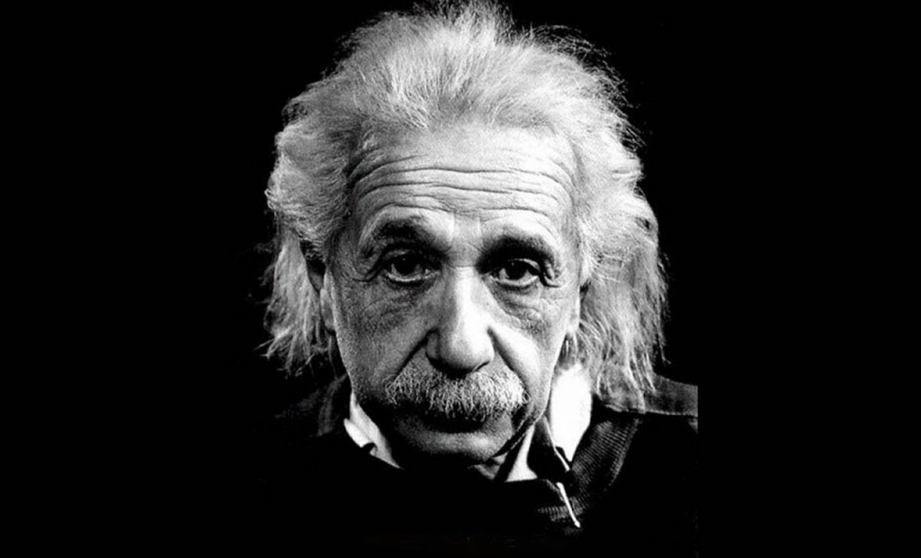
Smartphone

Slide 9
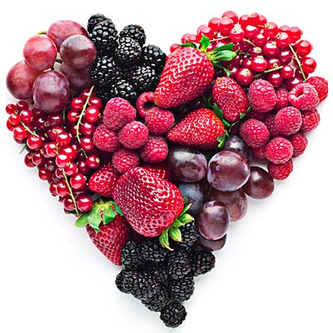
Blueberry

Slide 10
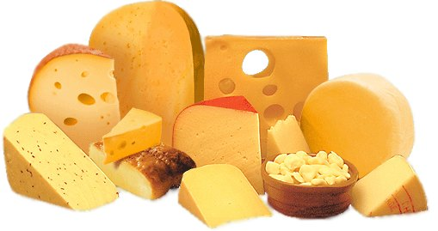
Cheesecake

Slide 11
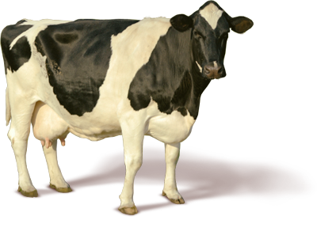
Cowboy

Slide 12
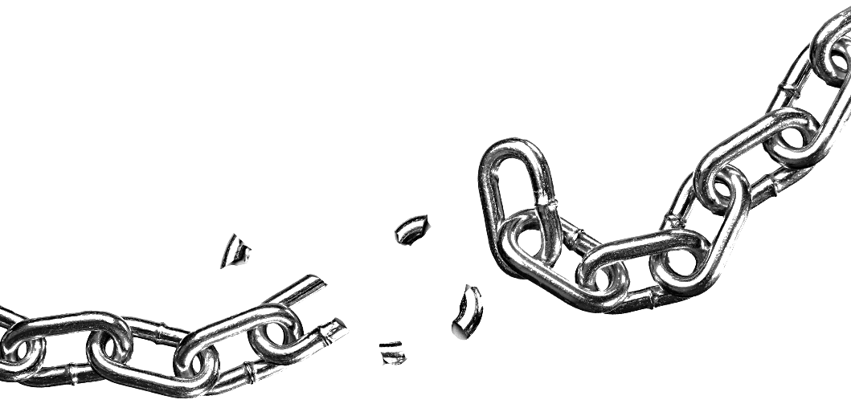
Breakfast

Slide 13
Keyboard

Slide 14
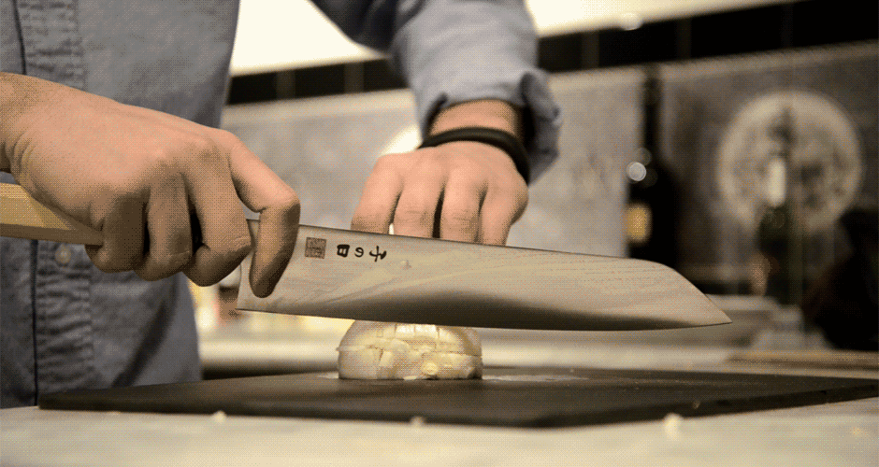
Chopstick

Slide 15
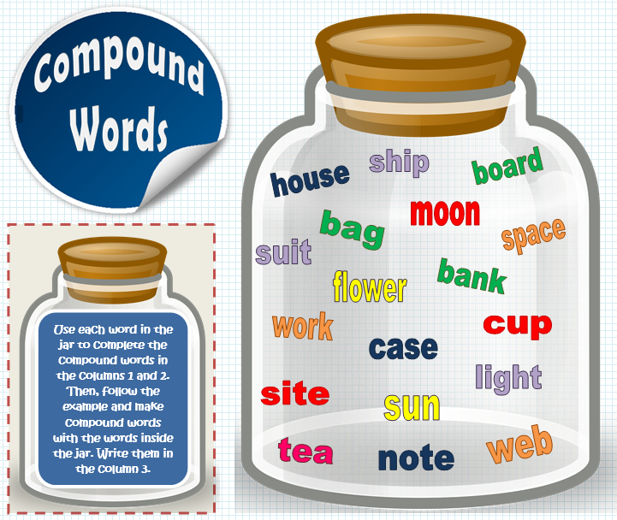
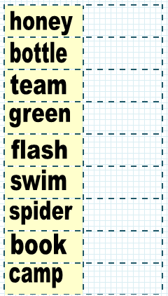
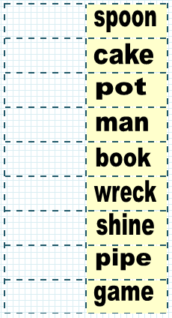
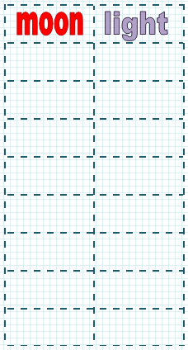

Slide 16
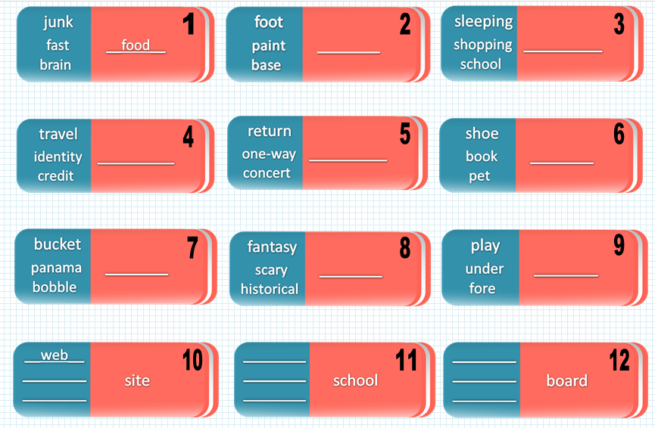

Slide 17
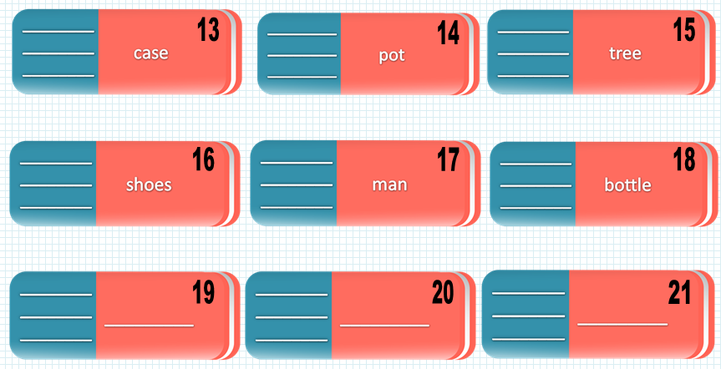

Slide 18
Compound Words Memory Game

Slide 19
Find the word that doesn’t match.
Make compounds words with the cards.
One card doesn’t have a match.
Car
Berry
Blue

Slide 20
Turn over and mix
Take turns flipping over cards.
The first one to find a match takes the cards. (touch the cards)
Book
Port
Air
Spider
Flash
Web

