Slide 1
Alien Planets

Slide 2
Review
What is adaptation?
Can you make an example?

Slide 3
What is the sun?
It’s a star!
The “sun” is the name that we gave our star.

Slide 4
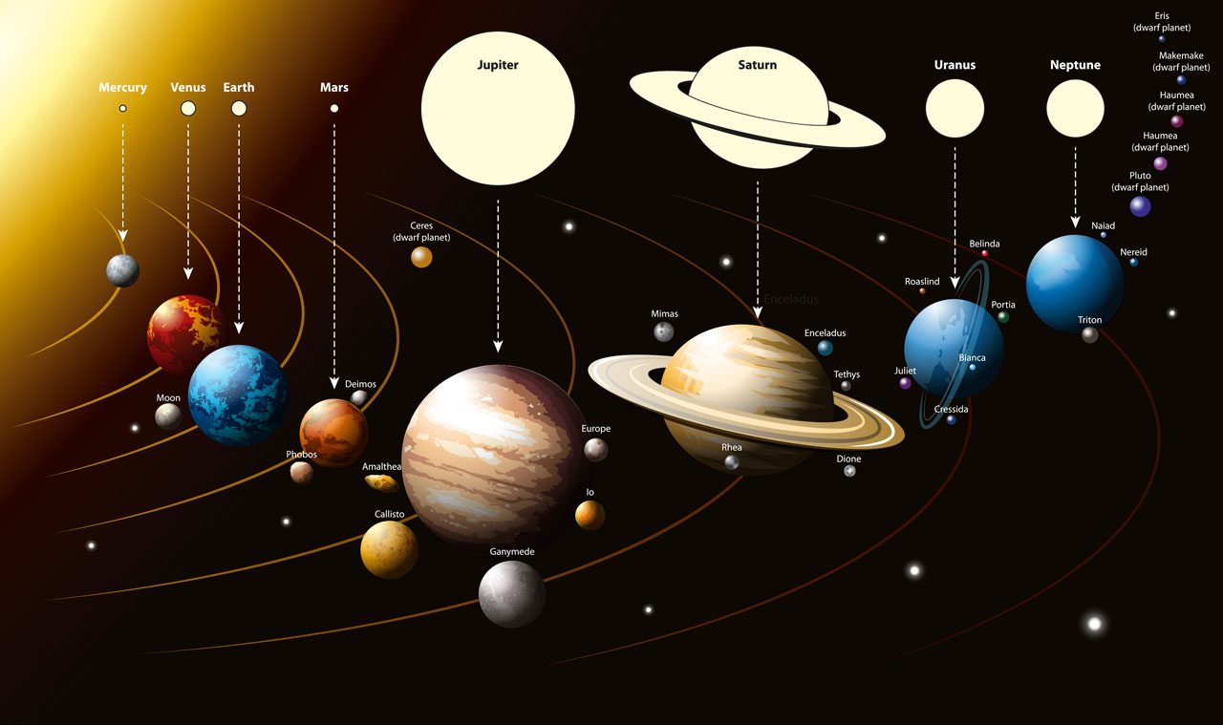
How many planets are around our star?
There are 8
BUT
There are many more that are just a little smaller

Slide 5
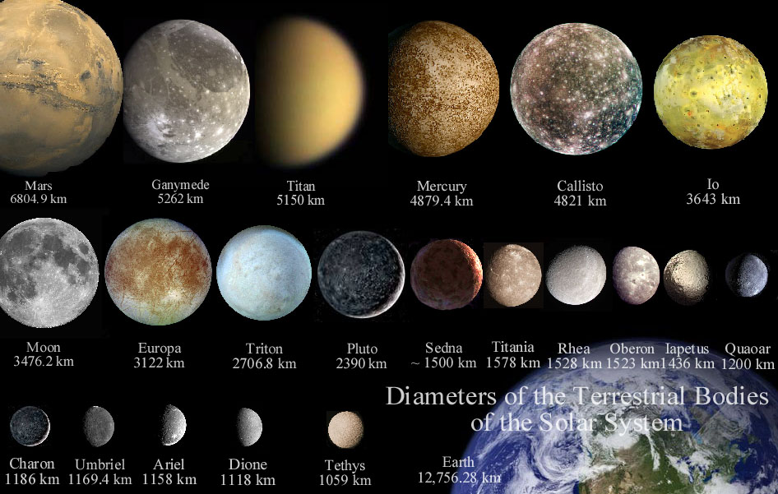
How many stars are there?
There are about 1,000,000,000,000,000,000,000 stars in our universe
If each star has 8 planets, there are about 8,000,000,000,000,000,000,000 planets.
Some moons might are big enough to be planets.

Slide 6
Alien Planets
So far we don’t know too much about far away planets.
They are very difficult to see and find.
But we know about some.
We found one planet that is similar to earth
Kepler 186f

Slide 7
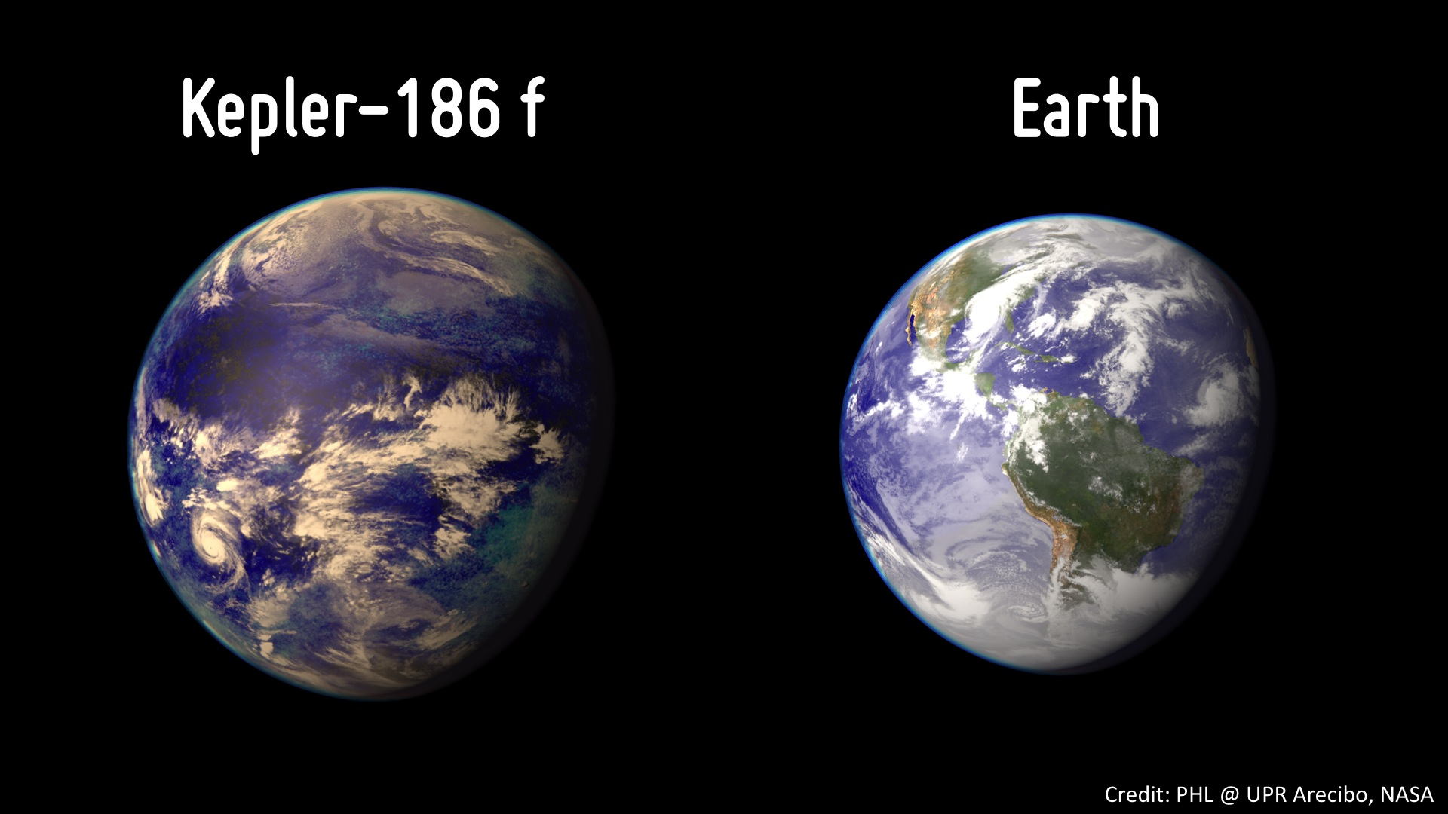

Slide 8
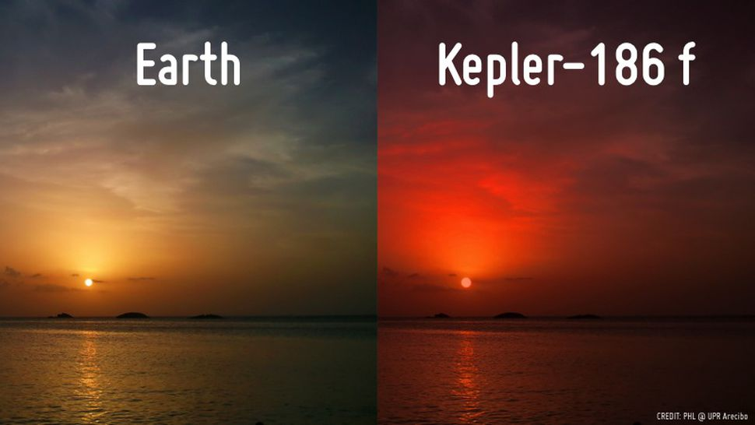

Slide 9
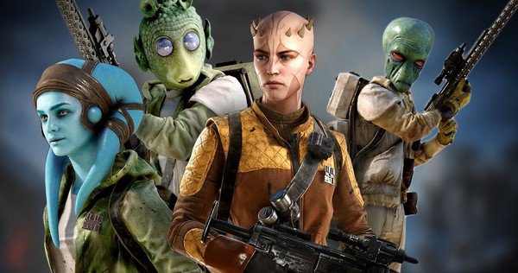
Think about Kepler 186f
If animals live there, they would not be like on earth
What would they look like?

Slide 10
Types of planets:

Slide 11
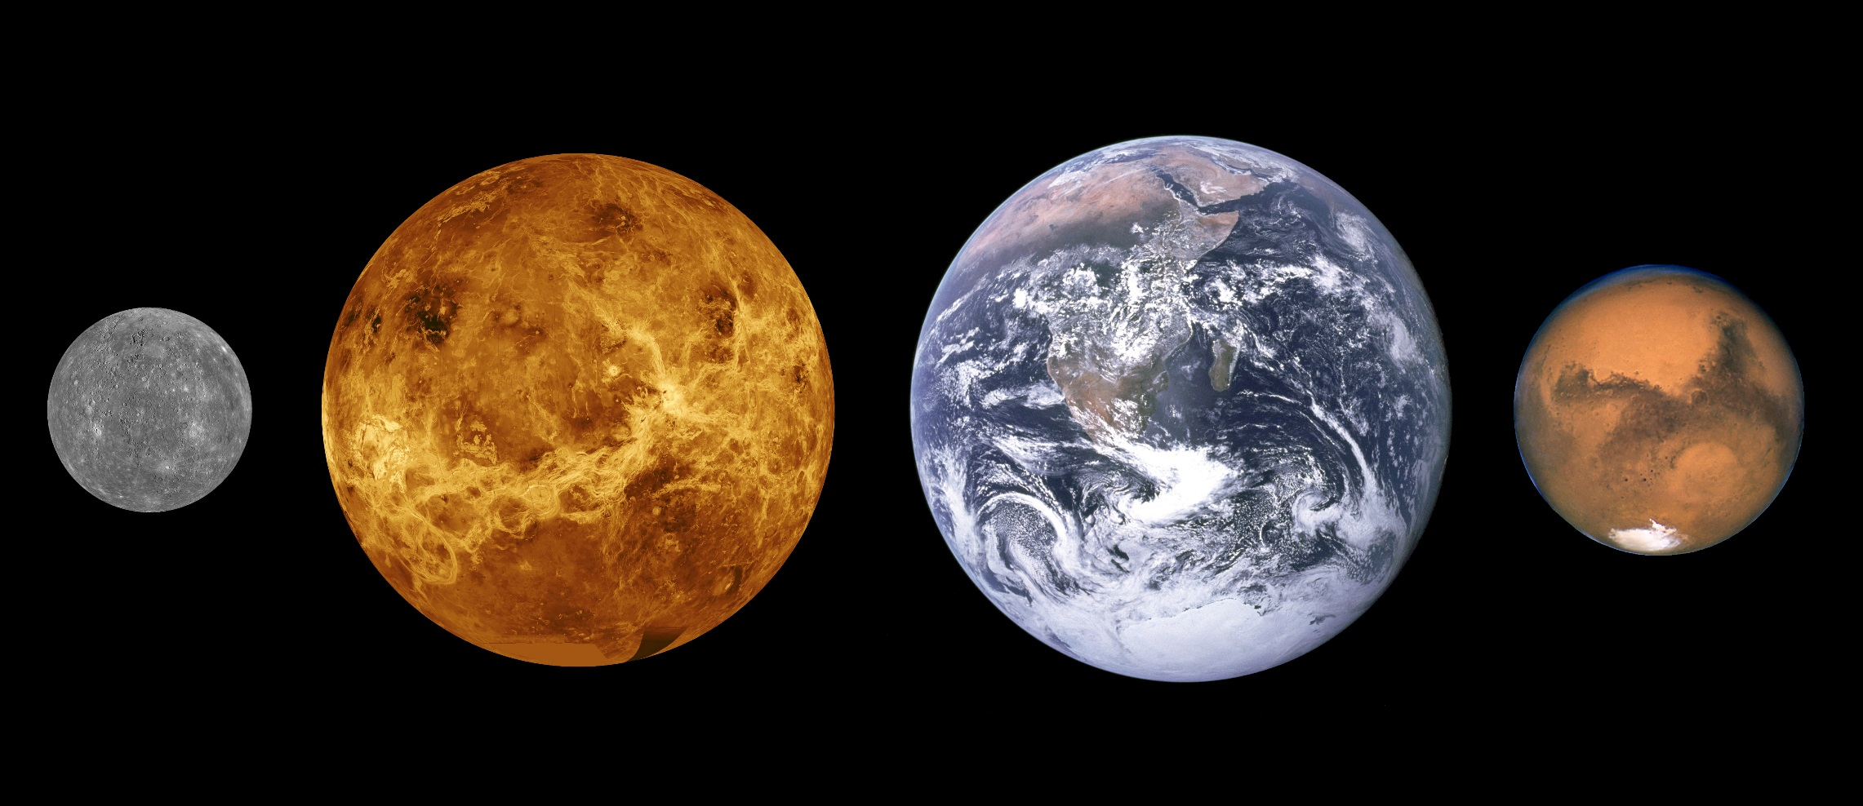
Types of planets: Rocky Planets
Earth
Venus
Mars
Moon

Slide 12
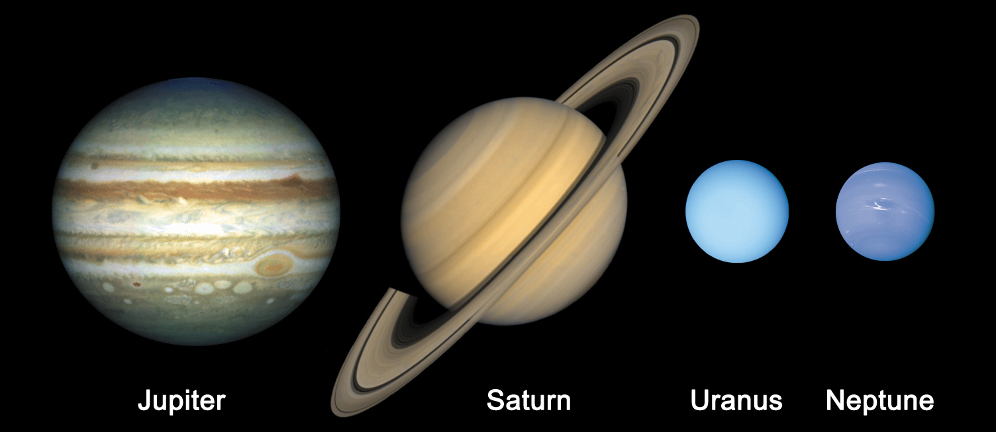
Types of planets: Gas Giants
Jupiter
Saturn

Slide 13
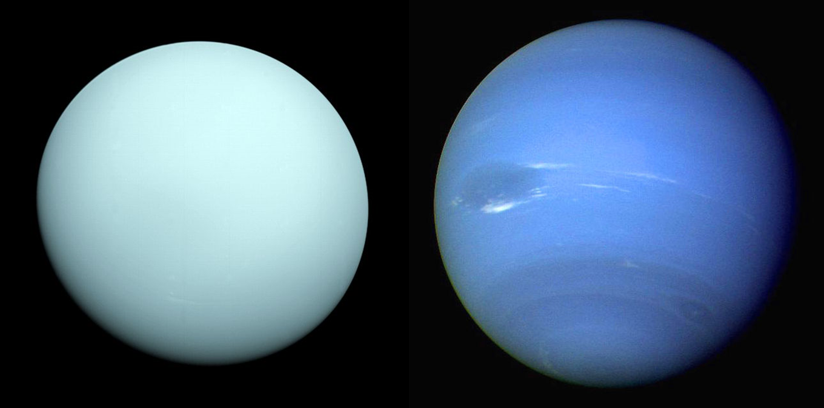
Types of planets: Ice Giant
Uranus
Neptune

Slide 14
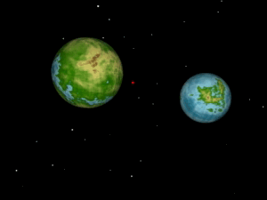
Types of planets: Double Planets

Slide 15
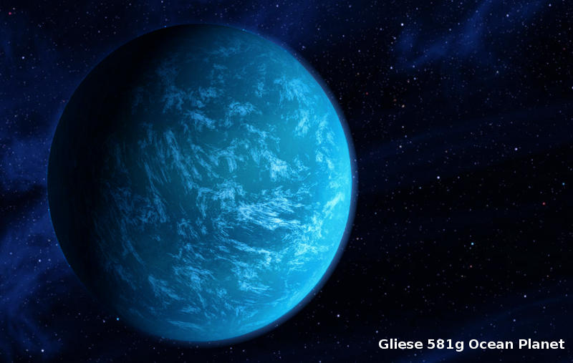
Types of planets: Ocean Planets

Slide 16
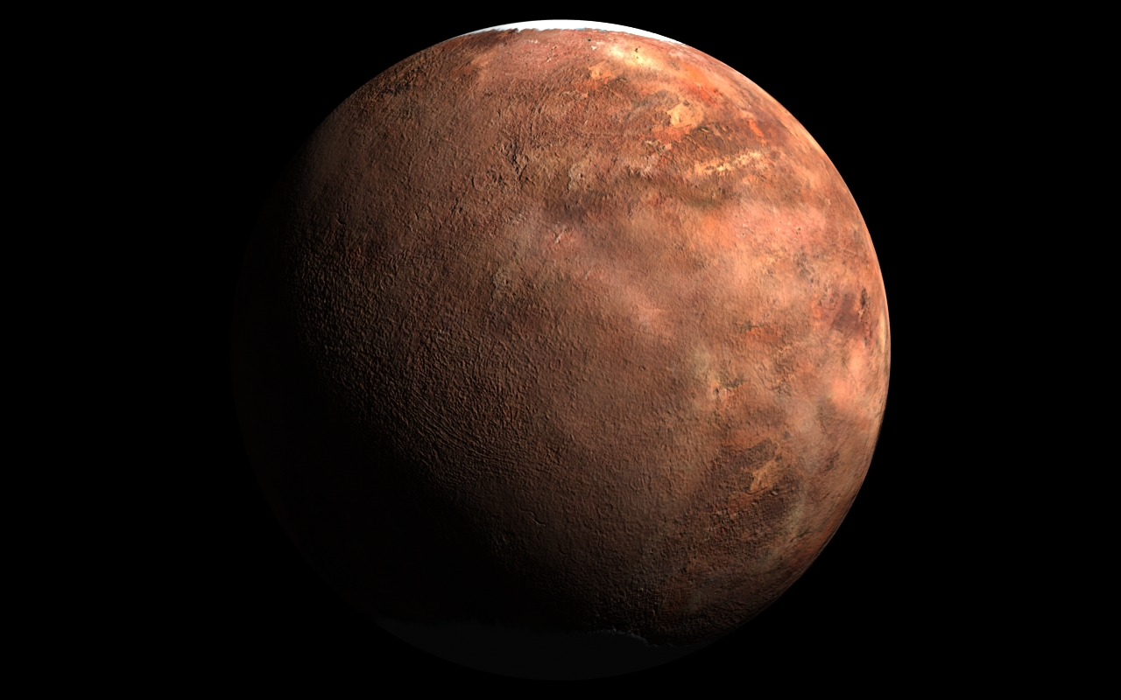
Types of planets: Desert Planets

Slide 17
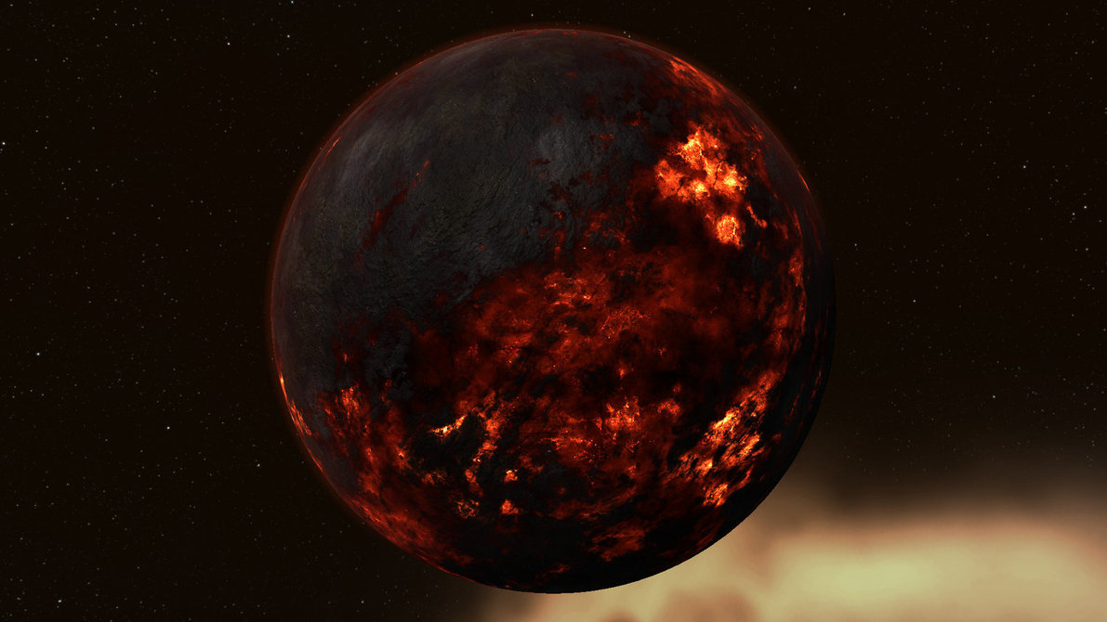
Types of planets: Lava Planets

Slide 18
Planets can be very strange
On Saturn and Jupiter, it rains diamonds
Neptune is very windy, the wind speed is around 2000 kph
A hurricane is about 200 kph
What other strange worlds are there?
https://www.youtube.com/watch?v=0FsQ-v8Tec4

Slide 20
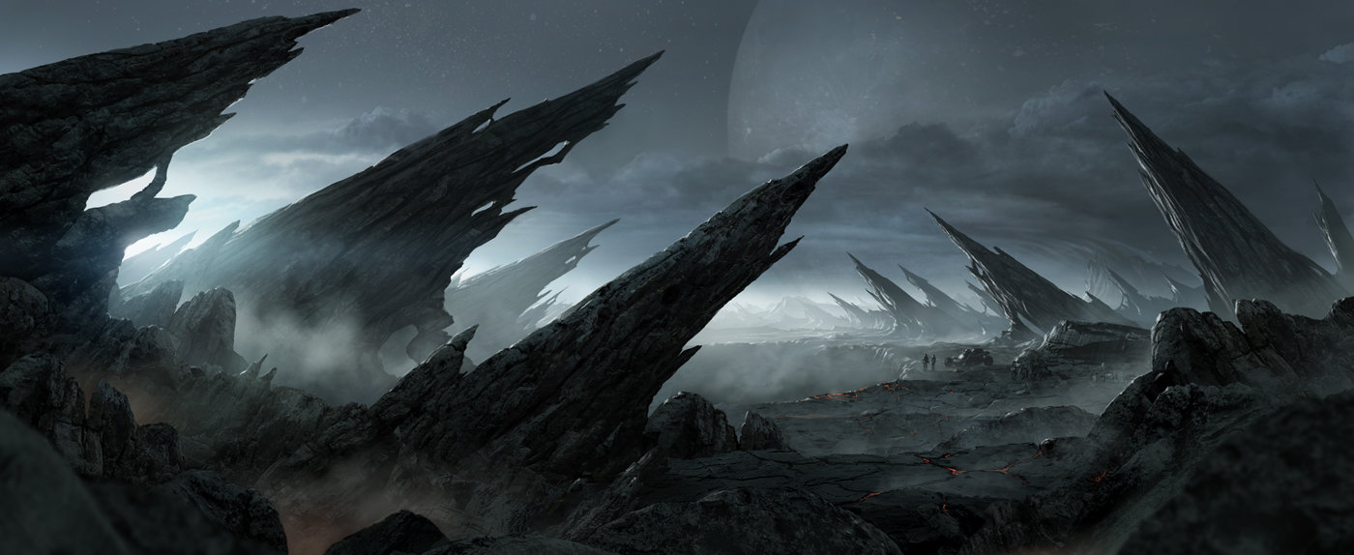

Slide 21
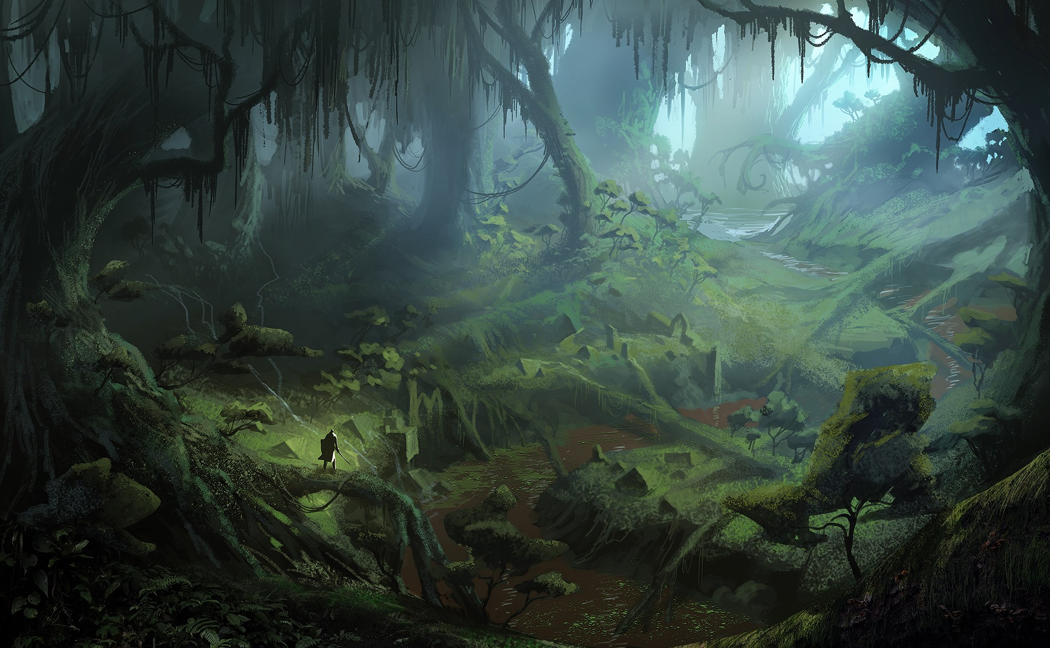

Slide 22
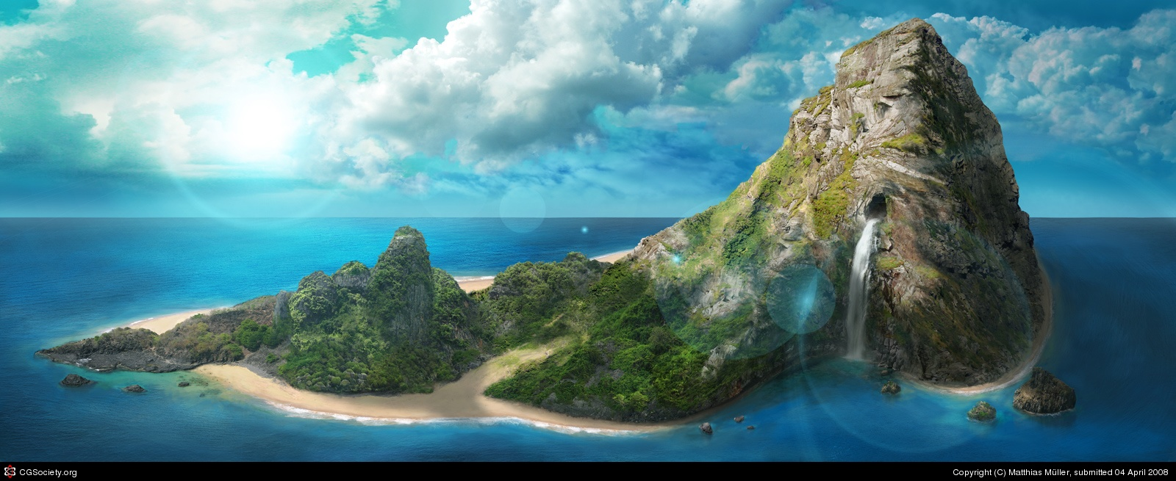

Slide 23
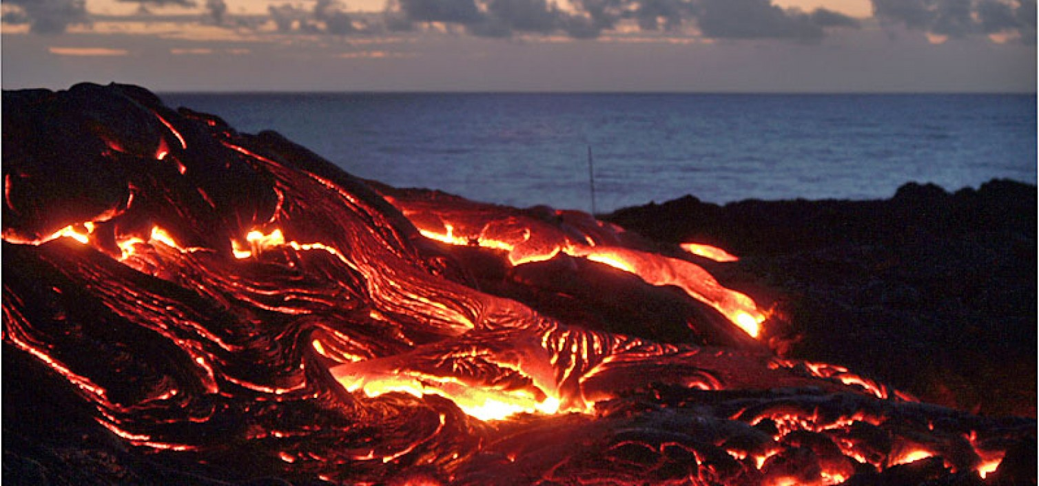

Slide 24
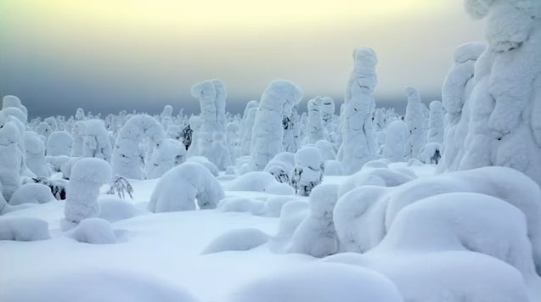

Slide 25
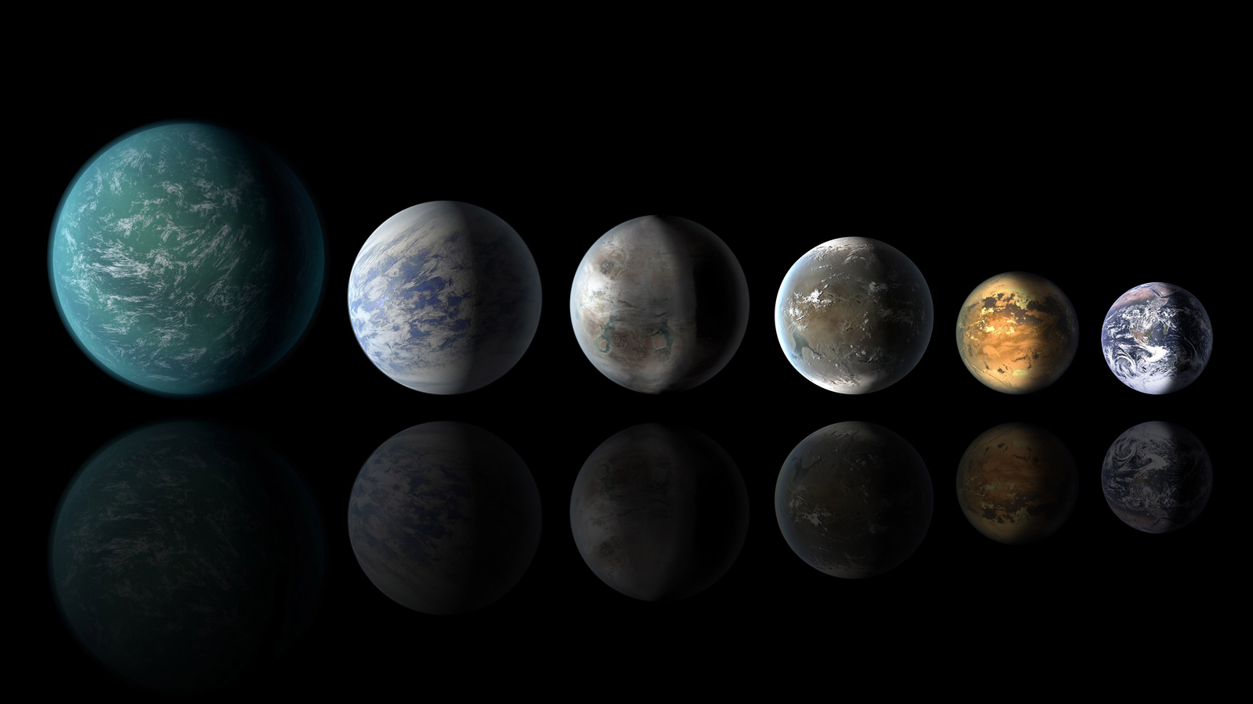
Pretend there is another planet
How is it different from Earth?
How did the animals adapt to this new planet.

Slide 26
Balloon Planets
Give the students some markers and balloons
Have them show what their planet is like by choosing a balloon and coloring it in.

