Slide 1
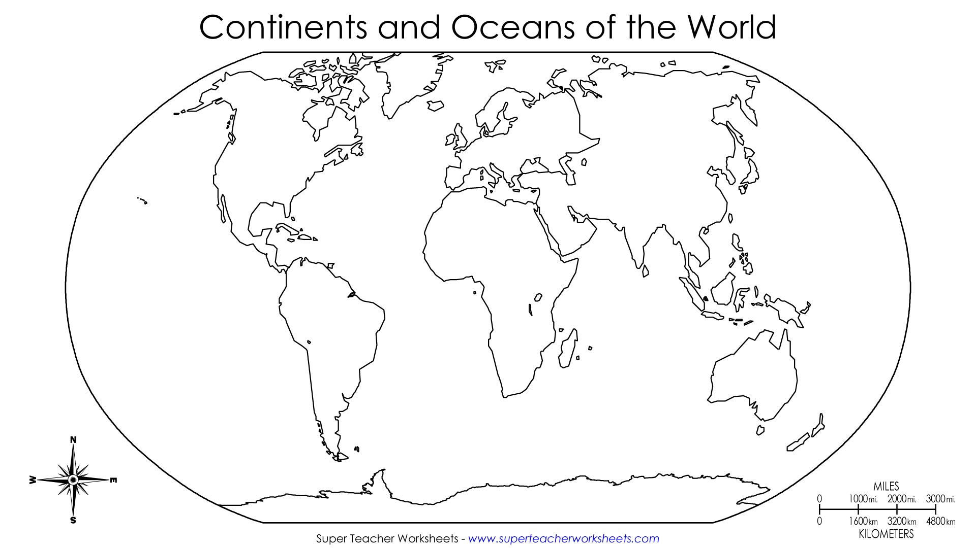
Asia
Australia
Antarctica
North America
South America
Europe
Africa

Slide 2
