Slide 1
On a Map

Slide 2
Compound Words
Memory Game

Slide 3
Turn over and mix
Take turns flipping over cards.
The first one to find a match takes the cards. (touch the cards)
Book
Port
Air
Spider
Flash
Web

Slide 4
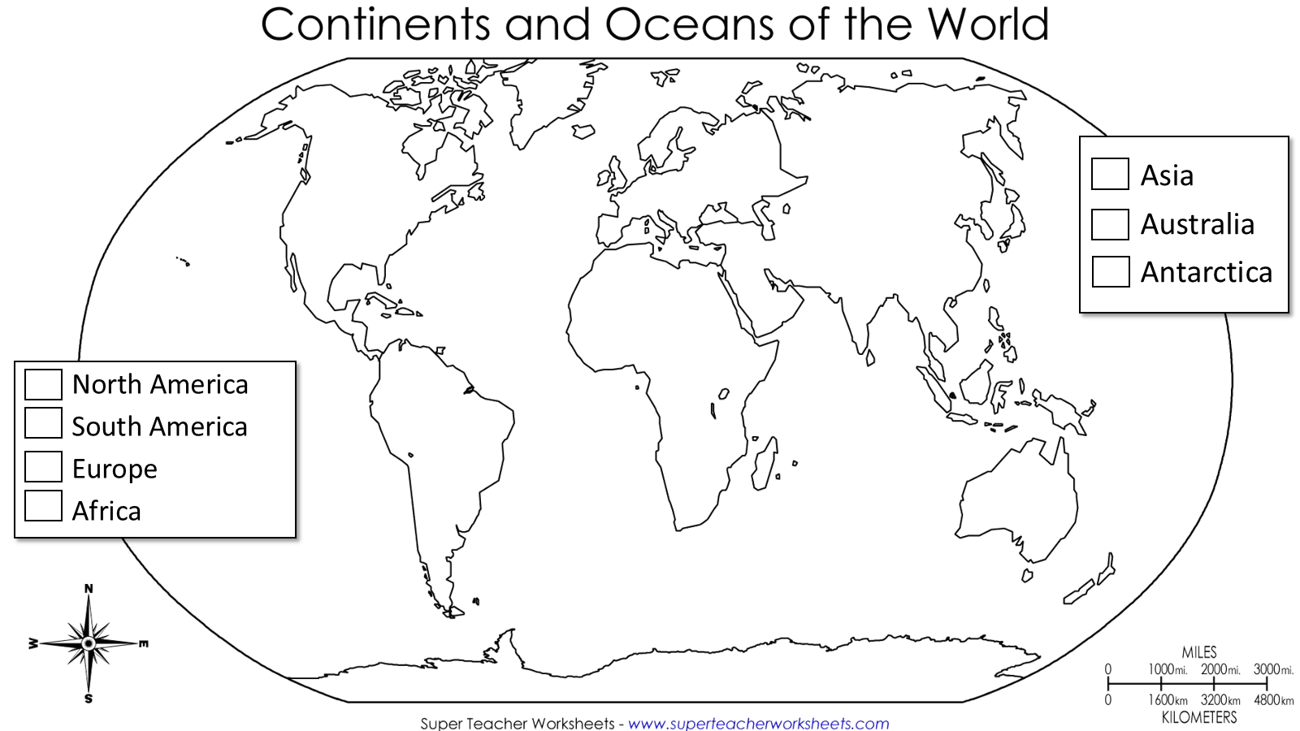
Continents and Animals
Color the map

Slide 5
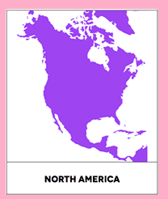
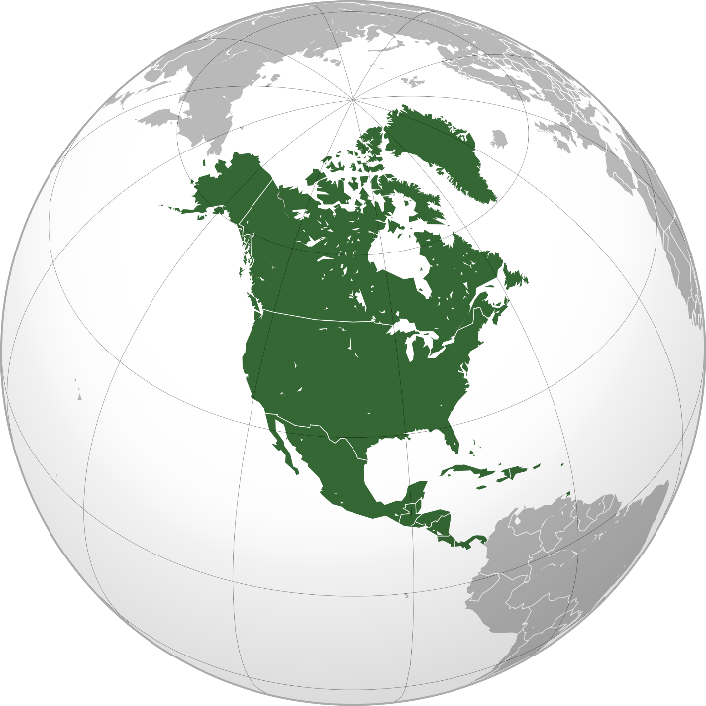
North America
Population: 579 million
Land Mass: 24.71 million km²
Notes:
https://kr.pinterest.com/pin/369365606910393086/

Slide 6
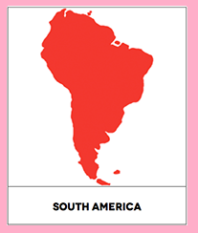
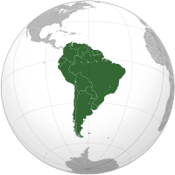
South America
Population: 422 million
Land Mass: 17.84 million km²
Notes:
https://kr.pinterest.com/pin/369365606910393086/

Slide 7
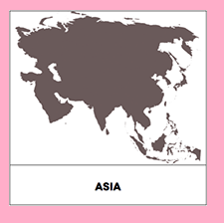
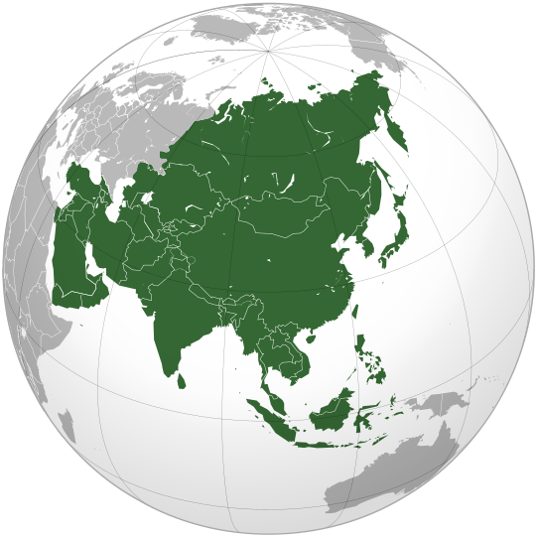
Asia
Population: 4,436 million
Land Mass: 44.58 million km²
Notes:
https://kr.pinterest.com/pin/369365606910393086/

Slide 8
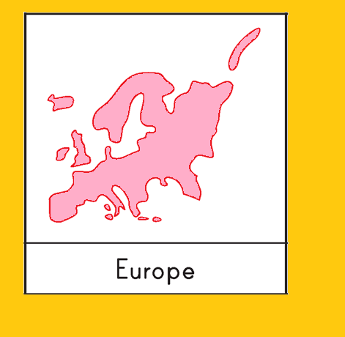
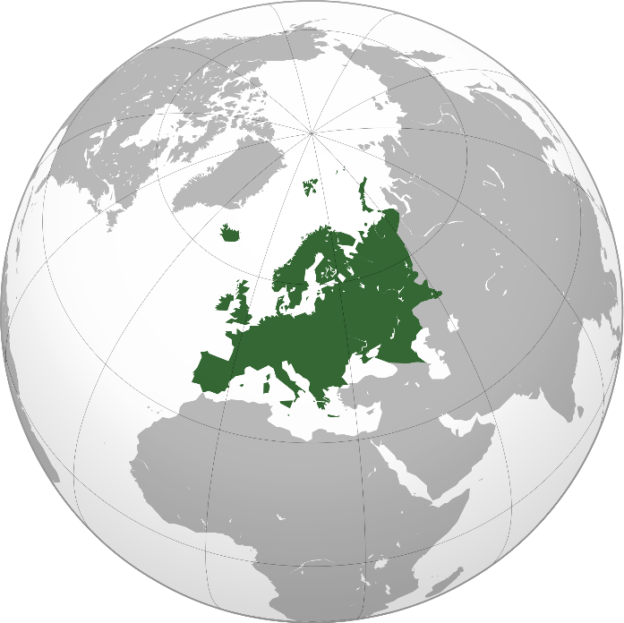
Europe
Population: 743.1 million
Land Mass: 10.18 million km²
Notes:
http://www.giftofcuriosity.com/product/montessori-continents-3-part-cards/

Slide 9
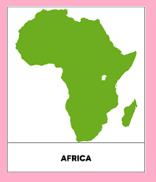
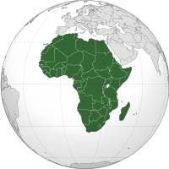
Africa
Population: 1,216 million
Land Mass: 30.37 million km²
Notes:
https://kr.pinterest.com/pin/369365606910393086/

Slide 10
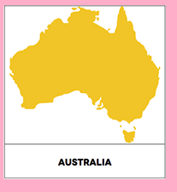
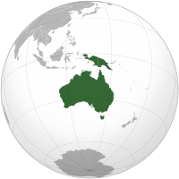
Australia
Population: 31.26 million
Land Mass: 8.6 million km2
Notes:
https://kr.pinterest.com/pin/369365606910393086/

Slide 11
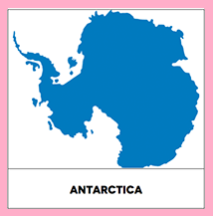
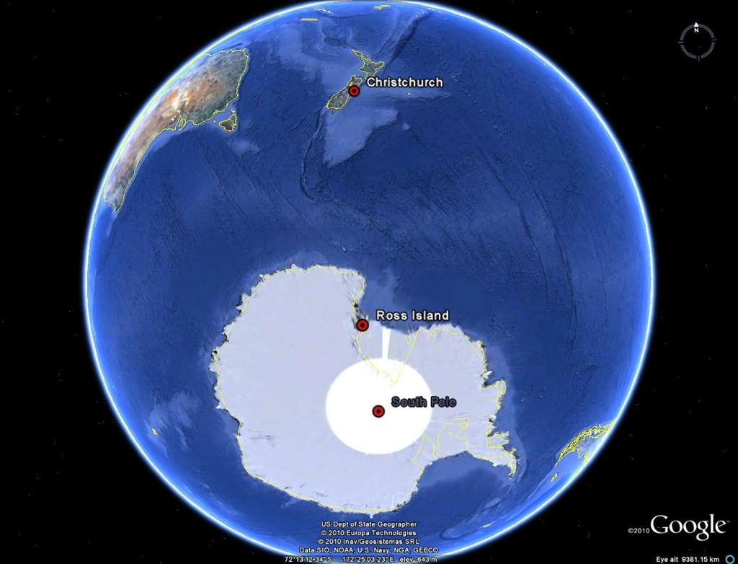
Antarctica
Population: 4000 (summer)
1000 (winter)
Land Mass: 14 million km²
Notes:
https://kr.pinterest.com/pin/369365606910393086/

Slide 12
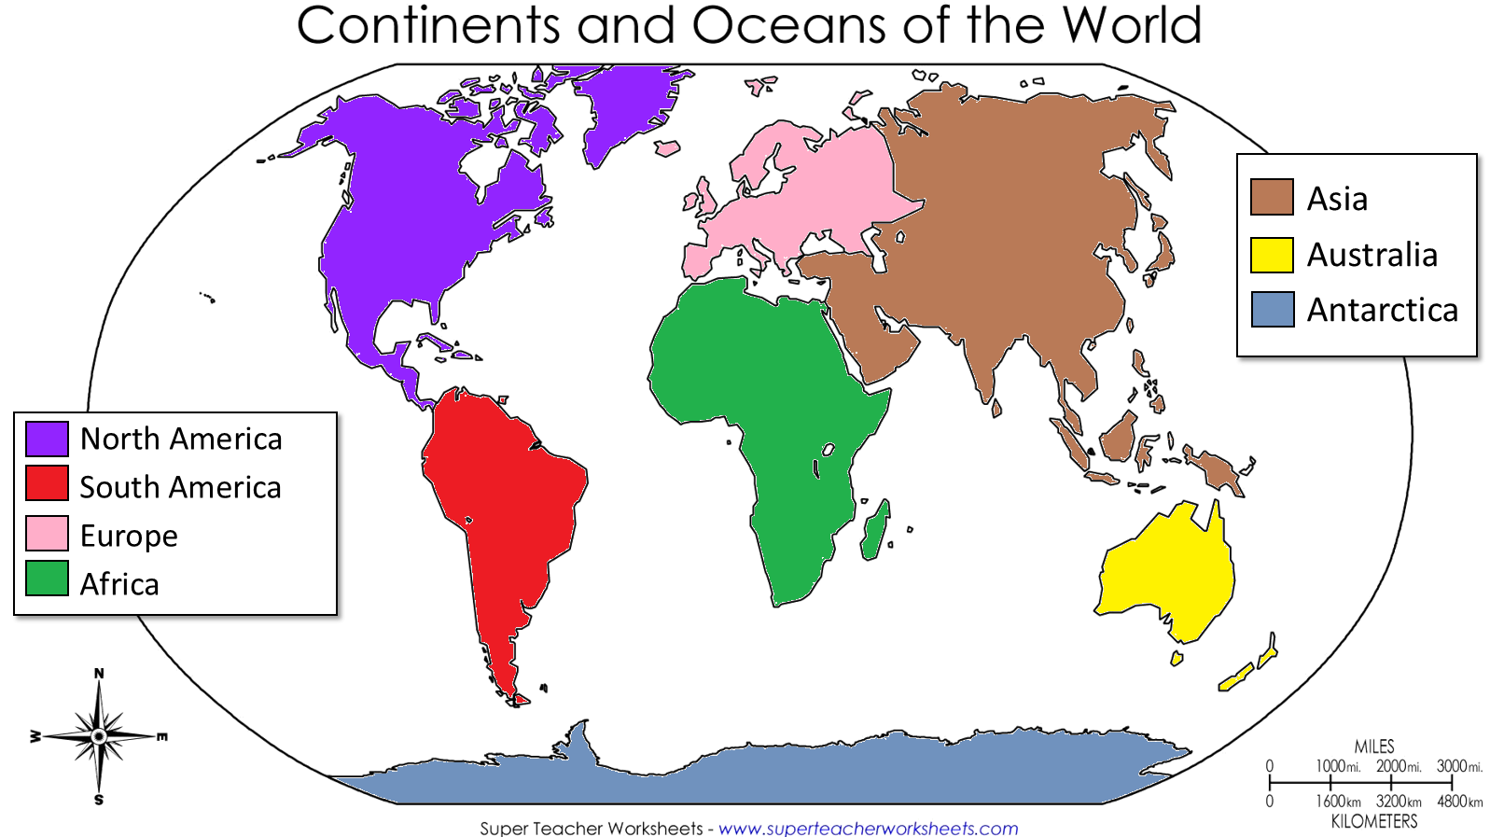

Slide 13
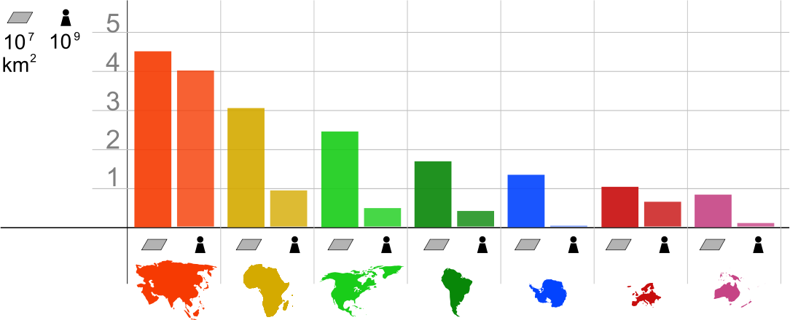
Which continent is largest?

Slide 14
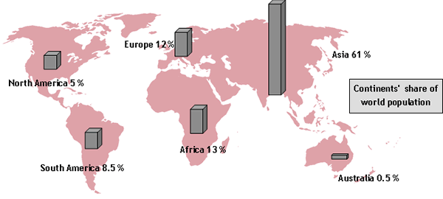
Which continent has the most people?

Slide 15
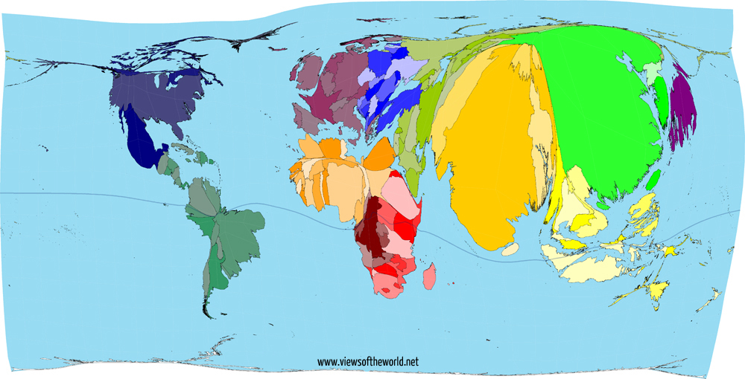
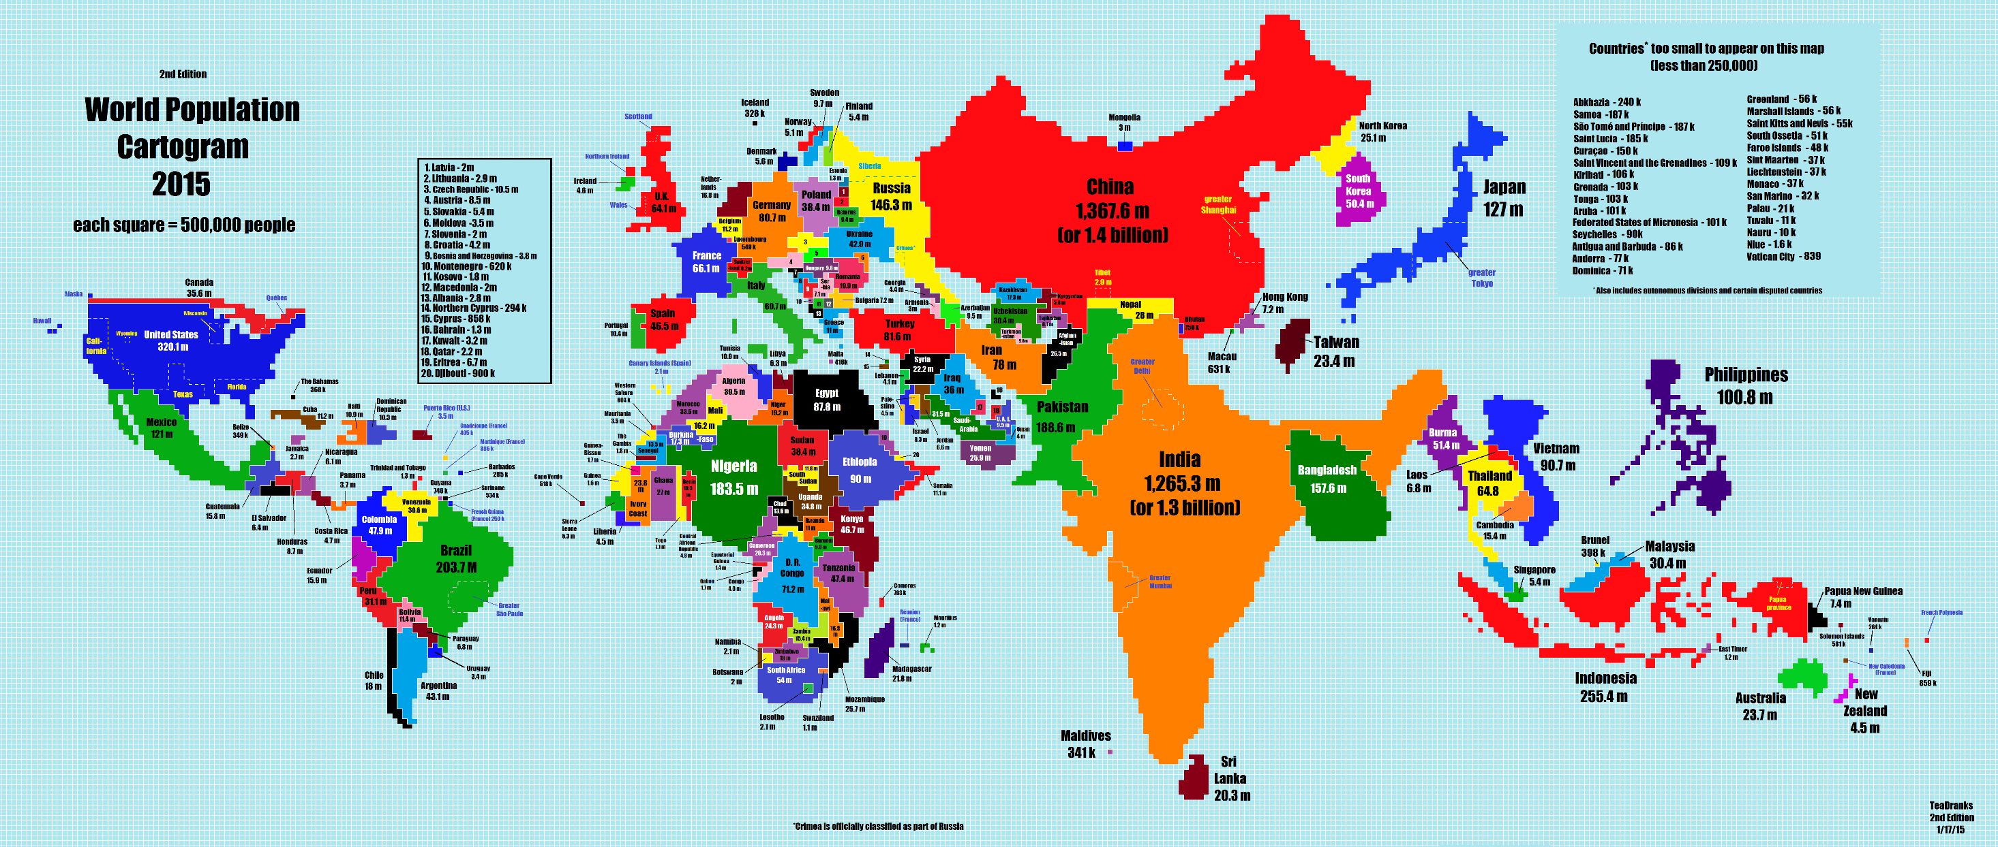

Slide 16
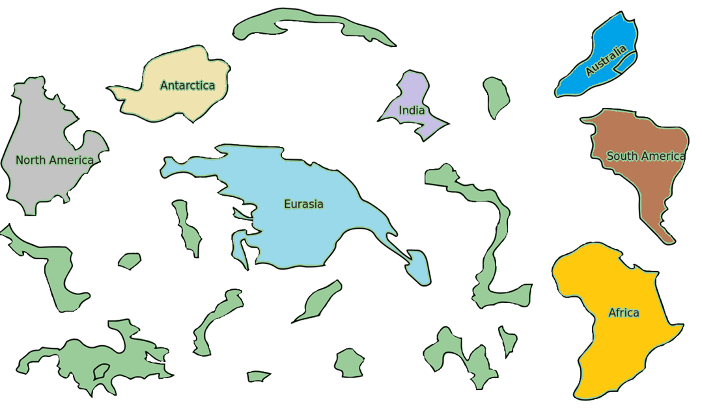
Pangea
Many years ago, all of the contents were together.
This SUPERcontinent was called, “Pangea”
Can you Cut and Paste the
continents to create Pangea?

Slide 17


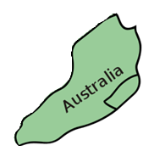
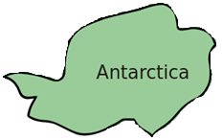
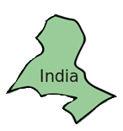
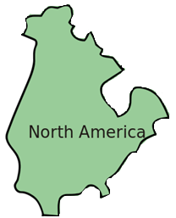

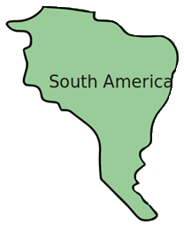
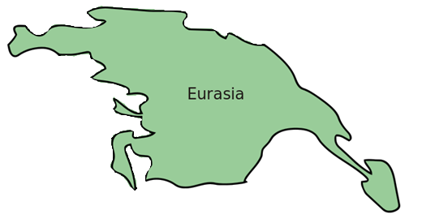
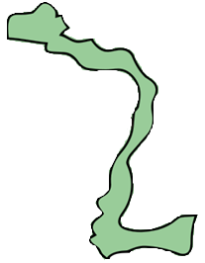

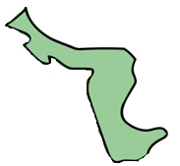
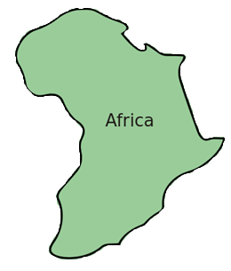



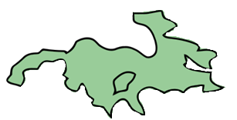
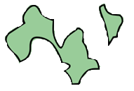


Slide 18
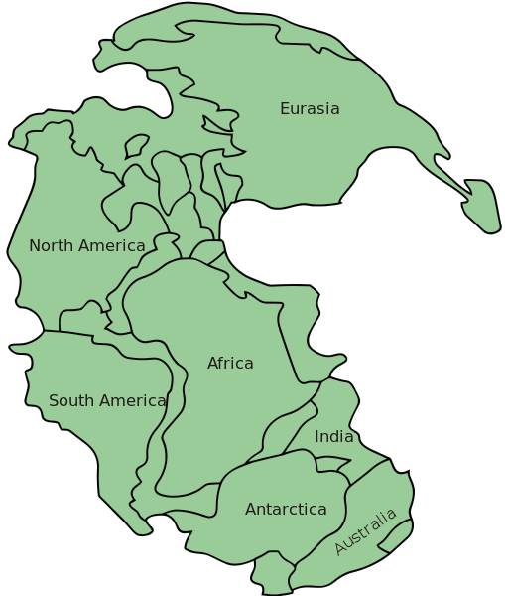
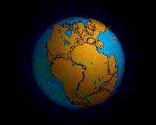
Pangea
This is what the world looked like about 200,000,000 years ago
https://www.youtube.com/watch?v=bQywDr-btz4
Notes:
By Original upload by en:User:Tbower - http://geomaps.wr.usgs.gov/parks/animate/A08.gif, Public Domain, https://commons.wikimedia.org/w/index.php?curid=583951
By en:User:Kieff - File:Pangaea continents.png, CC BY-SA 3.0, https://commons.wikimedia.org/w/index.php?curid=8161694

Slide 19
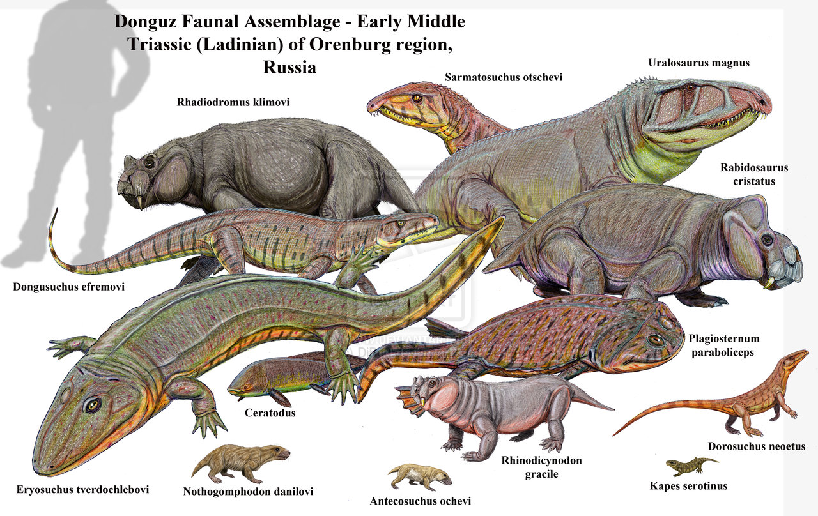
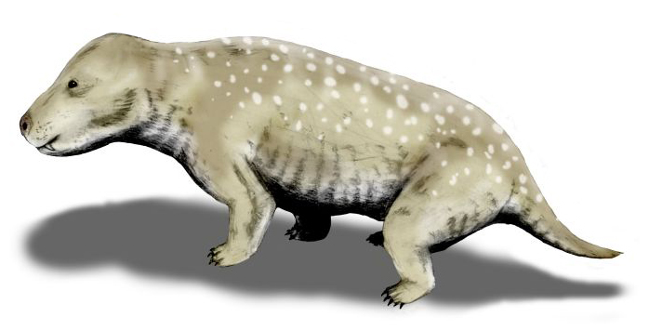
Pangea
What animals lived there?
Notes:
By Nobu Tamura (http://spinops.blogspot.com) - Own work, CC BY 3.0, https://commons.wikimedia.org/w/index.php?curid=19459212

Slide 20
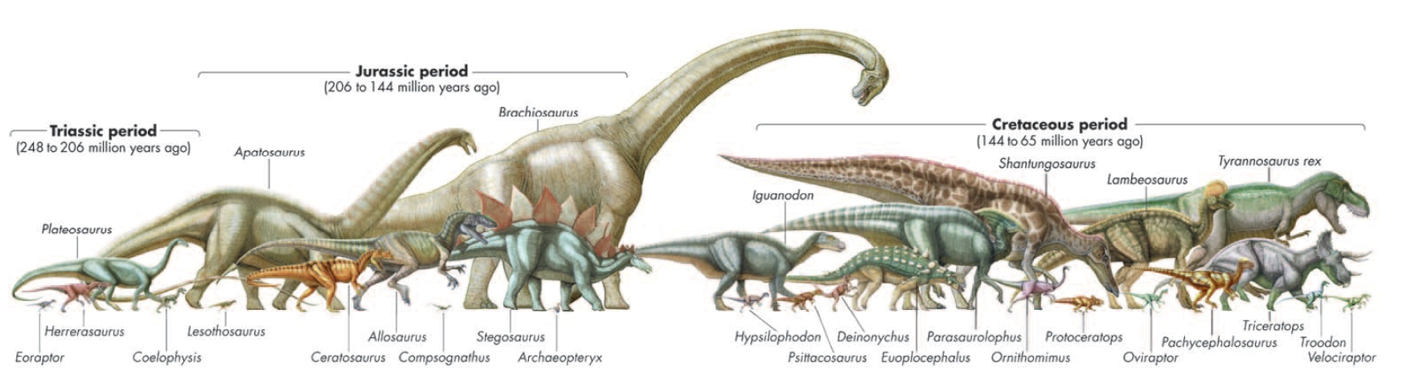
Pangea
What animals lived there?

Slide 21
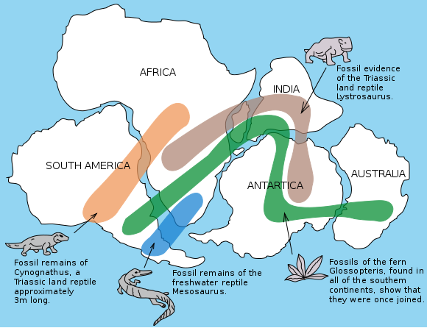
Pangea
What animals lived there?
Notes:
By Osvaldocangaspadilla - Own work, Public Domain, https://commons.wikimedia.org/w/index.php?curid=11310183

Slide 22
Before Pangea?
https://www.youtube.com/watch?v=UwWWuttntio

Slide 23
Country Speed Quiz
You will hear a random country.
The first one to find it on the map gets a point.
http://random.country/

