Slide 1
Story Telling
p.70

Slide 2
Characters
Who is in the story?

Slide 3
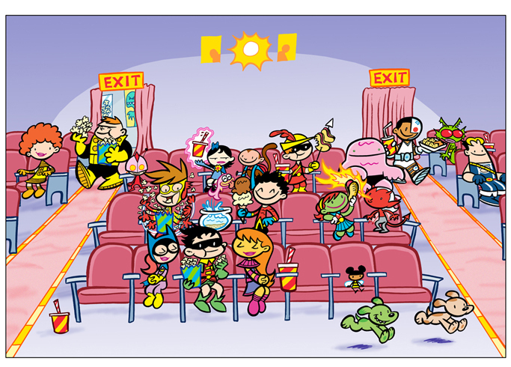
Setting
Where is the story taking place?
When did the story take place?

Slide 4
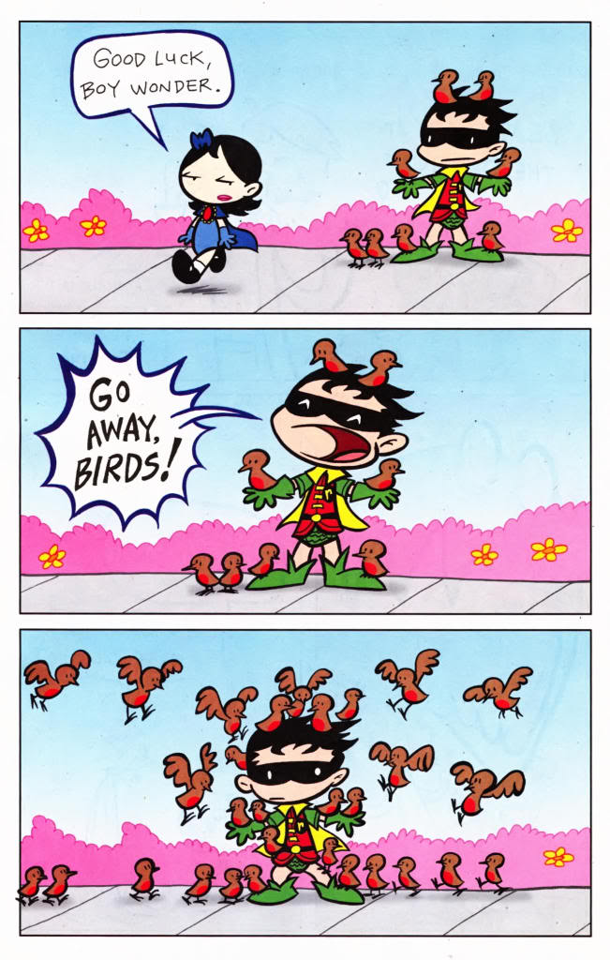
Plot
What happens in the story?

Slide 5
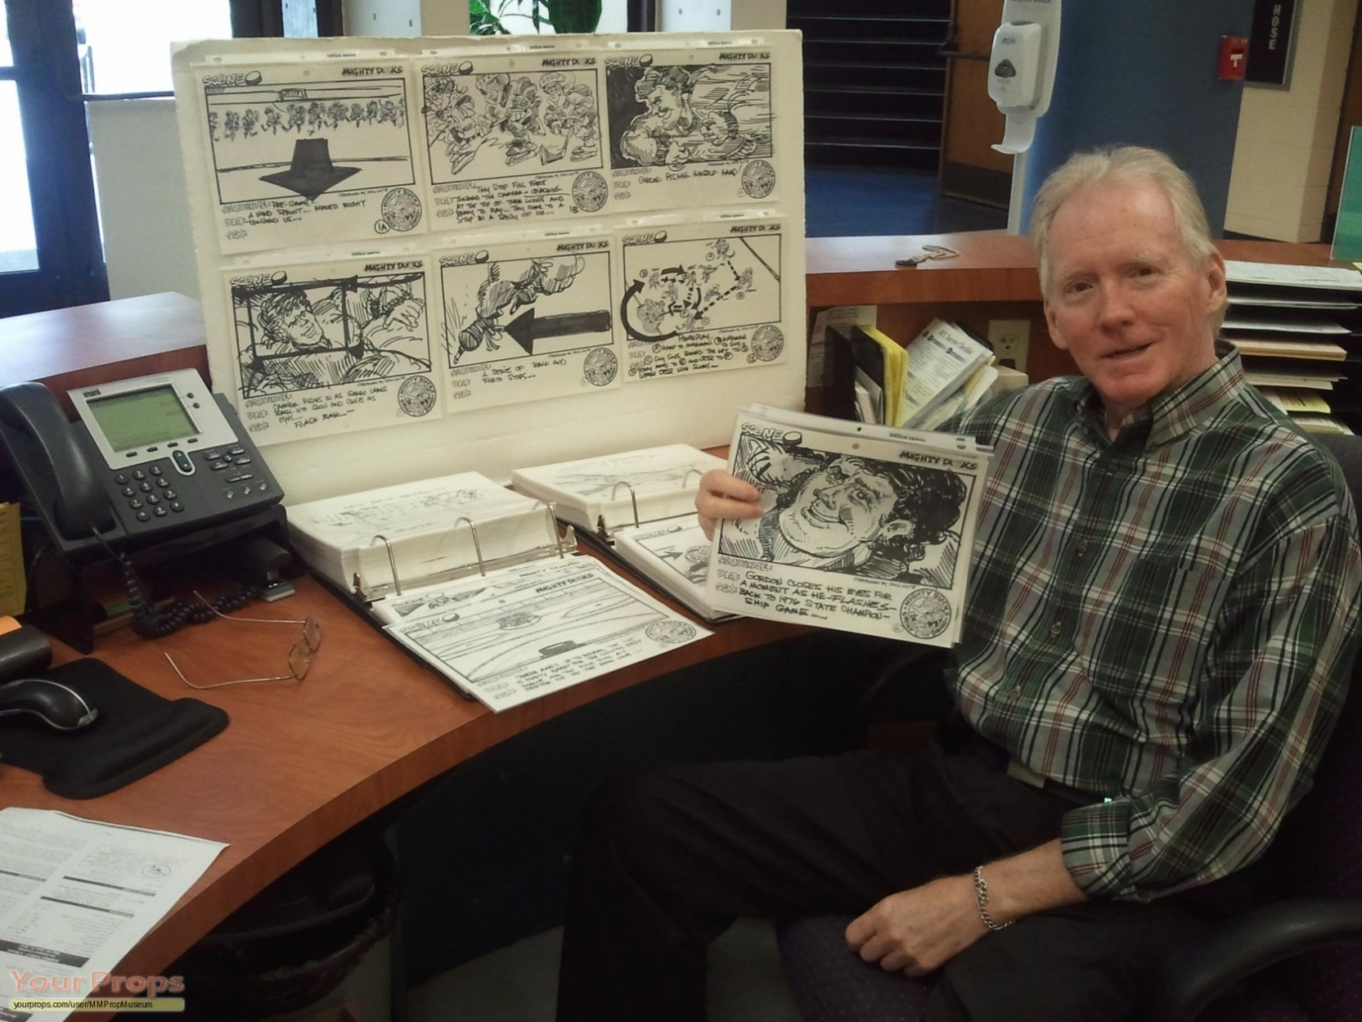
Plot
Story Cells

Slide 6
Last Comic
Find the Characters, Setting, and Plot

Slide 7
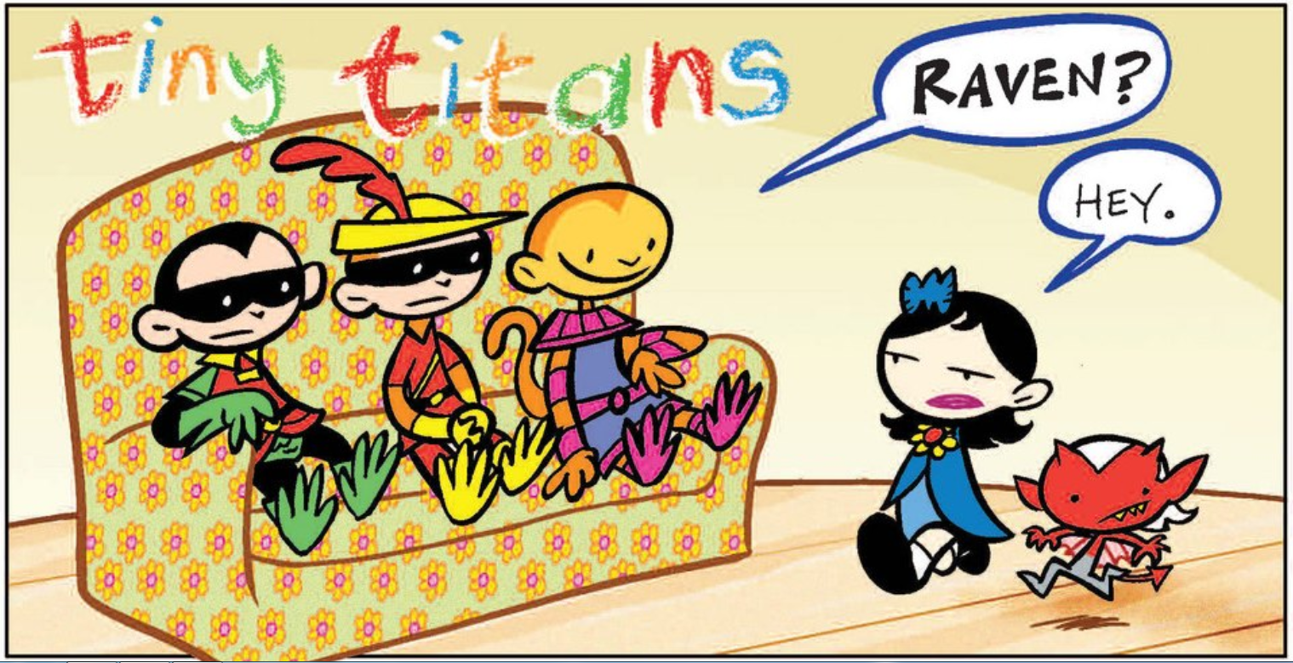

Slide 8
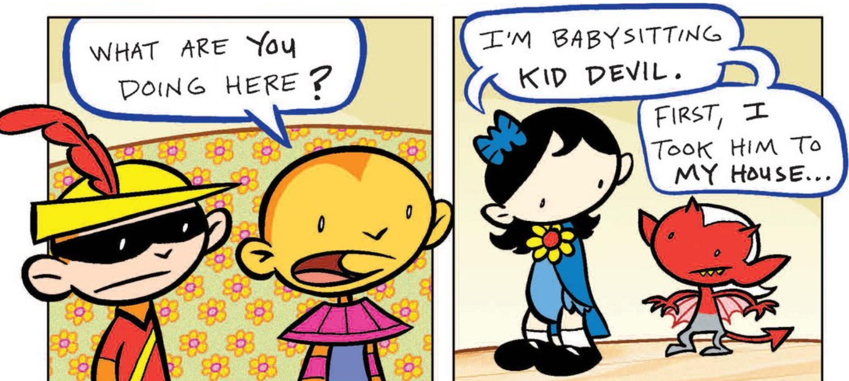

Slide 9
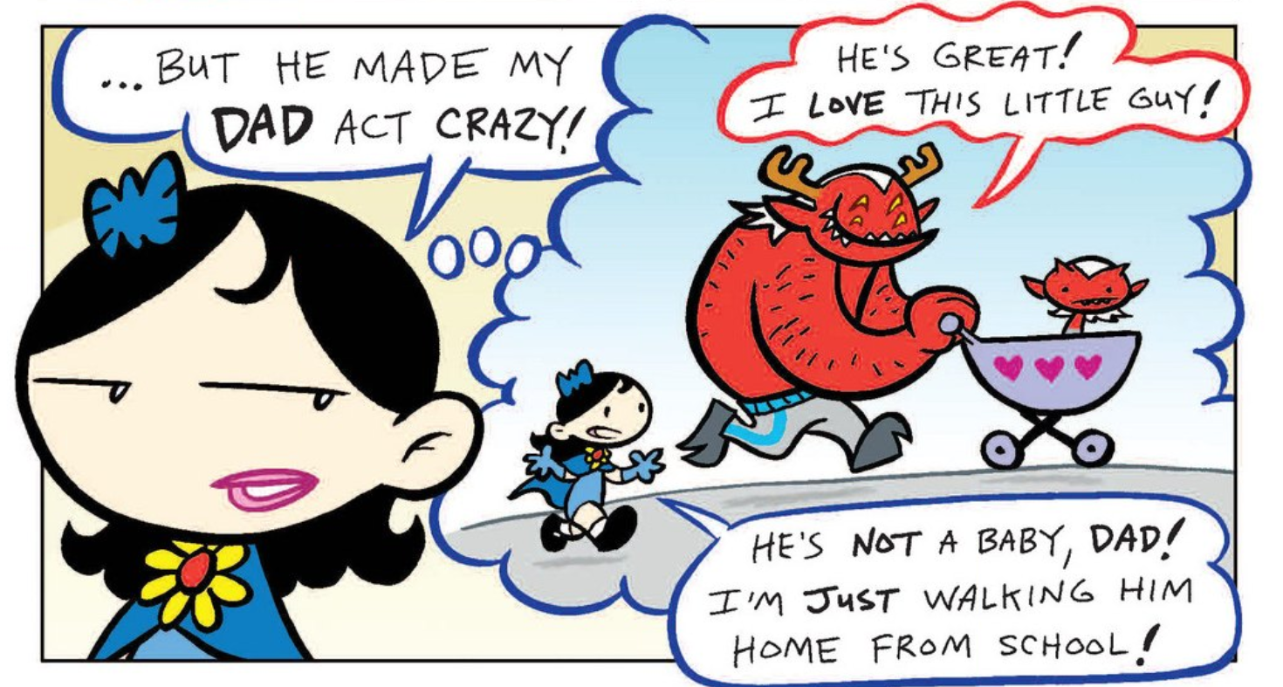

Slide 10
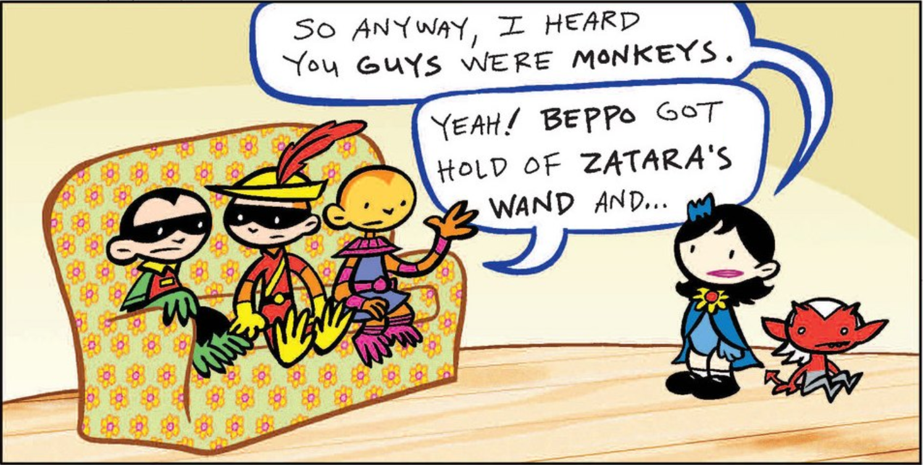

Slide 11
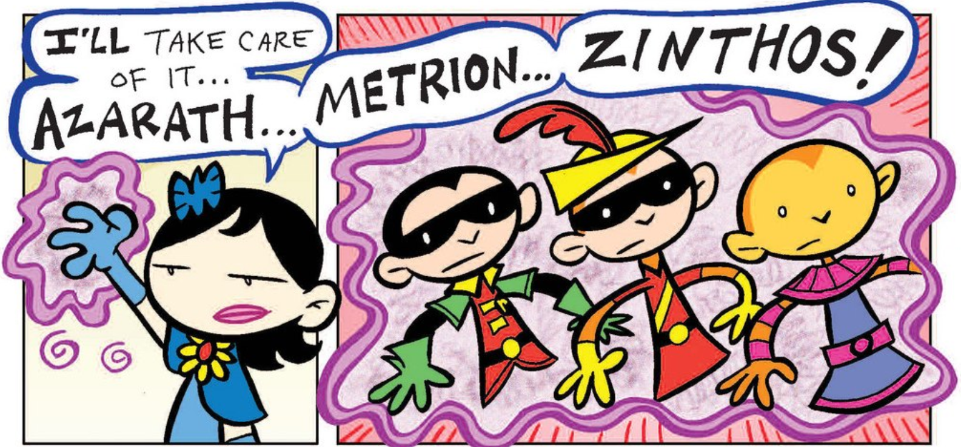

Slide 12
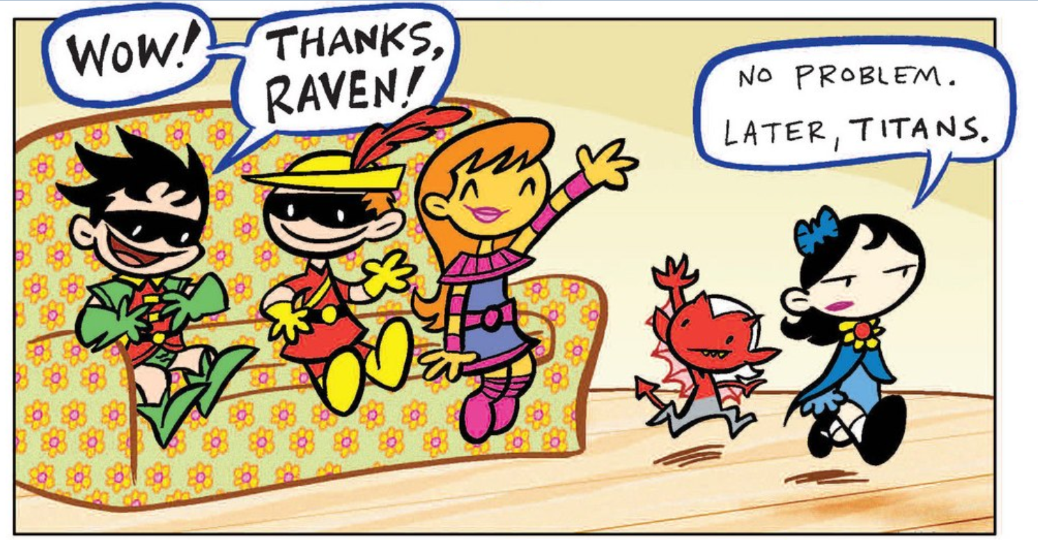

Slide 13
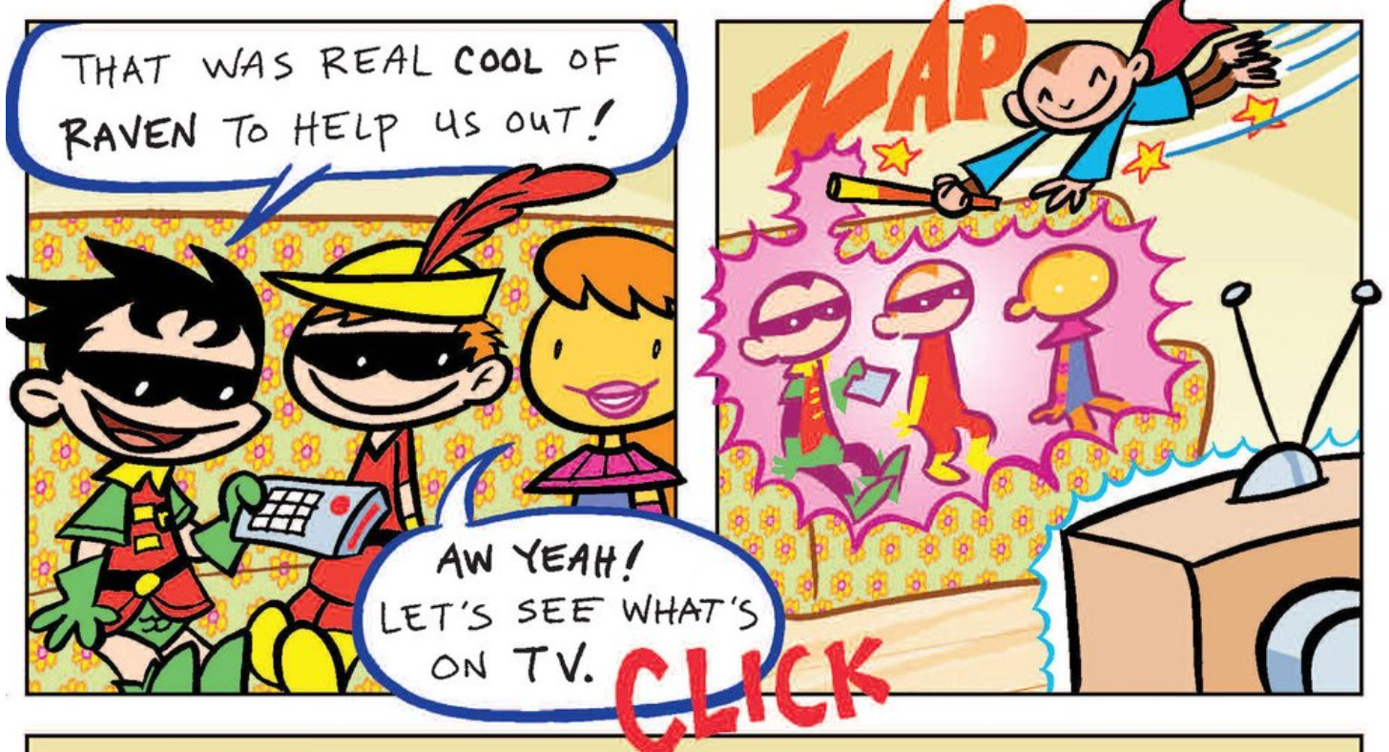

Slide 16
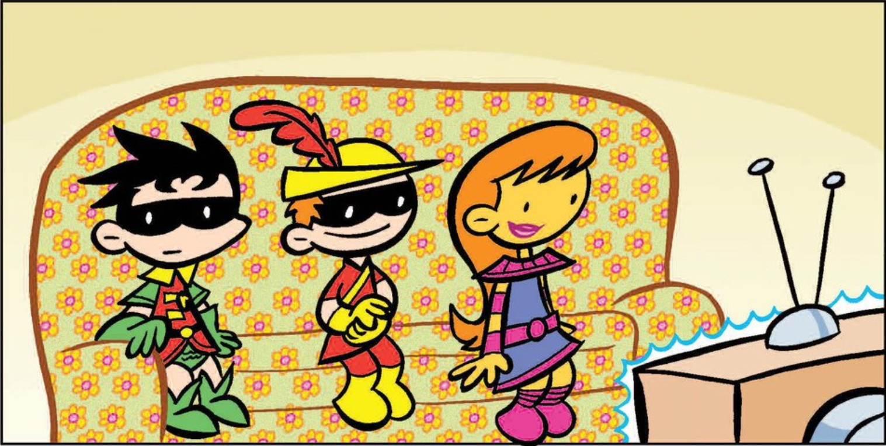

Slide 17
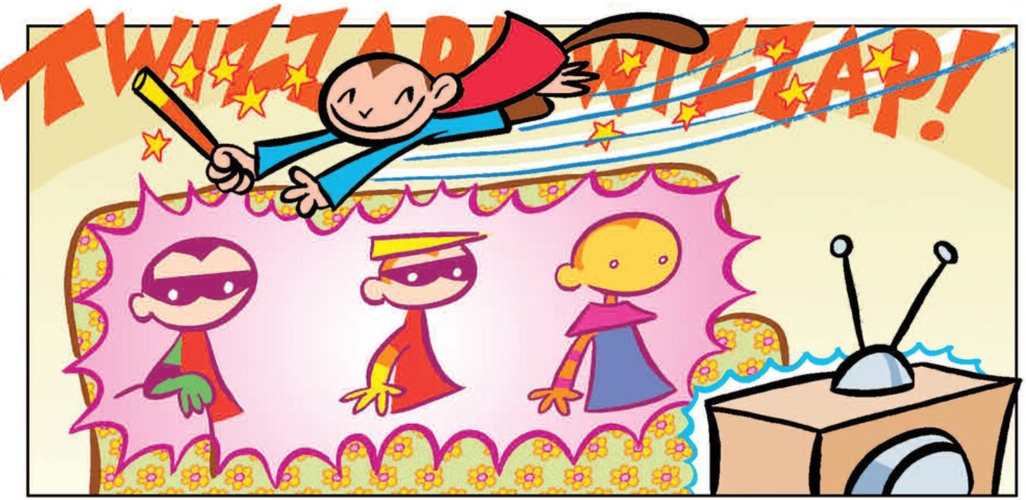

Slide 18
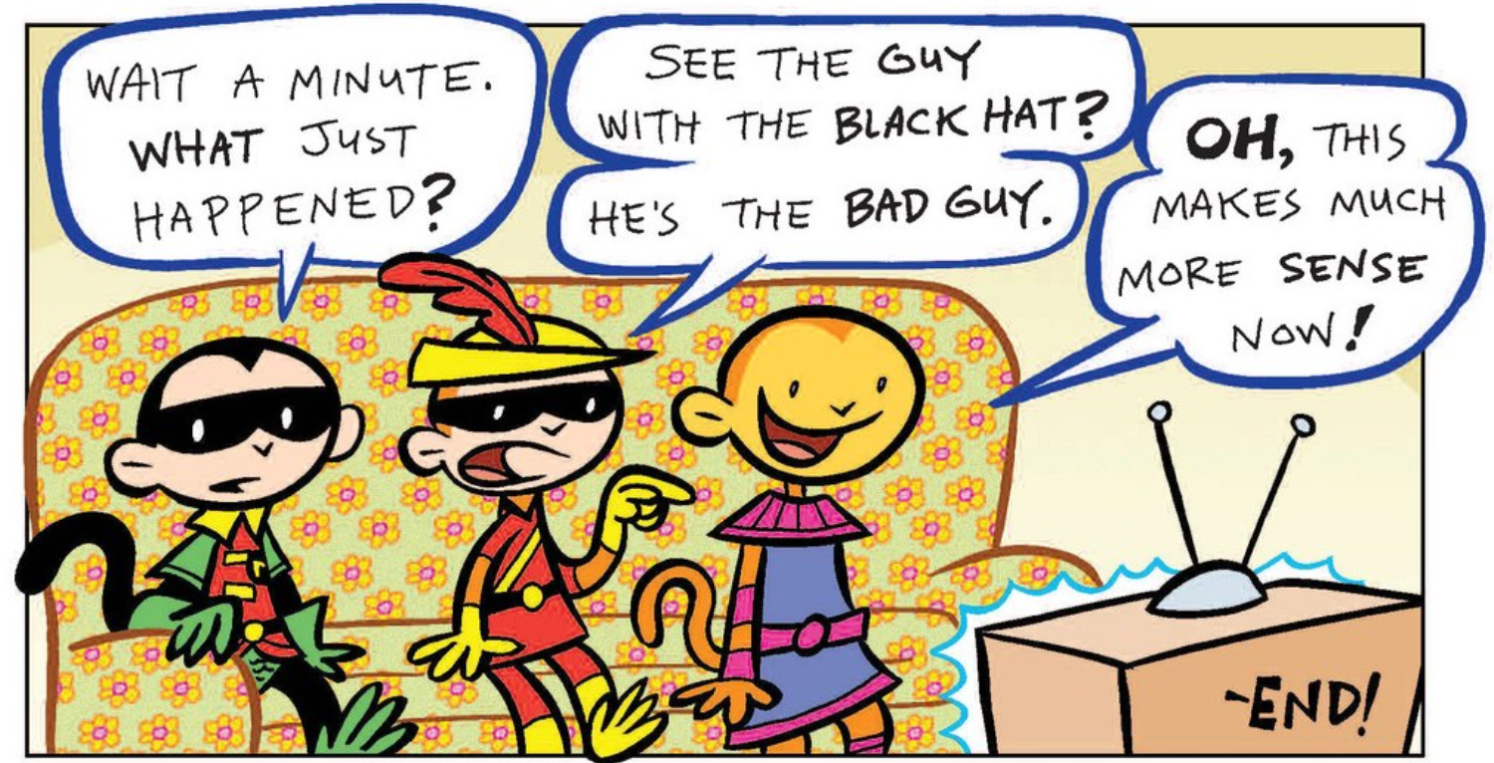

Slide 20
Make your own comic strip:

Slide 21
Characters
Cut out the characters you will use

Slide 22
Setting
Draw the place in the background.
Then paste the characters onto the paper.

Slide 23
Plot
What will happen?
Use the speech bubbles to tell the story.

