Slide 1
Atlantis Game

Slide 2
Rules
Place the teams near the middle of the board.
Each team take a turn answering a question.
If you get the correct answer, you may either:
Move one space
Remove a tile attached to water.

Slide 3
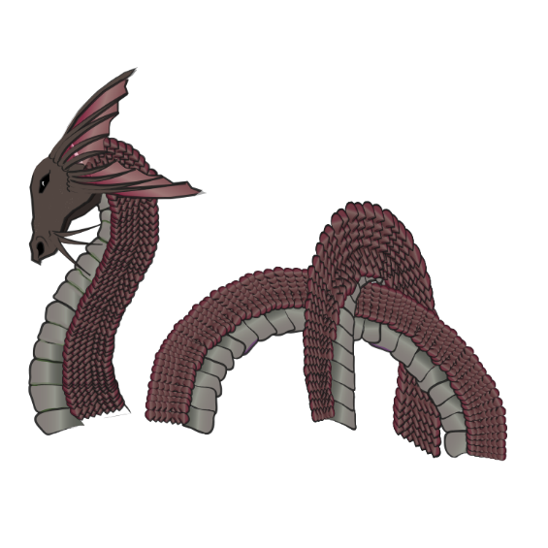
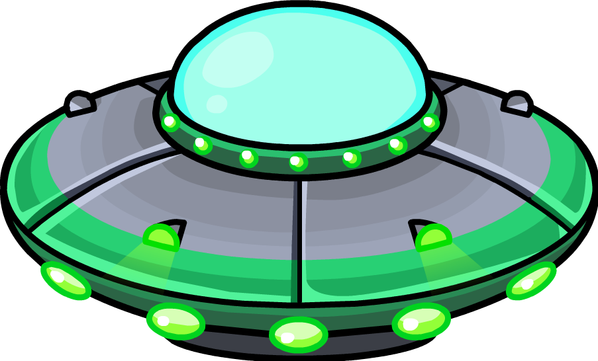
How to Die
You end in water
An animal eats you
An alien kills you

Slide 4
Winner
Whoever is the last alive on the island is the winner.

Slide 5
24
10
23
32
37
25
11
9
22
33
12
1
8
21
36
13
3
2
7
39
34
14
4
6
20
26
15
5
19
38
35
27
16
18
31
40
29
28
17
30

Slide 6
24
10
23
32
37
25
11
9
22
33
12
1
8
21
36
13
3
2
7
39
34
14
4
6
20
26
15
5
19
38
35
27
16
18
31
40
29
28
17
30

