Slide 1
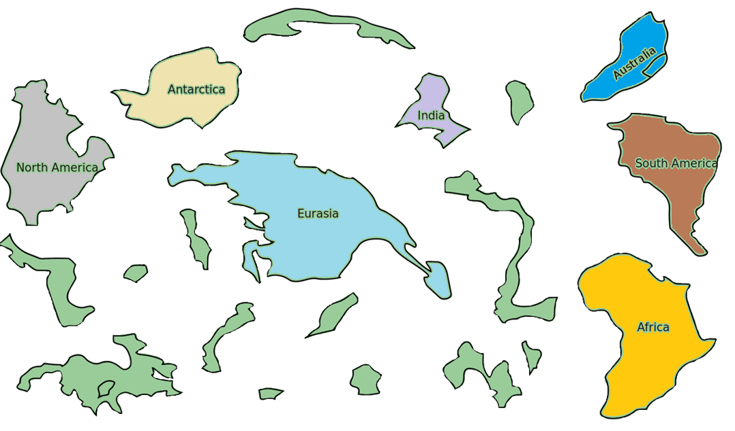
Pangea
Many years ago, all of the contents were together.
This SUPERcontinent was called, “Pangea”

Slide 2
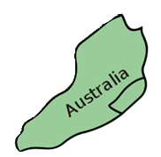
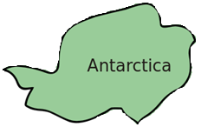
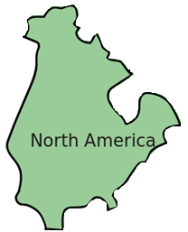
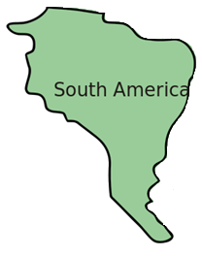
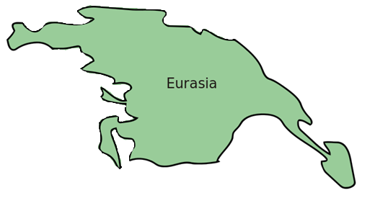
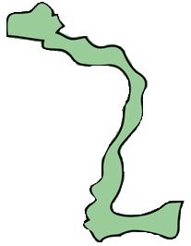
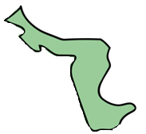
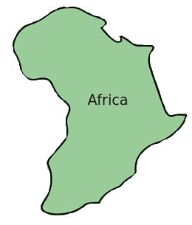
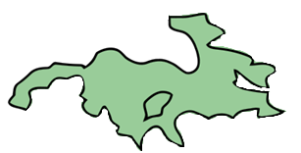

Slide 3
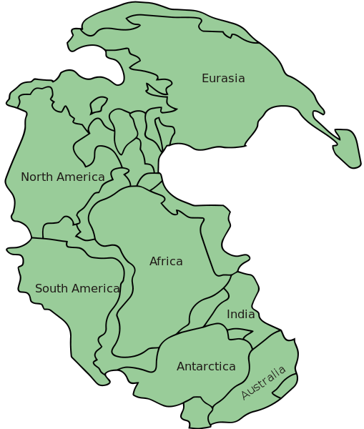
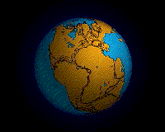
Pangea
This is what the world looked like about 200,000,000 years ago
https://www.youtube.com/watch?v=bQywDr-btz4
Notes:
By Original upload by en:User:Tbower - http://geomaps.wr.usgs.gov/parks/animate/A08.gif, Public Domain, https://commons.wikimedia.org/w/index.php?curid=583951
By en:User:Kieff - File:Pangaea continents.png, CC BY-SA 3.0, https://commons.wikimedia.org/w/index.php?curid=8161694

Slide 4
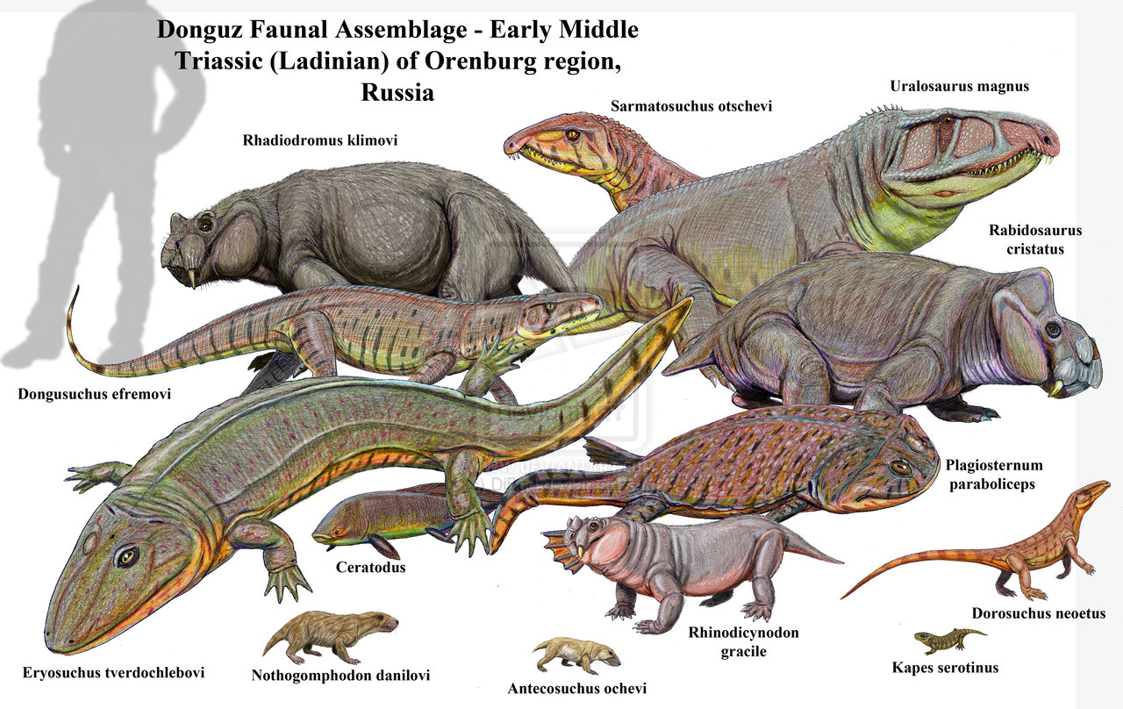
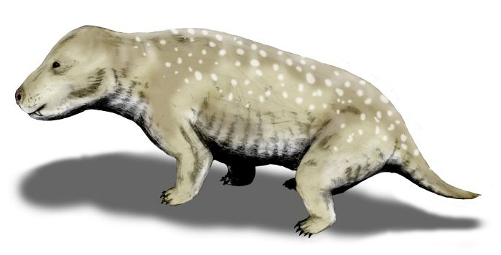
Pangea
What animals lived there?
Notes:
By Nobu Tamura (http://spinops.blogspot.com) - Own work, CC BY 3.0, https://commons.wikimedia.org/w/index.php?curid=19459212

Slide 5
Pangea
What animals lived there?

Slide 6
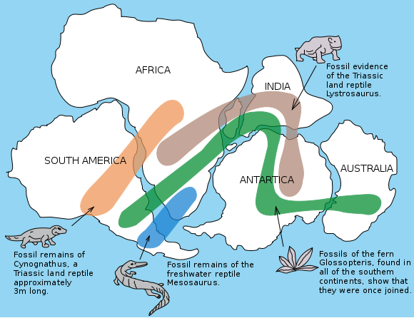
Pangea
What animals lived there?
Notes:
By Osvaldocangaspadilla - Own work, Public Domain, https://commons.wikimedia.org/w/index.php?curid=11310183

Slide 7
Before Pangea?
https://www.youtube.com/watch?v=UwWWuttntio

Slide 8
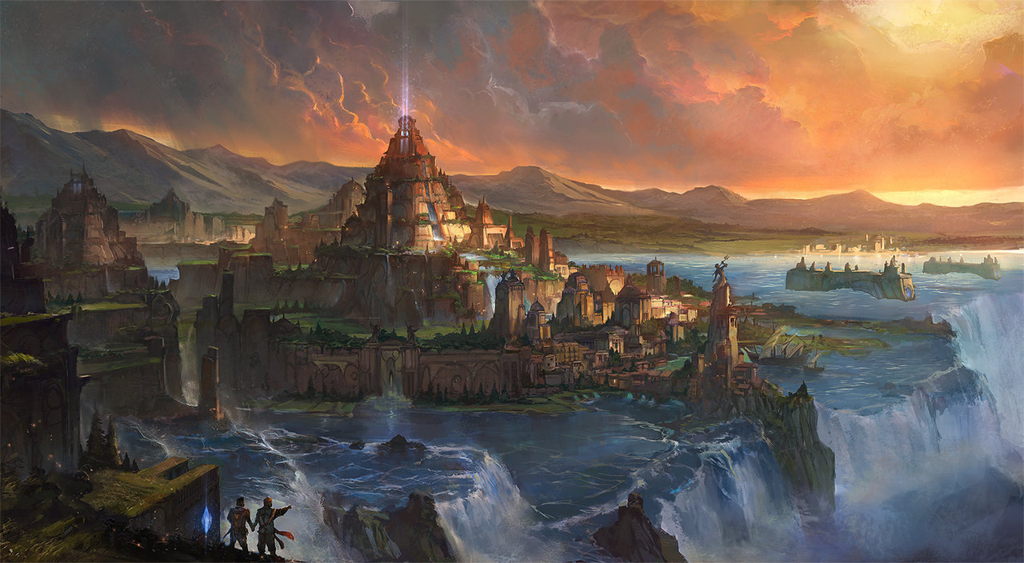
Atlantis
Notes:
http://www.deviantart.com/tag/atlantis

Slide 9
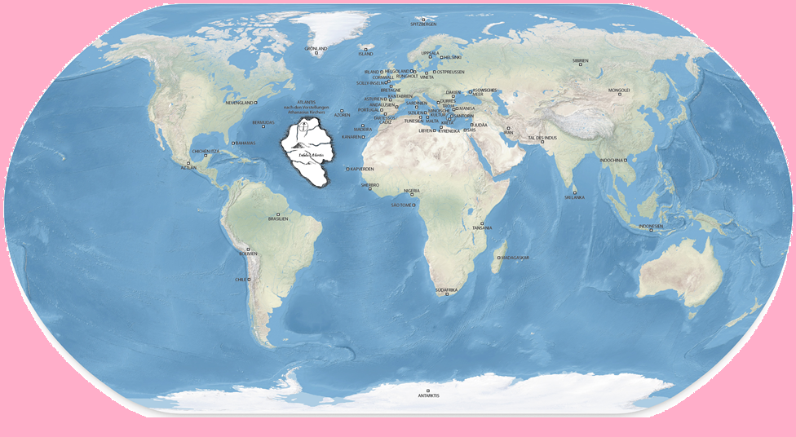
The legend
It was a continent from a long time ago
In the Atlantic Ocean
It sank to the bottom of the ocean
Notes:
http://easyscienceforkids.com/all-about-the-lost-city-of-atlantis/

Slide 10
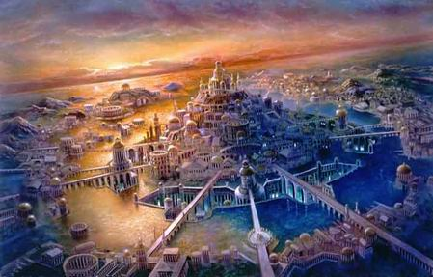
Life on Atlantis
Very smart people
Engineers and Architects
Lots of sailing
Warriors and Merchants
Notes:
https://higherdensity.wordpress.com/2016/04/12/atlantis-2/

Slide 11
Atlantis Game
Play the Atlantis game

Slide 12
Country Speed Quiz
You will hear a random country.
The first one to find it on the map gets a point.
http://random.country/

Slide 13
Drawing things
https://quickdraw.withgoogle.com/#

