Slide 1
Things from Countries

Slide 2
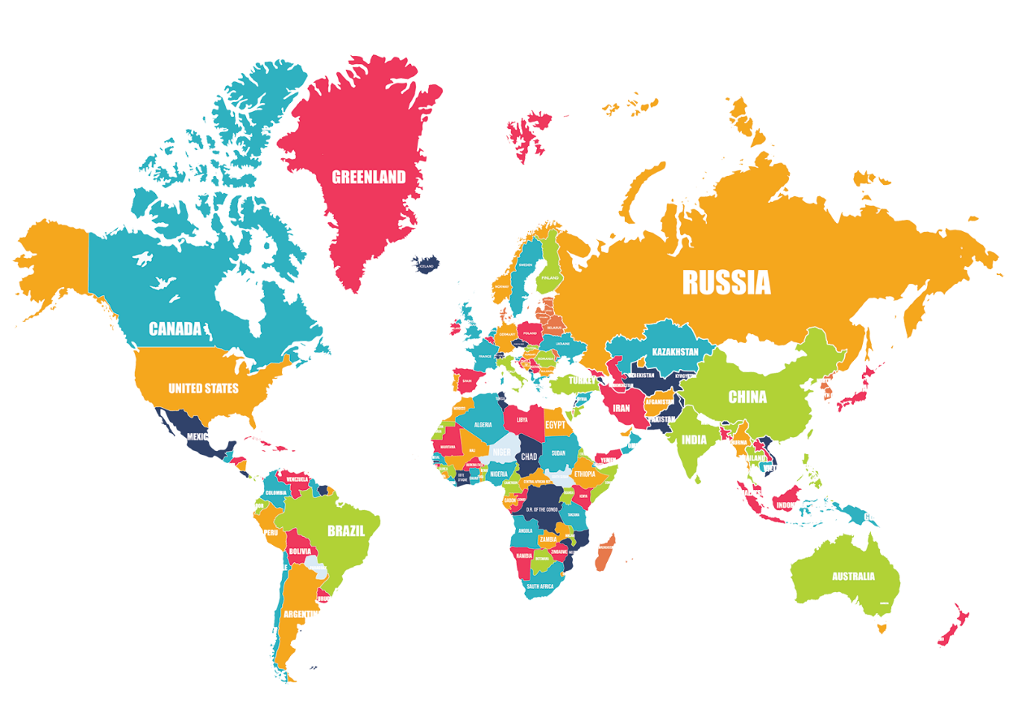
Country Speed Quiz
You will hear a random country.
The first one to find it on the map gets a point.
http://random.country/

Slide 3
Continents Review
Name the Continent

Slide 4
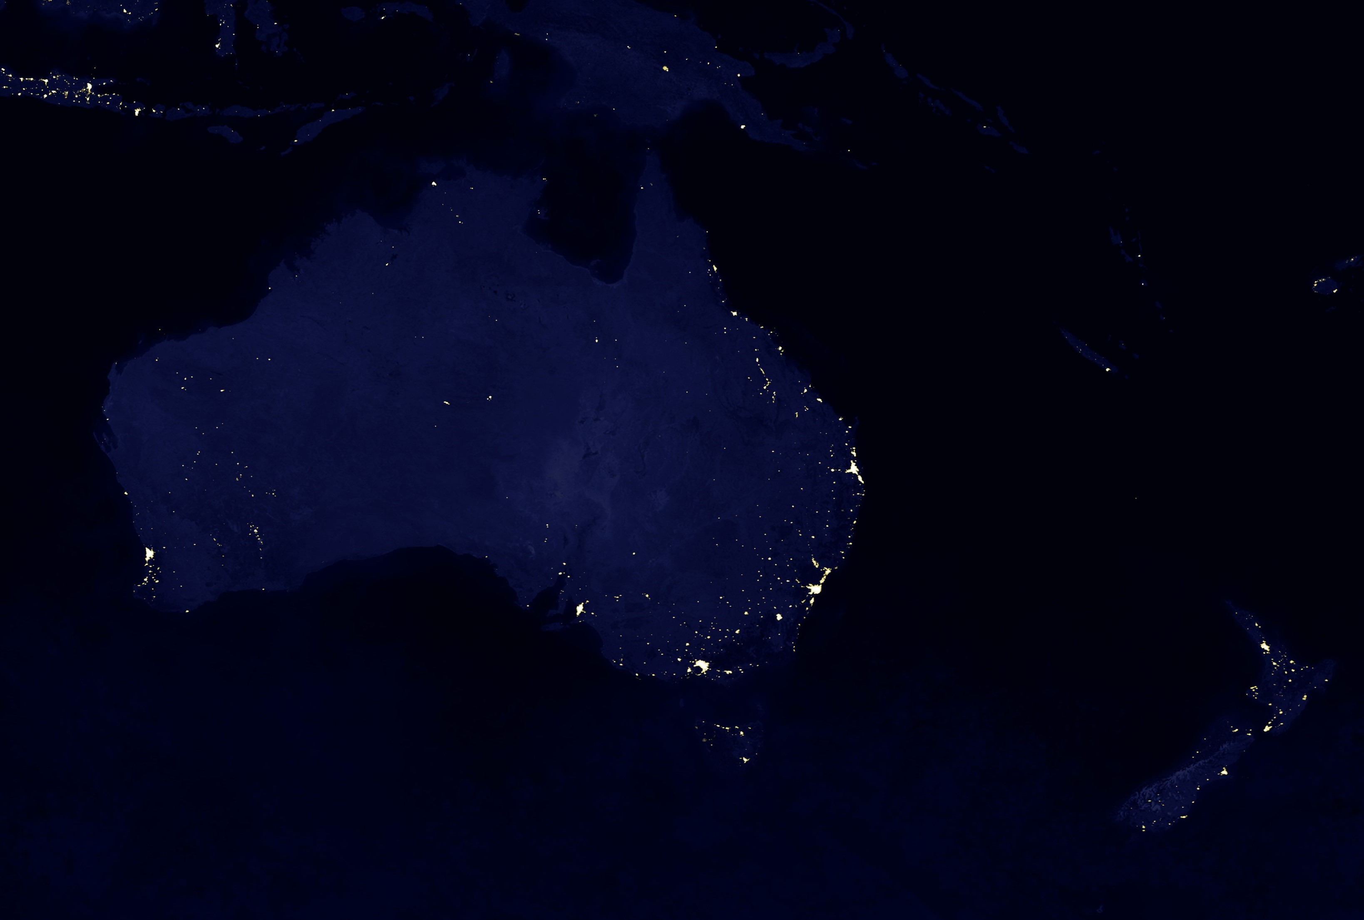
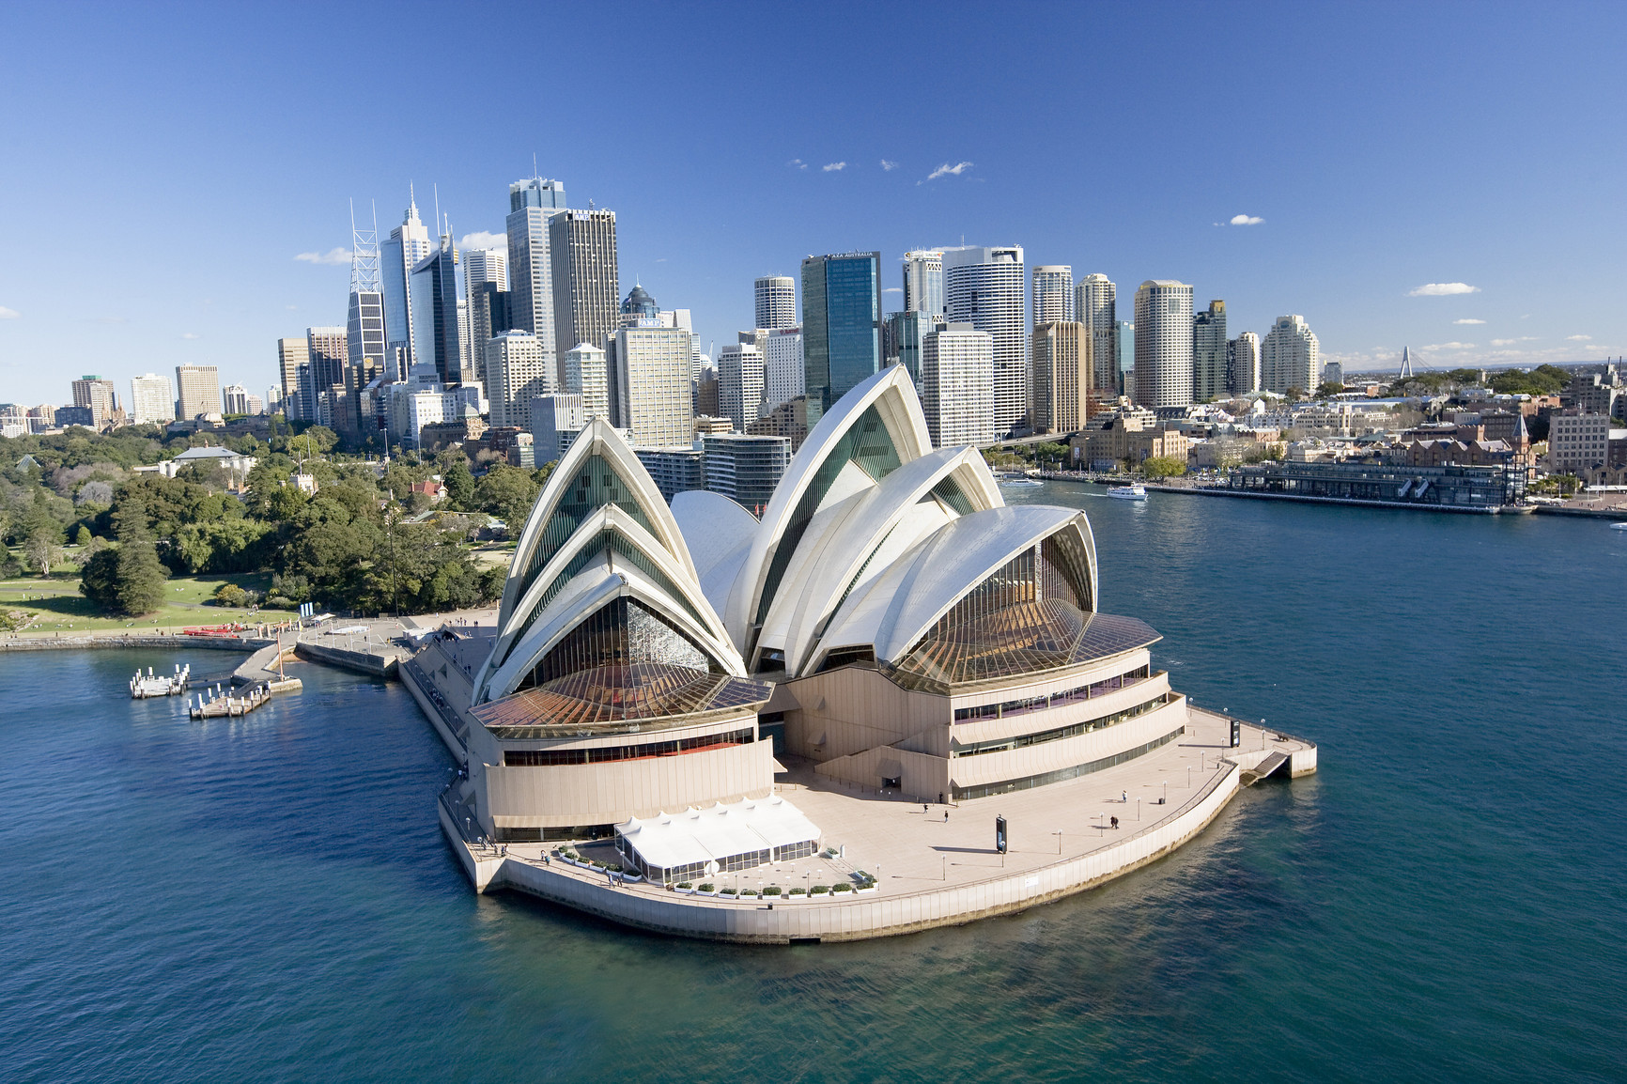
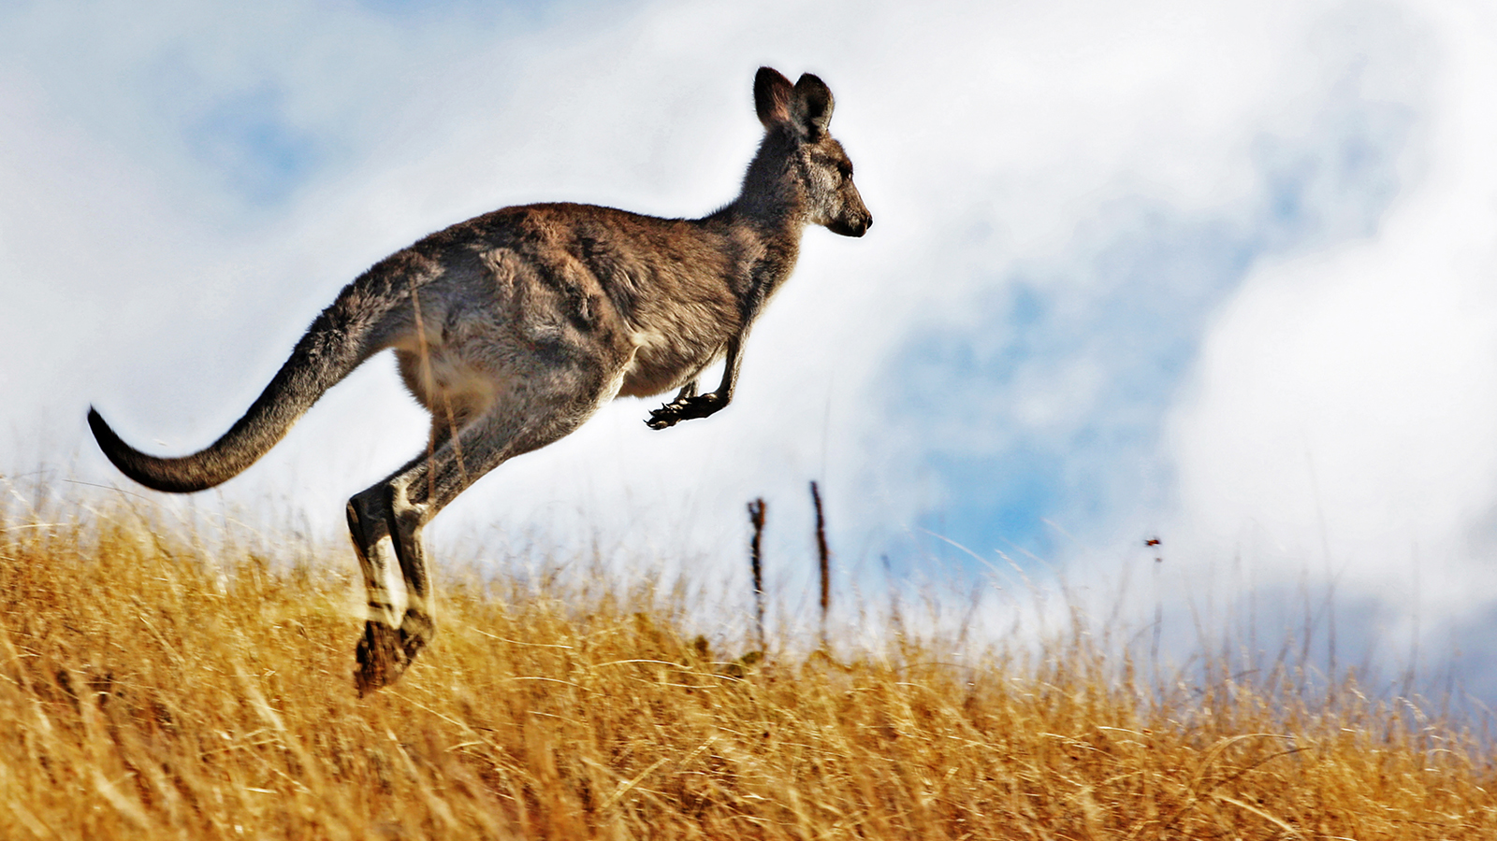
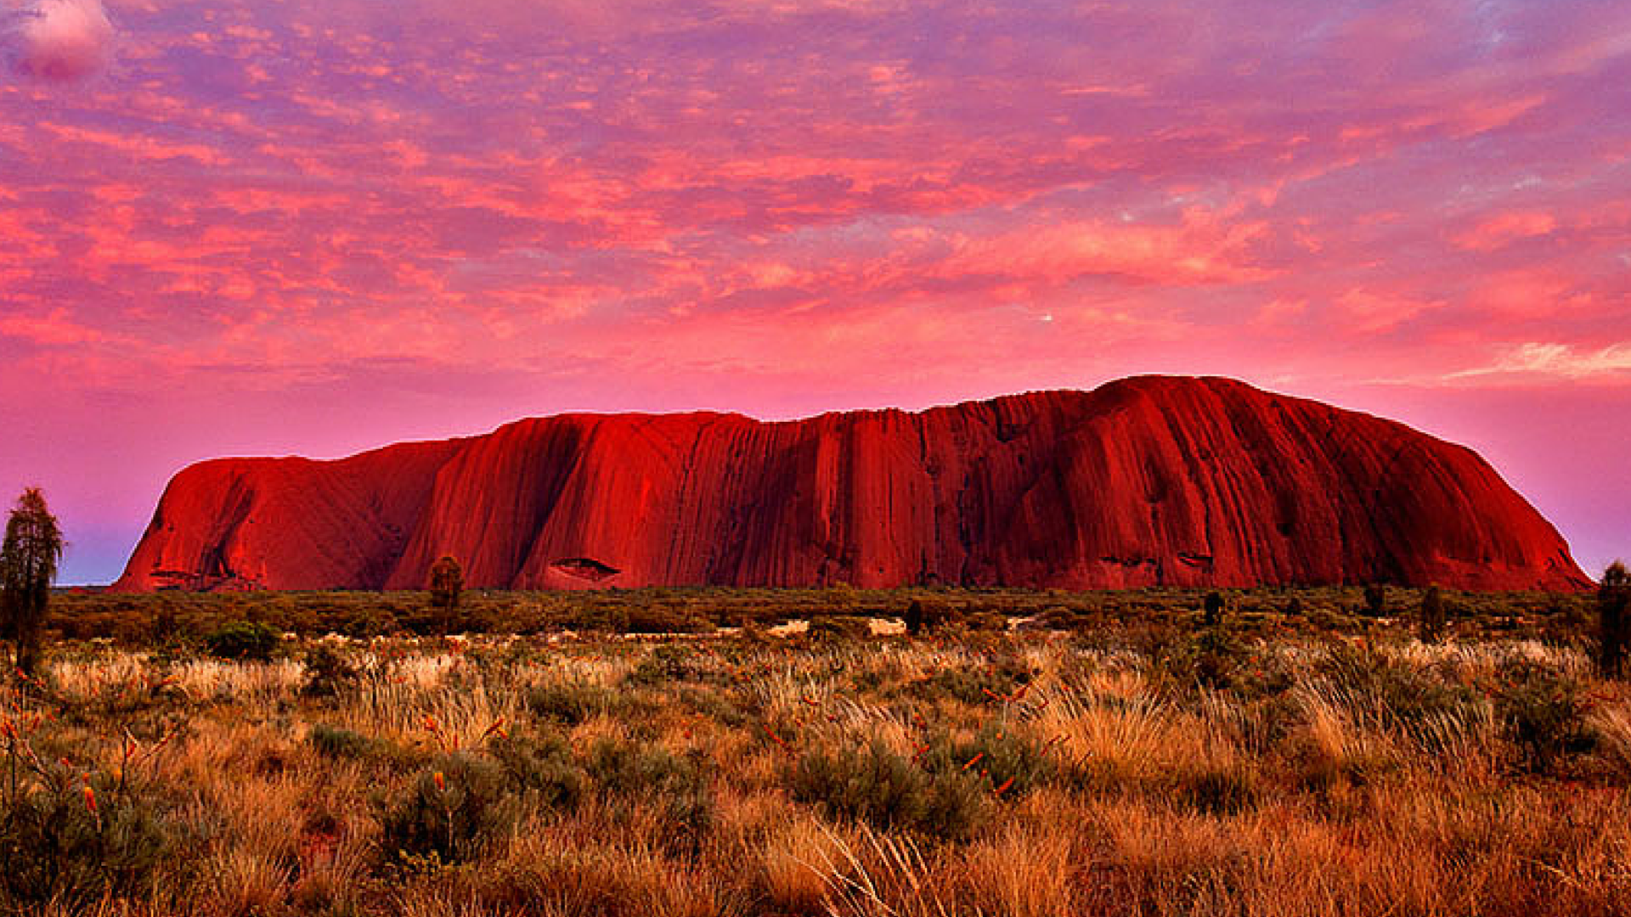
Australia

Slide 5
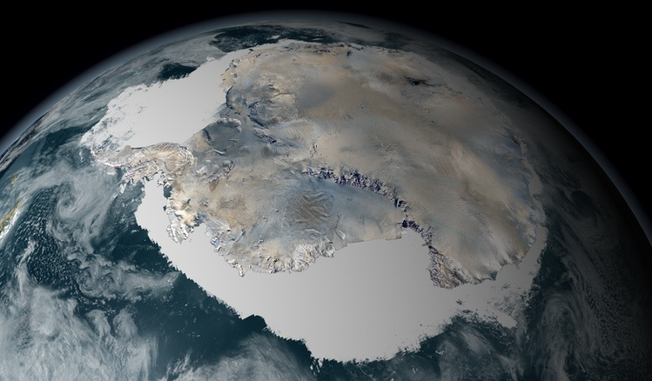
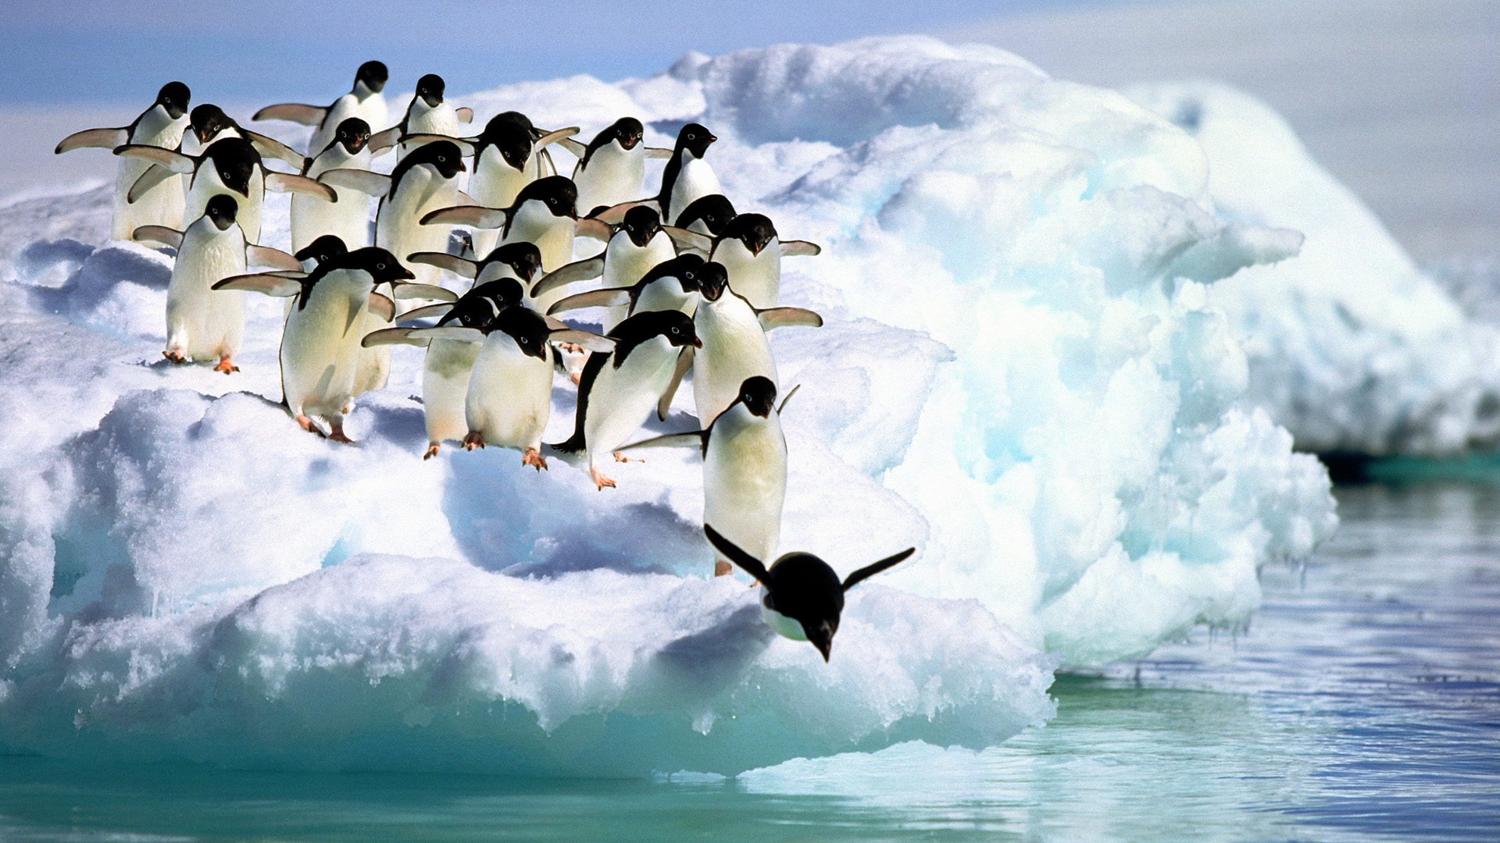
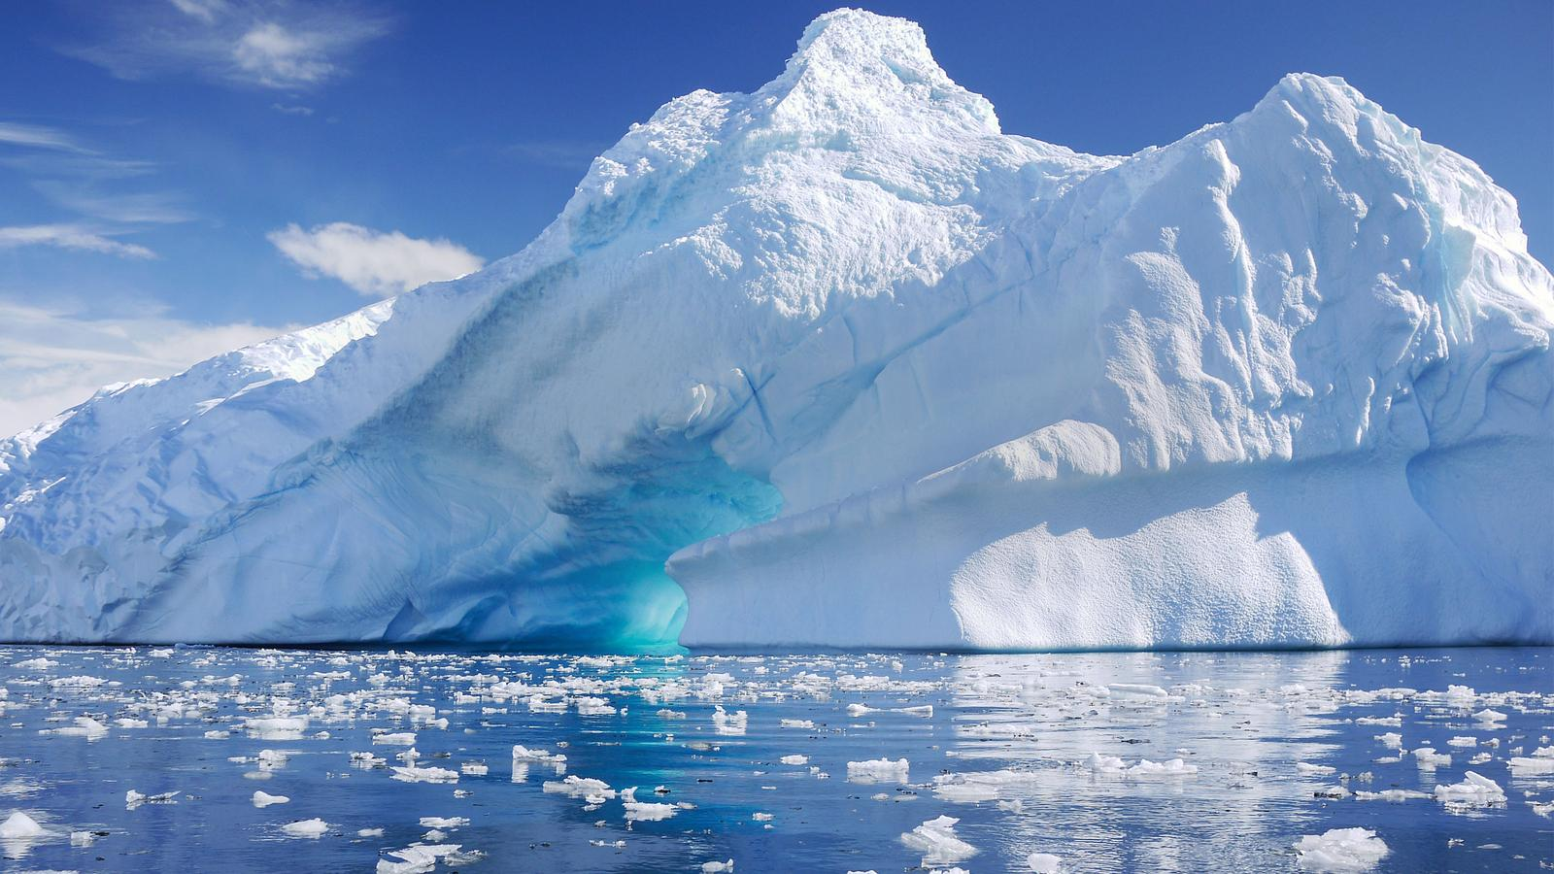
Antarctica

Slide 6
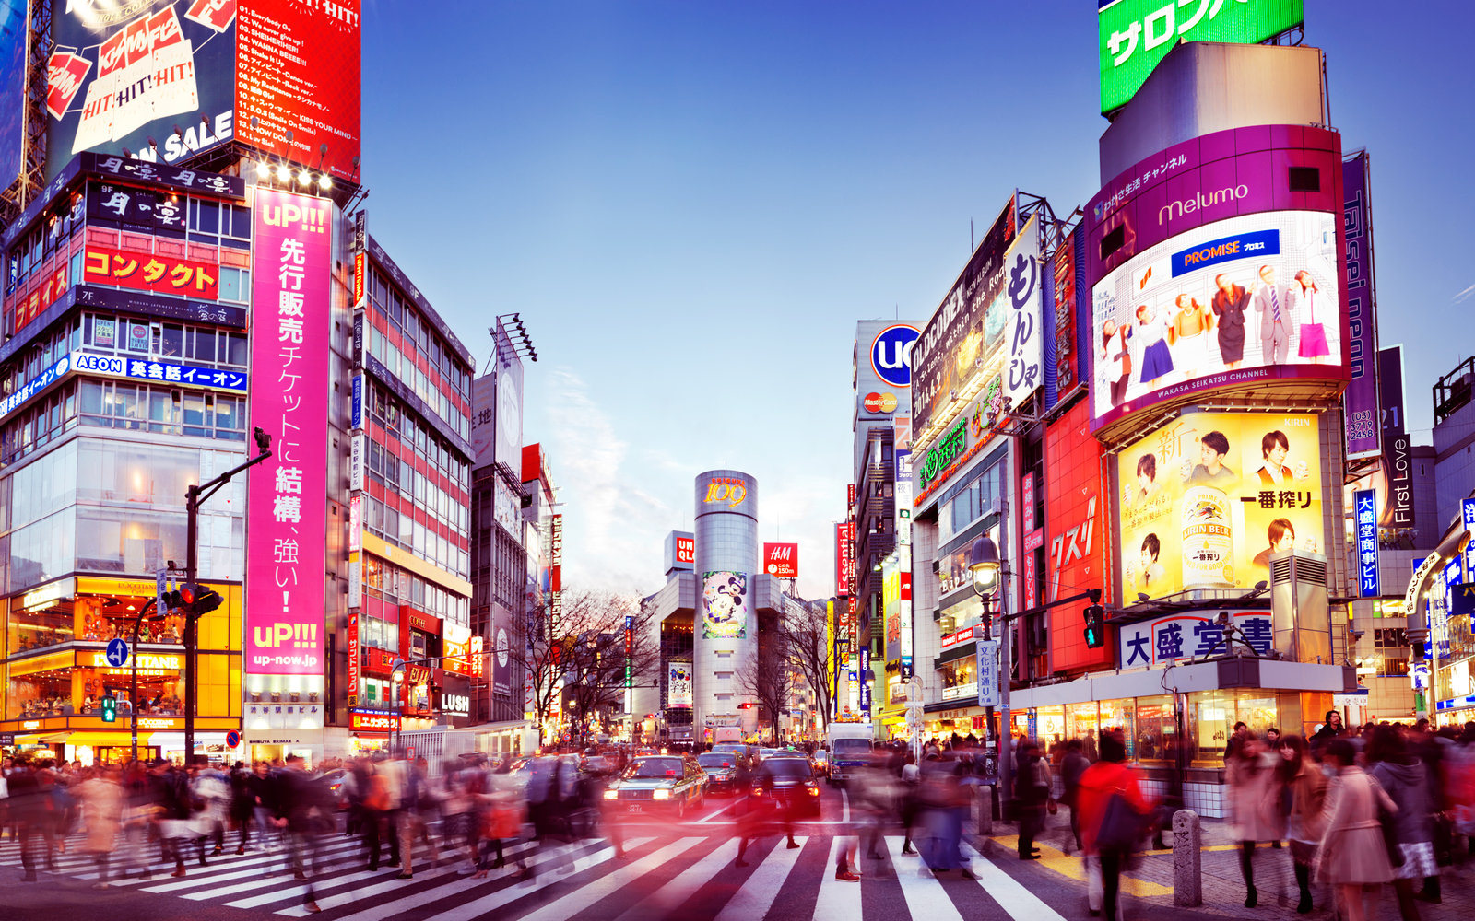
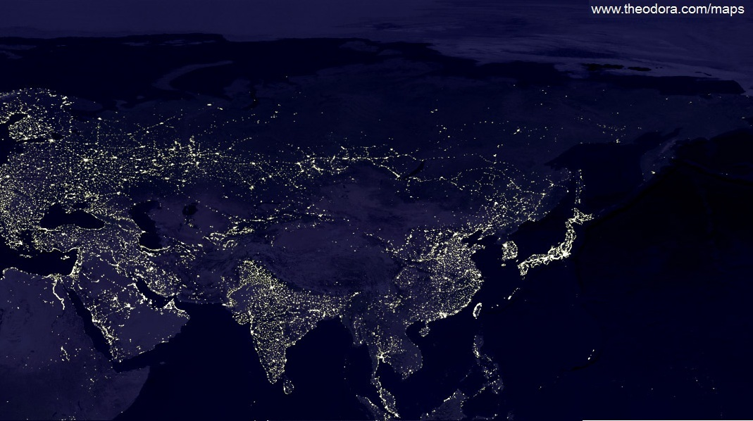
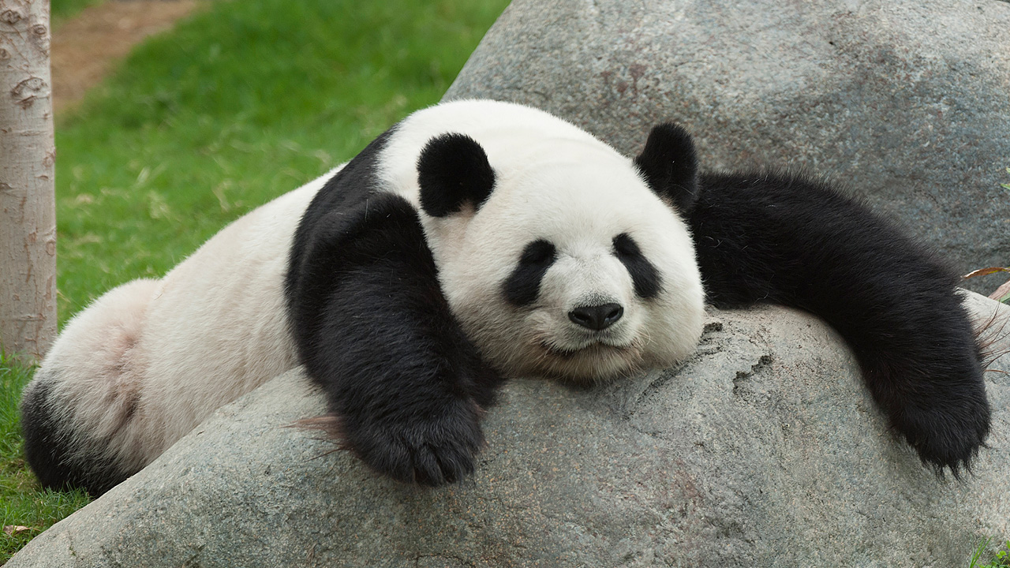
Asia

Slide 7
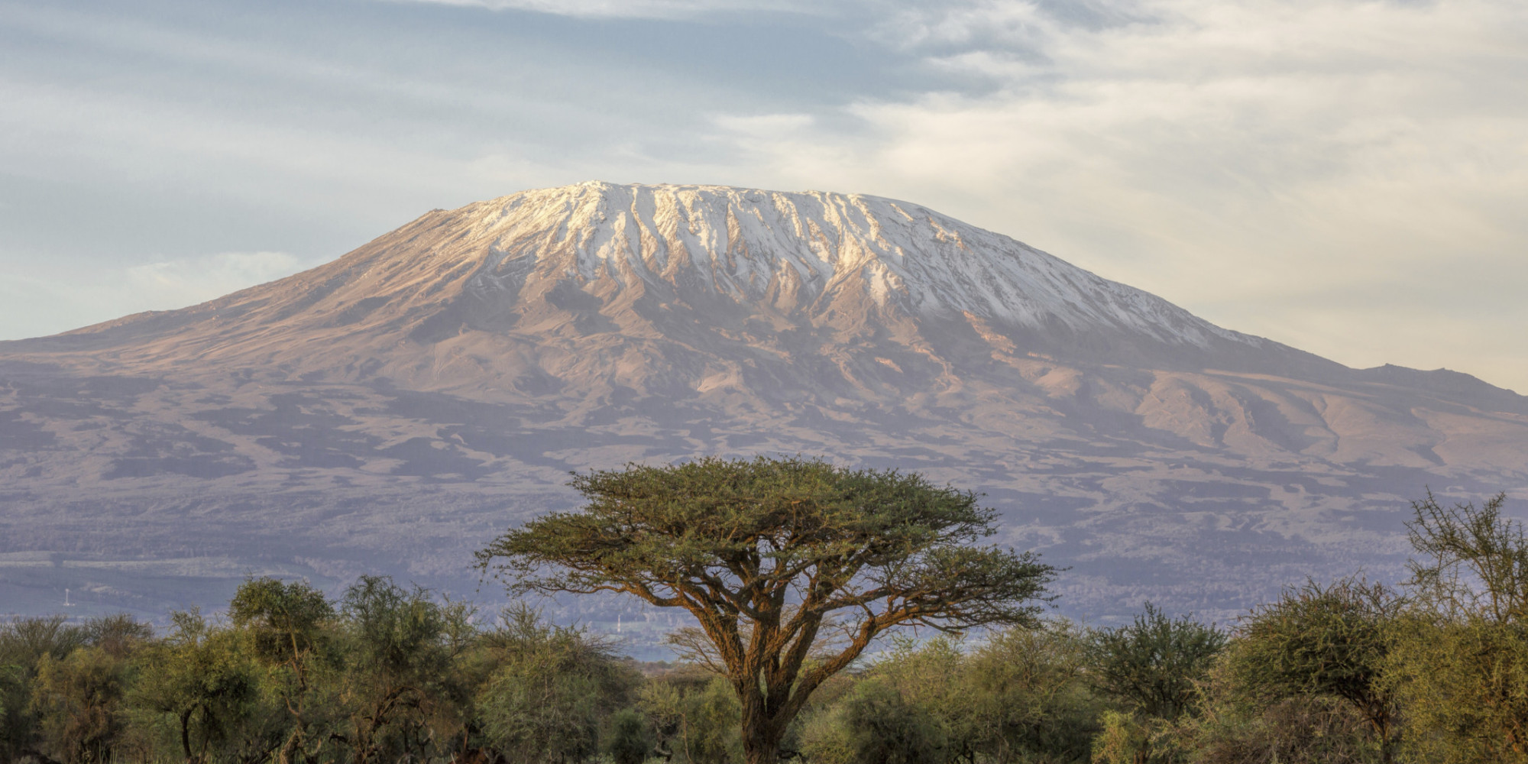
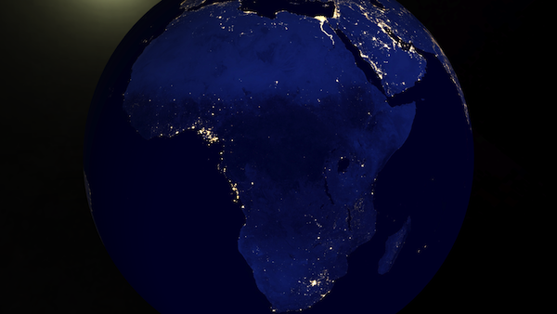
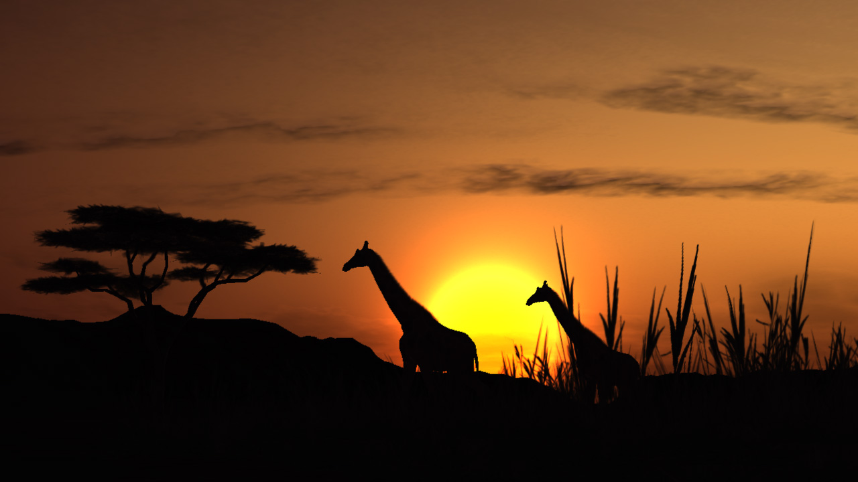
Africa

Slide 8
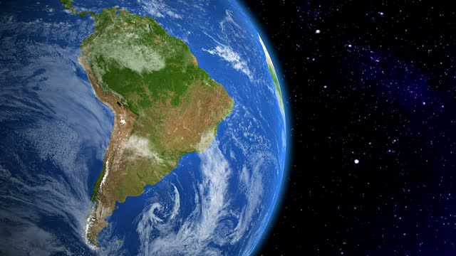
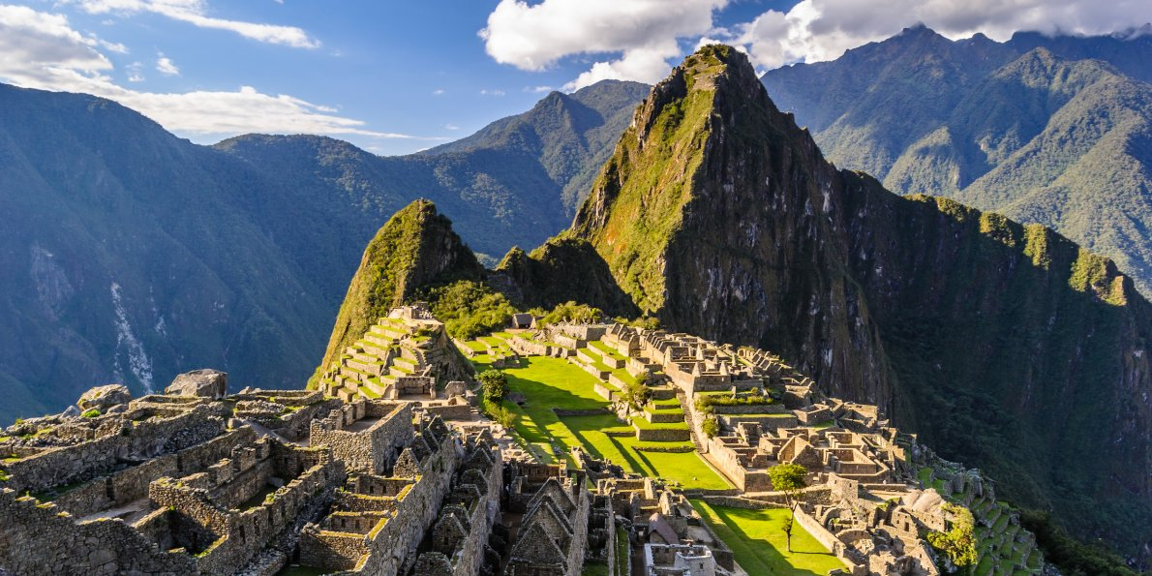
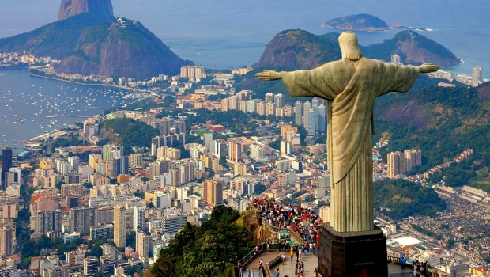
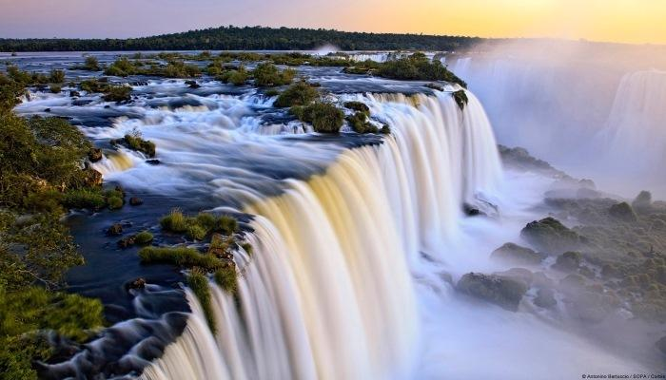
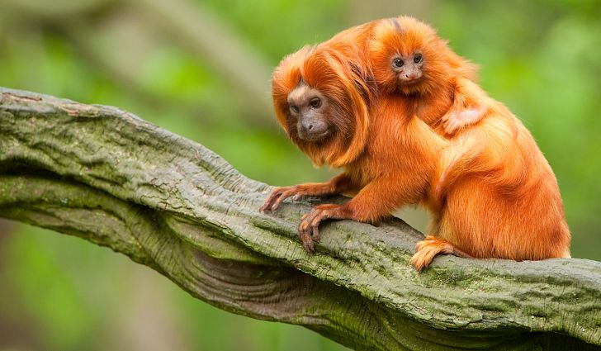
South America

Slide 9
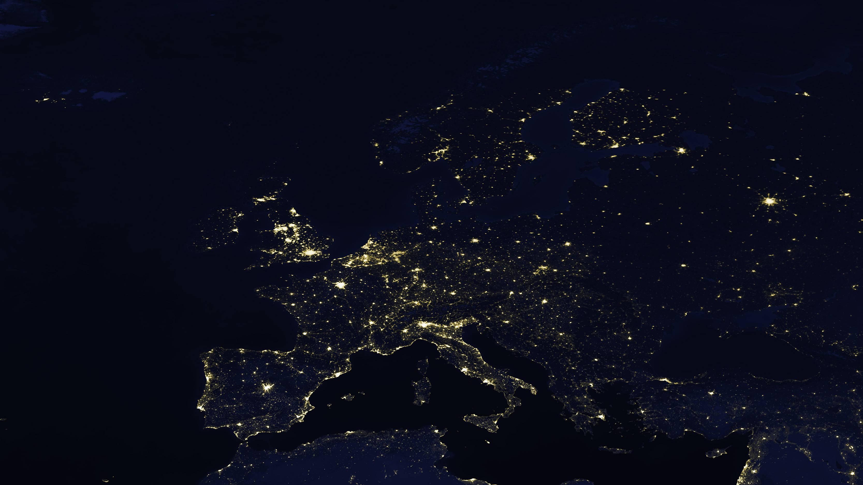
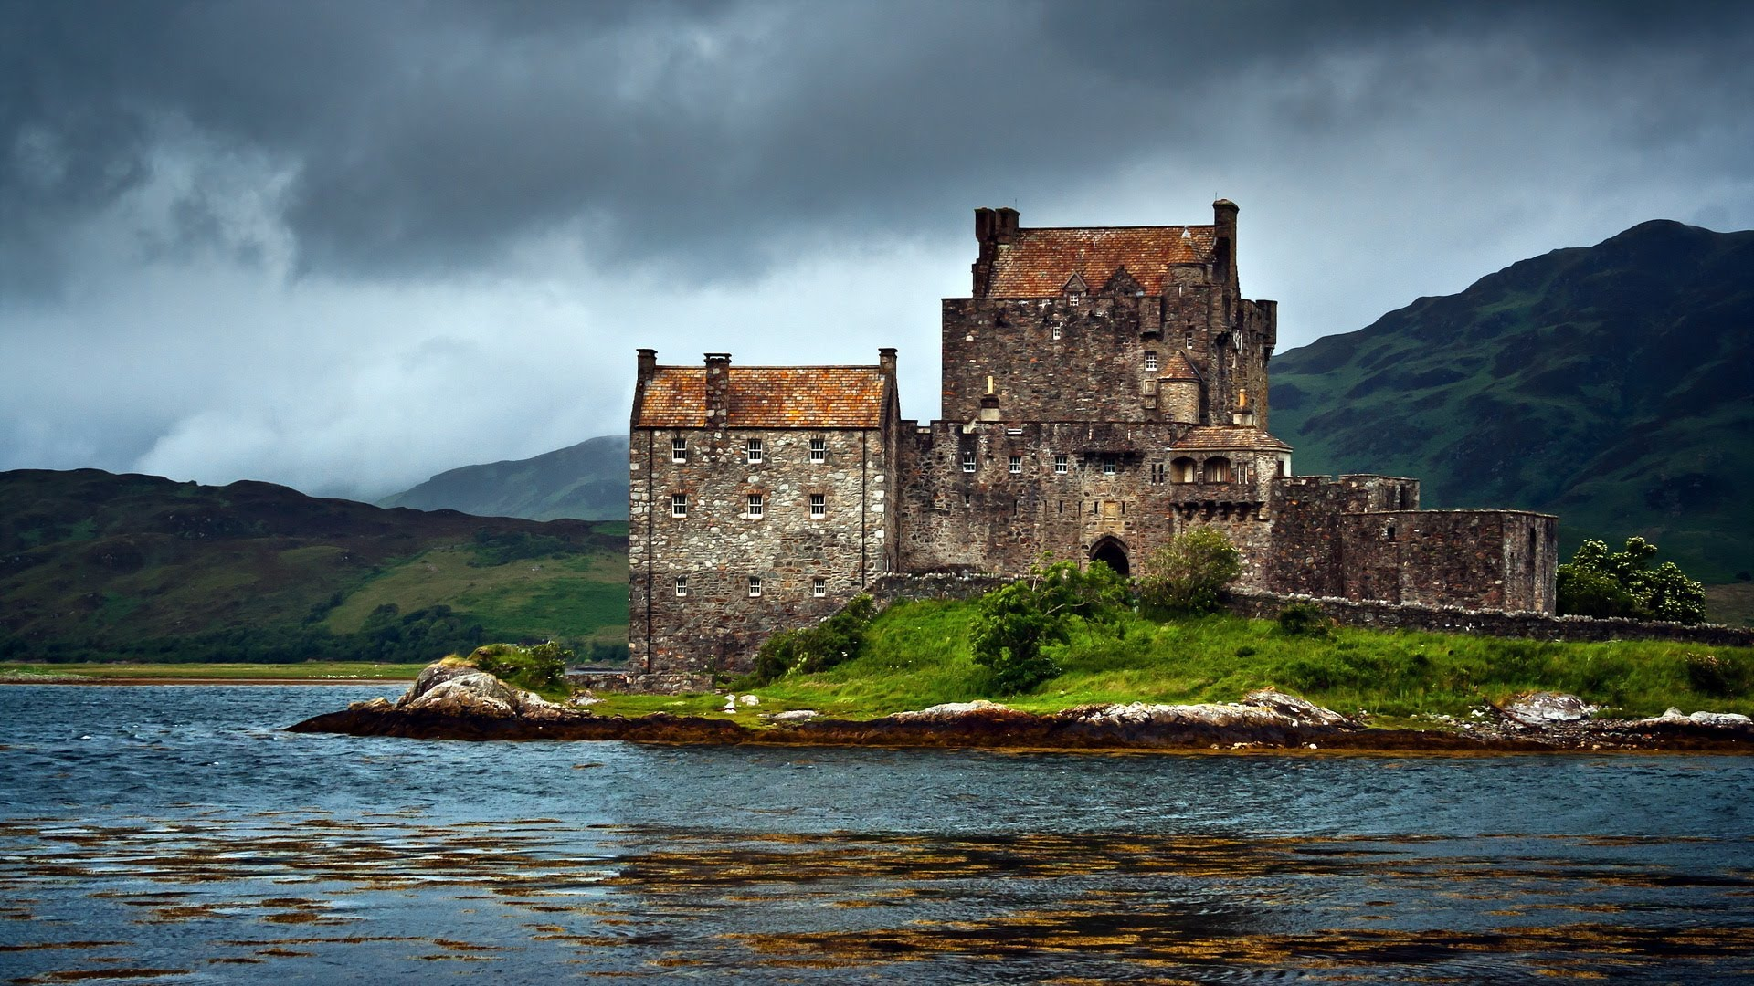
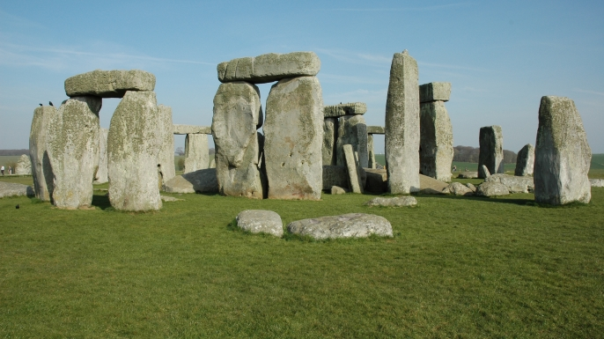
Europe

Slide 10
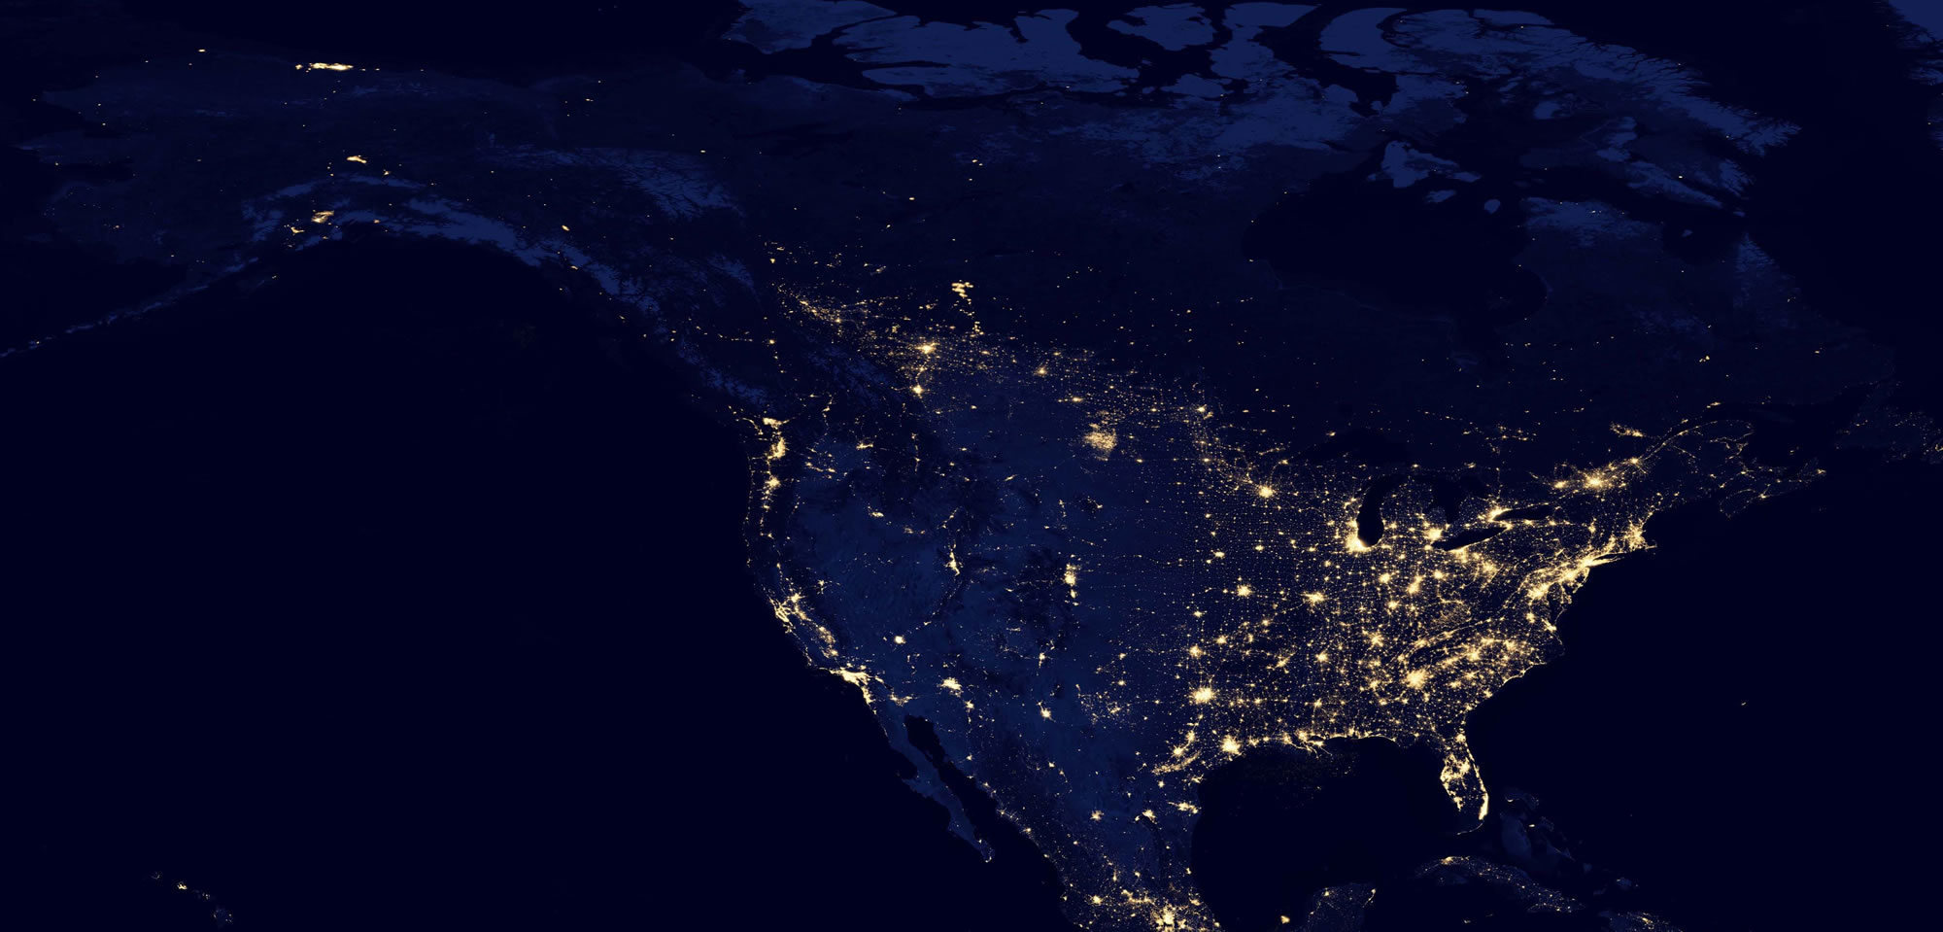
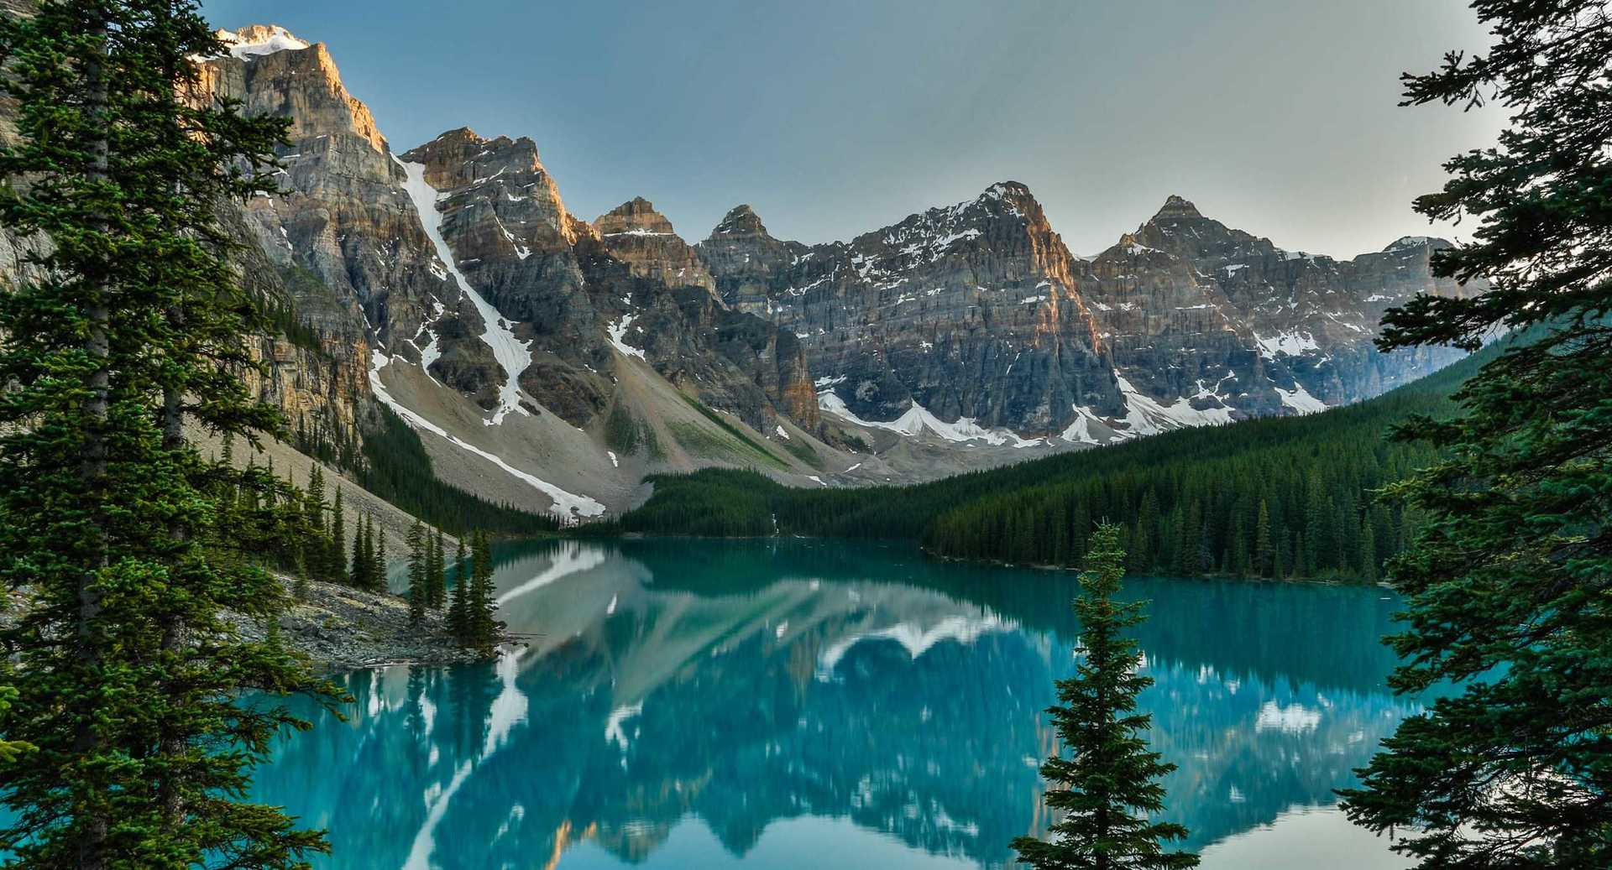
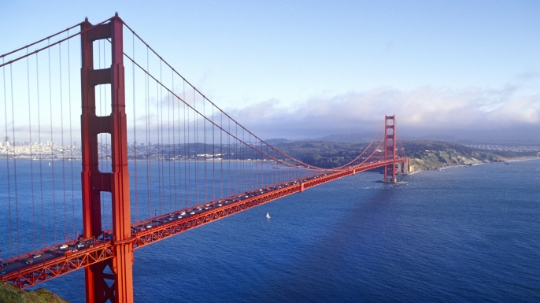
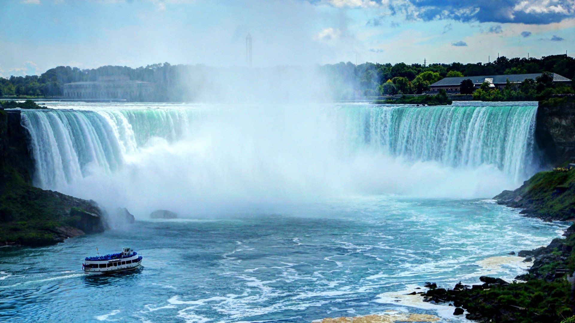
North America

Slide 11
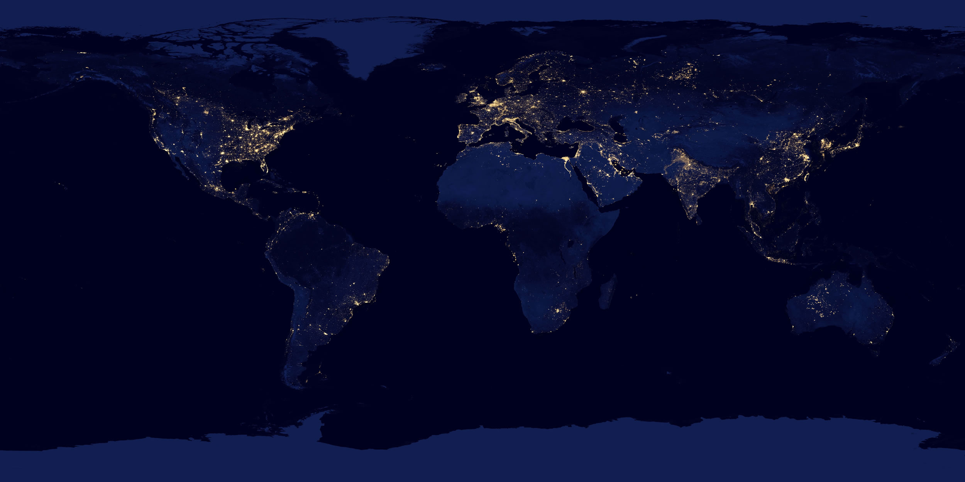

Slide 12
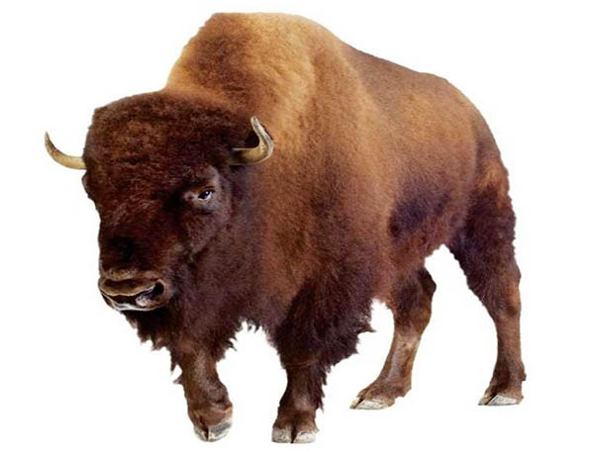
What if there is something from there?
From North America?
North American

Slide 13
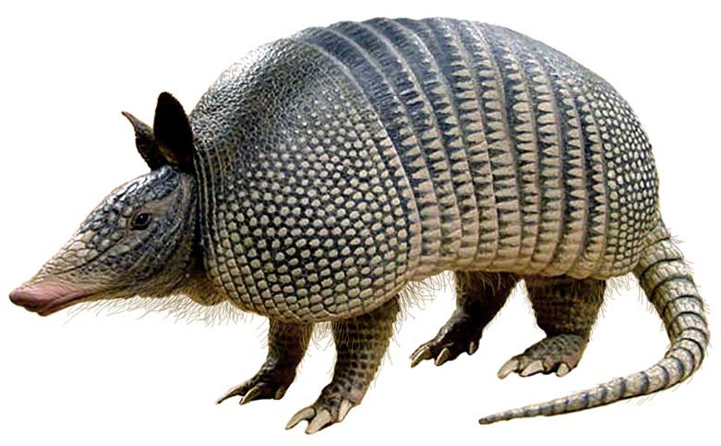
What if there is something from there?
From South America?
South American

Slide 14
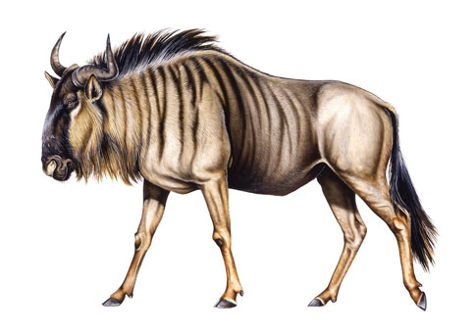
What if there is something from there?
From Africa?
African

Slide 15
What if there is something from there?
From Europe?
European

Slide 16
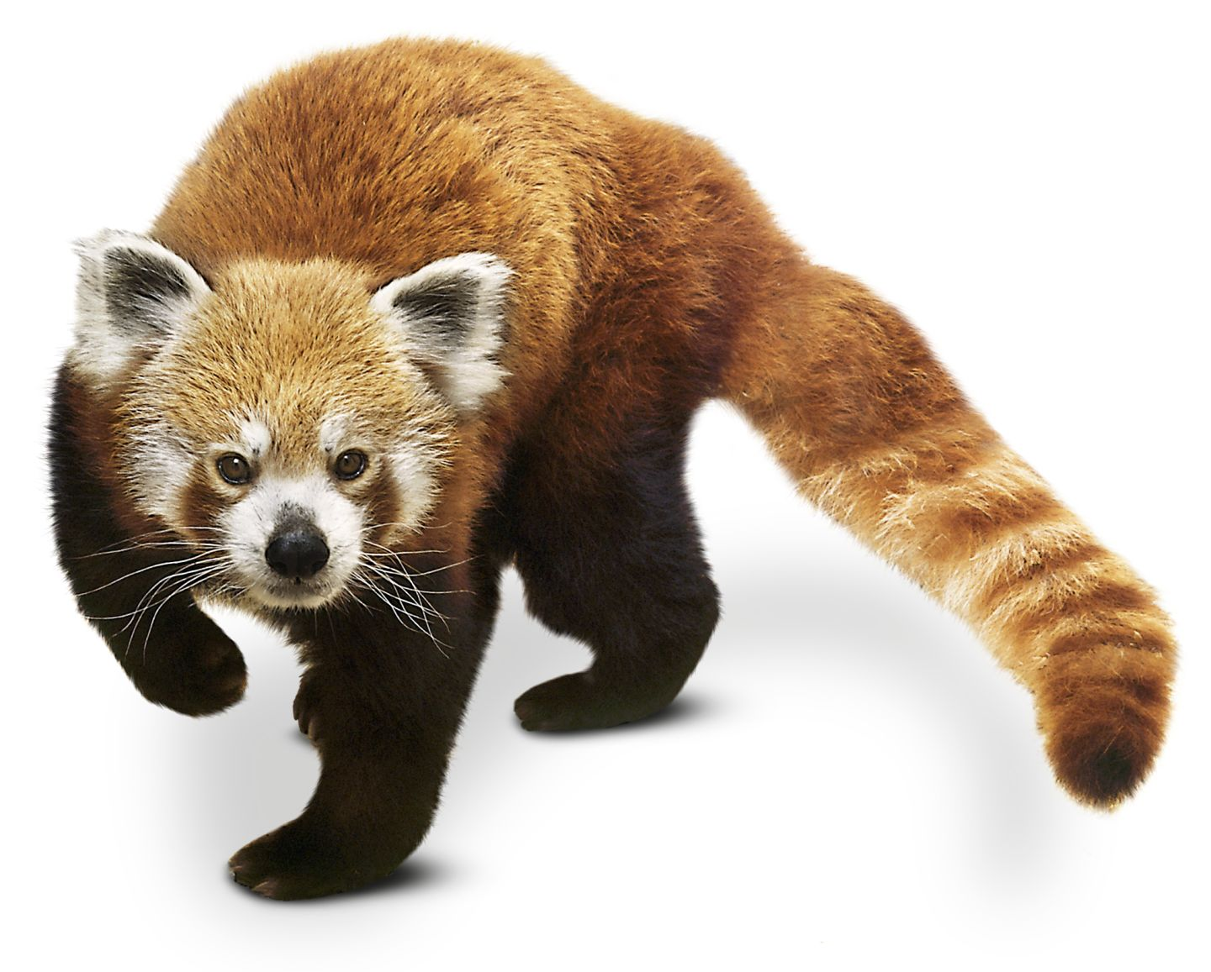
What if there is something from there?
From Asia?
Asian

Slide 17
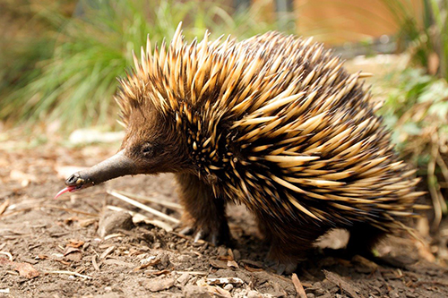
What if there is something from there?
From Australia?
Australian

Slide 18
What if there is something from there?
From Antarctica?
Antarctic

Slide 19
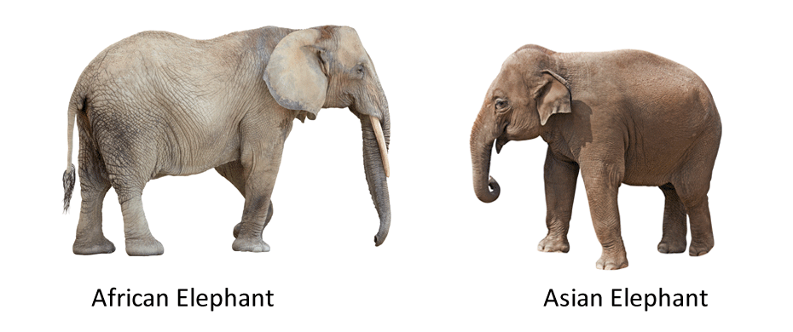
African Elephant / Asian Elephant

Slide 20
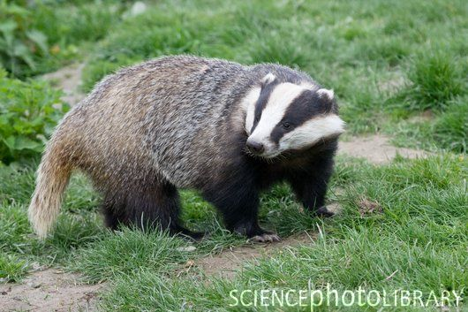
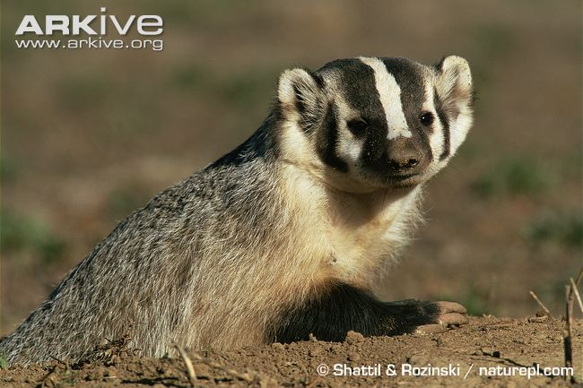
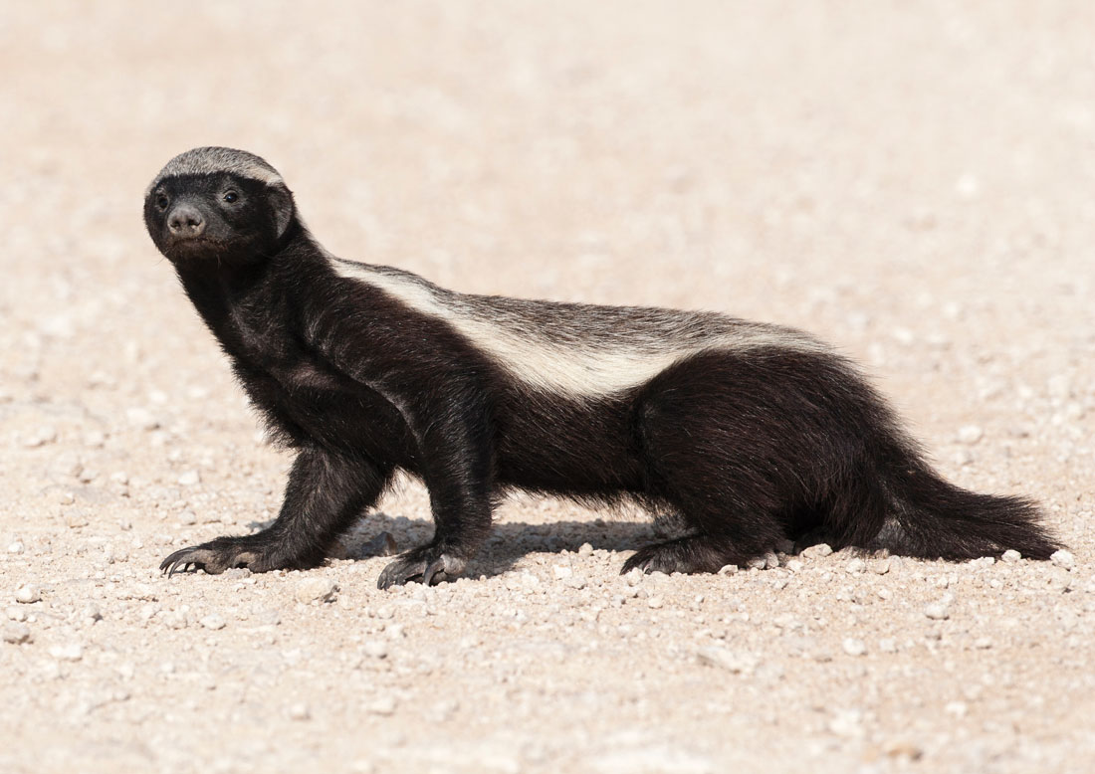
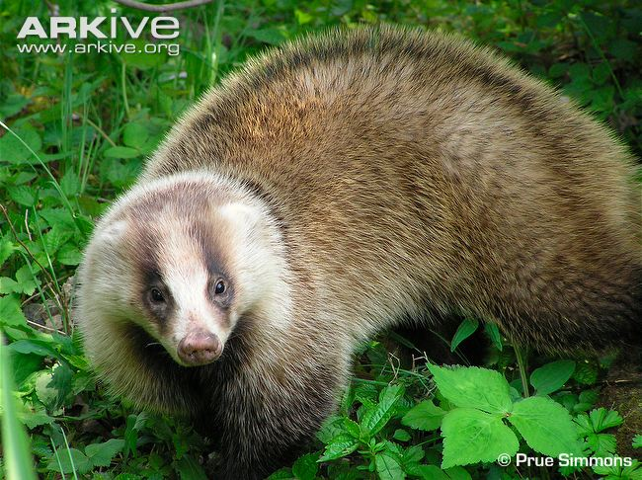
American Badger / European Badger / Honey Badger
Japanese Badger

Slide 21
Countries
Write the adjective next to the country

Slide 22
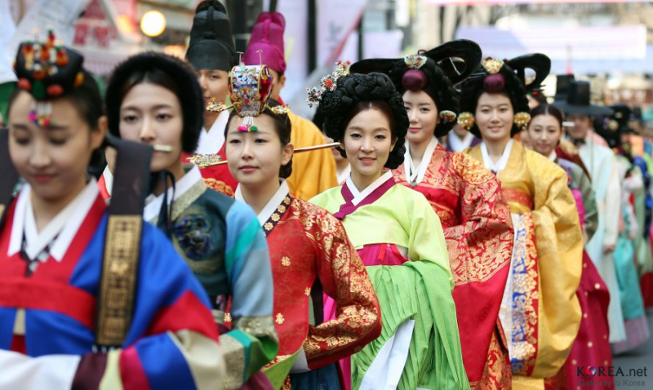
Korea
Korean

Slide 23
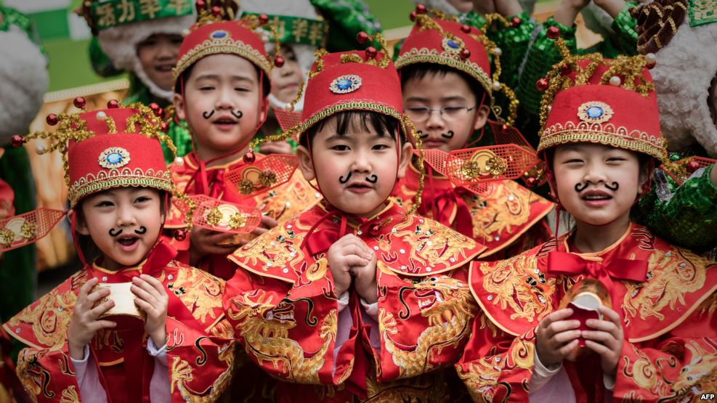
China
Chinese

Slide 24
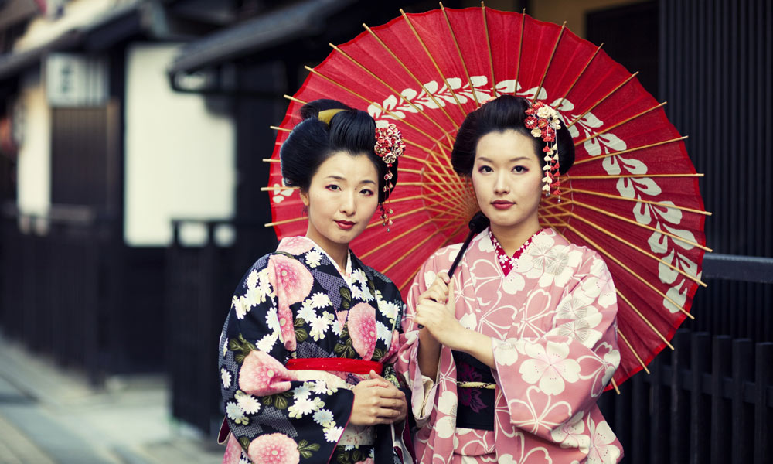
Japan
Japanese

Slide 25
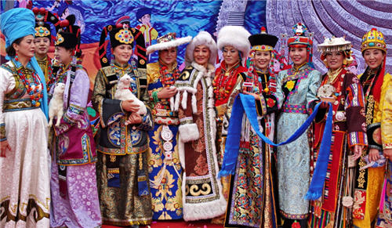
Mongolia
Mongolian

Slide 26
Russia
Russian

Slide 27
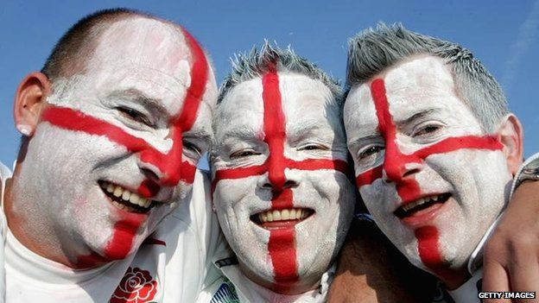
England
English

Slide 28
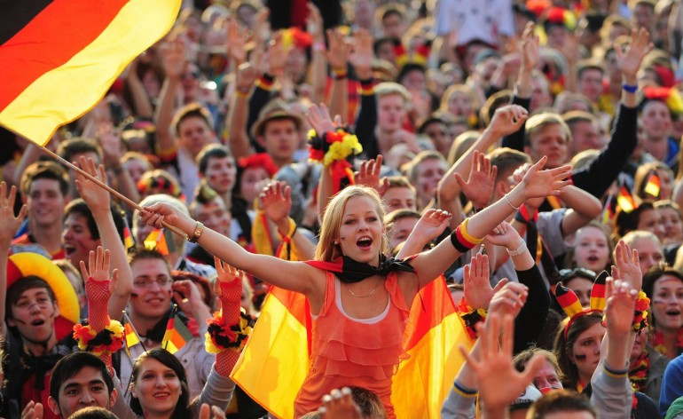
Germany
German

Slide 29
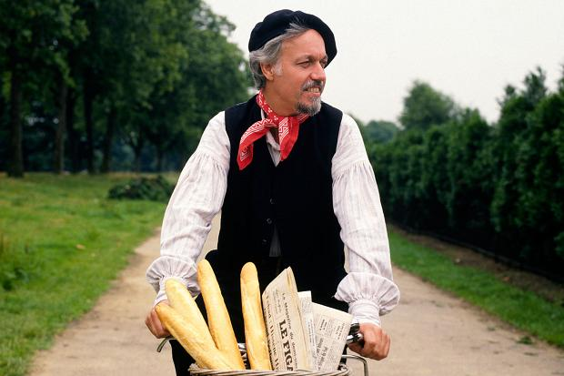
France
French

Slide 30
Spain
Spanish

Slide 31
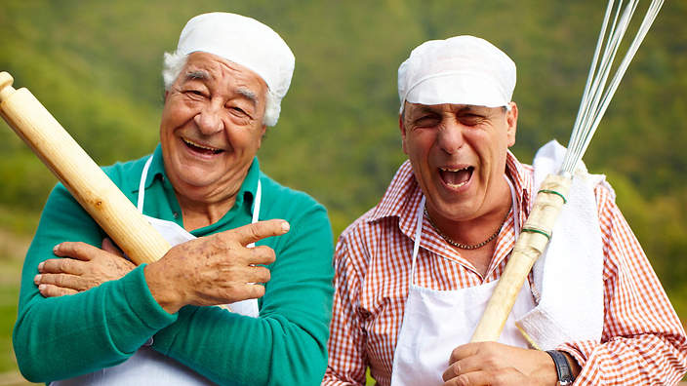
Italy
Italian

Slide 32
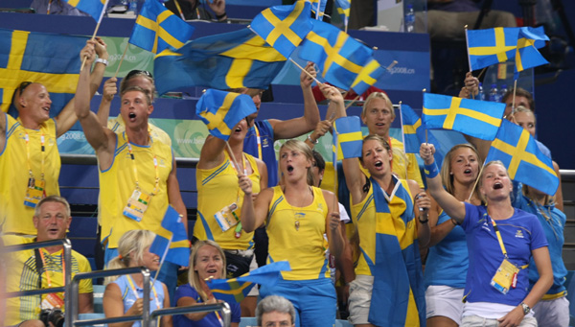
Sweden
Swedish

Slide 33
Finland
Finnish

Slide 34
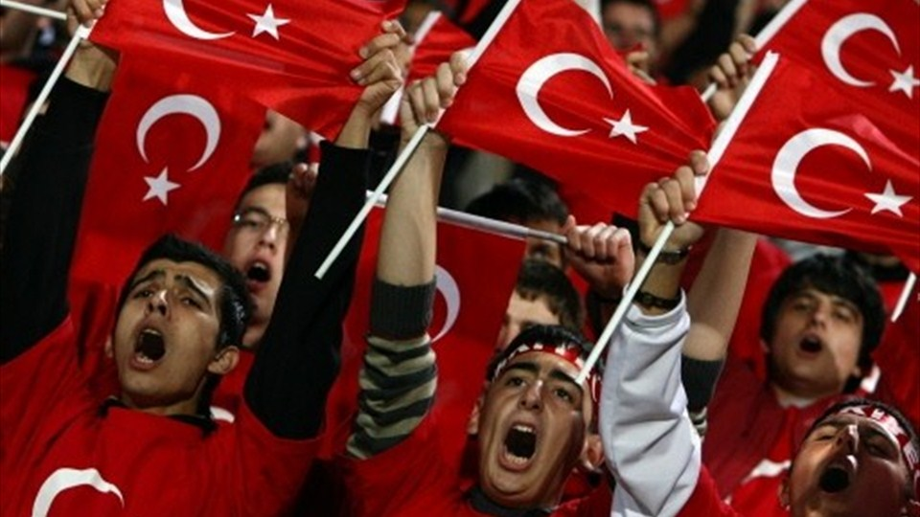
Turkey
Turkish

Slide 35
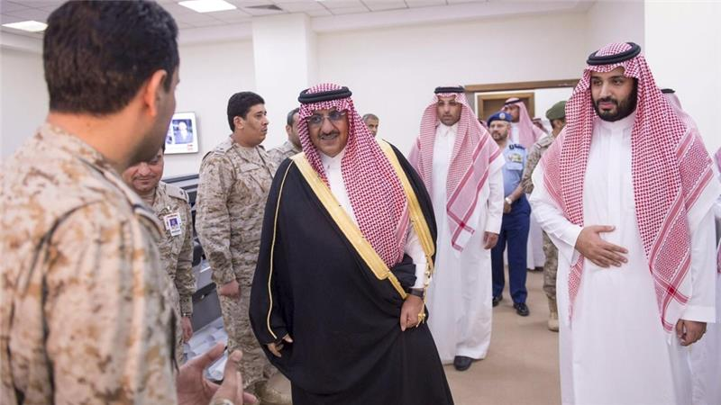
Saudi Arabia
Saudi Arabian

Slide 36
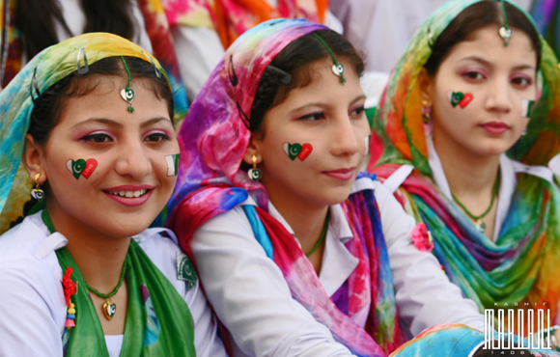
Pakistan
Pakistani

Slide 37
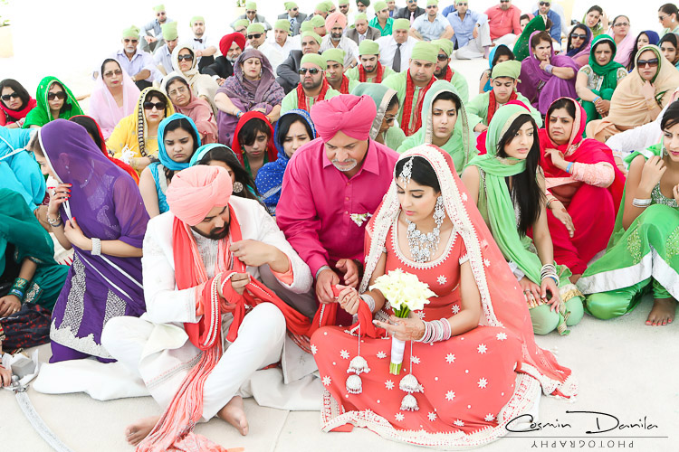
India
Indian

Slide 38
Thailand
Thai

Slide 39
Vietnam
Vietnamese

Slide 40
Indonesia
Indonesian

Slide 41
Australia
Australian

Slide 42
New Zealand
New Zealander

Slide 43
Chile
Chilean

Slide 44
Argentina
Argentinean

Slide 45
Brazil
Brazilian

Slide 46
Peru
Peruvian

Slide 47
Mexico
Mexican

Slide 48
USA
American

Slide 49
Canada
Canadian

Slide 50
What Kind of Food is it?

Slide 51
Korean Food

Slide 52
Mexican Food

Slide 53
Japanese Food

Slide 54
American Food

Slide 55
Chinese Food

Slide 56
Indian Food

Slide 57
French Food

Slide 58
Thai Food

Slide 59
Traditional Food Quiz
http://www.funtrivia.com/playquiz/quiz2437421be8318.html

