Slide 1
Fingerprints

Slide 2
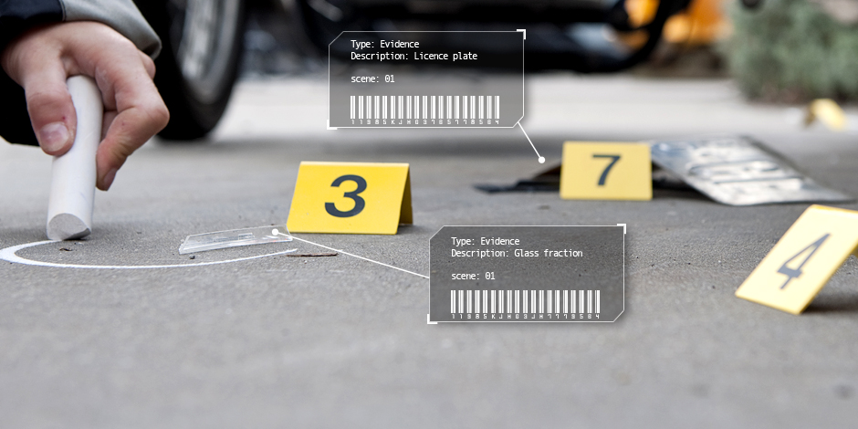
Evidence – Something that helps to explain something else

Slide 3
Collecting Evidence:
Why do they wear gloves?

Slide 4
Collecting Evidence:
Types of evidence:
DNA
Fingerprints
Fibers
Blood
Documents
Weapon
Witness
Etc.

Slide 5
Fingerprints

Slide 6
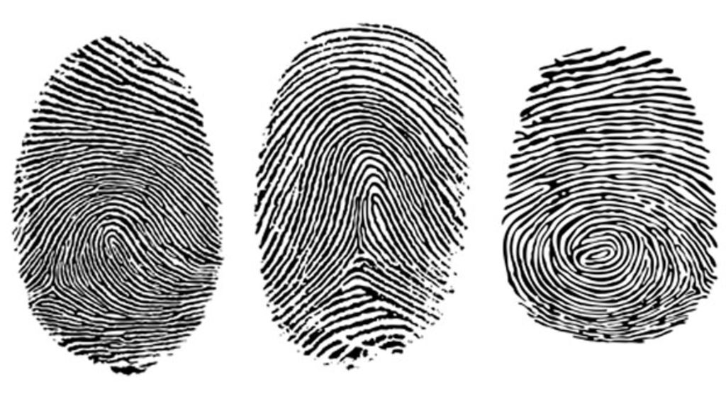
Every fingerprint is different

Slide 7
Finger Names
Middle finger
Index (Pointer) finger
Ring finger
Pinky
Thumb

Slide 8
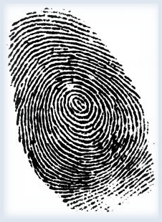
Fingerprints
Wash your hands
Help each other
Use the ink pad to make your fingerprints
Touch a scrap paper before putting fingerprints on the worksheet.
Wash your hands with the wet tissue.

Slide 9
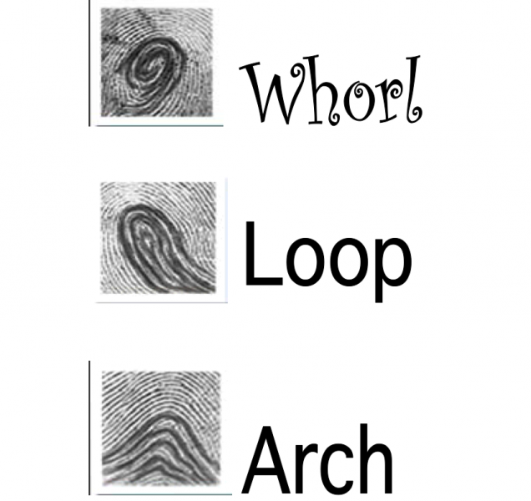
Analyzing Fingerprints

Slide 10
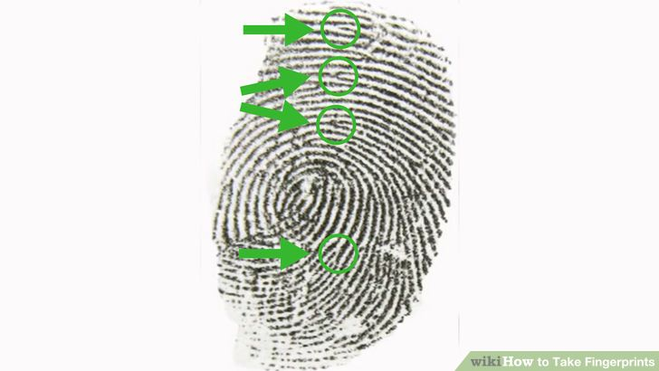
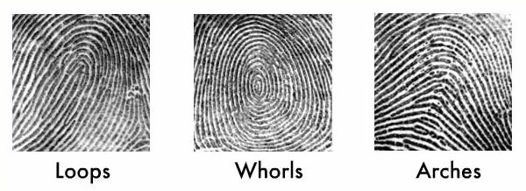
Analyzing Fingerprints
Deltas
Look at your index fingerprint

Slide 11
Diffuse the Bomb
http://www.inc.eng.kmutt.ac.th/course/inc551/waterpuzzle.swf

Slide 12
Red Remover
http://www.1001games.com/games/red_remover_blast

Slide 13
Jigsaw Puzzle
http://www.jigsaw.x0.com/index_e.html

