Slide 1
Suspects
https://www.youtube.com/watch?v=ubNF9QNEQLA

Slide 2
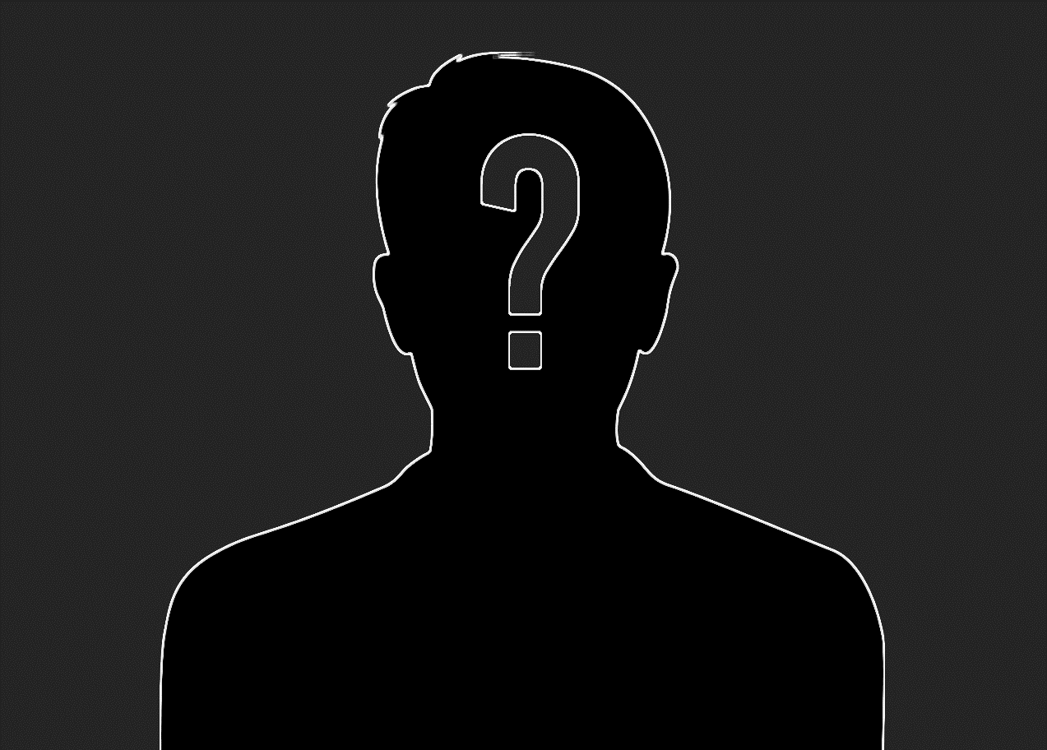
Suspect
Who the police think did it.

Slide 3
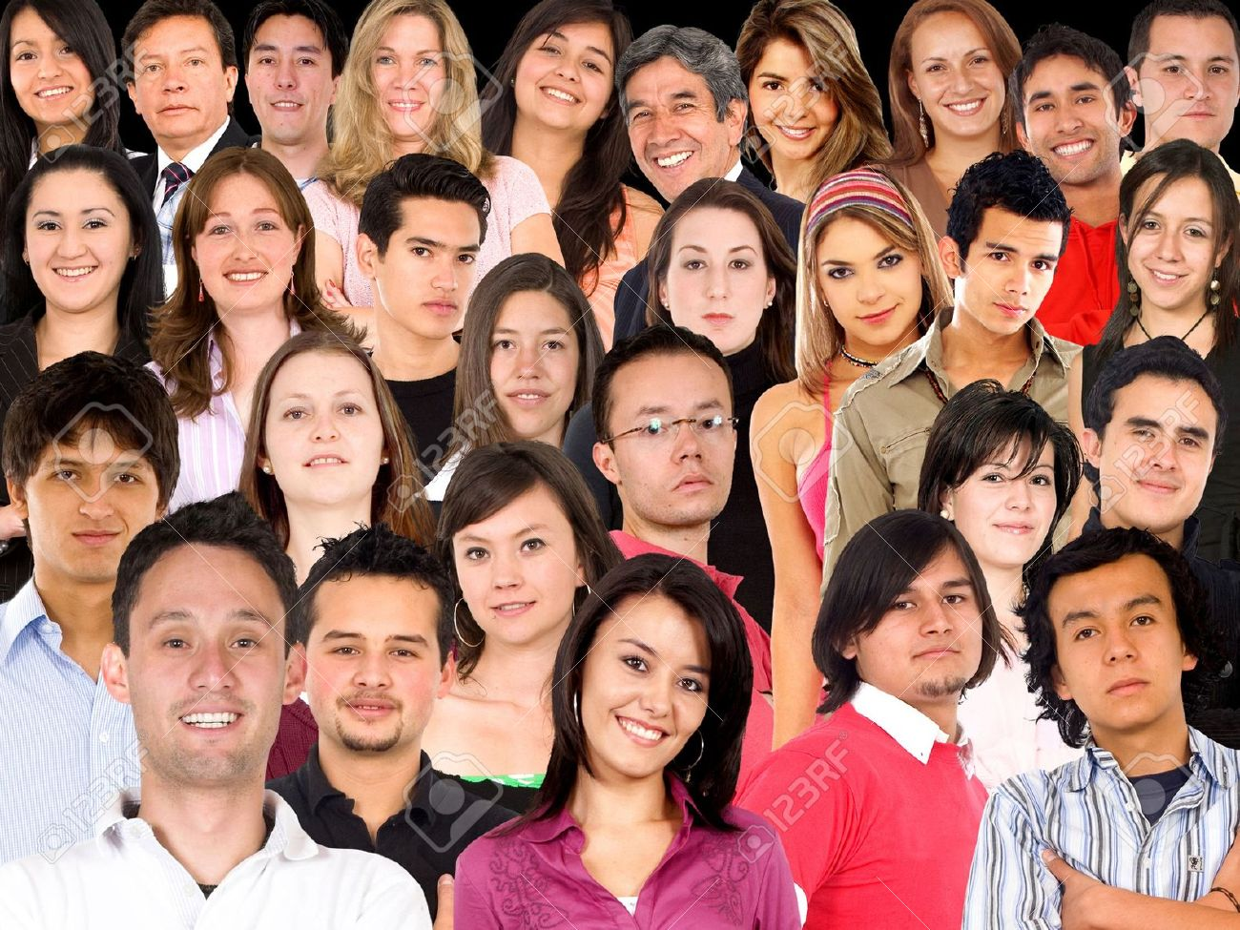
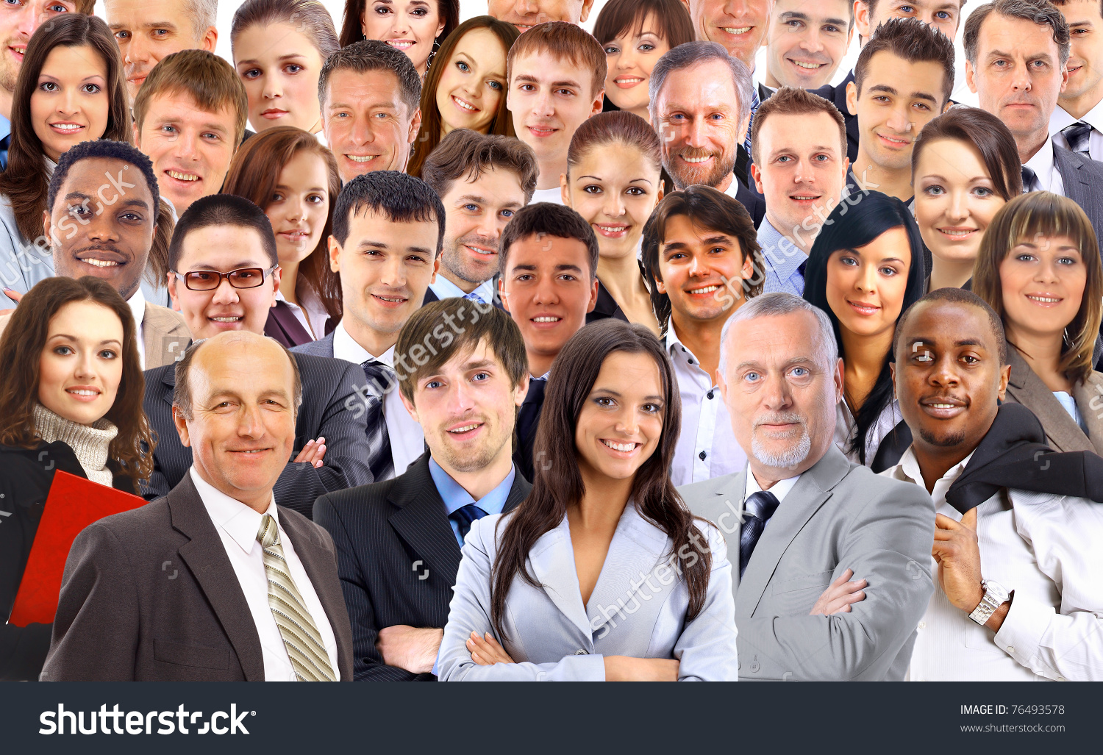
Describing a Person (adjectives)

Slide 4
Police Lineup

Slide 5
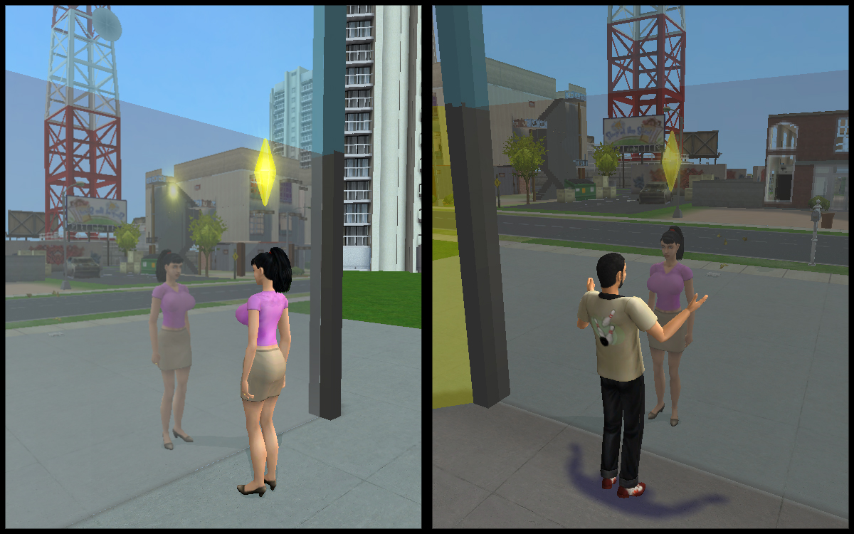
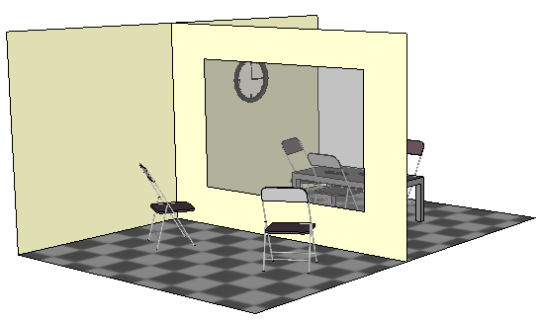
Police Lineup
One way mirror

Slide 6
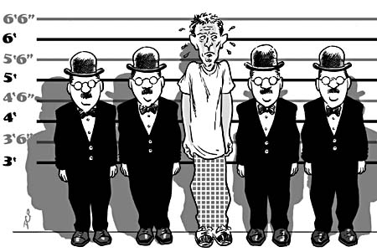
Police Lineup
Similar people

Slide 7
Suspect Game
http://www.knowledgeadventure.com/games/find-the-suspect/

Slide 8
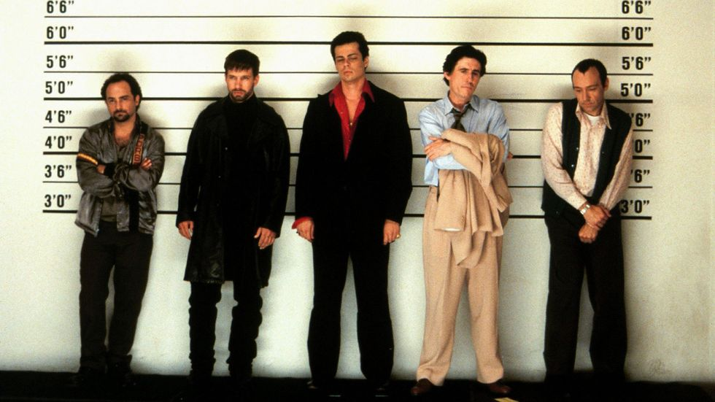
2
3
4
5
1

Slide 9
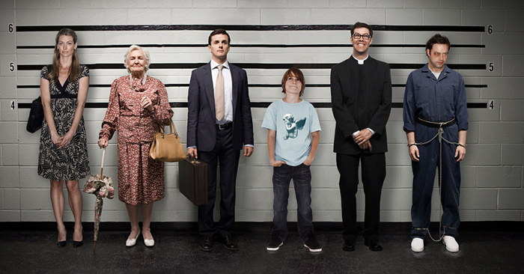
1
2
3
4
5
6

Slide 10
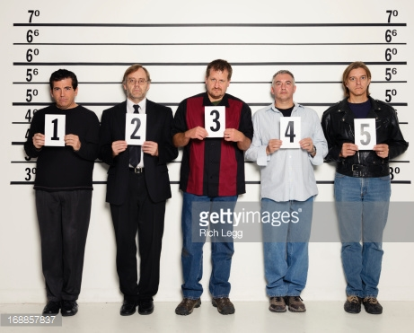

Slide 11
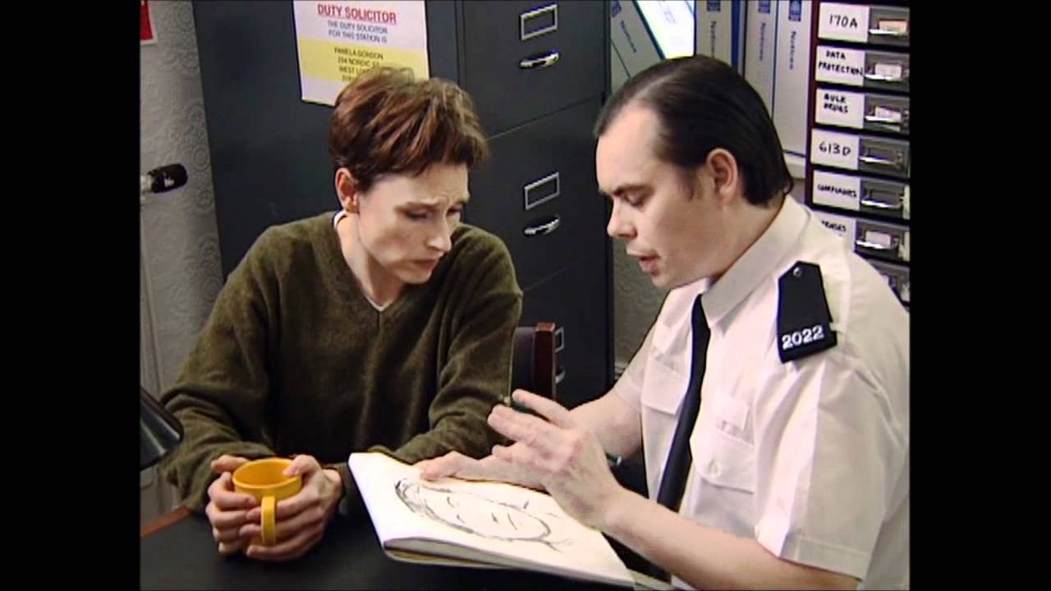
Police Sketch
Listens to the description
Draws what he hears
Helps to find the suspect

Slide 12
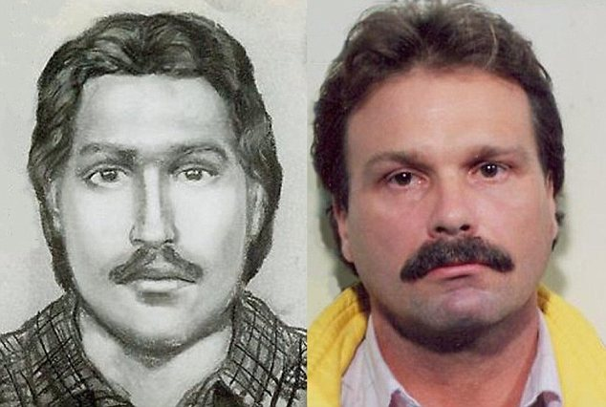
Good Police Sketch

Slide 13
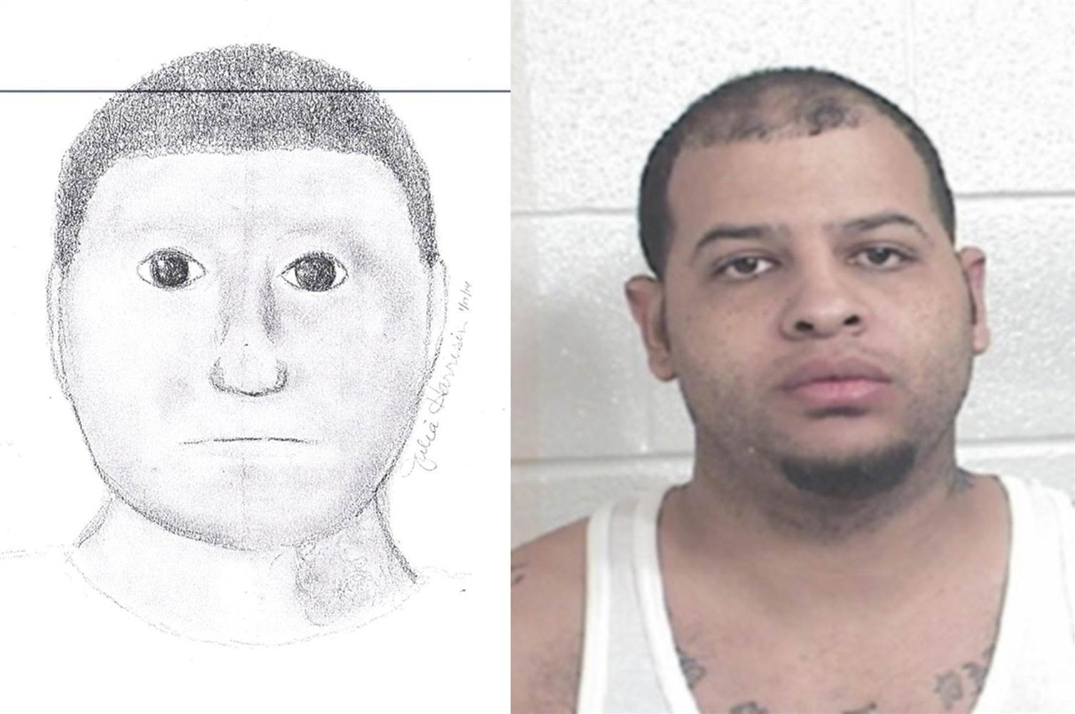
Bad Police Sketch

Slide 14
Your Turn
Draw the person I describe
Draw their “bust” (chest and up) Most similar wins a sticker.

Slide 15
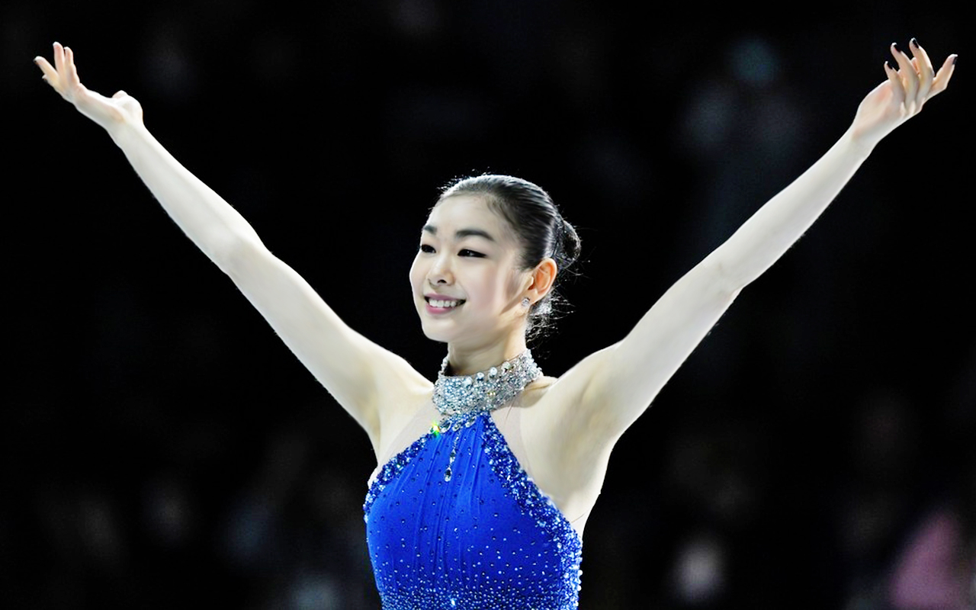
Suspect #1
She is Asian.
She has short, black hair (in a bun)
She has small black eyes.
She has large black eyebrows.
She has big teeth and a nice smile.
She is wearing diamond earrings and a blue dress.

Slide 17
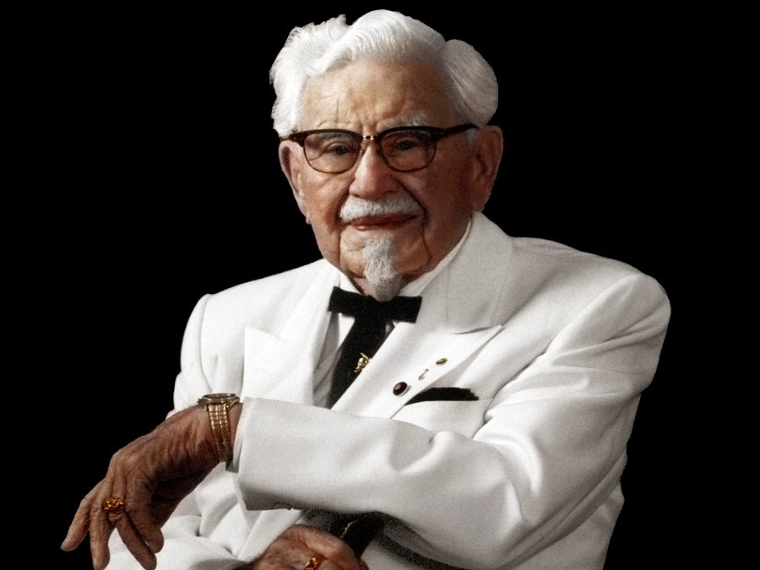
Suspect #2
He is old.
He has wavy white hair.
He has small black eyes.
He has a white mustache and a small white goatee.
He has large ears and black glasses.
He is wearing a white suit and a black tie

Slide 19
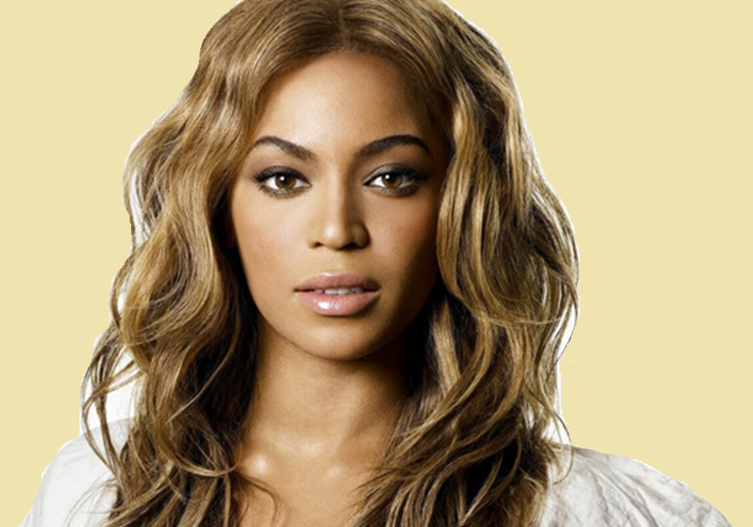
Suspect #3
She has light brown skin.
She has big brown eyes.
She has high eyebrows.
She has big pink lips.
She has long, wavy, light brown hair.
She is wearing a white shirt.

Slide 20
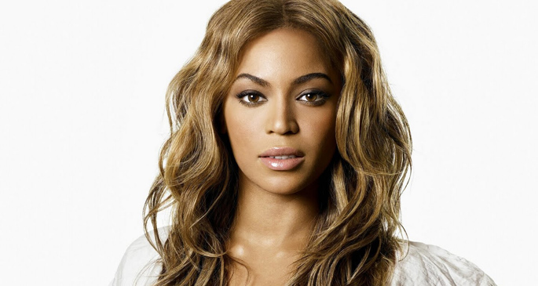

Slide 21
Suspect #4
He has short, black hair.
He has crazy black eyes.
He has very large, black eye brows.
He has wrinkles on his forehead
He has a very large bottom lip and thin top lip.
He has some moles.
He is wearing a brown jacket and white shirt.

Slide 22
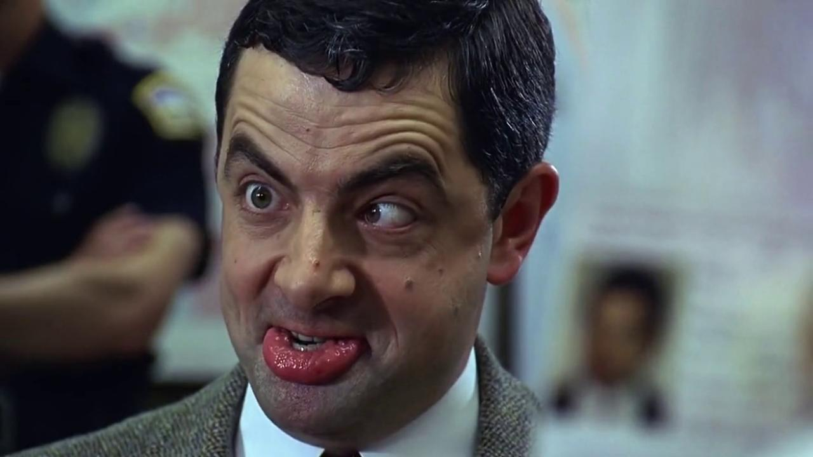

Slide 23
Suspect #5
She has long, brown, straight, but messy hair.
She has light brown skin.
She is a little dirty.
She has big brown eye brows.
She has large green eyes.
She is wearing a red hood.

Slide 24
