Slide 1
Things from Countries

Slide 2
What Kind of Food is it?

Slide 3
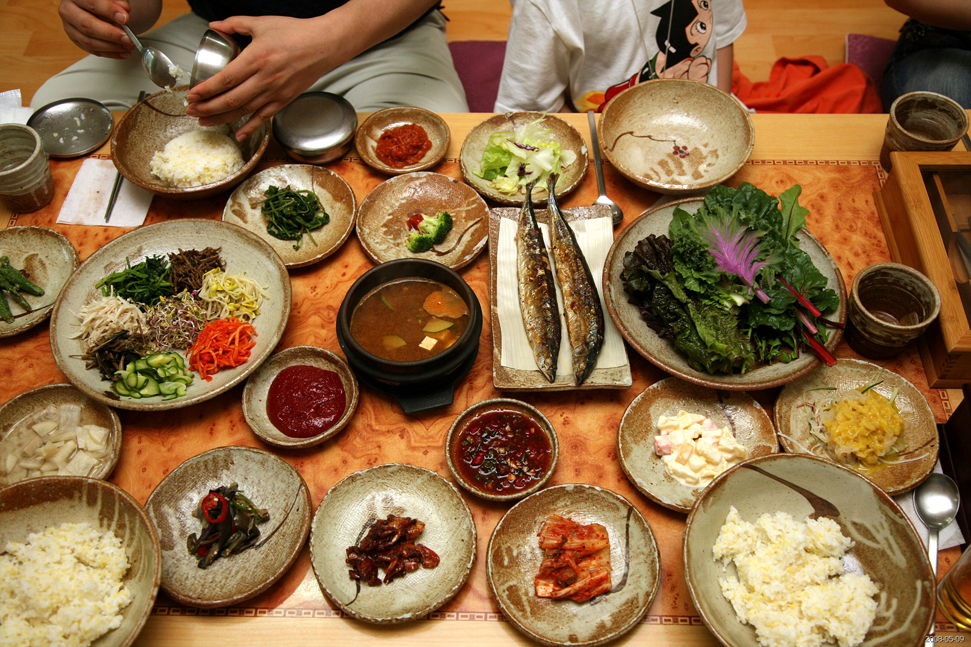
Korean Food

Slide 4
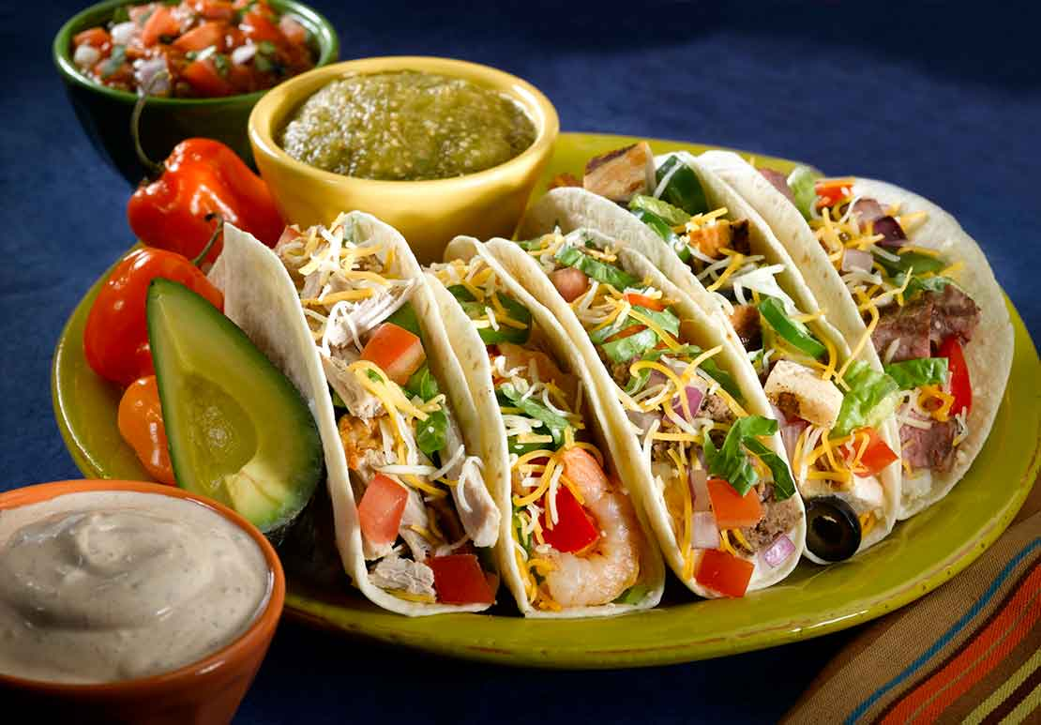
Mexican Food

Slide 5
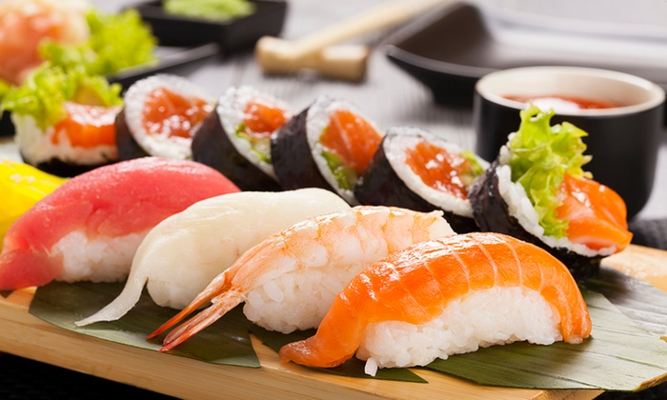
Japanese Food

Slide 6
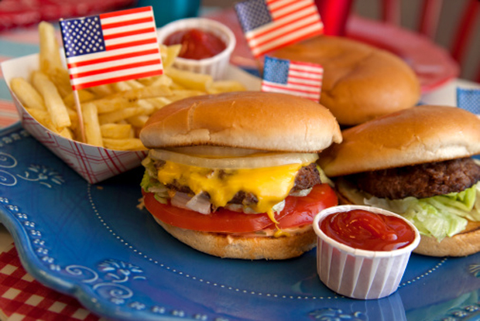
American Food

Slide 7
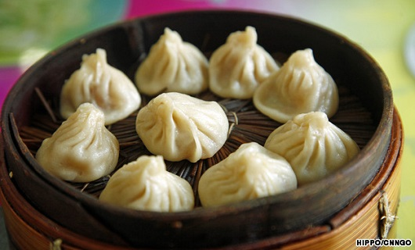
Chinese Food

Slide 8
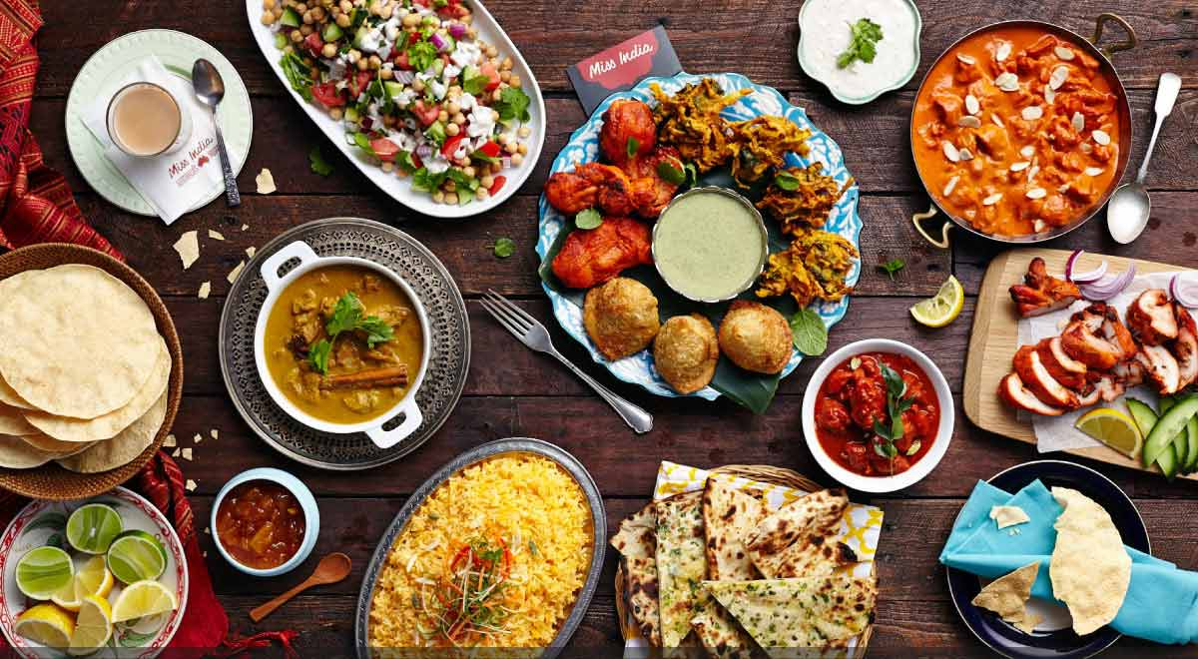
Indian Food

Slide 9
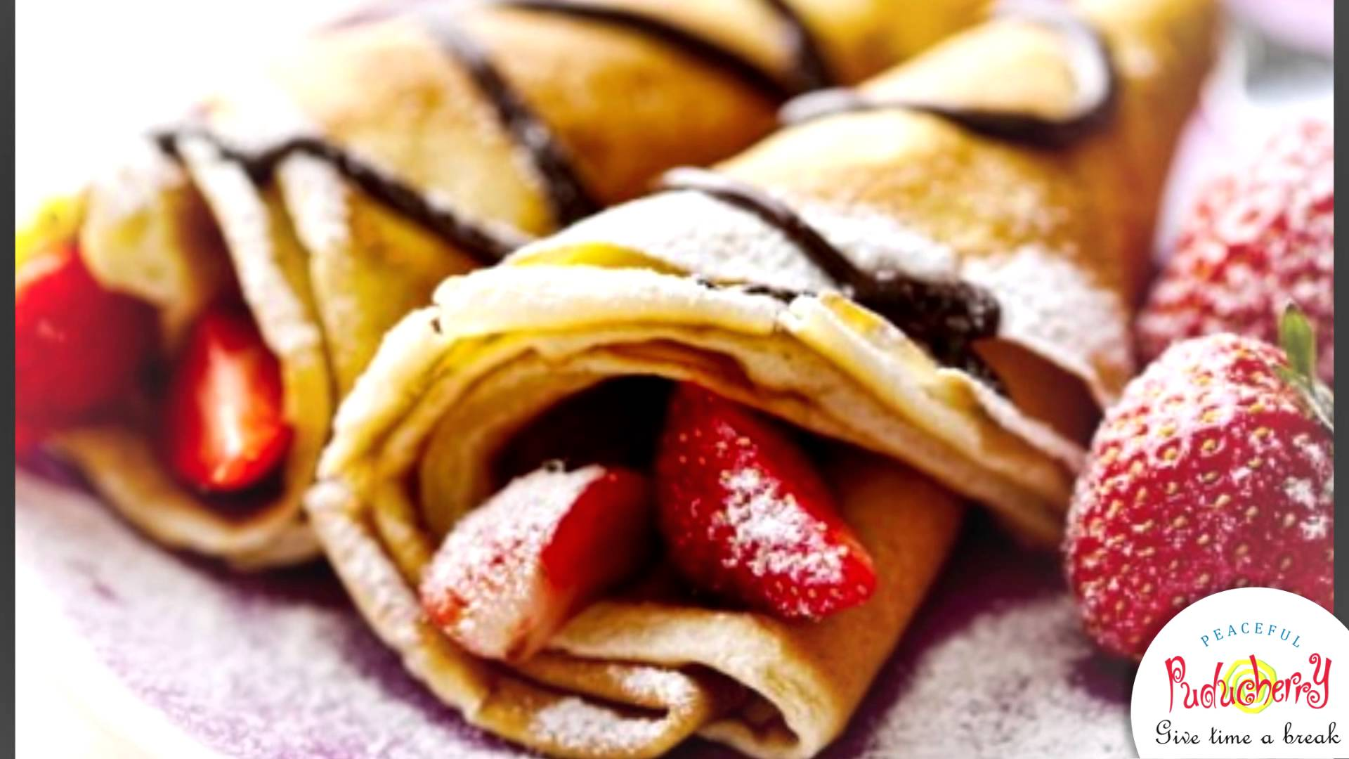
French Food

Slide 10
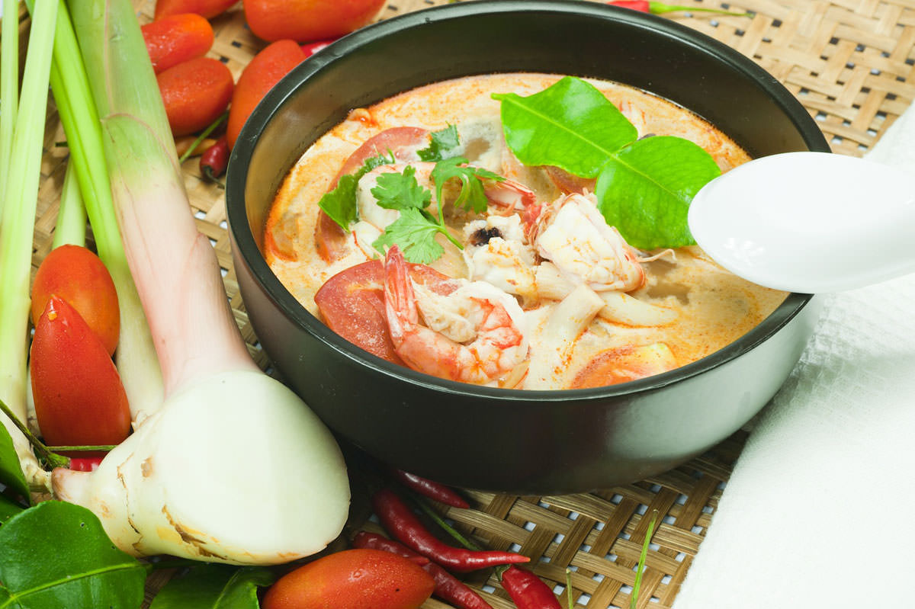
Thai Food

Slide 11
Traditional Food Quiz
http://www.funtrivia.com/playquiz/quiz2437421be8318.html

Slide 12
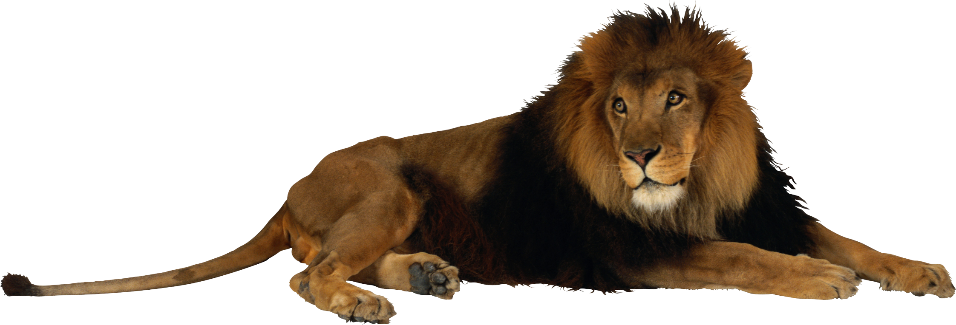
An African Animal
Describe things from countries

Slide 13
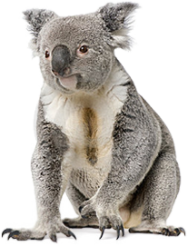
Australian Animal

Slide 14
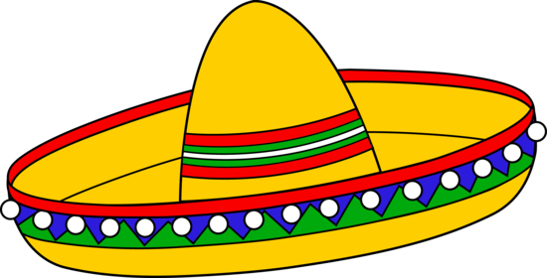
Mexican Hat

Slide 15
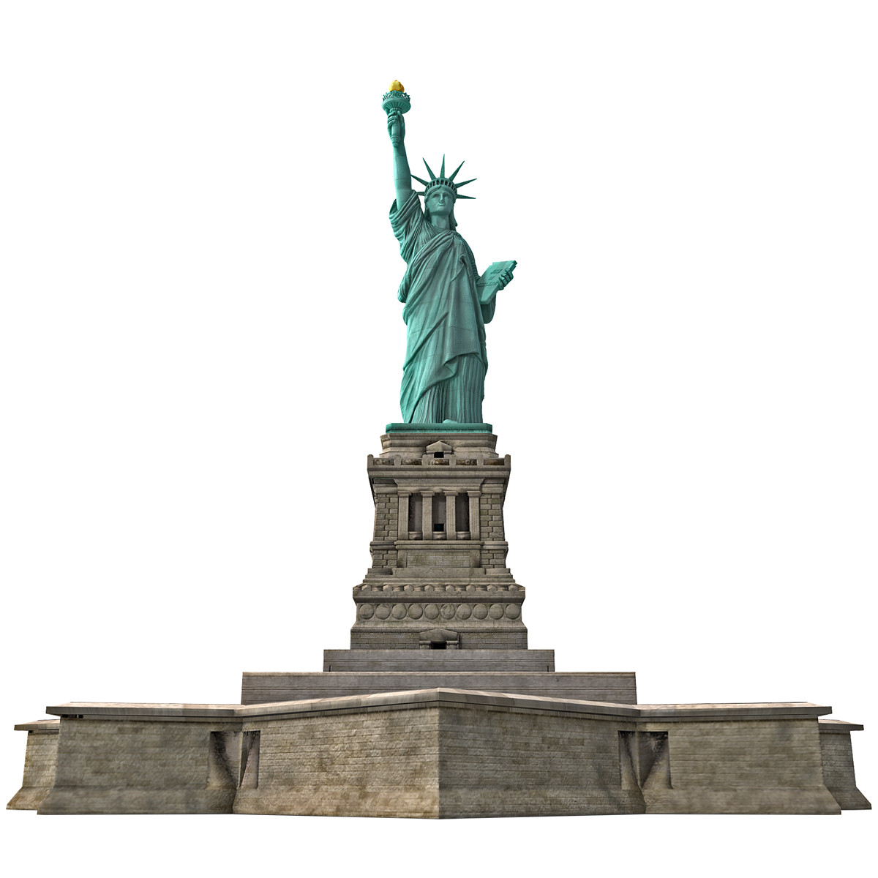
American Statue

Slide 16
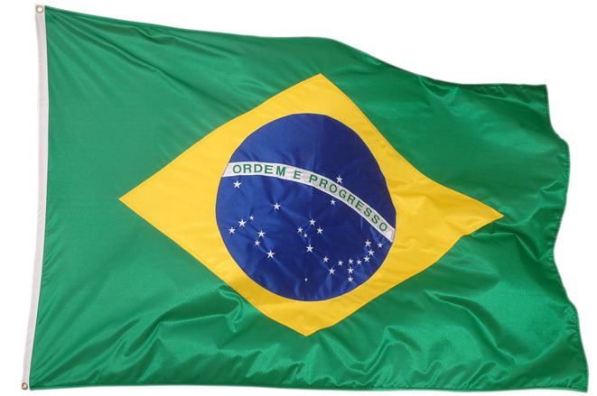
Brazilian Flag

Slide 17
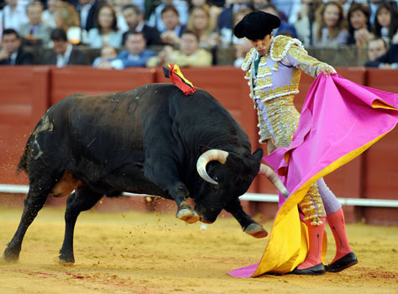
Spanish Sport

Slide 18
German Car

Slide 19
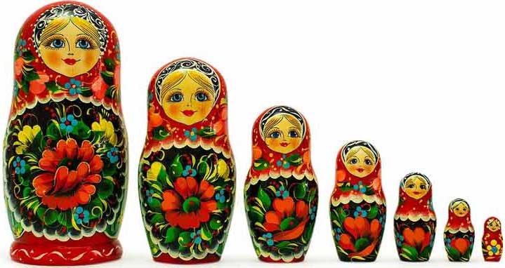
Russian Dolls

Slide 20
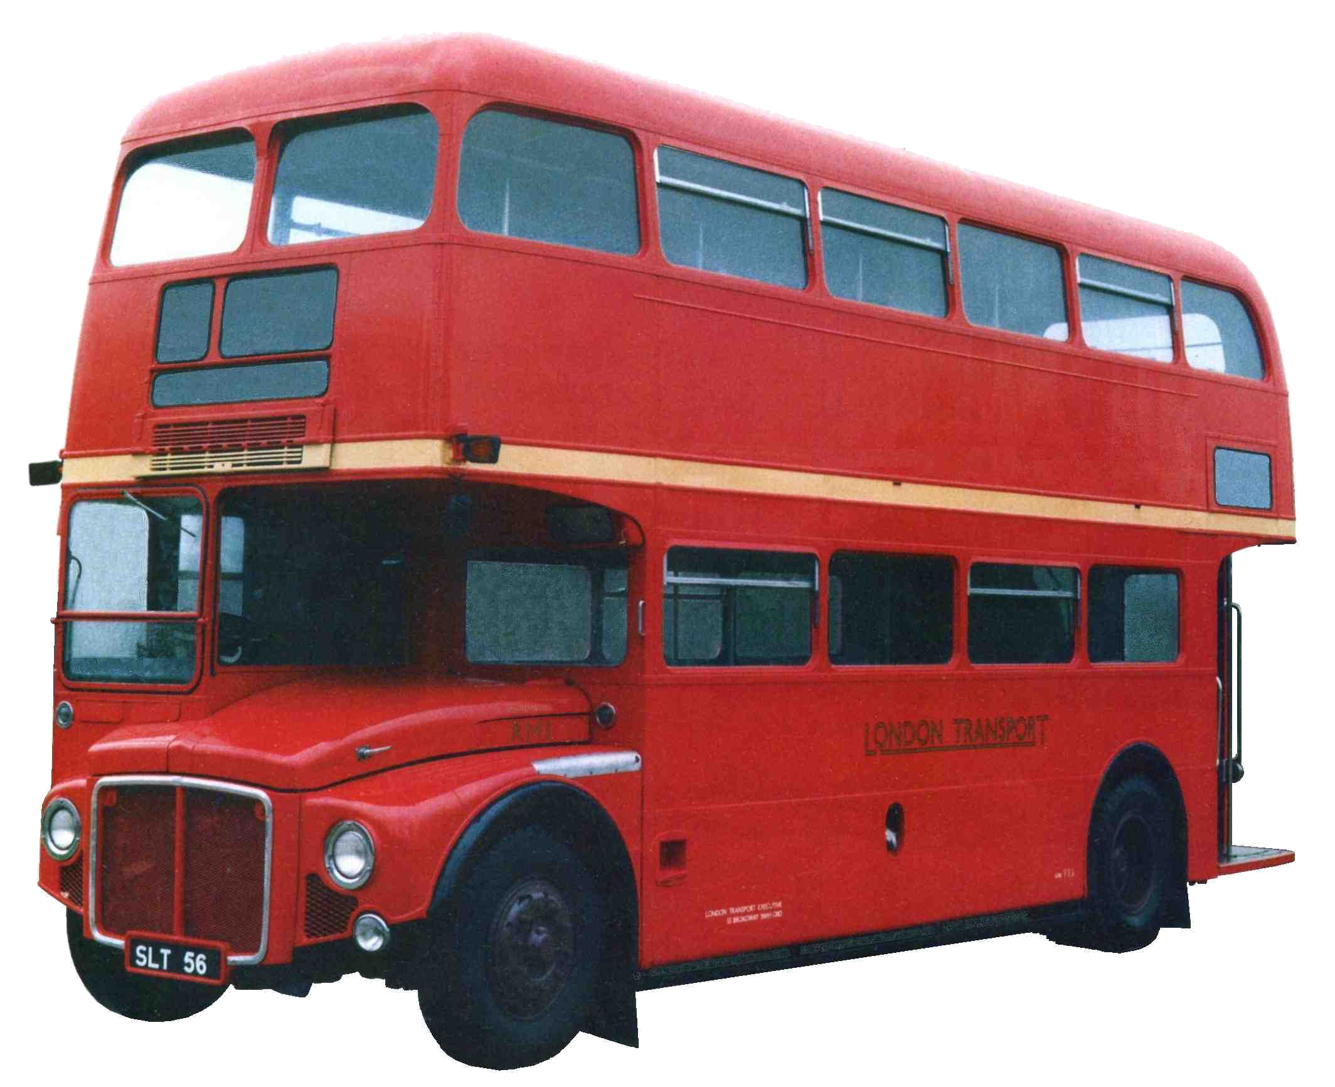
English Bus

Slide 21
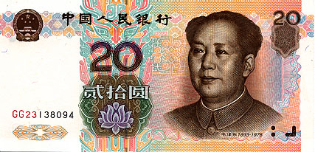
Chinese Money

Slide 22
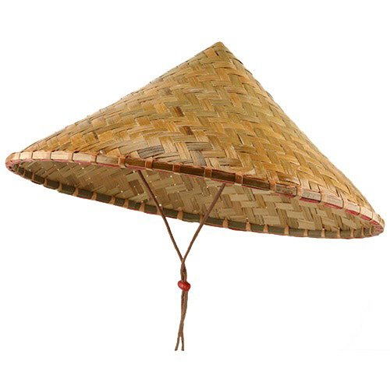
Vietnamese Hat

Slide 23
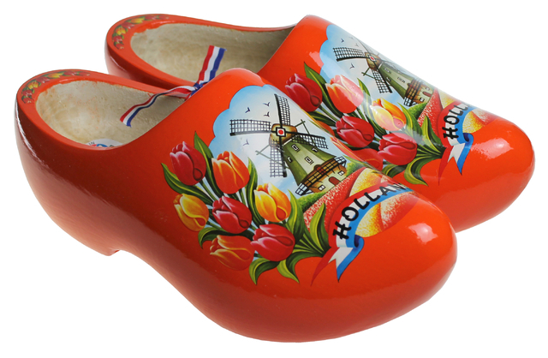
Dutch Shoes

Slide 24
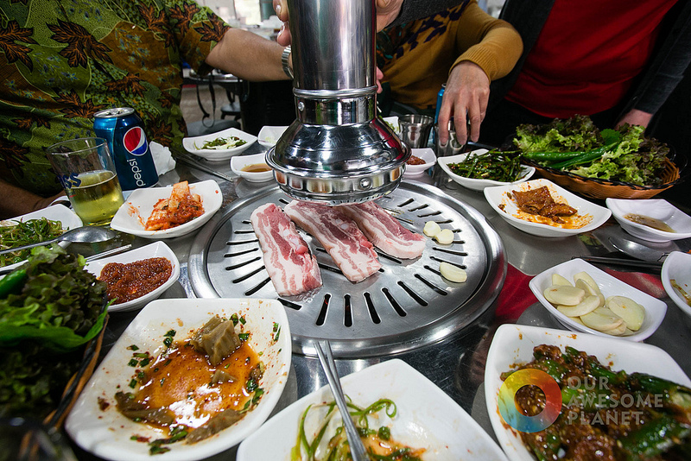
Korean Barbeque

Slide 25
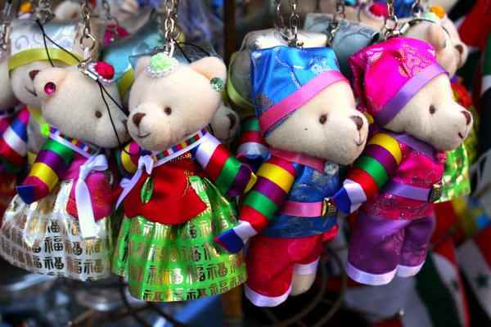
What are some more Korean things?

Slide 26
Crossword
What are the countries famous for?

Slide 27
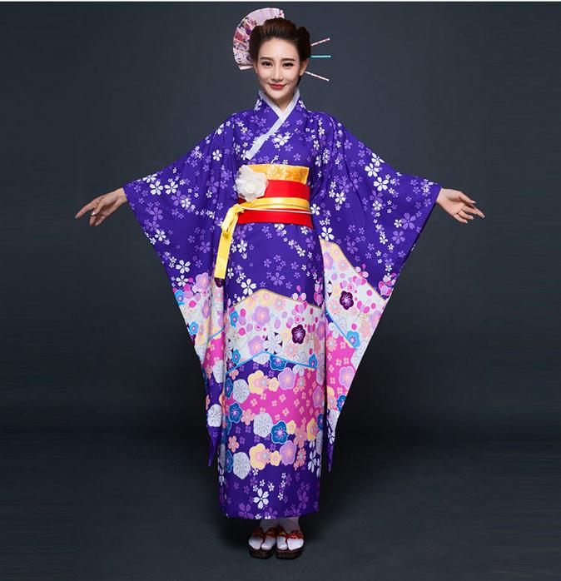
A Japanese Dress

Slide 28
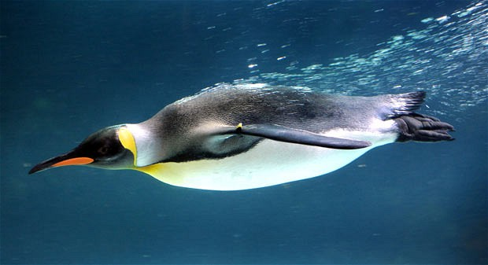
An Antarctic Animal

Slide 29
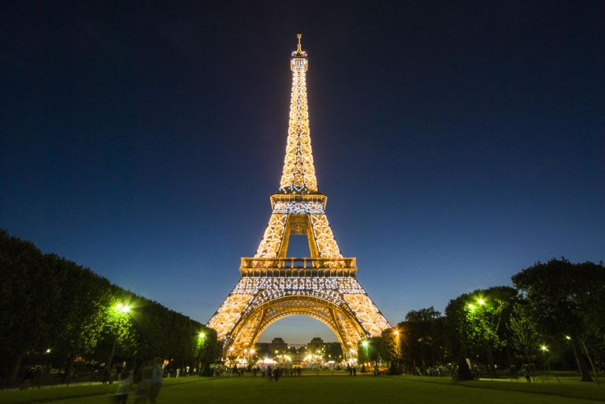
A French tower

Slide 30
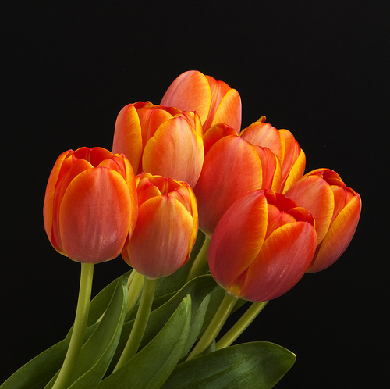
A Dutch Flower

Slide 31
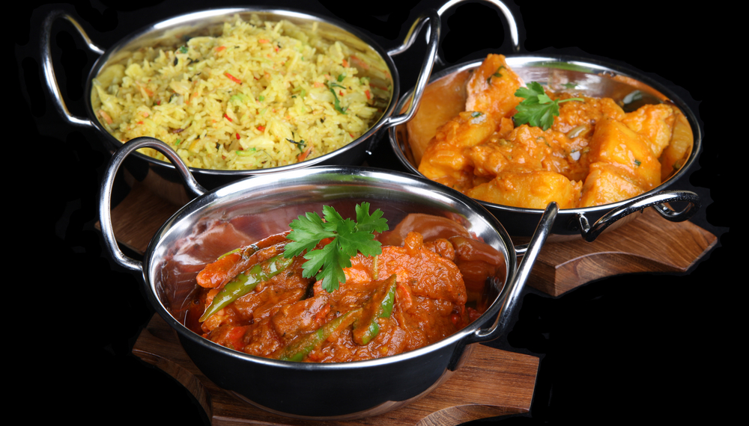
Indian Food

Slide 32
A Canadian Game

Slide 33
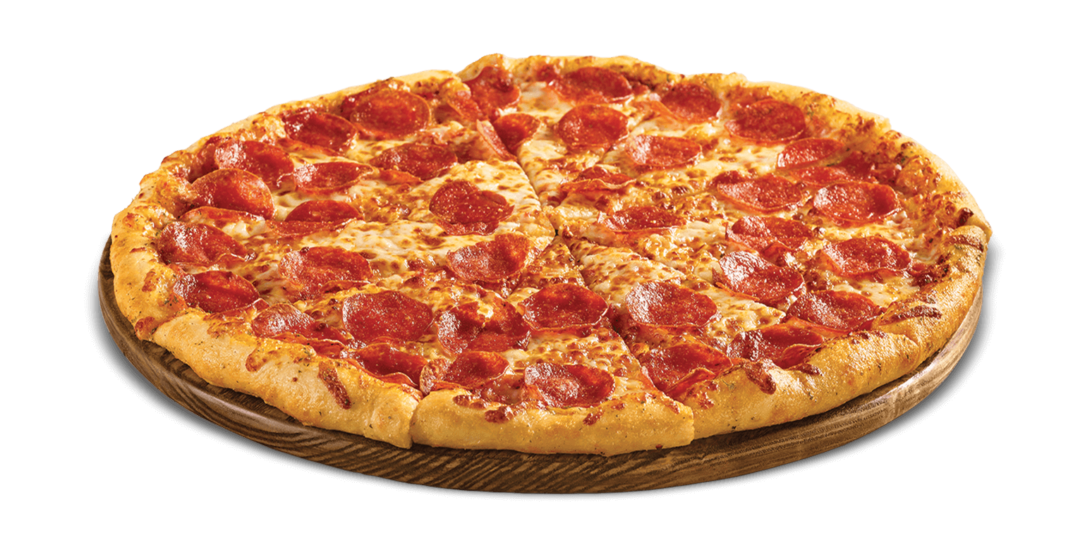
Italian Food

Slide 34
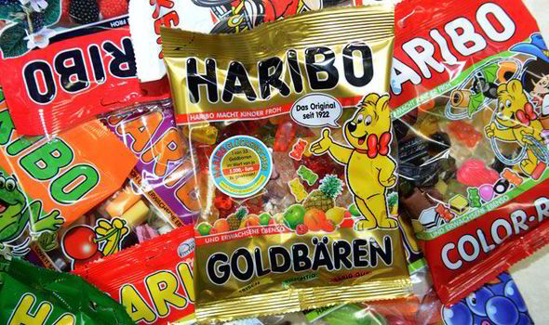
German Candies

Slide 35
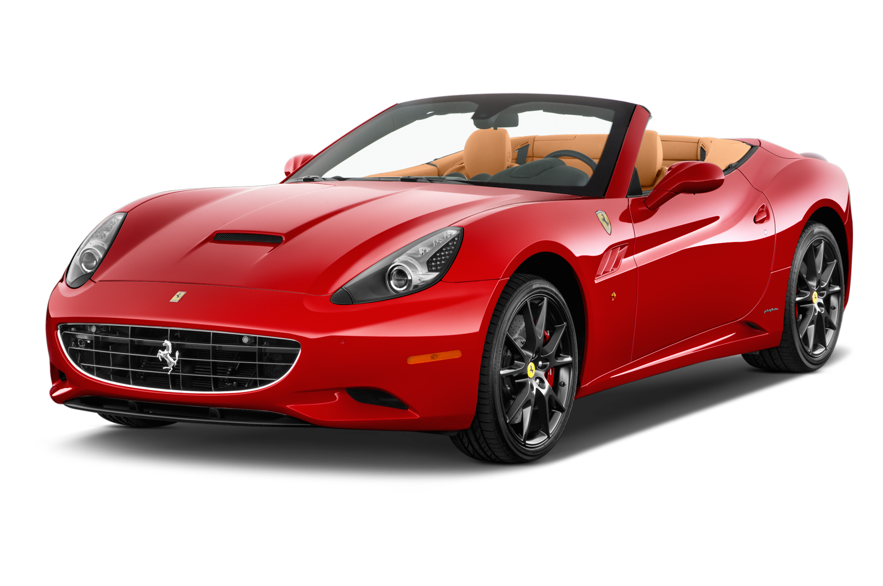
Italian Car

Slide 36
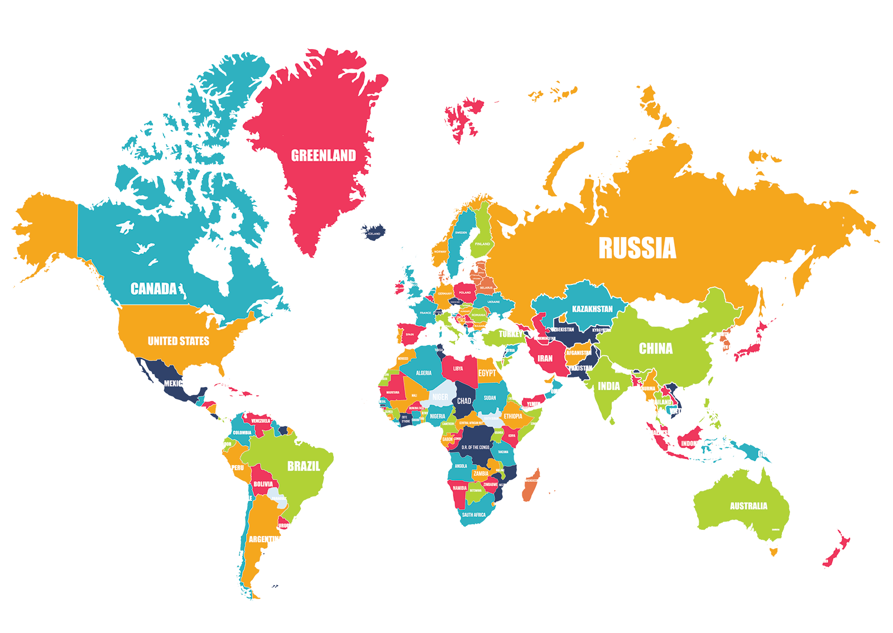

Slide 37
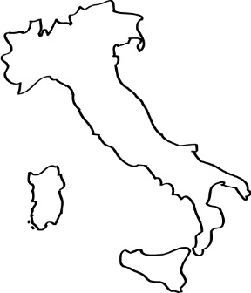
Famous Places
Use the shapes to find the country names
Italy

Slide 38
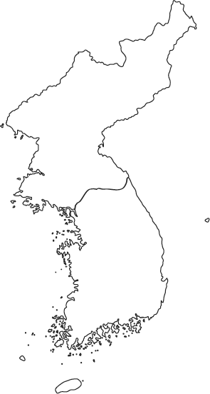
Find the Country
Use the shapes to find the country names
Korea

Slide 39
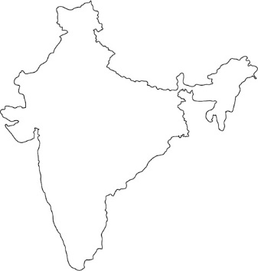
Find the Country
Use the shapes to find the country names
India

Slide 40
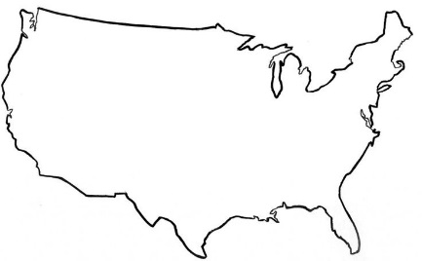
Find the Country
Use the shapes to find the country names
USA

Slide 41
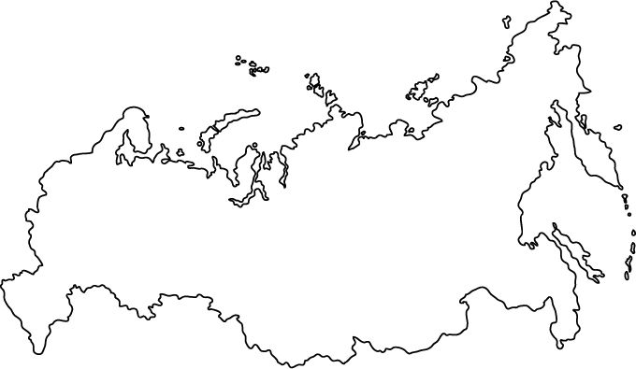
Find the Country
Use the shapes to find the country names
Russia

Slide 42
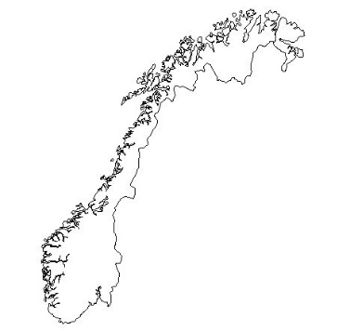
Find the Country
Use the shapes to find the country names
Norway

Slide 43
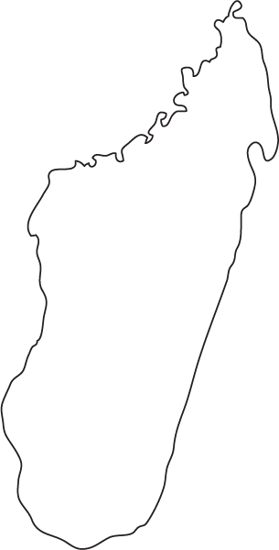
Find the Country
Use the shapes to find the country names
Madagascar

Slide 44
Find the Country
Use the shapes to find the country names
Indonesia

Slide 45
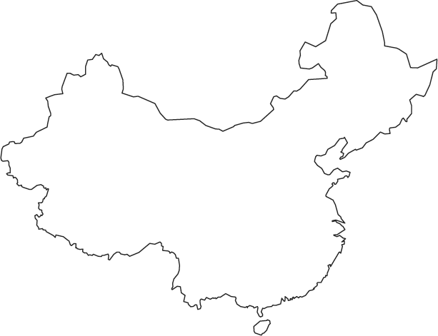
Find the Country
Use the shapes to find the country names
China

Slide 46
Find the Country
Use the shapes to find the country names
Spain

Slide 47
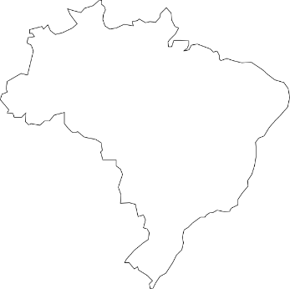
Find the Country
Use the shapes to find the country names
Brazil

Slide 48
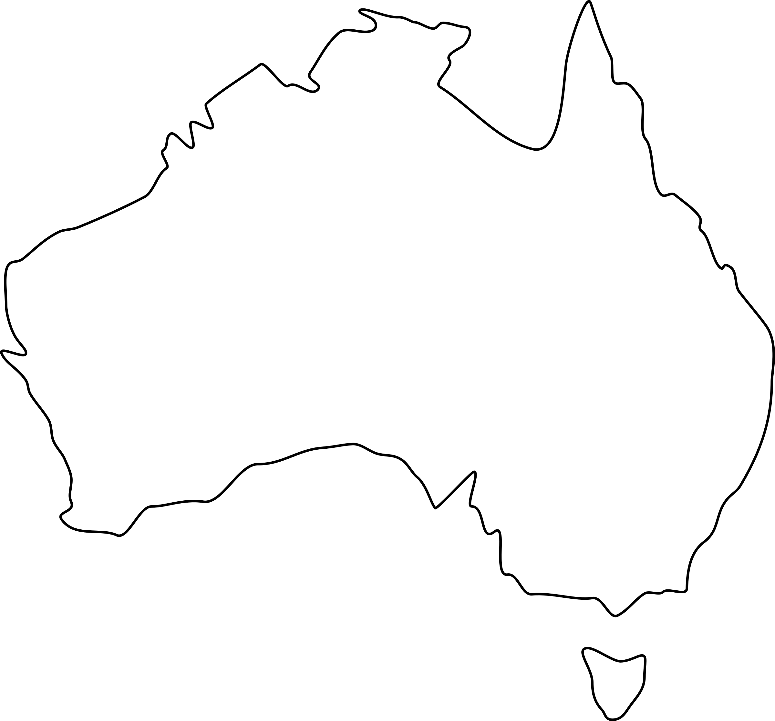
Find the Country
Use the shapes to find the country names
Australia

Slide 49
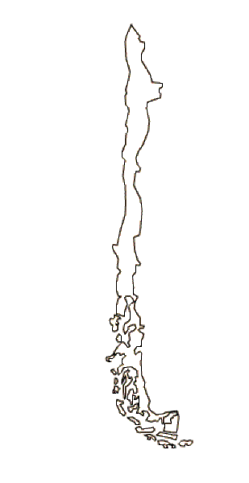
Find the Country
Use the shapes to find the country names
Chile

Slide 50
Find the Country
Use the shapes to find the country names
Mexico

Slide 51
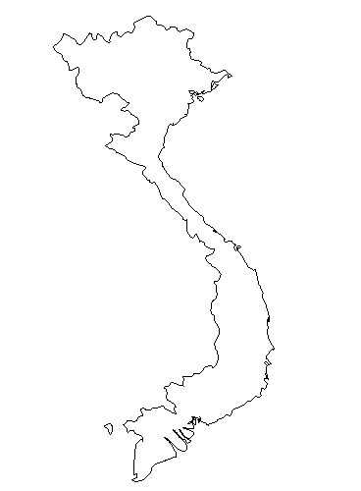
Find the Country
Use the shapes to find the country names
Vietnam

Slide 52
Find the Country
Use the shapes to find the country names
Mongolia

Slide 53
Find the Country
http://world-geography-games.com/countries_continents.html

Slide 54
Where is it?
https://geoguessr.com/

