Slide 1
A Good Detective
https://www.youtube.com/watch?v=2mfUGWif6pQ
https://www.youtube.com/watch?v=OFYYJZwYy_8

Slide 2
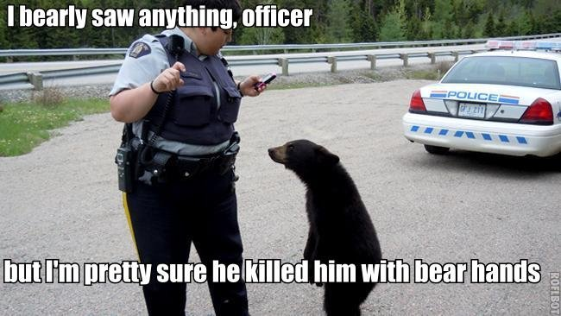
Eye witness.
Someone who saw the crime

Slide 3
Suspect
Someone the police think did the crime.

Slide 4
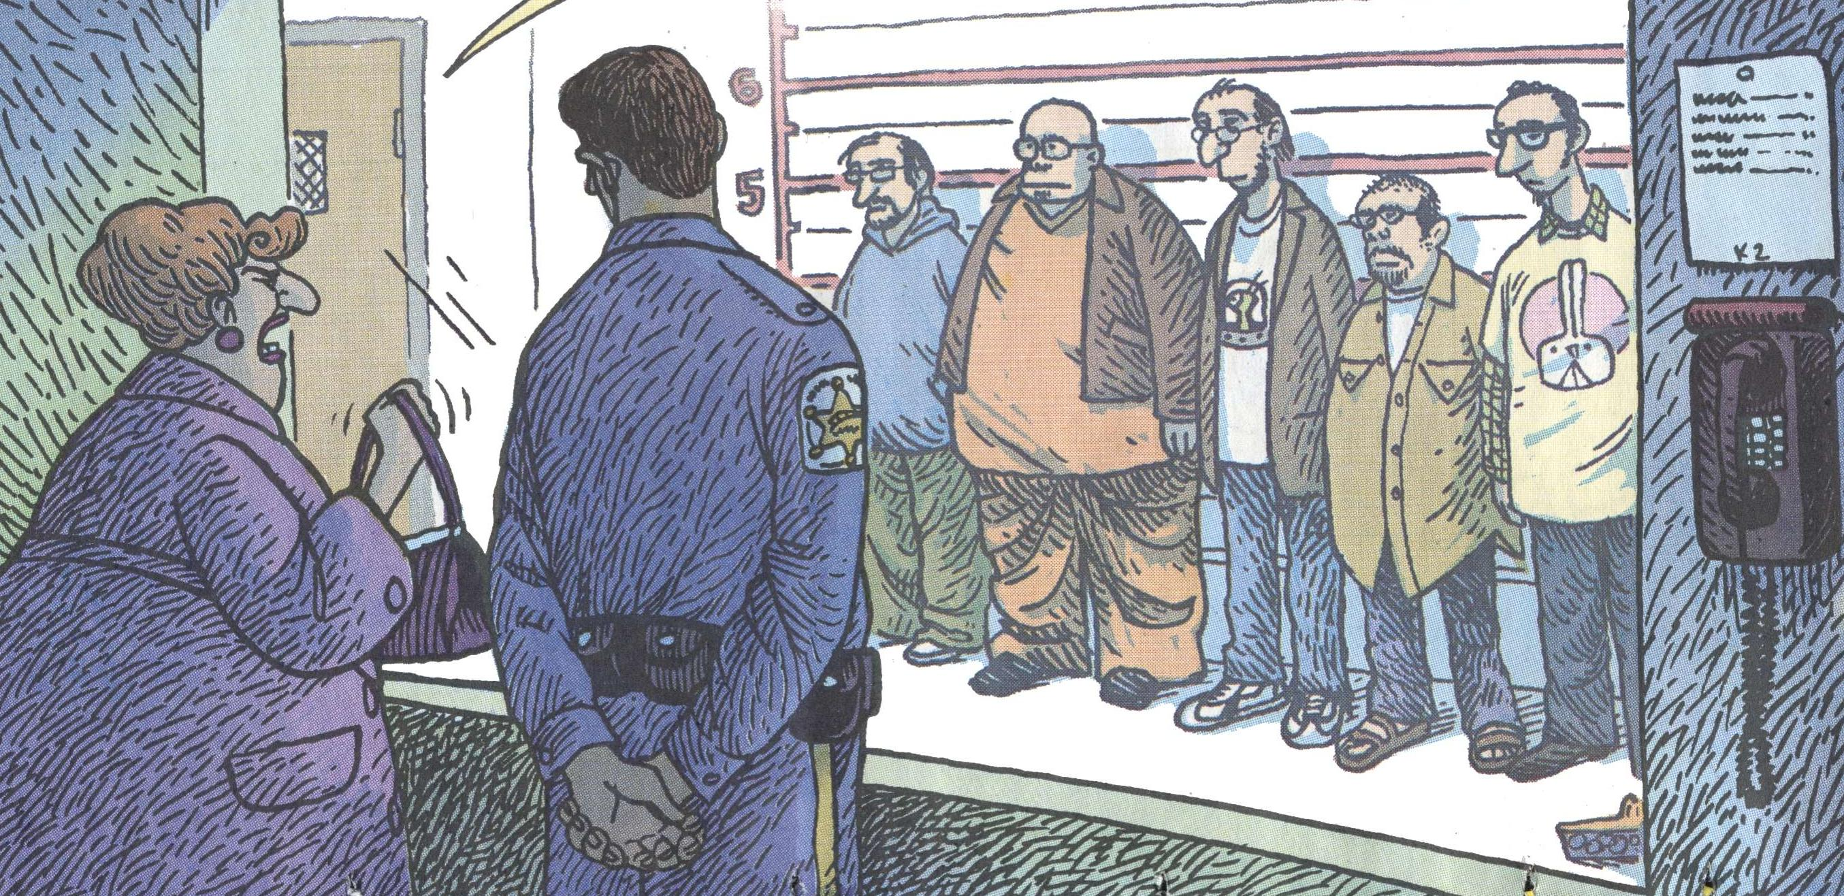
Police Line Up
One suspect and many actors.

Slide 5
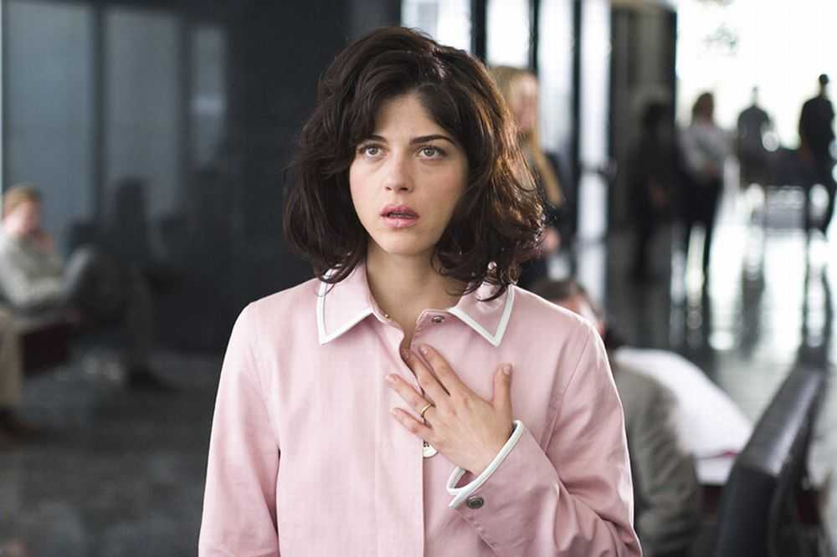
Alibi
Prove you were somewhere else

Slide 6
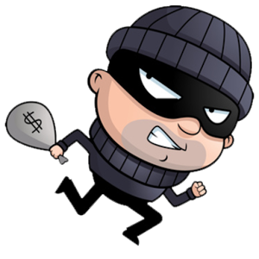
Motive
Why would they do the crime?

Slide 7
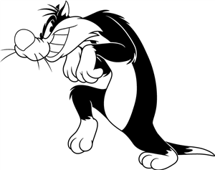
How police use alibis:
Ask everyone what they were doing.
A suspect can prove they didn’t do the crime.
If a suspect lies, maybe they are a criminal.

Slide 8
Types of CRIME

Slide 9
Robbery
We need 4 suspects
You will receive information about your character.
If the other students ask questions, you should answer.
If the answer is not on the paper, you can make up the answer, or just say, “I don’t know.”
The rest of the students are police officers.

Slide 10
Who Robbed Mrs. Red?
 | Mrs. Red | Mr. Red | Mr. Green | Mrs. Yellow | Mrs. Blue
TIME | what / who | what / who | what / who | what / who | what / who
5:00
6:00
7:00
8:00
9:00
10:00
11:00
12:00
1:00

Slide 11
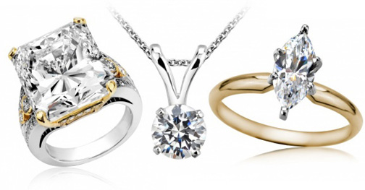
Robbery
 | Mrs. Red
TIME | what / who
5:00
6:00
7:00
8:00
9:00
10:00
11:00
12:00
1:00
Last night Mrs. Red’s jewelry was stolen.
She was at work until 7:00pm
She went to the restaurant for dinner at 7:00pm.
She ate dinner with Mrs. Yellow
She got home at 9:00pm
She watched TV with Mr. Red from 9:00pm to 10:00pm.
She went for a walk with Mr. Red at 10:00pm
She went to bed at 11:00pm
Mrs. Red noticed the jewelry was missing when she woke up. She called the police.
The jewelry was there when she left the house to go to the restaurant.

Slide 12
Mr. Red
I am married to Mrs. Red.
I love Mrs. Red.
I am poor and I want money.
The jewelry is expensive.
5:00 | Exercise with Mrs. Blue
6:00
7:00 | Dinner with Mr. Green
8:00 | And Mrs. Blue
9:00
10:00 | Watch TV with Mrs. Red
11:00 | Walked with Mrs. Red
12:00
1:00 | Sleeping
2:00
3:00 - 7:00

Slide 13
Mr. Green
I am friends with Mr. Red.
I don’t like Mrs. Red.
She is always angry and mean.
I don’t know where she keeps her jewelry.
I know her jewelry is expensive.
I am friends with everybody.
5:00 | Exercised with
6:00 | Mrs. Yellow
7:00 | Dinner with Mr. Red
8:00 | And Mrs. Blue
9:00 | Watched a movie with
10:00 | Mrs. Yellow and Mrs. Blue
11:00 | Walked with Mrs. Yellow
12:00 | Ate Ice cream
1:00
2:00 | Sleeping
3:00 - 7:00

Slide 14
Mrs. Yellow
I am friends with Mrs. Red.
I ate dinner with Mrs. Red.
Sometimes Mrs. Red lets me borrow her jewelry.
I am rich. I don’t need to steal jewelry.
5:00 | Exercised with
6:00 | Mr. Green
7:00 | Dinner with Mrs. Red
8:00
9:00 | Watched a movie with
10:00 | Mrs. Blue and Mr. Green.
11:00 | Walked with Mr. Green
12:00
1:00 | Sleeping
2:00
3:00 - 7:00

Slide 15
Mrs. Blue
I am Mrs. Red’s friend.
I know everything about her.
Mrs. Red doesn’t play with me anymore.
Mrs. Red plays with Mrs. Yellow and not me.
I am poor.
5:00 | Exercised with Mr. Red
6:00
7:00 | Dinner with Mr. Red
8:00 | And Mr. Green
9:00 | Watched a movie with
10:00 | Mrs. Yellow and Mr. Green
11:00 | Walked with Mr. Red
12:00
1:00 | Sleeping
2:00
3:00 - 7:00

