Slide 1
Review

Slide 2
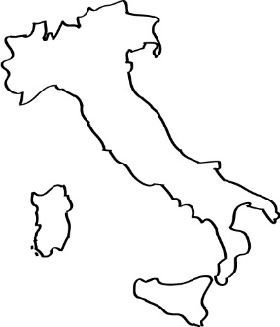
Famous Places
Use the shapes to find the country names
Italy

Slide 3
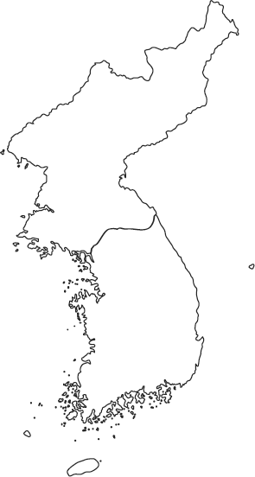
Find the Country
Use the shapes to find the country names
Korea

Slide 4
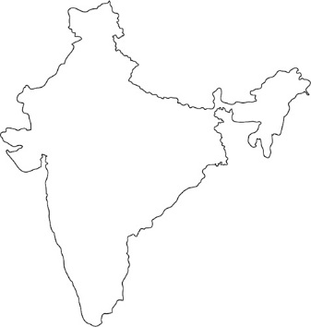
Find the Country
Use the shapes to find the country names
India

Slide 5
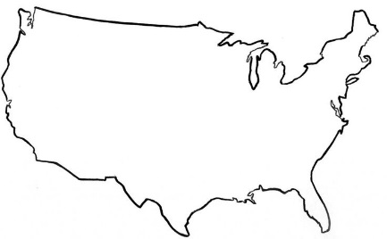
Find the Country
Use the shapes to find the country names
USA

Slide 6
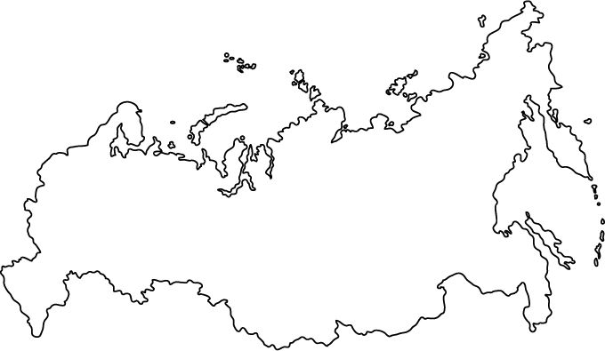
Find the Country
Use the shapes to find the country names
Russia

Slide 7
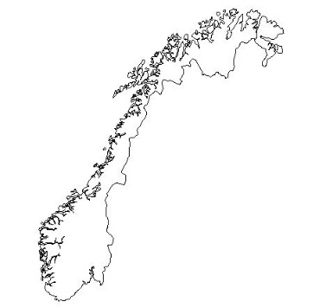
Find the Country
Use the shapes to find the country names
Norway

Slide 8
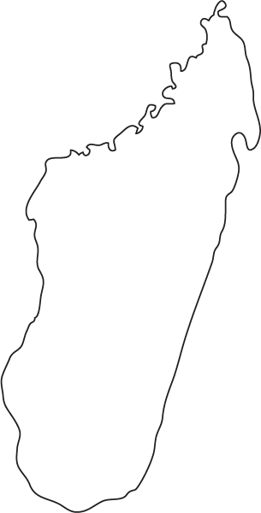
Find the Country
Use the shapes to find the country names
Madagascar

Slide 9
Find the Country
Use the shapes to find the country names
Indonesia

Slide 10
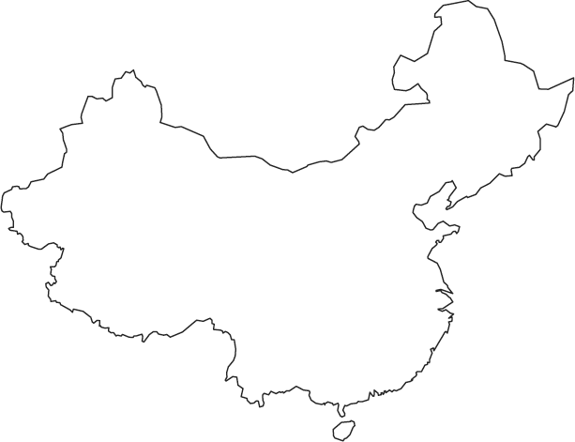
Find the Country
Use the shapes to find the country names
China

Slide 11
Find the Country
Use the shapes to find the country names
Spain

Slide 12
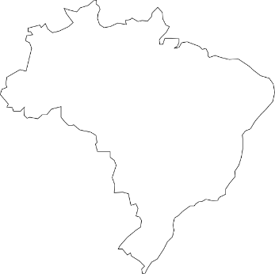
Find the Country
Use the shapes to find the country names
Brazil

Slide 13
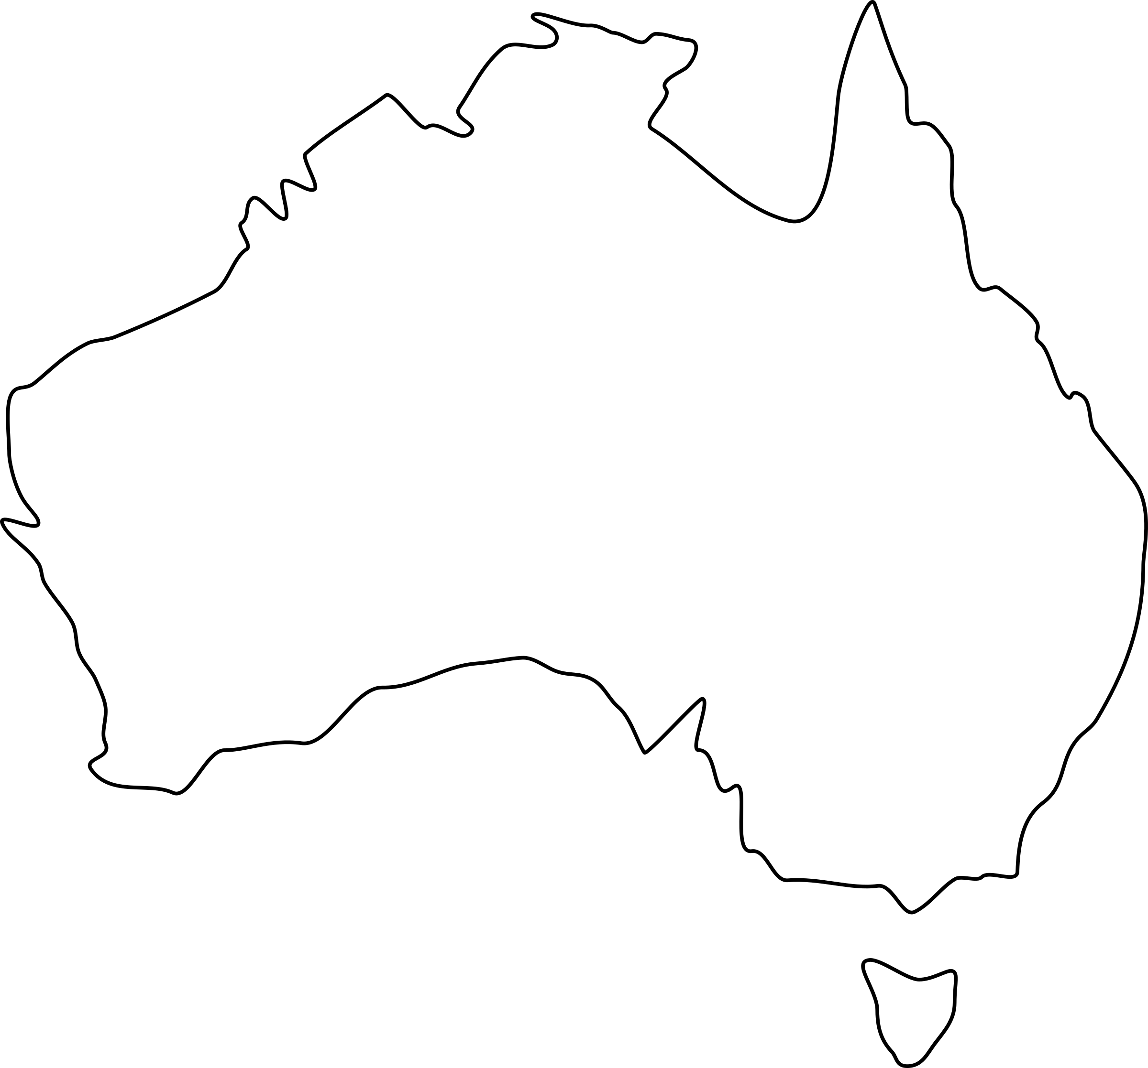
Find the Country
Use the shapes to find the country names
Australia

Slide 14
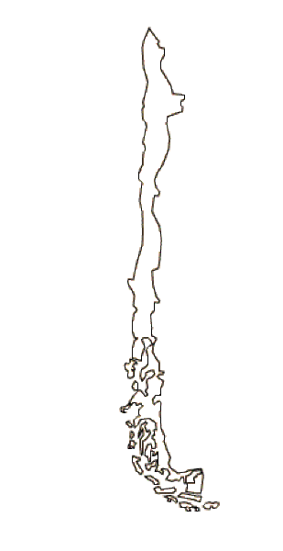
Find the Country
Use the shapes to find the country names
Chile

Slide 15
Find the Country
Use the shapes to find the country names
Mexico

Slide 16
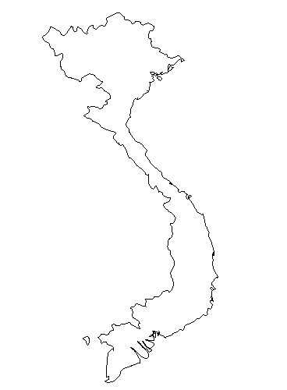
Find the Country
Use the shapes to find the country names
Vietnam

Slide 17
Find the Country
Use the shapes to find the country names
Mongolia

Slide 18
Seasons Around the World

Slide 19
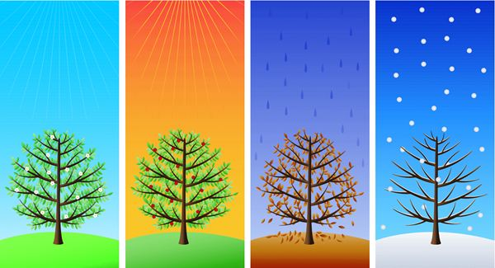
4 Seasons
Notes:
https://www.tes.com/lessons/dlsIL-OwexbDgg/seasons

Slide 20
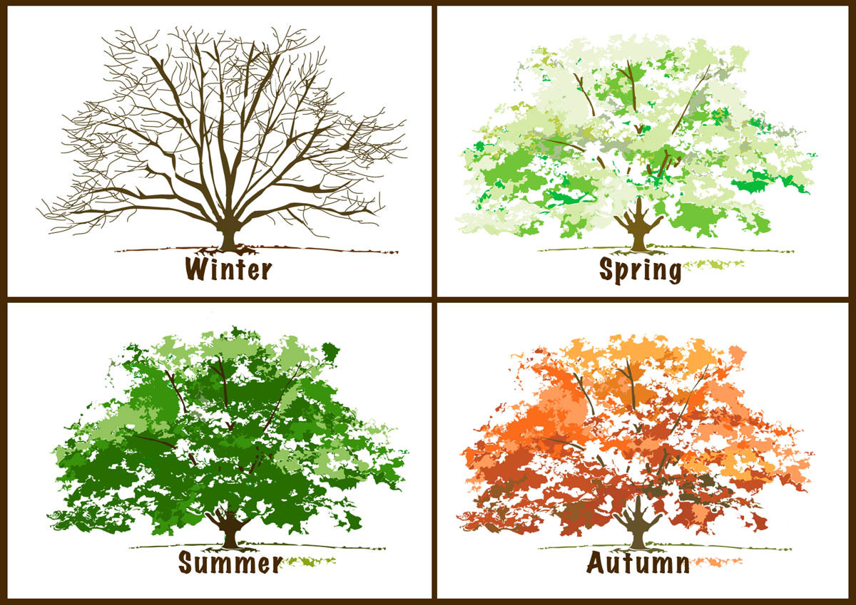
Fall
Notes:
https://www.tes.com/lessons/dlsIL-OwexbDgg/seasons

Slide 21
Spring
What is spring famous for?
What can you do in spring time?
Notes:
http://dreamatico.com/spring.html

Slide 22
Summer
What is summer famous for?
What can you do in summer time?
Notes:
http://mustangmorningnews.com/tag/summer/

Slide 23
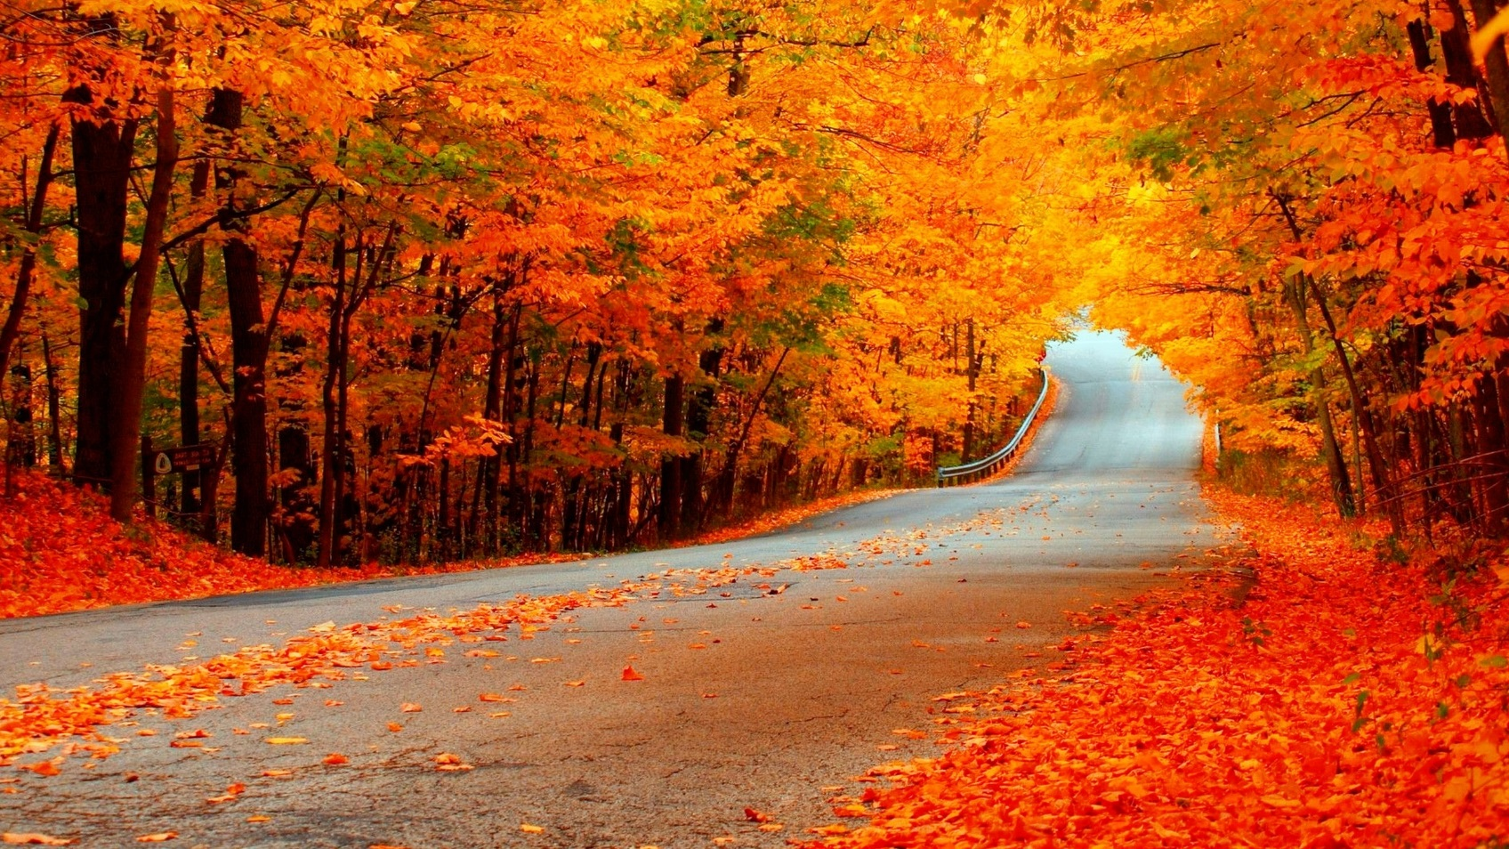
Autumn / Fall
What is fall famous for?
What can you do in fall time?
Notes:
http://www.hercampus.com/school/app-state/fall-upon-us-5-things-do-fall

Slide 24
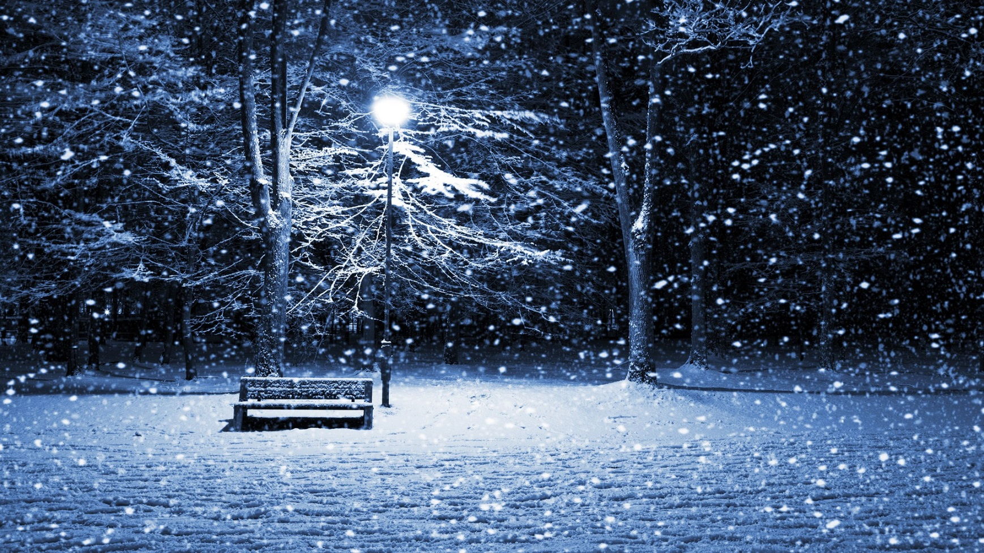
Winter
What is winter famous for?
What can you do in winter time?

Slide 25
Notes:
http://patimes.org/predicting-unpredictable-navigating-uncertain-times/compass-10pwuk7/

Slide 26
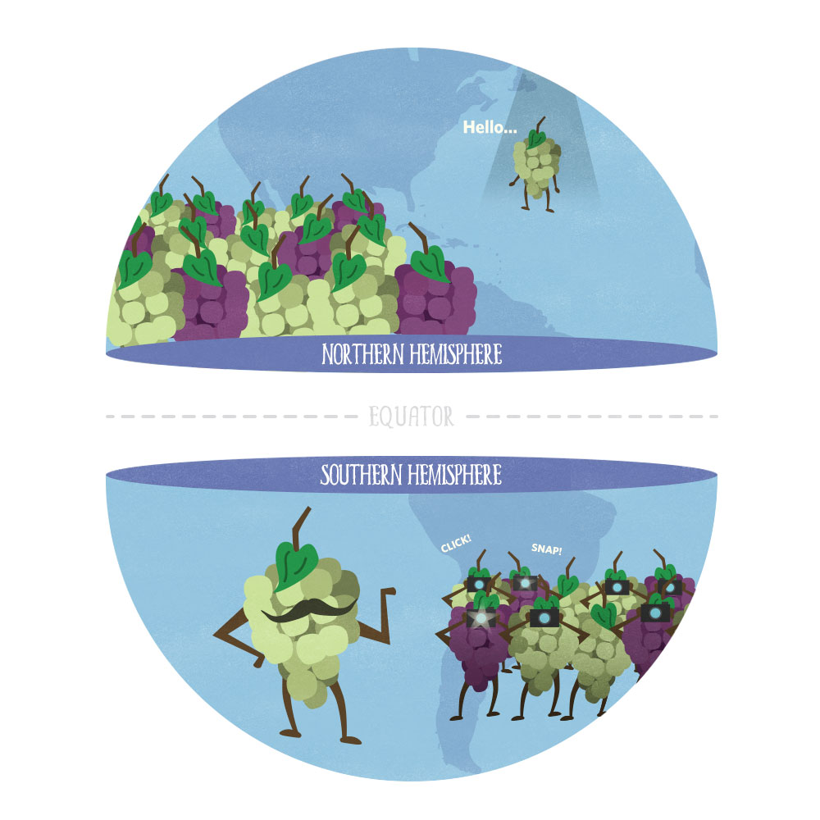
Hemisphere (2 halves)
Notes:
https://www.vivino.com/wine-news/northern-vs-southern-hemisphere-wines

Slide 27
Northern Hemisphere
Equator →
Southern Hemisphere
Notes:
https://www.vivino.com/wine-news/northern-vs-southern-hemisphere-wines

Slide 28
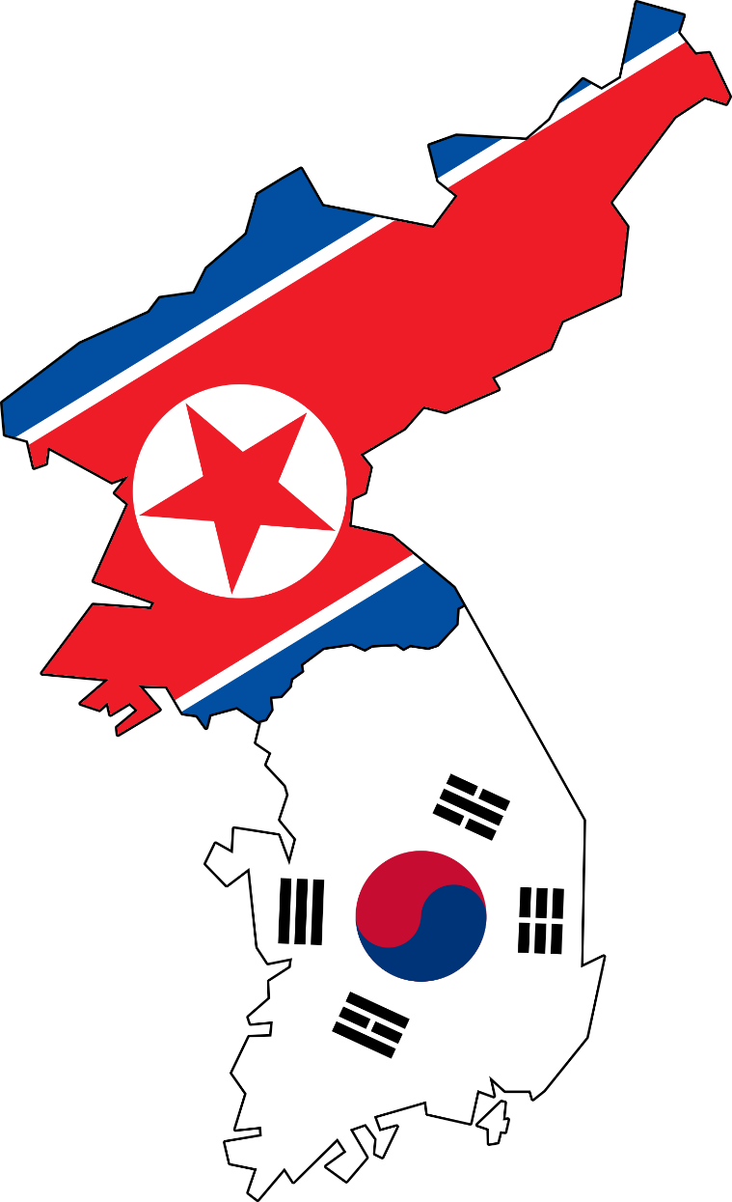
Northern Hemisphere / Southern Hemisphere
Notes:
http://www.globalresearch.ca/u-s-south-korea-war-games-practice-collapsing-north-korean-leadership/5542695

Slide 29
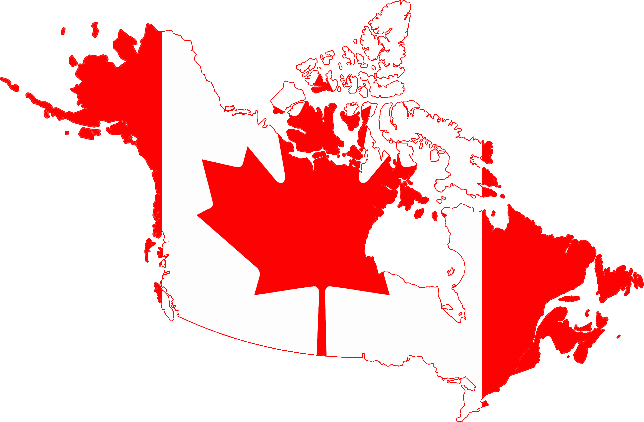
Northern Hemisphere / Southern Hemisphere
Notes:
http://www.zoueinconsulting.com/index.php/en-ca/about-canada/canada-in-brief

Slide 30
Northern Hemisphere / Southern Hemisphere
Notes:
http://www.huffingtonpost.com/fred-redmond/in-brazil-do-black-lives_b_10098384.html

Slide 31
Northern Hemisphere / Southern Hemisphere
Notes:
https://commons.wikimedia.org/wiki/File:Australia_flag-map_South_at_top.svg

Slide 32
Northern Hemisphere / Southern Hemisphere
Notes:
https://twitter.com/france

Slide 33
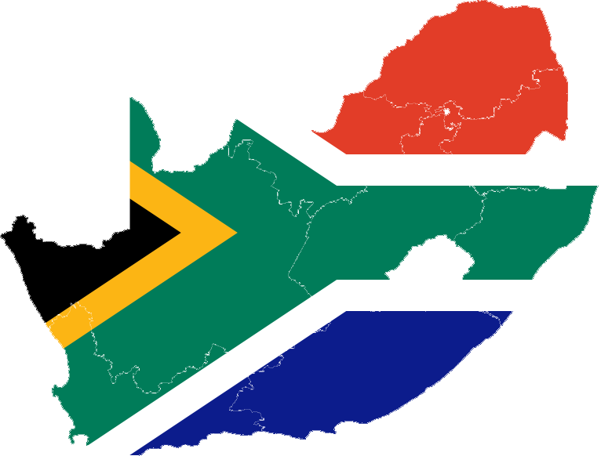
Northern Hemisphere / Southern Hemisphere
Notes:
http://www.sasportstours.co.za/international-inbound-tours

Slide 34
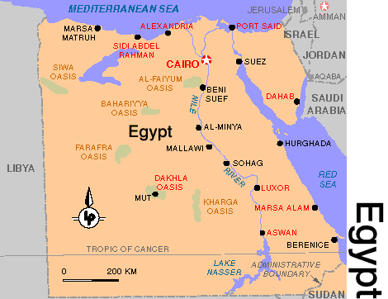
Northern Hemisphere / Southern Hemisphere
Notes:
http://ghaly.union.edu/Egypt/index.htm

Slide 35
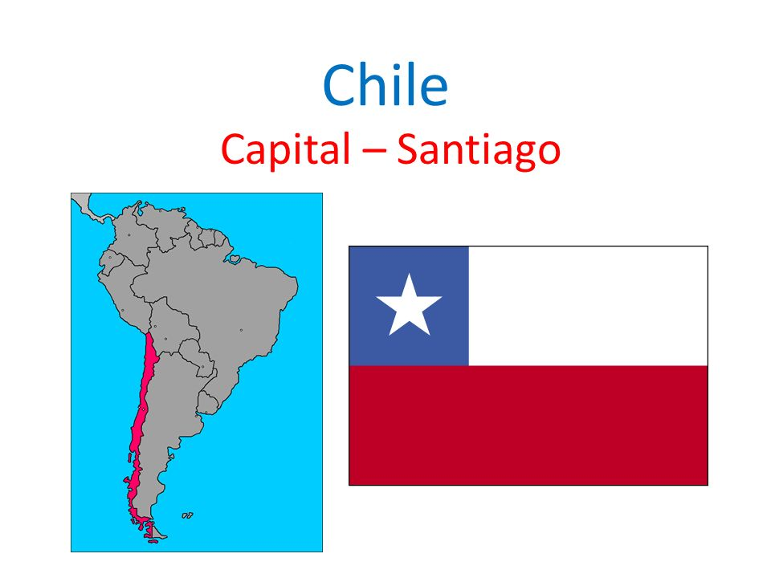
Northern Hemisphere / Southern Hemisphere
Notes:
http://slideplayer.com/slide/8246620/

Slide 36
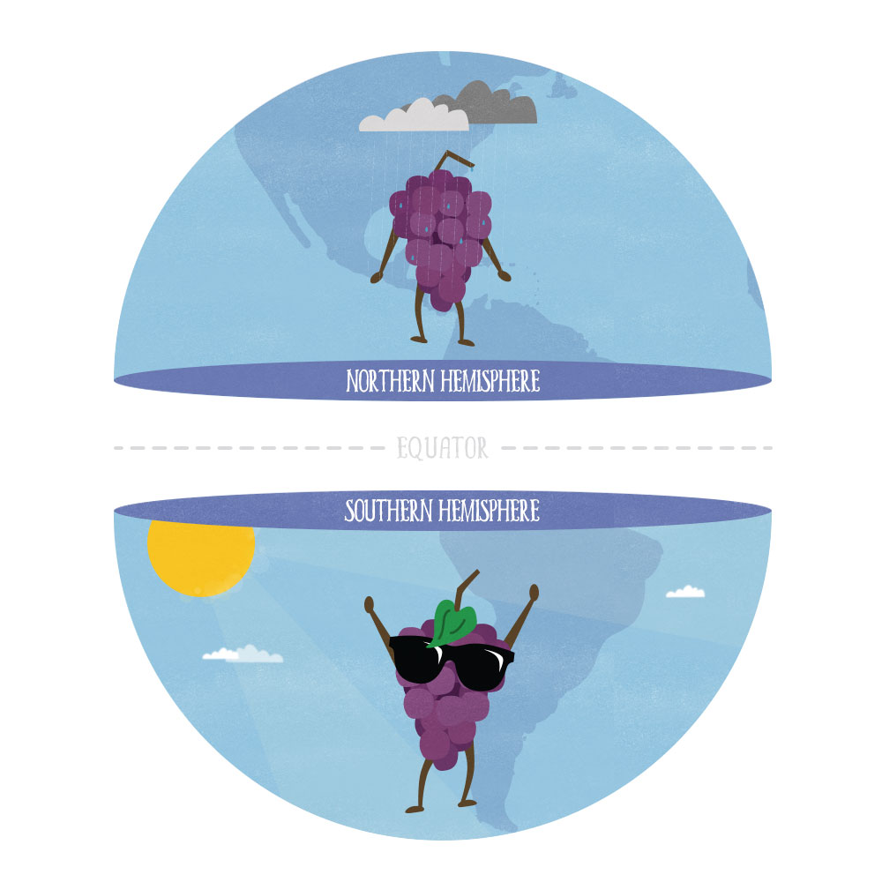
When it’s winter in South Korea, it’s summer in Australia.
Notes:
https://www.vivino.com/wine-news/northern-vs-southern-hemisphere-wines

Slide 37
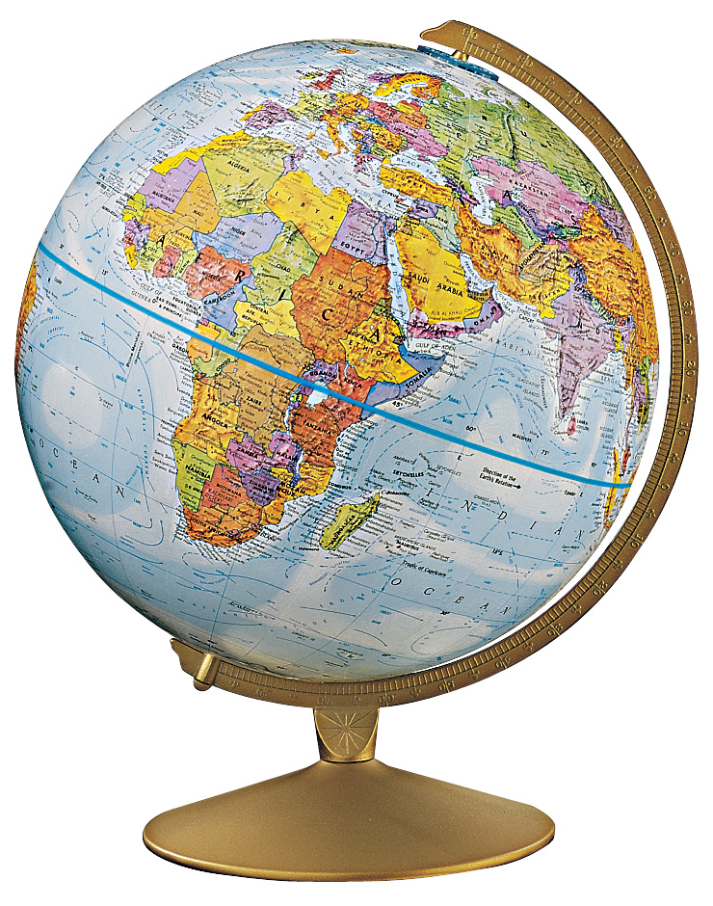
Tilt
Not exactly up and down.
Notes:
http://blog.pad-group.com/Padgroup/studentpad

Slide 38
Bill Nye
Answer the questions
https://www.youtube.com/watch?v=KUU7IyfR34o
Notes:
https://play.google.com/store/tv/show/Bill_Nye_the_Science_Guy?id=UOKvjpLvdpU

Slide 39
Why do we have seasons?
The earth is tilted

Slide 40
Daytime / Nighttime
Daytime / Nighttime
Notes:
http://blog.pad-group.com/Padgroup/studentpad
http://www.cypresslakesfla.com/wp-content/uploads/sites/3/revslider/bear_about/

Slide 41
Summer / Winter
Summer / Winter
Notes:
http://blog.pad-group.com/Padgroup/studentpad
http://www.cypresslakesfla.com/wp-content/uploads/sites/3/revslider/bear_about/

Slide 42
Where are the coldest places on earth?
North and South Pole
Notes:
http://www.slideshare.net/kmacdevitt/seasons-10676010

Slide 43
Where are the warmest places on earth?
Near the equator

Slide 44
Find the Country
http://world-geography-games.com/countries_continents.html

