Slide 1
Evidence Collection
https://www.youtube.com/watch?v=1GEEvvTiiQk

Slide 2
Crime
Something that is illegal.

Slide 3
Crime Scene
Where the crime happened

Slide 4
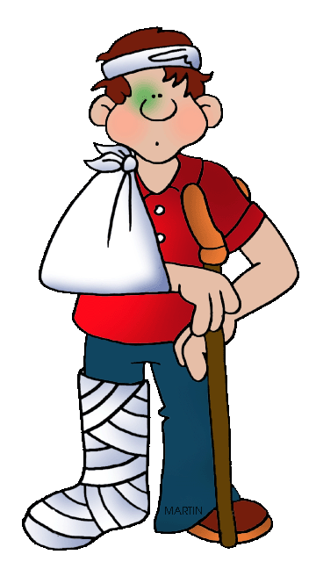
Victim
The person affect by the crime.

Slide 5
Suspect
The person you think might have done the crime.

Slide 6
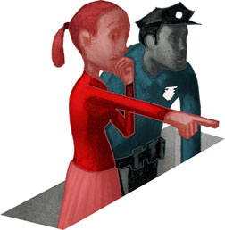
Eyewitness
Someone who saw the crime.

Slide 7
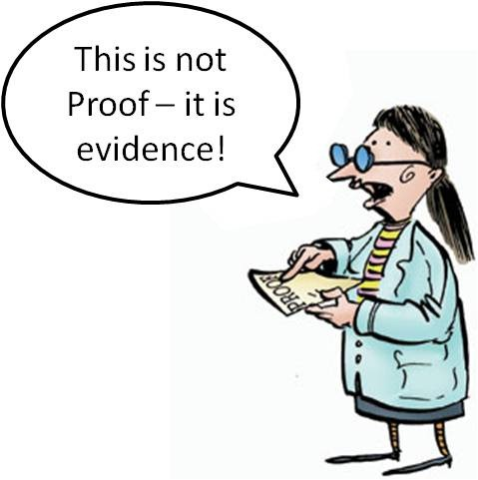
Evidence vs Proof
Help to explain
Explain the truth
Doubt
No Doubt

Slide 8
The suspect had blood on his shirt.
Evidence or Proof

Slide 9
There is a video showing the suspect commit the crime.
Evidence or Proof

Slide 10
An eye witness saw the crime
Evidence or Proof

Slide 11
The victim ripped out some hair of the suspect and is holding it.
Evidence or Proof

Slide 12
The murder weapon was found at the suspect’s house.
Evidence or Proof

Slide 13
You found hair on the victim that came from the suspect. AND The fingerprints on the murder weapon match the suspect AND An eye witness said they saw the suspect leave the crime scene
Evidence or Proof

Slide 14
A police officer caught the suspect red-handed
Evidence or Proof

Slide 15
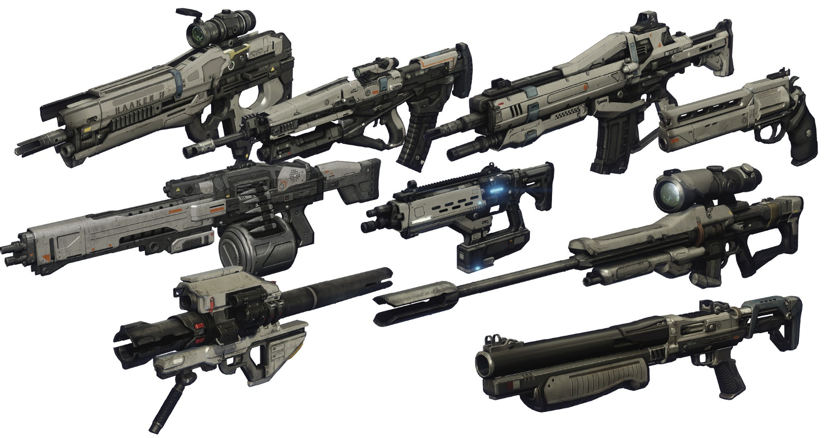
Weapon
Something used to hurt or kill someone

Slide 16
Murderer
Someone who killed someone else.

Slide 17
Suicide
Kill yourself.

Slide 18
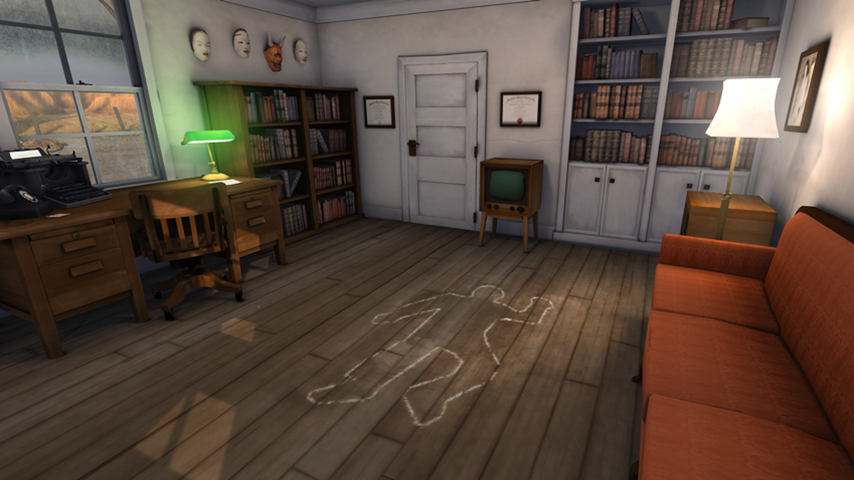
CSI: Eoeun

Slide 19
CSI: Eoeun Elementary
DNA
Unique to each person.
Fingerprints
Unique to each person.
Fibers
Small pieces of clothing.
Examine
Look closely at it.

