Slide 1
Winter Wonderland
https://www.youtube.com/watch?v=ie2E0hEN24Q

Slide 2
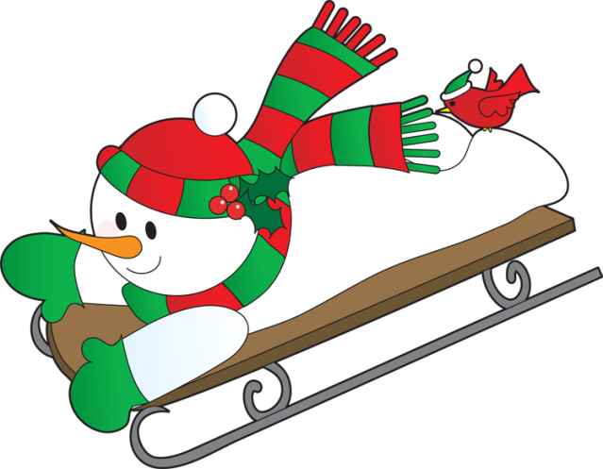
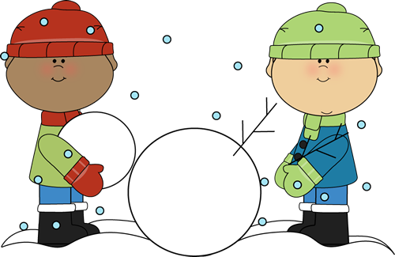
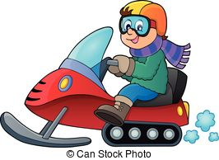
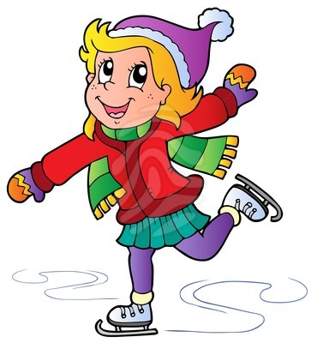
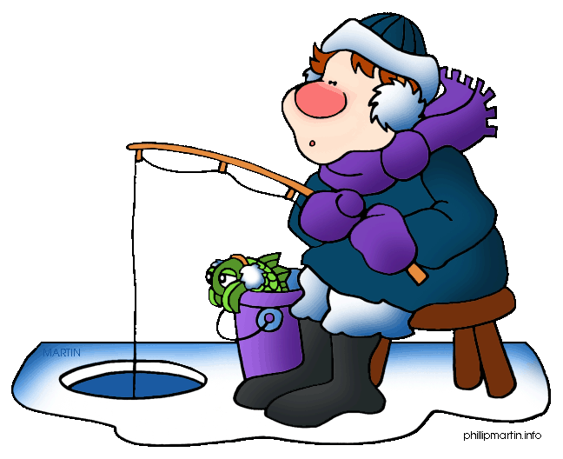
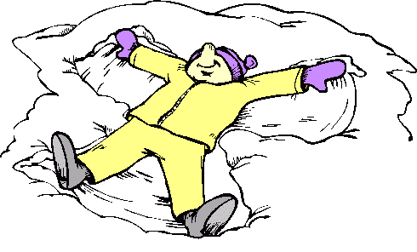
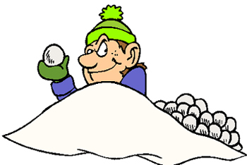
Winter Fun
Hockey
Sledding
What can you do in winter?
Build a Snowman
Snowmobile
Skating
Skiing
Make a Snow Angel
Ice Fishing
Snowball Fight

Slide 3
Winter Wonderland
Sleigh bells ring Are you listening In the lane Snow is glistening A beautiful sight, We're happy tonight Walking in a winter wonderland

Slide 4
Winter Wonderland
Gone away, is the blue bird Here to stay, is the new bird He sings a love song, As we go along Walking in a winter wonderland

Slide 5
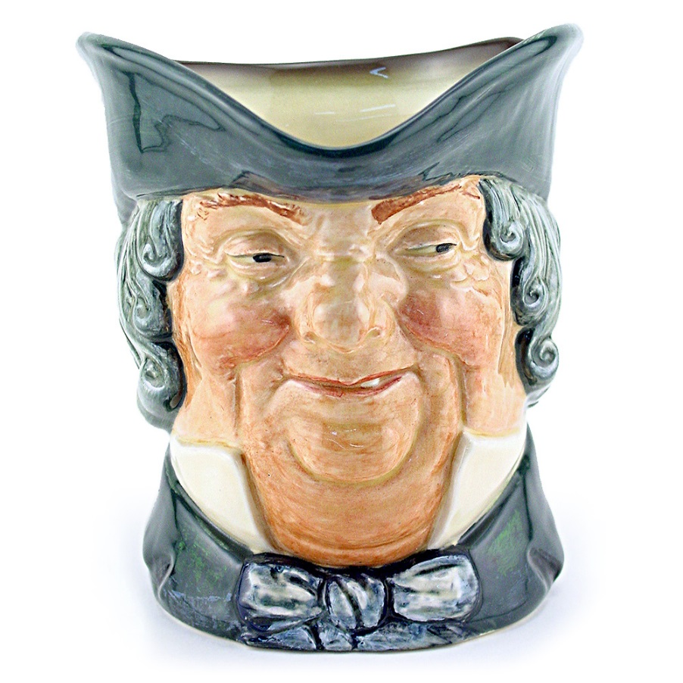
Winter Wonderland
In the meadow we can build a snowman And pretend that he is Parson Brown He'll say are you married We'll say no man But you can do the job When you're in town

Slide 6
Winter Wonderland
Later on We'll conspire As we dream by the fire To face unafraid The plans that we've made Walking in a winter wonderland

Slide 7
Winter Wonderland
Sleigh bells ringing Are you listening In the lane Snow is glistening A beautiful sight, We're happy tonight Walking in a winter wonderland

Slide 8
Winter Wonderland
Gone away, is the blue bird Here to stay, is the new bird He sings a love a song As we go along Walking in a winter wonderland

Slide 9
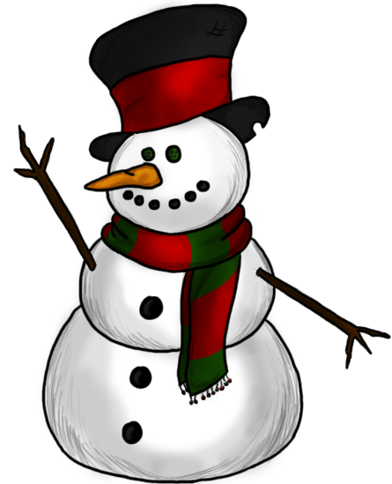
Winter Wonderland
In the meadow we can build a snowman And pretend that he's a circus clown We'll have lots of fun with Mr. Snowman Until the other kiddies knock them down

Slide 10
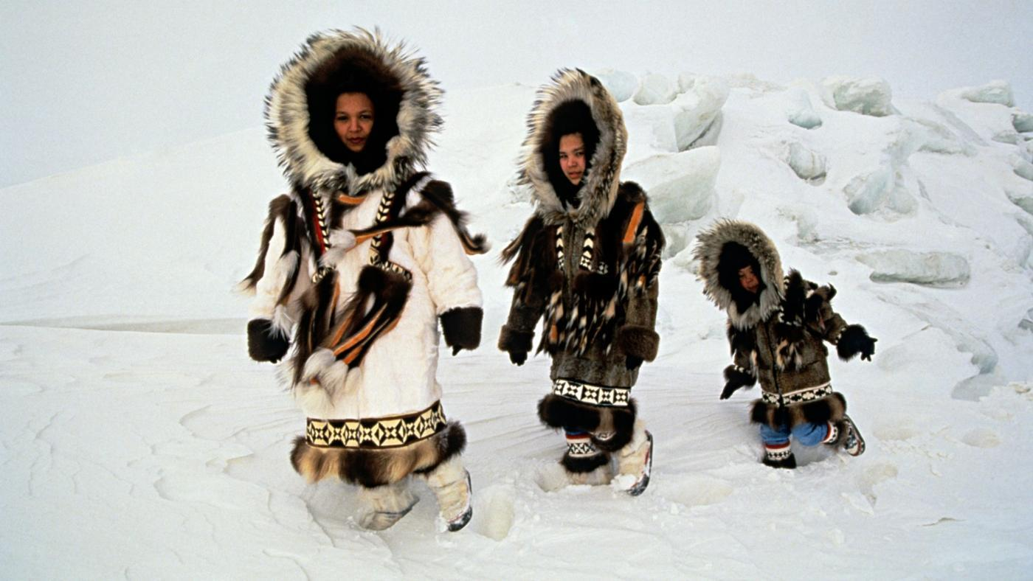
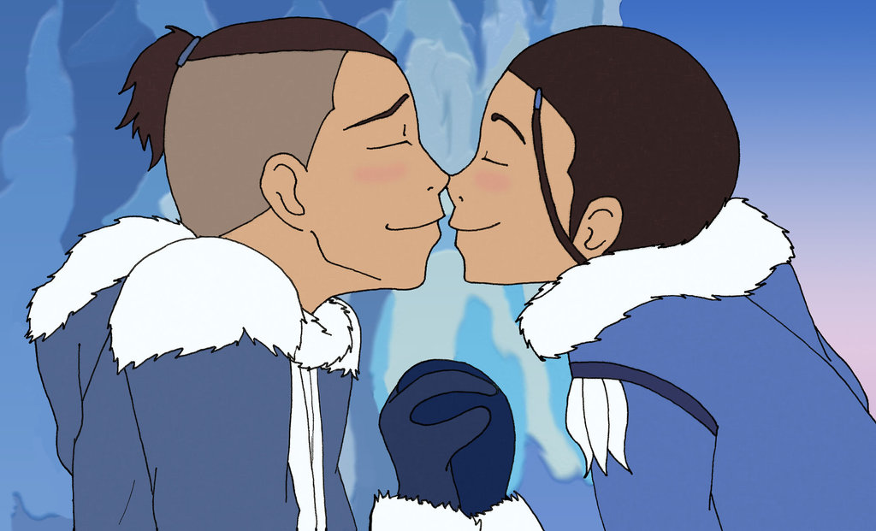
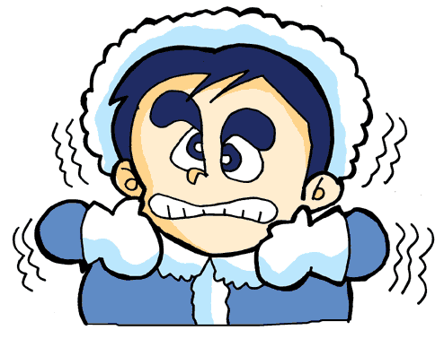
Winter Wonderland
When it snows ain't it thrilling Though your nose, gets a chilling We'll frolic and play, the Eskimo way Walking in a winter wonderland Walking in a winter wonderland

Slide 11
What is it?
Sleigh

Slide 12
A Small Road:
Lane

Slide 13
Like Shining:
Glistening

Slide 14
Something nice to see:
A beautiful sight

Slide 15
An area with no trees:
Meadow

Slide 16
Make plans:
Conspire

Slide 17
Not scared:
Unafraid

Slide 18
Exciting:
Thrilling

Slide 19
I feel cold:
Chilling

Slide 20
People who live in the arctic circle:
Eskimo

Slide 21
Winter Wonderland
https://www.youtube.com/watch?v=L1nQpoAvTSg

Slide 22
Christmas Tree
Decorate the Christmas Tree

Slide 23
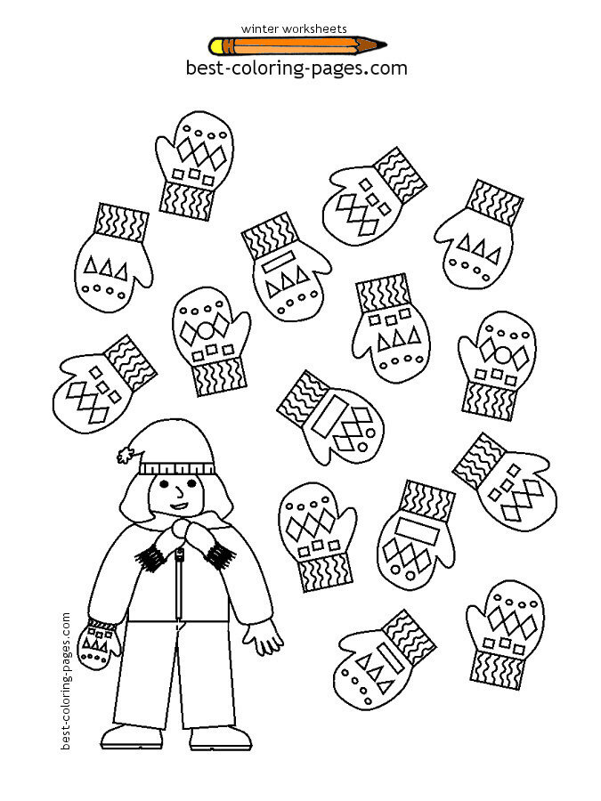

Slide 24
