Slide 1
Monster Manners

Slide 2
Monster Manners vs Human Manners
You should fight.
You should break toys.
You should growl loudly when answering the phone.
You should shew up rocks.
You shouldn’t fight.
Use a napkin, knife and fork.
Say “please.”
Sit quietly on the couch.

Slide 3
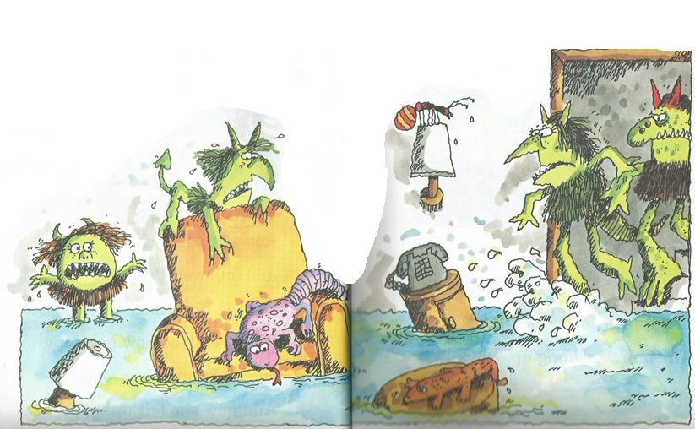
What happened to the house?

Slide 4
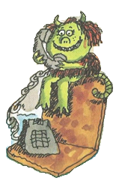
Who saved the day?

Slide 5
How did Rosie help?

Slide 6
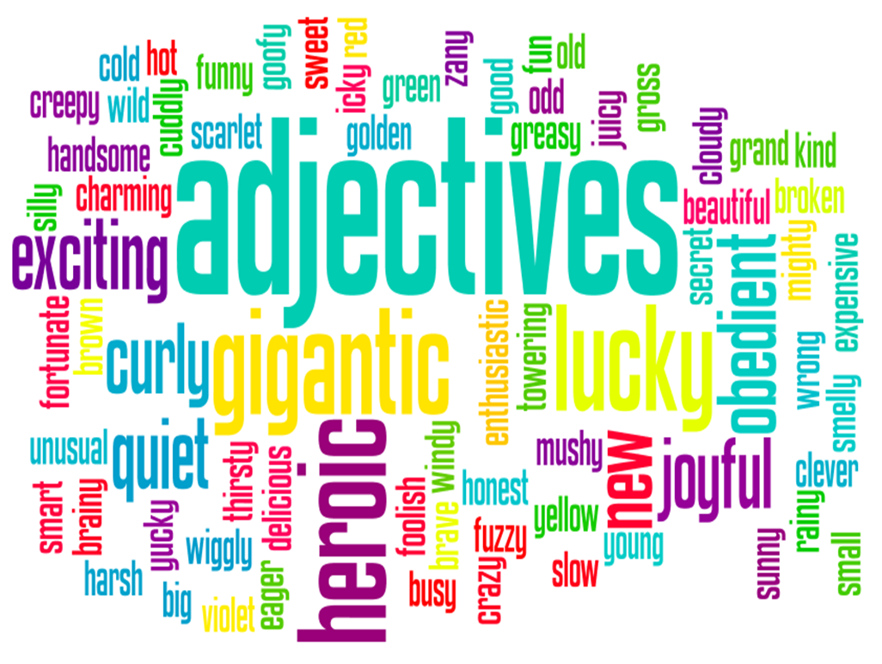
Adjectives: What are they?

Slide 7
Silly Monster
Mr.S will ask for some adjectives

Slide 8
Number:
Number:
Color:
Color:
Adjective:
Number:
Color:
Size:
Number:
Adjective:

Slide 9
It has _____ legs and _______ arms.
It’s body is ______, but it’s head is ________.
On it’s head, it has a _______ horn.
It has ___________ ___________ eyes.
It’s nose is __________.
This monster has ________ scary teeth.
Finally, you won’t believe this, but it has ______ ears

Slide 10
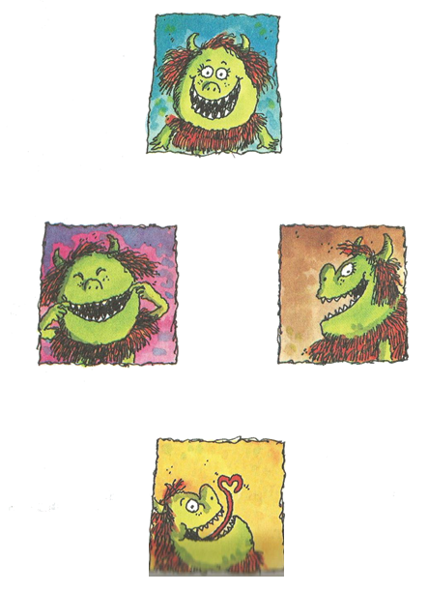
Monster Faces
Draw monster faces on the board.
Give each monster a name.

Slide 11
Monster Faces
Now, one student will describe a monster.
The other students must guess which monster it is.
If you get the answer correct, you can describe the next monster.

