Slide 1
Movie Day
“Thanks Haram!”
https://www.youtube.com/watch?v=4FPCrB2EDyc

Slide 2
Spooky Stories 1.4 – Mutant Pumpkins from Outer Space
https://www.netflix.com/watch/70217951?trackId=3623124&tctx=2%2C0%2Cfc3a5256-d4d5-4dac-80f0-5ced9c85eb25-8236649

Slide 3
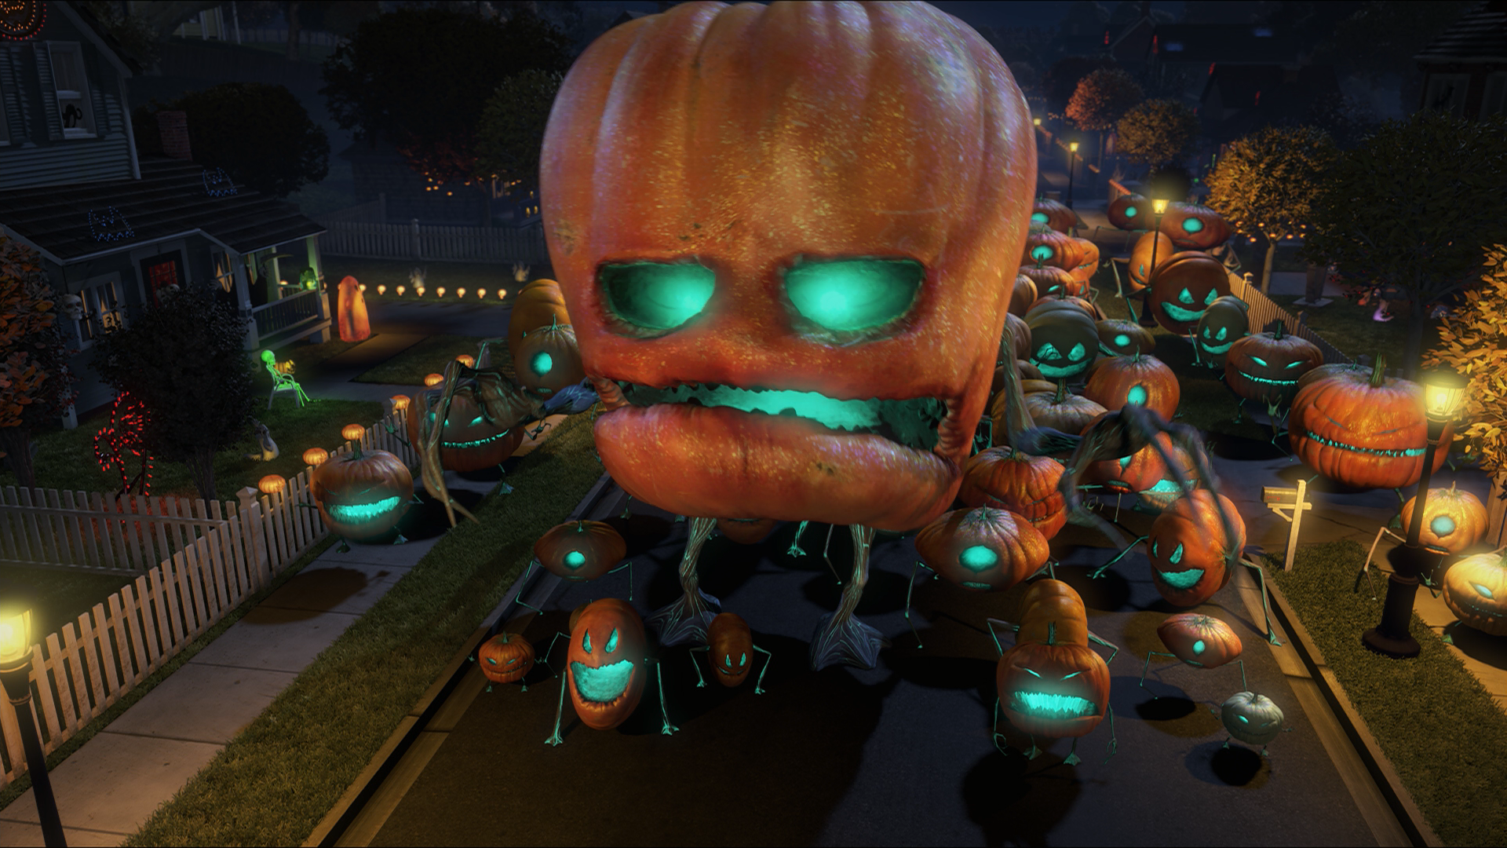
Describe the Aliens

Slide 4
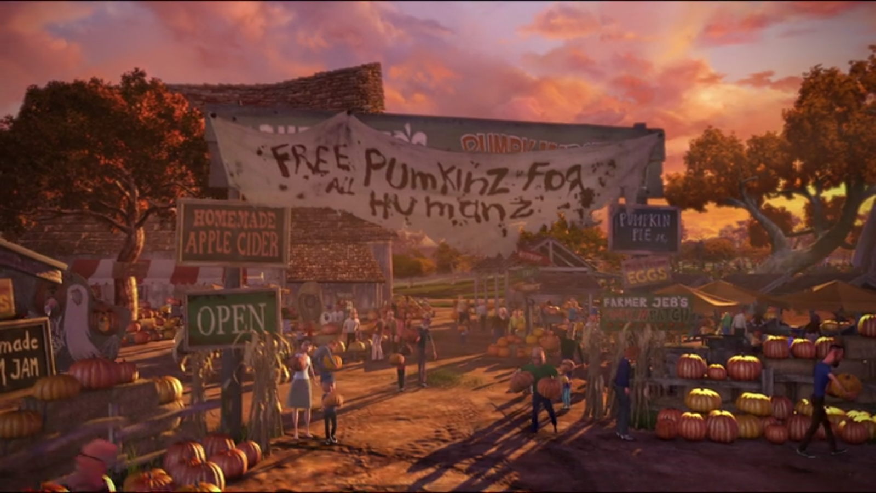
What does ASAP mean?
As soon as possible
(quickly)

Slide 5
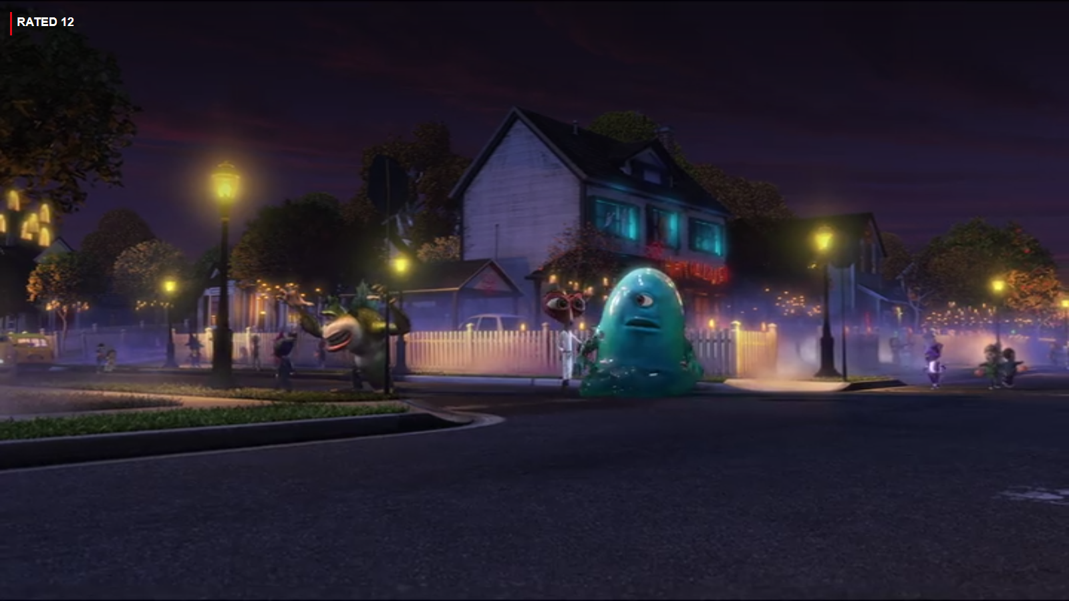
What do kids say on Halloween?
Trick or Treat

Slide 6
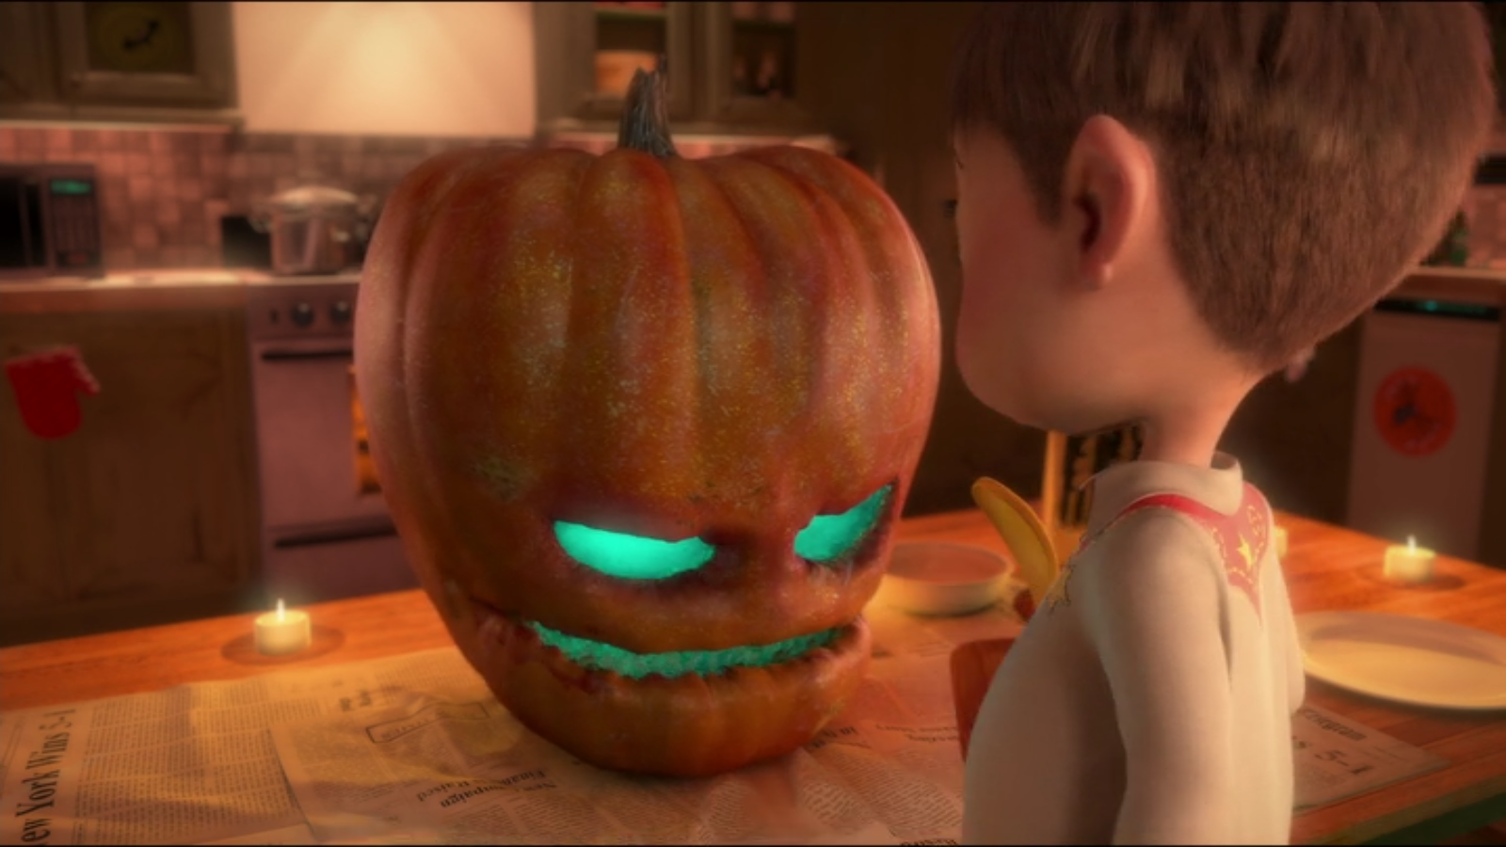
What do the mutant pumpkins want?
Candy

Slide 7
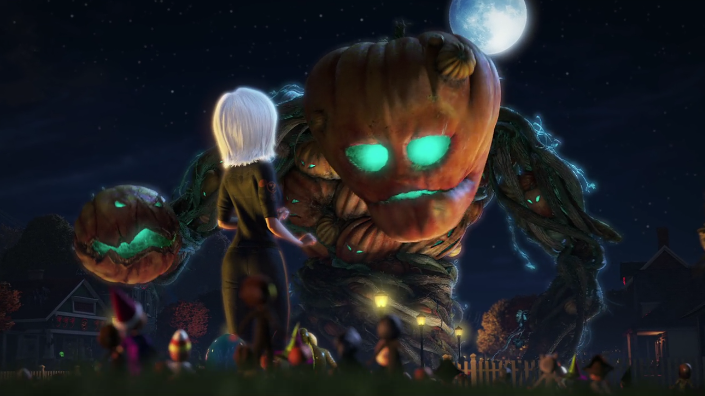
What happens when the pumpkins eat candy?
They get bigger.

Slide 8
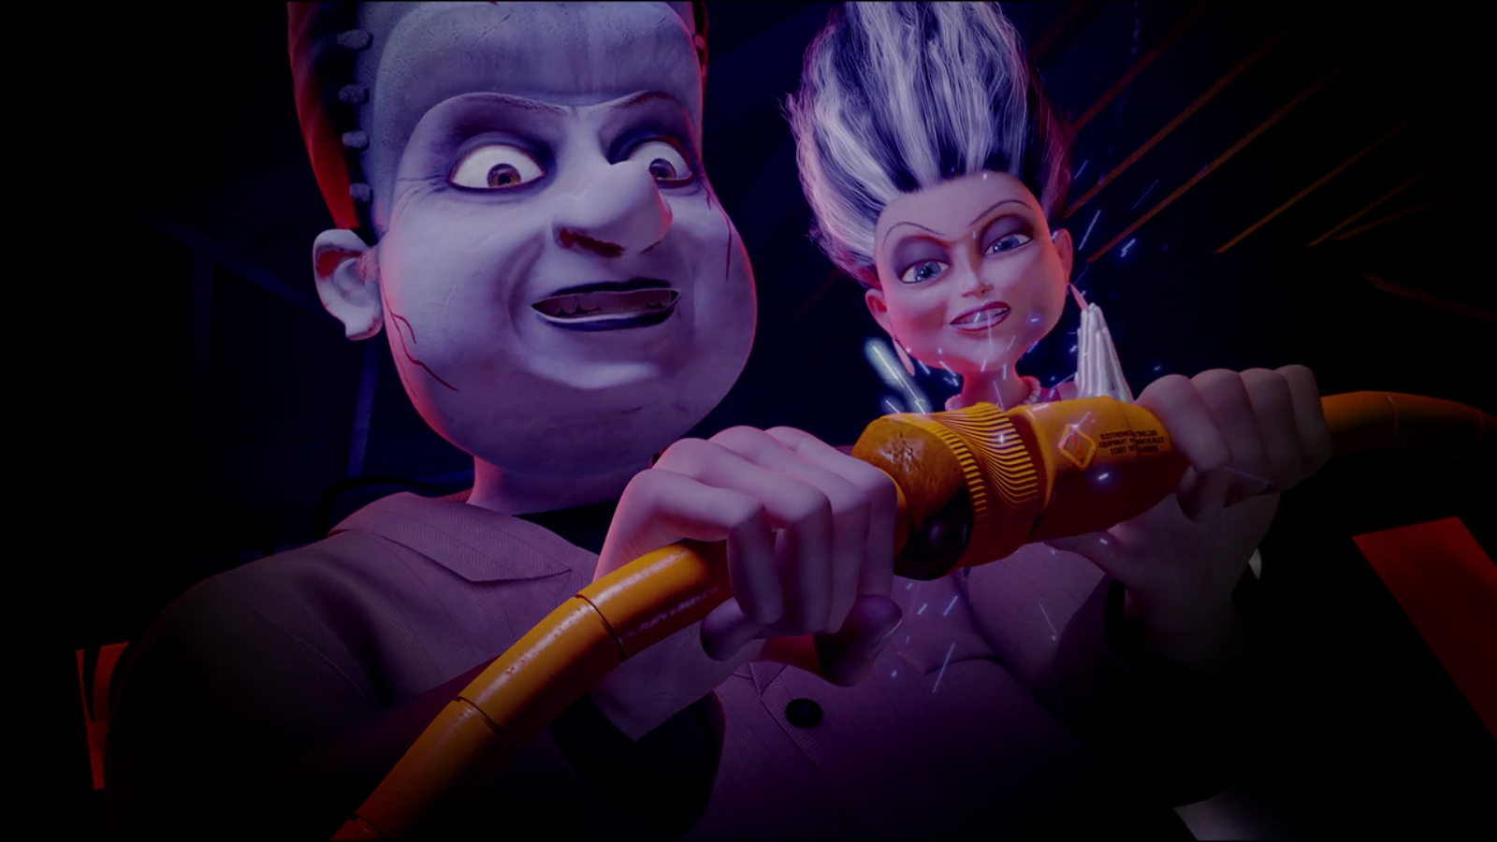
What happens when YOU eat too many candies?
Bad teeth
Fat
Unhealthy

Slide 9
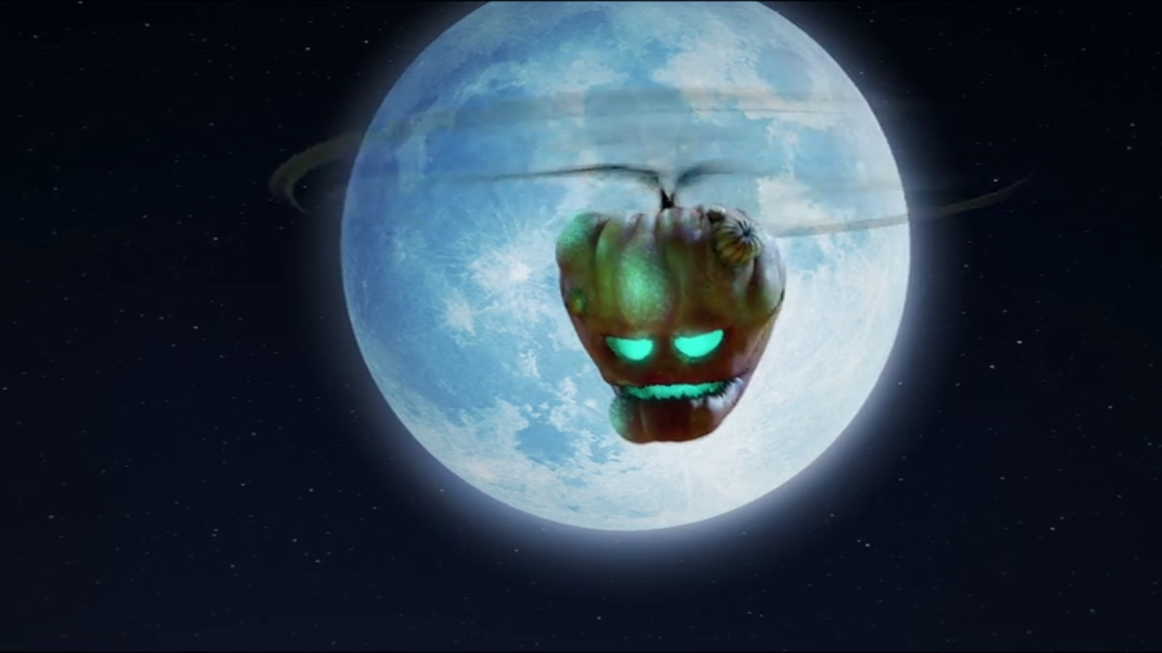
How do they beat the pumpkins?
They feed them too many candies.

Slide 10
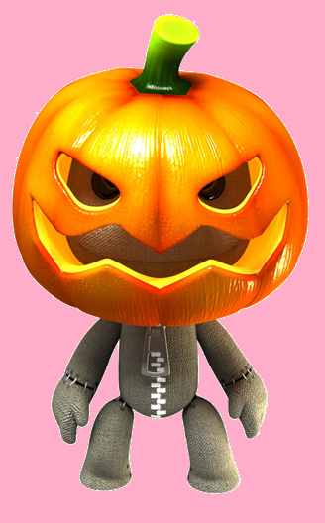
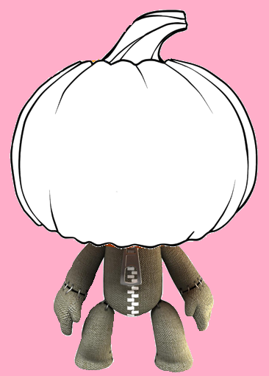
Make an Alien Pumpkin

