Slide 1
If I was rich…

Slide 2
If I Had a Million Dollars (song):
Listen and circle what they want to buy

Slide 3
Circle what they would buy:
Expensive Ketchup
Giraffe
House
Books
Monkey
Horse
Airplane
Hamburger
Turtle
John Merrick’s Remains
Video Game
Fur Coat
Towel
Coffee
Newspaper
Bicycle
Flowers
Furniture
Art
Ice Cream
Cow
Vacation
Island
K-Car
Milk
Exotic Pet
Apple
Green Dress
Clock

Slide 4
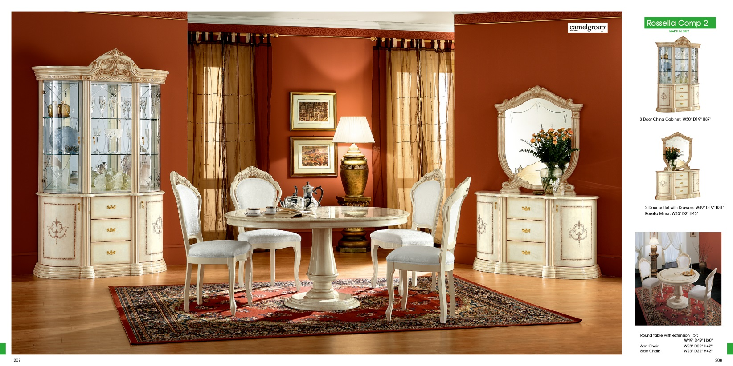
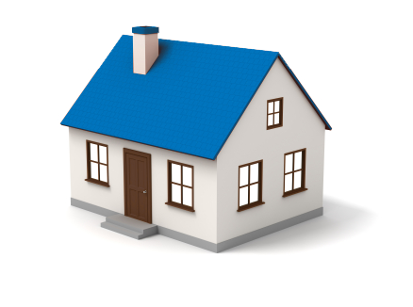
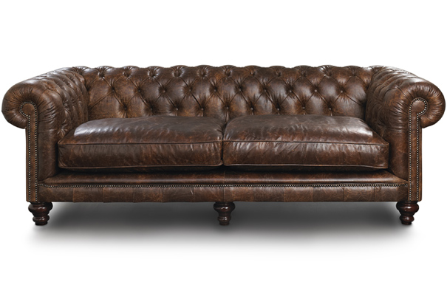
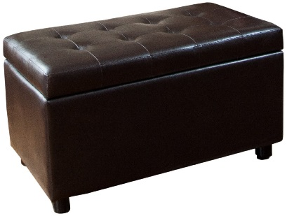
If I had a million dollars If I had a million dollars Well, I'd buy you a house I would buy you a house
And if I had a million dollars If I had a million dollars I'd buy you furniture for your house Maybe a nice Chesterfield or an ottoman

Slide 5
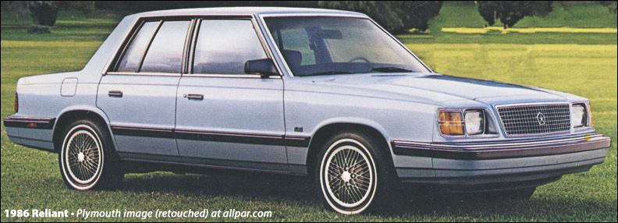
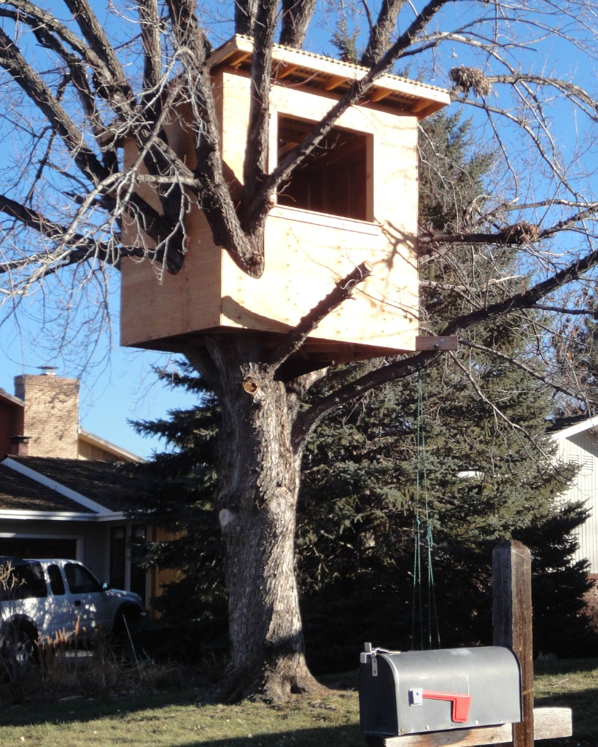
And if I had a million dollars If I had a million dollars Well, I'd buy you a K-Car A nice Reliant automobile And if I had a million dollars, I'd buy your love
If I had a million dollars I'd build a tree-fort in our yard If I had a million dollars you could help It wouldn't be that hard

Slide 6
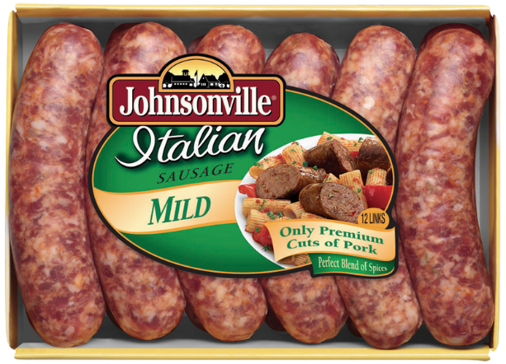
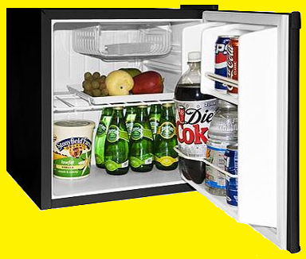
If I had a million dollars Maybe we could put a little tiny fridge In there somewhere We could just go up there and hang out
Like open the fridge and stuff And there'd all be foods laid out for us Like little pre-wrapped sausages and things
They have pre-wrapped sausages But they don't have pre-wrapped bacon Well, can you blame them? Yeah!

Slide 7
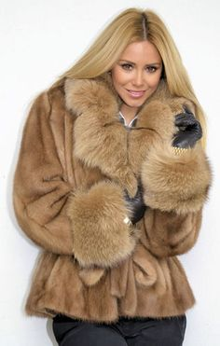
If I had a million dollars If I had a million dollars Well, I'd buy you a fur coat But not a real fur coat, that's cruel
And if I had a million dollars If I had a million dollars Well, I'd buy you an exotic pet Yep, like a llama or an emu

Slide 8
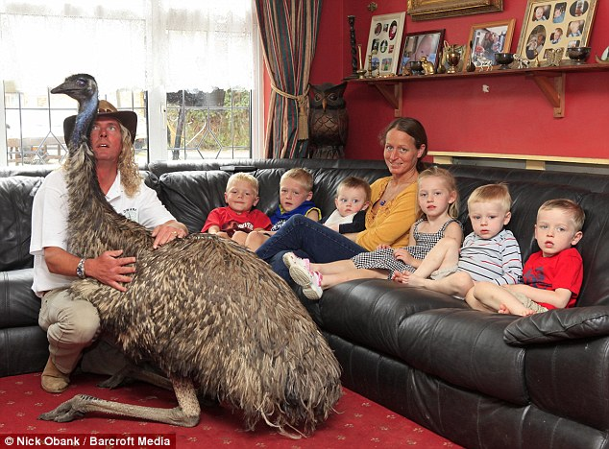
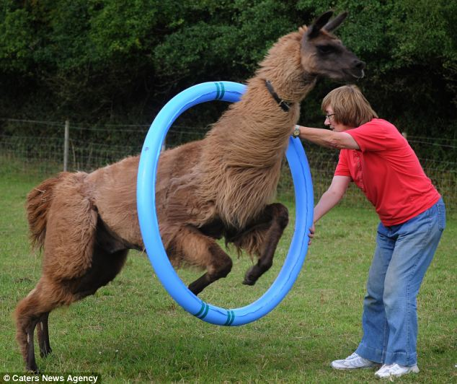
If I had a million dollars If I had a million dollars Well, I'd buy you a fur coat But not a real fur coat, that's cruel
And if I had a million dollars If I had a million dollars Well, I'd buy you an exotic pet Yep, like a llama or an emu

Slide 9
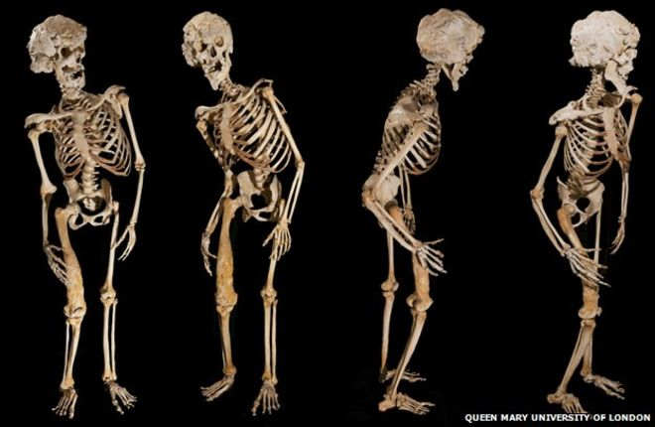
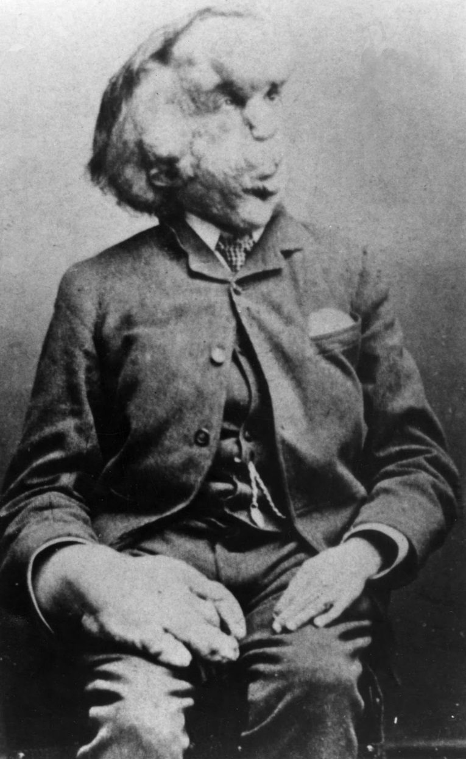
And if I had a million dollars If I had a million dollars Well, I'd buy you John Merrick's remains All them crazy elephant bones And if I had a million dollars I'd buy your love
If I had a million dollars We wouldn't have to walk to the store If I had a million dollars We'd take a limousine, 'cause it costs more

Slide 10
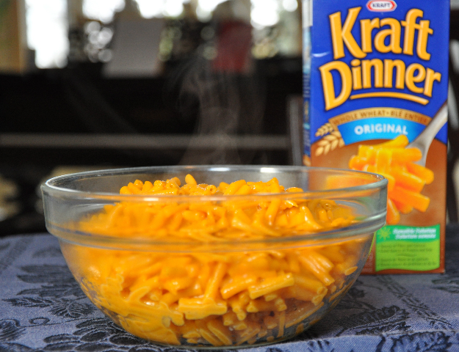
If I had a million dollars We wouldn't have to eat Kraft Dinner But we would eat Kraft Dinner
Of course we would, we'd just eat more And buy really expensive ketchups with it That's right, all the fanciest Dijon ketchups

Slide 11
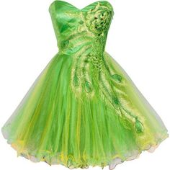
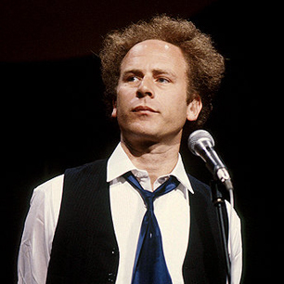
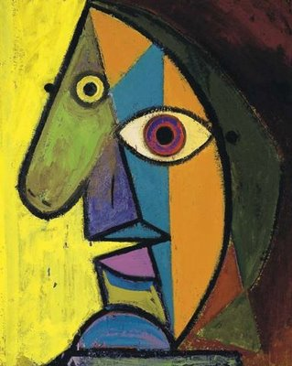
If I had a million dollars If I had a million dollars Well, I'd buy you a green dress But not a real green dress, that's cruel
And if I had a million dollars If I had a million dollars Well, I'd buy you some art A Picasso or a Garfunkel

Slide 12
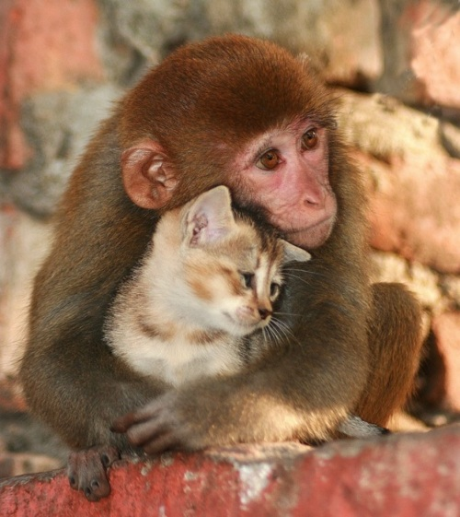
If I had a million dollars If I had a million dollars Well, I'd buy you a monkey Haven't you always wanted a monkey? If I had a million dollars I'd buy your love
If I had a million dollars If I had a million dollars If I had a million dollars If I had a million dollars If I had a million dollars I'd be rich!

Slide 13
If I had a Million Dollars (Pictures)
https://www.youtube.com/watch?v=nCImrmR63JE

Slide 15
The Singers
https://www.youtube.com/watch?v=KNVkEqy7lpI

Slide 16
If ________________, I would
I would _ _ _ _ _ _ _ _
You would _ _ _ _ _ _ _ _
She would _ _ _ _ _ _ _ _
He would _ _ _ _ _ _ _ _
They would _ _ _ _ _ _ _ _
We would _ _ _ _ _ _ _ _

Slide 17
If I had a million dollars, I would __________.

