Slide 1
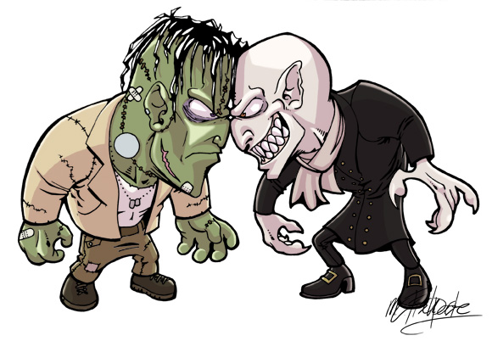
Monster Card Game
Monster Fight

Slide 2
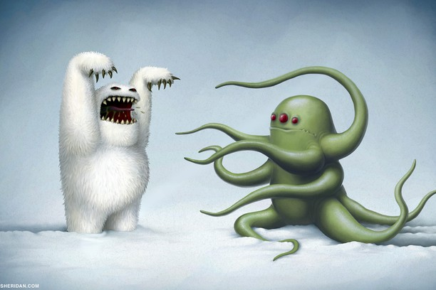

Slide 3
Famous Monsters

Slide 4
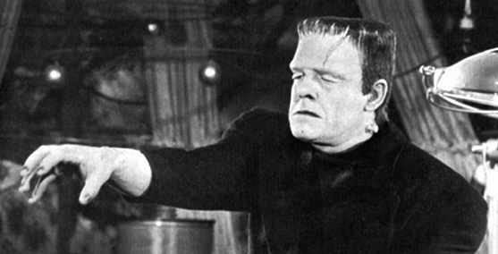
Frankenstein

Slide 5
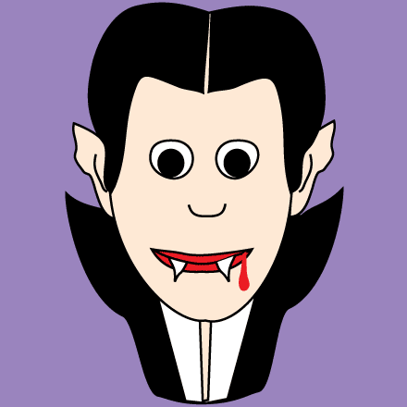
Dracula

Slide 6
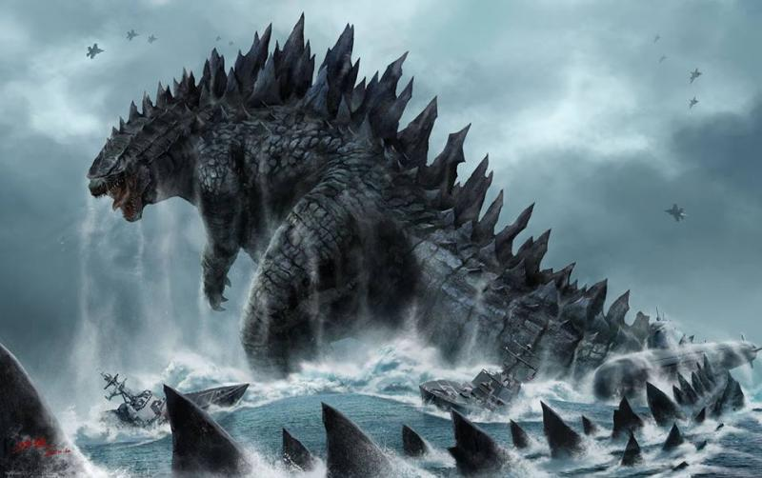
Godzilla

Slide 7
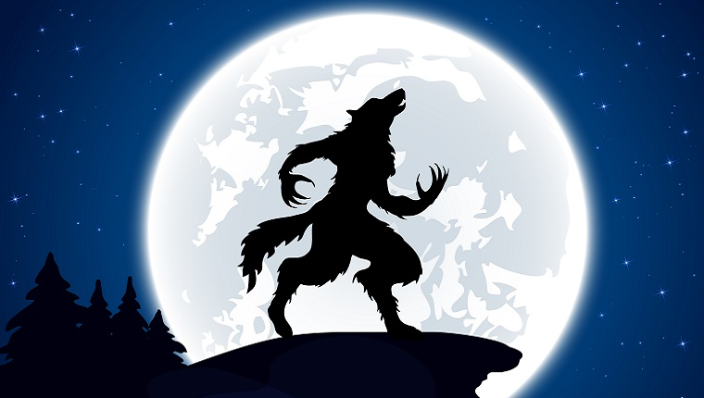
Werewolf

Slide 8
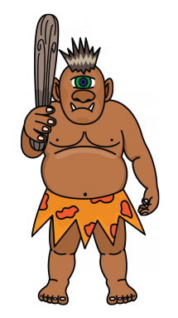
Cyclops

Slide 9
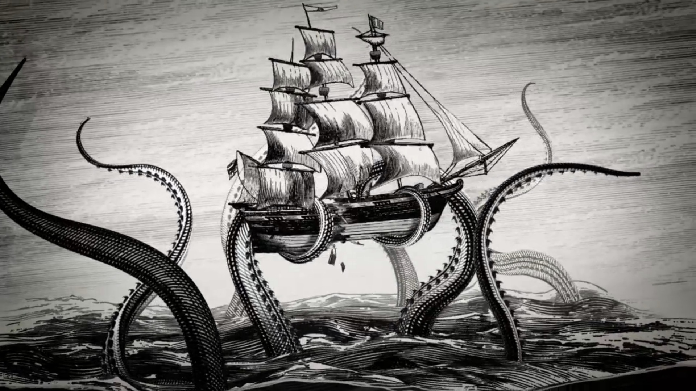
Kraken

Slide 10
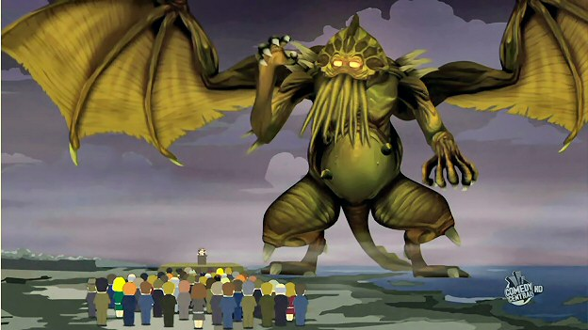
Cthulhu

Slide 11
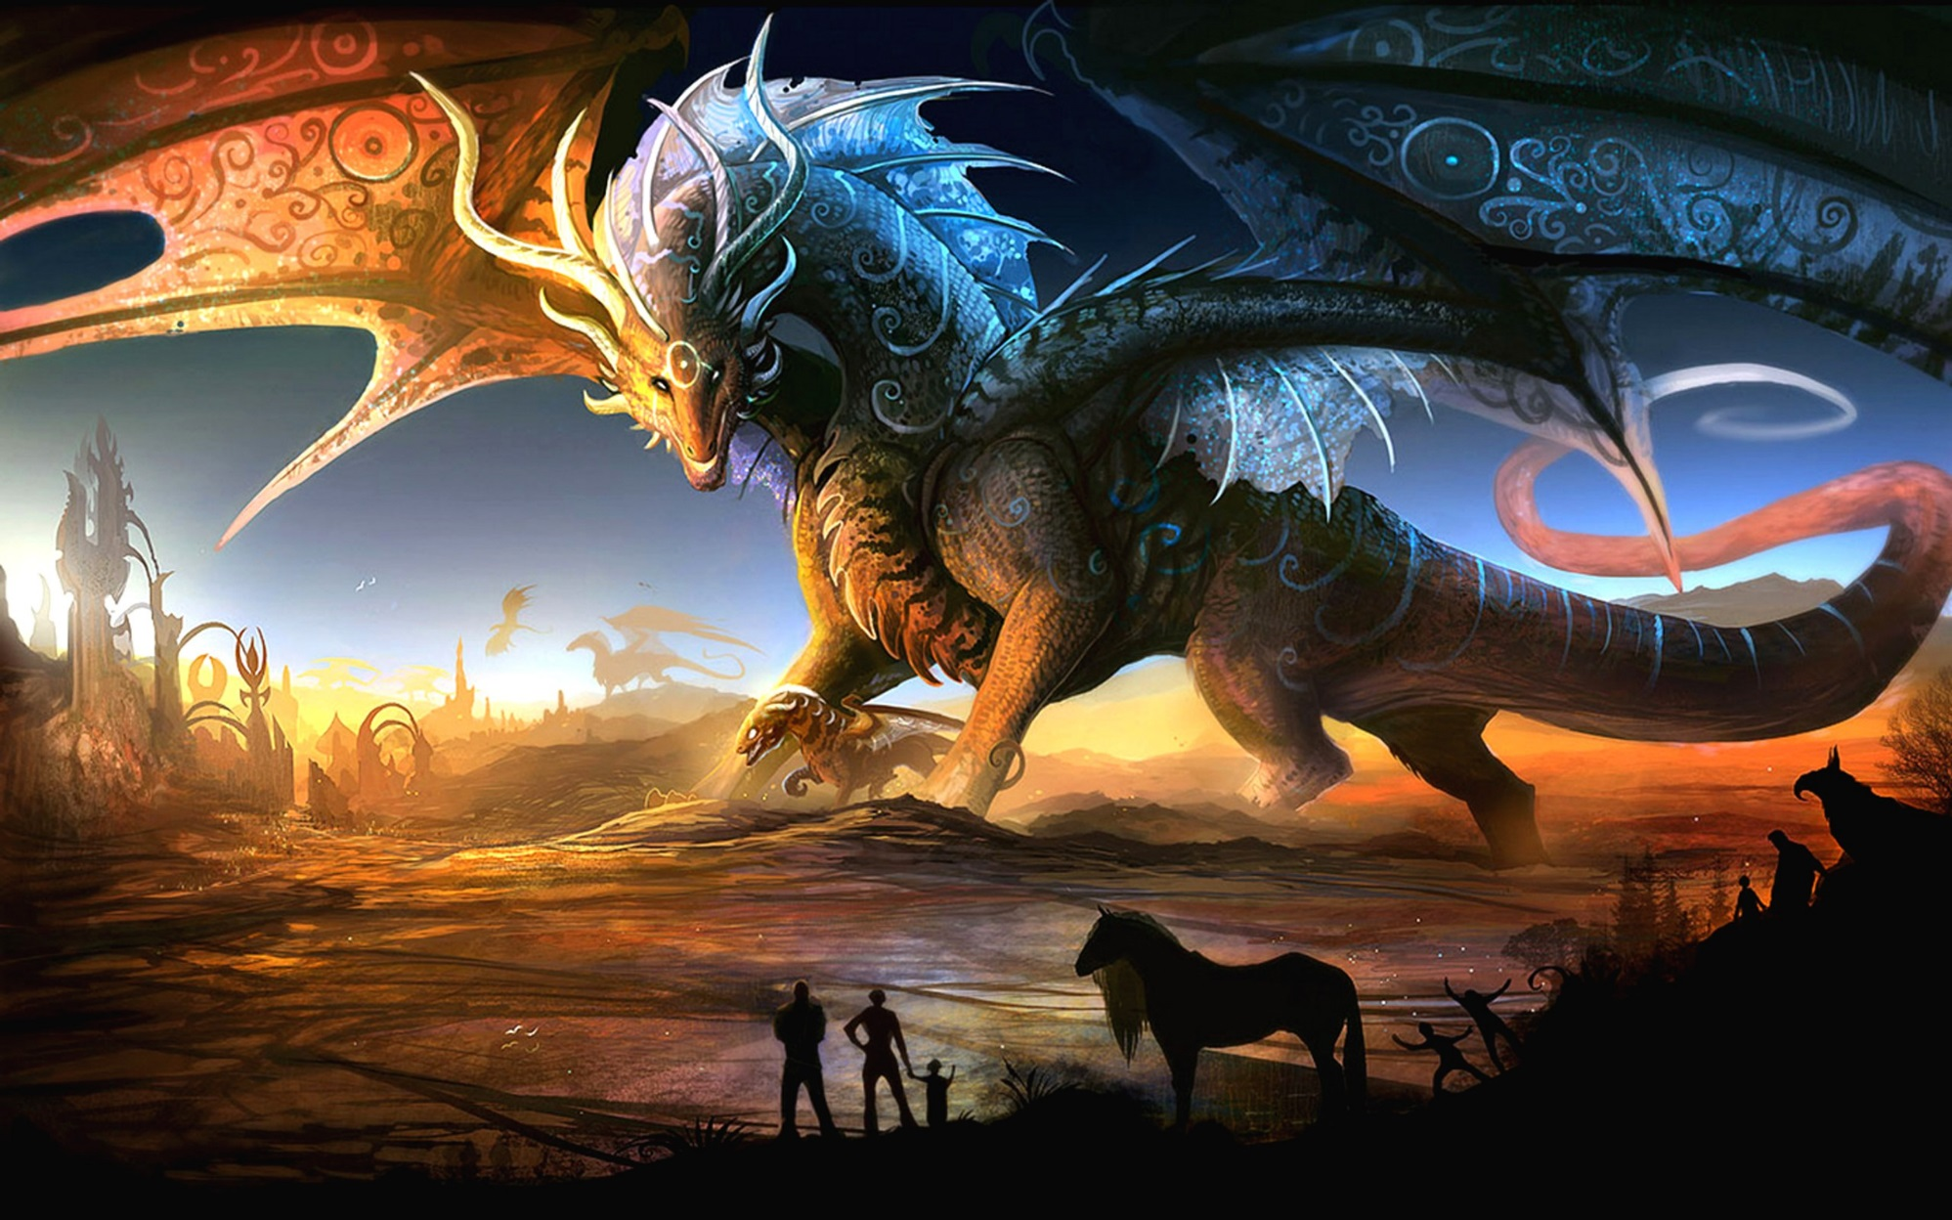
Dragon

Slide 12
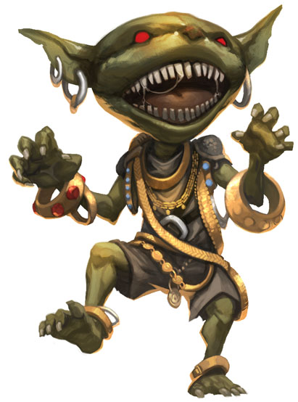
Goblin

Slide 13
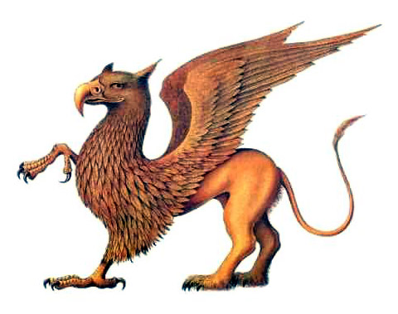
Griffin

Slide 14
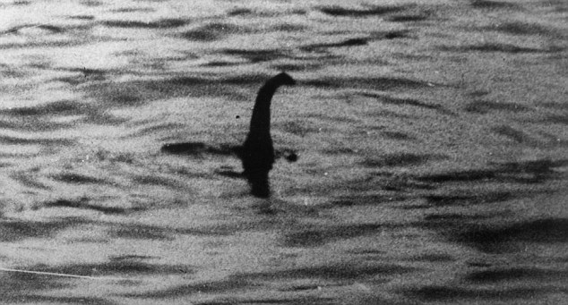
Loch Ness Monster

Slide 15
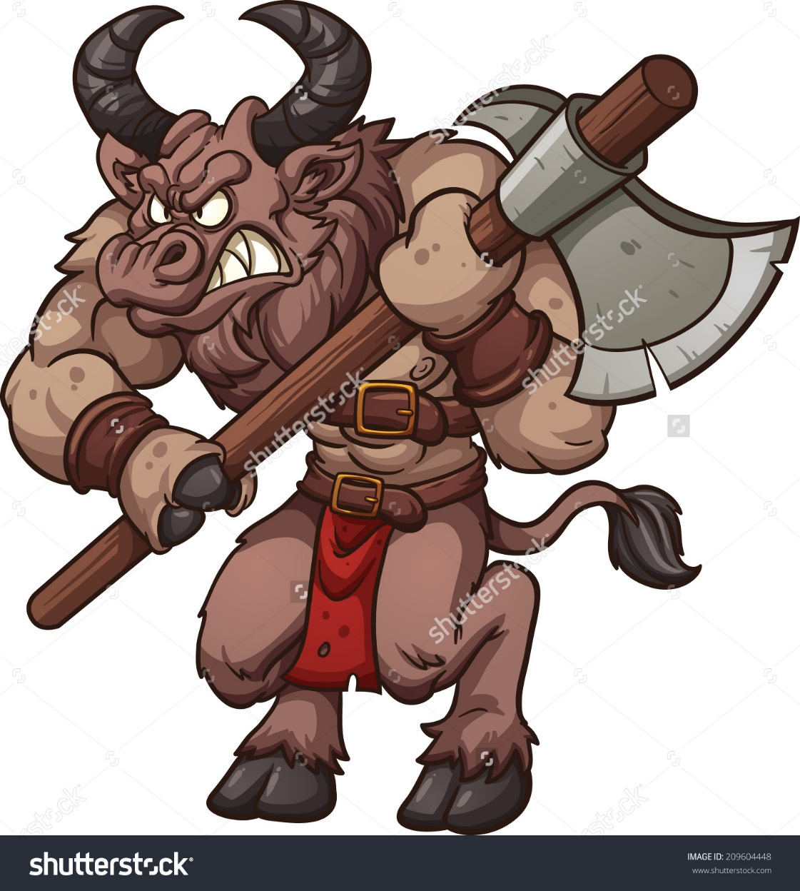
Minotaur

Slide 16
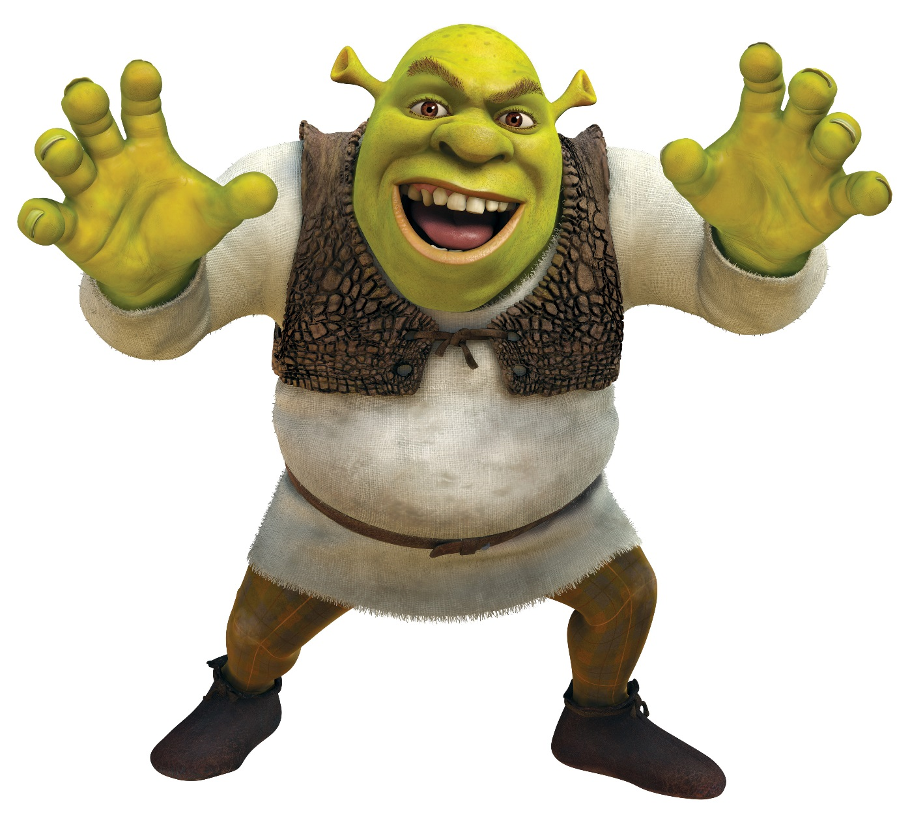
Ogre

Slide 17
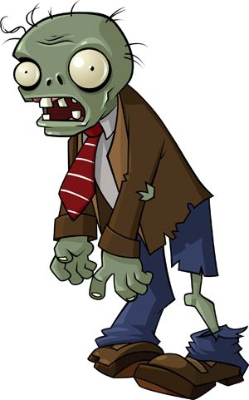
Zombie

Slide 18
Alien

Slide 19
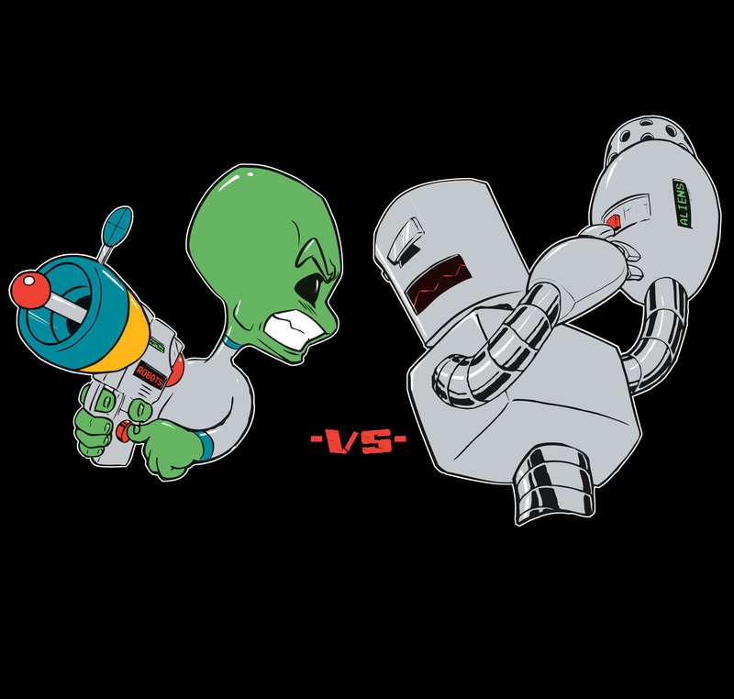
Color Meaning:
Strength
Intelligence
Speed
Agility
Bravery
Cuteness

Slide 20
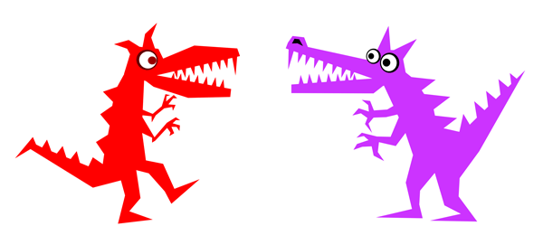

Slide 21
Make Your Own Cards
Strength
Intelligence
Speed
Agility
Bravery
Cuteness
Draw a monster
Give it a name
How does it attack
Color in the circles

Slide 22
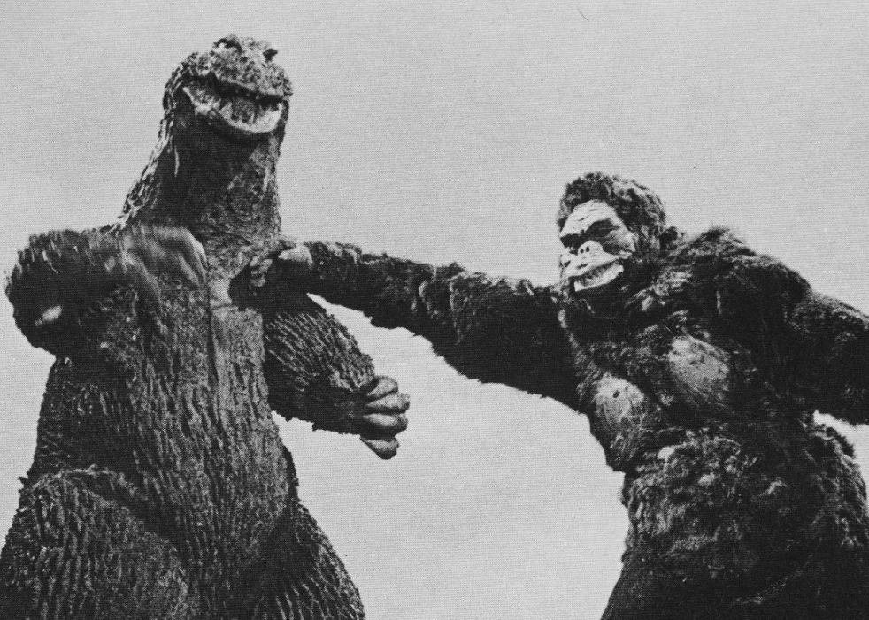

Slide 23
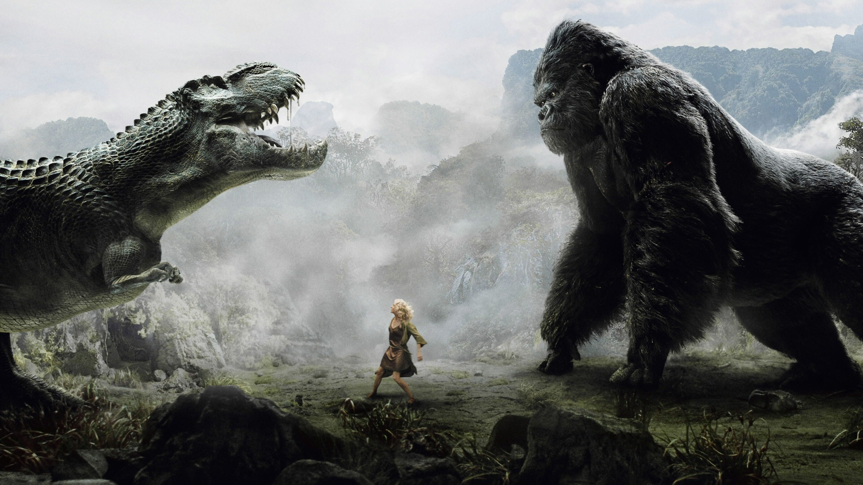

Slide 24
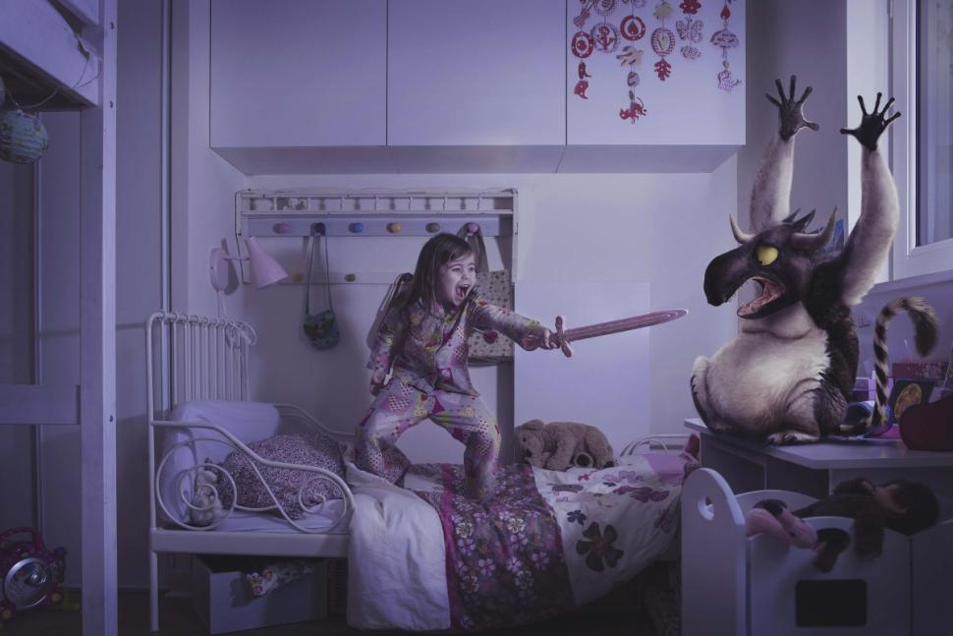

Slide 25
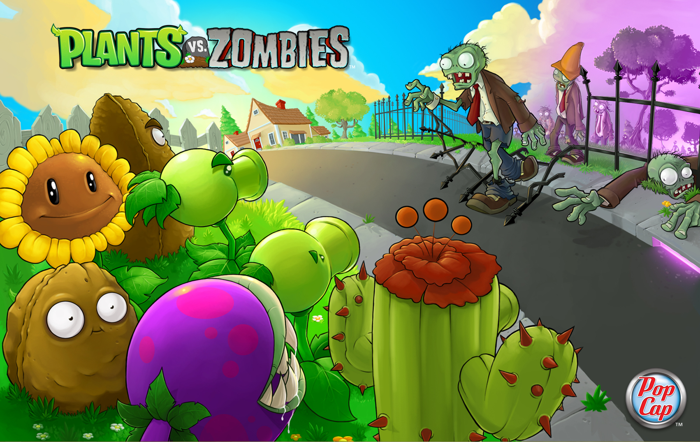

Slide 26
How to Fight

Slide 27
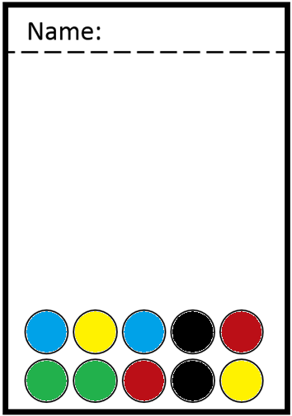
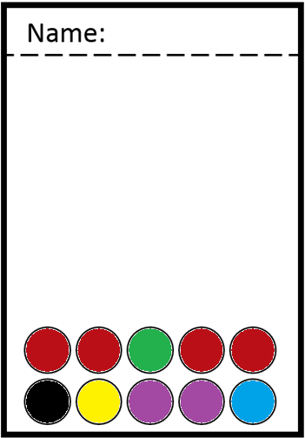
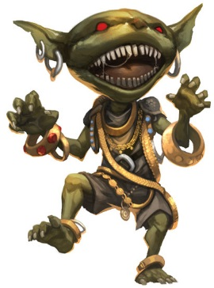
Choose a Monster to Fight for you
Rock / paper / scissors for first attack.
Choose a stat to fight with (roll that many dice)
Each colored circle = a dice
The highest three dice count
The other player rolls the same stat to defend (roll that many dice)
Each colored circle = a dice
The highest three dice count
The higher total wins
The loser must cross off one circle
vs

