Slide 1
Africa

Slide 2
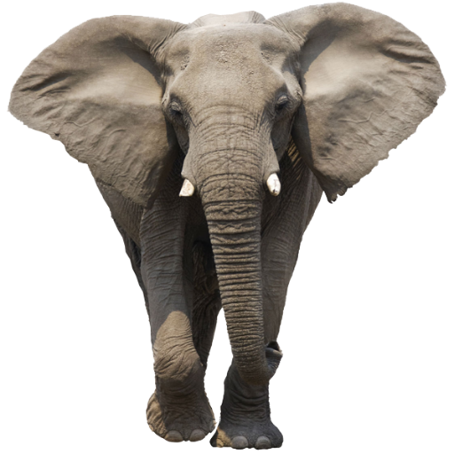
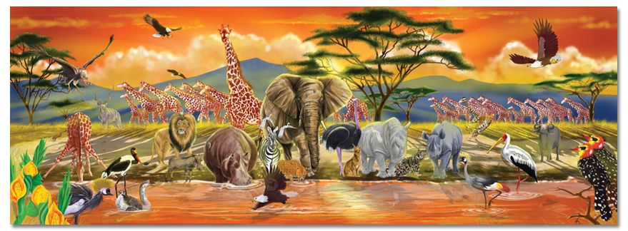
What is the largest land animal in the world?

Slide 3
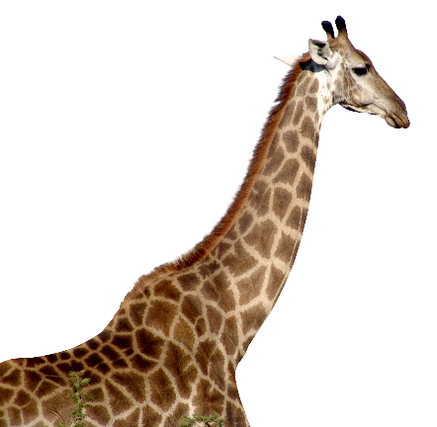
What is the tallest animal in the world?

Slide 4
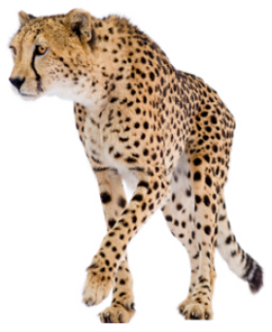
What is the fastest animal in the world?

Slide 5
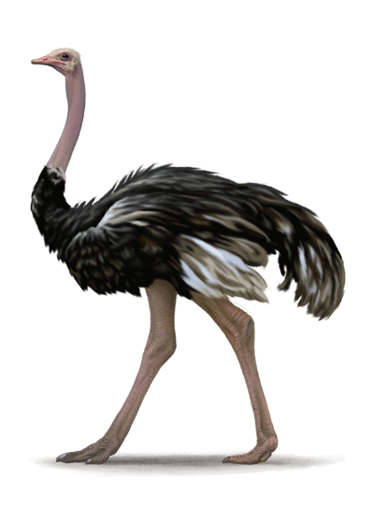
What is the biggest bird in the world?

Slide 6
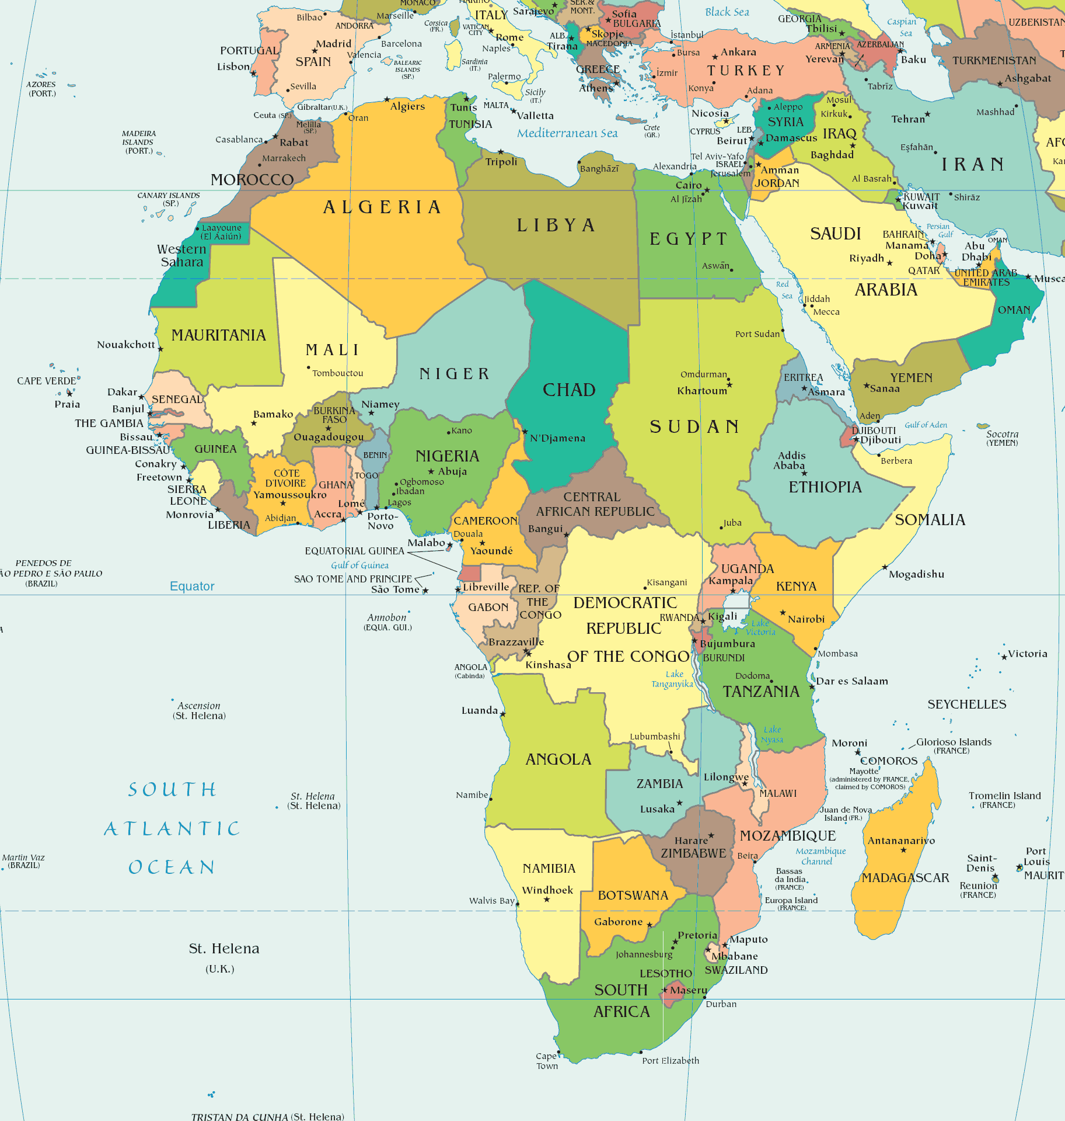
How many countries?
54 (+ 9 Territories)

Slide 7
How many people live there?
1.1 billion
(1,100,000,000)

Slide 8
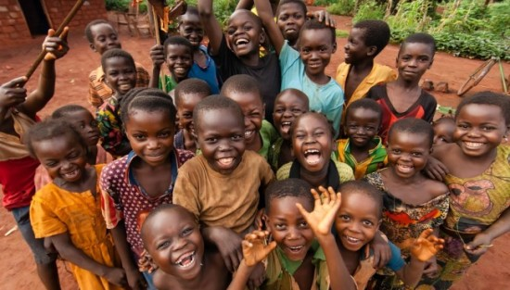

Slide 9
What is the largest country?
Algeria

Slide 10
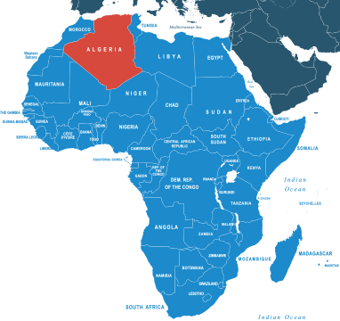
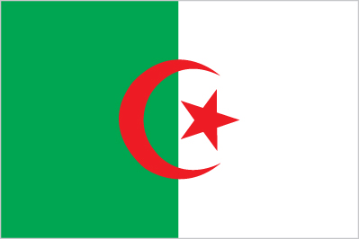

Slide 11
What is the country with the most people?
Nigeria (185 million people)

Slide 12
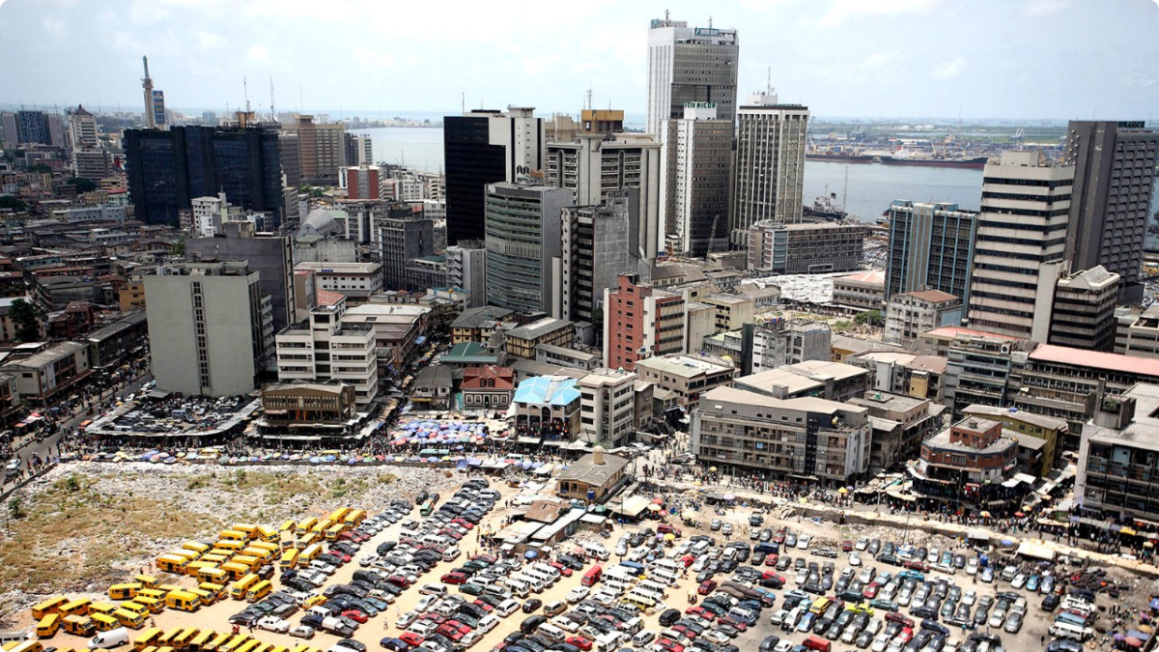
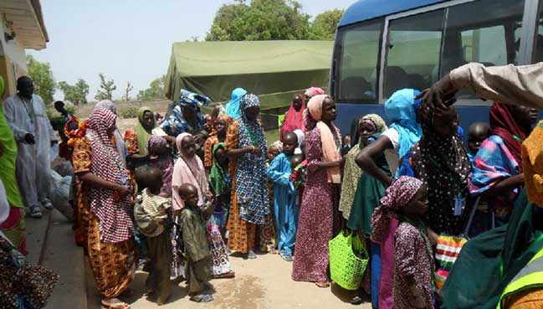
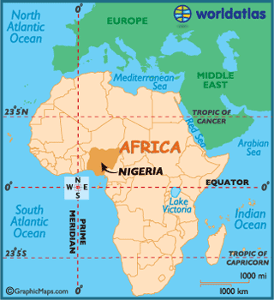

Slide 13
What is the largest city?
Lagos, Nigeria (11 million people)

Slide 14
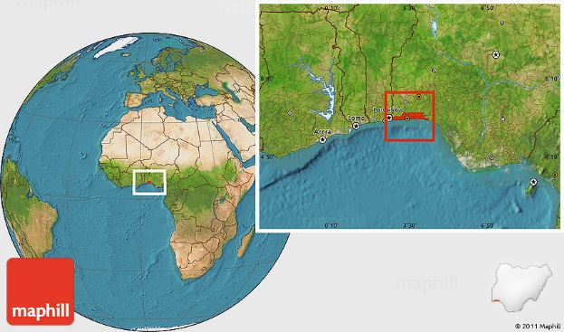

Slide 15
What is the smallest country?
Seychelles

Slide 16
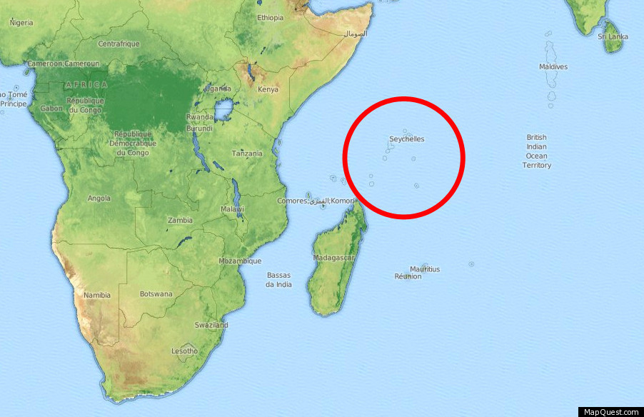

Slide 17
What is the biggest island?
Madagascar

Slide 18
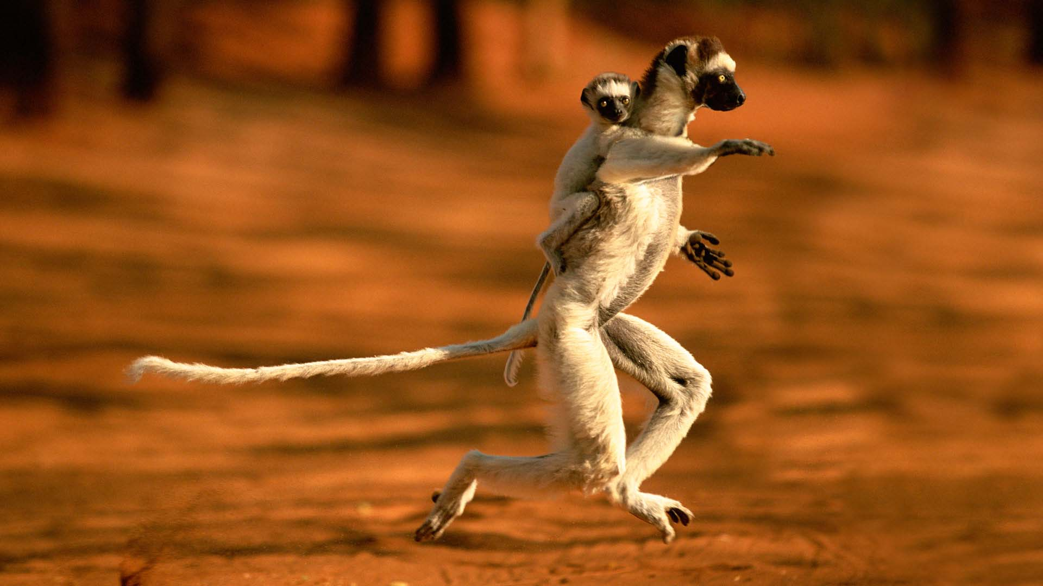
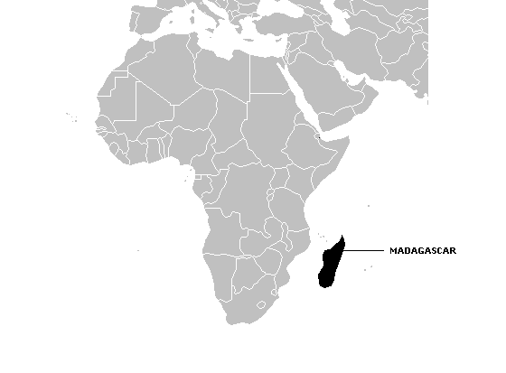

Slide 19
What is the longest river in the world?
Nile River

Slide 20
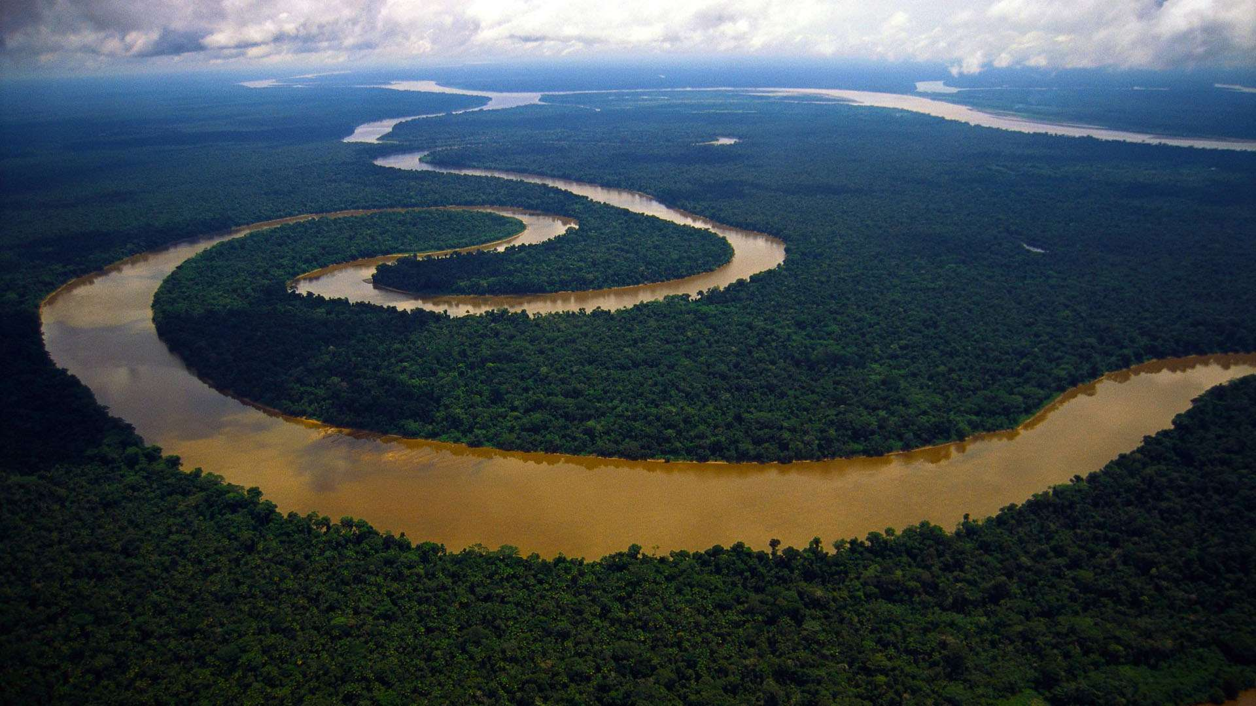

Slide 21
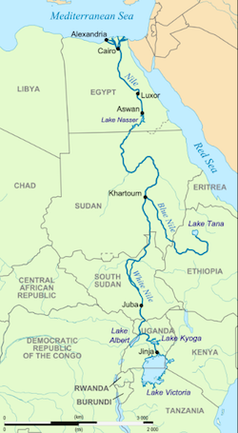
How many countries does the Nile go through?
5
Egypt
Sudan
South Sudan
Ethiopia
Uganda

Slide 22
What is the highest mountain in Africa?
Mount Kilimanjaro

Slide 23
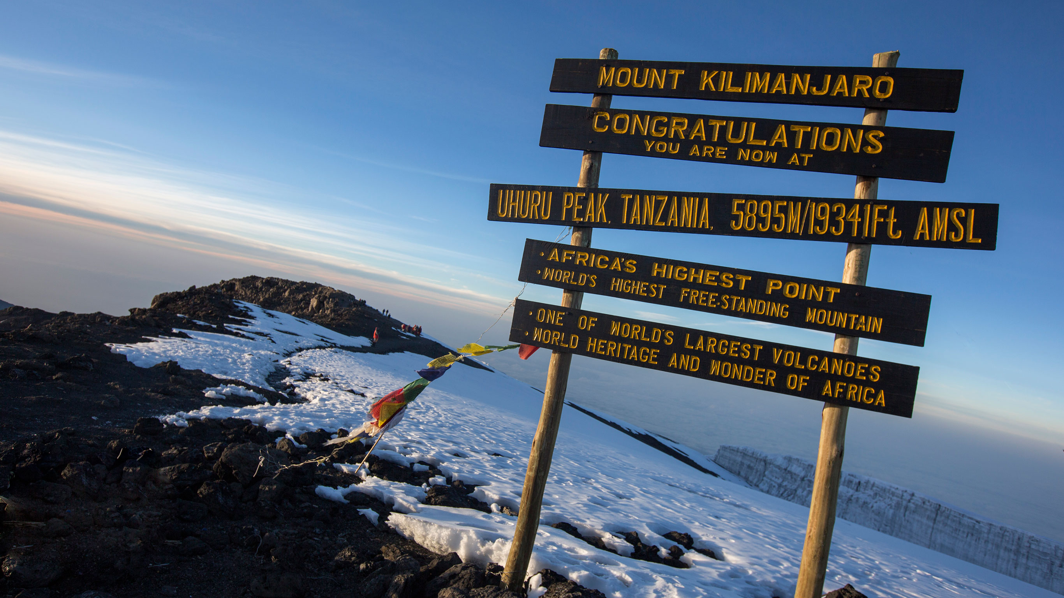
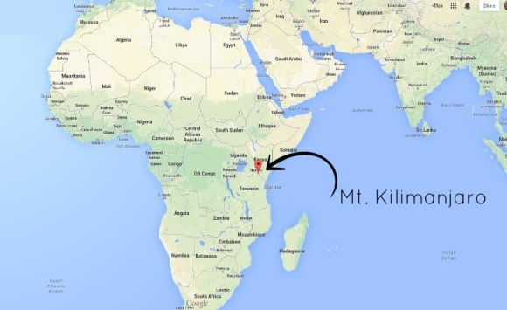

Slide 24
What is the biggest lake in Africa?
Lake Victoria

Slide 25
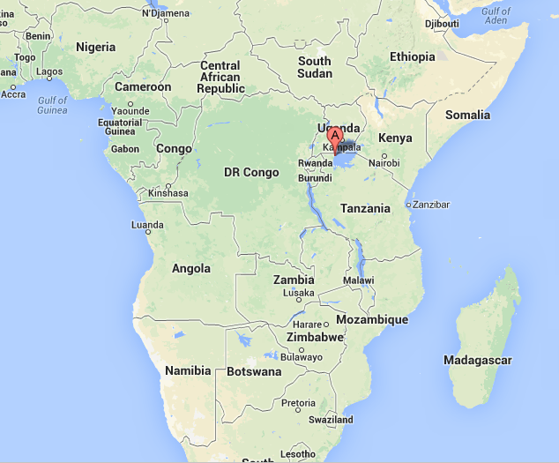

Slide 26
What is the name of the very large desert in Africa?
Sahara

Slide 27
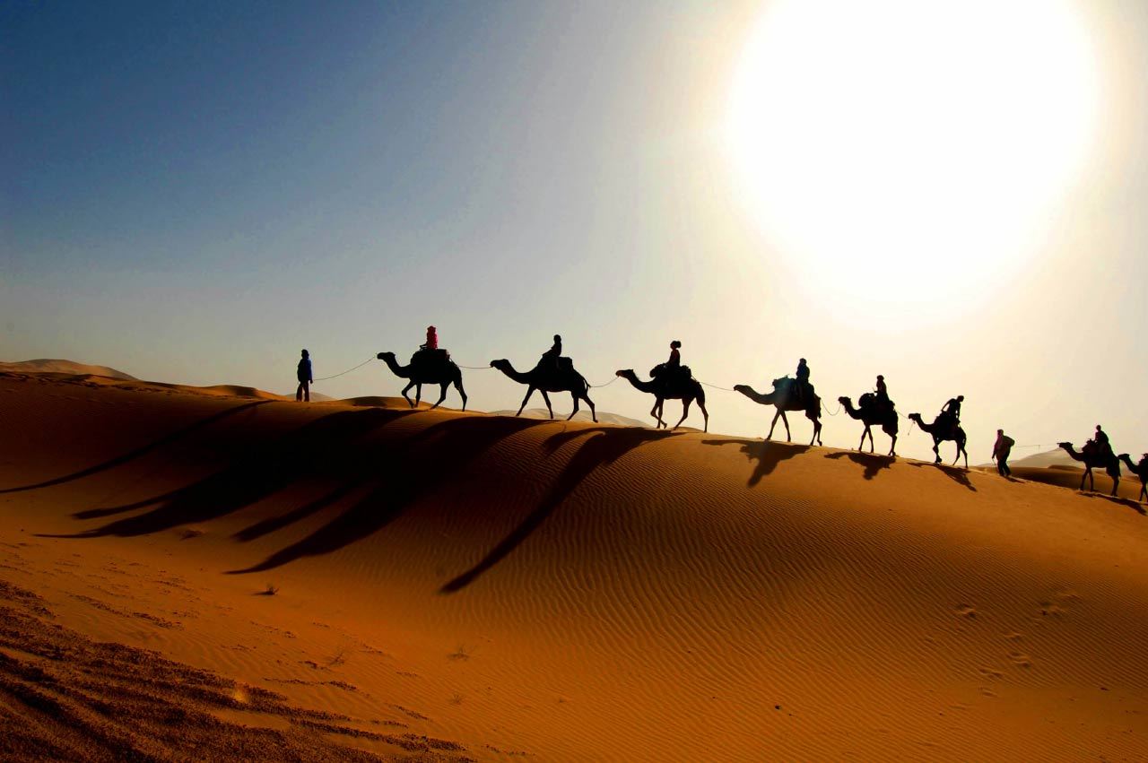
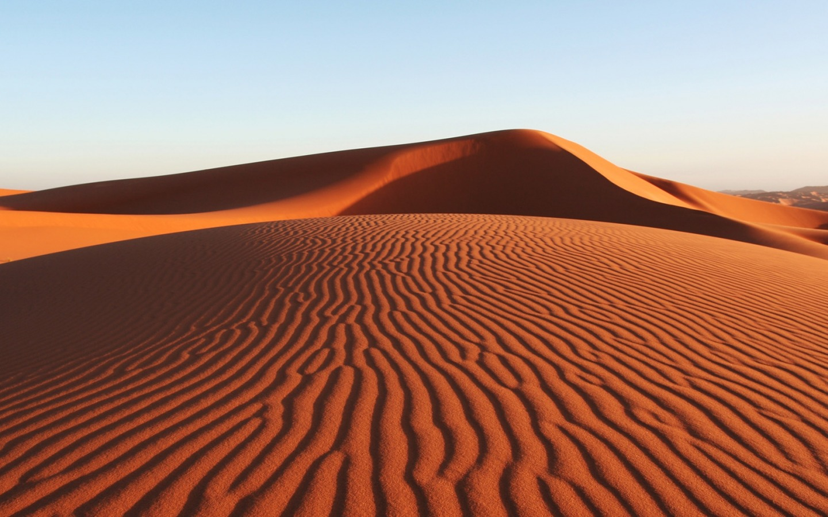

Slide 28
How many different languages are there in Africa?
About 3,000

Slide 30
What is the largest waterfalls in Africa?
Victoria Falls

Slide 31
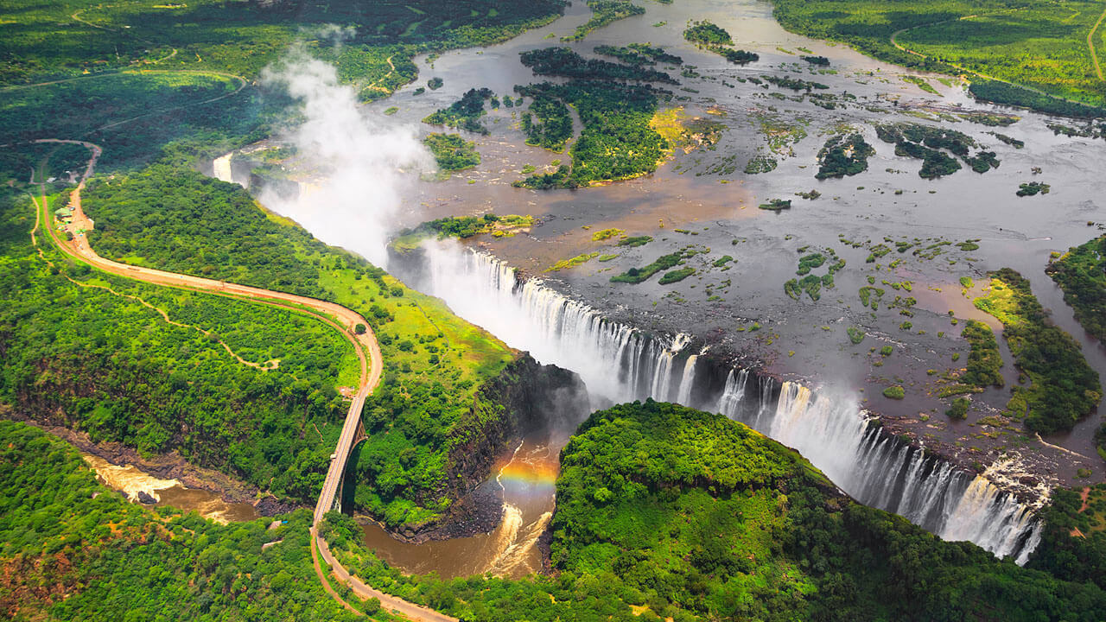
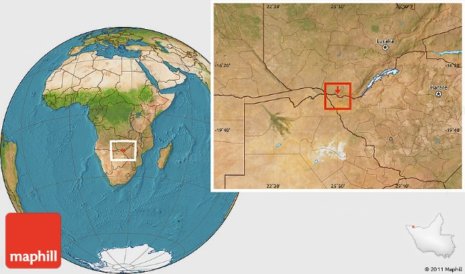

Slide 32
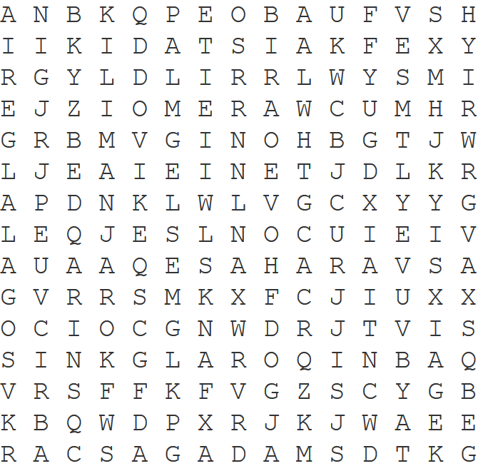
Africa Things
Find 10 words from today’s lesson

Slide 33
Africa Things
Find 10 words from today’s lesson

Slide 34
African Countries Quiz
http://online.seterra.com/en/vgp/3163

