Slide 1
If I had _____, I would ____.
https://www.youtube.com/watch?v=nCImrmR63JE

Slide 3
If ________________, I would
I would _ _ _ _ _ _ _ _
You would _ _ _ _ _ _ _ _
She would _ _ _ _ _ _ _ _
He would _ _ _ _ _ _ _ _
They would _ _ _ _ _ _ _ _
We would _ _ _ _ _ _ _ _

Slide 4
If I had a million dollars, I would __________.

Slide 5
Conditional Sentence
If I had a million dollars, I would buy you a monkey.

Slide 6
Conditional Sentence (2 parts – clauses)
If I had a million dollars, I would buy you a monkey.
Conditional Clause
Main Clause
If ….
… would ….

Slide 7
Conditional Sentence
If I had a million dollars, I would buy you a monkey.
Use past tense BUT talk about now
This sentence is NOT real.

Slide 8
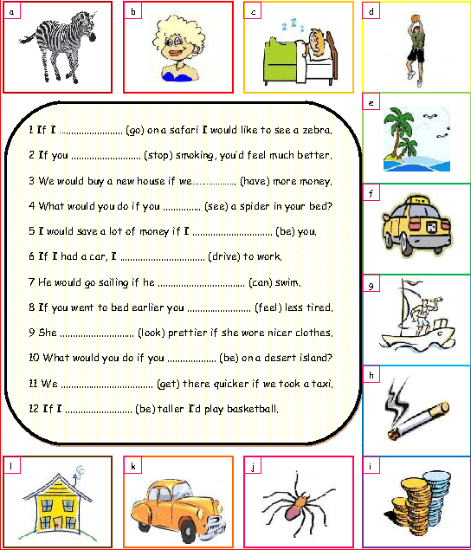

Slide 9
Examples:
If I knew her name, I would tell you.

Slide 10
Examples:
If I was rich, I would…

Slide 11
Examples:
If I could drive, I would…

Slide 12
Examples:
If I was Mr. S, I would…

Slide 13
Can you make your own example?

Slide 14
If _________________, I would___________.
Stand up
Make a sentence

Slide 15
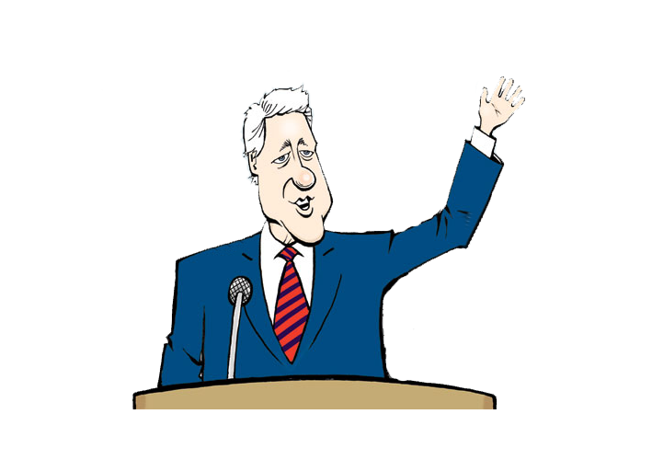
If I became president…

Slide 16
If I was an animal…

Slide 17
If I was invisible…

Slide 18
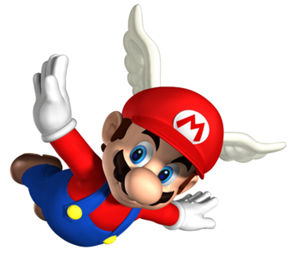
If I could fly…

Slide 19
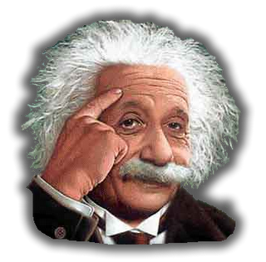
If I was smarter than Einstein…

Slide 20
If I had keys to everyone’s house…

Slide 21
If I was older…

Slide 22
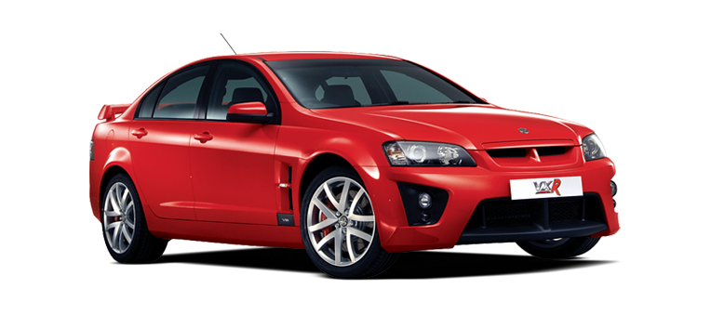
If I had a car…

Slide 23
If I could do magic…

Slide 24
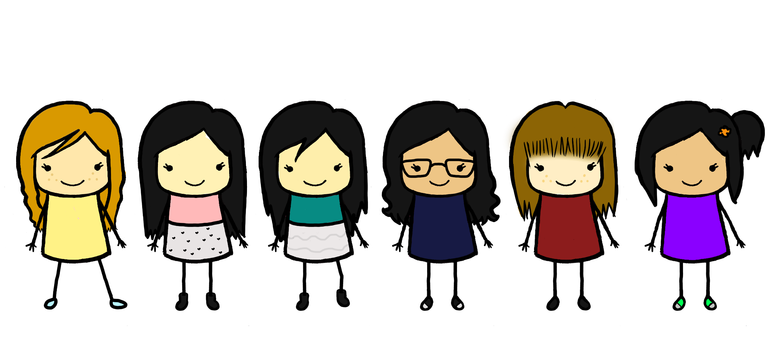
If I had more friends…

Slide 25
If I was a famous person…

Slide 26
If I drank coffee…

Slide 27
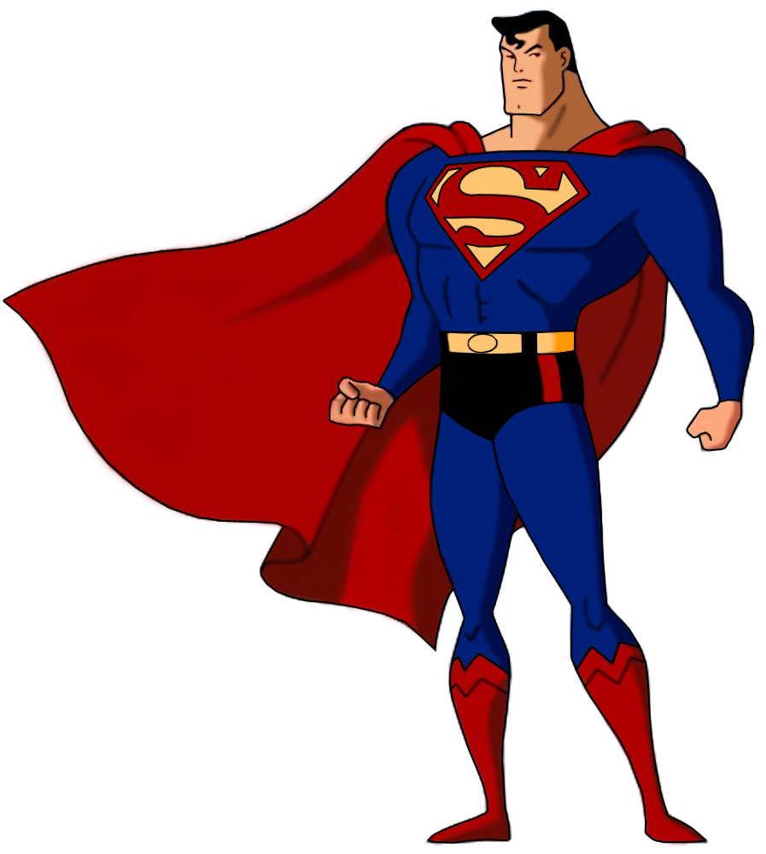
If I my best friend was superman…

Slide 28
Take a card and ask your friend
Answer using:
If _________, I would_________.

