Slide 1
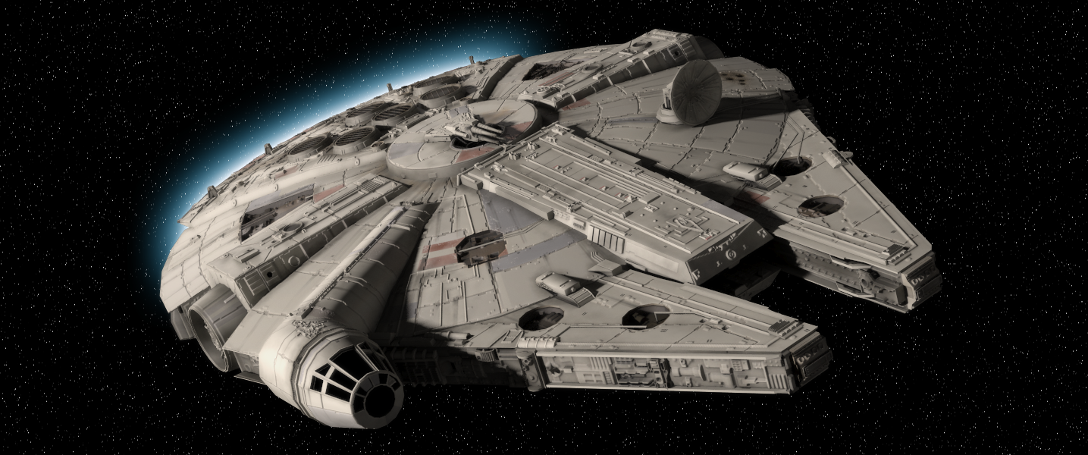
Spaceships

Slide 2
Do you get dizzy in space?
https://www.youtube.com/watch?v=GPnLShiJ-t4

Slide 3
Spaceship
If you travelled in a spaceship for 1 year, what would you need?
What are some problems you might have?

Slide 4
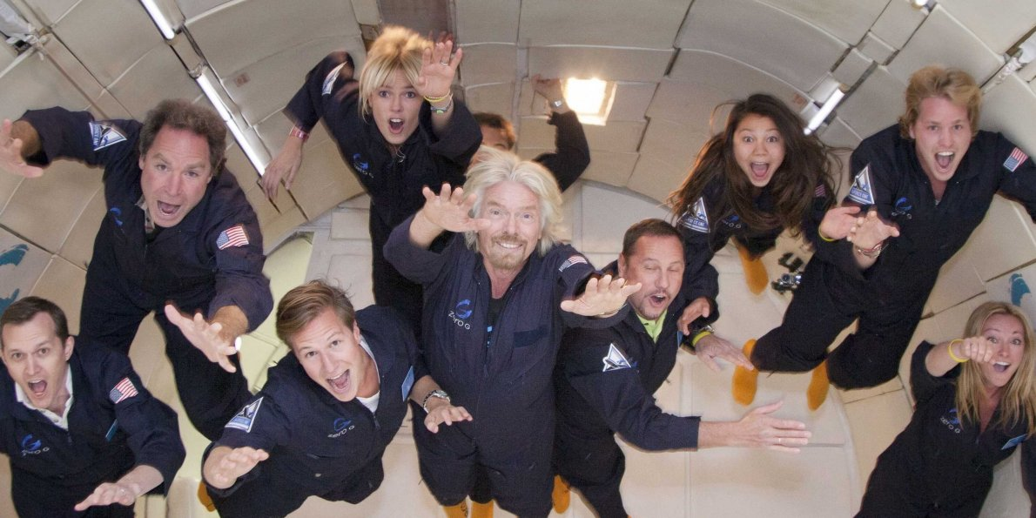
Gravity

Slide 5
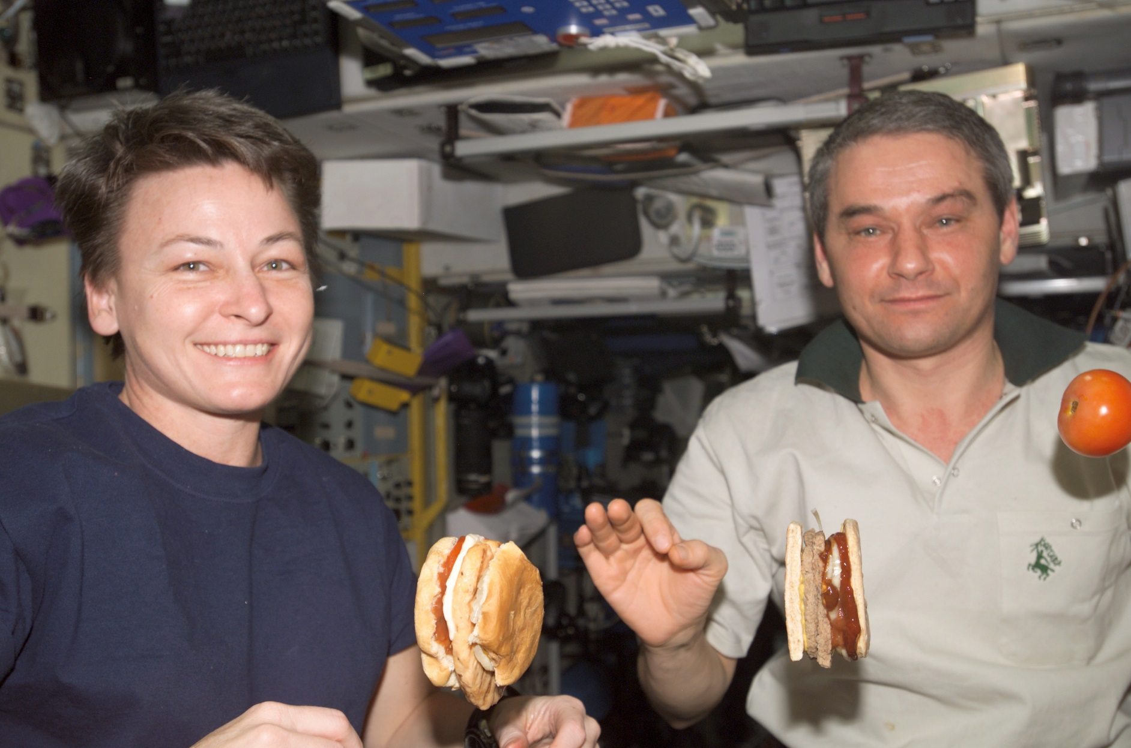
Food

Slide 6
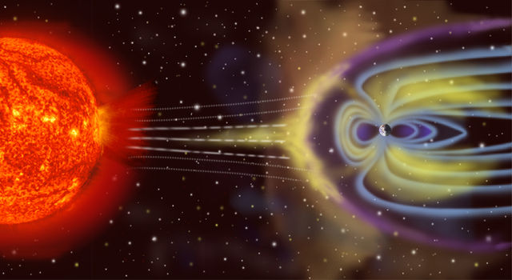
Radiation

Slide 7
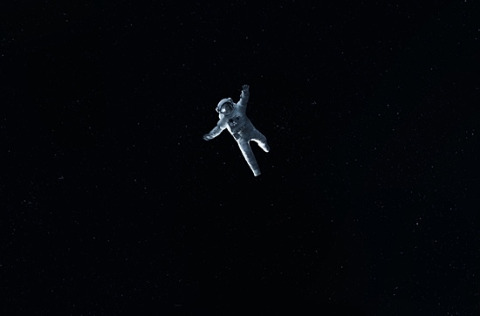
Boring

Slide 8
Go Crazy

Slide 9
How Long Would It Take?

Slide 10
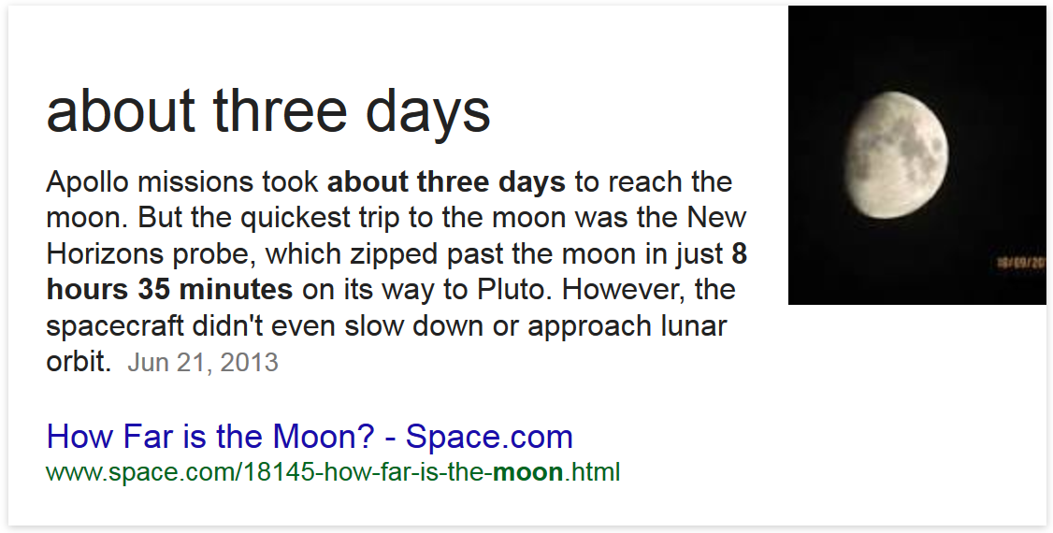
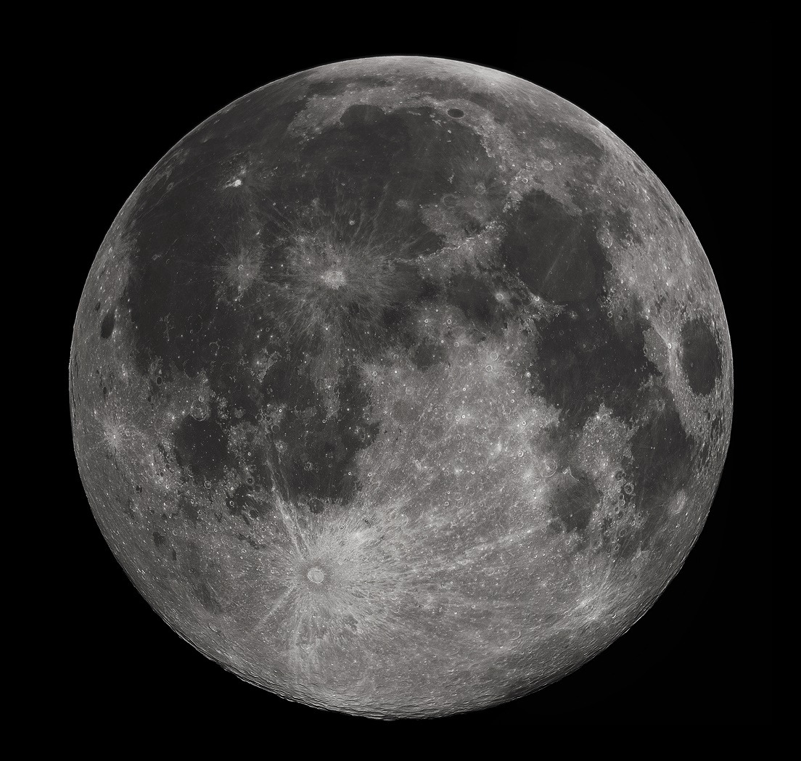
Moon

Slide 11
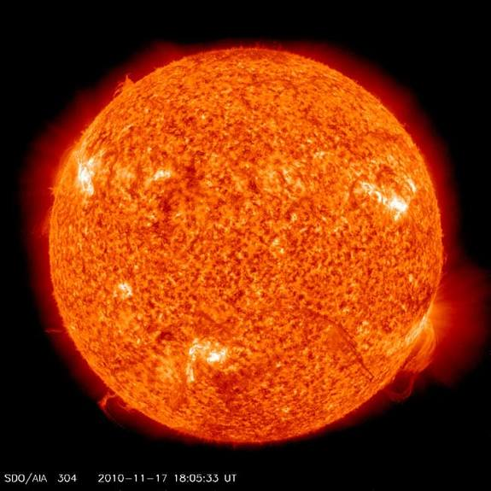
Sun

Slide 12
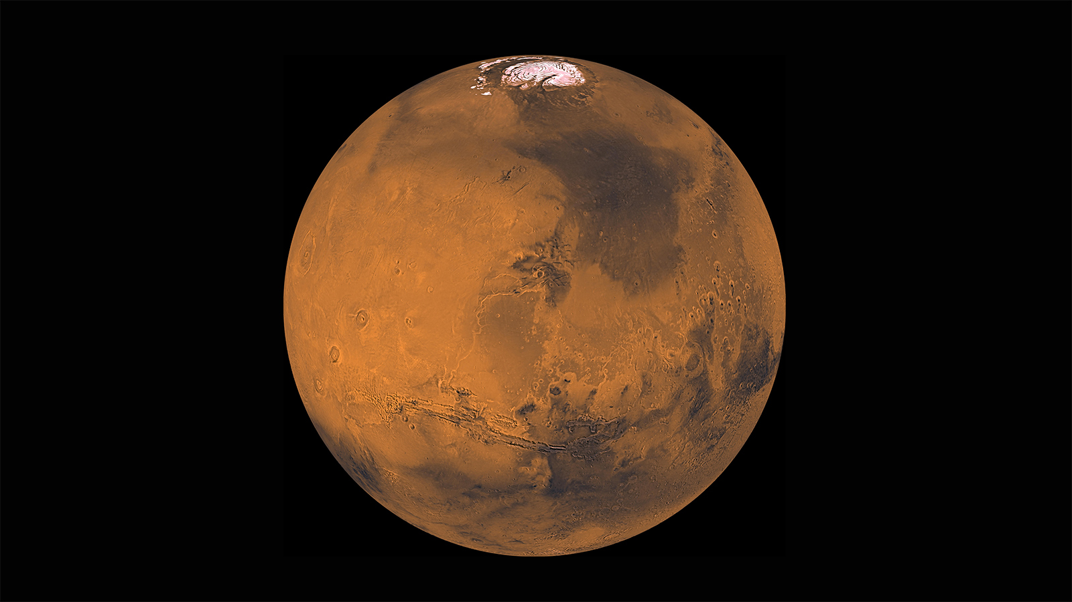
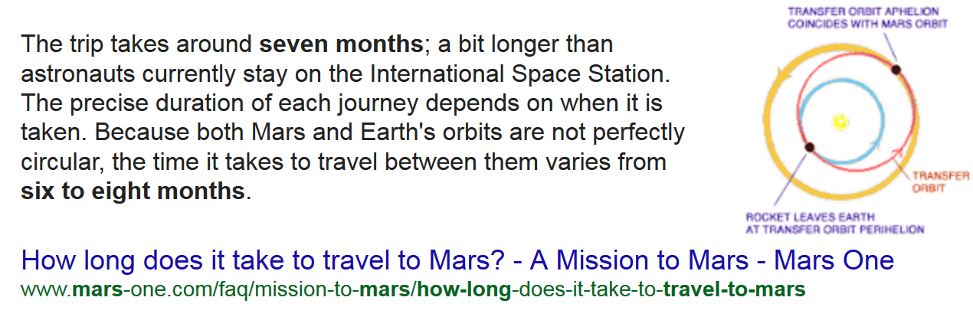
Mars

Slide 13
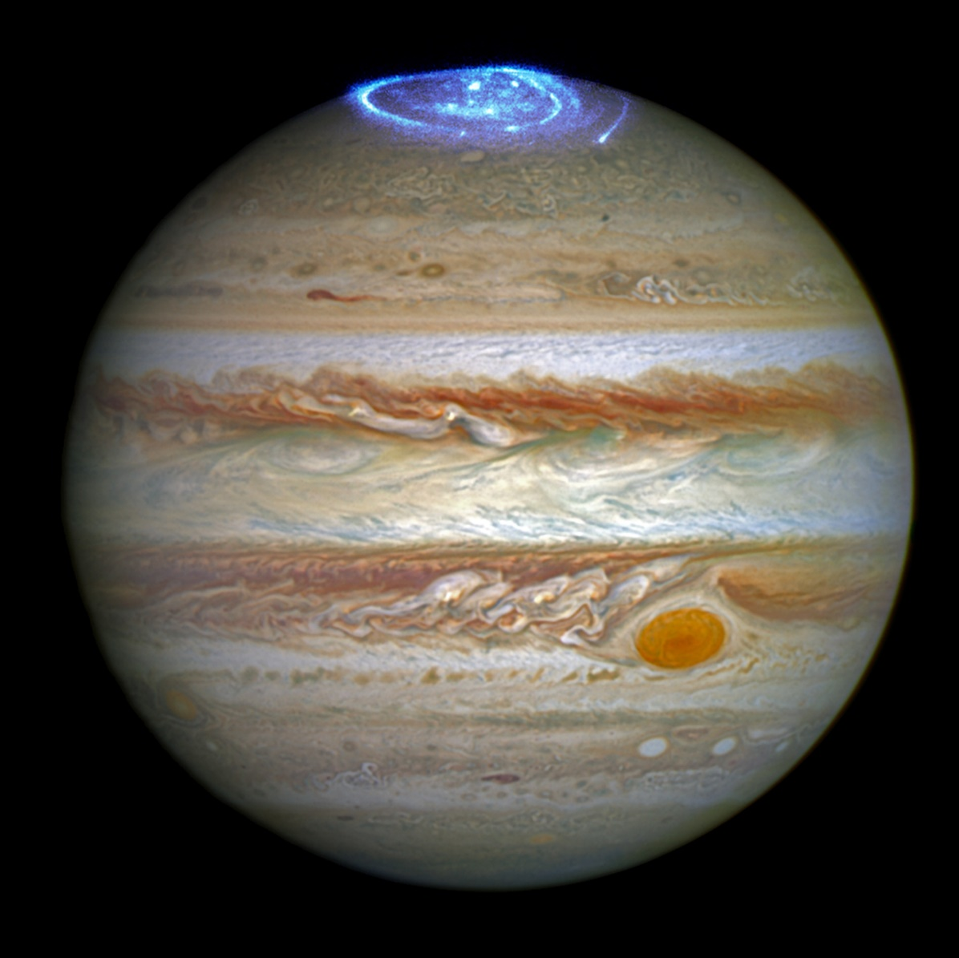
Jupiter

Slide 14
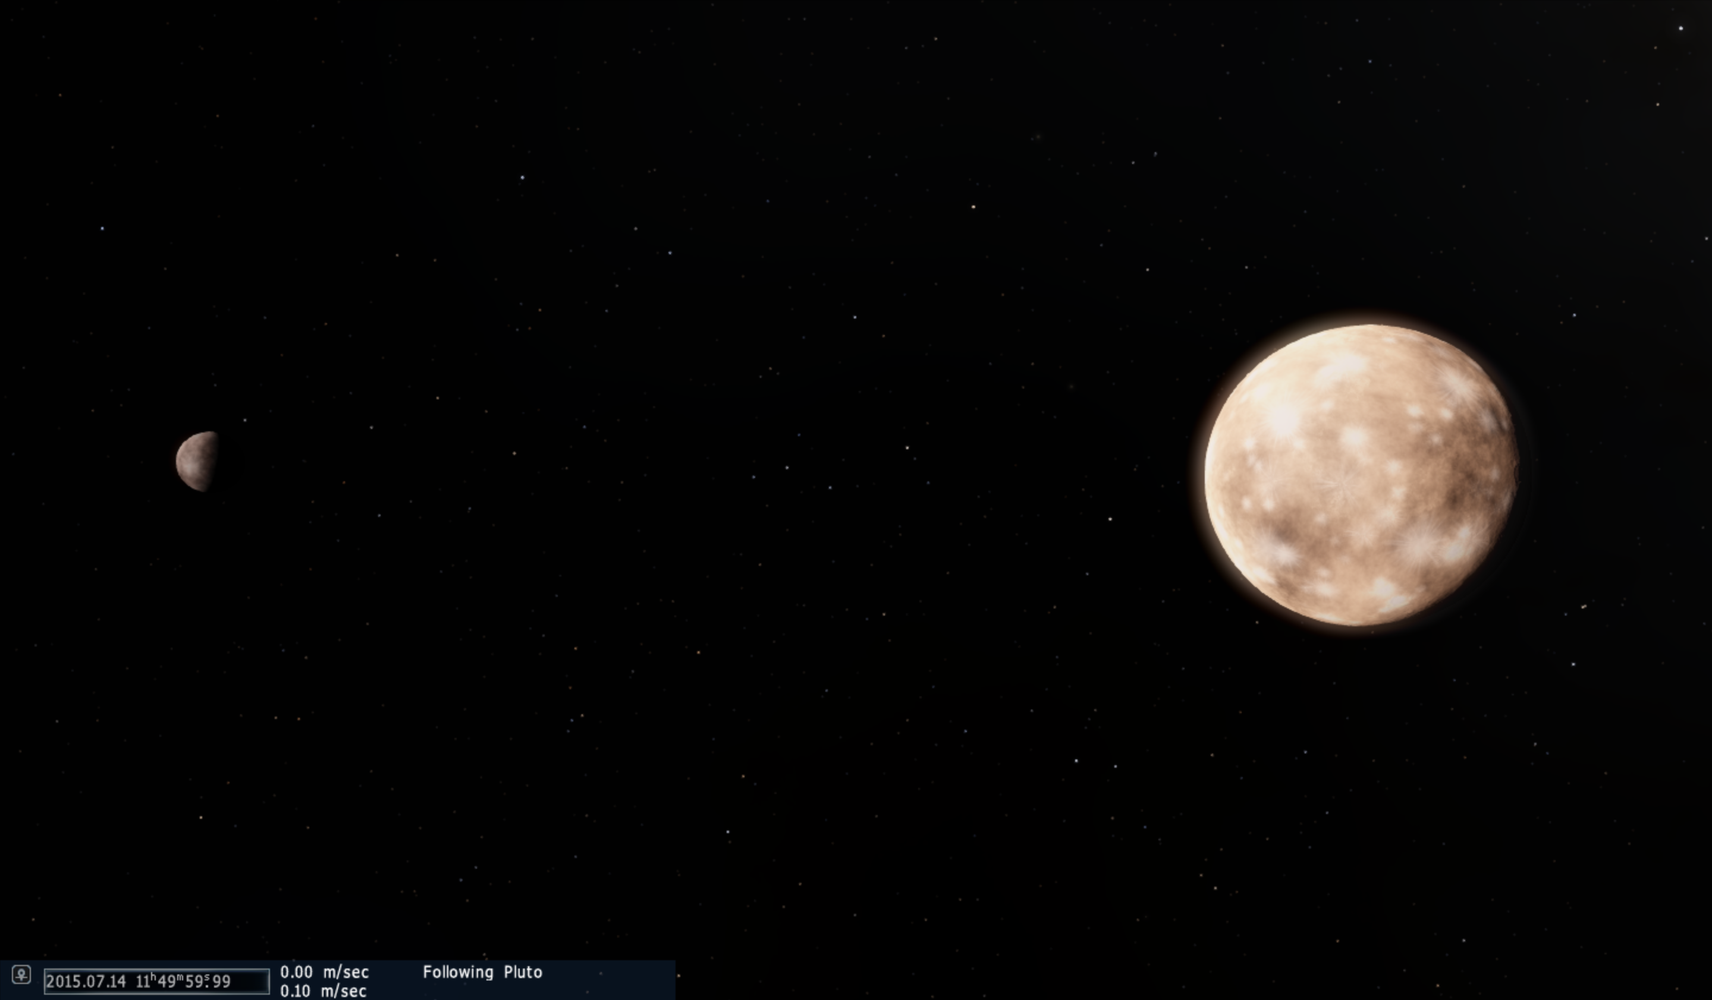
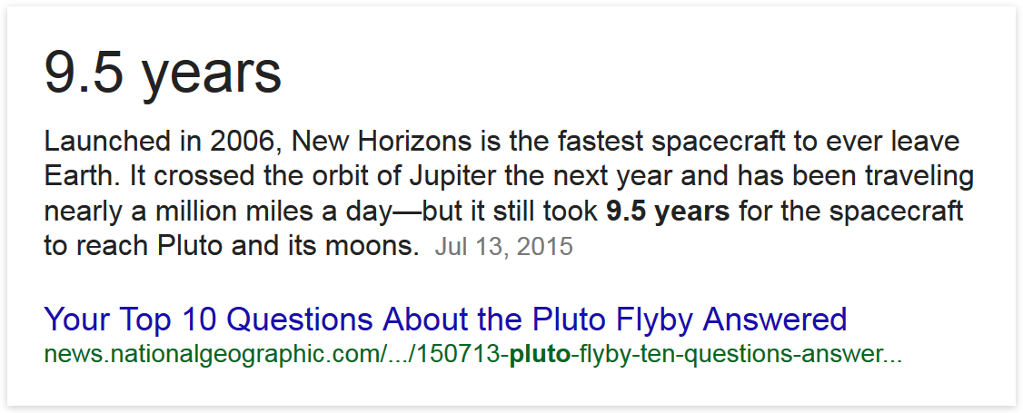
Pluto

Slide 15
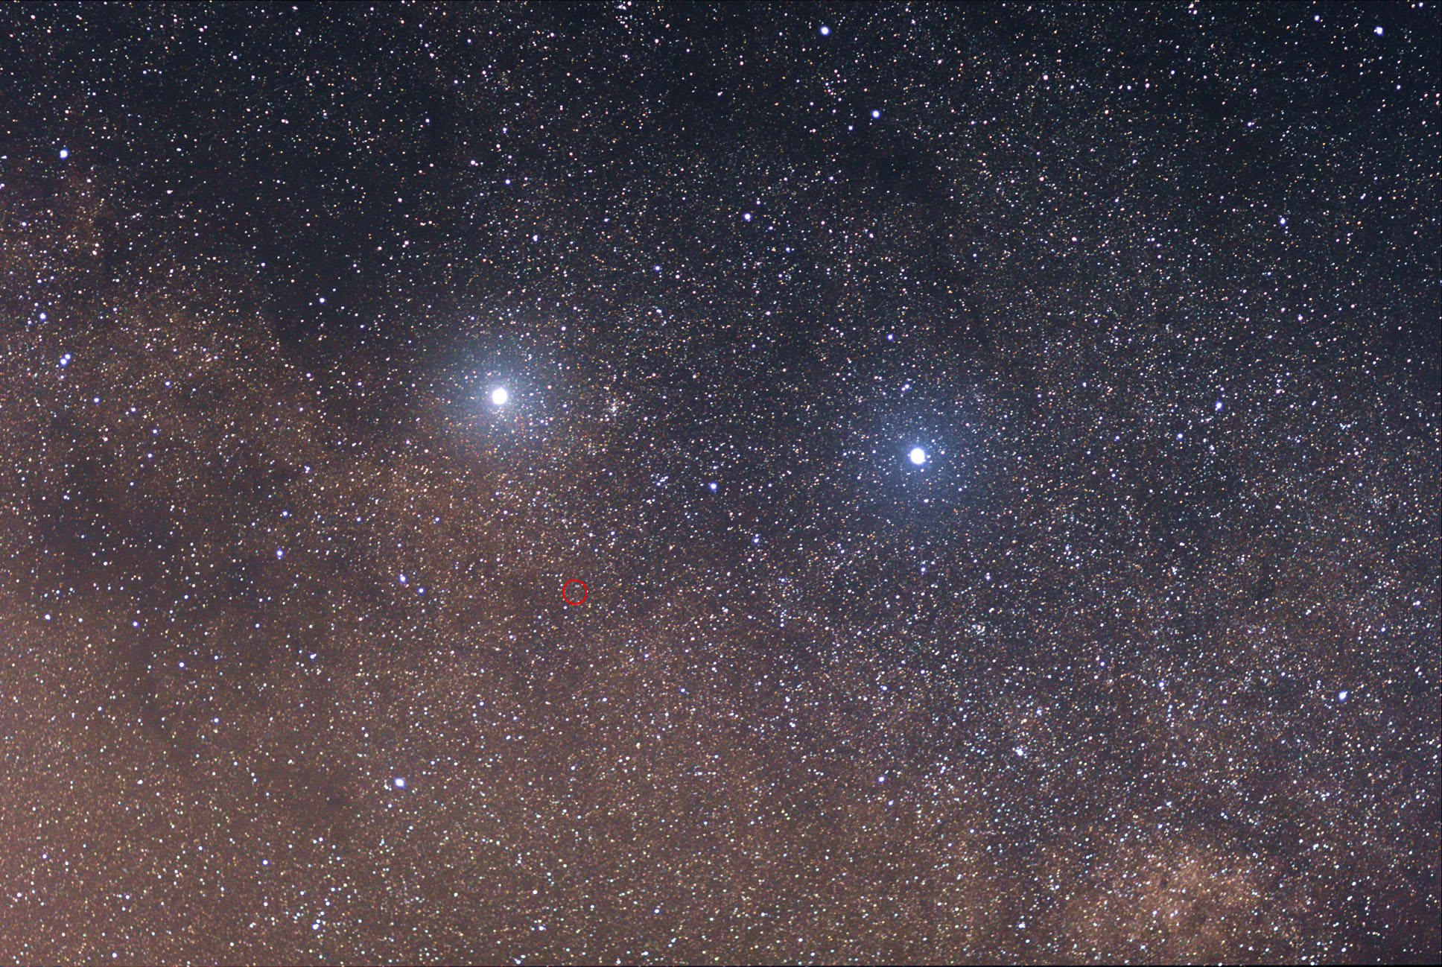
Alpha Centauri

Slide 16
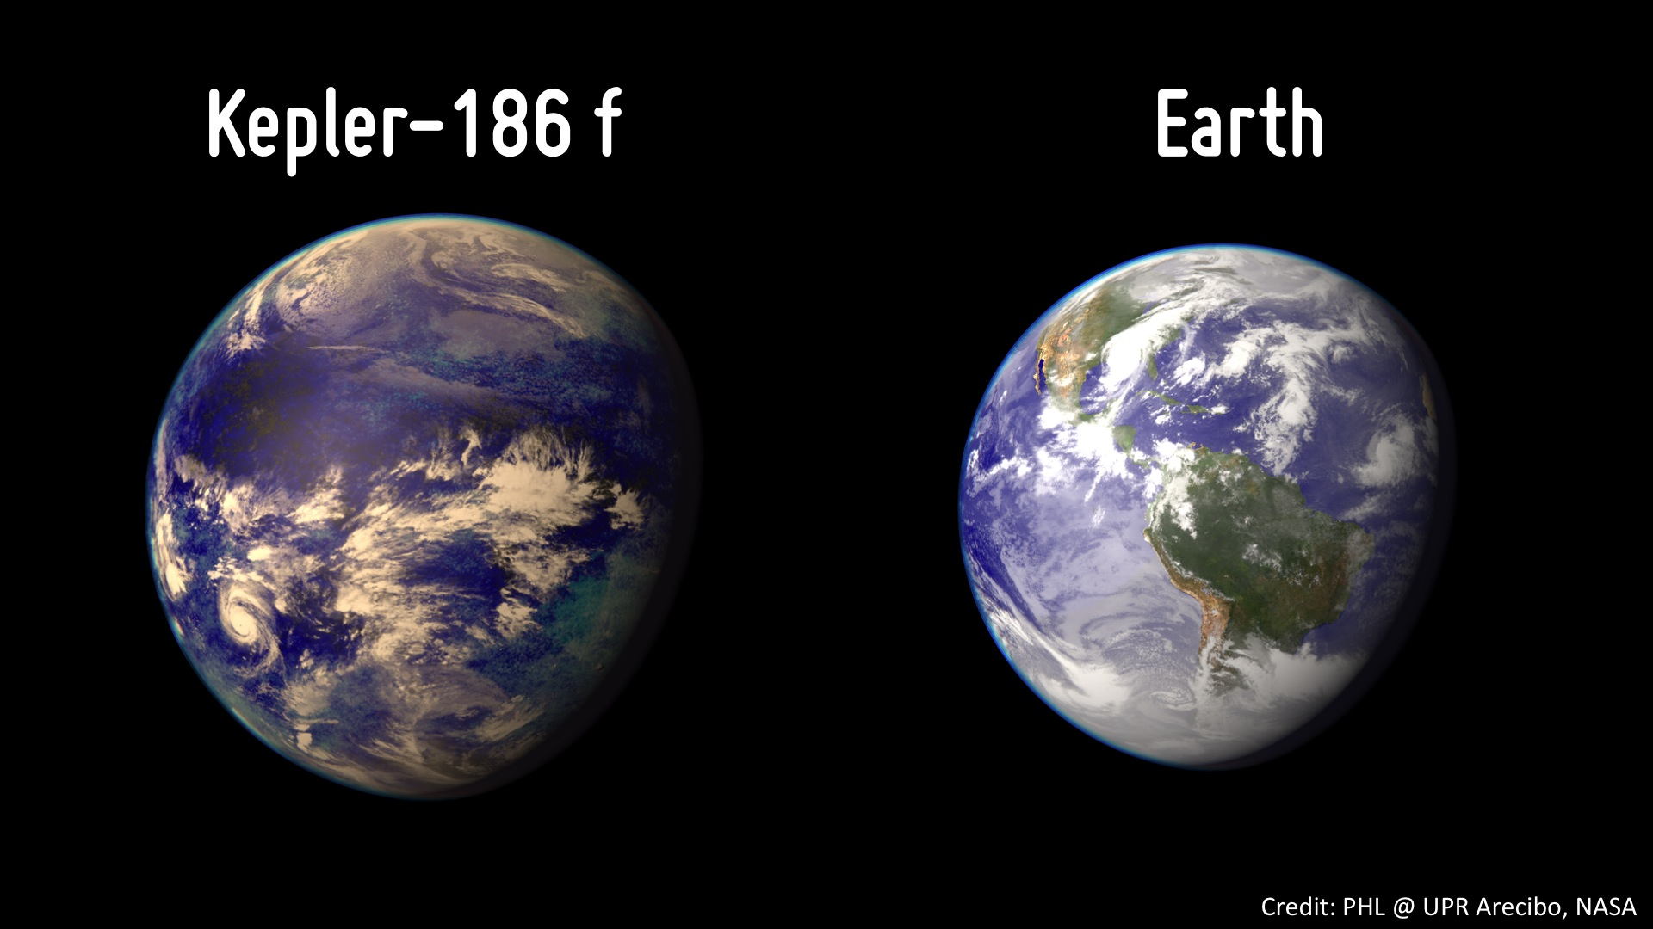
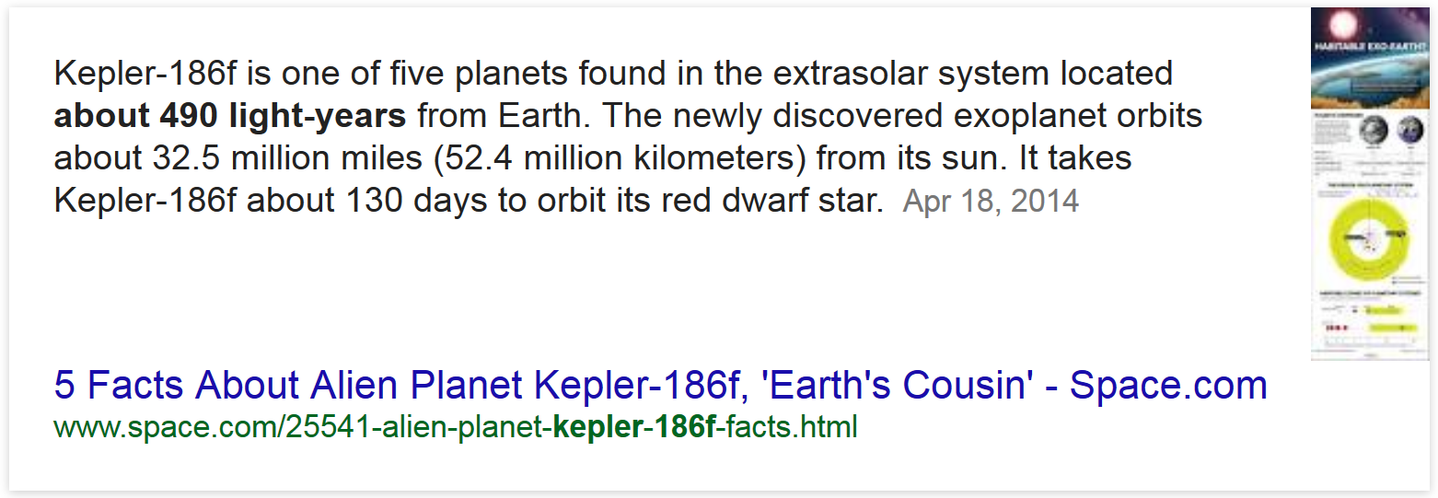
Kepler 186f

Slide 17
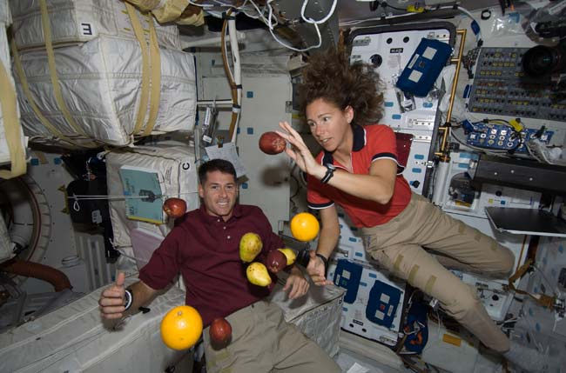
Eating in Space
https://www.youtube.com/watch?v=Rb8fKWBAUCM

Slide 18
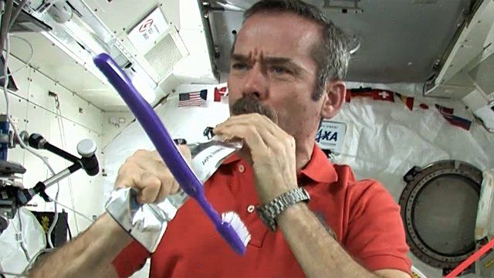
Brush your teeth in space
https://www.youtube.com/watch?v=3bCoGC532p8

Slide 19
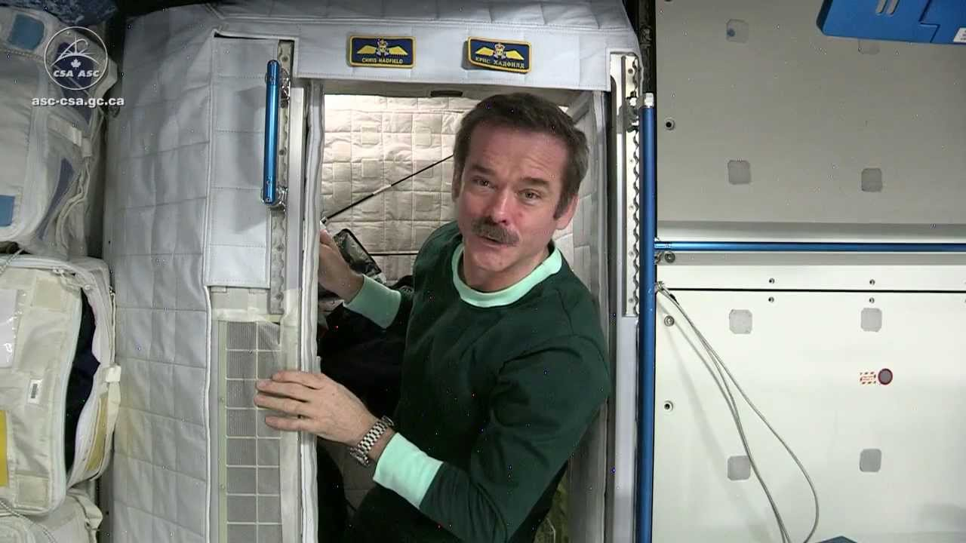
Sleeping in Space
https://www.youtube.com/watch?v=UyFYgeE32f0

Slide 20
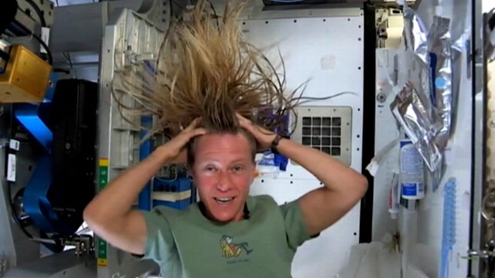
Brushing your hair in space
https://www.youtube.com/watch?v=kOIj7AgonHM

Slide 21
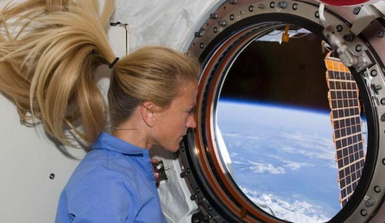
Life in Space
https://www.youtube.com/watch?v=X9vOoXU56KI

