Slide 1
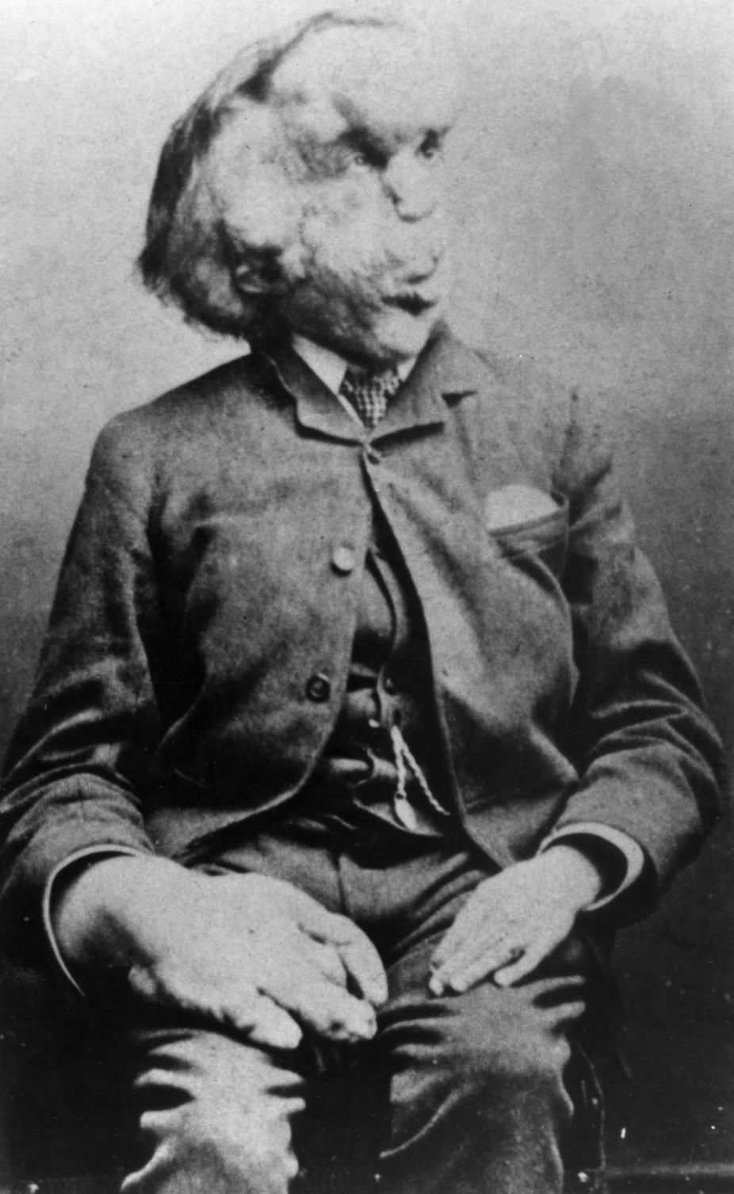

Slide 2
John Merrick’s Story

Slide 3
Before Reading:
Change slowly (grow or get older)
Illness, Injury, disease
Have lots of lumps
“No”
Fix the medical condition
Develop =
Medical Condition =
Lumpy =
Reject =
Cure =

Slide 4
John (Joseph) Merrick was born in Leicester, England on August 5th, 1862.
He was a normal when he was born and for the first few years of his life.
When he was a child, Joseph started to develop a strange condition.

Slide 5
Joseph’s skin was thick and lumpy.
He developed a lump on his head.
His lips also became quite large.

Slide 6
When he was 11, his mother died.
His father remarried when he was 13
His father and step mother rejected him.
He started working when he was 13 years old!

Slide 7
When Joseph was 21 years old, he tried to make money from his condition.
He toured England with the name, “elephant man”

Slide 8
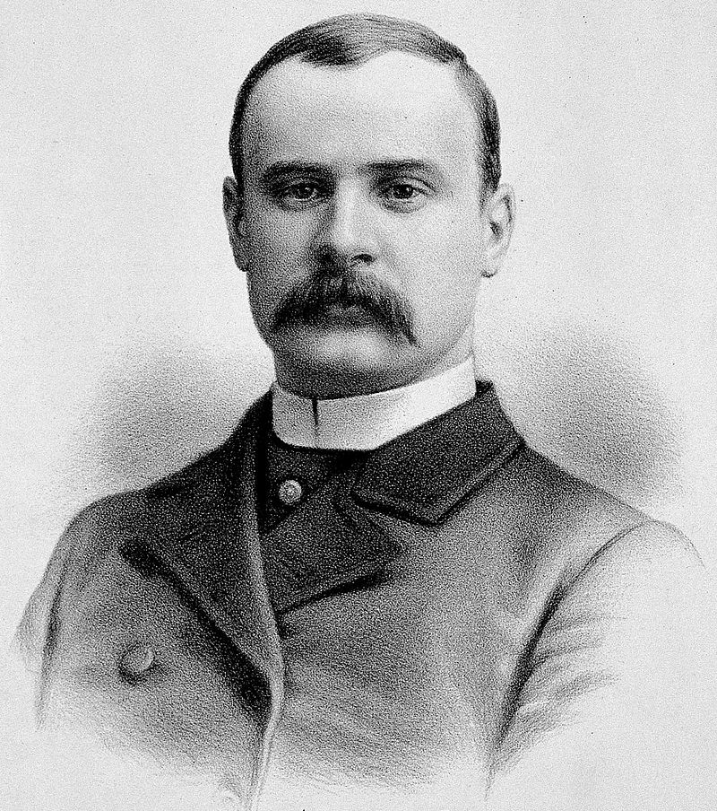
While he was on tour, he met Dr. Treves.
Dr. Treves told Joseph that he could not cure the disease, but he could stay at the hospital for the rest of his life.

Slide 9
Dr. Treves and Joseph met every day and became friends.
Joseph Merrick died on April 11, 1890.

Slide 10
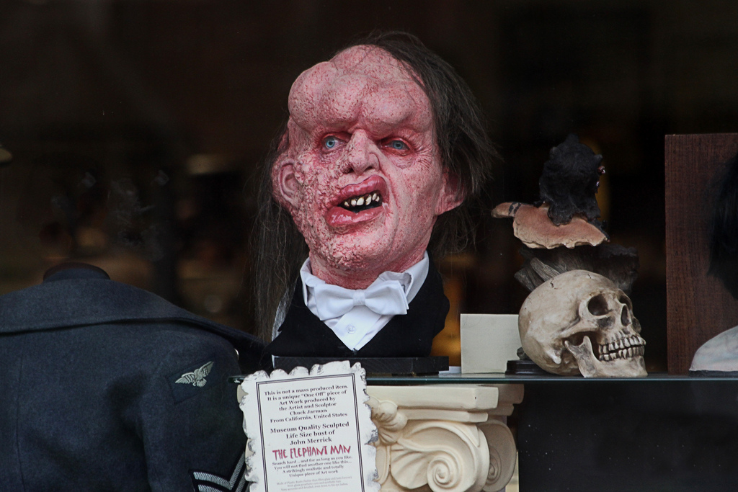

Slide 11
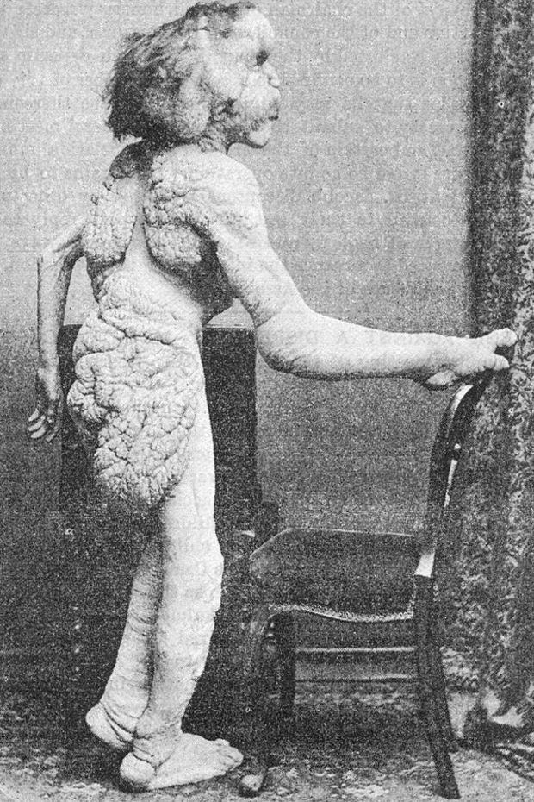
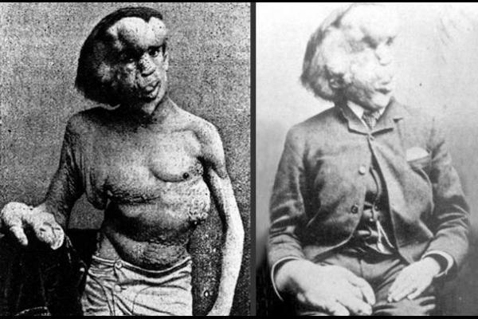

Slide 12
Where was Joseph Merrick Born?
Leicester, England

Slide 13
When did he start working?
He started working when he was 13.

Slide 14
What was his nickname?
“Elephant Man”

Slide 15
Who was Joseph Merrick’s Best Friend?
Dr. Treves was Joseph's Best friend.

Slide 16
Dr. Treves thought that Joseph had Proteus syndrome
It was his medical condition

Slide 17
How old was he when he died?
He was 27 years old

Slide 18
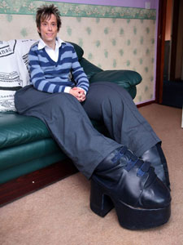
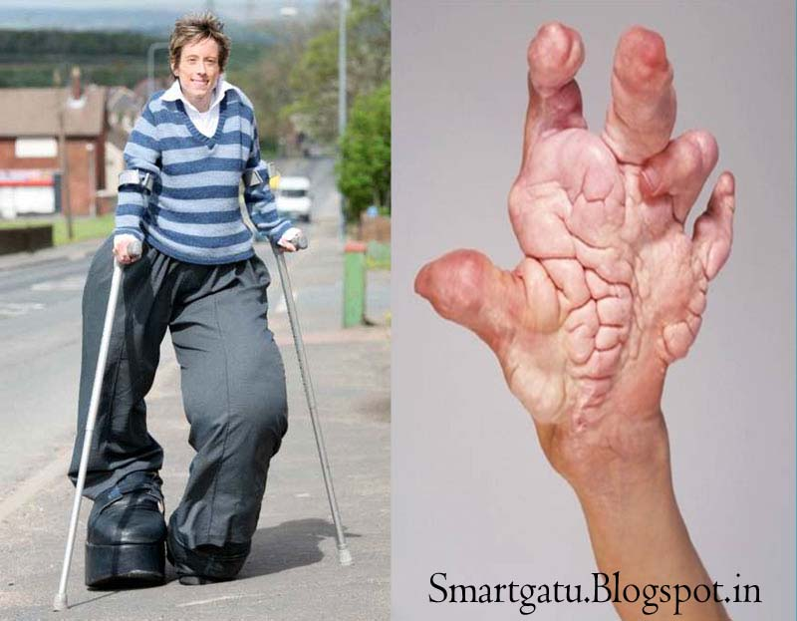
Mandy Sellers

Slide 19
What would you do if you had Proteus Syndrome?

Slide 20
Injury Illness Disability

Slide 21
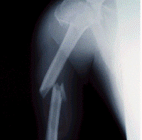
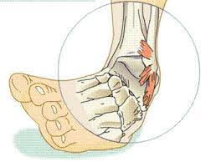
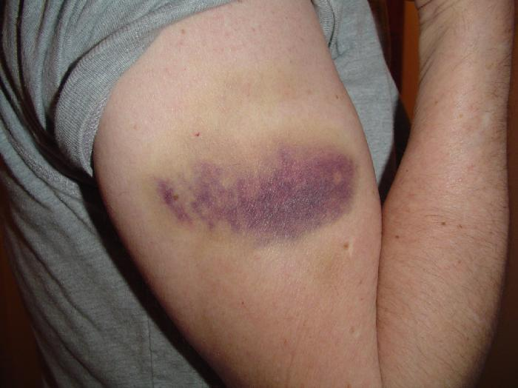
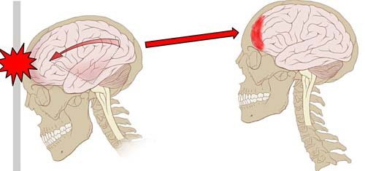
Injury
After something happens to you
Broken Bones
Sprains
Bruises
Concussion

Slide 22
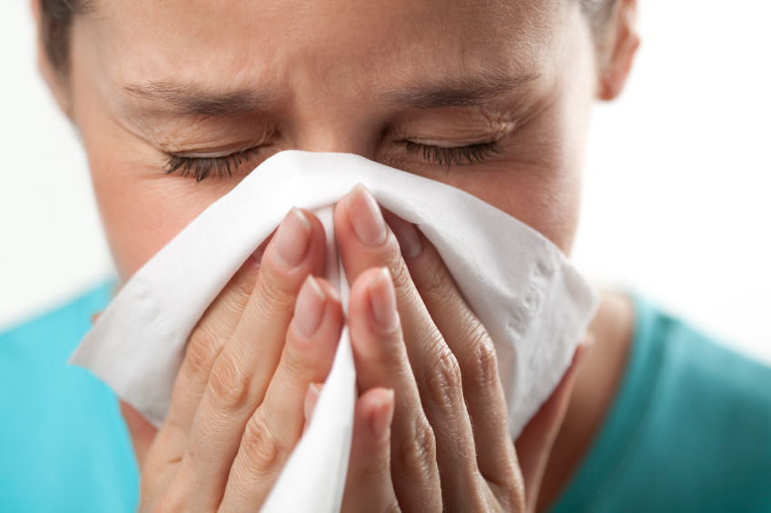
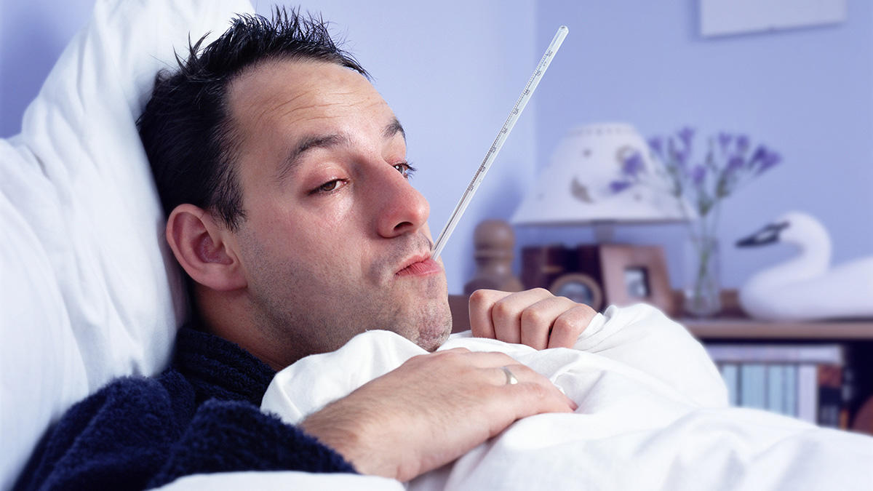
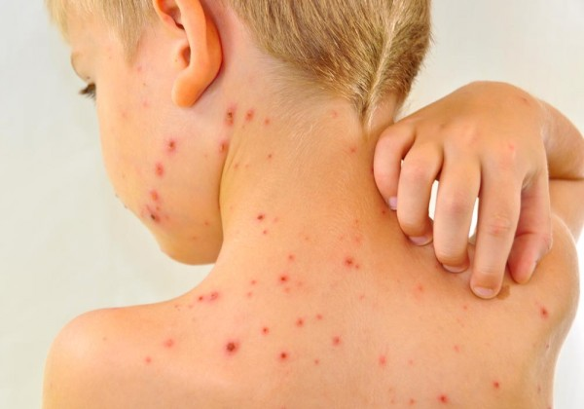
Illness
Feeling sick. When you catch a disease
Cold
Flu
Allergies
Chicken Pox

Slide 23
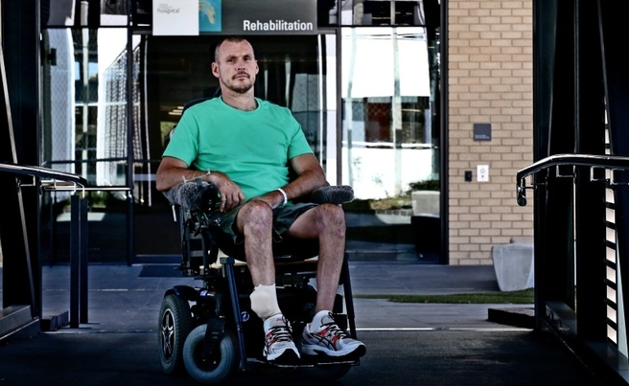
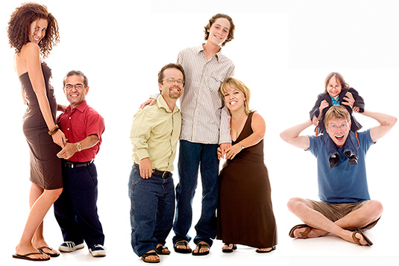
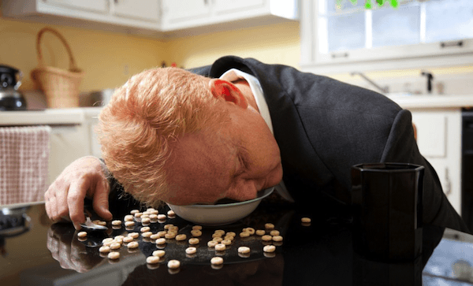
Disability
Something that makes regular life difficult.
Paralysis
Blindness
Dwarfism
Narcolepsy

Slide 24
What was Joseph’s medical condition?
Was it an injury, illness or disability?

