Slide 1
http://www.dan-dare.org/FreeFun/Games/More/StarWarsRogueSquadron.htm

Slide 2
Have you watched this movie?

Slide 3
Do you like Star Wars? Why / Why not?

Slide 4
What do you see in the movie poster?

Slide 5
What is a movie trailer?
A short introduction about the movie.

Slide 6
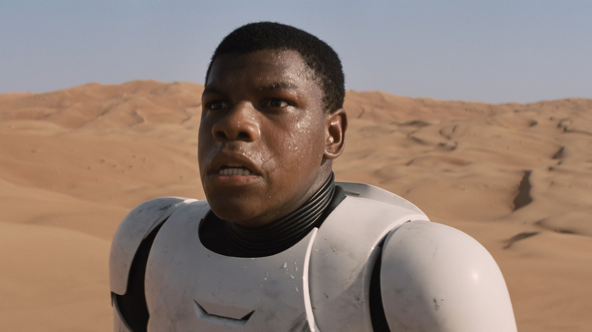
Watch the movie trailer and answer the questions:
Who are the good guys?
Who are the bad guys?
What is his job?

Slide 7
Star Wars: The Force Awakens
https://www.youtube.com/watch?v=sGbxmsDFVnE

Slide 8
Watch the movie trailer and answer the questions:
Who are the good guys?
Who are the bad guys?
What is his job?

Slide 9
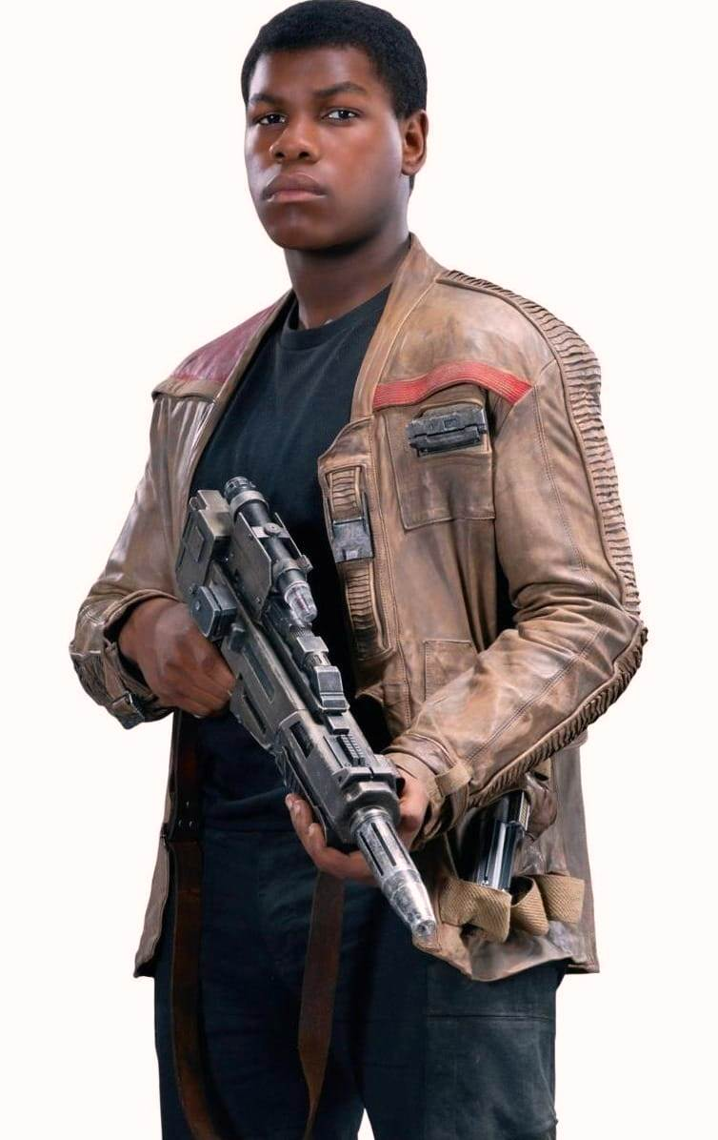
Finn
Finn was a Stormtrooper
His job was to fight for the dark side.
Now he fights for the Jedi

Slide 10
Rogue One: A Star Wars Story
https://www.youtube.com/watch?v=frdj1zb9sMY

Slide 11
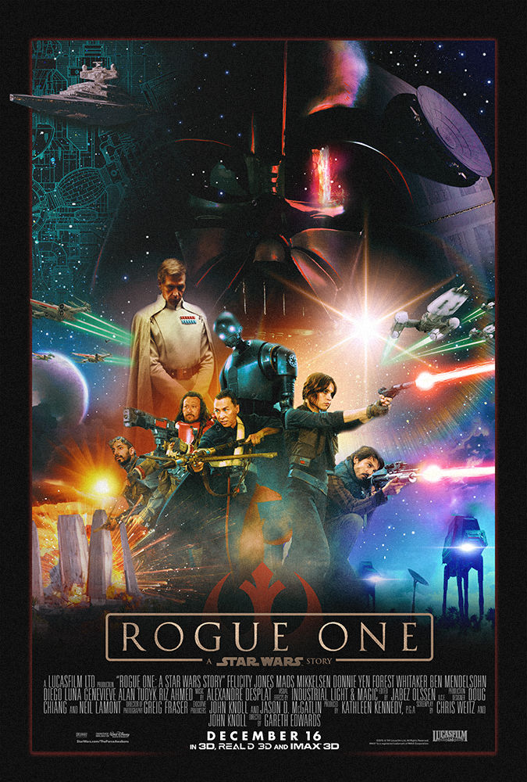
Parts of a Movie Poster
Title
Day
Actor Names
Picture about the movie

Slide 12
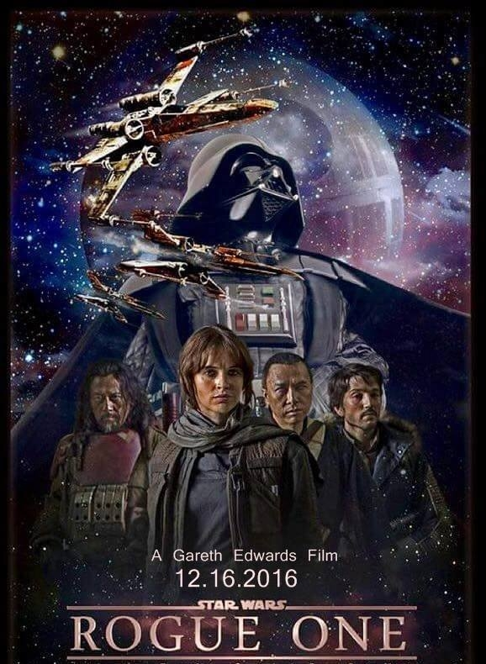

Slide 13
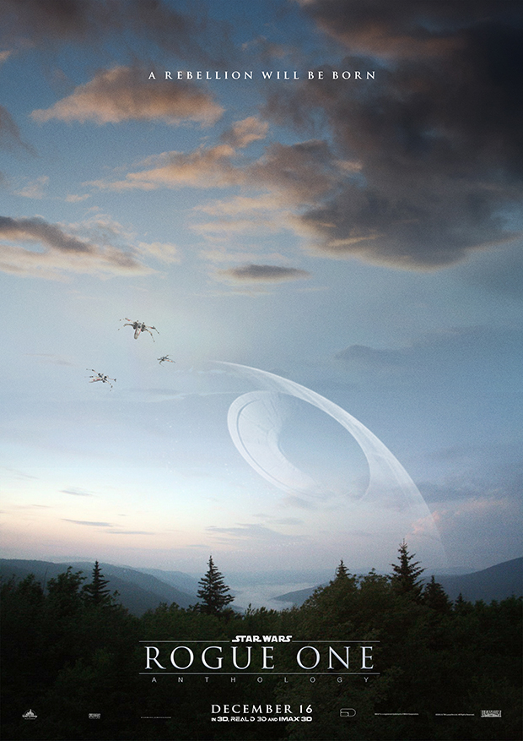
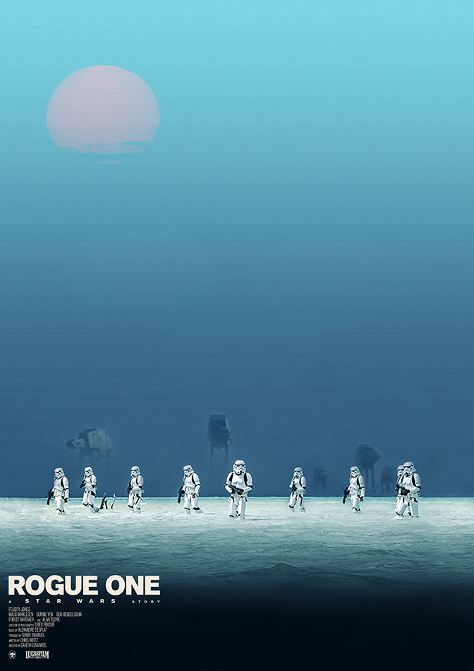

Slide 15
Make your own poster
Title
Day
Actor Names
Picture about the movie

Slide 16
How to draw a Stormtrooper
https://www.youtube.com/watch?v=_ANSihNbTJo (17 minutes)
https://www.youtube.com/watch?v=NaQh3vHOTHg (9 minutes)

