Slide 1
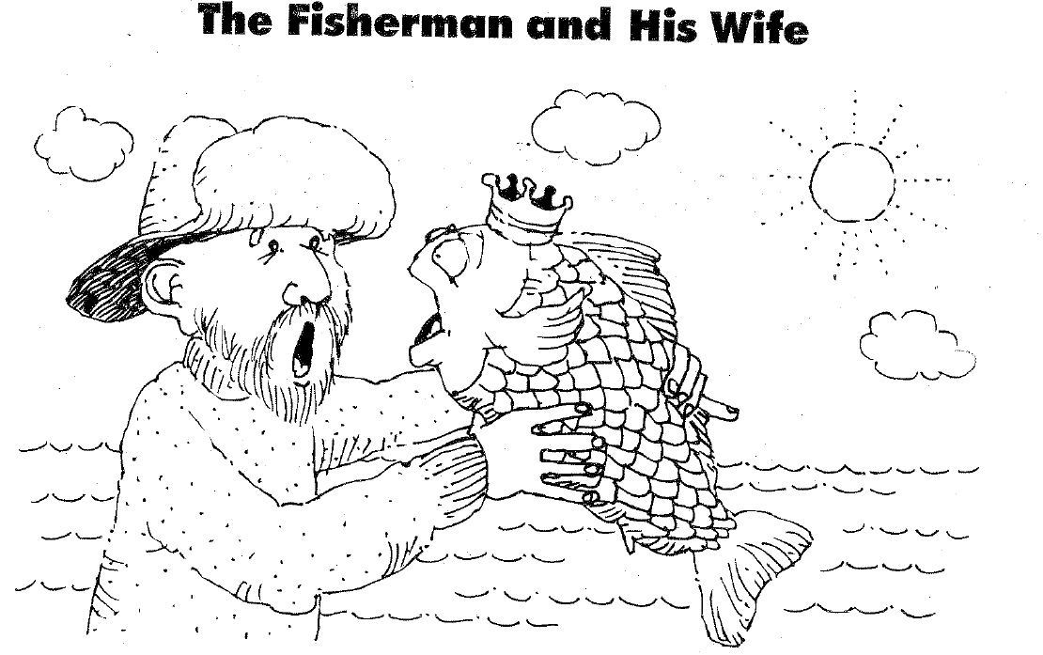
Fisherman and His Wife

Slide 2
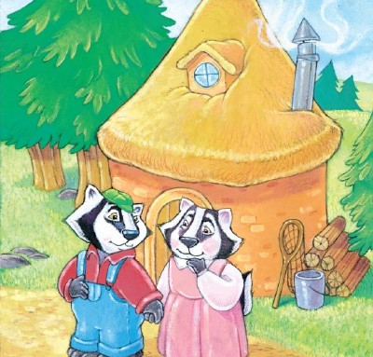


Slide 3
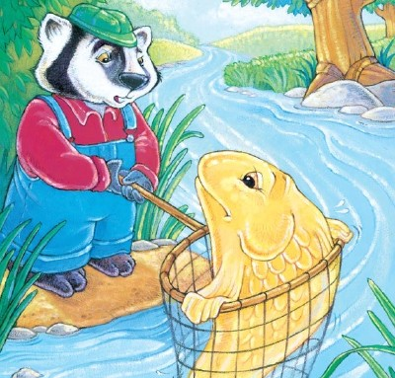


Slide 4
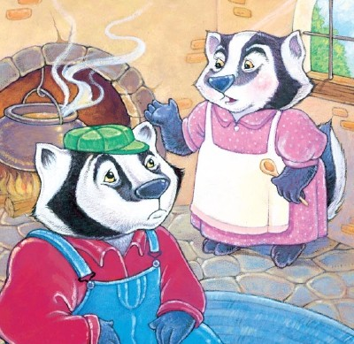


Slide 5


Slide 6
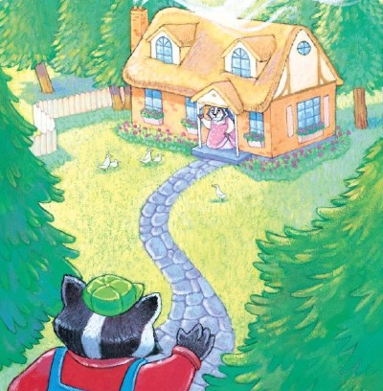


Slide 7
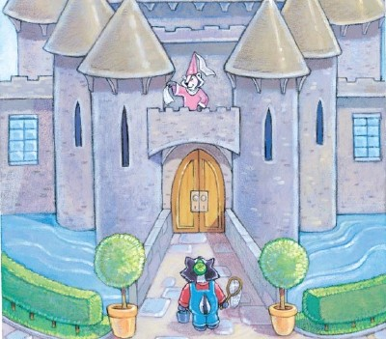


Slide 8
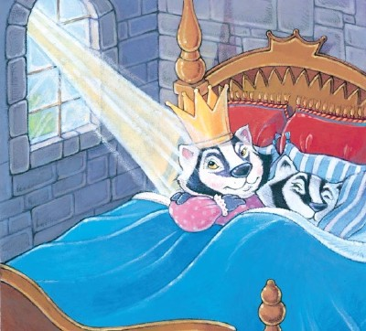

Slide 9
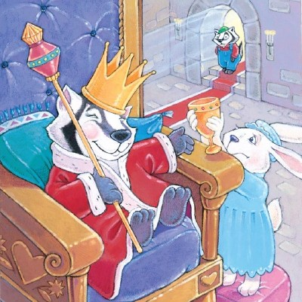


Slide 10



Slide 11
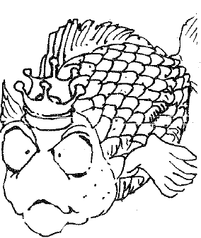
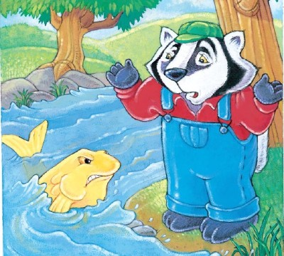
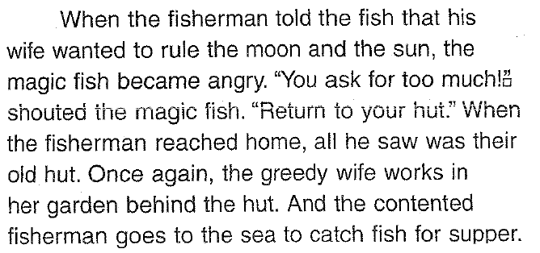

Slide 12
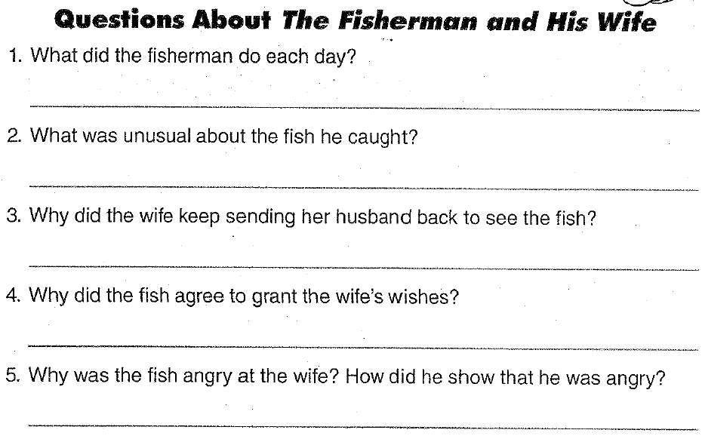


Slide 13
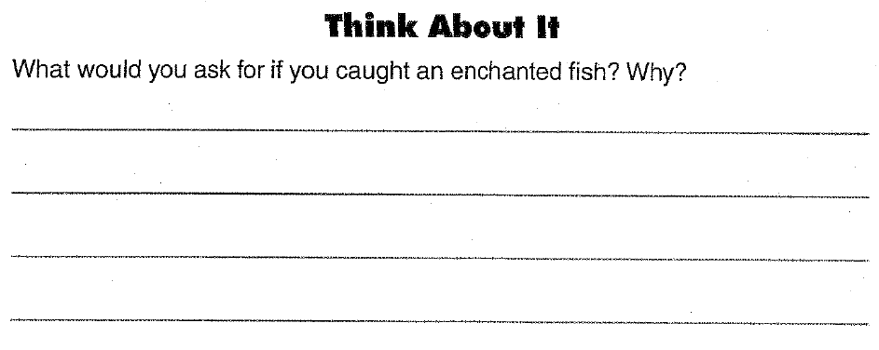

Slide 14
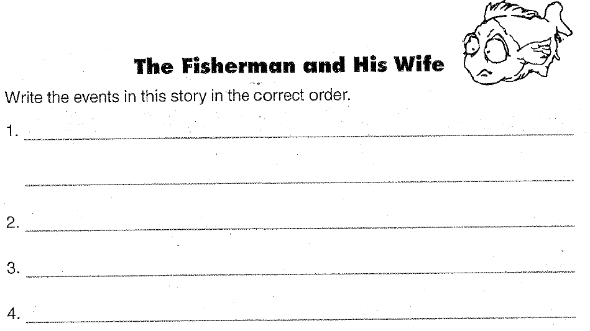


Slide 15
The Fisherman and His Wife
https://www.youtube.com/watch?v=A310NZlOYqA

Slide 16
Go Fish Game

Slide 17
Rules:
“_(name)_, do you have _(color)_ _(number)_ fish?”
  “Yes, I do.”
  “No, go fish”

